Slide 1
CSE 332: Data Structures & Parallelism Lecture 22: P, NP, NP-Complete
Arthur Liu
Summer 2022

Slide 2
Announcements
Reminder your final is on two days, Section 10/18, Lecture 10/19
Make sure to be in your correct quiz section on Thursday for pt1. of the exam! We will take attendance, so bring student ID to section
Final Review Session: MOR 220 Wed 10/17 from 3:00-4:00pm
Exam Topics and Practice Exams on the website!
Make sure to look at some past finals to practice!

Slide 3
Class Survey!
You should have received an email for a survey for this class!
It closes this Friday!
I will give out 1 extra credit point to everyone who fills it out
It is anonymous, I will know if you filled it out but not what you said

Slide 4
Outline
A Few Problems:
Euler Circuits
Hamiltonian Circuits
P and NP
NP-Complete
What now?

Slide 5
Try it
Which of these can you draw (trace all edges) without lifting your pencil, drawing each line only once? Can you start and end at the same point?

Slide 6
Your First Task
Your company has to inspect a set of roads between cities by driving over each of them.
Driving over the roads costs money (fuel), and there are a lot of roads.
Your boss wants you to figure out how to drive over each road exactly once, returning to your starting point.

Slide 7
Euler Circuits
Euler circuit: a path through a graph that visits each edge exactly once and starts and ends at the same vertex
Named after Leonhard Euler (1707-1783), who cracked this problem and founded graph theory in 1736
A Euler circuit exists iff
the graph is connected and
each vertex has even degree (= # of edges on the vertex)

Slide 8
Euler Circuit Example
A
B
C
G
D
E
F
Euler(A) :

Slide 9
Euler Circuit Example
A
B
C
G
D
E
F
Euler(A) :
A B G E D G C A

Slide 10
Euler Circuit Example
A
B
C
B
C
G
D
E
D
E
F
F
Euler(A) :
A B G E D G C A
Euler(B)

Slide 11
Euler Circuit Example
A
B
C
B
C
G
D
E
D
E
F
F
Euler(A) :
A B G E D G C A
Euler(B):
B D F E C B

Slide 12
Euler Circuit Example
A
B
C
B
C
G
D
E
D
E
F
F
Euler(A) :
A B G E D G C A
Euler(B):
B D F E C B
Splice
A B D F E C B G E D G C A

Slide 13
The Road Inspector: Finding Euler Circuits
Given a connected, undirected graph G = (V,E), find an Euler circuit in G
Can check if one exists:
Check if all vertices have even degree
Basic Euler Circuit Algorithm:
Do an edge walk from a start vertex until you are back to the start vertex.
You never get stuck because of the even degree property.
“Remove” the walk, leaving several components each with the even degree property.
Recursively find Euler circuits for these.
Splice all these circuits into a Euler circuit
Running time?
Notes:
Remove answers and add with ink.

Slide 14
The Road Inspector: Finding Euler Circuits
Given a connected, undirected graph G = (V,E), find an Euler circuit in G
Can check if one exists: (in O(|V|+|E|) )
Check if all vertices have even degree
Basic Euler Circuit Algorithm:
Do an edge walk from a start vertex until you are back to the start vertex.
You never get stuck because of the even degree property.
“Remove” the walk, leaving several components each with the even degree property.
Recursively find Euler circuits for these.
Splice all these circuits into a Euler circuit
Running time? O(|V|+|E|)
Notes:
HIDE

Slide 15
Your Second Task
Your boss is pleased…and assigns you a new task.
Your company has to send someone by car to a set of cities.
The primary cost is the exorbitant toll going into each city.
Your boss wants you to figure out how to drive to each city exactly once, returning in the end to the city of origin.

Slide 16
Hamiltonian Circuits
Euler circuit: A cycle that goes through each edge exactly once
Hamiltonian circuit: A cycle that goes through each vertex exactly once
Does graph I have:
An Euler circuit?
A Hamiltonian circuit?
Does graph II have:
An Euler circuit?
A Hamiltonian circuit?
Which problem sounds harder?
B
C
G
I
D
E
B
C
G
II
D
E

Slide 17
Finding Hamiltonian Circuits
Problem: Find a Hamiltonian circuit in a connected, undirected graph G
One solution: Search through all paths to find one that visits each vertex exactly once
Can use your favorite graph search algorithm to find paths
This is an exhaustive search (“brute force”) algorithm
Worst case: need to search all paths
How many paths??

Slide 18
Analysis of Exhaustive Search Algorithm
Worst case: need to search all paths
How many paths?
Can depict these paths as a search tree:
B
C
G
B
D
E
D G C
G E D E C G E
Etc.
Search tree of paths from B

Slide 19
Analysis of Exhaustive Search Algorithm
Let the average branching factor of each node in this tree be b
|V| vertices, each with ≈ b branches
Total number of paths ≈ b·b·b … ·b
Worst case →
B
D G C
G E D E C G E
Etc.
Search tree of paths from B

Slide 20
Analysis of Exhaustive Search Algorithm
Let the average branching factor of each node in this tree be b
|V| vertices, each with ≈ b branches
Total number of paths ≈ b·b·b … ·b
O(b^{|V|})
Worst case → Exponential time!
B
D G C
G E D E C G E
Etc.
Search tree of paths from B

Slide 21
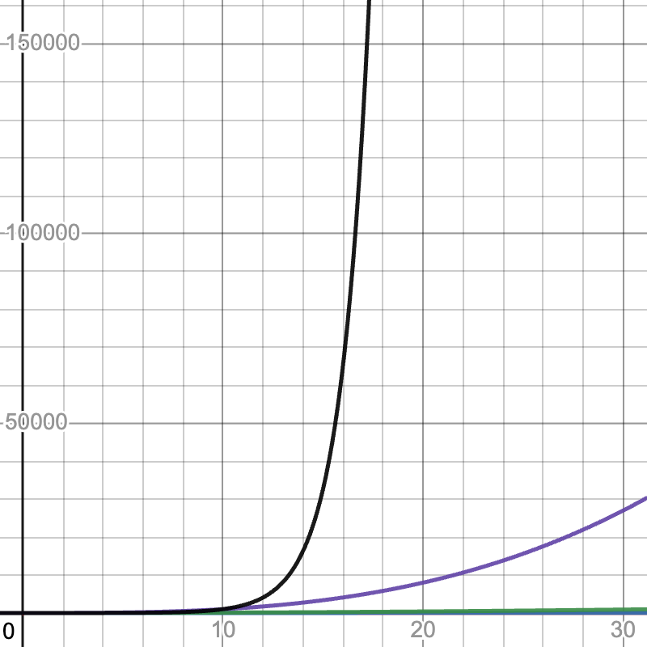
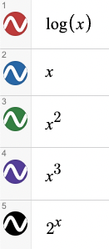
Running Times
https://www.desmos.com/calculator/pwxhtawjnx

Slide 22
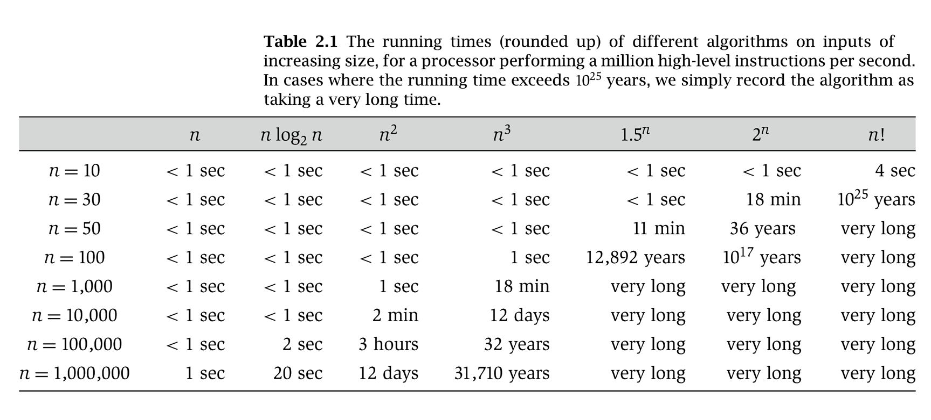
More Running Times
Somewhat old, from Rosen
Notes:
From Rosen (I think) – old!

Slide 23
Polynomial vs. Exponential Time
All of the algorithms we have discussed in this class have been polynomial time algorithms:
Examples: O(log N), O(N), O(N log N), O(N²)
Algorithms whose running time is O(N^{k}) for some k > 0
Exponential time b^{N} is asymptotically worse than any polynomial function N^{k} for any k
Notes:
Euler circuit – easy “edges”
Hamilton circuit very very hard, “vertices”

Slide 24
The Complexity Class P
Definition: P is the set of all problems that can be solved in polynomial worst-case time
All problems that have some algorithm whose running time is O(N^{k}) for some k
Examples of problems in P: sorting, shortest path, Euler circuit, etc.

Slide 25
P
Sorting
Shortest Path
Euler Circuit

Slide 26
Hamiltonian Circuit
P
Sorting
Shortest Path
Euler Circuit

Slide 27
Hamiltonian Circuit
Satisfiability (SAT)
Vertex Cover
Travelling Salesman
P
Sorting
Shortest Path
Euler Circuit

Slide 28
Satisfiability
Input: a logic formula of size m containing n variables
Output: An assignment of Boolean values to the variables in the formula such that the formula is true
Algorithm: Try every variable assignment
Notes:
Useful for optimization problems. If you can rewrite your requirements as a series of conditionals, an efficient solver would allow you to readily produce an answer

Slide 29
Vertex Cover
Input: A graph (V,E) and a number m
Output: A subset S of V such that for every edge (u,v) in E, at least one of u or v is in S and |S|=m (if such an S exists)
Algorithm: Try every subset of vertices of size m
Notes:
Camera that looks at different locations. Determine if possible to cover every spot.

Slide 30
Traveling Salesman
Input: A complete weighted graph (V,E) and a number m
Output: A circuit that visits each vertex exactly once and has total cost < m if one exists
Algorithm: Try every path, stop if find cheap enough one

Slide 31
A Glimmer of Hope
If given a candidate solution to a problem, we can check if that solution is correct in polynomial-time, then maybe a polynomial-time solution exists?
Can we do this with Hamiltonian Circuit?
Given a candidate path, is it a Hamiltonian Circuit?

Slide 32
A Glimmer of Hope
If given a candidate solution to a problem, we can check if that solution is correct in polynomial-time, then maybe a polynomial-time solution exists?
Can we do this with Hamiltonian Circuit?
Given a candidate path, is it a Hamiltonian Circuit?
just check if all vertices are visited exactly once in the candidate path
Notes:
HIDE

Slide 33
The Complexity Class NP
Definition: NP is the set of all problems for which a given candidate solution can be tested in polynomial time
Examples of problems in NP:
Hamiltonian circuit: Given a candidate path, can test in linear time if it is a Hamiltonian circuit
Vertex Cover: Given a subset of vertices, do they cover all edges?
All problems that are in P (why?)
Notes:
We can solve the problem in polynomial time.

Slide 34
Hamiltonian Circuit
Satisfiability (SAT)
Vertex Cover
Travelling Salesman
NP
P
Sorting
Shortest Path
Euler Circuit

Slide 35
Why do we call it “NP”?
NP stands for Nondeterministic Polynomial time
Why “nondeterministic”? Corresponds to algorithms that can guess a solution (if it exists), the solution is then verified to be correct in polynomial time
Can also think of as allowing a special operation that allows the algorithm to magically guess the right choice at each branch point.
Nondeterministic algorithms don’t exist – purely theoretical idea invented to understand how hard a problem could be
It does NOT stand for “non-polynomial”

Slide 36
Reductions
Let’s say we want to make some claim about NP problems, we would want to pick the “most difficult” NP problem as our representative.
What does it mean for one problem to be harder than another?
We say A reduces to B in polynomial time, if there is an algorithm that, using a (hypothetical) polynomial-time algorithm for B, solves problem A in polynomial-time.
Polynomial Time Reducible

Slide 37
Another way of thinking about it
Problem A reduces to Problem B
Problem A “can be converted” to Problem B
Problem B is the “broader, harder” problem.
If we can solve problem B, we can solve problem A.
Problem A: I want to solve a math equation with only addition
Problem B: I want to solve a math equation with any operators

Slide 38
NP-complete
Let’s say we want to make some claim about NP problems, we would want to pick the “most difficult” NP problem as our representative.
What does it mean for one problem to be harder than another?
a problem B is NP-complete if B is in NP and for all problems A in NP, A reduces to B in polynomial time.
NP-complete
Interesting fact: If any one NP-complete problem could be solved in polynomial time, then all NP-complete problems could be solved in polynomial time…
…and all NP problems can be solved in polynomial time

Slide 39
What The World Looks Like (We Think)
NP-Complete
Hamiltonian Circuit
Satisfiability (SAT)
Vertex Cover
Travelling Salesman
NP
P
Sorting
Shortest Path
Euler Circuit

Slide 40
One more class – NP-Hard
a problem B is NP-complete if B is in NP and for all problems A in NP, A reduces to B in polynomial time.
NP-complete
a problem B is NP-hard if for all problems A in NP, A reduces to B in polynomial time.
NP-Hard

Slide 41
What The World Looks Like (We Think)
NP-Hard
NP-Complete
Halting Problem
nxn chess
Hamiltonian Circuit
Satisfiability (SAT)
Vertex Cover
Travelling Salesman
NP
P
Sorting
Shortest Path
Euler Circuit

Slide 42
Your Chance to Win a Turing Award!
It is generally believed that P ≠ NP,
i.e. prove there are problems in NP that are not in P
But no one has been able to show even one such problem!
This is the fundamental open problem in theoretical computer science
Nearly everyone has given up trying to prove it. Instead, theoreticians prove theorems about what follows once we assume P ≠ NP !
Notes:
$1,000,000. The Clay Mathematics Institute will give $1,000,000 to whoever solves P vs. NP (or any of the 5 remaining problems they listed)
Decrypt (essentially) all current internet communication.

Slide 43
Saving Your Job
Try as you might, every solution you come up with for the Hamiltonian Circuit problem runs in exponential time…..
You have to report back to your boss.
Your options:
Keep working
Come up with an alternative plan…

Slide 44
In general, what to do with a Hard Problem
Your problem seems really hard.
If you can transform a known NP-complete problem into the one you’re trying to solve, then you can stop working on your problem!

Slide 45
Your Third Task
Your boss buys your story that others couldn’t solve the last problem.
Again, your company has to send someone by car to a set of cities. There is a road between every pair of cities.
The primary cost is distance traveled (which translates to fuel costs).
Your boss wants you to figure out how to drive to each city exactly once, then return to the first city, while staying within a fixed mileage budget k.

Slide 46
Travelling Salesman Problem (TSP)
Your third task is basically TSP:
Given complete weighted graph G, integer k.
Is there a cycle that visits all vertices with cost <= k?
One of the canonical problems.
Note difference from Hamiltonian cycle:
graph is complete
we care about weight.

Slide 47
Transforming Hamiltonian Cycle to TSP
We can “reduce” Hamiltonian Cycle to TSP.
Given graph G=(V, E):
Assign weight of 1 to each edge
Augment the graph with edges until it is a complete graph G’=(V, E’)
Assign weights of 2 to the new edges
Let k = |V|.
Notes:
The transformation must take polynomial time
You reduce the known NP-complete problem into your problem (not the other way around)
In this case we are assuming Hamiltonian Cycle is our known NP-complete problem (in reality, both are known NP-complete)
Notes:
Do example with N=5.
TSP is “as hard as” Hamiltonian cycle.

Slide 48
Example
G
Input to Hamiltonian Circuit Problem

Slide 49
Example
2
1
1
2
1
1
1
1
1
1
G
Input to Hamiltonian Circuit Problem
Polynomial time transformation
G’
Input to Traveling Salesman Problem
Notes:
Check if the TSP solution has

Slide 50
Polynomial-time transformation
G’ has a TSP tour of weight |V| iff G has a Hamiltonian Cycle.
What was the cost of transforming HC into TSP?
In the end, because there is a polynomial time transformation from HC to TSP, we say TSP is “at least as hard as” Hamiltonian cycle.
Notes:
O(V^2) to xform – polynomial time.

Slide 51
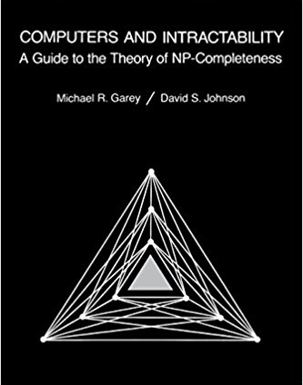
NP-Complete Problems
But Wait! There’s more!
By 1979, at least 300 problems had been proven NP-complete.
Garey and Johnson put a list of all the NP-complete problems they could find in this textbook.
Took them almost 100 pages to just list them all.

Slide 52
What do we do about it?
Approximation Algorithm:
Can we get an efficient algorithm that guarantees something close to optimal? (e.g. Answer is guaranteed to be within 1.5x of Optimal, but solved in polynomial time).
Restrictions:
Many hard problems are easy for restricted inputs (e.g. graph is always a tree, degree of vertices is always 3 or less).
Heuristics:
Can we get something that seems to work well (good approximation/fast enough) most of the time? (e.g. In practice, n is small-ish)

