Slide 1
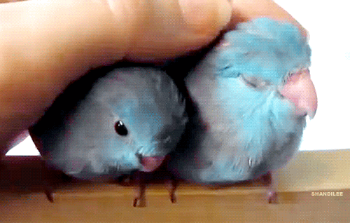
CSE 332: Data Structures & Parallelism Lecture 21: MST
Hans Easton
Summer 2022

Slide 2
Announcements

Slide 3
Outline for Today
Intro to MST
Prim’s algorithm
Kruskal’s algorithm

Slide 4
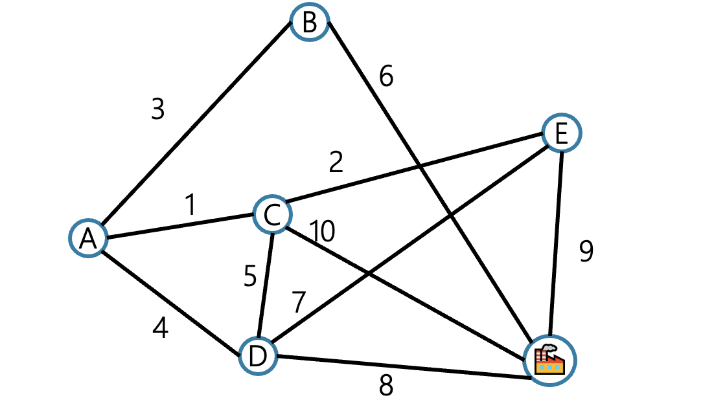
Time travel – 1920s
It’s the 1920’s. Your friend works at an electric company. They want to know where to build electrical wires to connect all cities to the powerplant.
They know how much it would cost to lay electric wires between any pair of locations, and they want the cheapest way to make sure there’s electricity from the plant to every city.

Slide 5
Time travel – 1950s
It’s the 1950’s. Your friend works at a phone company. They want to know where to build phone wires to connect phones to each other.
They know how much it would cost to lay phone wires between any pair of locations, and they want the cheapest way to make sure everyone can call everyone else.

Slide 6
Time travel – 2020s
It’s 2022! Your friend works at an internet company. They want to know where to build internet cables to connect all cities to the Internet.
They know much it would cost to lay internet cables between any pair of locations, and they want the cheapest way to make sure everyone can reach the server.

Slide 7
What are we looking for?
A set of edges such that…
1. Every vertex touches at least one edge
2. Graph on these edges is connected
3. Sum of edge weights is minimized
Claim: The set of edges we pick never has a cycle

Slide 8
Aside: Tree!
1. Don’t need a root
2. Varying numbers of children
3. Connected and no cycles
Tree (when talking about undirected graphs)
An undirected, connected acyclic graph.

Slide 9
MST Problem
We need a minimum spanning tree
A set of edges such that…
1. Edges span the graph
2. Graph on these edges is connected
3. Sum of edge weights is minimized
4. Contains no cycle
Minimum Spanning Tree Problem
Given: an undirected, weighted graph G
Find: A minimum-weight set of edges such that you can get from any vertex of G to any other on only those edges.

Slide 10
Prim’s Algorithm
Choose arbitrary starting point
Add a new edge to the result each step
How to choose the new edge?
Will let you reach more vertices
Is as light as possible

Slide 11
Try it out
Prim’s travelling strategy as a broke college student!
1. research neighboring cities (update table)
2. decide on the cheapest city to travel to
3. travel to that city (mark graph)!
50
G
6
B
Vertex | Dist. | Best Edge | Processed
A
B
C
D
E
F
G
2
3
E
4
C
5
A
9
2
7
7
F
D
8

Slide 12
Try it out
Prim’s travelling strategy as a broke college student!
1. research neighboring cities (update table)
2. decide on the cheapest city to travel to
3. travel to that city (mark graph)!
50
G
6
B
2
3
E
Vertex | Dist. | Best Edge | Processed
A | -- | -- | Yes
B | 2 | (A,B) | Yes
C | 4 | (A,C) | Yes
D | 7 2 | (A,D)(C,D) | Yes
E | 6 5 | (B,E)(C,E) | Yes
F | 3 | (B,F) | Yes
G | 50 | (B,G) | Yes
4
C
5
A
9
2
7
7
F
D
8

Slide 13
Pseudocode
initialize distances to $∞$
mark source as distance 0
mark all vertices unprocessed
foreach(edge (source, v) )
v.dist = w(source,v)
while(there are unprocessed vertices){
let u be the closest unprocessed vertex
add u.bestEdge to spanning tree
foreach(edge (u,v) leaving u){
if(w(u,v) < v.dist){
v.dist = w(u,v)
v.bestEdge = (u,v)
}
}
mark u as processed
}

Slide 14
Does Prim’s Algorithm Always Work?
Prim’s Algorithm is a greedy algorithm
Always select the best option available at the moment
Once it decides to include an edge in the MST, it never reconsiders its decision
Life lesson? Be greedy!

Slide 15
A different Approach
Prim’s algorithm - vertex by vertex
What if you think edge by edge instead?
Start from the lightest edge
add it if it connects new things to each other
don’t add it if it would create a cycle
This is Kruskal’s Algorithm

Slide 16
Kruskal’s Algorithm
KruskalMST(Graph G)
initialize each vertex to be a connected component
sort the edges by weight
foreach(edge (u, v) in sorted order){
if(u and v are in different components){
add (u,v) to the MST
Update u and v to be in the same component
}
}

Slide 17
Try It Out
B
3
6
Two simple steps:
1. If edge connects different clouds
then add edge, combine clouds
2. Otherwise, ignore
E
2
1
C
10
A
5
9
7
4
D
F
8
Edge | Include? | Reason
(A,C)
(C,E)
(A,B)
(A,D)
(C,D)
Edge | Include? | Reason
(B,F)
(D,E)
(D,F)
(E,F)
(C,F)

Slide 18
Kruskal’s Algorithm: Running Time
KruskalMST(Graph G)
initialize each vertex to be a connected component
sort the edges by weight
foreach(edge (u, v) in sorted order){
if(u and v are in different components){
add (u,v) to the MST
Update u and v to be in the same component
}
}
Notes:
1. Explain runtime
2. Explain relationship between V and E
3. We are adding one edge at a time, and the connected components of the graph do not change that much. Yet we are repeating BFS over and over again in each iteration, which is relatively slow. So is the case for the last line when we are combining two components together.
4. Need a more efficient way to find out whether two elements belong to the same component or not, and also an efficient to combine two components together.

Slide 19
Union-Find
Union-Find ADT
state
Set of Sets
Disjoint: No element appears in multiple sets
No required order
Each set has representative
behavior
makeSet(x) – creates a new set where the only member (and the representative) is x.
findSet(x) – looks up the set containing element x, returns name of that set
union(x, y) – combines sets named x and y. Picks new name for combined set.

Slide 20
Union-Find Running Time
What’s important for us?
Amortized running times! We care about the total time across the entire set of unions and finds, not the running time of just one.
Operation | Amortized | Non-amortized
MakeSet() | $$Θ(1)$$ | $$Θ(1)$$
Union() | $$O(\log^{∗}{n})$$ | $$O(\log{n)}$$
Find() | $$O(\log^{∗}{n)}$$ | $$O(\log{n)}$$

Slide 21
log * n
$\log^{∗}{n}:$the number of times you need to apply $log⁡()$ to get a number at most 1.
E.g. $\log^{∗}{(16)}=3$
$$\log\left(16\right)=4 \log\left(4\right)=2 \log\left(2\right)=1.$$
$\log^{∗}{n}$ grows ridiculously slowly.
$$\log^{∗}\left({10}^{80}\right) =5.$$
For all practical purposes, $\log^{∗}{n}$ operations are constant time

Slide 22
Using Union-Find
Have each disjoint set represent a connected component
When you add an edge, you union those connected components.
How do you know if two vertices belong to the same component?

Slide 23
Kruskal’s with Union Find
KruskalMST(Graph G)
initialize each vertex to be a connected component
sort the edges by weight
foreach(edge (u, v) in sorted order){
if(find(u) != find(v)){
add (u,v) to the MST
union(find(u),find(v)) }
}

Slide 24
Full circle
Let’s time travel again!

Slide 25
Time travel (again) – 1920s
It’s the 1920’s. Your friend works at an electric company. They want to know where to build electrical wires to connect all cities to the powerplant.
They know how much it would cost to lay electric wires between any pair of locations, and they want the cheapest way to make sure there’s electricity from the plant to every city.

Slide 26
Time travel (again) – 1950s
It’s the 1950’s. Your friend works at a phone company. They want to know where to build phone wires to connect phones to each other.
They know how much it would cost to lay phone wires between any pair of locations, and they want the cheapest way to make sure everyone can call everyone else.

Slide 27
Time travel (again) – 2020s
It’s 2022! You work at an internet company. They want to know where to build internet cables to connect all cities to the Internet. Maybe you will come up with the next MST algorithm!

Slide 28
A Graph of Trees
Recall a tree is an undirected, connected, and acyclic graph.
How would we describe the graph Kruskal’s builds?
It’s not a tree until the end.
It’s a forest!
Forest
any undirected and acyclic graph

Slide 29
EVERY TREE IS A FOREST.

