Slide 1
CSE 332: Data Structures & Parallelism Lecture 19: Topological Sort, Traversals
Arthur Liu
Summer 2022

Slide 2
Outline for Today
Topological Sort
BFS, DFS

Slide 3
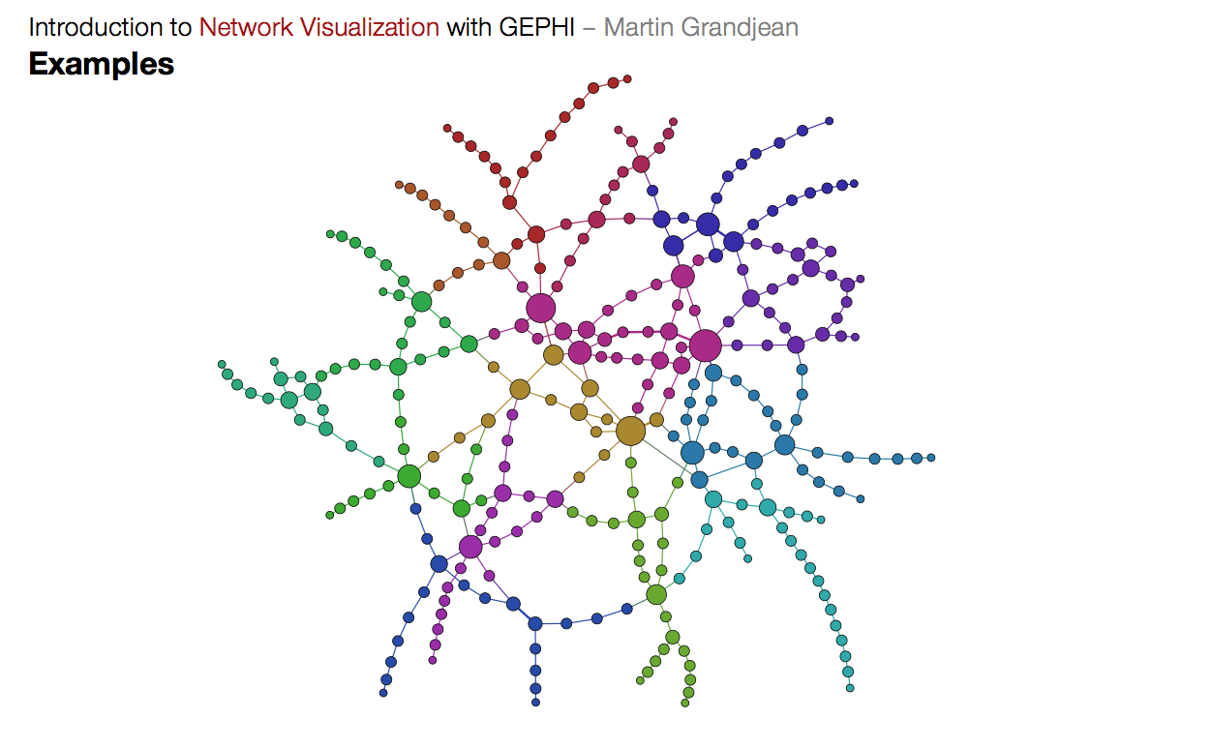
Graph Problems
Lots of interesting questions we can ask about a graph:
What is the shortest route from S to T? What is the longest route without cycles?
Are there cycles in this graph?
Is there a cycle that uses each vertex exactly once?
Is there a cycle that uses each edge exactly once?
T
S
Notes:
http://www.martingrandjean.ch/wp-content/uploads/2013/07/Gephi5.png

Slide 4
Graph Problems More Theoretically
Some well known graph problems and their common names:
s-t Path. Is there a path between vertices s and t?
Connectivity. Is the graph connected?
Biconnectivity. Is there a vertex whose removal disconnects the graph?
Shortest s-t Path. What is the shortest path between vertices s and t?
Cycle Detection. Does the graph contain any cycles?
Euler Tour. Is there a cycle that uses every edge exactly once?
Hamilton Tour. Is there a cycle that uses every vertex exactly once?
Planarity. Can you draw the graph on paper with no crossing edges?
Isomorphism. Are two graphs the same graph (in disguise)?
Often can’t tell how difficult a graph problem is without very deep consideration.

Slide 5
First graph algorithm!

Slide 6
Topological Sort
Disclaimer: Do not use for official advising purposes! (Implies that CSE 332 is a pre-req for CSE 312 – not true)
Problem: Given a DAG G=(V,E), output all the vertices in order such that no vertex appears before any other vertex that has an edge to it
Example input:
Example output:
142, 126, 143, 311, 331, 332, 312, 341, 351, 333, 440, 352
CSE 331
CSE 440
CSE 332
CSE 142
CSE 143
CSE 311
…
CSE 312
MATH
126
CSE 341
CSE 351
CSE 333
CSE 352

Slide 7
0,1,2,3,4 0,1,3,2,4 1,0,2,3,4 1,0,3,2,4 1,2,0,3,4
2
1
4
3
0
Valid Topological Sorts:
Notes:
There are 5 total ones
0,1,2,3,4
1,0,2,3,4
0,1,3,2,4
1,2,0,3,4
1,0,3,2,4

Slide 8
A First Algorithm for Topological Sort
Label (“mark”) each vertex with its in-degree
Think “write in a field in the vertex”
Could also do this via a data structure (e.g., array) on the side
While there are vertices not yet output:
Choose a vertex v labeled with in-degree of 0
Output v and conceptually remove it from the graph
For each vertex w adjacent to v (i.e. w such that (v,w) in E), decrement the in-degree of w
In-degree
0
3
/
2
1
2
3
/
1
4
2
4
/
3
0
3
4
/
4
/
Notes:
O(V+E)
Fill in the in-degree
Write output: at the bottom

Slide 9
Example
Output:
CSE 331
CSE 440
CSE 332
CSE 142
CSE 143
CSE 311
CSE 312
MATH
126
CSE 341
CSE 351
CSE 333
CSE 352
Node: | 126 | 142 | 143 | 311 | 312 | 331 | 332 | 333 | 341 | 351 | 352 | 440
Removed?
In-degree | 0 | 0 | 2 | 1 | 2 | 1 | 1 | 2 | 1 | 1 | 1 | 1
Notes:
0 0 2 1 2 1 1 2 1 1 1 1

Slide 10
Example
Output:
126
CSE 331
CSE 440
CSE 332
CSE 142
CSE 143
CSE 311
CSE 312
MATH
126
CSE 341
CSE 351
CSE 333
CSE 352
Node: | 126 | 142 | 143 | 311 | 312 | 331 | 332 | 333 | 341 | 351 | 352 | 440
Removed? | x
In-degree | 0 | 0 | 2 1 | 1 | 2 | 1 | 1 | 2 | 1 | 1 | 1 | 1
Notes:
0 0 2 1 2 1 1 2 1 1 1 1

Slide 11
Example
Output:
126
142
CSE 331
CSE 440
CSE 332
CSE 142
CSE 143
CSE 311
CSE 312
MATH
126
CSE 341
CSE 351
CSE 333
CSE 352
Node: | 126 | 142 | 143 | 311 | 312 | 331 | 332 | 333 | 341 | 351 | 352 | 440
Removed? | x | x
In-degree | 0 | 0 | 1 0 | 1 | 2 | 1 | 1 | 2 | 1 | 1 | 1 | 1
Notes:
0 0 2 1 2 1 1 2 1 1 1 1

Slide 12
Example
Output:
126
142
143
CSE 331
CSE 440
CSE 332
CSE 142
CSE 143
CSE 311
CSE 312
MATH
126
CSE 341
CSE 351
CSE 333
CSE 352
Node: | 126 | 142 | 143 | 311 | 312 | 331 | 332 | 333 | 341 | 351 | 352 | 440
Removed? | x | x | x
In-degree | 0 | 0 | 0 | 1 0 | 2 | 1 0 | 1 | 2 | 1 0 | 1 0 | 1 | 1
Notes:
0 0 2 1 2 1 1 2 1 1 1 1

Slide 13
Example
Output:
126
142
143
311
CSE 331
CSE 440
CSE 332
CSE 142
CSE 143
CSE 311
CSE 312
MATH
126
CSE 341
CSE 351
CSE 333
CSE 352
Node: | 126 | 142 | 143 | 311 | 312 | 331 | 332 | 333 | 341 | 351 | 352 | 440
Removed? | x | x | x | x
In-degree | 0 | 0 | 0 | 0 | 2 1 | 0 | 1 0 | 2 | 0 | 0 | 1 | 1
Notes:
0 0 2 1 2 1 1 2 1 1 1 1

Slide 14
Example
Output:
126
142
143
311
331
CSE 331
CSE 440
CSE 332
CSE 142
CSE 143
CSE 311
CSE 312
MATH
126
CSE 341
CSE 351
CSE 333
CSE 352
Node: | 126 | 142 | 143 | 311 | 312 | 331 | 332 | 333 | 341 | 351 | 352 | 440
Removed? | x | x | x | x |  | x
In-degree | 0 | 0 | 0 | 0 | 1 | 0 | 0 | 2 | 0 | 0 | 1 | 1
Notes:
0 0 2 1 2 1 1 2 1 1 1 1

Slide 15
Example
Output:
126
142
143
311
331
332
CSE 331
CSE 440
CSE 332
CSE 142
CSE 143
CSE 311
CSE 312
MATH
126
CSE 341
CSE 351
CSE 333
CSE 352
Node: | 126 | 142 | 143 | 311 | 312 | 331 | 332 | 333 | 341 | 351 | 352 | 440
Removed? | x | x | x | x |  | x | x
In-degree | 0 | 0 | 0 | 0 | 1 0 | 0 | 0 | 2 1 | 0 | 0 | 1 | 1 0
Notes:
0 0 2 1 2 1 1 2 1 1 1 1

Slide 16
Example
Output:
126
142
143
311
331
332
312
CSE 331
CSE 440
CSE 332
CSE 142
CSE 143
CSE 311
CSE 312
MATH
126
CSE 341
CSE 351
CSE 333
CSE 352
Node: | 126 | 142 | 143 | 311 | 312 | 331 | 332 | 333 | 341 | 351 | 352 | 440
Removed? | x | x | x | x | x | x | x
In-degree | 0 | 0 | 0 | 0 | 0 | 0 | 0 | 1 | 0 | 0 | 1 | 0
Notes:
0 0 2 1 2 1 1 2 1 1 1 1

Slide 17
Example
Output:
126
142
143
311
331
332
312
341
CSE 331
CSE 440
CSE 332
CSE 142
CSE 143
CSE 311
CSE 312
MATH
126
CSE 341
CSE 351
CSE 333
CSE 352
Node: | 126 | 142 | 143 | 311 | 312 | 331 | 332 | 333 | 341 | 351 | 352 | 440
Removed? | x | x | x | x | x | x | x |  | x
In-degree | 0 | 0 | 0 | 0 | 0 | 0 | 0 | 1 | 0 | 0 | 1 | 0
Notes:
0 0 2 1 2 1 1 2 1 1 1 1

Slide 18
Example
Output:
126
142
143
311
331
332
312
341
351
CSE 331
CSE 440
CSE 332
CSE 142
CSE 143
CSE 311
CSE 312
MATH
126
CSE 341
CSE 351
CSE 333
CSE 352
Node: | 126 | 142 | 143 | 311 | 312 | 331 | 332 | 333 | 341 | 351 | 352 | 440
Removed? | x | x | x | x | x | x | x |  | x | x
In-degree | 0 | 0 | 0 | 0 | 0 | 0 | 0 | 1 0 | 0 | 0 | 1 0 | 0
Notes:
0 0 2 1 2 1 1 2 1 1 1 1

Slide 19
Example
Output:
126
142
143
311
331
332
312
341
351
333
CSE 331
CSE 440
CSE 332
CSE 142
CSE 143
CSE 311
CSE 312
MATH
126
CSE 341
CSE 351
CSE 333
CSE 352
Node: | 126 | 142 | 143 | 311 | 312 | 331 | 332 | 333 | 341 | 351 | 352 | 440
Removed? | x | x | x | x | x | x | x | x | x | x
In-degree | 0 | 0 | 0 | 0 | 0 | 0 | 0 | 0 | 0 | 0 | 0 | 0
Notes:
0 0 2 1 2 1 1 2 1 1 1 1

Slide 20
Example
Output:
126
142
143
311
331
332
312
341
351
333
352
CSE 331
CSE 440
CSE 332
CSE 142
CSE 143
CSE 311
CSE 312
MATH
126
CSE 341
CSE 351
CSE 333
CSE 352
Node: | 126 | 142 | 143 | 311 | 312 | 331 | 332 | 333 | 341 | 351 | 352 | 440
Removed? | x | x | x | x | x | x | x | x | x | x | x
In-degree | 0 | 0 | 0 | 0 | 0 | 0 | 0 | 0 | 0 | 0 | 0 | 0
Notes:
0 0 2 1 2 1 1 2 1 1 1 1

Slide 21
Example
Output:
126
142
143
311
331
332
312
341
351
333
352
440
CSE 331
CSE 440
CSE 332
CSE 142
CSE 143
CSE 311
CSE 312
MATH
126
CSE 341
CSE 351
CSE 333
CSE 352
Node: | 126 | 142 | 143 | 311 | 312 | 331 | 332 | 333 | 341 | 351 | 352 | 440
Removed? | x | x | x | x | x | x | x | x | x | x | x | x
In-degree | 0 | 0 | 0 | 0 | 0 | 0 | 0 | 0 | 0 | 0 | 0 | 0
Notes:
0 0 2 1 2 1 1 2 1 1 1 1

Slide 22
A couple of things to note
Needed a vertex with in-degree of 0 to start
No cycles
Ties between vertices with in-degrees of 0 can be broken arbitrarily
Potentially many different correct orders
What DAGs have exactly 1 topological ordering?

Slide 23
Topological Sort: Running time?
labelEachVertexWithItsInDegree();
for(ctr=0; ctr < numVertices; ctr++){
v = findNewVertexOfDegreeZero();
put v next in output
for each w adjacent to v
w.indegree--;
}
Notes:
Go over this one together
O(V + E. + V(V + 1 + d))
O(V + E. + V^2 + V + E)
O(V^2 + E)
Could use a heap to make faster, but we can do it even better. We don’t want smallest, we want only ones with vertices of size 0

Slide 24
Topological Sort: Running time?
labelEachVertexWithItsInDegree();
for(ctr=0; ctr < numVertices; ctr++){
v = findNewVertexOfDegreeZero();
put v next in output
for each w adjacent to v
w.indegree--;
}
What is the worst-case running time?
Initialization O(|V| + |E|) (assuming adjacency list)
Sum of all find-new-vertex O(|V|²) (because each O(|V|))
Sum of all decrements O(|E|) (assuming adjacency list)
So total is O(|V|² + |E|) – not good for a sparse graph!
Notes:
HIDE

Slide 25
Doing better
The trick is to avoid searching for a zero-degree node every time!
Keep the “pending” zero-degree nodes in a list, stack, queue, box, table, or something
Order we process them affects output but not correctness or efficiency provided add/remove are both O(1)
Using a queue:
Label each vertex with its in-degree, enqueue 0-degree nodes
While queue is not empty
v = dequeue()
Output v and remove it from the graph
For each vertex w adjacent to v (i.e. w such that (v,w) in E), decrement the in-degree of w, if new degree is 0, enqueue it

Slide 26
Topological Sort(optimized): Running time?
pollev.com/artliu
labelAllAndEnqueueZeros();
for(ctr=0; ctr < numVertices; ctr++){
v = dequeue();
put v next in output
for each w adjacent to v {
w.indegree--;
if(w.indegree==0)
enqueue(w);
}
}

Slide 27
Topological Sort(optimized): Running time?
labelAllAndEnqueueZeros();
for(ctr=0; ctr < numVertices; ctr++){
v = dequeue();
put v next in output
for each w adjacent to v {
w.indegree--;
if(w.indegree==0)
enqueue(w);
}
}
What is the worst-case running time?
Initialization: O(|V|+|E|) (assuming adjacency list)
Sum of all enqueues and dequeues: O(|V|)
Sum of all decrements: O(|E|) (assuming adjacency list)
So total is O(|E| + |V|) – much better for sparse graph!
Notes:
HIDE

Slide 28
Topological Sort Uses
Figuring out how to finish your degree
Determining the order to compile files using a Makefile
Determining what order a processor should execute threads
Determining what assignment you should work on next
In general, taking a dependency graph and coming up with an order of execution

Slide 29
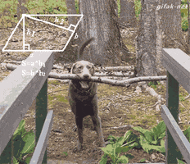
Another graph algorithm!

Slide 30
Graph Traversals
Next problem: For an arbitrary graph and a starting node v, find all nodes reachable (i.e., there exists a path) from v
Possibly “do something” for each node (an iterator!)
E.g. Print to output, set some field, etc.
Basic idea:
Keep following adjacent nodes
But “mark” nodes after visiting them, so the traversal terminates, and we process each reachable node exactly once

Slide 31
Graph Traversal: Abstract Idea
traverseGraph(Node start) {
Set pending = emptySet();
pending.add(start)
mark start as visited
while(pending is not empty) {
next = pending.remove()
for each node u adjacent to next
if(u is not marked) {
mark u
pending.add(u)
}
}
}

Slide 32
Running time and options
Assuming add and remove are O(1), entire traversal is O(|E|)
Use an adjacency list representation
The order we traverse depends entirely on how add and remove work/are implemented
Depth-first graph search (DFS): a stack
Breadth-first graph search (BFS): a queue
DFS and BFS are “big ideas” in computer science
Depth: recursively explore one part before going back to the other parts not yet explored
Breadth: Explore areas closer to the start node first

Slide 33
Recursive DFS, Example : trees
A tree is a graph and DFS and BFS are particularly easy to “see”
A
DFS(Node start) {
mark and “process”(e.g. print) start
for each node u adjacent to start
if u is not marked
DFS(u)
}
B
C
D
E
F
G
H
Order processed: A, B, D, E, C, F, G, H
Exactly what we called a “pre-order traversal” for trees
The marking is not needed here, but we need it to support arbitrary graphs , we need a way to process each node exactly once

Slide 34
DFS with a stack, Example: trees
DFS2(Node start) {
initialize stack s to hold start
mark start as visited
while(s is not empty) {
next = s.pop() // and “process”
for each node u adjacent to next
if(u is not marked)
mark u and push onto s
}
}
A
B
C
D
E
F
G
H
Order processed:
A different but perfectly fine traversal

Slide 35
DFS with a stack, Example: trees
DFS2(Node start) {
initialize stack s to hold start
mark start as visited
while(s is not empty) {
next = s.pop() // and “process”
for each node u adjacent to next
if(u is not marked)
mark u and push onto s
}
}
A
B
C
D
E
F
G
H
Order processed: A, C, F, H, G, B, E, D
A different but perfectly fine traversal
Notes:
HIDE

Slide 36
BFS with a queue, Example: trees
BFS(Node start) {
initialize queue q to hold start
mark start as visited
while(q is not empty) {
next = q.dequeue()// and “process”
for each node u adjacent to next
if(u is not marked)
mark u and enqueue onto q
}
}
A
B
C
D
E
F
G
H
Order processed:
A “level-order” traversal

Slide 37
BFS with a queue, Example: trees
BFS(Node start) {
initialize queue q to hold start
mark start as visited
while(q is not empty) {
next = q.dequeue()// and “process”
for each node u adjacent to next
if(u is not marked)
mark u and enqueue onto q
}
}
A
B
C
D
E
F
G
H
Order processed: A, B, C, D, E, F, G, H
A “level-order” traversal
Notes:
HIDE

Slide 38
pollev.com/artliu
For each of the following, indicate what traversal could have processed the graph in that order
A, D, H, I, J, C, G, B, F, E
A, B, C, D, E, F, G, H, J, I
A, D, C, B, H, G, F, E, I, J
A, B, E, C, G, F, J, D, H, I
A
D
B
C
E
H
F
G
J
I
Notes:
DFS
BFS
BFS
None

Slide 39
DFS/BFS Comparison
Breadth-first search:
Always finds shortest paths, i.e., “optimal solutions
Better for “what is the shortest path from x to y”
Queue may hold O(|V|) nodes (e.g. at the bottom level of binary tree of height h, 2^{h} nodes in queue)
Depth-first search:
Can use less space in finding a path
If longest path in the graph is p and highest out-degree is d then DFS stack never has more than d*p elements
A third approach: Iterative deepening (IDDFS):
Try DFS but don’t allow recursion more than K levels deep.
If that fails, increment K and start the entire search over
Like BFS, finds shortest paths. Like DFS, less space.

Slide 40
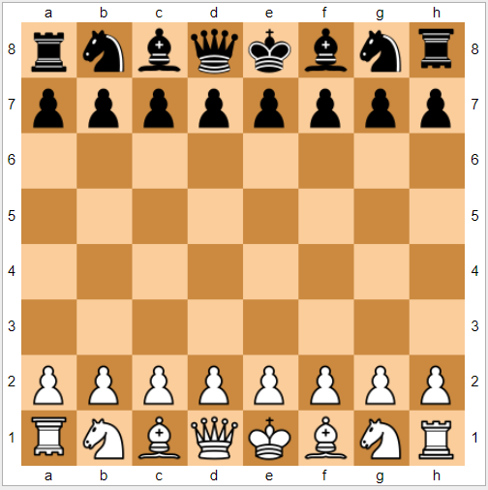
IDDFS and AI
IDDFS ideas can be applied to AI search algorithms to prune out bad branches earlier instead of traversing them too far
Helps us figure out how to “break ties” when picking a path
Take CSE473 AI (CSE415 AI Non-Majors)

Slide 41
Saving the path
Our graph traversals can answer the “reachability question”:
“Is there a path from node x to node y?”
Q: But what if we want to output the actual path?
A: Like this:
Instead of just “marking” a node, store the previous node along the path (when processing u causes us to add v to the search, set v.path field to be u)

Slide 42
Example using BFS
What is a path from Seattle to Austin
Remember marked nodes are not re-enqueued
Note shortest paths may not be unique
Chicago
Seattle
Salt Lake City
Austin
San Francisco
Dallas

Slide 43
Example using BFS
What is a path from Seattle to Austin
Remember marked nodes are not re-enqueued
Note shortest paths may not be unique
0
1
Chicago
Seattle
1
Salt Lake City
Austin
1
3
San Francisco
2
Dallas

