Slide 1
CSE 332: Data Structures & Parallelism Lecture 18: Graphs Intro
Arthur Liu
Summer 2022

Slide 2
Outline for Today
Graph terminology
Adjacency Matrix, Adjacency List

Slide 3
ADTs so far
We’ve seen:
Queues and Stacks
Our data points have some order we’re maintaining
Priority Queues
Our data had some priority we needed to keep track of.
Dictionaries
Our data points came as (key, value) pairs.

Slide 4
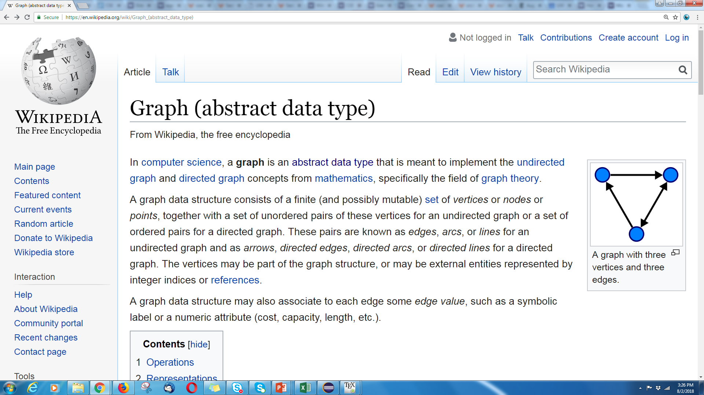
Graphs
Graphs are too versatile to think of them as only an ADT!

Slide 5
Graphs
Represent data points and the relationships between them.
That’s vague.
Formally:
A graph is a pair: G = (V,E)
V: set of vertices (aka nodes)
E: set of edges
Each edge is a pair of vertices.
Hans
Nathan
Dara
V = {Hans,Dara,Nathan}
E = {(Nathan,Dara),
(Hans,Dara),
(Dara,Hans)}

Slide 6
Making Graphs
If your problem has data and relationships, you might want to represent it as a graph
How do you choose a representation?
Usually:
Think about what your “fundamental” objects are
Those become your vertices.
Then think about how they’re related
Those become your edges.

Slide 7
Some examples
For each of the following think about what you should choose for vertices and edges.
The internet.
Facebook friendships
Input data for the “6 degrees of Kevin Bacon” game
Course Prerequisites

Slide 8
Some examples
For each of the following think about what you should choose for vertices and edges.
The internet.
Vertices: webpages. Edges from a to b if a has a hyperlink to b.
Facebook friendships
Vertices: people. Edges: if two people are friends
Input data for the “6 Degrees of Kevin Bacon” game
Vertices: actors. Edges: if two people appeared in the same movie
Or: Vertices for actors and movies, edge from actors to movies they appeared in.
Course Prerequisites
Vertices: courses. Edge: from a to b if a is a prereq for b.

Slide 9
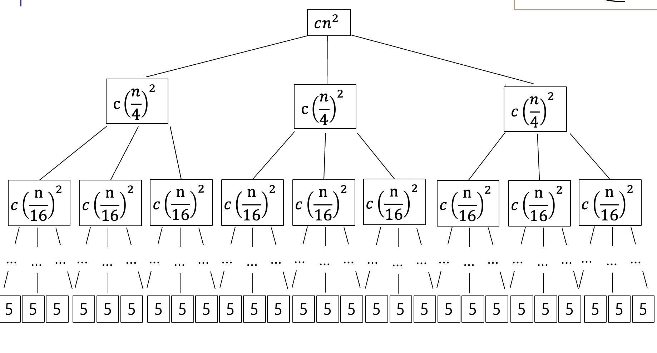
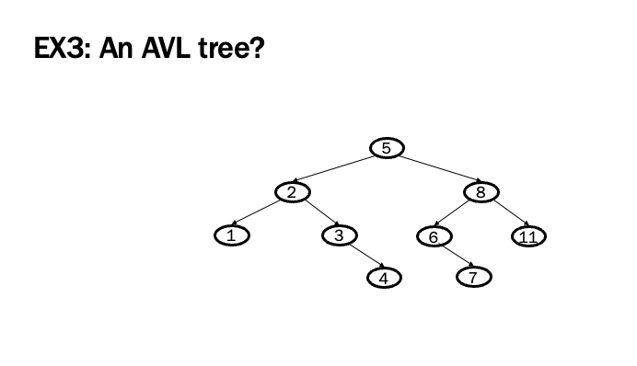
More Graphs
We’ve already used graphs to represent things in this course:
A LOT

Slide 10
Graph Terms

Slide 11
Undirected Graphs
In undirected graphs, edges have no specific direction
Edges are always “two-way”
D
A
C
B
Thus, (u,v) ∈ E implies (v,u) ∈ E.
Only one of these edges needs to be in the set; the other is implicit
Degree of a vertex: number of edges containing that vertex
Put another way: the number of adjacent vertices

Slide 12
Directed Graphs
In directed graphs (sometimes called digraphs), edges have a direction
D
D
A
C
A
or
C
2 edges here
B
B
Thus, (u,v) ∈ E does not imply (v,u) ∈ E.
Let (u,v) ∈ E mean u → v
Call u the source and v the destination
In-Degree of a vertex: number of in-bound edges,
i.e., edges where the vertex is the destination
Out-Degree of a vertex: number of out-bound edges
i.e., edges where the vertex is the source
Notes:
in-degree of B
Out-degree of B

Slide 13
Self-edges
A self-edge a.k.a. a loop is an edge of the form (u,u)
Depending on the use/algorithm, a graph may have:
No self edges
Some self edges
All self edges (often therefore implicit, but we will be explicit)
0.3
1
0.9
Alive
0.1
Sick
Dead
0.2
0.5
X X

Slide 14
Graph Terms
Walk – A sequence of adjacent vertices. Each connected to next by an edge.
(Directed) Walk–must follow the direction of the edges
Length – The number of edges in a walk
- (A,B,C,D) has length 3.
A,B,C,D is a walk.
So is A,B,A
A
B
C
D
A
B
C
D
A,B,C,D,A is a directed walk.
A,B,A is not.
Notes:
Terminology here varies by source. This is what the textbook uses – some people use walk instead of path’ and reserve path for what we called a simple path.

Slide 15
Graph Terms
Path – A walk that doesn’t repeat a vertex. A,B,C,D is a path. A,B,A is not.
Cycle – path with an extra edge from last vertex back to first.
Be careful looking at other sources. Some people call our “walks” “paths” and our “paths” “simple paths”
Use the definitions on these slides.
A
B
C
D
A
B
C
D
Notes:
Terminology here varies by source. This is what the textbook uses – some people use walk instead of path’ and reserve path for what we called a simple path.

Slide 16
Undirected graph connectivity
An undirected graph is connected if for all
pairs of vertices u,v, there exists a path from u to v
Connected graph
Disconnected graph

Slide 17
Directed graph connectivity
A directed graph is strongly connected if there is a path from every vertex to every other vertex
A directed graph is weakly connected if there is a path from every vertex to every other vertex ignoring direction of edges

Slide 18
Complete Graph
A complete graph is a graph in which there is an edge between every pair of vertices.

Slide 19
Some math with edges
D
A
C
For a graph G = (V,E):
|V| = N, is the number of vertices
|E| = M, is the number of edges
Minimum?
Maximum for undirected?
Maximum for directed?
If (u,v) ∈ E
Then v is a neighbor of u, i.e., v is adjacent to u
Order matters for directed edges
u is not adjacent to v unless (v,u) ∈ E
B
V = {A, B, C, D}
E = {(C, B),
(A, B),
(B, A)
(C, D)}

Slide 20
Density / Sparsity
Sparse
Dense
0 edges
O(V) edges
O(V²) edges
Undirected connected graph must have at least V – 1 edges

Slide 21
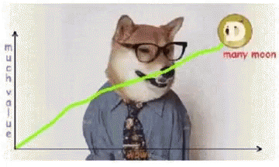
Representing and Using Graphs

Slide 22
Adjacency Matrix
Assign each node a number from 0 to |V|-1
A |V| x |V| matrix (i.e., 2-D array) of Booleans (or 1 vs. 0)
If M is the matrix, then M[u][v] == true means there is an edge from u to v
A
B
C
D
D
A
F
T
F
F
A
C
B
T
F
F
F
B
C
F
T
F
T
D
F
F
F
F

Slide 23
Adjacency Matrix Properties
A
B
C
D
Running time to:
Get a vertex’s out-edges:
Get a vertex’s in-edges:
Decide if some edge exists:
Insert an edge:
Delete an edge:
Space requirements:
Best for sparse or dense graphs?
A
F
T
F
F
B
T
F
F
F
C
F
T
F
T
D
F
F
F
F
D
A
C
B
Notes:
|V|, and |E|
Space could literally be bits, but it depends on what you’re storing. Could store weights or some other meta information about these edges in here.
How would our matrix change if these edges were undirected?

Slide 24
Adjacency Matrix Properties
A
B
C
D
Running time to:
Get a vertex’s out-edges: O(|V|)
Get a vertex’s in-edges: O(|V|)
Decide if some edge exists: O(1)
Insert an edge: O(1)
Delete an edge: O(1)
Space requirements:
|V|² bits
Best for sparse or dense graphs?
Best for dense graphs
A
F
T
F
F
B
T
F
F
F
C
F
T
F
T
D
F
F
F
F
D
A
C
B
Notes:
HIDE

Slide 25
Adjacency Matrix Properties
How will the adjacency matrix vary for an undirected graph?
How can we adapt the representation for weighted graphs?
A
B
C
D
A
F
T
F
F
B
T
F
F
F
C
F
T
F
T
D
F
F
F
F

Slide 26
Adjacency Matrix Properties
How will the adjacency matrix vary for an undirected graph?
Undirected will be symmetric about diagonal axis
How can we adapt the representation for weighted graphs?
Instead of a Boolean, store a number in each cell
Need some value to represent ‘not an edge’
In some situations, 0 or -1 works
A
B
C
D
A
F
T
F
F
B
T
F
F
F
C
F
T
F
T
D
F
F
F
F

Slide 27
Adjacency List
Assign each node a number from 0 to |V|-1
An array of length |V| in which each entry stores a list of all adjacent vertices (e.g., linked list)
D
A
B
/
A
C
B
A
/
B
C
D
B
/
D
/
Notes:
Order doesn’t matter, as long as it is here, it means there is an edge from D to B

Slide 28
Adjacency List Properties
A
B
/
B
A
/
Running time to:
Get all of a vertex’s out-edges:
Get all of a vertex’s in-edges:
Decide if some edge exists:
Insert an edge:
Delete an edge:
Space requirements:
Best for dense or sparse graphs?
C
D
B
/
D
/
D
A
C
B
Notes:
So we have V, E, and now also d, which is the out-degree of a vertex.

Slide 29
Adjacency List Properties
A
B
/
B
A
/
Running time to:
Get all of a vertex’s out-edges:
O(d) where d is out-degree of vertex
Get all of a vertex’s in-edges:
O(|V| + |E|) (but could keep a second adjacency list for this!)
Decide if some edge exists:
O(d) where d is out-degree of source
Insert an edge: O(1) (unless you need to check if it’s there)
Delete an edge: O(d) where d is out-degree of source
Space requirements:
O(|V|+|E|)
Best for dense or sparse graphs?
Best for sparse graphs, so can sometimes just stick with linked lists
C
D
B
/
D
/
D
A
C
B
Notes:
HIDE

Slide 30
Which is better?
Graphs are often sparse:
Streets form grids
every corner is not connected to every other corner
Airlines rarely fly to all possible cities
or if they do it is to/from a hub rather than directly to/from all small cities to other small cities
Adjacency lists should generally be your default choice

Slide 31
Some other special graphs we’ve seen

Slide 32
Trees as graphs
In graph theory,
we say a tree is a graph that is:
undirected
acyclic
connected
How does this relate to the trees we know and love?...
Example:
D
E
B
A
C
F
G
H

Slide 33
Rooted Trees
We are more accustomed to rooted trees where:
We identify a unique (“special”) root
We think of edges as directed: parent to children
Given a tree, once you pick a root, you have a unique rooted tree (just drawn differently and with undirected edges)
D
E
A
B
redrawn
A
B
C
C
D
E
F
F
G
H
G
H

Slide 34
Rooted Trees (Another example)
We are more accustomed to rooted trees where:
We identify a unique (“special”) root
We think of edges as directed: parent to children
Given a tree, once you pick a root, you have a unique rooted tree (just drawn differently and with undirected edges)
D
E
F
B
redrawn
G
H
C
A
A
C
B
F
D
E
G
H

Slide 35
Directed acyclic graphs (DAGs)
A DAG is a directed graph with no (directed) cycles
Every rooted directed tree is a DAG
But not every DAG is a rooted directed tree:
Every DAG is a directed graph
But not every directed graph is a DAG:

Slide 36
First graph algorithm!

Slide 37
Topological Sort
Disclaimer: Do not use for official advising purposes! (Implies that CSE 332 is a pre-req for CSE 312 – not true)
Problem: Given a DAG G=(V,E), output all the vertices in order such that no vertex appears before any other vertex that has an edge to it
Example input:
Example output:
142, 126, 143, 311, 331, 332, 312, 341, 351, 333, 440, 352
CSE 331
CSE 440
CSE 332
CSE 142
CSE 143
CSE 311
…
CSE 312
MATH
126
CSE 341
CSE 351
CSE 333
CSE 352

Slide 38
0,1,2,3,4 0,1,3,2,4 1,0,2,3,4 1,0,3,2,4 1,2,0,3,4
2
1
4
3
0
Valid Topological Sorts:
Notes:
There are 5 total ones
0,1,2,3,4
1,0,2,3,4
0,1,3,2,4
1,2,0,3,4
1,0,3,2,4

Slide 39
A First Algorithm for Topological Sort
Label (“mark”) each vertex with its in-degree
Think “write in a field in the vertex”
Could also do this via a data structure (e.g., array) on the side
While there are vertices not yet output:
Choose a vertex v labeled with in-degree of 0
Output v and conceptually remove it from the graph
For each vertex w adjacent to v (i.e. w such that (v,w) in E), decrement the in-degree of w
In-degree
0
3
/
2
1
2
3
/
1
4
2
4
/
3
0
3
4
/
4
/
Notes:
O(V+E)
Fill in the in-degree
Write output: at the bottom

Slide 40
Example
Output:
CSE 331
CSE 440
CSE 332
CSE 142
CSE 143
CSE 311
CSE 312
MATH
126
CSE 341
CSE 351
CSE 333
CSE 352
Node: | 126 | 142 | 143 | 311 | 312 | 331 | 332 | 333 | 341 | 351 | 352 | 440
Removed?
In-degree | 0 | 0 | 2 | 1 | 2 | 1 | 1 | 2 | 1 | 1 | 1 | 1
Notes:
0 0 2 1 2 1 1 2 1 1 1 1

Slide 41
Example
Output:
126
CSE 331
CSE 440
CSE 332
CSE 142
CSE 143
CSE 311
CSE 312
MATH
126
CSE 341
CSE 351
CSE 333
CSE 352
Node: | 126 | 142 | 143 | 311 | 312 | 331 | 332 | 333 | 341 | 351 | 352 | 440
Removed? | x
In-degree | 0 | 0 | 2 1 | 1 | 2 | 1 | 1 | 2 | 1 | 1 | 1 | 1
Notes:
0 0 2 1 2 1 1 2 1 1 1 1

Slide 42
Example
Output:
126
142
CSE 331
CSE 440
CSE 332
CSE 142
CSE 143
CSE 311
CSE 312
MATH
126
CSE 341
CSE 351
CSE 333
CSE 352
Node: | 126 | 142 | 143 | 311 | 312 | 331 | 332 | 333 | 341 | 351 | 352 | 440
Removed? | x | x
In-degree | 0 | 0 | 1 0 | 1 | 2 | 1 | 1 | 2 | 1 | 1 | 1 | 1
Notes:
0 0 2 1 2 1 1 2 1 1 1 1

Slide 43
Example
Output:
126
142
143
CSE 331
CSE 440
CSE 332
CSE 142
CSE 143
CSE 311
CSE 312
MATH
126
CSE 341
CSE 351
CSE 333
CSE 352
Node: | 126 | 142 | 143 | 311 | 312 | 331 | 332 | 333 | 341 | 351 | 352 | 440
Removed? | x | x | x
In-degree | 0 | 0 | 0 | 1 0 | 2 | 1 0 | 1 | 2 | 1 0 | 1 0 | 1 | 1
Notes:
0 0 2 1 2 1 1 2 1 1 1 1

Slide 44
Example
Output:
126
142
143
311
CSE 331
CSE 440
CSE 332
CSE 142
CSE 143
CSE 311
CSE 312
MATH
126
CSE 341
CSE 351
CSE 333
CSE 352
Node: | 126 | 142 | 143 | 311 | 312 | 331 | 332 | 333 | 341 | 351 | 352 | 440
Removed? | x | x | x | x
In-degree | 0 | 0 | 0 | 0 | 2 1 | 0 | 1 0 | 2 | 0 | 0 | 1 | 1
Notes:
0 0 2 1 2 1 1 2 1 1 1 1

Slide 45
Example
Output:
126
142
143
311
331
CSE 331
CSE 440
CSE 332
CSE 142
CSE 143
CSE 311
CSE 312
MATH
126
CSE 341
CSE 351
CSE 333
CSE 352
Node: | 126 | 142 | 143 | 311 | 312 | 331 | 332 | 333 | 341 | 351 | 352 | 440
Removed? | x | x | x | x |  | x
In-degree | 0 | 0 | 0 | 0 | 1 | 0 | 0 | 2 | 0 | 0 | 1 | 1
Notes:
0 0 2 1 2 1 1 2 1 1 1 1

Slide 46
Example
Output:
126
142
143
311
331
332
CSE 331
CSE 440
CSE 332
CSE 142
CSE 143
CSE 311
CSE 312
MATH
126
CSE 341
CSE 351
CSE 333
CSE 352
Node: | 126 | 142 | 143 | 311 | 312 | 331 | 332 | 333 | 341 | 351 | 352 | 440
Removed? | x | x | x | x |  | x | x
In-degree | 0 | 0 | 0 | 0 | 1 0 | 0 | 0 | 2 1 | 0 | 0 | 1 | 1 0
Notes:
0 0 2 1 2 1 1 2 1 1 1 1

Slide 47
Example
Output:
126
142
143
311
331
332
312
CSE 331
CSE 440
CSE 332
CSE 142
CSE 143
CSE 311
CSE 312
MATH
126
CSE 341
CSE 351
CSE 333
CSE 352
Node: | 126 | 142 | 143 | 311 | 312 | 331 | 332 | 333 | 341 | 351 | 352 | 440
Removed? | x | x | x | x | x | x | x
In-degree | 0 | 0 | 0 | 0 | 0 | 0 | 0 | 1 | 0 | 0 | 1 | 0
Notes:
0 0 2 1 2 1 1 2 1 1 1 1

Slide 48
Example
Output:
126
142
143
311
331
332
312
341
CSE 331
CSE 440
CSE 332
CSE 142
CSE 143
CSE 311
CSE 312
MATH
126
CSE 341
CSE 351
CSE 333
CSE 352
Node: | 126 | 142 | 143 | 311 | 312 | 331 | 332 | 333 | 341 | 351 | 352 | 440
Removed? | x | x | x | x | x | x | x |  | x
In-degree | 0 | 0 | 0 | 0 | 0 | 0 | 0 | 1 | 0 | 0 | 1 | 0
Notes:
0 0 2 1 2 1 1 2 1 1 1 1

Slide 49
Example
Output:
126
142
143
311
331
332
312
341
351
CSE 331
CSE 440
CSE 332
CSE 142
CSE 143
CSE 311
CSE 312
MATH
126
CSE 341
CSE 351
CSE 333
CSE 352
Node: | 126 | 142 | 143 | 311 | 312 | 331 | 332 | 333 | 341 | 351 | 352 | 440
Removed? | x | x | x | x | x | x | x |  | x | x
In-degree | 0 | 0 | 0 | 0 | 0 | 0 | 0 | 1 0 | 0 | 0 | 1 0 | 0
Notes:
0 0 2 1 2 1 1 2 1 1 1 1

Slide 50
Example
Output:
126
142
143
311
331
332
312
341
351
333
CSE 331
CSE 440
CSE 332
CSE 142
CSE 143
CSE 311
CSE 312
MATH
126
CSE 341
CSE 351
CSE 333
CSE 352
Node: | 126 | 142 | 143 | 311 | 312 | 331 | 332 | 333 | 341 | 351 | 352 | 440
Removed? | x | x | x | x | x | x | x | x | x | x
In-degree | 0 | 0 | 0 | 0 | 0 | 0 | 0 | 0 | 0 | 0 | 0 | 0
Notes:
0 0 2 1 2 1 1 2 1 1 1 1

Slide 51
Example
Output:
126
142
143
311
331
332
312
341
351
333
352
CSE 331
CSE 440
CSE 332
CSE 142
CSE 143
CSE 311
CSE 312
MATH
126
CSE 341
CSE 351
CSE 333
CSE 352
Node: | 126 | 142 | 143 | 311 | 312 | 331 | 332 | 333 | 341 | 351 | 352 | 440
Removed? | x | x | x | x | x | x | x | x | x | x | x
In-degree | 0 | 0 | 0 | 0 | 0 | 0 | 0 | 0 | 0 | 0 | 0 | 0
Notes:
0 0 2 1 2 1 1 2 1 1 1 1

Slide 52
Example
Output:
126
142
143
311
331
332
312
341
351
333
352
440
CSE 331
CSE 440
CSE 332
CSE 142
CSE 143
CSE 311
CSE 312
MATH
126
CSE 341
CSE 351
CSE 333
CSE 352
Node: | 126 | 142 | 143 | 311 | 312 | 331 | 332 | 333 | 341 | 351 | 352 | 440
Removed? | x | x | x | x | x | x | x | x | x | x | x | x
In-degree | 0 | 0 | 0 | 0 | 0 | 0 | 0 | 0 | 0 | 0 | 0 | 0
Notes:
0 0 2 1 2 1 1 2 1 1 1 1

Slide 53
A couple of things to note
Needed a vertex with in-degree of 0 to start
No cycles
Ties between vertices with in-degrees of 0 can be broken arbitrarily
Potentially many different correct orders
What DAGs have exactly 1 topological ordering?

Slide 54
Topological Sort: Running time?
labelEachVertexWithItsInDegree();
for(ctr=0; ctr < numVertices; ctr++){
v = findNewVertexOfDegreeZero();
put v next in output
for each w adjacent to v
w.indegree--;
}
Notes:
Go over this one together
O(V + E. + V(V + 1 + d))
O(V + E. + V^2 + V + E)
O(V^2 + E)
Could use a heap to make faster, but we can do it even better. We don’t want smallest, we want only ones with vertices of size 0

Slide 55
Topological Sort: Running time?
labelEachVertexWithItsInDegree();
for(ctr=0; ctr < numVertices; ctr++){
v = findNewVertexOfDegreeZero();
put v next in output
for each w adjacent to v
w.indegree--;
}
What is the worst-case running time?
Initialization O(|V| + |E|) (assuming adjacency list)
Sum of all find-new-vertex O(|V|²) (because each O(|V|))
Sum of all decrements O(|E|) (assuming adjacency list)
So total is O(|V|² + |E|) – not good for a sparse graph!
Notes:
HIDE

Slide 56
Doing better
The trick is to avoid searching for a zero-degree node every time!
Keep the “pending” zero-degree nodes in a list, stack, queue, box, table, or something
Order we process them affects output but not correctness or efficiency provided add/remove are both O(1)
Using a queue:
Label each vertex with its in-degree, enqueue 0-degree nodes
While queue is not empty
v = dequeue()
Output v and remove it from the graph
For each vertex w adjacent to v (i.e. w such that (v,w) in E), decrement the in-degree of w, if new degree is 0, enqueue it

Slide 57
Topological Sort(optimized): Running time?
labelAllAndEnqueueZeros();
for(ctr=0; ctr < numVertices; ctr++){
v = dequeue();
put v next in output
for each w adjacent to v {
w.indegree--;
if(w.indegree==0)
enqueue(w);
}
}

Slide 58
Topological Sort(optimized): Running time?
labelAllAndEnqueueZeros();
for(ctr=0; ctr < numVertices; ctr++){
v = dequeue();
put v next in output
for each w adjacent to v {
w.indegree--;
if(w.indegree==0)
enqueue(w);
}
}
What is the worst-case running time?
Initialization: O(|V|+|E|) (assuming adjacency list)
Sum of all enqueues and dequeues: O(|V|)
Sum of all decrements: O(|E|) (assuming adjacency list)
So total is O(|E| + |V|) – much better for sparse graph!
Notes:
HIDE

Slide 59
Topological Sort Uses
Figuring out how to finish your degree
Determining the order to compile files using a Makefile
Determining what assignment you should work on next
In general, taking a dependency graph and coming up with an order of execution

