Slide 1

CSE 332: Data Structures & Parallelism
Lecture 15: Analysis of Fork-Join Parallel Programs
Arthur Liu
Summer 2022

Slide 2
The Parallelism Part of this class
Introduction of Parallelism Ideas
  Java’s Thread
  ForkJoin Library
General Parallelism Algorithms
  Reduce, Map
  Analysis (span, work)
Clever Parallelism Ideas
  Parallel Prefix
  Parallel Sorts
Synchronization
  The need for locks (Concurrency)
Other Synchronization Issues
  Race Conditions: Data Races & Bad Interleavings

Slide 3
The prefix-sum problem
Given int[] input, produce int[] output where:
output[i] = input[0]+input[1]+…+input[i]
Sequential can be a CSE142 exam problem:
input
6
4
16
10
16
14
2
8
output
6
10
26
36
52
66
68
76
int[] prefix_sum(int[] input){
int[] output = new int[input.length];
output[0] = input[0];
for(int i=1; i < input.length; i++)
output[i] = output[i-1]+input[i];
return output;
}

Slide 4
Parallel prefix-sum
The parallel-prefix algorithm does two passes
  Each pass has O(n) work and O(log n) span
  So in total there is O(n) work and O(log n) span
  So like with array summing, parallelism is n/log n
    An exponential speedup
First pass builds a tree bottom-up: the “up” pass
Second pass traverses the tree top-down: the “down” pass

Slide 5


Local bragging
Historical note:
  Original algorithm due to R. Ladner and M. Fischer at UW in 1977
  Richard Ladner joined the UW faculty in 1971 and hasn’t left
1968?
recent

Slide 6
The algorithm, part 1
Propagate ‘sum’ up: Build a binary tree where
  Root has sum of input[0]..input[n-1]
  Each node has sum of input[lo]..input[hi-1]
    Build up from leaves; parent.sum=left.sum+right.sum
  A leaf’s sum is just it’s value; input[i]
This is an easy fork-join computation: same as sum algorithm of array but this time store answers in tree as we move up

Slide 7
The (completely non-obvious) idea:
Do an initial pass to gather information, enabling us to do a second pass to get the answer
range 0,8
sum
fromleft
range 0,4
sum
fromleft
range 4,8
sum
fromleft
range 0,2
sum
fromleft
range 2,4
sum
fromleft
range 4,6
sum
fromleft
range 6,8
sum
fromleft
r 0,1
s
f
r 1,2
s
f
r 2,3
s
f
r 3,4
s
f
r 4,5
s
f
r 5,6
s
f
r 6,7
s
f
r 7.8
s
f
input
6
4
16
10
16
14
2
8
output

Slide 8
First pass (animated)
range 0,8
sum
fromleft
76
range 0,4
sum
fromleft
range 4,8
sum
fromleft
36
40
range 0,2
sum
fromleft
range 2,4
sum
fromleft
range 4,6
sum
fromleft
range 6,8
sum
fromleft
10
26
30
10
r 0,1
s
f
r 1,2
s
f
r 2,3
s
f
r 3,4
s
f
r 4,5
s
f
r 5,6
s
f
r 6,7
s
f
r 7.8
s
f
6
4
16
10
16
14
2
8
input
6
4
16
10
16
14
2
8
output

Slide 9
The algorithm, part 2
Propagate ‘fromleft’ down:
  Root given a fromLeft of 0
  Node takes its fromLeft value and
    Passes its left child the same fromLeft
    Passes its right child its fromLeft plus its left child’s sum (as stored in part 1)
  At the leaf for array position i, output[i]=fromLeft+input[i]
This is also an easy fork-join computation: traverse the tree built in step 1 and fill in the fromLeft field using saved information
  Invariant: fromLeft is sum of elements left of the node’s range

Slide 10
Second pass
range 0,8
sum
fromleft
76
0
Using ‘sum’, get the sum of everything to the left of this range (call it ‘fromleft’); propagate down from root
range 0,4
sum
fromleft
range 4,8
sum
fromleft
36
40
0
36
range 0,2
sum
fromleft
range 2,4
sum
fromleft
range 4,6
sum
fromleft
range 6,8
sum
fromleft
10
26
30
10
0
10
36
66
r 0,1
s
f
r 1,2
s
f
r 2,3
s
f
r 3,4
s
f
r 4,5
s
f
r 5,6
s
f
r 6,7
s
f
r 7.8
s
f
6
4
16
10
16
14
2
8
0
6
10
26
36
52
66
68
input
6
4
16
10
16
14
2
8
output
6
10
26
36
52
66
68
76
Notes:
Q to class: Is this a map or a reduction?
A: a map, the f values at the leaves just assign into the output array. No single value is returned.

Slide 11
Analysis of Algorithm
Original boring 142 algorithm: O(n)
Analysis of our fancy prefix sum algorithm:
Analysis of first step:
Analysis of second step:
Total for algorithm:

Slide 12
Analysis of Algorithm
Original boring 142 algorithm: O(n)
Analysis of our fancy prefix sum algorithm:
Analysis of first step:
O(n) work, O(log n) span
Analysis of second step:
O(n) work, O(log n) span
Total for algorithm:
O(n) work, O(log n) span

Slide 13
Sequential cut-off
Optimizing: Adding a sequential cut-off isn’t too bad:
Step One: Propagating Up the sums:
  Have a leaf node just hold the sum of a range of values instead of just one array value (Sequentially compute sum for that range)
  The tree itself will be shallower
Step Two: Propagating Down the fromLefts:
  At leaf, compute prefix sum over its [lo,hi):
On the topic of optimization, do we need to actually have a tree?
1, 1, 2
7,8,10

Slide 14
Parallel prefix, generalized
Just as sum-array was the simplest example of a common pattern,
prefix-sum illustrates a pattern that arises in many, many problems
Minimum, maximum of all elements
Is there an element satisfying some property?
Count of elements satisfying some property
  This last one is perfect for an efficient parallel pack…
  Perfect for building on top of the “parallel prefix trick”
to the left of i
to the left of i
to the left of i

Slide 15
Pack (think “Filter”)
Given an array input, produce an array output containing only elements such that f(element) is true
Example: input [17, 4, 6, 8, 11, 5, 13, 19, 0, 24]
f: “is element > 10”
output [17, 11, 13, 19, 24]
Parallelizable?
  Determining whether an element belongs in the output is easy
  But determining where an element belongs in the output is hard; seems to depend on previous results….

Slide 16
Solution! Parallel Pack = parallel map + parallel prefix + parallel map
In this example,
Filter =
element > 10
Parallel map to compute a bit-vector for true elements:
  input [17, 4, 6, 8, 11, 5, 13, 19, 0, 24]
  bits [ 1, 0, 0, 0, 1, 0, 1, 1, 0, 1]
Parallel-prefix sum on the bit-vector:
  bitsum [ 1, 1, 1, 1, 2, 2, 3, 4, 4, 5]
  Parallel map to produce the output:
  output [17, 11, 13, 19, 24]
output = new array of size bitsum[n-1]
FORALL(i=0; i < input.length; i++){
if(bits[i]==1)
output[bitsum[i]-1] = input[i];
}

Slide 17
Pack comments
First two steps can be combined into one pass
  Just using a different base case for the prefix sum
  No effect on asymptotic complexity
Can also combine third step into the down pass of the prefix sum
  Again no effect on asymptotic complexity
Analysis: O(n) work, O(log n) span
  2 or 3 passes, but 3 is a constant ☺
Parallelized packs will help us parallelize quicksort…

Slide 18
The Parallelism Part of this class
Introduction of Parallelism Ideas
  Java’s Thread
  ForkJoin Library
General Parallelism Algorithms
  Reduce, Map
  Analysis (span, work)
Clever Parallelism Ideas
  Parallel Prefix
  Parallel Sorts (Next)
Synchronization
  The need for locks (Concurrency)
Other Synchronization Issues
  Race Conditions: Data Races & Bad Interleavings

Slide 19

Quick Quick Sort Analysis Note
For all of our quick sort analysis, we’ll do best case.
The average case is the same as best case.
Worst case is still going to be the same (bad) $Θ\left(n^{2}\right)$ with parallelism or not.

Slide 20
Sequential Quicksort review
Recall quicksort was sequential, in-place, expected time O(n log n)
Best / expected case work
Pick a pivot element O(1)
Partition all the data into: O(n)
  The elements less than the pivot
  The pivot
  The elements greater than the pivot
Recursively sort A and C 2T(n/2)
Recurrence (assuming a good pivot):
Run-time:
Notes:
T(1) = O(1)
T(n) = 2 T(n/2) + O(n)

Slide 21
Review: Really common recurrences
Should know how to solve recurrences but also recognize some
really common ones:
T(n) = O(1) + T(n-1) linear
T(n) = O(1) + 2T(n/2) linear
T(n) = O(1) + T(n/2) logarithmic
T(n) = O(1) + 2T(n-1) exponential
T(n) = O(n) + T(n-1) quadratic
T(n) = O(n) + T(n/2) linear
T(n) = O(n) + 2T(n/2) O(n log n)
Note big-Oh can also use more than one variable
Example: can sum all elements of an n-by-m matrix in O(nm)

Slide 22
Parallel Quicksort VERSION 1
Best / expected case work
Pick a pivot element O(1)
Partition all the data into: O(n)
  The elements less than the pivot
  The pivot
  The elements greater than the pivot
Recursively sort A and C 2T(n/2)
Idea: Do the two recursive calls in parallel
Work:
Span:
Notes:
Work: Unchanged
Span: T(1) = O(1)
T(n) = T(n/2) + O(n)
T(n) = O(n)

Slide 23
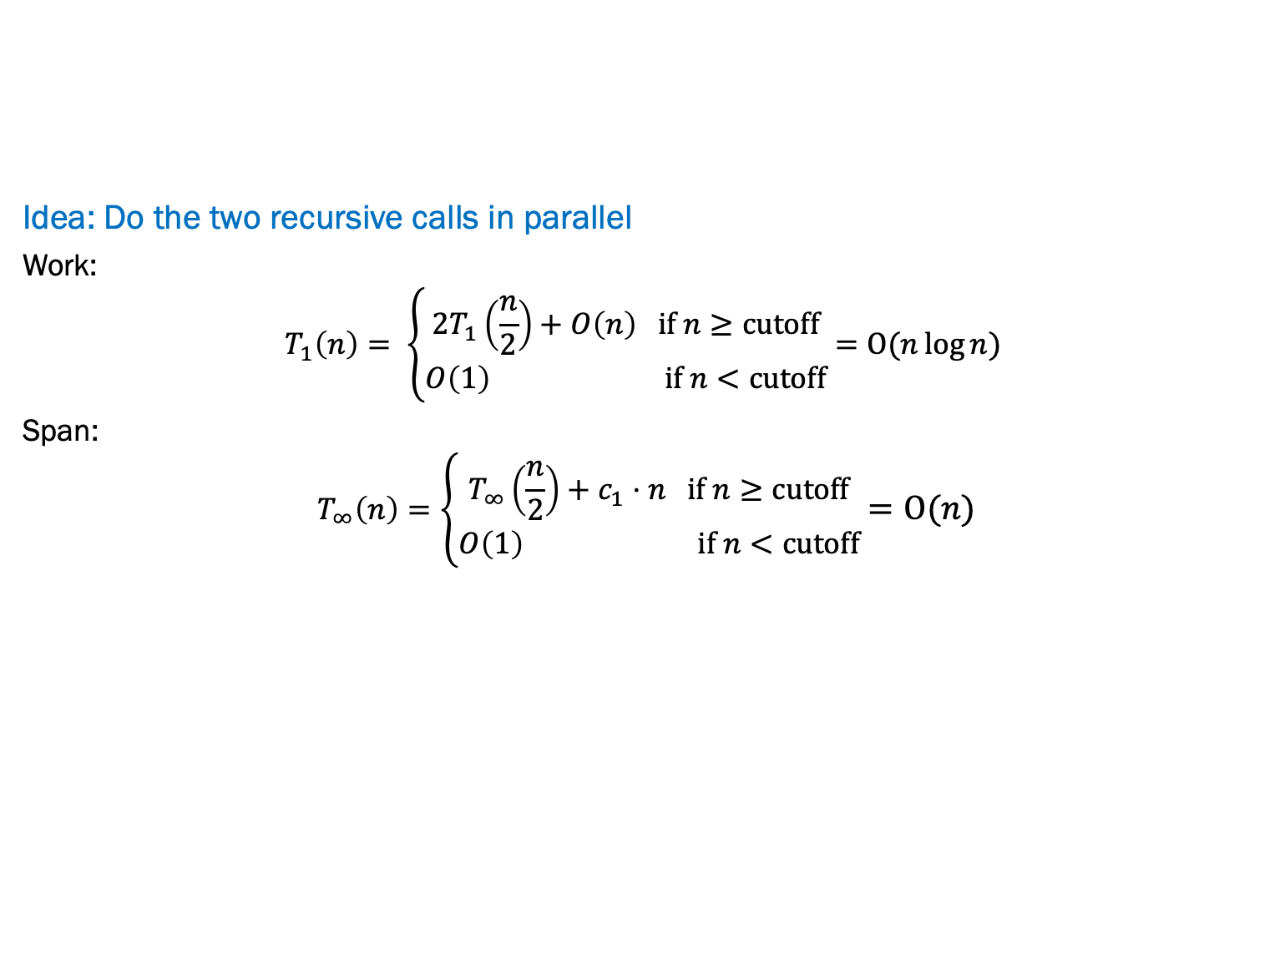
Parallel Quicksort VERSION 1
Best / expected case work
Pick a pivot element O(1)
Partition all the data into: O(n)
  The elements less than the pivot
  The pivot
  The elements greater than the pivot
Recursively sort A and C 2T(n/2)
Idea: Do the two recursive calls in parallel
Work:
$$T_{1}\left(n\right)= \left\{\begin{aligned}2T_{1}\left(\frac{n}{2}\right)+O\left(n\right) if n≥cutoff \\ O\left(1\right) if n<cutoff\end{aligned}\right.=O(n\log{n) }$$
Span:
$$T_{∞}\left(n\right)=\left\{\begin{aligned}T_{∞}\left(\frac{n}{2}\right)+c_{1}⋅n if n≥cutoff \\ O\left(1\right) if n<cutoff\end{aligned}\right.=O(n)$$
Notes:
Work: Unchanged
Span: T(1) = O(1)
T(n) = T(n/2) + O(n)
T(n) = O(n)

Slide 24
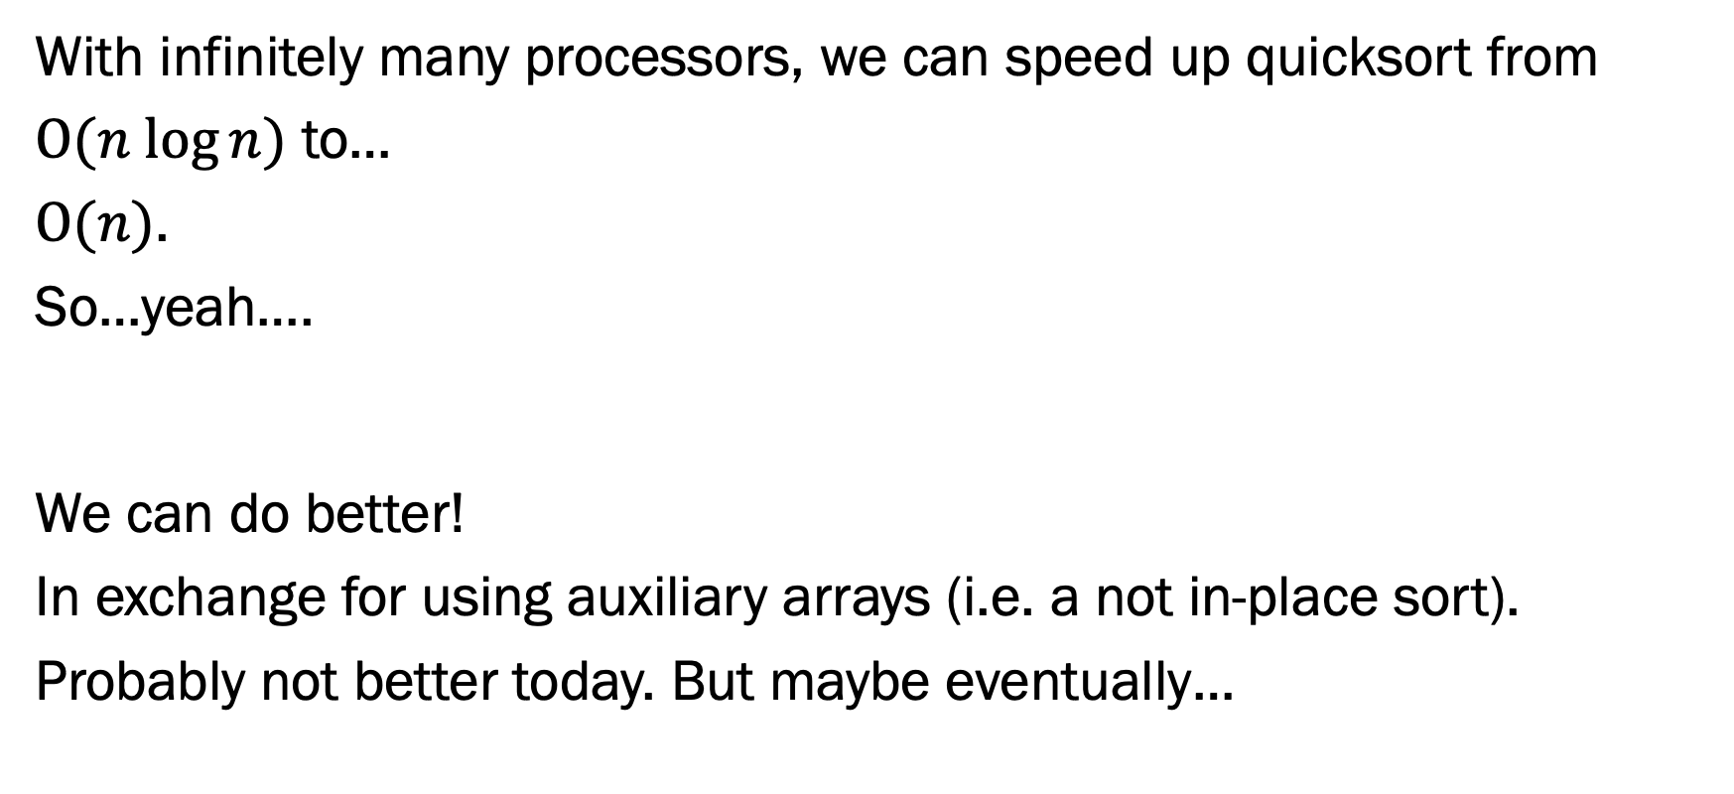
Parallel Quick Sort
With infinitely many processors, we can speed up quicksort from
$O(n log⁡n)$ to…
$O(n)$.
So…yeah….
We can do better!
In exchange for using auxiliary arrays (i.e. a not in-place sort).
Probably not better today. But maybe eventually…

Slide 25
Parallel partition (not in place)
Partition all the data into:
The elements less than the pivot
The pivot
The elements greater than the pivot
This is just two packs!
  We know a pack is O(n) work, O(log n) span
  Pack elements less than pivot into left side of aux array
  Pack elements greater than pivot into right size of aux array
  Put pivot between them and recursively sort
  With a little more cleverness, can do both packs at once but no effect on asymptotic complexity

Slide 26
Parallel Quicksort Example (version 2)
Step 1: pick pivot as median of three
8
1
4
9
0
3
5
2
7
6
Steps 2a and 2c (combinable): pack less than, then pack greater than into a second array (NOTE: no longer in-place!)
  Fancy parallel prefix to pull this off (not shown)
1
4
0
3
5
2
1
4
0
3
5
2
6
8
9
7
Step 3: Two recursive sorts in parallel

Slide 27
Parallel Quicksort VERSION 2
Best / expected case work
Pick a pivot element O(1)
Partition all the data into: O(n)
  The elements less than the pivot
  The pivot
  The elements greater than the pivot
Recursively sort A and C 2T(n/2)
Idea: Do the partition with some parallel prefix packing
Work:
Span:
Notes:
Work: more logic for partitioning than before, but still O(n) for partition so overall work is still going to be the same as before. Same recurrence, nlogn.
Span:
T(1) = O(1)
T(n) = T(n/2) + O(log(n)) because the partition step has a span of logn with infinite processors.
T(n) = log^2(n)

Slide 28

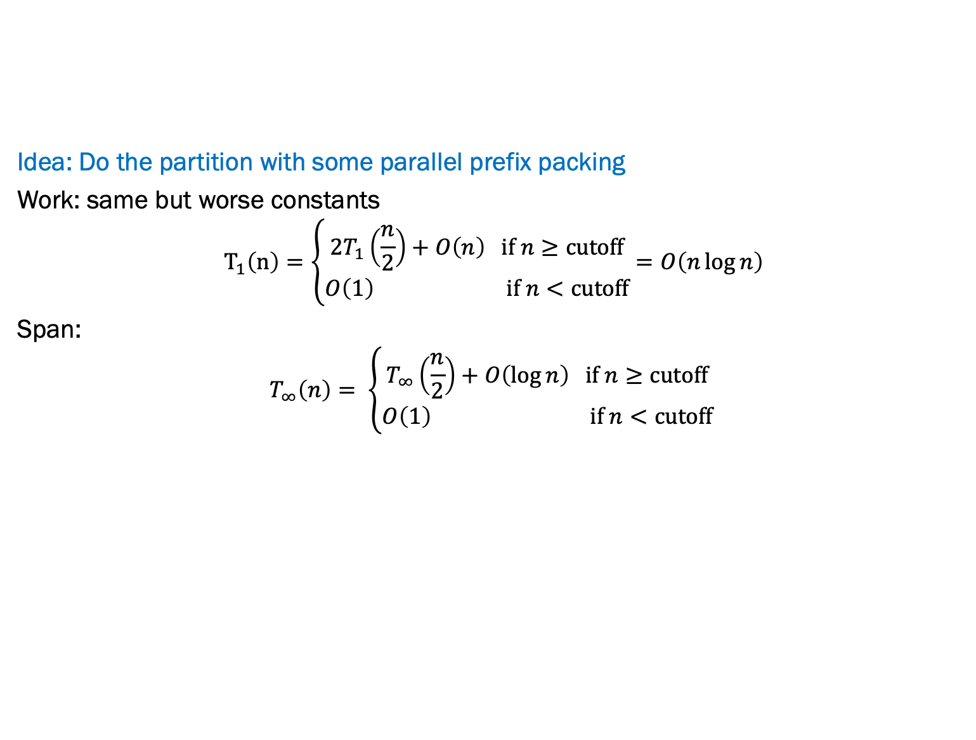
Parallel Quicksort VERSION 2
Best / expected case work
Pick a pivot element O(1)
Partition all the data into: O(n)
  The elements less than the pivot
  The pivot
  The elements greater than the pivot
Recursively sort A and C 2T(n/2)
Idea: Do the partition with some parallel prefix packing
Work: same but worse constants
$${ T}_{1}\left(n\right)=\left\{\begin{aligned}2T_{1}\left(\frac{n}{2}\right)+O\left(n\right) if n≥cutoff \\ O\left(1\right) if n<cutoff\end{aligned}\right.=O\left(n\log{n}\right)$$
Span:
$$T_{∞}\left(n\right)= \left\{\begin{aligned}T_{∞}\left(\frac{n}{2}\right)+O\left(\log{n}\right) if n≥cutoff \\ O\left(1\right) if n<cutoff\end{aligned}\right.$$
Closed form: $T_{∞}\left(n\right)=O\left(\log^{2}\left(n\right)\right)$
Notes:
Work: more logic for partitioning than before, but still O(n) for partition so overall work is still going to be the same as before. Same recurrence, nlogn.
Span:
T(1) = O(1)
T(n) = T(n/2) + O(log(n)) because the partition step has a span of logn with infinite processors.
T(n) = log^2(n)

Slide 29
Parallelize Mergesort?
Recall mergesort: sequential, not-in-place, worst-case O(n log n)
Sort left half and right half 2T(n/2)
Merge results O(n)
Just like quicksort, doing the two recursive sorts in parallel changes the recurrence for the Span to T(n) = O(n) + 1T(n/2) = O(n)
  Again, Work is O(nlogn), and
  parallelism is work/span = O(log n)
  To do better, need to parallelize the merge
    The trick won’t use parallel prefix this time…

Slide 30
Parallelizing the merge (in more detail)
Need to merge two sorted subarrays (may not have the same size)
Idea: Recursively divide subarrays in half, merge halves in parallel
0
4
6
8
9
1
2
3
5
7
Suppose the larger subarray has m elements. In parallel:
  Pick the median element of the larger array (here 6) in constant time
  In the other array, use binary search to find the first element greater than or equal to that median (here 7)
Then, in parallel:
  Merge half the larger array (from the median onward) with the upper part of the shorter array
  Merge the lower part of the larger array with the lower part of the shorter array

Slide 31
Example: Parallelizing the Merge
0
4
6
8
9
1
2
3
5
7

Slide 32
Example: Parallelizing the Merge
0
4
6
8
9
1
2
3
5
7
Get median of bigger half: O(1) to compute middle index

Slide 33
Example: Parallelizing the Merge
0
4
6
8
9
1
2
3
5
7
Get median of bigger half: O(1) to compute middle index
Find how to split the smaller half at the same value:
O(log n) to do binary search on the sorted small half

Slide 34
Example: Parallelizing the Merge
0
4
6
8
9
1
2
3
5
7
Get median of bigger half: O(1) to compute middle index
Find how to split the smaller half at the same value:
O(log n) to do binary search on the sorted small half
Size of two sub-merges conceptually splits output array: O(1)

Slide 35
Example: Parallelizing the Merge
0
4
6
8
9
1
2
3
5
7
merge
merge
0
4
1
2
3
5
6
8
9
7
Get median of bigger half: O(1) to compute middle index
Find how to split the smaller half at the same value:
O(log n) to do binary search on the sorted small half
Two sub-merges conceptually splits output array: O(1)
Do two submerges in parallel

Slide 36
Example: Parallelizing the Merge
0
4
6
8
9
1
2
3
5
7
merge
merge
0
4
1
2
3
5
6
8
9
7
0
4
1
2
3
5
6
8
9
7
merge
merge
merge
0
1
2
4
3
5
6
8
7
9
0
1
2
4
3
5
6
8
7
9
merge
merge
merge
0
1
2
4
3
5
6
7
8
9
0
1
2
3
4
5
6
7
8
9

Slide 37
Example: Parallelizing the Merge
0
4
6
8
9
1
2
3
5
7
merge
merge
0
4
1
2
3
5
6
8
9
7
When we do each merge in parallel:
we split the bigger array in half
use binary search to split the smaller array
And in base case we do the copy
0
4
1
2
3
5
6
8
9
7
merge
merge
merge
0
1
2
4
3
5
6
8
7
9
0
1
2
4
3
5
6
8
7
9
merge
merge
merge
0
1
2
4
3
5
6
7
8
9
0
1
2
3
4
5
6
7
8
9

Slide 38
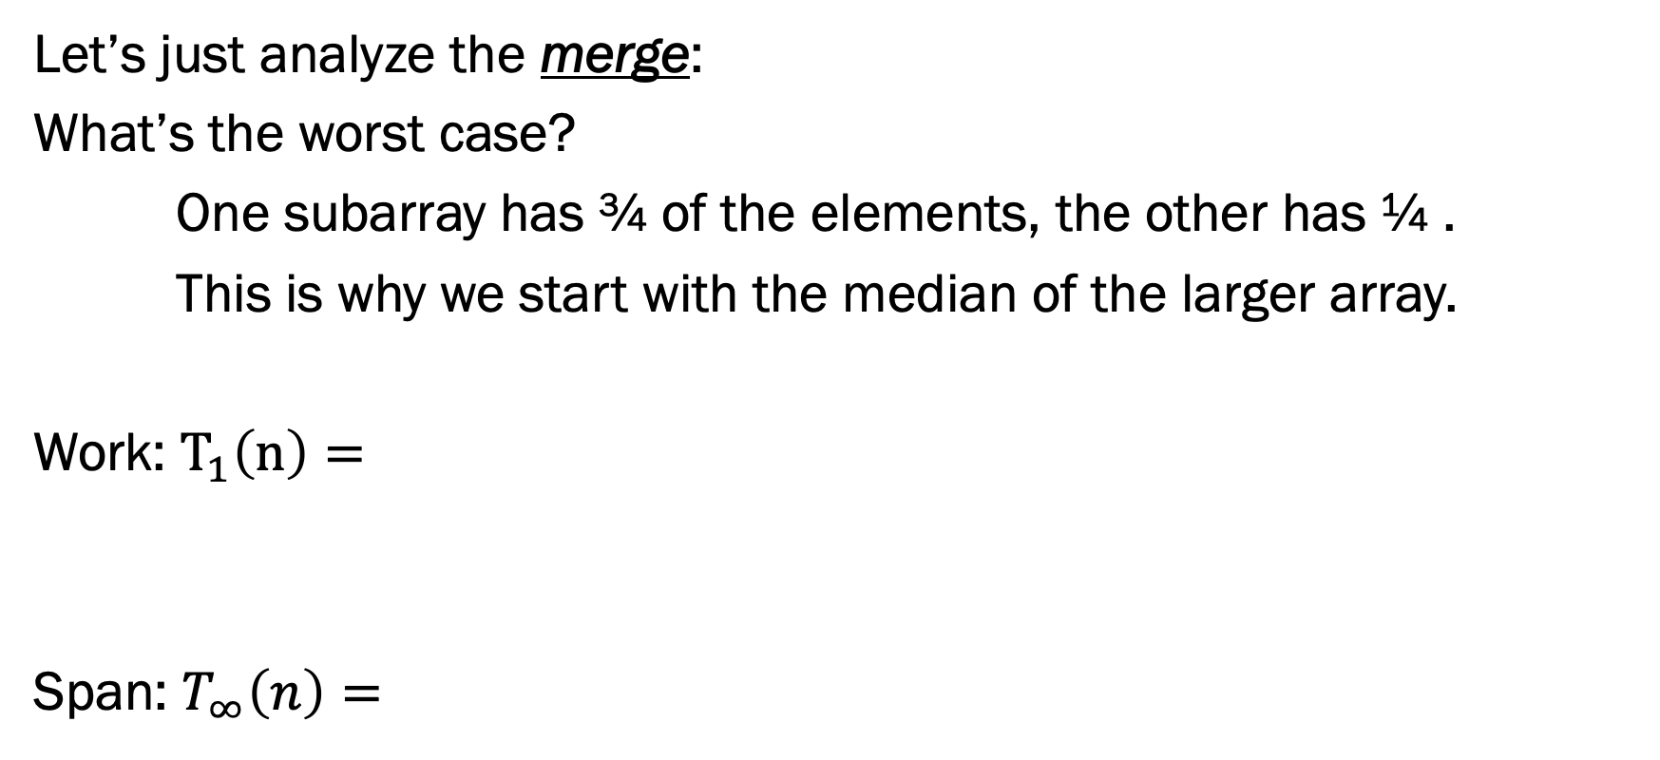
Parallel Merge Sort
Let’s just analyze the merge:
What’s the worst case?
One subarray has ¾ of the elements, the other has ¼ .
This is why we start with the median of the larger array.
Work: $T_{1}\left(n\right)=$
Span: $T_{∞}\left(n\right)=$

Slide 39
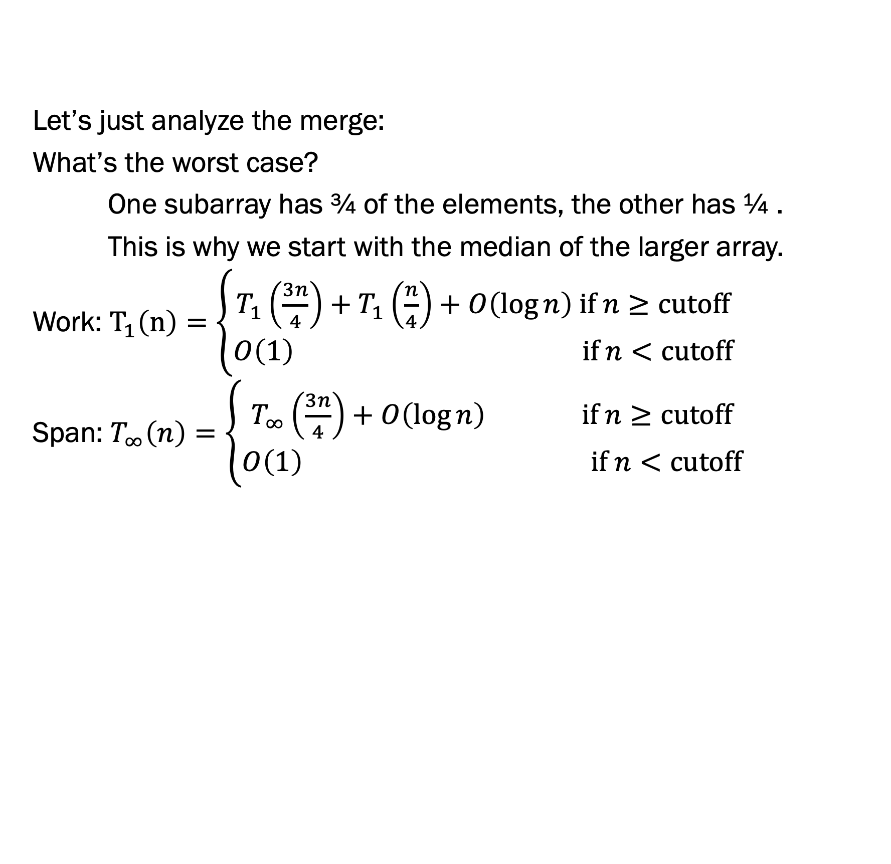
Parallel Merge Sort
Let’s just analyze the merge:
What’s the worst case?
One subarray has ¾ of the elements, the other has ¼ .
This is why we start with the median of the larger array.
Work: $T_{1}\left(n\right)=\left\{\begin{aligned}T_{1}\left(\frac{3n}{4}\right)+T_{1}\left(\frac{n}{4}\right)+O\left(\log{n}\right) if n≥cutoff \\ O\left(1\right) if n<cutoff\end{aligned}\right.$
Span: $T_{∞}\left(n\right)=\left\{\begin{aligned}T_{∞}\left(\frac{3n}{4}\right)+O\left(\log{n}\right) if n≥cutoff \\ O\left(1\right) if n<cutoff\end{aligned}\right.$

Slide 40
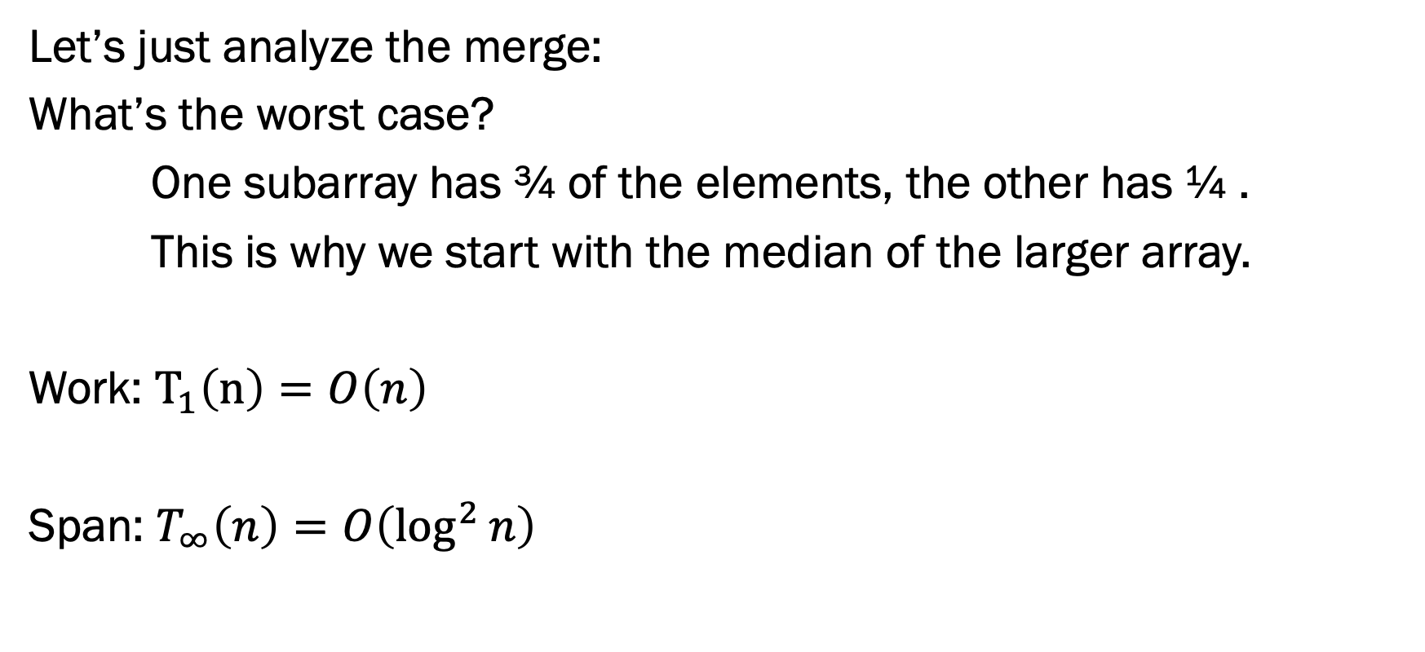
Parallel Merge Sort
Let’s just analyze the merge:
What’s the worst case?
One subarray has ¾ of the elements, the other has ¼ .
This is why we start with the median of the larger array.
Work: $T_{1}\left(n\right)=O\left(n\right)$
Span: $T_{∞}\left(n\right)=O\left(\log^{2}{n}\right)$

Slide 41
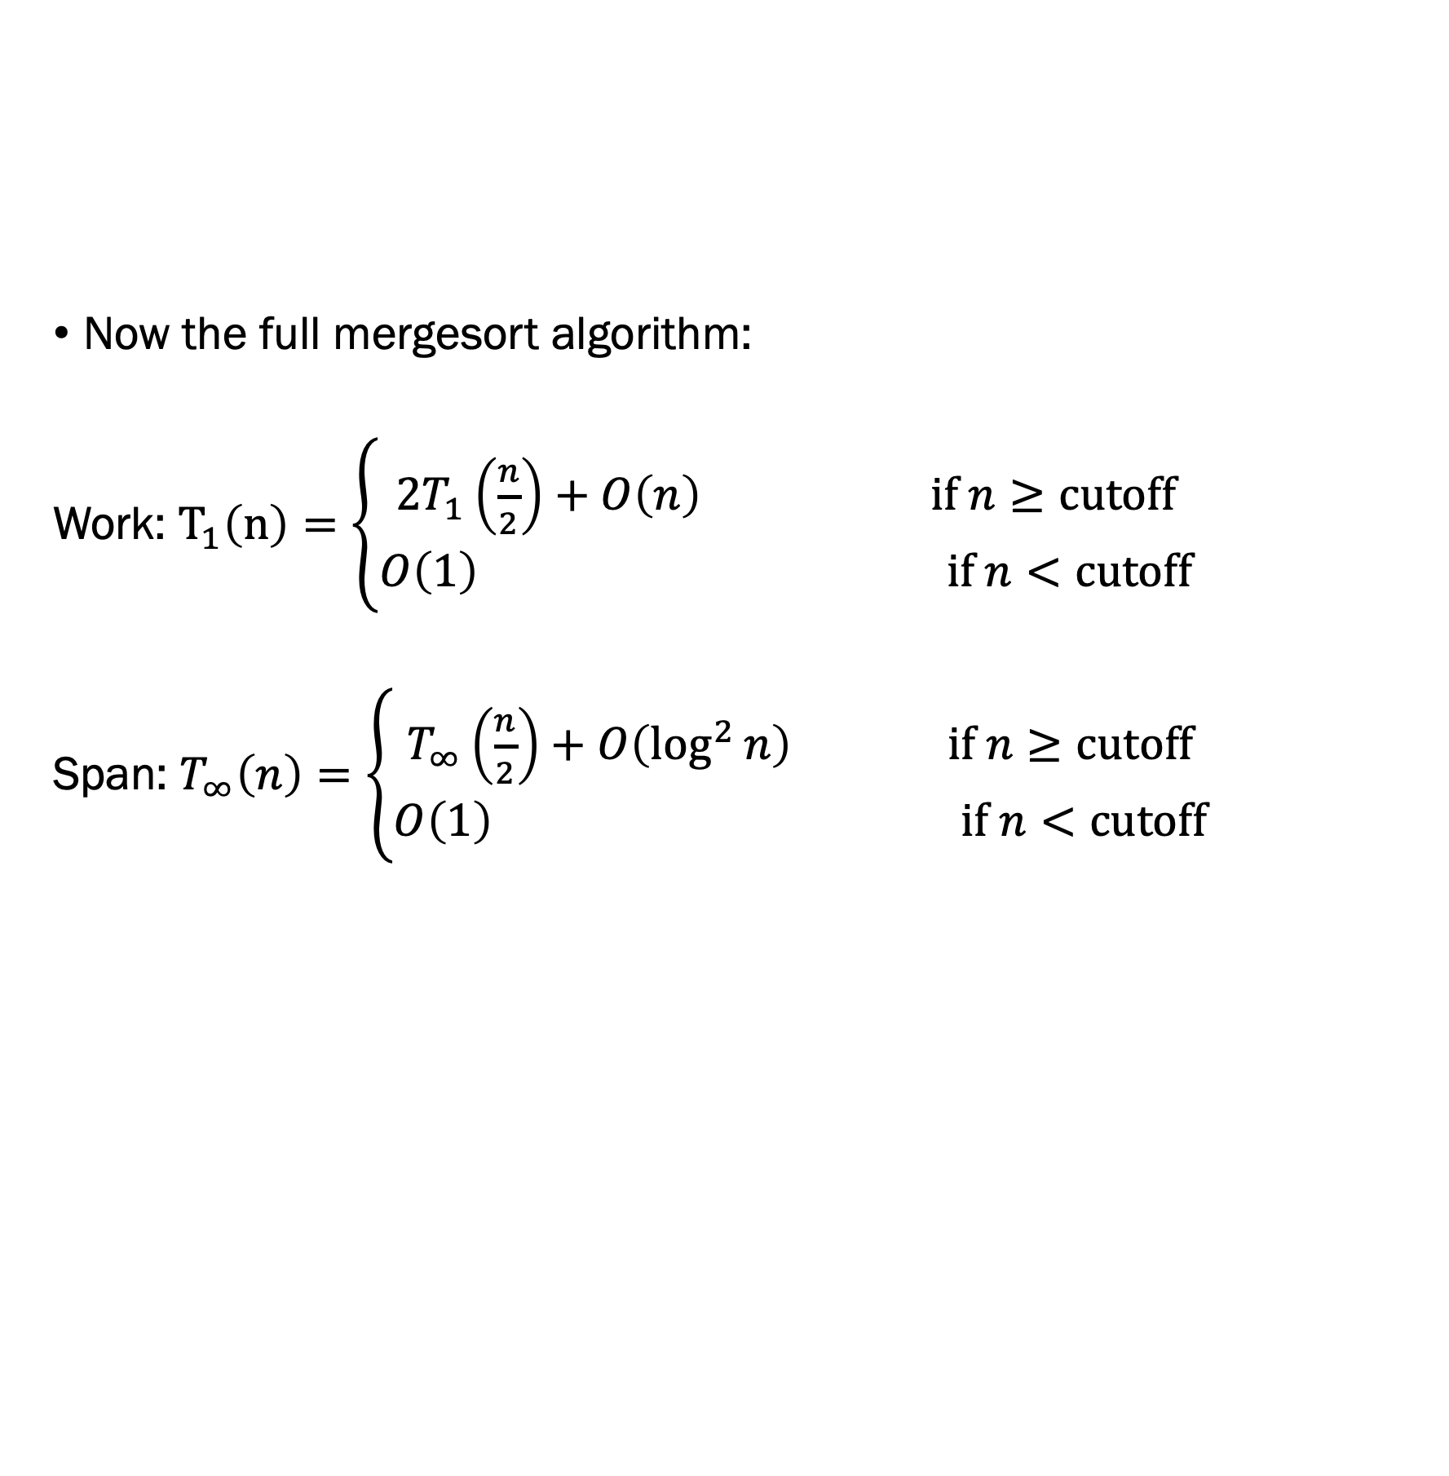
Parallel Merge Sort
Now the full mergesort algorithm:
Work: $T_{1}\left(n\right)=\left\{\begin{aligned}2T_{1}\left(\frac{n}{2}\right)+O\left(n\right) if n≥cutoff \\ O\left(1\right) if n<cutoff\end{aligned}\right.$
Span: $T_{∞}\left(n\right)=\left\{\begin{aligned}T_{∞}\left(\frac{n}{2}\right)+O\left(\log^{2}{n}\right) if n≥cutoff \\ O\left(1\right) if n<cutoff\end{aligned}\right.$

Slide 42

Parallel Merge Sort
Now the full mergesort algorithm:
Work: $T_{1}\left(n\right)=O(n\log{n)}$
Span: $T_{∞}\left(n\right)=O\left(\log^{3}{n}\right)$

