Slide 1
CSE 332: Data Structures & Parallelism Lecture 14: Analysis of Fork-Join Parallel Programs
Arthur Liu
Summer 2022

Slide 2
Reduce
It shouldn’t be too hard to imagine how to modify our code to:
Find the maximum element in an array.
Determine if there is an element meeting some property.
Find the left-most element satisfying some property.
Count the number of elements meeting some property.
Check if elements are in sorted order.
[And so on…]
In O(log N) !!!

Slide 3
Reduce
You’ll do similar problems in section tomorrow.
The key is to describe:
How to compute the answer at the cut-off.
How to merge the results of two subarrays.
We say parallel code like this “reduces” the array
We’re reducing the arrays to a single item
Then combining with an associative operation.
e.g. sum, max, leftmost, product, count, or, and, …
Doesn’t have to be a single number, could be an object.
Notes:
Associative means doesn’t matter order of operations within a group

Slide 4
Even easier: Maps (Data Parallelism)
A map operates on each element of a collection independently to create a new collection of the same size
No combining results
For arrays, this is so trivial some hardware has direct support
Canonical example: Vector addition
int[] vector_add(int[] arr1, int[] arr2){
assert (arr1.length == arr2.length);
result = new int[arr1.length];
FORALL(i=0; i < arr1.length; i++) {
result[i] = arr1[i] + arr2[i];
}
return result;
}
Notes:
Multiply every element by 2

Slide 5
Maps in ForkJoin Framework
class VecAdd extends RecursiveAction {
int lo; int hi; int[] res; int[] arr1; int[] arr2;
VecAdd(int l,int h,int[] r,int[] a1,int[] a2){ … }
protected void compute(){
if(hi – lo < SEQUENTIAL_CUTOFF) {
for(int i=lo; i < hi; i++)
res[i] = arr1[i] + arr2[i];
} else {
int mid = (hi+lo)/2;
VecAdd left = new VecAdd(lo,mid,res,arr1,arr2);
VecAdd right= new VecAdd(mid,hi,res,arr1,arr2);
left.fork();
right.compute();
left.join();
}
}
}
static final ForkJoinPool POOL = new ForkJoinPool();
int[] add(int[] arr1, int[] arr2){
assert (arr1.length == arr2.length);
int[] ans = new int[arr1.length];
POOL.invoke(new VecAdd(0,arr.length,ans,arr1,arr2);
return ans;
}
Even though there is no result-combining, it still helps with load balancing to create many small tasks
Maybe not for vector-add but for more compute-intensive maps
The forking is O(log n) whereas theoretically other approaches to vector-add is O(1)
Notes:
Compare this to the reduce code.
Compare and contrast this (both should be on your handout)
No return
Top line

Slide 6
Maps and reductions
Maps and reductions: the “workhorses” of parallel programming
By far the two most important and common patterns
Two more-advanced patterns in next lecture
Learn to recognize when an algorithm can be written in terms of maps and reductions
Use maps and reductions to describe (parallel) algorithms
Programming them becomes “trivial” with a little practice
Exactly like sequential for-loops seem second-nature

Slide 7
Map vs reduce in ForkJoin framework
In our examples:
Reduce:
Parallel-sum extended RecursiveTask
Result was returned from compute()
Map:
Class extended was RecursiveAction
Nothing returned from compute()
In the above code, the ‘answer’ array was passed in as a parameter

Slide 8
Analyzing Algorithms: Work and Span
Let T_{P} be the running time if there are P processors available
Two key measures of run-time:
Work: How long it would take 1 processor = T₁
Just “sequentialize” the recursive forking
Cumulative work that all processors must complete
Span: How long it would take infinity processors = T∞
The hypothetical ideal for parallelization
This is the longest “dependence chain” in the computation
Example: O(log n) for summing an array
Notice in this example having > n/2 processors is no additional help
Also called “critical path length” or “computational depth”
Notes:
Still going to use N, but we have a new variable, P
We’re going to assume that we have enough processors available for us.
Work includes the start calls as well. So all of the stuff.

Slide 9
The DAG (Directed Acyclic Graph)
A program execution using fork and join can be seen as a DAG
[A DAG is a graph that is directed (edges have direction (arrows)), and those arrows do not create a cycle (ability to trace a path that starts and ends at the same node).]
Nodes: Pieces of work
Edges: Source must finish before destination starts
A fork “ends a node” and makes two outgoing edges
New thread
Continuation of current thread
A join “ends a node” and makes a node with two incoming edges
Node just ended
Last node of thread joined on
Notes:
Nodes are things that need to be done
Arrows show dependencies
With our fork join, well a fork needs to happen before some threads even exist. A join waits for threads to finish before it can continue.

Slide 10
Our simple examples, in more detail
Our fork and join often look like this:
divide
base cases
combine results
In this context, the span (T∞) is:
The longest dependence-chain; longest ‘branch’ in parallel ‘tree’
Example: O(log n) for summing an array; we halve the data down to our cut-off, then add back together; O(log n) steps, O(1) time for each
Also called “critical path length” or “computational depth”
Notes:
Perfect tree
Log(n)
Log(n)
Every node in a level can be happening at the same time
If we don’t have enough processors, we may have a different kind of bottleneck. Example, P = 2 processors
DAGS are not always this simple

Slide 11
Connecting to performance
Recall: T_{P} = running time if there are P processors available
Work = T₁ = sum of run-time of all nodes in the DAG
That lonely processor does everything
Any topological sort is a legal execution
O(n) for simple maps and reductions
Span = T∞ = sum of run-time of all nodes on the most-expensive path in the DAG
Note: costs are on the nodes not the edges
Our infinite army can do everything that is ready to be done, but still has to wait for earlier results
O(log n) for simple maps and reductions

Slide 12
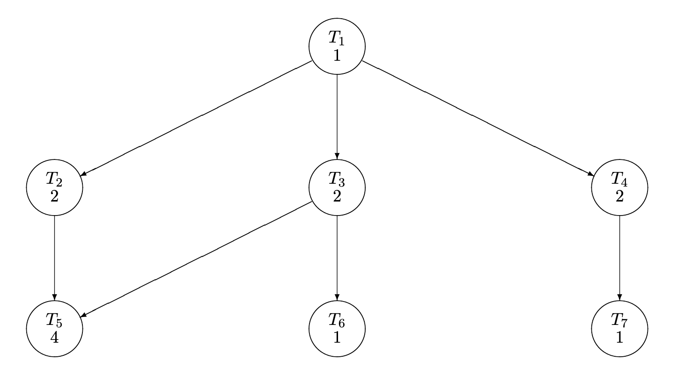
pollev.com/artliu
Consider this graph
The numbers indicate the amount of time it takes for the task to execute
What is the work?
What is the span?
What is the minimum time it takes two processors to complete the tasks?
Notes:
https://www.polleverywhere.com/surveys/83NBvzVlqV7SoOvUwrakz

Slide 13
Definitions
A couple more terms:
Speed-up on P processors: T₁ / T_{P}
If speed-up is P as we vary P, we call it perfect linear speed-up
Perfect linear speed-up means doubling P halves running time
Usually our goal; hard to get in practice
Parallelism is the maximum possible speed-up: T₁ / T ∞
At some point, adding processors won’t help
What that point is depends on the span
Parallel algorithms is about decreasing span without
increasing work too much

Slide 14
Optimal T_{P}: Thanks ForkJoin library!
So we know T₁ and T ∞ but we want T_{P} (e.g., P=4)
Ignoring memory-hierarchy issues (caching), T_{P} can’t beat
T₁ / P why not?
T ∞ why not?
So an asymptotically optimal execution would be:
T_{P} = O((T₁ / P) + T ∞)
First term dominates for small P, second for large P
The ForkJoin Framework gives an expected-time guarantee of asymptotically optimal!
Guarantee requires a few assumptions about your code…

Slide 15
Division of responsibility
Our job as ForkJoin Framework users:
Pick a good algorithm, write a program
When run, program creates a DAG of things to do
Make all the nodes a small-ish and approximately equal amount of work
The framework-writer’s job:
Assign work to available processors to avoid idling
Let framework-user ignore all scheduling issues
Keep constant factors low
Give the expected-time optimal guarantee assuming framework-user did his/her job
T_{P} = O((T₁ / P) + T ∞)

Slide 16
Examples
T_{P} = O((T₁ / P) + T ∞)
In the algorithms seen so far (e.g., sum an array):
T₁ = O(n)
T ∞= O(log n)
So expect (ignoring overheads): T_{P} = O(n/P + log n)
Suppose instead:
T₁ = O(n²)
T ∞= O(n)
So expect (ignoring overheads): T_{P} = O(n²/P + n)

Slide 17
And now for the bad news…
So far: talked about a parallel program in terms of work and span
In practice, it’s common that your program has:
a) parts that parallelize well:
Such as maps/reduces over arrays and trees
b) …and parts that don’t parallelize at all:
Such as reading a linked list, getting input, or just doing computations where each step needs the results of previous step
These unparallelized parts can turn out to be a big bottleneck, which brings us to Amdahl’s Law …

Slide 18
Amdahl’s Law (mostly bad news)
Let the work (time to run on 1 processor) be 1 unit time
Let S be the portion of the execution that can’t be parallelized
Then: $T_{1}=S+\left(1−S\right)=1$
Suppose we get perfect linear speedup on the parallel portion
Then: $T_{P}=S+\frac{1−S}{P}$
So the theoretical overall speedup with P processors is (Amdahl’s Law):
$\frac{T_{1}}{T_{P}}=\frac{1}{S+(1−S)/P}$
And the parallelism (infinite processors) is:
$\frac{T_{1}}{T_{∞}}=\frac{1}{S}$

Slide 19
Amdahl’s Law
$$T_{P}=S+\frac{1−S}{P}$$
Suppose our program takes 100 seconds.
And $S$ is 1/3 (i.e. 33 seconds). What is the running time with
3 processors
6 processors
22 processors
67 processors
1,000,000 processors (approximately).

Slide 20
Amdahl’s Law
$$T_{P}=S+\frac{1−S}{P}$$
Suppose our program takes 100 seconds.
And $S$ is 1/3 (i.e. 33 seconds). What is the running time with
3 processors: 33 + 67/3 $≈$ 55 seconds
6 processors: 33 + 67/6 $≈$ 44 seconds
22 processors: 33 + 67/22 $≈$ 36 seconds
67 processors 33 + 67/67 $≈$ 34 seconds
1,000,000 processors (approximately). $≈$ 33 seconds

Slide 21
Amdahl’s Law
This is BAD NEWS
If 1/3 of our program can’t be parallelized, we can’t get a speedup better than 3.
No matter how many processors we throw at our problem.
And while the first few processors make a huge difference, the benefit diminishes quickly.

Slide 22
The future and Amdahl’s Law
T₁ / T_{P} = $\frac{1}{S+(1−S)/P}$ T₁ / T∞ = $\frac{1}{S}$
Suppose you miss the good old days (1980-2005) where 12ish years was long enough to get 100x speedup
Now suppose in 12 years, clock speed is the same but you get 256 processors instead of 1
What portion of the program must be parallelizable to get 100x speedup?
$$100≤\frac{1}{S+\frac{1−S}{256}}$$
[wolframalpha says] $S≤0.0061$.

Slide 23
Amdahl’s Law: Moving Forward
Unparallelized code becomes a bottleneck quickly.
What do we do? Design smarter algorithms!
Consider the following problem:
Given an array of numbers, return an array with the “running sum”
3 | 7 | 6 | 2 | 4
3 | 10 | 16 | 18 | 22

Slide 24
More clever algorithms
Doesn’t look parallelizable…
But it is!
Think about how you might do this (it’s NOT obvious)
We’ll go through it on Friday (or possibly Monday)!

Slide 25
Moore and Amdahl
Moore’s “Law” is an observation about the progress of the semiconductor industry
Transistor density doubles roughly every 18 months
Amdahl’s Law is a mathematical theorem
Diminishing returns of adding more processors
Both are incredibly important in designing computer systems

