Slide 1
CSE 332: Data Structures & Parallelism Lecture 11: Hashing 2, Comparison Sorts
Arthur Liu
Summer 2022

Slide 2
Outline
Hashing
Open Addressing
Rehashing
Hashing in Practice
Comparison Sorting

Slide 3
Hash Tables: Review
Aim for constant-time (i.e., O(1)) find, insert, and delete
“On average” under some reasonable assumptions
A hash table is an array of some fixed size
But growable as we’ll see
hash table
0
 | …
client
hash table library
collision?
collision
resolution
E
int
table-index
TableSize –1

Slide 4
Separate Chaining: Review
Chaining: All keys that map to the same table location are kept in a list (a.k.a. a “chain” or “bucket”)
As easy as it sounds
Example: insert 10, 22, 107, 12, 42 with mod hashing and TableSize = 10
Worst case time for find?
Average case time for find?
0
1 | /
2
3 | /
4 | /
5 | /
6 | /
7
8 | /
9 | /
10
/
42
12
22
/
107
/

Slide 5
More rigorous separate chaining analysis
Definition: The load factor, λ, of a hash table is
← number of elements
Under chaining, the average number of elements per bucket is ___
So if some inserts are followed by random finds, then on average:
Each unsuccessful find compares against ____ items
Each successful find compares against _____ items
How big should TableSize be??

Slide 6
Equal objects must hash the same
The Java library (and your project hash table) make a very important assumption that clients must satisfy…
Object-oriented way of saying it:
If a.equals(b), then we must require a.hashCode()==b.hashCode()
Function object way of saying it:
If c.compare(a,b) == 0, then we must require
h.hash(a) == h.hash(b)
If you ever override equals
You need to override hashCode also in a consistent way
See CoreJava book, Chapter 5 for other "gotchas" with equals

Slide 7
Hashing Choices
Choose a Hash function
Choose TableSize
Choose a Collision Resolution Strategy from these:
Separate Chaining
Open Addressing
Linear Probing
Quadratic Probing
Double Hashing
Other issues to consider:
Deletion?
What to do when the hash table gets “too full”?

Slide 8
Open Addressing: Linear Probing
Why not use up the empty space in the table?
Store directly in the array cell (no linked list)
How to deal with collisions?
If h(key) is already full,
try (h(key) + 1) % TableSize. If full,
try (h(key) + 2) % TableSize. If full,
try (h(key) + 3) % TableSize. If full…
Example: insert 38, 19, 8, 109, 10
0
1
2
3
4
5
6
7
8 | 38
9

Slide 9
Open Addressing: Linear Probing
Another simple idea: If h(key) is already full,
try (h(key) + 1) % TableSize. If full,
try (h(key) + 2) % TableSize. If full,
try (h(key) + 3) % TableSize. If full…
Example: insert 38, 19, 8, 109, 10
0 | /
1 | /
2 | /
3 | /
4 | /
5 | /
6 | /
7 | /
8 | 38
9 | 19

Slide 10
Open Addressing: Linear Probing
Another simple idea: If h(key) is already full,
try (h(key) + 1) % TableSize. If full,
try (h(key) + 2) % TableSize. If full,
try (h(key) + 3) % TableSize. If full…
Example: insert 38, 19, 8, 109, 10
8₂
0 | /
1 | /
2 | /
3 | /
4 | /
5 | /
6 | /
7 | /
8 | 38
9 | 19
8₀
8₁

Slide 11
Open Addressing: Linear Probing
Another simple idea: If h(key) is already full,
try (h(key) + 1) % TableSize. If full,
try (h(key) + 2) % TableSize. If full,
try (h(key) + 3) % TableSize. If full…
Example: insert 38, 19, 8, 109, 10
0 | 8
1 | /
2 | /
3 | /
4 | /
5 | /
6 | /
7 | /
8 | 38
9 | 19
109₁
109₂
109₀

Slide 12
Open Addressing: Linear Probing
Another simple idea: If h(key) is already full,
try (h(key) + 1) % TableSize. If full,
try (h(key) + 2) % TableSize. If full,
try (h(key) + 3) % TableSize. If full…
Example: insert 38, 19, 8, 109, 10
0 | 8
1 | 109
2 | /
3 | /
4 | /
5 | /
6 | /
7 | /
8 | 38
9 | 19
10₀
10₁
10₂

Slide 13
Open Addressing: Linear Probing
Another simple idea: If h(key) is already full,
try (h(key) + 1) % TableSize. If full,
try (h(key) + 2) % TableSize. If full,
try (h(key) + 3) % TableSize. If full…
Example: insert 38, 19, 8, 109, 10
0 | 8
1 | 109
2 | 10
3 | /
4 | /
5 | /
6 | /
7 | /
8 | 38
9 | 19

Slide 14
Open addressing
Linear probing is one example of open addressing
In general, open addressing means resolving collisions by trying a sequence of other positions in the table.
Trying the next spot is called probing
We just did linear probing:
i^{th} probe: (h(key) + i) % TableSize
In general have some probe function f and :
i^{th} probe: (h(key) + f(i)) % TableSize
Open addressing does poorly with high load factor λ
So, want larger tables
Too many probes means no more O(1)

Slide 15
Aside: Terminology
We and the book use the terms
“chaining” or “separate chaining”
“open addressing”
Very confusingly,
“open hashing” is a synonym for “chaining”
“closed hashing” is a synonym for “open addressing”

Slide 16
Questions: Open Addressing: Linear Probing
How should find work? If value is in table? If not there?
Worst case scenario for find?
How should we implement delete?
How does open addressing with linear probing compare to separate chaining?
Notes:
Talk to neighbors

Slide 17
Open Addressing: Linear Probing
Another simple idea: If h(key) is already full,
try (h(key) + 1) % TableSize. If full,
try (h(key) + 2) % TableSize. If full,
try (h(key) + 3) % TableSize. If full…
Example: insert 38, 19, 8, 109, 10
0 | 8
1 | 109
2 | 10
3 | /
4 | /
5 | /
6 | /
7 | /
8 | 38
9 | 19
Notes:
How should we try to find 109?
How would find(20) look like?
How should we implement delete? Well what would happen if we deleted 109? Find is broken, how might we fix this?
The way we re-insert values can also depend on your implementation – either just re-insert it at that location or replace it
What are some finds that may not be as fast?

Slide 18
Open Addressing: Other Operations
insert finds an open table position using a probe function
What about find?
Must use same probe function to “retrace the trail” for the data
Unsuccessful search when reach empty position
What about delete?
Must use “lazy” deletion. Why?
Marker indicates “no data here, but don’t stop probing”
As with lazy deletion on other data structures, on insert, spots marked “deleted” can be filled in.
Note: delete with chaining is just calling delete on the bucket (e.g. linked list)
Notes:
That last question, how does linear probing compare to separate chaining?

Slide 19
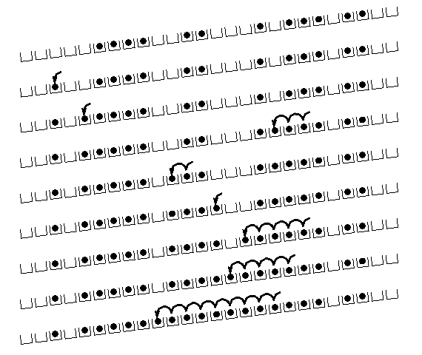
Primary Clustering
It turns out linear probing is a bad idea, even though the probe function is quick to compute (a good thing)
Tends to produce clusters, which lead to long probe sequences
Called primary clustering
Saw the start of a cluster in our linear probing example
[R. Sedgewick]

Slide 20
Analysis of Linear Probing
Trivial fact: For any λ < 1, linear probing will find an empty slot
It is “safe” in this sense: no infinite loop unless table is full
Non-trivial facts we won’t prove:
Average # of probes given λ (in the limit as TableSize →∞ )
Unsuccessful search:
Successful search:
This is pretty bad: need to leave sufficient empty space in the table to get decent performance (see chart)

Slide 21
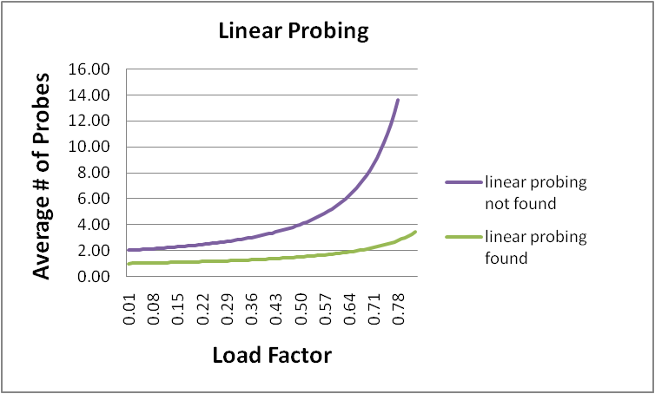
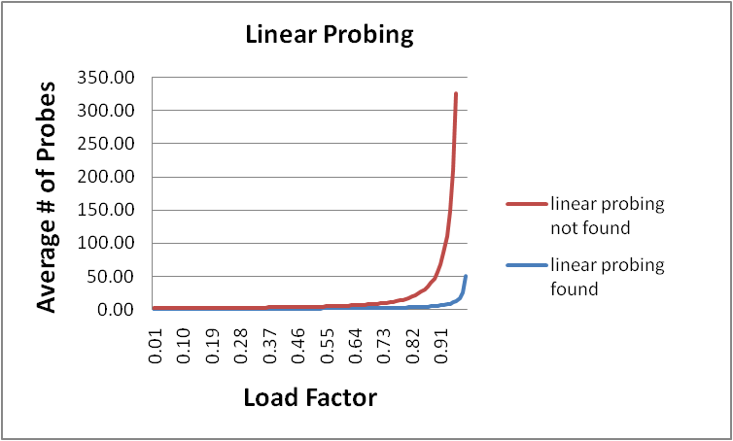
Analysis in chart form
Linear-probing performance degrades rapidly as table gets full
(Formula assumes “large table” but point remains)
By comparison, separate chaining performance is linear in λ and has no trouble with λ>1

Slide 22
Open Addressing: Linear probing
(h(key) + f(i)) % TableSize
For linear probing:
f(i) = i
So probe sequence is:
0th probe: h(key) % TableSize
1st probe: (h(key) + 1) % TableSize
2nd probe: (h(key) + 2) % TableSize
3rd probe: (h(key) + 3) % TableSize
…
i^{th} probe: (h(key) + i) % TableSize

Slide 23
Open Addressing: Quadratic probing
We can avoid primary clustering by changing the probe function…
(h(key) + f(i)) % TableSize
For quadratic probing:
f(i) = i²
So probe sequence is:
0th probe: h(key) % TableSize
1st probe: (h(key) + 1) % TableSize
2nd probe: (h(key) + 4) % TableSize
3rd probe: (h(key) + 9) % TableSize
…
i^{th} probe: (h(key) + i²) % TableSize
Intuition: Probes quickly “leave the neighborhood”

Slide 24
Quadratic Probing Example
ith probe: (h(key) + i²) % TableSize
0
1
2
3
4
5
6
7
8
9
TableSize=10
Insert:
89
18
49
58
79

Slide 25
Quadratic Probing Example
TableSize = 10
insert(89)
0
1
2
3
4
5
6
7
8
9

Slide 26
Quadratic Probing Example
TableSize = 10
insert(89)
insert(18)
0
1
2
3
4
5
6
7
8
9 | 89

Slide 27
Quadratic Probing Example
TableSize = 10
insert(89)
insert(18)
insert(49)
0
1
2
3
4
5
6
7
8 | 18
9 | 89

Slide 28
Quadratic Probing Example
TableSize = 10
insert(89)
insert(18)
insert(49)
49 % 10 = 9 collision!
(49 + 1) % 10 = 0
insert(58)
0 | 49
1
2
3
4
5
6
7
8 | 18
9 | 89

Slide 29
Quadratic Probing Example
TableSize = 10
insert(89)
insert(18)
insert(49)
insert(58)
58 % 10 = 8 collision!
(58 + 1) % 10 = 9 collision!
(58 + 4) % 10 = 2
insert(79)
0 | 49
1
2 | 58
3
4
5
6
7
8 | 18
9 | 89

Slide 30
Quadratic Probing Example
TableSize = 10
insert(89)
insert(18)
insert(49)
insert(58)
insert(79)
79 % 10 = 9 collision!
(79 + 1) % 10 = 0 collision!
(79 + 4) % 10 = 3
0 | 49
1
2 | 58
3 | 79
4
5
6
7
8 | 18
9 | 89

Slide 31
Another Quadratic Probing Example
ith probe: (h(key) + i²) % TableSize
TableSize = 7
Insert:
76 (76 % 7 = 6)
40 (40 % 7 = 5)
48 (48 % 7 = 6)
5 (5 % 7 = 5)
55 (55 % 7 = 6)
47 (47 % 7 = 5)
0
1
2
3
4
5
6

Slide 32
Another Quadratic Probing Example
ith probe: (h(key) + i²) % TableSize
TableSize = 7
Insert:
76 (76 % 7 = 6)
40 (40 % 7 = 5)
48 (48 % 7 = 6)
5 (5 % 7 = 5)
55 (55 % 7 = 6)
47 (47 % 7 = 5)
0
1
2
3
4
5
6 | 76

Slide 33
Another Quadratic Probing Example
ith probe: (h(key) + i²) % TableSize
TableSize = 7
Insert:
76 (76 % 7 = 6)
40 (40 % 7 = 5)
48 (48 % 7 = 6)
5 (5 % 7 = 5)
55 (55 % 7 = 6)
47 (47 % 7 = 5)
0
1
2
3
4
5 | 40
6 | 76

Slide 34
Another Quadratic Probing Example
ith probe: (h(key) + i²) % TableSize
TableSize = 7
Insert:
76 (76 % 7 = 6)
40 (40 % 7 = 5)
48 (48 % 7 = 6)
5 (5 % 7 = 5)
55 (55 % 7 = 6)
47 (47 % 7 = 5)
0 | 48
1
2
3
4
5 | 40
6 | 76

Slide 35
Another Quadratic Probing Example
ith probe: (h(key) + i²) % TableSize
TableSize = 7
Insert:
(76 % 7 = 6)
(40 % 7 = 5)
48 (48 % 7 = 6)
5 (5 % 7 = 5)
55 (55 % 7 = 6)
47 (47 % 7 = 5)
0 | 48
1
2 | 5
3
4
5 | 40
6 | 76

Slide 36
Another Quadratic Probing Example
ith probe: (h(key) + i²) % TableSize
TableSize = 7
Insert:
76 (76 % 7 = 6)
40 (40 % 7 = 5)
48 (48 % 7 = 6)
5 (5 % 7 = 5)
55 (55 % 7 = 6)
47 (47 % 7 = 5)
0 | 48
1
2 | 5
3 | 55
4
5 | 40
6 | 76

Slide 37
Another Quadratic Probing Example
ith probe: (h(key) + i²) % TableSize
TableSize = 7
Insert:
76 (76 % 7 = 6)
40 (40 % 7 = 5)
48 (48 % 7 = 6)
5 (5 % 7 = 5)
55 (55 % 7 = 6)
47 (47 % 7 = 5)
(47 + 1) % 7 = 6 collision!
(47 + 4) % 7 = 2 collision!
(47 + 9) % 7 = 0 collision!
(47 + 16) % 7 = 0 collision!
(47 + 25) % 7 = 2 collision!
0 | 48
1
2 | 5
3 | 55
4
5 | 40
6 | 76
Will we ever get a 1 or 4?!?

Slide 38
Another Quadratic Probing Example
insert(47) will always fail here. Why?
For all i, (5 + i²) % 7 is 0, 2, 5, or 6
Proof uses induction and
(5 + i²) % 7 = (5 + (i - 7)²) % 7
In fact, for all c and k,
(c + i²) % k = (c + (i - k)²) % k
0 | 48
1
2 | 5
3 | 55
4
5 | 40
6 | 76

Slide 39
From bad news to good news
Bad News:
After TableSize quadratic probes, we cycle through the same indices
Good News:
If TableSize is prime and λ < ½, then quadratic probing will find an empty slot in at most TableSize/2 probes
So: If you keep λ < ½ and TableSize is prime, no need to detect cycles

Slide 40
Quadratic Probing: Success guarantee for λ < ½
First size/2 probes distinct. If < half full, one is empty.
If size is prime and λ < ½, then quadratic probing will find an empty slot in size/2 probes or fewer.
show for all 0 ≤ i,j ≤ size/2 and i ≠ j
(h(x) + i²) mod size ≠ (h(x) + j²) mod size
by contradiction: suppose that for some i ≠ j:
(h(x) + i²) mod size = (h(x) + j²) mod size
⇒ i² mod size = j² mod size
⇒ (i² - j²) mod size = 0
⇒ [(i + j)(i - j)] mod size = 0
BUT size does not divide (i - j) or (i + j)
How can i + j = 0 or i + j = size when:
i ≠ j and 0 ≤ i,j ≤ size/2?
Similarly how can i - j = 0 or i - j = size ?
(ith probe and jth probe map to distinct locations)
(Optional for this class, but just know the guarantee for < half full)
Notes:
Well, we can guarantee that this succeeds for loads under 1/2.
And, in fact, for large tables it _usually_ succeeds as long as we’re not close to 1.
But, it’s not guaranteed!

Slide 41
Clustering reconsidered
Quadratic probing does not suffer from primary clustering: As we resolve collisions we are not merely growing “big blobs” by adding one more item to the end of a cluster, we are looking i² locations away, for the next possible spot.
But quadratic probing does not help resolve collisions between keys that initially hash to the same index
Any 2 keys that initially hash to the same index will have the same series of moves after that looking for any empty spot
Called secondary clustering
Can avoid secondary clustering with a probe function that depends on the key: double hashing…

Slide 42
Open Addressing: Double hashing
Idea: Given two good hash functions h and g, and two different keys k1 and k2, it is very unlikely that: h(k1)==h(k2) and g(k1)==g(k2)
(h(key) + f(i)) % TableSize
For double hashing:
f(i) = i*g(key)
So probe sequence is:
0th probe: h(key) % TableSize
1st probe: (h(key) + g(key)) % TableSize
2nd probe: (h(key) + 2*g(key)) % TableSize
3rd probe: (h(key) + 3*g(key)) % TableSize
…
i^{th} probe: (h(key) + i*g(key)) % TableSize
Detail: Make sure g(key) can’t be 0

Slide 43
Open Addressing: Double Hashing
ith probe:(h(key) + i*g(key)) % TableSize
0
1
2
3
4
5
6
7
8
9
T = 10 (TableSize)
Hash Functions:
h(key) = key mod T
g(key) = 1 + ((key/T) mod (T-1))
Insert these values into the hash table in this order. Resolve any collisions with double hashing:
13
28
33
147
43

Slide 44
Double Hashing
ith probe:(h(key) + i*g(key)) % TableSize
T = 10 (TableSize)
Hash Functions:
h(key) = key mod T
g(key) = 1 + ((key/T) mod (T-1))
0
1
2
3 | 13
4
5
6
7
8
9
Insert these values into the hash table in this order. Resolve any collisions with double hashing:
13
28
33
147
43

Slide 45
Double Hashing
ith probe:(h(key) + i*g(key)) % TableSize
T = 10 (TableSize)
Hash Functions:
h(key) = key mod T
g(key) = 1 + ((key/T) mod (T-1))
0
1
2
3 | 13
4
5
6
7
8 | 28
9
Insert these values into the hash table in this order. Resolve any collisions with double hashing:
13
28
33
147
43

Slide 46
Double Hashing
ith probe:(h(key) + i*g(key)) % TableSize
T = 10 (TableSize)
Hash Functions:
h(key) = key mod T
g(key) = 1 + ((key/T) mod (T-1))
0
1
2
3 | 13
4
5
6
7 | 33
8 | 28
9
Insert these values into the hash table in this order. Resolve any collisions with double hashing:
13
28
33 → g(33) = 1 + 3 mod 9 = 6
147
43

Slide 47
Double Hashing
ith probe:(h(key) + i*g(key)) % TableSize
T = 10 (TableSize)
Hash Functions:
h(key) = key mod T
g(key) = 1 + ((key/T) mod (T-1))
0
1
2
3 | 13
4
5
6
7 | 33
8 | 28
9 | 147
Insert these values into the hash table in this order. Resolve any collisions with double hashing:
13
28
33 → g(33) = 1 + 3 mod 9 = 4
147 → g(147) = 1 + 14 mod 9 = 6
43

Slide 48
Double Hashing
ith probe:(h(key) + i*g(key)) % TableSize
T = 10 (TableSize)
Hash Functions:
h(key) = key mod T
g(key) = 1 + ((key/T) mod (T-1))
0
1
2
3 | 13
4
5
6
7 | 33
8 | 28
9 | 147
Insert these values into the hash table in this order. Resolve any collisions with double hashing:
13
28
33 → g(33) = 1 + 3 mod 9 = 6
147 → g(147) = 1 + 14 mod 9 = 6
43 → g(43) = 1 + 4 mod 9 = 5
We have a problem:
3 + 0 = 3 3 + 5 = 8 3 + 10 = 13 3 + 15 = 18 3 + 20 = 23

Slide 49
Double-hashing analysis
Intuition: Since each probe is “jumping” by g(key) each time, we “leave the neighborhood” and “go different places from other initial collisions”
But, as in quadratic probing, we could still have a problem where we are not "safe" due to an infinite loop despite room in table:
No guarantee that i*g(key) will let us try all/most indices
It is known that this cannot happen in at least one case:
For primes p and q such that 2 < q < p
h(key) = key % p
g(key) = q – (key % q)

Slide 50
Yet another reason to use a prime TableSize
So, for double hashing
i^{th} probe: (h(key) + i*g(key))% TableSize
Say g(key) divides Tablesize
That is, there is some integer x such that x*g(key)=Tablesize
After x probes, we’ll be back to trying the same indices as before
Ex:
Tablesize=50
g(key)=25
Probing sequence:
h(key)
h(key)+25
h(key)+50=h(key)
h(key)+75=h(key)+25
Only 1 & itself divide a prime

Slide 51
More double-hashing facts (Just cool facts)
Assume “uniform hashing”
Means probability of g(key1) % p == g(key2) % p is 1/p
Non-trivial facts we won’t prove:
Average # of probes given λ (in the limit as TableSize →∞ )
Unsuccessful search (intuitive):
Successful search (less intuitive):
Bottom line: unsuccessful bad (but not as bad as linear probing), but successful is not nearly as bad

Slide 52
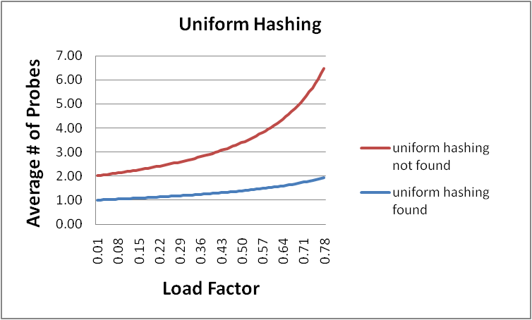
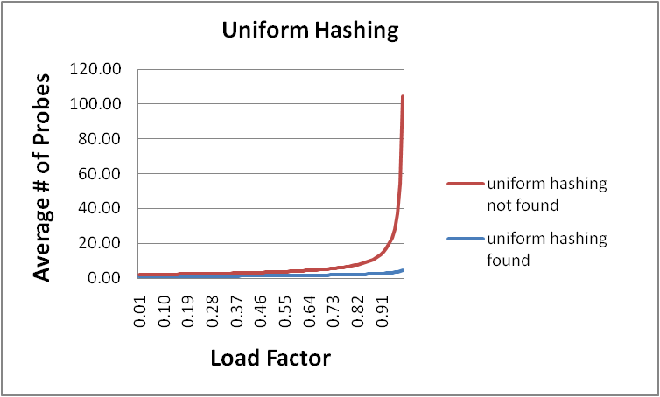
Charts

Slide 53
Outline - Where are we?
Separate Chaining is easy
find, insert, delete proportional to load factor on average if using unsorted linked list nodes
If using another data structure for buckets (e.g. AVL tree) , runtime is proportional to runtime for that structure.
Open addressing uses probing, has clustering issues as table fills Why use it:
Less memory allocation?
Some run-time overhead for allocating linked list (or whatever) nodes; open addressing could be faster
Easier data representation?
Now:
Growing the table when it gets too full (aka “rehashing”)
Relation between hashing/comparing and connection to Java
Notes:
Java using separate chaining
Python using open addressing

Slide 54
Rehashing
As with array-based stacks/queues/lists, if table gets too full, create a bigger table and copy everything over
With separate chaining, we get to decide what “too full” means
Keep load factor reasonable (e.g., < 1)?
Consider average or max size of non-empty chains?
For open addressing, half-full is a good rule of thumb
New table size
Twice-as-big is a good idea, except, uhm, that won’t be prime!
So go about twice-as-big
Can have a list of prime numbers in your code since you probably won’t grow more than 20-30 times, and then calculate after that

Slide 55
More on rehashing
Can we just copy all data to the same indices in the new table?
Will not work; we calculated the index based on TableSize
Go through table, do standard insert for each into new table
Iterate over old table: O(n)
n inserts / calls to the hash function: n ⋅ O(1) = O(n)
Is there some way to avoid all those hash function calls?
Space/time tradeoff: Could store h(key) with each data item
Growing the table is still O(n); saving h(key) only helps by a constant factor

Slide 56
A Generally Good hashCode()
int result = 17; // start at a prime
foreach field f
int fieldHashcode =
boolean: (f ? 1: 0)
byte, char, short, int: (int) f
long: (int) (f ^ (f >>> 32))
float: Float.floatToIntBits(f)
double: Double.doubleToLongBits(f), then above
Object: object.hashCode( )
result = 31 * result + fieldHashcode;
return result;

Slide 57
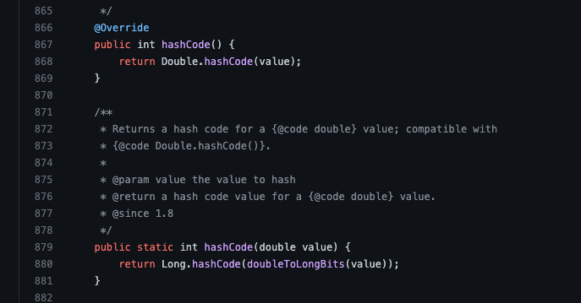
Check it out!
https://github.com/openjdk/jdk/blob/master/src/java.base/share/classes/java/lang/Double.java

Slide 58
Final word on hashing
The hash table is one of the most important data structures
Efficient find, insert, and delete
Operations based on sorted order are not so efficient!
Useful in many, many real-world applications
Popular topic for job interview questions
Important to use a good hash function
Good distribution, Uses enough of key’s components
Not overly expensive to calculate (bit shifts good!)
Important to keep hash table at a good size
Prime #
Preferable λ depends on type of table
Side-comment: hash functions have uses beyond hash tables
Examples: Cryptography, check-sums
Notes:
Check-sums are really cool

Slide 59
Outline
Hashing
Open Addressing
Rehashing
Hashing in Practice
Comparison Sorting

Slide 60
Sorting
Great general pre-processing step
Binary Search
Let’s us find the $k^{th}$element in $O(1)$ time for any $k$.
Also, a convenient way to discuss algorithm design principles.

Slide 61
Three goals
Three things you might want in a sorting algorithm:
In-Place
Only use $O(1)$ extra memory.
Sorted array given back in the input array.
Stable
If a appears before b in the initial array and a.compareTo(b) == 0
Then a appears before b in the final array.
Example: sort by first name, then by last name.
Fast

Slide 62
Insertion Sort
How you sort a hand of cards.
Maintain a sorted subarray at the front.
Start with one element.
While(your subarray is not the full array)
Take the next element not in your subarray
Insert it into the sorted subarray

Slide 63
Insertion Sort
for(i from 1 to n-1){
int index = i
while(a[index-1] > a[index]){
swap(a[index-1], a[index])
index = index-1
}
}

Slide 64
Insertion Sort
0 | 1 | 2 | 3 | 4 | 5 | 6 | 7 | 8 | 9
2 | 3 | 6 | 7 | 5 | 8 | 4 | 10 | 2 | 8
Sorted Items
Current Item
Unsorted Items
0 | 1 | 2 | 3 | 4 | 5 | 6 | 7 | 8 | 9
2 | 3 | 5 | 6 | 7 | 8 | 4 | 10 | 2 | 8
Sorted Items
Unsorted Items
Current Item
0 | 1 | 2 | 3 | 4 | 5 | 6 | 7 | 8 | 9
2 | 3 | 5 | 6 | 7 | 8 | 4 | 10 | 2 | 8
Sorted Items
Unsorted Items
Current Item

Slide 65
Insertion Sort Analysis
Stable? Yes! (If you’re careful)
In Place? Yes!
Running time:
Best Case: $O(n)$
Worst Case: $O(n^{2})$
Average Case: $O\left(n^{2}\right)$

Slide 66
Sort
Here’s another idea for a sorting algorithm:
Maintain a sorted subarray
While(subarray is not full array)
Find the smallest element remaining in the unsorted part.
Insert it at the end of the sorted part.

Slide 67
Selection Sort
Here’s another idea for a sorting algorithm:
Maintain a sorted subarray
While(subarray is not full array)
Find the smallest element remaining in the unsorted part.
By scanning the remainder of the array
Insert it at the end of the sorted part.
Running time $O(n^{2})$

Slide 68
Selection Sort
0 | 1 | 2 | 3 | 4 | 5 | 6 | 7 | 8 | 9
2 | 3 | 6 | 7 | 18 | 10 | 14 | 9 | 11 | 15
Sorted Items
Current Item
Unsorted Items
0 | 1 | 2 | 3 | 4 | 5 | 6 | 7 | 8 | 9
2 | 3 | 6 | 7 | 9 | 10 | 14 | 18 | 11 | 15
Sorted Items
Current Item
Unsorted Items
0 | 1 | 2 | 3 | 4 | 5 | 6 | 7 | 8 | 9
2 | 3 | 6 | 7 | 9 | 10 | 18 | 14 | 11 | 15
Sorted Items
Unsorted Items
Current Item

Slide 69
Selection Sort
Here’s another idea for a sorting algorithm:
Maintain a sorted subarray
While(subarray is not full array)
Find the smallest element remaining in the unsorted part.
By scanning the remainder of the array
Insert it at the end of the sorted part.
Running time $O(n^{2})$
Can we do better? With a data structure?

Slide 70
Heap Sort
Here’s another idea for a sorting algorithm:
Maintain a sorted subarray; Make the unsorted part a min-heap
While(subarray is not full array)
Find the smallest element remaining in the unsorted part.
By calling removeMin on the heap
Insert it at the end of the sorted part.
Running time $O(n\log{n})$

Slide 71
Heap Sort
0 | 1 | 2 | 3 | 4 | 5 | 6 | 7 | 8 | 9
1 | 4 | 2 | 14 | 15 | 18 | 16 | 17 | 20 | 22
Heap
Sorted Items
Current Item
0 | 1 | 2 | 3 | 4 | 5 | 6 | 7 | 8 | 9
22 | 4 | 2 | 14 | 15 | 18 | 16 | 17 | 20 | 1
percolateDown(22)
Heap
Sorted Items
Current Item
0 | 1 | 2 | 3 | 4 | 5 | 6 | 7 | 8 | 9
2 | 4 | 16 | 14 | 15 | 18 | 22 | 17 | 20 | 1
Heap
Sorted Items
Current Item

Slide 72
Heap Sort (Better)
We’re sorting in the wrong order!
Could reverse at the end.
Our heap implementation will implicitly assume that the heap is on the left of the array.
Switch to a max-heap and keep the sorted stuff on the right.
What’s our running time? $O(n\log{n)}$

Slide 73
Heap Sort
Our first step is to make a heap. Does using buildHeap instead of inserts improve the running time?
Not in a big-O sense (though we did by a constant factor).
In place: Yes
Stable: No

Slide 74
Next time
MergeSort, QuickSort
Beyond Comparison Sorting

