Slide 1
CSE 332: Data Structures & Parallelism Lecture 9 10: Hashing
Arthur Liu
Summer 2022

Slide 2
Announcements
Reminder EX05 due tonight!
P2 Writeup is significant! (A LOT TO WRITE!!)
Midterm Monday
Review Session Today at 2:15 MORE 220

Slide 3
Outline for Today
Hashing
Hashing
Collision Handling
Separate Chaining
Open Addressing

Slide 4
Motivating Hash Tables
For dictionary with n key/value pairs
* Assuming we must check to see if the key has already been inserted. Cost becomes cost of a find operation, inserting itself is O(1).
 | insert | find | delete
Unsorted linked-list | O(n)* | O(n) | O(n)
Unsorted array | O(n)* | O(n) | O(n)
Sorted linked-list | O(n) | O(n) | O(n)
Sorted Array | O(n) | O(log n) | O(n)
Balanced Tree | O(log n) | O(log n) | O(log n)
Notes:
Add in row for “Really big Array” O(1) O(1) O(1)
Point out wasted space.
Maybe we can approach that performance, get avg O(1)

Slide 5
Motivating Hash Tables
For dictionary with n key/value pairs
* Assuming we must check to see if the key has already been inserted. Cost becomes cost of a find operation, inserting itself is O(1).
 | insert | find | delete
Unsorted linked-list | O(n)* | O(n) | O(n)
Unsorted array | O(n)* | O(n) | O(n)
Sorted linked-list | O(n) | O(n) | O(n)
Sorted Array | O(n) | O(log n) | O(n)
Balanced Tree | O(log n) | O(log n) | O(log n)
HashTables | O(1) | O(1) | O(1) | (average)
Notes:
Add in row for “Really big Array” O(1) O(1) O(1)
Point out wasted space.
Maybe we can approach that performance, get avg O(1)

Slide 6
Really Big Array – my idea ☺
Notes:
Really Big Array

Slide 7
Really Big Array – my idea ☺
0
1
2
3
4
…
9,999,999
Keys: Student ID’s
0 – 9,999,999
Notes:
Really Big Array

Slide 8
Really Big Array – my idea ☺
0
1
2
3
4
…
9,999,999
Keys: Student ID’s
0 – 9,999,999
insert(4)
find(4)
delete(4)
Notes:
Really Big Array
Let’s not disregard these ideas from this example, hashtables will borrow from this idea but in a more practical sense

Slide 9
Hash Tables
Aim for constant-time (i.e., O(1)) find, insert, and delete
“On average” under some reasonable assumptions
A hash table is an array of some fixed size
hash table
0
 | …
Basic idea:
2015397
hash function:
h(key) → int
int mod Tablesize → index
2028689
2013486
key space (e.g., integers, strings)
TableSize –1
Notes:
Giant key space (10,000,000+ keys)
Take a hash function
We need good hash function

Slide 10
Hash Functions
An ideal hash function:
Is fast to compute
Is different for any two objects where .equals() == false
Often impossible in theory; easy in practice
Will handle collisions a bit later
hash table
0
 | …
Basic idea:
hash function:
h(key) → int
int mod Tablesize → index
key space (e.g., integers, strings)
TableSize –1
Notes:
Hash function is used for every operation
STAY ON THIS SLIDE A LITTLE
Example of a hash function keys -> student numbers
hashFunction(student #) -> first digit
Anyone comfortable with revealing their first digit?
Digits only 0-9
Some of the things to consider when making a good hash function

Slide 11
Who’s Responsible for Making it good
Clients write good hashCodes for their custom objects, so Hash tables can be generic
To store keys of type E, we just need to be able to:
Hashable: convert any E to an int
Test equality: are you the E I’m looking for?
When hash tables are a reusable library, the division of responsibility generally breaks down into two roles:
client
hash table library
collision?
collision
resolution
E
int
table-index

Slide 12
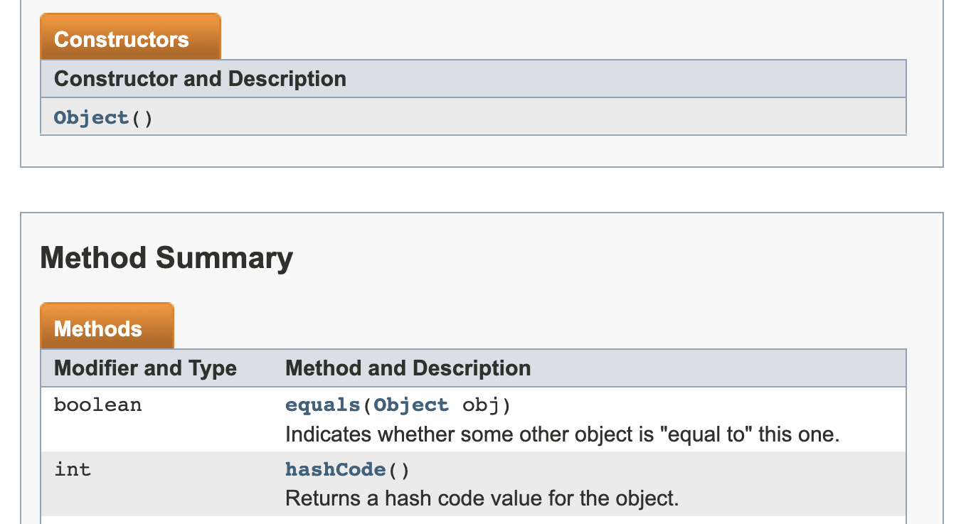
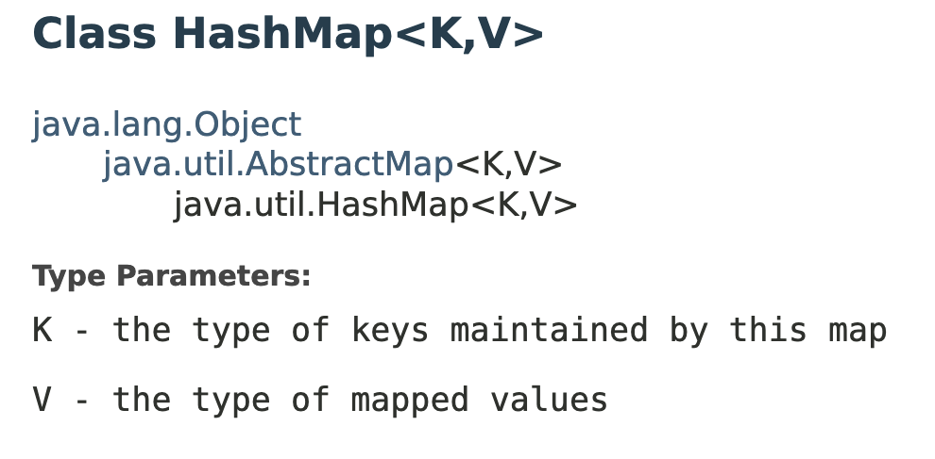
Ex: Java!
client
hash table library
collision?
collision
resolution
E
int
table-index
We will learn both roles, but most programmers “in the real world” spend more time as clients while understanding the library

Slide 13
Each Role’s Responsibility to Make It Good
client
hash table library
collision?
collision
resolution
E
int
table-index
Two roles must both contribute to minimizing collisions (heuristically)
Client should aim for different ints for different items
Avoid “wasting” any part of E or the 32 bits of the int
Library should aim for putting “similar” ints in different indices
conversion to index is almost always “mod table-size”
using prime numbers for table-size is common
Notes:
Ex: 10, 20

Slide 14
More arguments for a prime table size
If TableSize is 60 and…
Lots of keys are multiples of 5, wasting 80% of table
Lots of keys are multiples of 10, wasting 90% of table
Lots of keys are multiples of 2, wasting 50% of table
If TableSize is 61…
Collisions can still happen, but 5, 10, 15, 20, … will fill table
Collisions can still happen but 10, 20, 30, 40, … will fill table
Collisions can still happen but 2, 4, 6, 8, … will fill table
In general, if x and y are “co-prime” (means gcd(x,y)==1), then
(a * x) % y == (b * x) % y if and only if a % y == b % y
Given table size y and keys as multiples of x, we’ll get a decent distribution if x & y are co-prime
So good to have a TableSize that has no common factors with any “likely pattern” x

Slide 15
Hashing integers (try it out)
key space = integers
Simple hash function:
Client: h(x) = x
Library: g(x) = h(x) % TableSize
Fairly fast and natural
Example:
TableSize = 10
Insert 7, 18, 41, 34, 10
(As usual, ignoring corresponding data)
0
1
2
3
4
5
6
7
8
9
Notes:
What if we tried to insert 17?

Slide 16
Hashing integers (try it out)
key space = integers
Simple hash function:
Client: h(x) = x
Library: g(x) = h(x) % TableSize
Fairly fast and natural
Example:
TableSize = 10
Insert 7, 18, 41, 34, 10
(As usual, ignoring corresponding data)
0 | 10
1 | 41
2
3
4 | 34
5
6
7 | 7
8 | 18
9

Slide 17
What to hash?
If you have objects with several fields, it is usually best to have most of the “identifying fields” contribute to the hash to avoid collisions
Example:
class Person { String first; String middle; String last;
Date birthdate;
}
An inherent trade-off: hashing-time vs. collision-avoidance
Use all the fields?
Use only the birthdate?
Admittedly, what-to-hash is often an unprincipled guess ☹
Notes:
366 days of year
Some cultures don’t have middle names
Some cultures have a lot of the same last names

Slide 18
What if the key is not an int?
If keys aren’t ints, the client must convert to an int
Trade-off: speed and distinct keys hashing to distinct int
Common and important example: Strings
Key space K = s₀s₁s₂…s_{m-1}
where s_{i} are chars: s_{i} ∈ [0,256]
Some choices: Which avoid collisions best?
h(K) = s₀
h(K) =
h(K) =
Then on the library side we typically mod by Tablesize
to find index into the table
Notes:
What are things that can conflict for 2nd hash function
Can talk about an even worse hash function (just returns a singular value)
Note that when implementing this, java already has implemented hashcode for a lot of objects so you can just call the hashcode method!

Slide 19
Calculation tricks
Avoid heavy computation by using tricks!
String s;
h = 1;
for (int i = k – 1; i >= 0; i--) {
h = 31 * h + s[i];
}
Math.Pow(37, i) // bad
Notes:
Horner’s law

Slide 20
Specializing hash functions
How might you hash differently if all your strings were web addresses (URLs)?
Notes:
http
.com
UW websites?

Slide 21
Aside: Combining hash functions
A few rules of thumb / tricks:
Use all 32 bits (careful, that includes negative numbers)
Use different overlapping bits for different parts of the hash
This is why a factor of 37^{i} works better than 256^{i}
When smashing two hashes into one hash, use bitwise-xor
bitwise-and produces too many 0 bits
bitwise-or produces too many 1 bits
Rely on expertise of others; consult books and other resources
If keys are known ahead of time, choose a perfect hash

Slide 22
Outline for Today
Hashing
Hashing
Collision Handling
Separate Chaining
Open Addressing

Slide 23
Okay so collisions happen…
key space = integers
Simple hash function:
Client: h(x) = x
Library: g(x) = h(x) % TableSize
Fairly fast and natural
Example:
TableSize = 10
Insert 7, 18, 41, 34, 10
(As usual, ignoring corresponding data)
0 | 10
1 | 41
2
3
4 | 34
5
6
7 | 7
8 | 18
9

Slide 24
Collision resolution
Collision:
When two keys map to the same location in the hash table
We try to avoid it, but number-of-possible-keys exceeds table size
So, hash tables should support collision resolution
Ideas?

Slide 25
Flavors of Collision Resolution
Separate Chaining
Open Addressing
Linear Probing
Quadratic Probing
Double Hashing

Slide 26
Separate Chaining
Chaining: All keys that map to the same table location are kept in a list (a.k.a. a “chain” or “bucket”)
As easy as it sounds
Example: insert 10, 22, 107, 12, 42 with mod hashing and TableSize = 10
0
1
2
3
4
5
6
7
8
9

Slide 27
Separate Chaining
Chaining: All keys that map to the same table location are kept in a list (a.k.a. a “chain” or “bucket”)
As easy as it sounds
Example: insert 10, 22, 107, 12, 42 with mod hashing and TableSize = 10
0 | /
1 | /
2 | /
3 | /
4 | /
5 | /
6 | /
7 | /
8 | /
9 | /

Slide 28
Separate Chaining
Chaining: All keys that map to the same table location are kept in a list (a.k.a. a “chain” or “bucket”)
As easy as it sounds
Example: insert 10, 22, 107, 12, 42 with mod hashing and TableSize = 10
0
1 | /
2
3 | /
4 | /
5 | /
6 | /
7
8 | /
9 | /
10
/

Slide 29
Separate Chaining
Chaining: All keys that map to the same table location are kept in a list (a.k.a. a “chain” or “bucket”)
As easy as it sounds
Example: insert 10, 22, 107, 12, 42 with mod hashing and TableSize = 10
0
1 | /
2
3 | /
4 | /
5 | /
6 | /
7
8 | /
9 | /
10
/
22
/

Slide 30
Separate Chaining
Chaining: All keys that map to the same table location are kept in a list (a.k.a. a “chain” or “bucket”)
As easy as it sounds
Example: insert 10, 22, 107, 12, 42 with mod hashing and TableSize = 10
0
1 | /
2
3 | /
4 | /
5 | /
6 | /
7
8 | /
9 | /
10
/
22
/
107
/

Slide 31
Separate Chaining
Chaining: All keys that map to the same table location are kept in a list (a.k.a. a “chain” or “bucket”)
As easy as it sounds
Example: insert 10, 22, 107, 12, 42 with mod hashing and TableSize = 10
0
1 | /
2
3 | /
4 | /
5 | /
6 | /
7
8 | /
9 | /
10
/
12
22
/
107
/

Slide 32
Separate Chaining
Chaining: All keys that map to the same table location are kept in a list (a.k.a. a “chain” or “bucket”)
As easy as it sounds
Example: insert 10, 22, 107, 12, 42 with mod hashing and TableSize = 10
Worst case time for find?
0
1 | /
2
3 | /
4 | /
5 | /
6 | /
7
8 | /
9 | /
10
/
42
12
22
/
107
/
Notes:
How can we improve worst case time for find?

Slide 33
Thoughts on separate chaining
Worst-case time for find?
Linear
But only with really bad luck or bad hash function
So not worth avoiding (e.g., with balanced trees at each bucket)
Keep # of items in each bucket small
Overhead of AVL tree, etc. not worth it if small # items per bucket
Beyond asymptotic complexity, some “data-structure engineering” can improve constant factors
Linked list vs. array or a hybrid of the two
Move-to-front (part of Project 2)
Leave room for 1 element (or 2?) in the table itself, to optimize constant factors for the common case
A time-space trade-off…

Slide 34
Time vs. space (only makes a difference in constant factors)
0
1 | /
2
3 | /
4 | /
5 | /
6 | /
7
8 | /
9 | /
0 | 10 | /
1 | / | X
2 | 42
3 | / | X
4 | / | X
5 | / | X
6 | / | X
7 | 107 | /
8 | / | X
9 | / | X
10
/
42
12
22
/
12
22
/
107
/

Slide 35
More rigorous separate chaining analysis
Definition: The load factor, λ, of a hash table is
← number of elements
Under chaining, the average number of elements per bucket is ___
So if some inserts are followed by random finds, then on average:
Each unsuccessful find compares against ____ items
Each successful find compares against _____ items
How big should TableSize be??

Slide 36
More rigorous separate chaining analysis
Definition: The load factor, λ, of a hash table is
← number of elements
Under chaining, the average number of elements per bucket is λ
So if some inserts are followed by random finds, then on average:
Each unsuccessful find compares against λ items
Each successful find compares against λ / 2 items
If λ is low, find & insert likely to be O(1)
We like to keep λ around 1 for separate chaining

Slide 37
Load Factor?
0
1 | /
2
3 | /
4 | /
5 | /
6
7 | /
8 | /
9 | /
10
/
42
12
22
/
86
/
$$λ=\frac{n}{TableSize}= ?$$

Slide 38
Load Factor?
0
1 | /
2
3 | /
4 | /
5 | /
6
7 | /
8 | /
9 | /
10
/
42
12
22
/
86
/
$$λ=\frac{n}{TableSize}= ?$$
$$=\frac{5}{10}=0.5$$

Slide 39
Load Factor?
0
1
2
3
4 | /
5
6
7
8
9
10
/
71
2
31
/
42
12
22
/
63
73
/
75
5
65
95
/
86
/
27
47
88
18
38
98
/
99
/
$$λ=\frac{n}{TableSize}= ?$$

Slide 40
Load Factor?
0
1
2
3
4 | /
5
6
7
8
9
10
/
71
2
31
/
42
12
22
/
63
73
/
75
5
65
95
/
86
/
27
47
88
18
38
98
/
99
/
$$=\frac{21}{10}=2.1$$
$$λ=\frac{n}{TableSize}= ?$$

Slide 41
Separate Chaining Deletion?
0
1 | /
2
3 | /
4 | /
5 | /
6 | /
7
8 | /
9 | /
10
/
42
12
22
/
107
/

Slide 42
Separate Chaining Deletion
Not too bad
Find in table
Delete from bucket
Say, delete 12
Similar run-time as insert
0
1 | /
2
3 | /
4 | /
5 | /
6 | /
7
8 | /
9 | /
10
/
42
12
22
/
107
/

Slide 43
Motivating Hash Tables
For dictionary with n key/value pairs
* Assuming we must check to see if the key has already been inserted. Cost becomes cost of a find operation, inserting itself is O(1).
 | insert | find | delete
Unsorted linked-list | O(n)* | O(n) | O(n)
Unsorted array | O(n)* | O(n) | O(n)
Sorted linked-list | O(n) | O(n) | O(n)
Sorted Array | O(n) | O(log n) | O(n)
Balanced Tree | O(log n) | O(log n) | O(log n)
HashTables | O(1) | O(1) | O(1) | (average)
Notes:
It feels a little odd that we can just say HashTables get to be their average case

Slide 44
Why Hash Tables are a great approximation of our Really Big Array
Not that many elements that we need to store
There are m possible keys (m typically large, even infinite)
We expect our table to have only n items
n is much less than m (often written n << m)
Many dictionaries have this property
Compiler: All possible identifiers allowed by the language vs. those used in some file of one program
Database: All possible student names vs. students enrolled
AI: All possible chess-board configurations vs. those considered by the current player
…

Slide 45
Aside: Hash Tables vs. Balanced Trees
In terms of a Dictionary ADT for just insert, find, delete, hash tables and balanced trees are just different data structures
Hash tables O(1) on average (assuming few collisions)
Balanced trees O(log n) worst-case
Constant-time is better, right?
Yes, but you need “hashing to behave” (must avoid collisions)
Yes, but what if we want to findMin, findMax, predecessor, and successor, printSorted?
Hashtables are not designed to efficiently implement these operations

Slide 46
Client Collision Avoidance: Recall Our Ideal
An ideal hash function:
Is different for any two objects where .equals() == false
Often impossible in theory; easy in practice
Will handle collisions a bit later
Is fast to compute
hash table
0
 | …
Basic idea:
hash function:
h(key) → int
int mod Tablesize → index
key space (e.g., integers, strings)
TableSize –1
Notes:
Example of a hash function keys -> student numbers
hashFunction(student #) -> first digit

Slide 47
But making Sure It’s Still Correct
A correct hash function:
Any two objects where .equals() == true must return the same hashcode!
If you update .equals(), you should update your hashCode() and vice-versa
hash table
0
 | …
Basic idea:
hash function:
h(key) → int
int mod Tablesize → index
key space (e.g., integers, strings)
TableSize –1
Notes:
Example of a hash function keys -> student numbers
hashFunction(student #) -> first digit

Slide 48
🚨 🚨 🚨 Sneaky Bug Alert 🚨 🚨 🚨

Slide 49
Spot the bug >:C
pollev.com/artliu
ArrayList a
ArrayList b
arr
13 | 15 | 12 | 0 | 0 | 0
arr
13 | 15 | 12 | 0 | 0 | 0 | -3 | -5
size
3
size
3
// not the most ideal hashcode, but
// there’s a fatal error
int hashCode() {
int hash = 0;
for (int i = 0; i < arr.length; i++) {
hash += arr[i];
}
return hash;
}
Are these two ArrayList’s equal()?
What’s the error with the hashCode()?

Slide 50
Hashing and Equality
Our use of int key can lead to us overlooking a critical detail:
We initially hash E to get a table index
While chaining or probing we need to determine if this is the E that I am looking for… ie: equality testing!!!
So a hash table needs a hash function and an equality testing
In the Java library each object has an equals method and a hashCode method
class Object {
boolean equals(Object o) {…}
int hashCode() {…}
…
}

Slide 51
Equal objects must hash the same
The Java library (and your project hash table) make a very important assumption that clients must satisfy…
Object-oriented way of saying it:
If a.equals(b), then we must require a.hashCode()==b.hashCode()
Function object way of saying it:
If c.compare(a,b) == 0, then we must require
h.hash(a) == h.hash(b)
If you ever override equals
You need to override hashCode also in a consistent way
See CoreJava book, Chapter 5 for other "gotchas" with equals

Slide 52
By the way: comparison has rules too
We have not emphasized important “rules” about comparison for:
All our dictionaries
Sorting (next major topic)
Comparison must impose a consistent, total ordering:
For all a, b, and c,
If compare(a,b) < 0, then compare(b,a) > 0
If compare(a,b) == 0, then compare(b,a) == 0
If compare(a,b) < 0 and compare(b,c) < 0, then compare(a,c) < 0

Slide 53
Outline
Next time
3 flavors of open addressing (collision resolution)
More hashing in practice

