Slide 1

CSE 332: Data Structures & Parallelism
Lecture 7: AVL
Arthur Liu
Summer 2022

Slide 2
Announcements
EX03, EX04 due tonight
EX05 released, due next Friday!
  EX06 cancelled!
P2 project released!
  Checkpoint 1

Slide 3
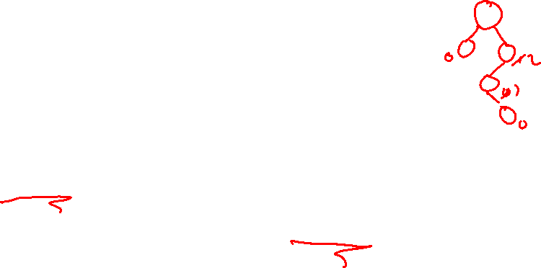
The AVL Balance Condition
Adelson-Velskii and Landis
Adelson-Velskii and Landis
Left and right subtrees of every node have heights differing by at most 1
Definition: balance(node) = height(node.left) – height(node.right)
AVL property: for every node x, –1 ≤ balance(x) ≤ 1
Ensures small depth
  Will prove this by showing that an AVL tree of height
  h must have a number of nodes exponential in h
Easy (well, efficient) to maintain
  Using single and double rotations

Slide 4
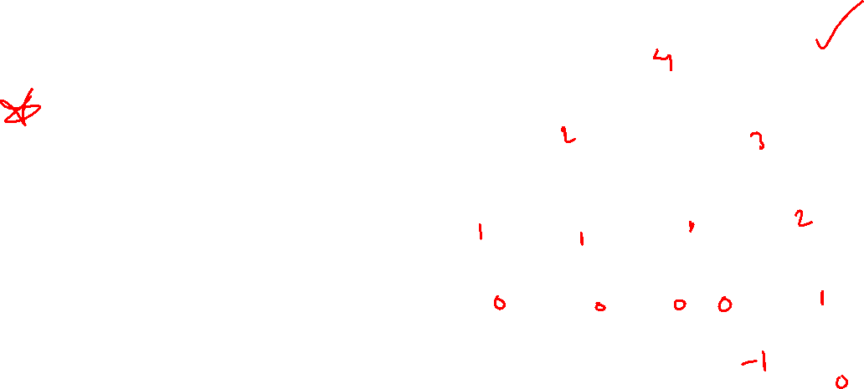
The AVL Tree Data Structure
Structural properties
  Binary tree property
  (0, 1, or 2 children)
  Heights of left and right subtrees of every node
  differ by at most 1
Result:
  Worst case depth of any node is: O(log n)
Ordering property
  Same as for BST
This is an AVL tree
8
5
11
2
6
10
13
4
7
9
12
14
15
Notes:
4
Note: height of a null tree is -1, height of tree with a single node is 0
So, AVL trees will be Binary Search Trees with one extra feature:
They balance themselves!
The result is that all AVL trees at any point will have a logarithmic asymptotic bound on their depths

Slide 5
EX1: An AVL tree?
pollev.com/artliu
6
4
8
1
7
11
10
12

Slide 6
EX1: An AVL tree?
6
3
4
1
8
2
1
0
0
11
1
7
0
10
12
0
Notes:
HIDE

Slide 7
EX2: An AVL tree?
6
4
8
1
5
7
11
3
2

Slide 8
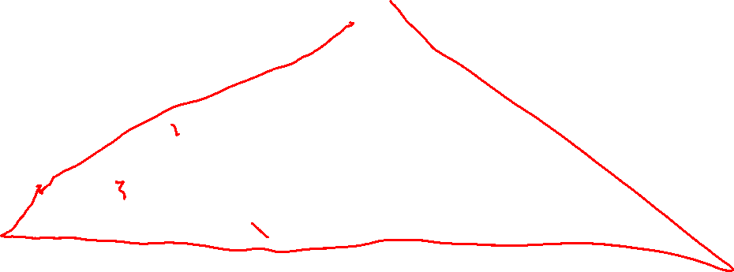
EX2: An AVL tree?
4
6
3
4
8
1
2
1
5
0
0
7
11
0
3
1
0
2
Notes:
HIDE

Slide 9
EX3: An AVL tree?
5
2
8
1
3
6
11
4
7

Slide 10
EX3: An AVL tree?
3
5
2
2
2
8
0
1
3
6
0
11
1
1
0
4
0
7

Slide 11

Good News Everyone!
We will prove that number of nodes grows exponentially with height of AVL tree so therefore: find is O(log n)
But as we insert and delete elements, we need to:
Track balance
Detect imbalance
Restore balance
10
5
15
2
9
20
7

Slide 12
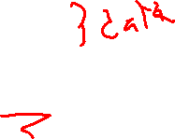
An AVL Tree
10
key
3
…
value
10
3
height
2
2
children
5
20
0
1
1
0
2
9
15
30
0
0
7
17
Track height at all times!
Notes:
Here’s a revision of that tree that’s balanced. (Same values, similar tree)
This one _is_ an AVL tree (and isn’t leftist).
I also have here how we might store the nodes in the AVL tree.
Notice that I’m going to keep track of height all the time. WHY?

Slide 13
AVL tree operations
AVL find:
  Same as BST find
AVL insert:
  First BST insert, then check balance and potentially “fix” the AVL tree
  Four different imbalance cases
AVL delete:
  The “easy way” is lazy deletion
  Otherwise, like insert we do the deletion and then have several imbalance cases

Slide 14

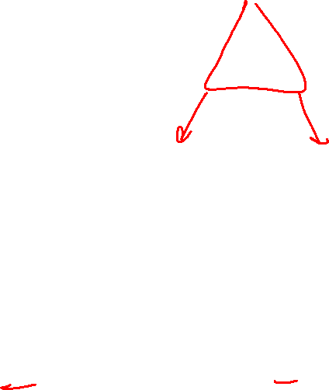
AVL tree insert
Let b be the node where an imbalance occurs.
Four cases to consider. The insertion is in the
left subtree of the left child of b.
right subtree of the left child of b.
left subtree of the right child of b.
right subtree of the right child of b.
Idea: Cases 1 & 4 are solved by a single rotation
Cases 2 & 3 are solved by a double rotation
b
a
c
X
U
V
Z
1 2 3 4

Slide 15
Insert: detect potential imbalance
Insert the new node as in a BST (a new leaf)
For each node on the path from the root to the new leaf, the insertion may (or may not) have changed the node’s height
So, after recursive insertion in a subtree, detect height imbalance and perform a rotation to restore balance at that node
All the action is in defining the correct rotations to restore balance
Fact that makes it a bit easier:
  There must be a deepest element that is imbalanced after the insert (all descendants still balanced)
  After rebalancing this deepest node, every node is balanced
  So at most one node needs to be rebalanced

Slide 16
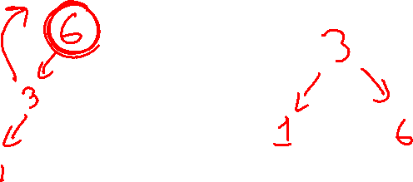
Case #1: Example
Insert(6)
Insert(3)
Insert(1)
Notes:
But, let’s start over…
Insert [SMALL]
Now, [MIDDLE].
Now, [TALL].
Is this tree balanced?
NO!
Who do we need at the root?
[MIDDLE!]
Alright, let’s pull er up.

Slide 17
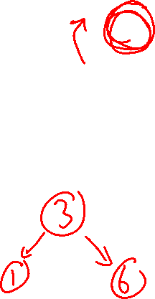
Case #1: Example
Insert(6)
Insert(3)
Insert(1)
Third insertion violates balance property
  happens to be at the root
What is the only way to fix this?
0
6
1
2
6
6
0
1
3
3
0
1

Slide 18
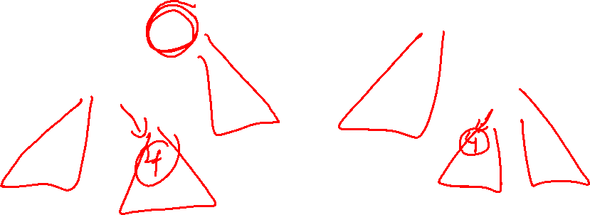
Fix: Apply “Single Rotation”
Single rotation: The basic operation we’ll use to rebalance
  Move child of unbalanced node into parent position
  Parent becomes the “other” child (always okay in a BST!)
  Other subtrees move in only way BST allows (next slide)
AVL Property violated here
1
2
6
3
1
0
3
0
1
6
0
1
Intuition: 3 must become root
new-parent-height = old-parent-height-before-insert
Single Rotation:
Rotate between self and child

Slide 19
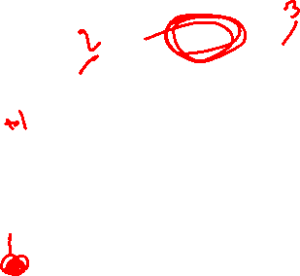
The example generalized
Notational note:
Oval: a node in the tree
Triangle: a subtree
Node imbalanced due to insertion somewhere in
left-left grandchild increasing height
  1 of 4 possible imbalance causes (other three coming)
First, we did the insertion, which would make b imbalanced
b
h+2
h+1
a
h
h
Z
h
X
Y
Notes:
DRAW NEXT STEPS BY HAND

Slide 20
The example generalized
Notational note:
Oval: a node in the tree
Triangle: a subtree
Node imbalanced due to insertion somewhere in
left-left grandchild increasing height
  1 of 4 possible imbalance causes (other three coming)
First, we did the insertion, which would make b imbalanced
b
h+2
b
h+3
h+1
h+2
a
h
h
Z
a
Z
h
h
h+1
h
X
Y
X
Y

Slide 21
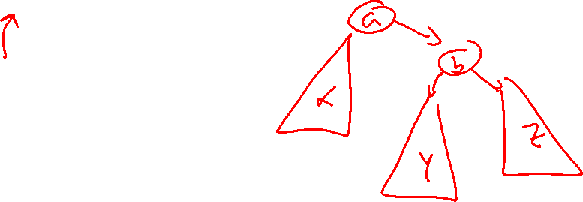
The general left-left case
Node imbalanced due to insertion somewhere in
left-left grandchild increasing height
  1 of 4 possible imbalance causes (other three coming)
Next, we rotate at b, using BST facts: X < a < Y < b < Z
b
h+3
h+2
a
h
h+1
Z
h
X
Y

Slide 22

The general left-left case
Node imbalanced due to insertion somewhere in
left-left grandchild increasing height
  1 of 4 possible imbalance causes (other three coming)
Next, we rotate at b, using BST facts: X < a < Y < b < Z
b
h+3
a
h+2
h+2
h
h+1
a
b
h+1
Z
h+1
h
h
X
h
X
Y
Y
Z
A single rotation restores balance at the node to same height as before insertion (so ancestors now balanced)

Slide 23
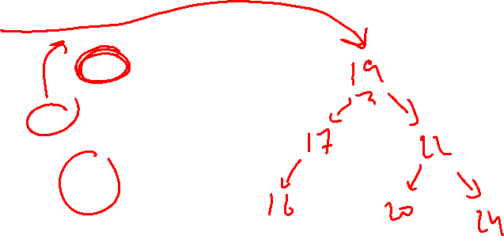
Another example: insert(16)
15
8
22
4
10
19
24
3
6
17
20
16

Slide 24
Another example: insert(16)
15
8
22
4
10
19
24
3
6
17
20
16
15
8
19
4
10
17
22
3
6
16
20
24
Notes:
Give students chance to try by themselves for a minute

Slide 25
The general right-right case
Mirror image to left-left case, so you rotate the other way
  Exact same concept, but need different code
h+3
a
h
h+2
X
b
h
h+1
Y
Z
Notes:
DRAW BY HAND

Slide 26
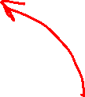
The general right-right case
Mirror image to left-left case, so you rotate the other way
  Exact same concept, but need different code
h+3
a
h+2
b
h+2
h
h+1
X
b
a
h+1
h
h
Z
h+1
h
Y
Z
X
Y

Slide 27
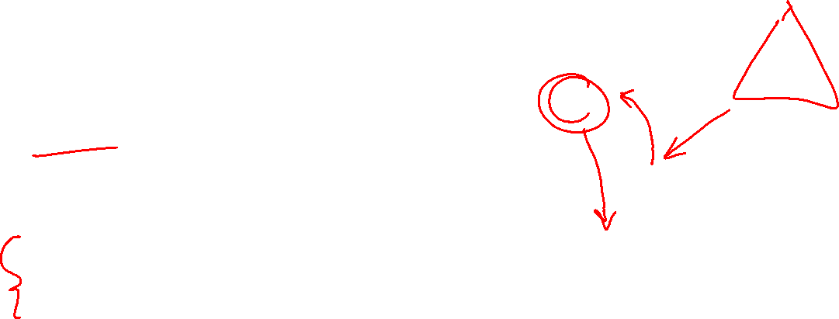
Single Rotation Pseudo-Code
RotateWithRight brings up the right child
root
a
Node RotateWithRight(Node root) {
Node temp = root.right
root.right = temp.left
temp.left = root
root.height = max(root.right.height(),
root.left.height()) + 1
temp.height = max(temp.right.height(),
temp.left.height()) + 1
root = temp
return root
}
temp
X
b
Y
Z
Notes:
Here’s code for one of the two single rotate cases.
RotateRight brings up the right child.
We’ve inserted into Z, and now we want to fix it.

Slide 28
Case #3 Example
Insert(1)
Insert(6)
Insert(3)
Notes:
There’s another bad case, though.
What if we insert:
[SMALL] [TALL] [MIDDLE]
Now, is the tree imbalanced?
Will a single rotation fix it?
(Try it by bringing up tall; doesn’t work!)

Slide 29
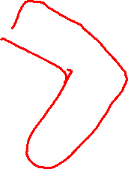
Two cases to go
Unfortunately, single rotations are not enough for insertions in the left-right subtree or the right-left subtree
Simple example: insert(1), insert(6), insert(3)
  First wrong idea: single rotation like we did for left-left
2
1
1
6
1
6
0
0
0
1
3
3

Slide 30
Two cases to go
Unfortunately, single rotations are not enough for insertions in the left-right subtree or the right-left subtree
Simple example: insert(1), insert(6), insert(3)
  Second wrong idea: single rotation on the child of the unbalanced node
2
2
1
1
1
1
6
3
0
0
3
6

Slide 31
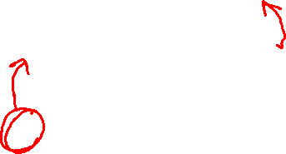
Sometimes two wrongs make a right ☺
First idea violated the BST property
Second idea didn’t fix balance
But if we do both single rotations, starting with the second, it works! (And not just for this example.)
Double rotation:
  Rotate problematic child and grandchild
  Then rotate between self and new child
Intuition: 3 must become root
2
2
1
1
1
1
3
6
3
1
0
0
0
0
3
1
6
6

Slide 32
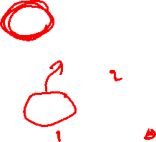
Insert 3
2
1
5
4
7
3

Slide 33
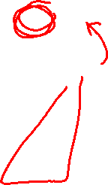
Insert 3
2
1
4
3
5
7

Slide 34
Insert 3
4
2
5
1
3
7

Slide 35
Double Rotation Pseudo-Code
Node DoubleRotateWithRight(Node root) {
root.right = RotateWithLeft(root.right)
root = RotateWithRight(root)
return root
}
First Rotation
a
a
c
Z
Z
b
W
Y
b
c
X
Y
X
W
Notes:
Here’s the double rotation code.
Pretty tough, eh?

Slide 36
Double Rotation Completed
First Rotation
Second Rotation
a
b
Z
b
a
c
Y
Z
Y
X
W
c
X
W

Slide 37
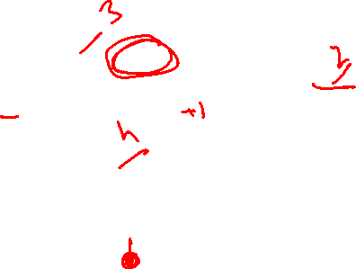
The general right-left case
h+2
a
h+1
h
h
c
X
h
b
h-1
h-1
Z
U
V

Slide 38
The general right-left case
h+3
a
h+2
h
h+1
c
X
h
b
h
h-1
Z
U
V
h+2
b
h+3
a
h+1
h+1
h+2
a
c
h
b
h
X
h+1
h
h
h
X
U
h-1
U
c
V
Z
h-1
V
h
Z

Slide 39
Comments
Like in the left-left and right-right cases, the height of the subtree after rebalancing is the same as before the insert
  So no ancestor in the tree will need rebalancing
Does not have to be implemented as two rotations; can just do:
h+3
h+2
a
h+2
b
h
h+1
c
h+1
X
h+1
h
a
c
b
h
h
h-1
Z
h
h
X
U
h-1
U
V
V
Z
Easier to remember than you may think:
Move b to grandparent’s position and then put a, c, X, U, V, and Z in the only legal positions for a BST

Slide 40
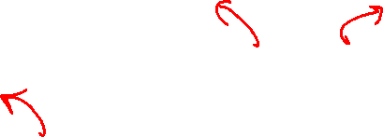
The last case, case 2: left-right
Mirror image of right-left
Again, no new concepts, only new code (read: two method calls) to write
h+3
c
h+2
h+2
b
a
h
h+1
h+1
Z
h+1
a
c
b
h
h
h
h
X
h
X
U
h-1
U
h-1
V
Z
V

Slide 41

Insert 5
15
8
17
4
10
16
3
6
5

Slide 42

Insert 5
15
8
17
6
10
16
4
3
5

Slide 43
Insert 5
15
6
17
4
8
16
3
5
10

Slide 44

Insert, summarized
b
a
c
X
U
V
Z
Insert as in a BST
Check back up path for imbalance, which will be 1 of 4 cases:
  node’s left-left grandchild is too tall
  node’s left-right grandchild is too tall
  node’s right-left grandchild is too tall
  node’s right-right grandchild is too tall
Only one case occurs because tree was balanced before insert
After the appropriate single or double rotation, the smallest-unbalanced subtree has the same height as before the insertion
  So all ancestors are now balanced
1 2 3 4

Slide 45
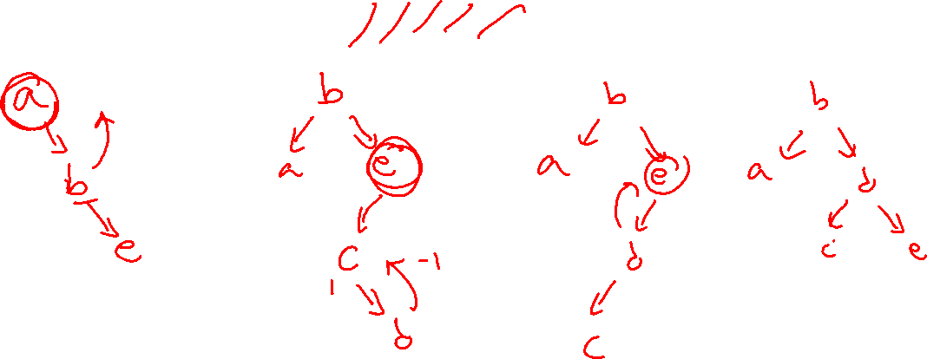
Insert into an AVL tree: a b e c d
Notes:
Problem node is e!!!

Slide 46
Not bad, is AVL that good though?
Let’s look at some height guarantees

Slide 47
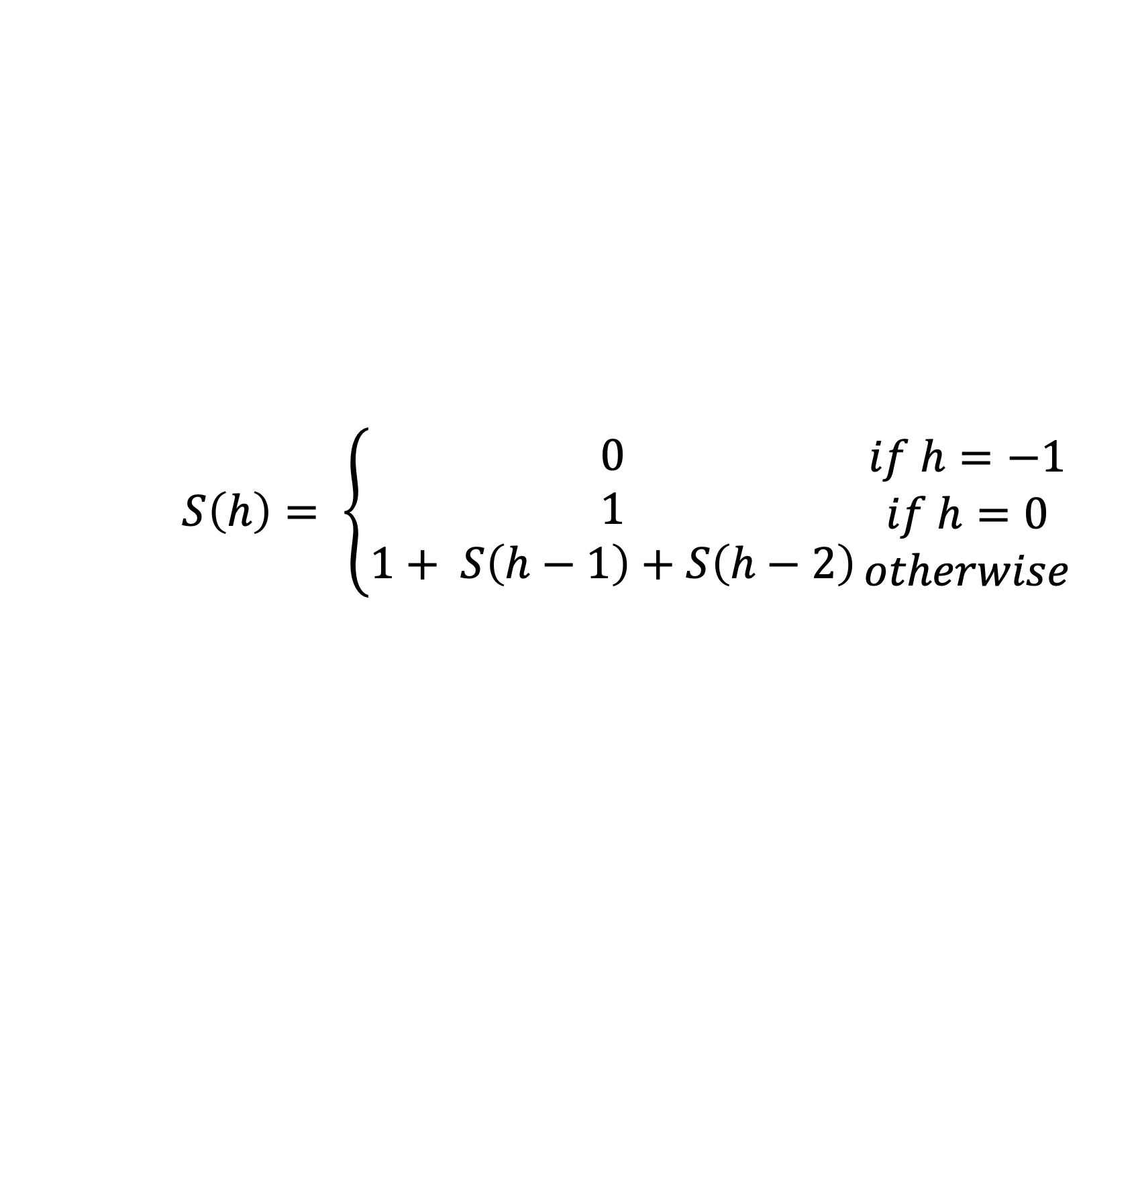
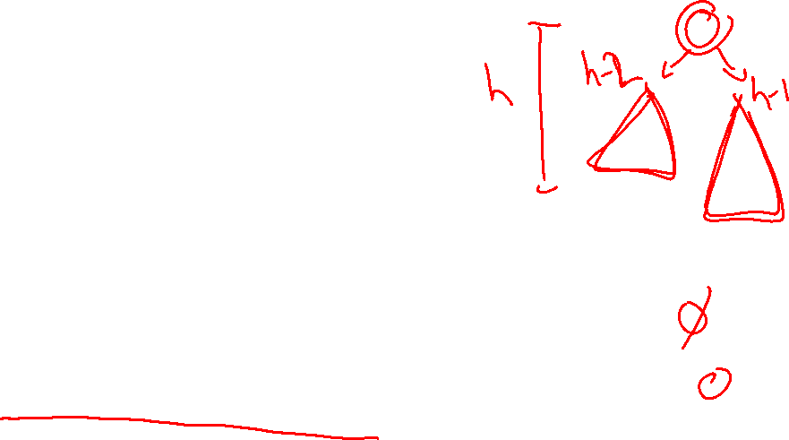
What even is the size of an AVL Tree?
Using the AVL balance property, we can determine the minimum number of nodes (size) in an AVL tree of height h
Let S(h)be the minimum # of nodes in an AVL tree of height h, then:
Goal: Get closed form, show that number of nodes grows exponential with height! (ie: height grows logarithmically with number of nodes)
$$S\left(h\right)= \left\{\begin{matrix}0 \\ 1 \\ 1+ S\left(h−1\right)+S\left(h−2\right)\end{matrix}\right.\begin{matrix}if h=−1 \\ if h=0 \\ otherwise\end{matrix}$$

Slide 48
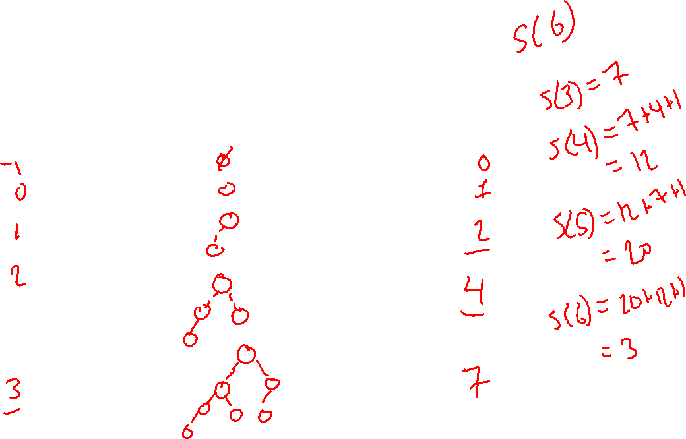
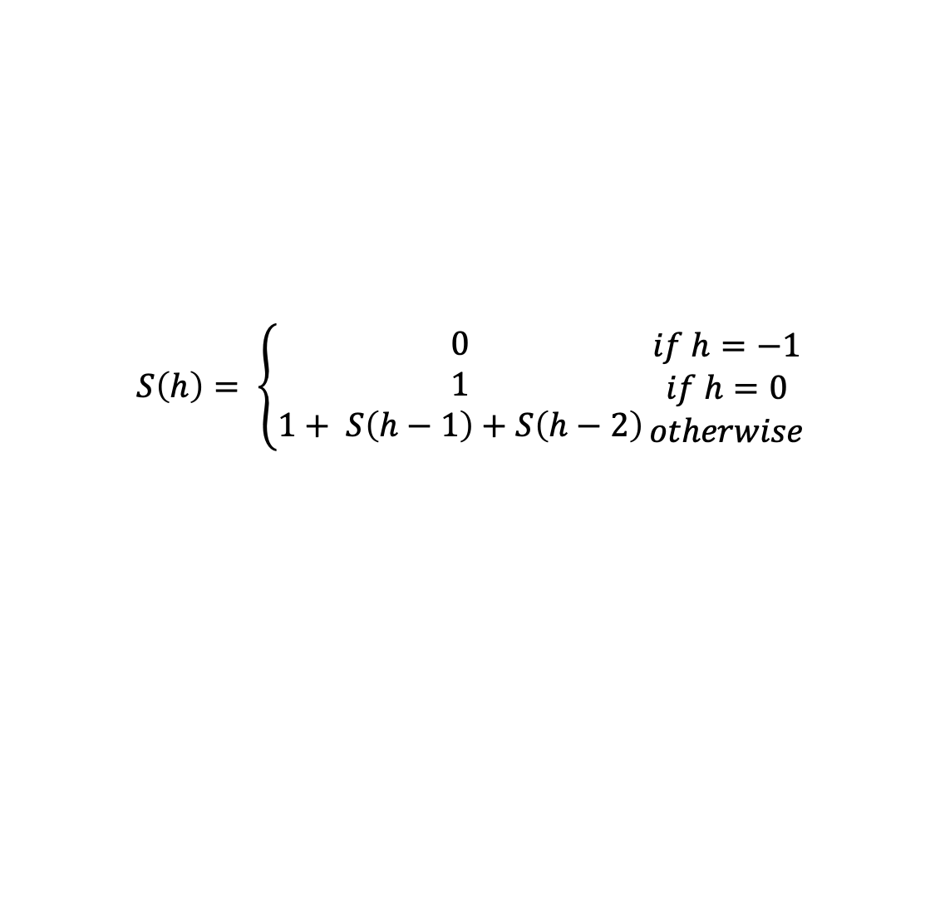
Let S(h)be the minimum # of nodes in an AVL tree of height h, then:
h Minimal AVL Tree S(h)
$$S\left(h\right)= \left\{\begin{matrix}0 \\ 1 \\ 1+ S\left(h−1\right)+S\left(h−2\right)\end{matrix}\right.\begin{matrix}if h=−1 \\ if h=0 \\ otherwise\end{matrix}$$

Slide 49
Minimal AVL Tree (height = 0)

Slide 50
Minimal AVL Tree (height = 1)

Slide 51
Minimal AVL Tree (height = 2)

Slide 52
Minimal AVL Tree (height = 3)

Slide 53
Minimal AVL Tree (height = 4)

Slide 54

The shallowness bound
Let S(h) = the minimum number of nodes in an AVL tree of height h
  If we can prove that S(h) grows exponentially in h, then a tree with n nodes has a logarithmic height
Step 1: Define S(h) inductively using AVL property
Step 2: Show this recurrence grows really fast
  Similar to Fibonacci numbers
  Can prove for all h, S(h) > φ^{h} – 1 where
  φ is the golden ratio, (1+√5)/2, about 1.62
  Growing faster than 1.6^{h} is “plenty exponential”
h
h-2
h-1
Notes:
If h is a min-size AVL tree, it has to have this structure (diagram) (okay to switch left-right subtrees). Ask why.
Note that each subtree is an AVL tree, by definition. Since the goal is to minimize the size of the tree, might as well choose the minimum h-2 and h-1 trees.
m(h) = m(h-1) + m(h-2) + 1

Slide 55
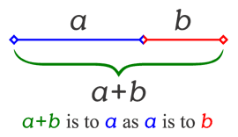
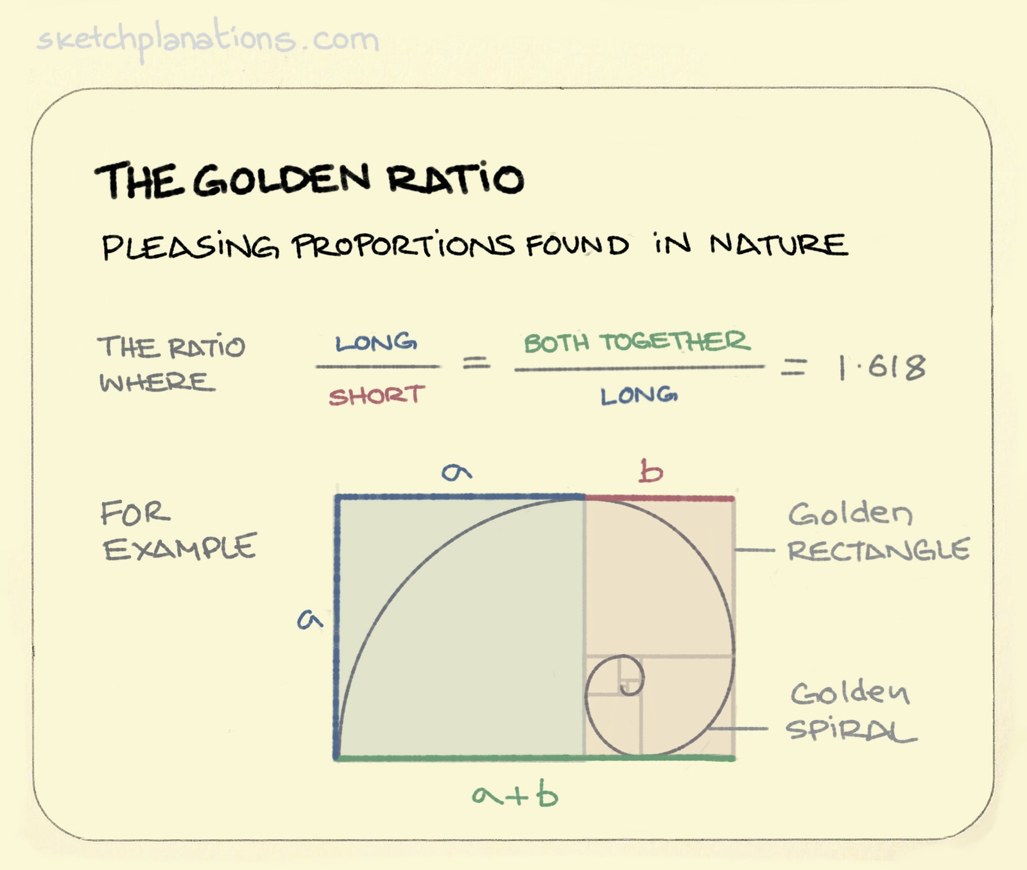
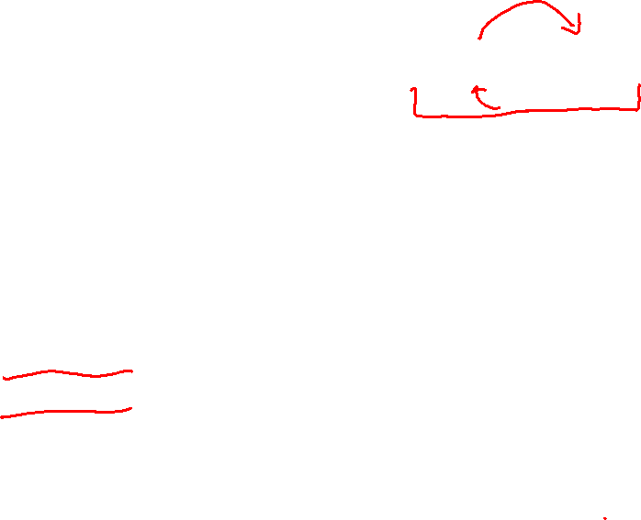
The Golden Ratio
This is a special number
Aside: Since the Renaissance, many artists and architects have proportioned their work (e.g., length:height) to approximate the golden ratio: If (a+b)/a = a/b, then a = φb
We will need one special arithmetic fact about φ :
φ²
= ((1+5^{1/2})/2)²
= (1 + 2*5^{1/2} + 5)/4
= (6 + 2*5^{1/2})/4
= (3 + 5^{1/2})/2
= 1 + (1 + 5^{1/2})/2
= 1 + φ

Slide 56
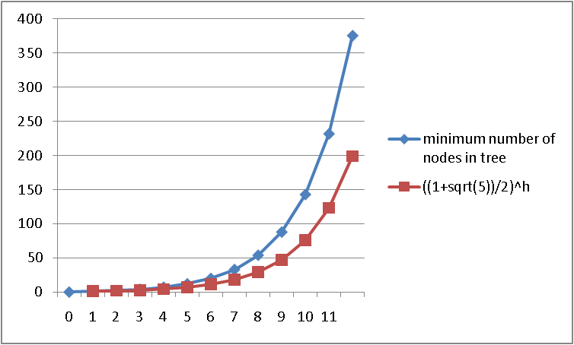
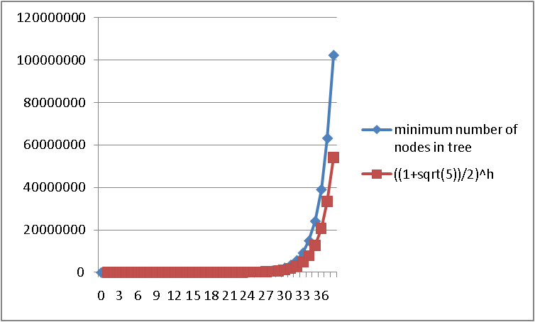
Before we prove it
Good intuition from plots comparing:
  S(h) computed directly from the definition
  ((1+√5)/2) ^{h}
S(h) is always bigger, up to trees with huge numbers of nodes
  Graphs aren’t proofs, so let’s prove it

Slide 57
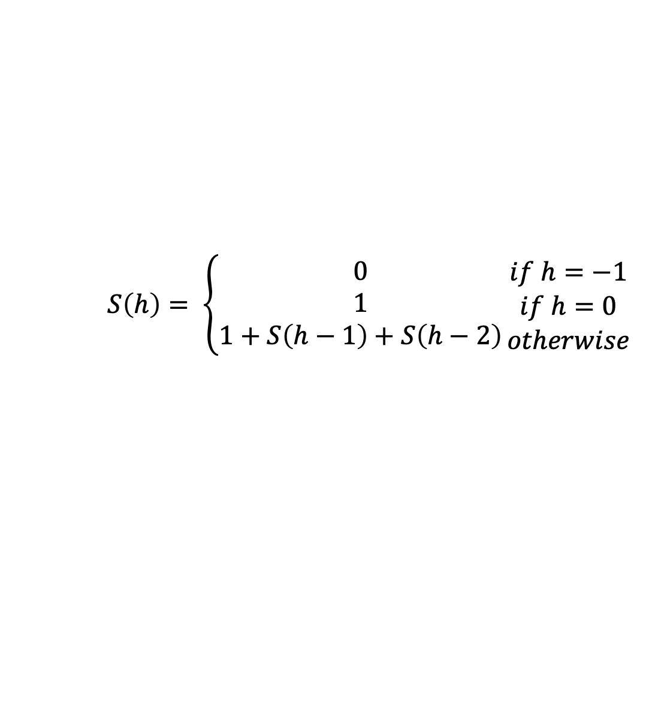
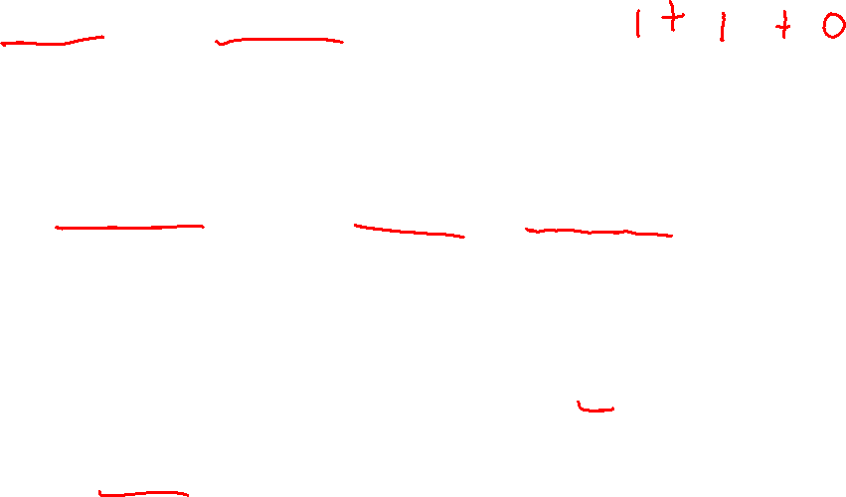
The proof
$$S\left(h\right)= \left\{\begin{matrix}0 \\ 1 \\ 1+S\left(h−1\right)+S\left(h−2\right)\end{matrix}\right.\begin{matrix}if h=−1 \\ if h=0 \\ otherwise\end{matrix}$$
Theorem: For all h ≥ 0, S(h) > φ^{h} – 1
Proof: By induction on h
Base cases:
  S(0) = 1 > φ⁰ – 1 = 0 S(1) = 2 > φ¹ – 1 ≈ 0.62
Inductive case (k > 1):
Show S(k+1) > φ^{k+1} – 1 assuming S(k) > φ^{k} – 1 and S(k-1) > φ^{k-1} – 1
S(k+1) = 1 + S(k) + S(k-1) by definition of S
> 1 + φ^{k} – 1 + φ^{k-1} – 1 by induction
= φ^{k} + φ^{k-1} – 1 by arithmetic (1-1=0)
= φ^{k-1} (φ + 1) – 1 by arithmetic (factor φ^{k-1} )
= φ^{k-1} φ² – 1 by special property of φ
= φ^{k+1} – 1 by arithmetic (add exponents)

Slide 58
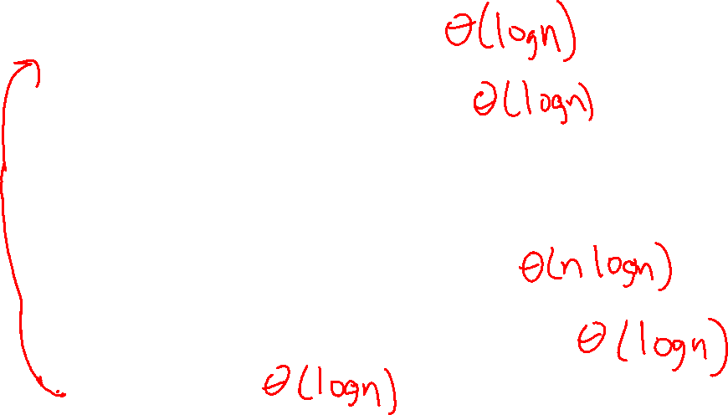
Now efficiency
Worst-case complexity of find: __________
  Tree is balanced
Worst-case complexity of insert: __________
  Tree starts balanced
  A rotation is O(1) and there’s an O(log n) path to root
  (Same complexity even without one-rotation-is-enough fact)
  Tree ends balanced
Worst-case complexity of buildTree: _________
delete? (see 3 ed. Weiss) requires more rotations: _________
Lazy deletion? ________________
Notes:
Delete may require a rotation at every level: https://webdocs.cs.ualberta.ca/~holte/T26/tree-deletion.html
So delete is still O(log(n)) but with heavier constant factors

Slide 59
Pros and Cons of AVL Trees
Arguments for AVL trees:
All operations logarithmic worst-case because trees are always balanced
  Big perk! Squaring input size will only at most double the time it takes
Height balancing adds no more than a constant factor to the speed of insert and delete
Arguments against AVL trees:
Difficult to program & debug
More space for height field
Asymptotically faster but rebalancing takes a little time
Most large searches are done in database-like systems on disk and use other structures (e.g., B-trees, our next data structure)

Slide 60

pollev.com/artliu
Pacing of lecture?
Too slow
A little slow
Just right
A little fast
Too fast
Start doing ____
Continue doing ___
Stop doing ___

Slide 61
More Examples…

Slide 62
Single and Double Rotations
Inserting what integer values would cause the tree to need a:
9
single rotation?
double rotation?
no rotation?
5
11
2
7
13
0
3

Slide 63
Easy Insert
3
Insert(3)
10
1
2
5
15
0
0
0
1
2
9
12
20
0
0
17
30
Unbalanced?
Notes:
Let’s insert 3.
This is easy!
It just goes under 2 (to the right).
Update the balances:
any imbalance?
NO!

Slide 64
Hard Insert
3
Insert(33)
10
2
2
5
15
1
0
0
1
2
9
12
20
0
0
0
3
17
30
Unbalanced?
How to fix?
Notes:
Now, let’s insert 33.
Where does it go?
Right of 30.

Slide 65
Single Rotation
3
3
10
10
2
3
2
2
5
15
5
20
1
0
0
2
1
0
1
1
2
9
12
20
2
9
15
30
0
0
1
0
0
0
0
3
17
30
3
12
17
33
0
33
Notes:
Here’s the tree with the balances updated.
Now, node 15 is bad!
Since the problem is in the left subtree of the left child, we can fix it with a single rotation.
We pull 20 up.
Hang 15 to the left.
Pass 17 to 15.
And, we’re done!
Notice that I didn’t update 10’s height until we checked 15. Did it change after all?

Slide 66
Hard Insert
3
Insert(18)
10
2
2
5
15
1
0
0
1
2
9
12
20
0
0
0
Unbalanced?
3
17
30
How to fix?
Notes:
Now, let’s back up to before 33 and insert 18 instead.
Goes right of 17.
Again, there’s imbalance.
But, this time, it’s a zig-zag!

Slide 67
Single Rotation (oops!)
3
3
10
10
2
3
2
3
5
15
5
20
1
0
0
2
1
0
2
0
2
9
12
20
2
9
15
30
0
1
0
0
0
1
3
17
30
3
12
17
0
0
18
18
Notes:
We can try a single rotation,
but we end up with another zig-zag!

Slide 68
Double Rotation (Step #1)
3
3
10
10
2
3
2
3
5
15
5
15
1
0
0
2
1
0
0
2
2
9
12
20
2
9
12
17
0
1
0
0
1
3
17
30
3
20
0
0
0
18
18
30
Notes:
So, we’ll double rotate.
Start by moving the offending grand-child up.
We get an even more imbalanced tree.
BUT, it’s imbalanced like a zig-zig tree now!

Slide 69
Double Rotation (Step #2)
3
3
10
10
2
3
2
2
5
15
5
17
1
0
0
2
1
0
1
1
2
9
12
17
2
9
15
20
0
1
0
0
0
0
3
20
3
12
18
30
0
0
18
30
Notes:
So, let’s pull 17 up again.
Now, we get a balanced tree.
And, again, 10’s height didn’t need to change.

