Slide 1
CSE 332: Data Structures & Parallelism Lecture 2: Algorithm Analysis
Arthur Liu
Summer 2022

Slide 2
Announcements
”About you” survey! (See Ed)
EX01
Resubmit as many times before deadline!
No late days!!
Due Sunday night
Post-lecture PollEV make-up (must submit before next lecture)
P1 Released
If you did not fill out partner form, fill it out ASAP
EX02 releasing later today
Notes:
Survey

Slide 3
Today – Algorithm Analysis
What do we care about?
How to compare two algorithms
Analyzing Code
Asymptotic Analysis
Big-Oh Definition

Slide 4
What do we care about?
Correctness:
Does the algorithm do what is intended
Performance:
Speed time complexity
Memory space complexity
Why analyze?
To make good design decisions
Enable you to look at an algorithm (or code) and identify the bottlenecks, etc.
Notes:
One thing we definitely care about is if it is correct
A lot of times, we care about performance

Slide 5
Q: How should we compare two algorithms?
I have some problem I need solved.
I ask Dara and Hans. They both have different ideas for how to solve the problem. How do we know which is better?
Easy. Have them both write the code and run it and see which is faster.
THIS IS A TERRIBLE IDEA

Slide 6
A: How should we compare two algorithms?
Uh, why NOT just run the program and time it??
Too much variability, not reliable or portable:
Hardware: processor(s), memory, etc.
OS, Java version, libraries, drivers
Other programs running
Implementation dependent
Choice of input (dataset)
Testing (inexhaustive) may miss worst-case input
Timing does not explain relative timing among inputs (what happens when n doubles in size)
Often want to evaluate an algorithm, not an implementation
Even before creating the implementation (“coding it up”)
Notes:
(read: Chrome browser, Minecraft)

Slide 7
Comparing Algorithms
When is one algorithm (NOT implementation) better than another?
Various possible answers (clarity, security, …)
But a big one is performance: for sufficiently large inputs, runs in less time (our focus) or less space
Large inputs (n) because probably any algorithm is “plenty good” for small inputs (if n is 10, probably anything is fast enough)
What we want:
Answer is independent of CPU speed, programming language, coding tricks, etc.
Answer is general and rigorous, complementary to “coding it up and timing it on some test cases”
Can do analysis before coding!

Slide 8
A better strategy?
What we want:
Answer is independent of CPU speed, programming language, coding tricks, etc.
Large inputs (n) because probably any algorithm is “plenty good” for small inputs (if n is 10, probably anything is fast enough)
Answer is general and rigorous, complementary to “coding it up and timing it on some test cases”
Can do analysis before coding!

Slide 9
Analyzing code (“worst case”)… let’s count!
Assume basic operations take “some amount of” constant time
Arithmetic
Assignment
Access one Java field or array index
Etc.
This is an approximation of reality: a very useful “lie”
Consecutive statements Sum of time of each statement
Loops Num iterations * time for loop body
Conditionals Time of condition plus time of slower branch
Function Calls Time of function’s body
Recursion Solve recurrence equation
Notes:
What is an operation?
Spend some time explaining these basic operations (351 throwback)
Assembly can be anything. 2 instructions? 1 instruction, etc.
Go through each of these examples

Slide 10
Examples
b = b + 5
c = b / a
b = c + 100
for (i = 0; i < n; i++) {
sum++; }
if (j < 5) { sum++; } else {
for (i = 0; i < n; i++) {
sum++; }
}
Notes:
6 ops (2 each)
First one is O(1)
Initialize loop (1)
Check if loop bounds (1)
Sum++ (2)
i++ (2)
So we have
N * 5 ops
O(n)
We don’t know anything about j. Sometimes we can guarantee that j is always less than 5
1 + (1 + 5n + 1)
O(n)

Slide 11
What is the number of operations in this code? What is the big Oh?
int coolFunction(int n, int sum) {
int i, j;
for (i = 0; i < n; i++) {
for (j = 0; j < n; j++)
sum++; }
}
print "This program is great!”
for (i = 0; i < n; i++) {
sum++;
}
return sum }

Slide 12
pollev.com/artliu
What is the number of operations in this code? What is the big Oh?
int coolFunction(int n, int sum) {
int i, j;
for (i = 0; i < n; i++) {
for (j = 0; j < n; j++)
sum++; }
}
print "This program is great!”
for (i = 0; i < n; i++) {
sum++;
}
return sum }
Notes:
https://www.polleverywhere.com/free_text_polls/jiZgDoNJuOp2GeslK53JD?preview=true&controls=none
Drop the constants
N * 5n
+1 (print)
5n
+1 (return)
Io is really slow

Slide 13
Examples
b = b + 5
c = b / a
b = c + 100
for (i = 0; i < n; i++) {
sum++; }
if (j < 5) { sum++; } else {
for (i = 0; i < n; i++) {
sum++; }
}
10,000,000
Notes:
6 ops (2 each)
First one is O(1)
Initialize loop (1)
Check if loop bounds (1)
Sum++ (2)
i++ (2)
So we have
N * 5 ops
O(n)
We don’t know anything about j. Sometimes we can guarantee that j is always less than 5
1 + (1 + 5n + 1)
O(n)

Slide 14
Using Summations for Loops
for (i = 0; i < n; i++) {
sum++;
}
Notes:
1 + sum_i=0^n-1 5 + 1 = 1 + 5 + 5 + 5 … + 1 = 2 + 5n = 5n -> O(n)
INCLUSIVE BOUNDS

Slide 15
When math is helpful
for (i = 0; i < n; i++) {
for (j = 0; j < i; j++) {
sum++
}
}
Notes:
Show it is a little harder to just guess by hand or figure ito ut
Sum(n-1)(Sum(i-1)(5) = sum(n-1) 5i = 5 sum(n-1) i = 5 * n(n – 1) / 2 = O(n^2)
Identity
Sum(n-1) i = n(n-1) / 2

Slide 16
Complexity Cases
We’ll start by focusing on two cases:
Worst-case complexity: max # steps algorithm takes on “most challenging” input of size N
Best-case complexity: min # steps algorithm takes on “easiest” input of size N
What is the dataset like? What are the best/worst paths through our code?
Incorrect to say: Best case is when N = 0
Correct to say: Best case is...
…when data is sorted
…our algorithm gets lucky
Notes:
Clarify what I mean by cases. Scenarios
Focus on worst case

Slide 17
Other Complexity Cases
Average-case complexity: what does “average” case even mean? What is an “average” dataset? Depends on your scenario
Amortized analysis: we’ll talk about this one later in this course.

Slide 18
Example
2
3
5
16
37
50
73
75
126
Find an integer in a sorted array
// requires array is sorted
// returns whether k is in array
boolean find(int[]arr, int k){
???
}
Notes:
40 minutes (rough estimate)

Slide 19
Linear search – Best Case & Worst Case
2
3
5
16
37
50
73
75
126
Find an integer in a sorted array
// requires array is sorted
// returns whether k is in array
boolean find(int[]arr, int k){
for(int i=0; i < arr.length; ++i)
if(arr[i] == k)
return true;
return false;
}
Best case:
Worst case:
Notes:
Find(2) first element (About 6 operations) O(1)
Find(126), Find(127), Find(4) something not in the list
6n + 2 -> O(n)
40 minutes (roughly)
Pause for questions

Slide 20
Linear search – Best Case & Worst Case
2
3
5
16
37
50
73
75
126
Find an integer in a sorted array
AGAIN, best case / worst case is INDEPENDENT of N (size of dataset)
// requires array is sorted
// returns whether k is in array
boolean find(int[]arr, int k){
for(int i=0; i < arr.length; ++i)
if(arr[i] == k)
return true;
return false;
}
Best case: 6 “ish” operations = O(1)
Worst case: 5 “ish” * (arr.length) = O(N)
Notes:
Arr length is n

Slide 21
Remember a faster search algorithm?
Notes:
Spolier alert
We will analyze binary search later on (recurrences)

Slide 22
Remember a faster search algorithm?
Worst Cases:
Binary Search – O(logn)
Linear Search – O(n)

Slide 23
Ignoring Constant Factors
So binary search is O(log n) and linear is O(n)
But which will actually be faster?
Depending on constant factors and size of n, in a particular situation, linear search could be faster….
How many assembly instructions, assignments, additions, etc. for each n
And could depend on size of n
But there exists some n₀ such that for all n > n₀ binary search “wins”
Let’s play with a couple plots to get some intuition…
Notes:
Which one would you choose?

Slide 24
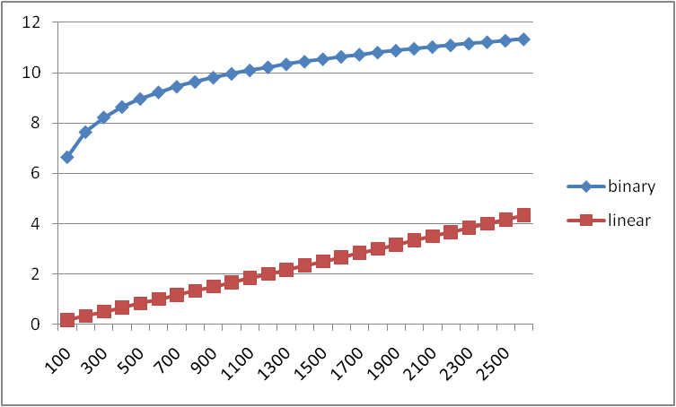
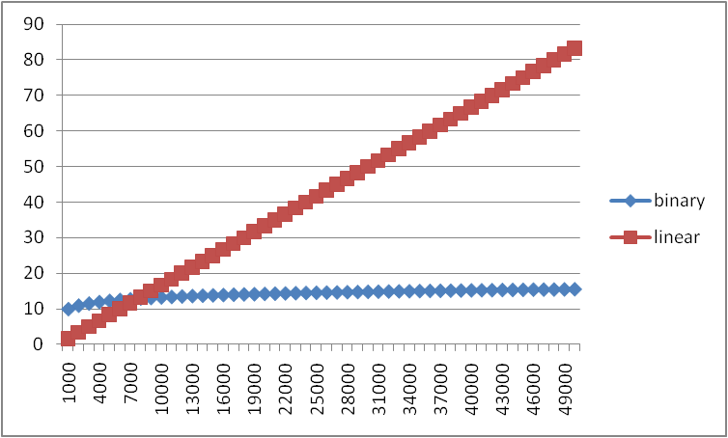
Example
Let’s “help” linear search
Run it on a computer 100x as fast
Use a new compiler/language that is 3x as fast
Be a clever programmer to eliminate half the work
Note: 600x is still helpful for problems! (esp. when no better algorithm)
600x speedup!
Notes:
The real world (with constant factors, assuming air resistance, friction, etc.)
Wait what, linear search wins?
2500 is pretty big, but we don’t care. The n we care about is infinity. N-growing
Some cutoff where logn wins
(50 minutes for Ruth)

Slide 25
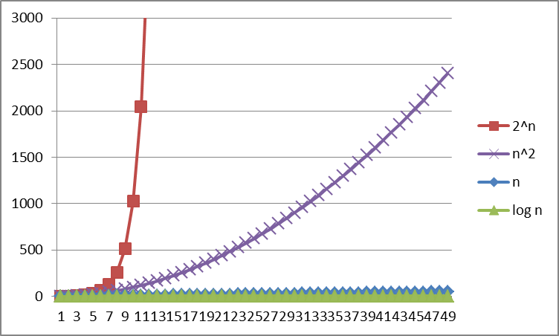
Logarithms and Exponents
Definition: log₂ x = y if x = 2^{y}
Logarithms grow as slowly as exponents grow quickly
So, log₂ 1,000,000 = “a little under 20”
Since so much is binary in CS, log almost always means log₂
Notes:
Some math related things I need to mention for this course
One takeaway is that there are BIG differences between the different functions we have
End of course talk about questions that we only know exponential algorithms for.

Slide 26
Log base doesn’t matter much
“Any base B log is equivalent to base 2 log within a constant factor”
And we are about to stop worrying about constant factors!
In particular, log₂ x = 3.22 log₁₀ x
In general, we can convert log bases via a constant multiplier
Say, to convert from base B to base A:
log_{B} x = (log_{A} x) / (log_{A} B)
Notes:
Even though I just mentioned binary base, doesn’t actually matter

Slide 27
Review: Properties of logarithms
log(A*B) = log A + log B
So log(N^{k})= k log N
log(A/B) = log A – log B
log₂ 2^{x} = x

Slide 28
Other functions with log
log(log x) is written log log x
Grows as slowly as 2² grows fast
Ex: log log 4billion ~ log log 2³² = log 32 = 5
(log x)(log x) is written log²x
It is greater than log x for all x > 2
NOT THE SAME
^{x}
Notes:
Taking log of a value makes something grow slowly
Contrast to log^2(x)
THESE ARE NOT THE SAME

Slide 29
Today
What do we care about?
How to compare two algorithms
Analyzing Code
Asymptotic Analysis
Big-Oh Definition

Slide 30
Asymptotic Analysis
About to show formal definition, which amounts to saying:
Eliminate low-order terms
Eliminate constant coefficients
Examples:
4n + 5
0.5n log n + 2n + 7
n³ + 2^{n} + 3n
n log (10n² )
Notes:
Quick recap
N(log10 + logn^2)
N*2logn
nlogn

Slide 31
Big-Oh relates functions
We use O on a function f(n) to mean the set of functions with asymptotic behavior less than or equal to f(n)
So (3n²+17) is in O(n²)
3n²+17 and n² have the same asymptotic behavior
Less ideal:
Confusingly, we also say/write:
(3n²+17) is O(n²)
(3n²+17) = O(n²)
But we would never say O(n²) = (3n²+17)

Slide 32
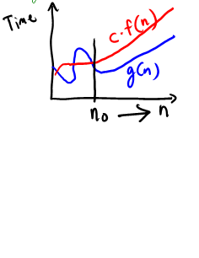
Formally Big-Oh
Definition: g(n) is in O( f(n) ) iff there exist positive constants c and n₀ such that g(n) ≤ c f(n) for all n ≥ n₀
Note: n₀ ≥ 1 (and a natural number) and c > 0
Notes:
Example: 3n+4
Try: c=4, n_0=5
3n+4 <= c*n
3n+4 <= 4n
19 <= 20

Slide 33
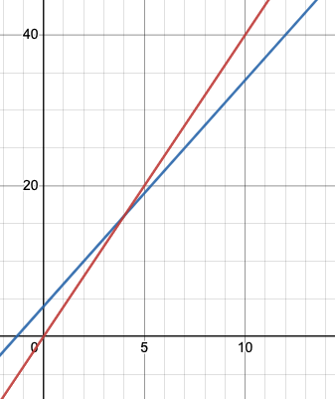
Formally Big-Oh
Definition: g(n) is in O( f(n) ) iff there exist positive constants c and n₀ such that g(n) ≤ c f(n) for all n ≥ n₀
Note: n₀ ≥ 1 (and a natural number) and c > 0
Example: Let g(n) = 3n + 4 and f(n) = n
c = 4 and n₀ = 5 is one possibility
4 * f(n)
g(n)

Slide 34
Formally Big-Oh
Definition: g(n) is in O( f(n) ) iff there exist positive constants c and n₀ such that g(n) ≤ c f(n) for all n ≥ n₀
Note: n₀ ≥ 1 (and a natural number) and c > 0
Example: Let g(n) = 3n + 4 and f(n) = n
c = 4 and n₀ = 5 is one possibility
4 * f(n)
g(n)
This is “less than or equal to”
So 3n + 4 is also O(n⁵) and O(2^{n}) etc.
Notes:
You can be technically correct if you say this in a job interview or a midterm etc. (But doesn’t mean you know it very well)

Slide 35
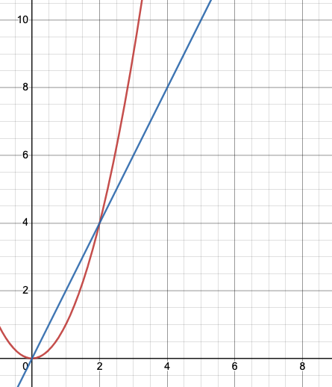
Why n₀?
n₀ gives time for the higher-order terms to cover the lower-order ones
Example:
g(n) = 2n
f(n) = n²
2n is in O(n²), but 2n is only smaller when
n exceeds 2

Slide 36
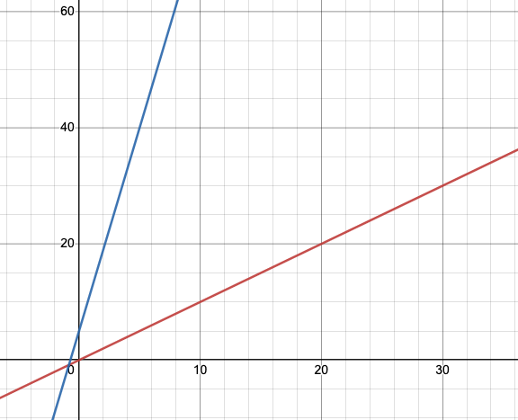
Why c?
The constant multiplier (called c) allows functions with the same asymptotic behavior to be grouped together
Pick a c large enough to “cover the dropped constant factors”
g(n) = 7n+5
f(n) = n
It’s true:
g(n) is in O( f(n) )
There is no positive n₀ such that g(n) ≤ f(n) for all n ≥ n₀

Slide 37
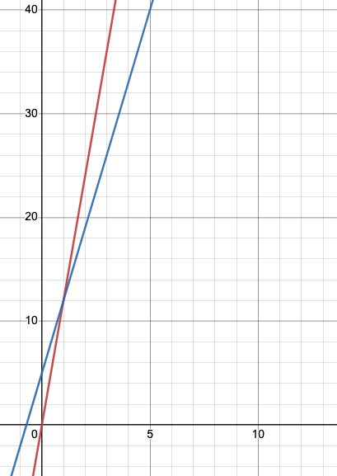
Why c?
g(n) = 7n+5
f(n) = n
The ‘c’ in the definition fixes this! for that: g(n) ≤ c f(n) for all n ≥ n₀
To show g(n) is in O(f(n)), have c = 12, n₀ = 1
f(n) = 12n
f(n) = n

Slide 38
Working through an example
To show g(n) is in O( f(n) ), pick a c large enough to “cover the constant factors” and n₀ large enough to “cover the lower-order terms”
Example: Let g(n) = 4n² + 3n + 4 and f(n) = n³

Slide 39
Lecture 3: Algorithm Analysis Continued!

Slide 40
Announcements
EX02 due Friday night
P1 Checkpoint 1 due Tuesday
Fill out BOTH checkpoint form AND gradescope

Slide 41
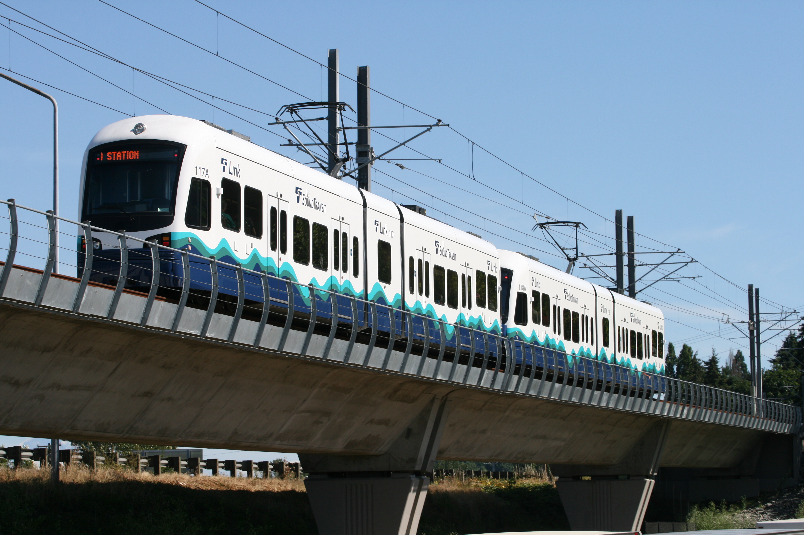
A word on checkpoints and projects
Checkpoints are (somewhat) lenient
Don’t expend all your energy staying up late if you can’t find the bug
That being said, a strong signal that you are behind and need to spend extra time to catch up
Stay on top of things! Easier to catch the train then to catch it after it leaves
Use the Ed board!
If possible, make questions public (can make anonymous)
Read Javadoc
Read the comments in the repository!
IntelliJ has functionality to jump to the reference (the interface, implementation of method, etc. Super helpful!)

Slide 42
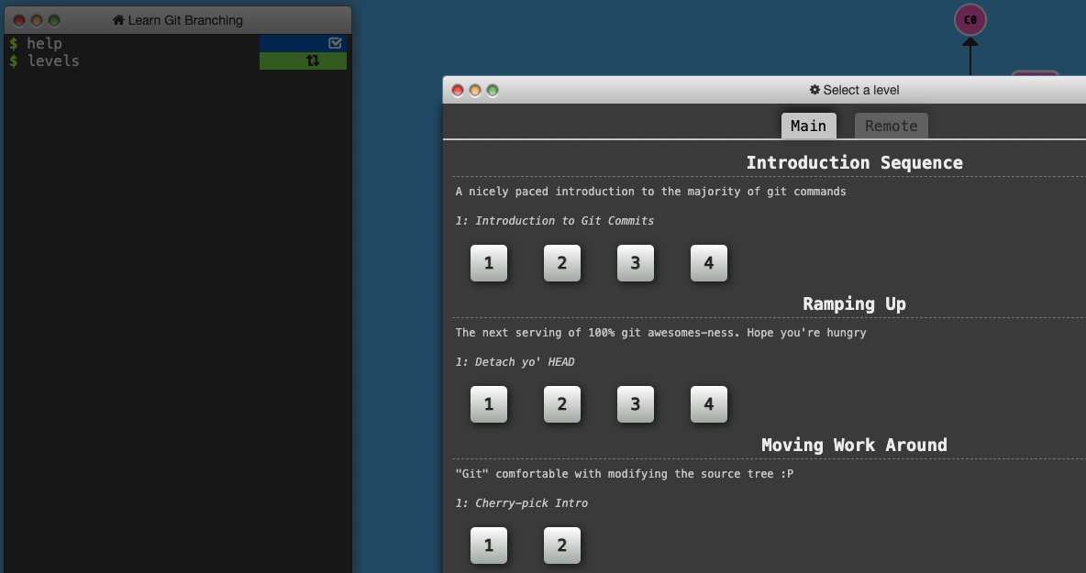
Git good at git
Git is a really good resource
https://learngitbranching.js.org/
Make frequent commits and messages (helpful for debugging!)

Slide 43
Pair Programming
Divide & Conquer
Boo :(
Good for algorithms, not so much for coding. Easy to miss subtle bugs… doubling your mistakes!
Pair Programming
Yay :)
You are responsible for knowing your code!

Slide 44
Today
Big-Oh Definition
And other friends
Proofs
Amortization

Slide 45
Recap:
for (i=0; i<n;i++){
…
}
Look at code and get a function of how long it runs based on input size
Heuristic: counting operations!
Too detailed, so… step 2…
Group it into a Big Oh set of functions
asymptotic behavior
Informally: “Drop” coefficients, lower-order terms
Formally: Find c and n₀
3n + 4
100n + 30 logn
O(1)
O(n)
O(n²)

Slide 46
What you can drop
Eliminate coefficients because we don’t have units anyway
3n² versus 5n² doesn’t mean anything when we cannot count operations very accurately
Eliminate low-order terms because they have vanishingly small impact as n grows
Do NOT ignore constants that are not multipliers
n³ is not O(n²)
3^{n} is not O(2^{n})
(This all follows from the formal definition) (We can prove it!)
Notes:
We can eliminate coefficients bc of c. We can eliminate low-order terms because of n0.

Slide 47
Big Oh: Common Categories
From fastest to slowest
O(1) constant (same as O(k) for constant k)
O(log n) logarithmic
O(n) linear
O(n log n) “n log n”
O(n²) quadratic
O(n³) cubic
O(n^{k}) polynomial (where is k is any constant > 1)
O(k^{n}) exponential (where k is any constant > 1)
Usage note: “exponential” does not mean “grows really fast”, it means “grows at rate proportional to k^{n} for some k>1”
Note: Don’t write O(5n) instead of O(n) – same thing!
It’s like writing 6/2 instead of 3. Looks weird
Notes:
Loglog(n)
Log(n)
Log(n) * log(n)
All exponents grow faster than polynomial in the long run. We’ll talk about problems that we only know exponential solutions to.

Slide 48
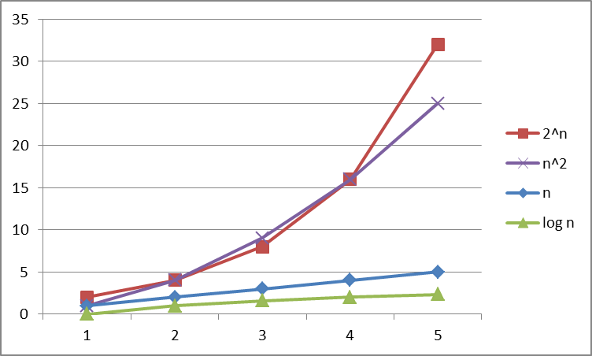
Big Oh: Common Categories

Slide 49
Big Oh: Common Categories

Slide 50
pollev.com/artliu
True or false?
4+3n is in O(n)
n+2logn is in O(logn)
logn+2 is in O(1)
n⁵⁰ is in O(1.1^{n})
Notes:
Do NOT ignore constants that are not multipliers:
n³ is O(n²) : FALSE
3^{n} is O(2^{n}) : FALSE
When in doubt, refer to the definition
Notes:
https://www.polleverywhere.com/surveys/mvfrtTkfplBbP2KlgMk9A

Slide 51
Examples (Answers)
True or false?
4+3n is O(n)
n+2logn is O(logn)
logn+2 is O(1)
n⁵⁰ is O(1.1^{n})
Notes:
Do NOT ignore constants that are not multipliers:
n³ is O(n²) : FALSE
3^{n} is O(2^{n}) : FALSE
When in doubt, refer to the definition
True, c=7, n=1
False
False
True, c=1, n0=4500

Slide 52
More asymptotic analysis
Upper bound: O( f(n) )
g(n) is in O( f(n) ) if there exist constants c and n₀ such that
g(n) ≤ c f(n) for all n ≥ n₀
Lower bound: Ω( f(n) )
g(n) is in Ω( f(n) ) if there exist constants c and n₀ such that
g(n) ≥ c f(n) for all n ≥ n₀
Tight bound: θ( f(n) )
g(n) is in θ( f(n) ) if it is in O( f(n) ) and it is in Ω( f(n) )

Slide 53
Regarding use of terms
A common error is to say O( f(n) ) when you mean θ( f(n) )
People often say O() to mean a tight bound
Say we have f(n)=n; we could say f(n) is in O(n), which is true, but only conveys the upper-bound
Since f(n)=n is also O(n⁵), it’s tempting to say “this algorithm is exactly O(n)”
Somewhat incomplete; instead say it is θ(n)
That means that it is not, for example O(log n)
Less common notation:
“little-oh”: like “big-Oh” but strictly less than
Example: sum is o(n²) but not o(n)
“little-omega”: like “big-Omega” but strictly greater than
Example: sum is ω(log n) but not ω(n)
Notes:
What about little theta?

Slide 54
(Previously) Formally Big-Oh
Definition: g(n) is in O( f(n) ) iff there exist positive constants c and n₀ such that g(n) ≤ c f(n) for all n ≥ n₀
Note: n₀ ≥ 1 (and a natural number) and c > 0
Example: Let g(n) = 3n + 4 and f(n) = n
c = 4 and n₀ = 5 is one possibility
4 * f(n)
g(n)
Notes:
Look at the picture and describe it again!

Slide 55
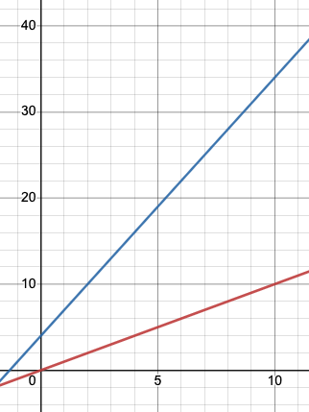
(NOW) Formally Big-Omega
Now red is on bottom!
Definition: g(n) is in Ω( f(n) ) iff there exist positive constants c and n₀ such that g(n) ≥ c f(n) for all n ≥ n₀
Note: n₀ ≥ 1 (and a natural number) and c > 0
Example: Let g(n) = 3n + 4 and f(n) = n
c = 1 and n₀ = 1 is one possibility
g(n)
1 * f(n)
Notes:
Look at the picture and describe it again
C can be 0.5 (fractional) just needs to be positive!

Slide 56
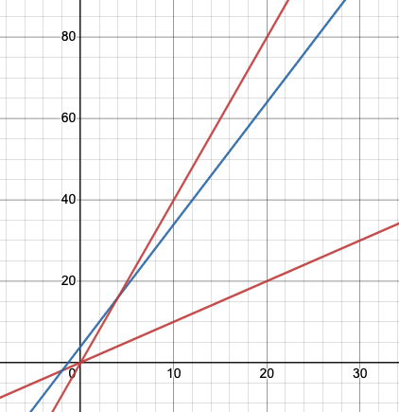
Formally Big-Theta
Definition: g(n) is in θ( f(n) ) iff g(n) is in
O( f(n) ) and it is in Ω( f(n) )
Equivalently: iff there exist positive constants c and n₀ such that c₁ f(n) ≤ g(n) ≤ c₂ f(n) for all n ≥ n₀
O(n)
g(n) = 3n + 4
Notice: c (and n₀) constants can be different for proving Oh and Omega
Ω(n)
Notes:
N_0 can be same since just take max of both the n_0
Notice that big oh and big omega are often the same

Slide 57
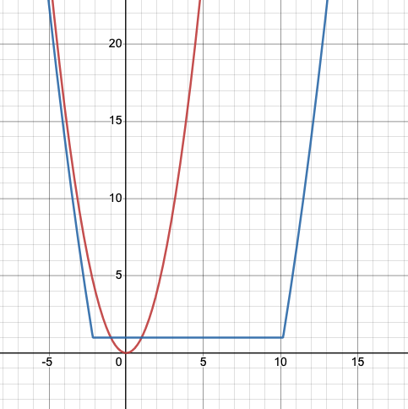
Another example of Big Omega
Can we pick c >= 0.5?
https://www.desmos.com/calculator/kmlqfe0lie
f(n) = n²
g(n) = max(1, 0.5n² – 4n – 10)
Notes:
https://www.desmos.com/calculator/kmlqfe0lie

Slide 58
Big-O, Big-Theta, Big-Omega Relationships
If a function is in Big-Theta, what does it mean for its membership in Big-O and Big-Omega? Vice versa?
Mystery Function | Big-O | Big-Theta | Big-Omega
 | O(N⁴) |  | Ω(N⁴)
 |  | Θ(N³)
 | O(N)
 |  |  | Ω(N²)

Slide 59
Big-O, Big-Theta, Big-Omega Relationships
If a function is in Big-Theta, what does it mean for its membership in Big-O and Big-Omega? Vice versa?
Mystery Function | Big-O | Big-Theta | Big-Omega
 | O(N⁴) | Θ(N⁴) | Ω(N⁴)
 | O(N³) | Θ(N³) | Ω(N³)
 | O(N) | ?? | ??, but cannot be Ω(N²)
 | ??, but cannot be O(N) | ?? | Ω(N²)
Notes:
Draw pictures to show what we mean

Slide 60
Theta, Oh, Omega != Worst-Case, Best-Case
These are independent!
We can analyze for both best-case and worst-case for all threE
Example: what is the asymptotic analysis for Omega and Theta
Find an integer in a sorted array
// requires array is sorted
// returns whether k is in array
boolean find(int[]arr, int k){
for(int i=0; i < arr.length; ++i)
if(arr[i] == k)
return true;
return false;
}
Best case: 6 “ish” operations = O(1)
Worst case: 5 “ish” * (arr.length) = O(N)

Slide 61
When are Oh and Omega (and theta) different?
When doing worst-case analysis on code, tight Oh and tight Omega are often the same. When are they different?
// toggle function, note we cannot just
// analyze slower branch
if (n % 5 == 0) {
// linear work
} else {
// constant work
}
O
Θ
Ω
time
n

Slide 62
Today
Big-Oh Definition
Proofs
Amortization
Notes:
25-30 minutes (15-20 minutes for proofs, 15 minutes amortization)

Slide 63
Proof Mistake: Backwards Reasoning
Careful to not assume something is true and work backwards
Backwards reasoning only shows “consistency” NOT “truth”
We need to start with something true and work towards the statement that we want to show is true
The last statement should be our claim!
Example | Claim: Show that 4 ≥ 5
Notes:
4 ≥ 5
4 * 0 ≥ 5 * 0
0 ≥ 0 (correct)

Slide 64
Big-Oh Proofs
There is likely some “scratch work” – the insight isn’t explained in the final proof
You just say “consider”
But don’t try to skip the scratch work when drafting your big-O proofs!
But it won’t necessarily appear in your final version

Slide 65
Example
Let’s show: 10n² + 15n is in O(n²)
Notes:
Scratch work. I like to promote terms
Okay formalized proof:
Let c=25 and n0=1
…

Slide 66
Example
Let’s show: 10n² + 15n is in O(n²)
Proof:
Let c = 25 and n₀=1
10n² + 15n ≤ 10n² + 15n² since n≥1
≤ 25n² addition
Which is exactly what we wanted to show from the definition of Big-Oh.

Slide 67
COUNTER Example
Let’s show: 10n² + 15n is in O(n²)
BAD:
10n² + 15n ≤ 25n²
15n ≤ 15n² subtract 10n^2
n ≤ n² divide by 15
1 ≤ n divide by n, tada (WRONG)
So, we can choose c = 25 and n₀ = 1 and thus we have shown it is in O(n²)
AGAIN, START WITH TRUE STATEMENT and END AT OUR GOAL CLAIM!

Slide 68
Proving NOT in Big Oh
Prove the negation is true
Prove by contradiction
Assume true, prove impossible

Slide 69
Negating Big-Oh
Definition: g(n) is in O( f(n) ) iff there exist positive constants c and n₀ such that g(n) ≤ c f(n) for all n ≥ n₀
$$∃_{c,n_{0}}∀_{n≥n_{0}} g\left(n\right)≤c⋅f(n)$$
Notes:
Write not

Slide 70
Negating Big-Oh
Definition: g(n) is in O( f(n) ) iff there exist positive constants c and n₀ such that g(n) ≤ c f(n) for all n ≥ n₀
$$∃_{c,n_{0}}∀_{n≥n_{0}} g\left(n\right)≤c⋅f(n)$$
$$∀_{c,n_{0}}∃_{n≥n_{0}} g\left(n\right)>c⋅f(n)$$
For any c or n₀ that you pick, there is a valid n where our function g(n) exceeds the Big Oh function f(n)

Slide 71
Proving NOT in Big Oh Example: Prove Negation
Not in Big OH: $∀_{c,n_{0}}∃_{n≥n_{0}} g\left(n\right)>c⋅f(n)$
Let’s show: 10n² is NOT O(n)
For any c or n₀ that you pick, there is a valid n where our function g(n) exceeds the Big Oh function f(n)
Notes:
Scratch:
Need to find an n that makes it true
10n^2 > cn
10n > c
n > c/10
Proof:
We will prove by proving the negation.
let n = max(c/10 + 1, n0)
n > c/10 (from def)
10n > c (math)
10n^2 > cn (multiply both sides by n, positive)
which is exactly what we wanted to prove

Slide 72
Proving NOT in Big Oh Example: Prove Negation
Not in Big OH: $∀_{c,n_{0}}∃_{n≥n_{0}} g\left(n\right)>c⋅f(n)$
Let’s show: 10n² is NOT O(n)
Scratch work:
Need to find an n
10n² > cn
10n > c
n > c/10
Proof:
Let n = max(c/10+1, n0)
n > c/10 from def
10n > c math
10n² > cn multiply both sides by n (positive)
Which is exactly the inequality that we wanted to show. Since c and n0 are arbitrary, we have shown this for all c and n0 and shown that it is not in Big Oh of O(n).
For any c or n₀ that you pick, there is a valid n where our function g(n) exceeds the Big Oh function f(n)

Slide 73
Proving NOT in Big Oh Example: Contradiction
Show: 10n² is NOT O(n)
For sake of contradiction, assume that 10n² is O(n)
10n² ≤ cn for some c and all n ≥ n₀ (definition)
10n ≤ c divide by n (positive)
n ≤ c/10 divide by 10
But this is true for all n ≥ n₀ so n = max(c/10+1, n0) contradicts the last statement. Since c and n0 are arbitrary, and by contradiction we have shown that 10n² is NOT O(n)
Notes:
Notice that we can re-use the same scratch work!

Slide 74
Today
Big-Oh Definition
Proofs
Amortization
Notes:
45 minutes

Slide 75
Amortization
How much does housing cost per day in Seattle?
Well, it depends on the day.
The day rent is due, it’s $1200.
Other days of the month, it’s free.

Slide 76
Amortization
Amortization is an accounting trick. It’s a way to reflect the fact that the “first of the month” is really responsible for the other days of the week, and each day should be assigned it’s “fair share.”

Slide 77
Amortization
Amortized:
It costs $1200/month, and we pay one day of the 30 in a month
Cost per day is 1200/30 = 40
“What does my daily pay need to be to afford housing?”
Un-amortized:
On the first it costs $1200
Every other day, it costs $0
“How much do I need to keep in my bank account, so it doesn’t get overdrawn?”

Slide 78
Array Insertion Example
What’s the worst case for insert into an array-based queue?
O(n) when we need to resize, O(1) otherwise
Is O(n) a good description of the worst-case behavior?

Slide 79
Amortization
Amortized:
It takes O(n) time to resize once, after n-1 calls that take O(1) time
Cost per operation is $\frac{O\left(n\right)+\left[n−1\right]O(1)}{n}=O(1)$
“What will happen when I do many insertions in a row?”
Un-amortized:
The resize takes O(n) time. That’s the worst case that could happen.
”How long might one (unlucky) user need to wait on a single insertion?”
Notes:
Notice that amortized is independent from the case analysis!

Slide 80
Why double size?
The most common strategy for increasing array size is doubling. Why not just increase the size by 10,000 each time we fill up?
Let’s say we did n insertions:
Costs of the unlucky insertions:
Costs of the other insertions:
Amortized insert cost:
Notes:
$$\sum_{i=0}^{n/10,000}{10,000i}≈10,000⋅\frac{n^{2}}{{10,000}^{2}}=O(n^{2})$$

Slide 81
Why double size?
The most common strategy for increasing array size is doubling. Why not just increase the size by 10,000 each time we fill up?
Let’s say we did n insertions:
Costs of the unlucky insertions:
$$\sum_{i=0}^{n/10,000}{10,000i}≈10,000⋅\frac{n^{2}}{{10,000}^{2}}=O(n^{2})$$
Costs of the other insertions:
O(1) * n = O(n)
Amortized insert cost:
$$O\left(\frac{n^{2}+n}{n}\right)=O(n)$$
Way worse than O(1) with doubling!
Notes:
More benchmarking to find ideal resize factor. (3/2) a bit less than golden ratio. “upper bound on reusing previously-allocated storage during reallocation for a first-fit allocator”.

Slide 82
Notes on Amortization
Depends on the question you are asking
Can customize your “rent pay-day” algorithm to the use-case
Pay all on one day?
Pay in 3 easy payments of 99.99?
See Weiss chapter 11

Slide 83
What we are (often) analyzing in 332
The most common thing to do is give an O or θ bound to the worst-case running time of an algorithm
Example: True statements about binary-search algorithm
Common: θ(log n) running-time in the worst-case
Less common: θ(1) in the best-case (item is in the middle)
Less common: Algorithm is Ω(log log n) in the worst-case (it is not really, really, really fast asymptotically)
Less common (but very good to know): the find-in-sorted-array problem is Ω(log n) in the worst-case
No algorithm can do better (without parallelism)
Notes:
Algorithm analysis, problem analysis.
A problem can be in omega, A problem cannot be in big Oh. That is saying that solving this problem

Slide 84
Problem vs. Algorithm Analysis
A problem cannot be O(f(n)) since you can always find a slower algorithm, so instead you can say there exists an algorithm that solves the problem in O(f(n))
A problem can be Ω(f(n)) which means that we cannot find an algorithm that solves the problem any faster!

Slide 85
Other things to analyze
Space instead of time
Remember we can often use space to gain time
Average case
Sometimes only if you assume something about the distribution of inputs
See CSE312 and STAT391
Sometimes uses randomization in the algorithm
Will see an example with sorting; also see CSE312
Sometimes an amortized guarantee

Slide 86
pollev.com/artliu
Sample Exam Questions:
Assume domain and co-domain of all functions are the natural numbers (1, 2, 3…)
Decide: Always True Sometimes True Never True
f(n) is in O(f(n)²)
f(n) is in Θ(f(n))
f(n)+g(n)is in Θ(max(f(n), g(n))
f(n) * n is in O(f(n)²)
Notes:
https://www.polleverywhere.com/surveys/ZPkhoE1U8lujS9UoJSPUT
Always true (bc co-domain is natural numbers so squaring it will always get larger)
Always true because a function is always the theta of itself
Always true because trivial that sum is larger than or equal to the max
f(n) + g(n) >= max(f(n), g(n))
Then, sum is less than 2 * the max. f(n) + g(n) < max(f(n), g(n)) + max(f(n), g(n)) < 2 max()

Slide 87
f(n) is in O(f(n)²) AT ST NT
f(n) is in Θ(f(n)) AT ST NT
f(n)+g(n)is in Θ(max(f(n), g(n)) AT ST NT
f(n) * n is in O(f(n)²) AT ST NT
Notes:
https://www.polleverywhere.com/surveys/ZPkhoE1U8lujS9UoJSPUT
Always true (bc co-domain is natural numbers so squaring it will always get larger)
Always true because a function is always the theta of itself
Always true because trivial that sum is larger than or equal to the max
f(n) + g(n) >= max(f(n), g(n))
Then, sum is less than 2 * the max. f(n) + g(n) < max(f(n), g(n)) + max(f(n), g(n)) < 2 max()

Slide 88
Summary
Analysis can be about:
The problem or the algorithm (usually algorithm)
Time or space (usually time)
Or power or dollars or …
Best-, worst-, or average-case (usually worst)
Upper-, lower-, or tight-bound (usually upper or tight)
Amortized or un-amortized

Slide 89
Big-Oh Caveats
Asymptotic complexity (Big-Oh) focuses on behavior for large n and is independent of any computer / coding trick
But you can “abuse” it to be misled about trade-offs
Example: n^{1/10} vs. log n
Asymptotically n^{1/10} grows more quickly
But the “cross-over” point is around 5 * 10¹⁷
So if you have input size less than 2⁵⁸, prefer n^{1/10}
Comparing O() for small n values can be misleading
Quicksort: O(nlogn) (expected)
Insertion Sort: O(n²) (expected)
Yet in reality Insertion Sort is faster for small n’s
We’ll learn about these sorts later

Slide 90
Addendum: Timing vs. Big-Oh?
At the core of CS is a backbone of theory & mathematics
Examine the algorithm itself, mathematically, not the implementation
Reason about performance as a function of n
Be able to mathematically prove things about performance
Yet, timing has its place
In the real world, we do want to know whether implementation A runs faster than implementation B on data set C
Ex: Benchmarking graphics cards
Evaluating an algorithm? Use asymptotic analysis
Evaluating an implementation of hardware/software? Timing can be useful
Notes:
What you are doing on your projects!

