Slide 1
CSE 332: Data Structures & Parallelism Lecture 2: Algorithm Analysis
Arthur Liu
Summer 2022

Slide 2
Announcements
”About you” survey! (See Ed)
EX01
Resubmit as many times before deadline!
No late days!!
Due Sunday night
Post-lecture PollEV make-up (must submit before next lecture)
P1 Released
If you did not fill out partner form, fill it out ASAP
EX02 releasing later today
Notes:
Survey

Slide 3
Today – Algorithm Analysis
What do we care about?
How to compare two algorithms
Analyzing Code
Asymptotic Analysis
Big-Oh Definition

Slide 4
What do we care about?
Correctness:
Does the algorithm do what is intended
Performance:
Speed time complexity
Memory space complexity
Why analyze?
To make good design decisions
Enable you to look at an algorithm (or code) and identify the bottlenecks, etc.
Notes:
One thing we definitely care about is if it is correct
A lot of times, we care about performance

Slide 5
Q: How should we compare two algorithms?
I have some problem I need solved.
I ask Dara and Hans. They both have different ideas for how to solve the problem. How do we know which is better?
Easy. Have them both write the code and run it and see which is faster.
THIS IS A TERRIBLE IDEA

Slide 6
A: How should we compare two algorithms?
Uh, why NOT just run the program and time it??
Too much variability, not reliable or portable:
Hardware: processor(s), memory, etc.
OS, Java version, libraries, drivers
Other programs running
Implementation dependent
Choice of input (dataset)
Testing (inexhaustive) may miss worst-case input
Timing does not explain relative timing among inputs (what happens when n doubles in size)
Often want to evaluate an algorithm, not an implementation
Even before creating the implementation (“coding it up”)
Notes:
(read: Chrome browser, Minecraft)

Slide 7
Comparing Algorithms
When is one algorithm (NOT implementation) better than another?
Various possible answers (clarity, security, …)
But a big one is performance: for sufficiently large inputs, runs in less time (our focus) or less space
Large inputs (n) because probably any algorithm is “plenty good” for small inputs (if n is 10, probably anything is fast enough)
What we want:
Answer is independent of CPU speed, programming language, coding tricks, etc.
Answer is general and rigorous, complementary to “coding it up and timing it on some test cases”
Can do analysis before coding!

Slide 8
A better strategy?
What we want:
Answer is independent of CPU speed, programming language, coding tricks, etc.
Large inputs (n) because probably any algorithm is “plenty good” for small inputs (if n is 10, probably anything is fast enough)
Answer is general and rigorous, complementary to “coding it up and timing it on some test cases”
Can do analysis before coding!

Slide 9
Analyzing code (“worst case”)… let’s count!
Assume basic operations take “some amount of” constant time
Arithmetic
Assignment
Access one Java field or array index
Etc.
This is an approximation of reality: a very useful “lie”
Consecutive statements Sum of time of each statement
Loops Num iterations * time for loop body
Conditionals Time of condition plus time of slower branch
Function Calls Time of function’s body
Recursion Solve recurrence equation
Notes:
What is an operation?
Spend some time explaining these basic operations (351 throwback)
Assembly can be anything. 2 instructions? 1 instruction, etc.
Go through each of these examples

Slide 10
Examples
b = b + 5
c = b / a
b = c + 100
for (i = 0; i < n; i++) {
sum++; }
if (j < 5) { sum++; } else {
for (i = 0; i < n; i++) {
sum++; }
}
Notes:
6 ops (2 each)
First one is O(1)
Initialize loop (1)
Check if loop bounds (1)
Sum++ (2)
i++ (2)
So we have
N * 5 ops
O(n)
We don’t know anything about j. Sometimes we can guarantee that j is always less than 5
1 + (1 + 5n + 1)
O(n)

Slide 11
What is the number of operations in this code? What is the big Oh?
int coolFunction(int n, int sum) {
int i, j;
for (i = 0; i < n; i++) {
for (j = 0; j < n; j++)
sum++; }
}
print "This program is great!”
for (i = 0; i < n; i++) {
sum++;
}
return sum }

Slide 12
pollev.com/artliu
What is the number of operations in this code? What is the big Oh?
int coolFunction(int n, int sum) {
int i, j;
for (i = 0; i < n; i++) {
for (j = 0; j < n; j++)
sum++; }
}
print "This program is great!”
for (i = 0; i < n; i++) {
sum++;
}
return sum }
Notes:
https://www.polleverywhere.com/free_text_polls/jiZgDoNJuOp2GeslK53JD?preview=true&controls=none
Drop the constants
N * 5n
+1 (print)
5n
+1 (return)
Io is really slow

Slide 13
Examples
b = b + 5
c = b / a
b = c + 100
for (i = 0; i < n; i++) {
sum++; }
if (j < 5) { sum++; } else {
for (i = 0; i < n; i++) {
sum++; }
}
10,000,000
Notes:
6 ops (2 each)
First one is O(1)
Initialize loop (1)
Check if loop bounds (1)
Sum++ (2)
i++ (2)
So we have
N * 5 ops
O(n)
We don’t know anything about j. Sometimes we can guarantee that j is always less than 5
1 + (1 + 5n + 1)
O(n)

Slide 14
Using Summations for Loops
for (i = 0; i < n; i++) {
sum++;
}
Notes:
1 + sum_i=0^n-1 5 + 1 = 1 + 5 + 5 + 5 … + 1 = 2 + 5n = 5n -> O(n)
INCLUSIVE BOUNDS

Slide 15
When math is helpful
for (i = 0; i < n; i++) {
for (j = 0; j < i; j++) {
sum++
}
}
Notes:
Show it is a little harder to just guess by hand or figure ito ut
Sum(n-1)(Sum(i-1)(5) = sum(n-1) 5i = 5 sum(n-1) i = 5 * n(n – 1) / 2 = O(n^2)
Identity
Sum(n-1) i = n(n-1) / 2

Slide 16
Complexity Cases
We’ll start by focusing on two cases:
Worst-case complexity: max # steps algorithm takes on “most challenging” input of size N
Best-case complexity: min # steps algorithm takes on “easiest” input of size N
What is the dataset like? What are the best/worst paths through our code?
Incorrect to say: Best case is when N = 0
Correct to say: Best case is...
…when data is sorted
…our algorithm gets lucky
Notes:
Clarify what I mean by cases. Scenarios
Focus on worst case

Slide 17
Other Complexity Cases
Average-case complexity: what does “average” case even mean? What is an “average” dataset? Depends on your scenario
Amortized analysis: we’ll talk about this one later in this course.

Slide 18
Example
2
3
5
16
37
50
73
75
126
Find an integer in a sorted array
// requires array is sorted
// returns whether k is in array
boolean find(int[]arr, int k){
???
}
Notes:
40 minutes (rough estimate)

Slide 19
Linear search – Best Case & Worst Case
2
3
5
16
37
50
73
75
126
Find an integer in a sorted array
// requires array is sorted
// returns whether k is in array
boolean find(int[]arr, int k){
for(int i=0; i < arr.length; ++i)
if(arr[i] == k)
return true;
return false;
}
Best case:
Worst case:
Notes:
Find(2) first element (About 6 operations) O(1)
Find(126), Find(127), Find(4) something not in the list
6n + 2 -> O(n)
40 minutes (roughly)
Pause for questions

Slide 20
Linear search – Best Case & Worst Case
2
3
5
16
37
50
73
75
126
Find an integer in a sorted array
AGAIN, best case / worst case is INDEPENDENT of N (size of dataset)
// requires array is sorted
// returns whether k is in array
boolean find(int[]arr, int k){
for(int i=0; i < arr.length; ++i)
if(arr[i] == k)
return true;
return false;
}
Best case: 6 “ish” operations = O(1)
Worst case: 5 “ish” * (arr.length) = O(N)
Notes:
Arr length is n

Slide 21
Remember a faster search algorithm?
Notes:
Spolier alert
We will analyze binary search later on (recurrences)

Slide 22
Remember a faster search algorithm?
Worst Cases:
Binary Search – O(logn)
Linear Search – O(n)

Slide 23
Ignoring Constant Factors
So binary search is O(log n) and linear is O(n)
But which will actually be faster?
Depending on constant factors and size of n, in a particular situation, linear search could be faster….
How many assembly instructions, assignments, additions, etc. for each n
And could depend on size of n
But there exists some n₀ such that for all n > n₀ binary search “wins”
Let’s play with a couple plots to get some intuition…
Notes:
Which one would you choose?

Slide 24
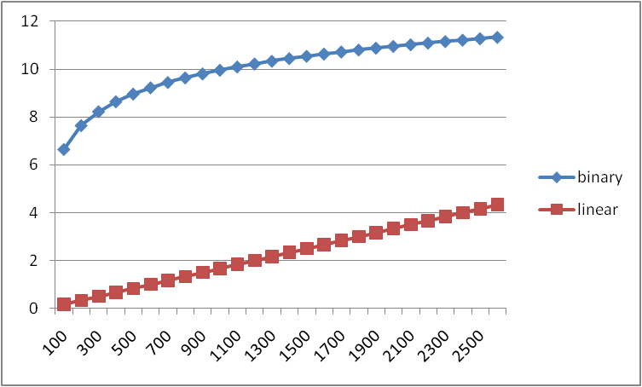
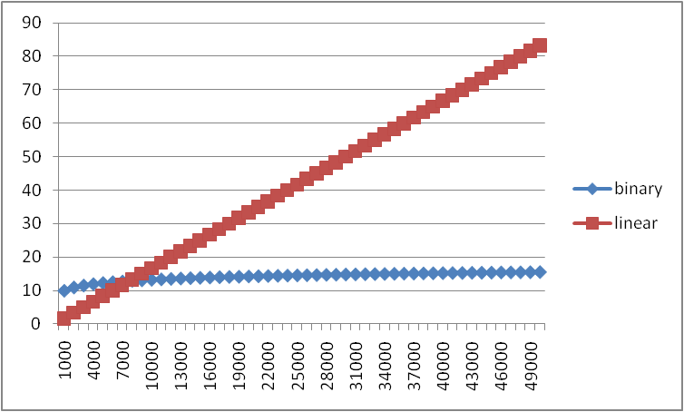
Example
Let’s “help” linear search
Run it on a computer 100x as fast
Use a new compiler/language that is 3x as fast
Be a clever programmer to eliminate half the work
Note: 600x is still helpful for problems! (esp. when no better algorithm)
600x speedup!
Notes:
The real world (with constant factors, assuming air resistance, friction, etc.)
Wait what, linear search wins?
2500 is pretty big, but we don’t care. The n we care about is infinity. N-growing
Some cutoff where logn wins
(50 minutes for Ruth)

Slide 25
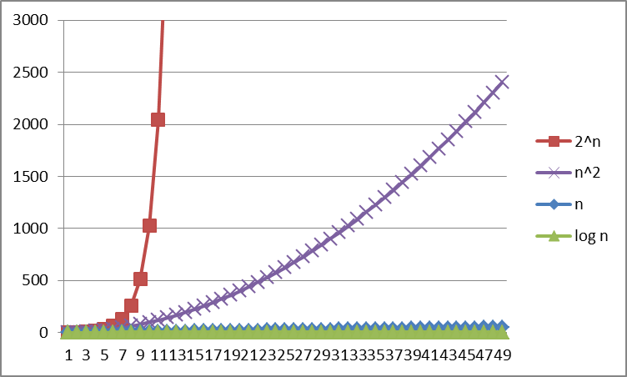
Logarithms and Exponents
Definition: log₂ x = y if x = 2^{y}
Logarithms grow as slowly as exponents grow quickly
So, log₂ 1,000,000 = “a little under 20”
Since so much is binary in CS, log almost always means log₂
Notes:
Some math related things I need to mention for this course
One takeaway is that there are BIG differences between the different functions we have
End of course talk about questions that we only know exponential algorithms for.

Slide 26
Log base doesn’t matter much
“Any base B log is equivalent to base 2 log within a constant factor”
And we are about to stop worrying about constant factors!
In particular, log₂ x = 3.22 log₁₀ x
In general, we can convert log bases via a constant multiplier
Say, to convert from base B to base A:
log_{B} x = (log_{A} x) / (log_{A} B)
Notes:
Even though I just mentioned binary base, doesn’t actually matter

Slide 27
Review: Properties of logarithms
log(A*B) = log A + log B
So log(N^{k})= k log N
log(A/B) = log A – log B
log₂ 2^{x} = x

Slide 28
Other functions with log
log(log x) is written log log x
Grows as slowly as 2² grows fast
Ex: log log 4billion ~ log log 2³² = log 32 = 5
(log x)(log x) is written log²x
It is greater than log x for all x > 2
NOT THE SAME
Notes:
Taking log of a value makes something grow slowly
Contrast to log^2(x)
THESE ARE NOT THE SAME

Slide 29
Today
What do we care about?
How to compare two algorithms
Analyzing Code
Asymptotic Analysis
Big-Oh Definition

Slide 30
Asymptotic Analysis
About to show formal definition, which amounts to saying:
Eliminate low-order terms
Eliminate constant coefficients
Examples:
4n + 5
0.5n log n + 2n + 7
n³ + 2^{n} + 3n
n log (10n² )
Notes:
Quick recap
N(log10 + logn^2)
N*2logn
nlogn

Slide 31
Big-Oh relates functions
We use O on a function f(n) to mean the set of functions with asymptotic behavior less than or equal to f(n)
So (3n²+17) is in O(n²)
3n²+17 and n² have the same asymptotic behavior
Less ideal:
Confusingly, we also say/write:
(3n²+17) is O(n²)
(3n²+17) = O(n²)
But we would never say O(n²) = (3n²+17)

Slide 32
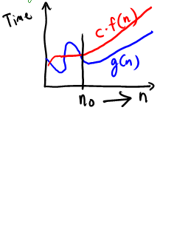
Formally Big-Oh
Definition: g(n) is in O( f(n) ) iff there exist positive constants c and n₀ such that g(n) ≤ c f(n) for all n ≥ n₀
Note: n₀ ≥ 1 (and a natural number) and c > 0
Notes:
Example: 3n+4
Try: c=4, n_0=5
3n+4 <= c*n
3n+4 <= 4n
19 <= 20

Slide 33
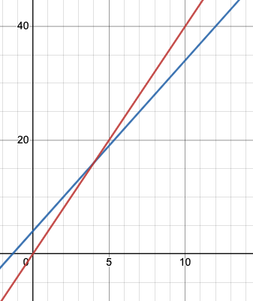
Formally Big-Oh
Definition: g(n) is in O( f(n) ) iff there exist positive constants c and n₀ such that g(n) ≤ c f(n) for all n ≥ n₀
Note: n₀ ≥ 1 (and a natural number) and c > 0
Example: Let g(n) = 3n + 4 and f(n) = n
c = 4 and n₀ = 5 is one possibility
4 * f(n)
g(n)

Slide 34
Formally Big-Oh
Definition: g(n) is in O( f(n) ) iff there exist positive constants c and n₀ such that g(n) ≤ c f(n) for all n ≥ n₀
Note: n₀ ≥ 1 (and a natural number) and c > 0
Example: Let g(n) = 3n + 4 and f(n) = n
c = 4 and n₀ = 5 is one possibility
4 * f(n)
g(n)
This is “less than or equal to”
So 3n + 4 is also O(n⁵) and O(2^{n}) etc.
Notes:
You can be technically correct if you say this in a job interview or a midterm etc. (But doesn’t mean you know it very well)

Slide 35
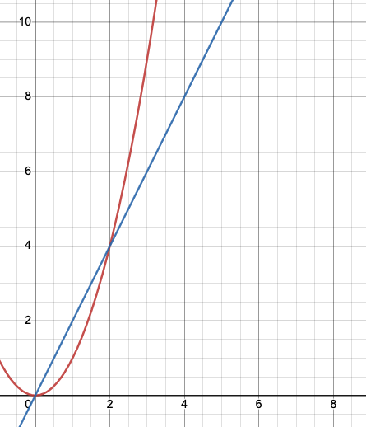
Why n₀?
n₀ gives time for the higher-order terms to cover the lower-order ones
Example:
g(n) = 2n
f(n) = n²
2n is in O(n²), but 2n is only smaller when
n exceeds 2

Slide 36
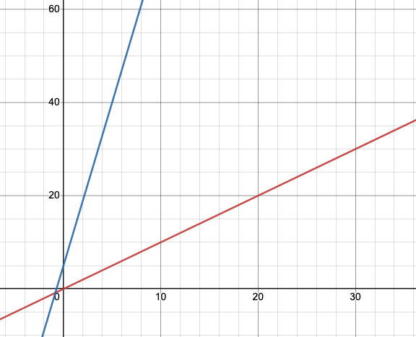
Why c?
The constant multiplier (called c) allows functions with the same asymptotic behavior to be grouped together
Pick a c large enough to “cover the dropped constant factors”
g(n) = 7n+5
f(n) = n
It’s true:
g(n) is in O( f(n) )
There is no positive n₀ such that g(n) ≤ f(n) for all n ≥ n₀

Slide 37
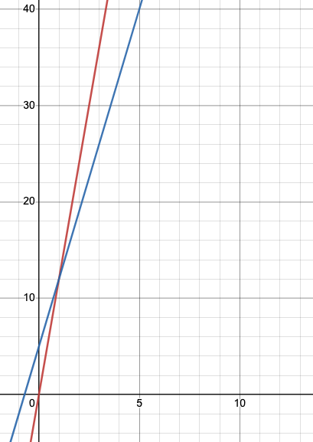
Why c?
g(n) = 7n+5
f(n) = n
The ‘c’ in the definition fixes this! for that: g(n) ≤ c f(n) for all n ≥ n₀
To show g(n) is in O(f(n)), have c = 12, n₀ = 1
f(n) = 12n
f(n) = n

Slide 38
Working through an example
To show g(n) is in O( f(n) ), pick a c large enough to “cover the constant factors” and n₀ large enough to “cover the lower-order terms”
Example: Let g(n) = 4n² + 3n + 4 and f(n) = n³

Slide 39
Big Oh: Common Categories
From fastest to slowest
O(1) constant (same as O(k) for constant k)
O(log n) logarithmic
O(n) linear
O(n log n) “n log n”
O(n²) quadratic
O(n³) cubic
O(n^{k}) polynomial (where is k is any constant > 1)
O(k^{n}) exponential (where k is any constant > 1)
Usage note: “exponential” does not mean “grows really fast”, it means “grows at rate proportional to k^{n} for some k>1”
Note: Don’t write O(5n) instead of O(n) – same thing!
It’s like writing 6/2 instead of 3. Looks weird
Notes:
Loglog(n)
Log(n)
Log(n) * log(n)

Slide 40
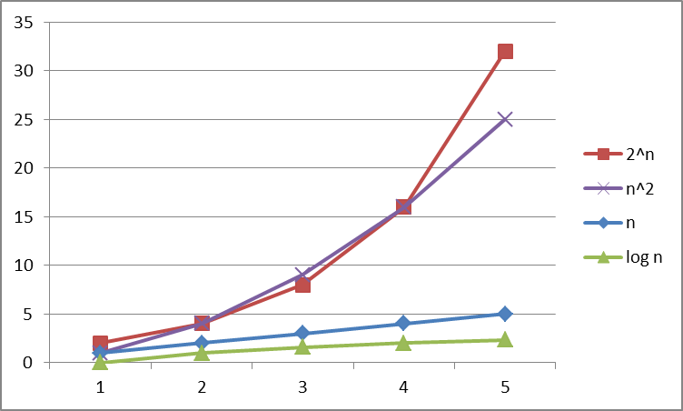
Big Oh: Common Categories

Slide 41
Big Oh: Common Categories

Slide 42
pollev.com/artliu
True or false? (If true, what is a possible c and n₀)
4+3n is in O(n)
n+2logn is in O(logn)
logn+2 is in O(1)
n⁵⁰ is in O(1.1^{n})
Notes:
Do NOT ignore constants that are not multipliers:
n³ is O(n²) : FALSE
3^{n} is O(2^{n}) : FALSE
When in doubt, refer to the definition
Notes:
I don’t think I can show results for this one

Slide 43
Examples (Answers)
True or false?
4+3n is O(n)
n+2logn is O(logn)
logn+2 is O(1)
n⁵⁰ is O(1.1^{n})
Notes:
Do NOT ignore constants that are not multipliers:
n³ is O(n²) : FALSE
3^{n} is O(2^{n}) : FALSE
When in doubt, refer to the definition
True
False
False
True
Notes:
HIDE

Slide 44
What you can drop
Eliminate coefficients because we don’t have units anyway
3n² versus 5n² doesn’t mean anything when we cannot count operations very accurately
Eliminate low-order terms because they have vanishingly small impact as n grows
Do NOT ignore constants that are not multipliers
n³ is not O(n²)
3^{n} is not O(2^{n})
(This all follows from the formal definition) (We can prove it!)

Slide 45
Next
More asymptotic analysis (theta, omega, little-oh)
Mentioning Big-Oh proofs
Heaps
EX02 released after lecture

