Slide 1
CSE 332: Data Structures & Parallelism Lecture 1: Intro, Stacks & Queues
Arthur Liu
Summer 2022

Slide 2
Welcome!
We have 9 weeks to learn fundamental data structures and algorithms for organizing and processing information
“Classic” data structures / algorithms and how to analyze rigorously their efficiency and when to use them
Queues, dictionaries, graphs, sorting, etc.
Parallelism and concurrency (!)

Slide 3
Today
Introductions
Administrative Info
What is this course about?
Review: Queues and stacks

Slide 4
CSE 332 Course Staff
Instructor:
Arthur Liu
Teaching Assistants:
Nathan Akkaraphab
Hans Easton
Winston Jodjana
Neel Jog
Dara Stotland
Thien Kim Tran

Slide 5
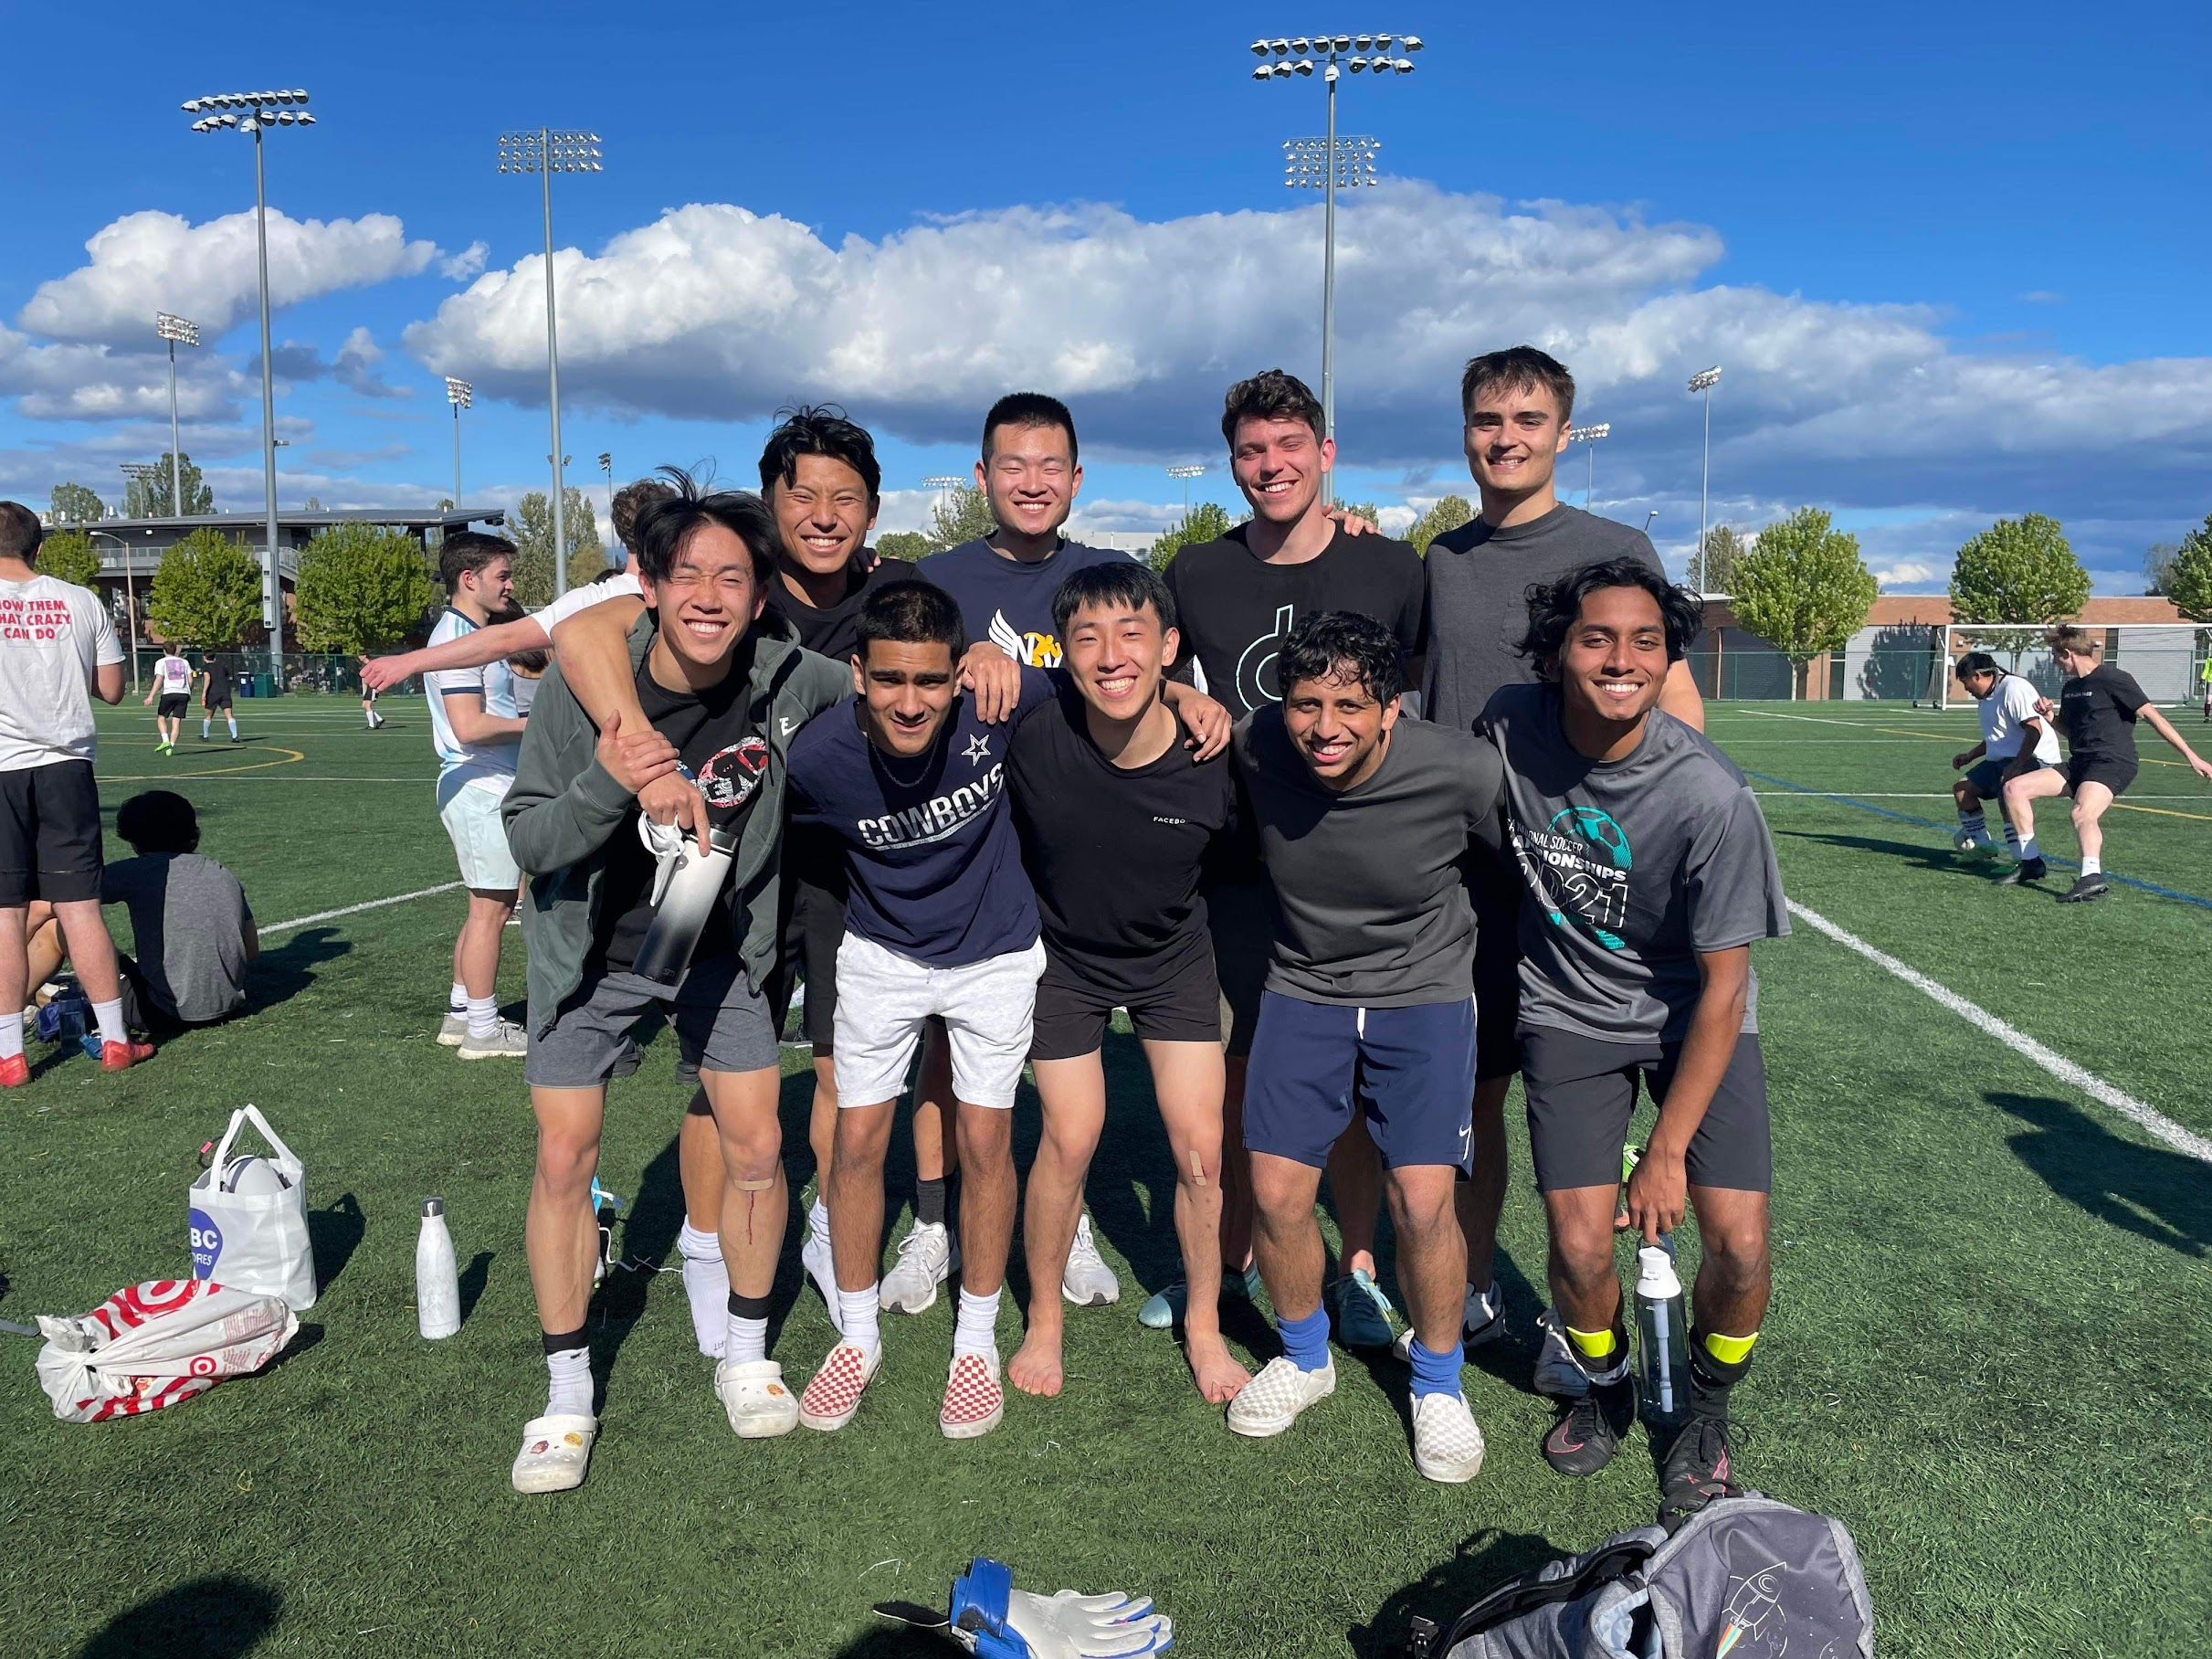
Me
BS/MS graduate
9+ quarters TA
Previously: Amazon, Microsoft, Startup
Meta
Soccer, Triathlon

Slide 6
Today
Introductions
Administrative Info
What is this course about?
Review: Queues and stacks

Slide 7
Course Information
Instructor: Arthur Liu, CSE210
Office Hours: see course web page, and by appointment
artliu@cs.washington.edu
Course Web Page:
cs.uw.edu/332
Text (optional): Data Structures & Algorithm Analysis in Java, (Mark Allen Weiss), 3rd edition, 2012 (2nd edition also o.k.)

Slide 8
Communication
Course email lists: cse332a_su22@uw
You are already subscribed
Ed Discussion board
Your first stop for questions about course content & assignments
Ed Announcement Emails - You must get and read announcements sent there
Anonymous feedback link
For good and bad: if you don’t tell us, we won’t know!

Slide 9
Course Meetings
Lecture
Take notes, materials posted (sometimes afterwards)
Ask questions, focus on key ideas (rarely coding details)
Attend synchronously as much as possible and interact with peers!
Section
Practice problems!
Answer Java/project/homework questions, etc.
Occasionally may introduce new material
An important part of the course (not optional)
Office hours
Use them: please visit us!

Slide 10
Course Materials
Lecture and section materials will be posted
They are visual aids, so not always a complete description!
If you have to miss, find out what you missed
Textbook: Weiss 3rd Edition in Java
Good read, but only responsible for lecture/section/hw topics
3rd edition improves on 2nd, but 2nd is fine
Parallelism / concurrency topics in separate free resource designed for 332
Notes:
WEBSITE TOUR AFTER THIS SLIDE

Slide 11
Course Work
~15 weekly individual homework exercises (25%)
Programming Projects (37%)
Use Java and IntelliJ, Gitlab
Done in partners*, o.k. if partner is in other quiz section
*Can do individually, but projects designed for partners
Midterm (15%) (Week 5 Monday 7/18)
Final (20%) (last Thursday section 8/18 and Friday of quarter 8/19)
Course-Wide Participation (3%)
Many ways to earn credit here, relatively lenient on this

Slide 12
Late Policy and Student Conduct
Late Policy
Exercises: No late submissions allowed
Projects: 4 late day tokens for the entire quarter, max 2 per project
Academic Conduct (see syllabus)
In short: don’t attempt to gain credit for something you didn’t do and don’t help others to do so either
This does not mean suffer in silence!
Learn from course staff and peers, talk, share ideas; but don’t share or copy work that is supposed to be yours
Extenuating Circumstances

Slide 13
pollev.com/artliu
Who is your favorite superhero?
Make sure you are logged in with your uw netid account
If you might have an issue with in-lecture polling, reach out to the instructor as soon as possible
Only need to vote on 60% of questions to get full credit!
1.05 points for correct answer, 1 point otherwise
If you are sick, stay home!
Notes:
https://www.polleverywhere.com/free_text_polls/H4ejvE05qWFiarzzTe7gY?preview=true&controls=none

Slide 14
Homework for Today!!
Project #1: Fill out partner request survey by Thursday 6pm
Partner Mixer Thursday 12-1 @ CSE2 271
Preliminary Survey: fill out by Friday night
Exercise #1: Due SUNDAY at 11:59pm
Make sure you are on Ed
Review Java & install Intellij
Reading (optional) in Weiss (see website)
Notes:
GO TO NEXT PAGE QUICK, THEN COME BACK TO THIS ONE, ASK FOR QUESTIONS, THEN SHOW POLL

Slide 15
Reading
Reading in Weiss
For this week:
Weiss 3.1-3.7 – Lists, Stacks & Queues (Topic for Project #1)
(Friday) Weiss 2.1-2.4 – Algorithm Analysis
(Useful) Weiss 1.1-1.6 – Mathematics and Java (NOT covered in lecture, will use some of these baseline facts)

Slide 16
Today
Introductions
Administrative Info
What is this course about?
Review: Queues and stacks
Notes:
Get a little philosophical

Slide 17
Data Structures & Parallelism
About 70% of the course is a “classic data-structures course”
Timeless, essential stuff
Core data structures and algorithms that underlie most software
How to analyze algorithms
Implement them
Plus a serious first treatment of programming with multiple threads
For parallelism: Use multiple processors to finish sooner
For concurrency: Correct access to shared resources
Will make many connections to the classic material

Slide 18
What 332 is about
Deeply understand the basic structures used in software
Understand the data structures and their trade-offs
Rigorously analyze the algorithms that use them
Learn how to pick “the right thing for the job”
Experience the purposes and headaches of multithreading
Practice design, analysis, and implementation
The elegant interplay of “theory” and “engineering” at the core of computer science
Notes:
Deeply understand (implement balanced binary tree)
Deeply understand hashing!
Enlarge toolkit of datastructures

Slide 19
Goals
You will understand:
What the tools are for storing and processing common data types
Which tools are appropriate for which need (read: tradeoffs)
So that you will be able to:
Make good design choices
Justify and communicate your design decisions
Notes:
Communicate!!

Slide 20
One view on this course
This is the class where you being to think like a computer scientist
You stop thinking in Java code
You start thinking that this is a hashtable problem, a stack problem, etc.
Feel more comfortable not having “right” answers

Slide 21
Data Structures?
“Clever” ways to organize information in order to enable efficient computation over that information
Notes:
Another way to think of this course… What do I mean by clever?

Slide 22
Example Datastructures and Their Trade-Offs
LinkedList, ArrayList
Notes:
What do I mean by clever? Figuring out tradeoffs
5, 3, 2, 6, 7, 4
Draw a binary search tree afterwards
Which do you think has the worst space complexity?

Slide 23
Trade-Offs
A data structure strives to provide many useful, efficient operations
But there are unavoidable trade-offs:
Time vs. Space
One operation more efficient if another less efficient
Generality vs. Simplicity vs. Performance
That is why there are many data structures; educated CSEers internalize their main trade-offs and techniques
Recognize and reason about logarithmic < linear < quadratic < exponential

Slide 24
Getting Serious: Terminology
Abstract Data Type (ADT)
Mathematical description of a ”thing” with set of operations on that “thing”
Data Structures
A specific organization of data and family of algorithms for implementing an ADT
Implementation of a data structure
The actual code implementation in a specific language
Algorithm
A high level, language-independent description of a step-by-step process
Notes:
Most abstract to Most concrete

Slide 25
Getting Serious: Terminology
List
Abstract Data Type (ADT)
Mathematical description of a ”thing” with set of operations on that “thing”
Data Structures
A specific organization of data and family of algorithms for implementing an ADT
Implementation of a data structure
The actual code implementation in a specific language
How to remove node,
How to resize
ArrayList, LinkedList
Algorithm
A high level, language-independent description of a step-by-step process
Your CSE143 code, Java Util Library

Slide 26
Getting Serious: Terminology
Abstract Data Type (ADT)
Mathematical description of a ”thing” with set of operations on that “thing”
Data Structures
A specific organization of data and family of algorithms for implementing an ADT
Implementation of a data structure
The actual code implementation in a specific language
0
2
4
5
6
9
21
Linear search
Binary search
Algorithm
A high level, language-independent description of a step-by-step process

Slide 27
Today
Introductions
Administrative Info
What is this course about?
Review: Queues and stacks

Slide 28
Terminology Example: Stack and Queue ADT
Stack ADT
Queue ADT
State:
Set of elements
Operations:
push(element)
pop() – returns the most recent element that was added to the stack
State:
Set of elements
Operations:
enqueue(element)
dequeue() – deletes and returns the element that has been in the queue the longest
Notes:
Draw pictures, LIFO

Slide 29
Terminology Example: Stack and Queue ADT
Stack ADT
State:
Set of elements
Operations:
push(element)
pop() – returns the most recent element that was added to the stack
Notes:
Draw pictures, LIFO

Slide 30
Why useful
The Stack ADT is a useful abstraction because:
It arises all the time in programming (see Weiss for more)
Recursive function calls
Balancing symbols (parentheses)
Evaluating postfix notation: 3 4 + 5 *
Clever: Infix ((3 + 4) * 5) to postfix conversion (see Weiss)
We can code up a reusable library
We can communicate in high-level terms
“Use a stack and push numbers, popping for operators…”
Rather than, “create a linked list and add a node when…”

Slide 31
Balancing Parenthesis
{([])}
(()()))

Slide 32
Stack Datastructures
Singly Linked List Implementation
Array Implementation
size
2
size
2
front
7
4
4
7

Slide 33
Queue Datastructures
Queue ADT
State:
Set of elements
Operations:
enqueue(element)
dequeue() – deletes and returns the element that has been in the queue the longest
Notes:
FIFO

Slide 34
Array Queue Data Structure
Q:
0
size - 1
a
b
c
d
e
back
Idea:
Enqueue by adding to back
Dequeue by removing from index 0 and shifting elements down
Dequeue inefficient :(

Slide 35
Circular Array Queue Data Structure
Q:
0
size - 1
b
c
d
e
f
front
back
// Basic idea only!
enqueue(x) {
Q[back] = x;
back = (back + 1) % size
}
What if queue is empty?
Enqueue?
Dequeue?
What if array is full?
How to test for empty?
What is the complexity of the operations?
// Basic idea only!
dequeue() {
x = Q[front];
front = (front + 1) % size;
return x;
}
Notes:
Runtime analysis O(1) both
Double the array size when full

Slide 36
Linked List Queue Data Structure
b
c
d
e
f
front
back
// Basic idea only!
enqueue(x) {
back.next = new Node(x);
back = back.next;
}
What if queue is empty?
Enqueue?
Dequeue?
Can list be full?
How to test for empty?
What is the complexity of the operations?
// Basic idea only!
dequeue() {
x = front.item;
front = front.next;
return x;
}

Slide 37
pollev.com/artliu
What are advantages and disadvantages of using CircularArray vs. LinkedList datastructure to implement the Queue ADT?
Array:
Linked List:
Notes:
https://www.polleverywhere.com/free_text_polls/YmFZ6d3k5UhQuJCDnJcYW?preview=true&controls=none

Slide 38
Circular Array vs. Linked List
Array:
May waste unneeded space or run out of space
Space per element is excellent
Operations very simple / fast
Operations not in Queue ADT, but also:
Constant-time “access to kth element”
For operation “insertAtPosition”, must shift all later elements
Linked List:
Always just enough space
But more space per element
Operations very simple / fast
Operations not in Queue ADT, but also:
No constant-time “access to kth element”
For operation “insertAtPosition”, must traverse all earlier elements

Slide 39
Homework for Today!!
Project #1: Fill out partner request survey by Thursday 6pm
Partner Mixer Thursday 12-1 @ CSE2 271
Preliminary Survey: fill out by Friday night
Exercise #1: Due SUNDAY at 11:59pm
Make sure you are on Ed
Review Java & install Intellij
Reading (optional) in Weiss (see website)
Notes:
Don’t stress about Big O just yet, I mentioned this a bit, we will talk about it in more detail and more formally Friday

