Slide 1
CSE 332: Data Structures and Parallelism
Spring 2022
Richard Anderson
Lecture 28: NP-Completeness II

Slide 2
Announcements
Final
Thursday, June 9, 8:30-10:20 AM, cse2 G20
No notes, calculator, internet, etc.
Comprehensive
All topics covered on the lecture slides
Estimate: 1/3rd pre-midterm, 2/3rd post-midterm
Resources
Old exams
Review session, Tuesday, June 7, 3:00-4:30 PM, location TBD

Slide 3
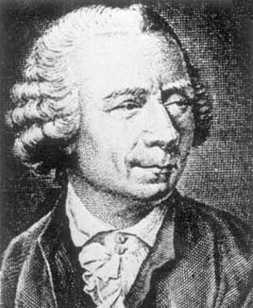
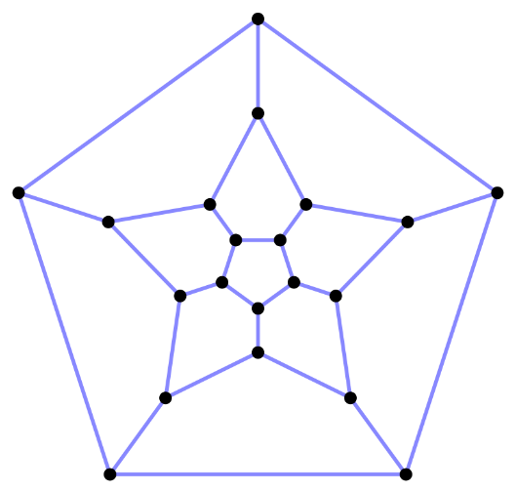
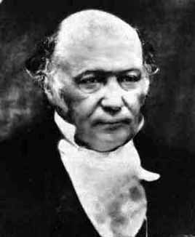
Where we are in the story
Eulerian Circuit: Easy, Polynomial time
i² + j² + k² = ijk = -1
Hamiltonian Cycle: Seems hard, Exponential time

Slide 4
NP Completeness
“Easy problems” – solvable in Polynomial Time
Hard problems – take exponential time
Interesting class of problems: Non-deterministic polynomial time
EXPTIME
NP
P

Slide 5
Travelling Salesman Problem
Given a connected, undirected graph with edge costs, find a cycle that includes all vertices with minimum total edge cost
2
2
5
2
2
Notes:
The cycle does not need to be simple, so it can visit vertices multiple times
The graph is often assumed to be complete. Missing edges can be given a cost of ∞.
6
4
1
5
1
2
7
5
4
4
2
How does TSP relate to HC?

Slide 6
Problem Reduction
Hamiltonian Circuit
Given a graph, is the a simple cycle that includes all of the vertices
Travelling Salesman Problem
Given a complete graph with edge costs and a constant C, is there a cycle that visits all vertices with total cost at most C
A reduction of HC to TSP uses an instance of TSP to solve an instance of HC
This shows TSP is harder than HC

Slide 7
Transforming HC into TSP
We can transform Hamiltonian Cycle into TSP.
Given graph G=(V, E):
Assign weight of 1 to each edge
Augment the graph with edges until it is a complete graph G’=(V, E’).
Assign weight of 2 to the new edges.
Let C = |V|.

Slide 8
Examples
A
A
B
B
C
C
D
E
D
E

Slide 9
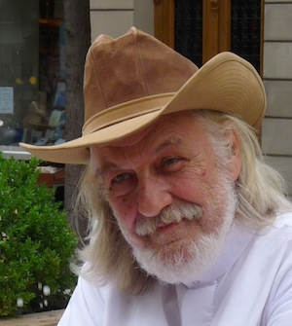
What is NP?
Problems solvable in non-deterministic polynomial time . . .
Problems where “yes” instances have polynomial time checkable certificates

Slide 10
Certificate examples
Independent set of size K
The Independent Set
Satifisfiable formula
Truth assignment to the variables
Hamiltonian Circuit Problem
A cycle including all of the vertices
K-coloring a graph
Assignment of colors to the vertices

Slide 11
Certifiers and Certificates: 3-Satisfiability
SAT: Does a given CNF formula have a satisfying formula
Certificate: An assignment of truth values to the n boolean variables
Certifier: Check that each clause has at least one true literal
Instance
Certificate

Slide 12
Certifiers and Certificates: Hamiltonian Cycle
HAM-CYCLE. Given an undirected graph G = (V, E), does there exist a simple cycle C that visits every node?
Certificate. A permutation of the n nodes.
Certifier. Check that the permutation contains each node in V exactly once, and that there is an edge between each pair of adjacent nodes in the permutation.
instance
certificate

Slide 13
Polynomial time reductions
Y is Polynomial Time Reducible to X
Solve problem Y with a polynomial number of computation steps and a polynomial number of calls to a black box that solves X
Notations: Y <_{P} X

Slide 14
Lemmas
Suppose Y <_{P} X. If X can be solved in polynomial time, then Y can be solved in polynomial time.
Suppose Y <_{P} X. If Y cannot be solved in polynomial time, then X cannot be solved in polynomial time.

Slide 15
NP-Completeness
A problem X is NP-complete if
X is in NP
For every Y in NP, Y <_{P} X
X is a “hardest” problem in NP
If X is NP-Complete, Z is in NP and X <_{P} Z
Then Z is NP-Complete

Slide 16
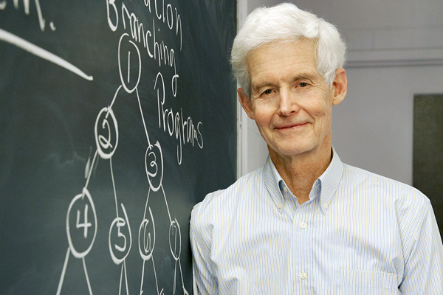
Cook’s Theorem
The Circuit Satisfiability Problem is NP-Complete

Slide 17
Circuit SAT
AND
Satisfying assignment
x₁ = T, x₂ = F, x₃ = F
x₄ = T, x₅ = T
OR
OR
Find a satisfying assignment
AND
AND
AND
AND
NOT
OR
NOT
OR
AND
NOT
OR
AND
AND
NOT
OR
NOT
AND
x₁
x₂
x₃
x₄
x₅

Slide 18
Proof of Cook’s Theorem
Reduce an arbitrary problem Y in NP to Circuit SAT
Let A be a non-deterministic polynomial time algorithm for Y
Convert A to a circuit, so that instance I of Y is a Yes instance iff and only if the circuit is satisfiable

Slide 19
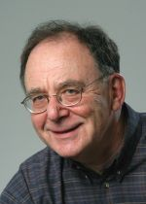
Populating the NP-Completeness Universe
NP-Complete
Circuit Sat <_{P} 3-SAT
3-SAT <_{P} Independent Set
3-SAT <_{P} Vertex Cover
Independent Set <_{P} Clique
3-SAT <_{P} Hamiltonian Circuit
Hamiltonian Circuit <_{P} Travelling Salesman
3-SAT <_{P} Integer Linear Programming
3-SAT <_{P} Graph Coloring
3-SAT <_{P} Subset Sum
Subset Sum <_{P} Scheduling with Release times and deadlines
NP
P

Slide 20
P, NP, NPC, and Exponential Time Problems
All currently known algorithms for NP-complete problems run in exponential worst case time
Diagram depicts relationship between P, NP, and EXPTIME (class of problems that provably require exponential time to solve)
EXPTIME
NPC
NP
P
It is believed that
P ≠ NP ≠ EXPTIME

Slide 21
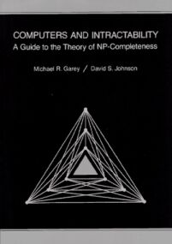
Great Quick Reference
Is this lecture complete? Hardly, but here’s a good reference:
Computers and Intractability:
A Guide to the Theory of
NP-Completeness
by Michael S. Garey and
David S. Johnson

