Slide 1
CSE 332: Data Structures and Parallelism
Spring 2022
Richard Anderson
Lecture 27: NP-Completeness

Slide 2
Announcements
Final
  Thursday, June 9, 8:30-10:20 AM, cse2 G20
  No notes, calculator, internet, etc.
  Comprehensive
    All topics covered on the lecture slides
    Estimate: 1/3rd pre-midterm, 2/3rd post-midterm
Resources
  Old exams
  Quiz section this week
  Review session, Tuesday, June 7, 3:00-4:30 PM, location TBD

Slide 3
Your First Task
Given a connected, undirected graph, can you find a cycle that includes every edge exactly once

Slide 4
Try it with paper and pencil
Which of these can you draw without lifting your
pencil, drawing each line only once?
Can you start and end at the same point?

Slide 5
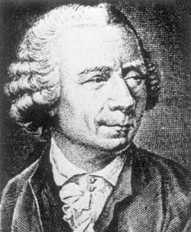
Euler Circuits and Tours
Euler tour: a path through a graph that visits each edge exactly once
Euler circuit: an Euler tour that starts and ends at the same vertex
Named after Leonhard Euler (1707-1783), who cracked this problem and founded graph theory in 1736
Some results for undirected graphs:
  An Euler circuit exists iff the graph is connected and each vertex has even degree (= # of edges on the vertex)
  An Euler tour exists iff the graph is connected and at most two vertices have odd degree

Slide 6
Finding Euler Circuits
Given a connected, undirected graph G = (V,E), find an Euler circuit in G.
Euler Circuit Existence Algorithm:
  Check to see that all vertices have even degree
Running time =
Euler Circuit Algorithm:
  Do an edge walk from a start vertex until you are back at the start vertex. Mark each edge you visit, and do not revisit marked edges. You never get stuck because of the even degree property.
  The walk is removed leaving several components each with the even degree property. Recursively find Euler circuits for these.
  Splice all these circuits into an Euler circuit
Running time =

Slide 7
Euler Tour
For an Euler Tour, exactly two vertices are odd, the rest even. Using a similar algorithm, you can find a path between the two odd vertices.
A
B
C
D
E
F
G

Slide 8
Your Second Task
Given a connected, undirected graph, can you find a simple cycle that includes every vertex exactly once

Slide 9
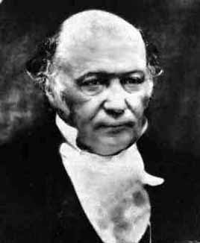
Hamiltonian Circuits
W. R. Hamilton
(1805-1865)
Euler circuit: A cycle that goes through each edge exactly once
Hamiltonian circuit: A cycle that goes through each vertex exactly once (except the first=last one)
Does graph I have:
  An Euler circuit?
  A Hamiltonian circuit?
Does graph II have:
  An Euler circuit?
  A Hamiltonian circuit?
Does the Hamiltonian circuit problem seem easier or harder?
B
C
G
I
D
E
B
C
G
II
D
E

Slide 10
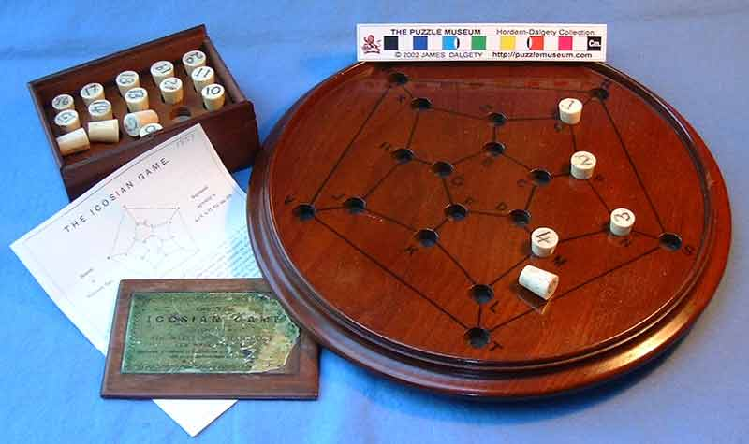
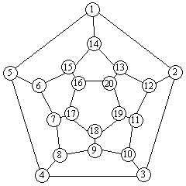
Hamilton’s Icosian Game

Slide 11
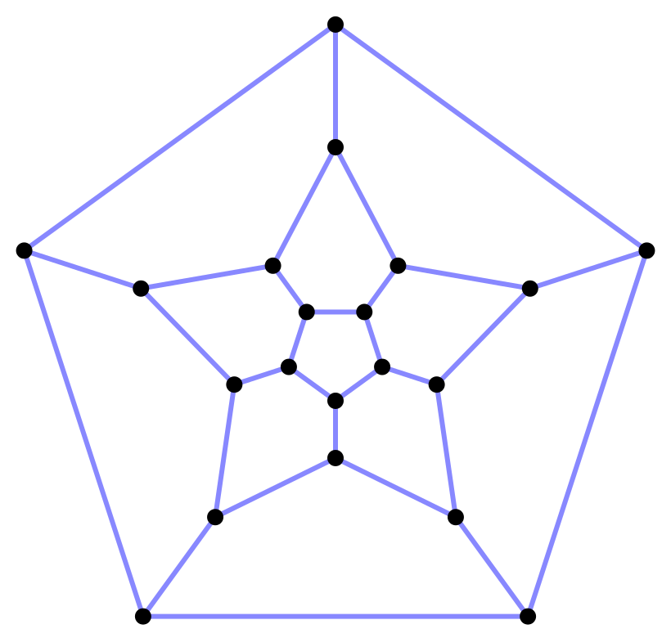
Icosian Graph

Slide 12
Finding Hamiltonian Circuits
Problem: Find a Hamiltonian circuit in a connected, undirected graph G.
One solution: Search through all paths to find one that visits each vertex exactly once
  Can use your favorite graph search algorithm (DFS!) to find various paths
This is an exhaustive search (“brute force”) algorithm.
Worst case → need to search all paths
  How many paths??

Slide 13
Analysis of our Exhaustive Search Algorithm
B
C
Worst case → need to search all paths
  How many paths?
Can depict these paths as a search tree
G
D
E
B
D G C
G E D E C G E
Etc.
Search tree of paths from B

Slide 14
Analysis of our Exhaustive Search Algorithm
Let the average branching factor of each node in this tree be b
|V| vertices, each with ≈ b branches
Total number of paths ≈ b·b·b … ·b
  =
Worst case → Exponential time!
B
D G C
G E D E C G E
Etc.
Search tree of paths from B

Slide 15
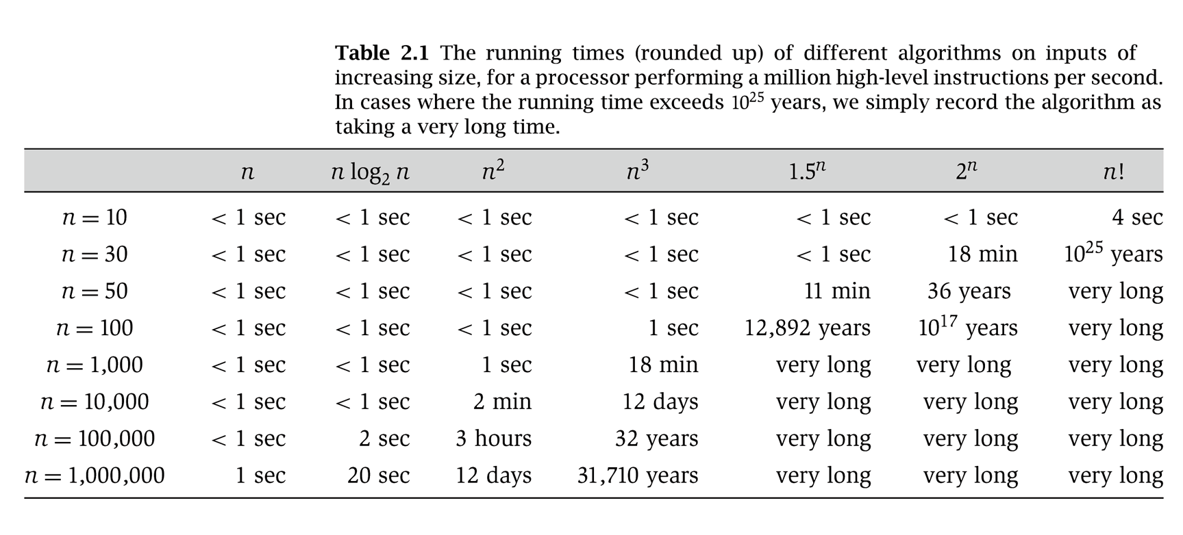
Running time
Notes:
From Rosen (I think) – old!

Slide 16
Polynomial vs Exponential Time
Most of our algorithms so far have been O(log N), O(N), O(N log N) or O(N²) running time for inputs of size N
  These are all polynomial time algorithms
  Their running time is O(N^{k}) for some k > 0
Exponential time b^{N} is asymptotically worse than any polynomial function N^{k} for any k

Slide 17
The Complexity Class P
The set P is defined as the set of all problems that can be solved in polynomial worst case time
  Also known as the polynomial time complexity class
  All problems that have some algorithm whose running time is O(N^{k}) for some k
Examples of problems in P: sorting, shortest path, Euler circuit, etc.

Slide 18
Problem Spaces
If a problem is not polynomial-time solvable (not in P), then it is an exponential-time problem.
Shorthand:
  P solutions are fast
  EXPTIME are slow
    Sometimes viewed
    as “intractable”
EXPTIME
P

Slide 19
When is a problem easy?
We’ve seen some “easy” graph problems:
  Graph search
  Shortest-path
  Minimum Spanning Tree
Not easy for us to come up with, but easy for the computer, once we know algorithm.

Slide 20
When is a problem hard?
Almost everything we’ve seen in class has had an efficient algorithm
But of course, computers can’t solve every problem quickly.
In fact, there are perfectly reasonable sounding problems that no computer could ever solve in any reasonable amount of time (as far as we know!).
  The Hamiltonian Circuit problem is one of these (as far as we know).

Slide 21
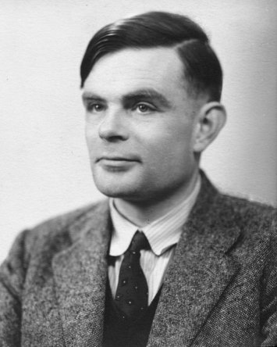
When is a problem hopeless?
Some problems are “undecidable” – no algorithm can be given for solving them.
  The Halting Problem: is it possible to specify any algorithm, which, given an arbitrary program and input to that program, will always correctly determine whether or not that program will enter an infinite loop?
  No! [Turing, 1936]
We’ll focus on problems that have
a glimmer of hope…
Alan Turing
(1912-1954)

Slide 22
A Glimmer of Hope
Suppose you have a problem that is at least decideable.
If the output can be checked for correctness in polynomial-time, then maybe a polynomial-time solution exists!

Slide 23
The Complexity Class NP
Definition: NP is the set of all problems for which a given candidate solution can be tested in polynomial time
Are the following in NP:
  Hamiltonian circuit problem?
  Euler circuit problem?
  All problems solved by polynomial time algorithms?

Slide 24
Why NP?
NP stands for Nondeterministic Polynomial time
  Why “nondeterministic”? Corresponds to algorithms that can guess a solution (if it exists) → the solution is then verified to be correct in polynomial time
  Nondeterministic algorithms require a nondeterministic computer
    Multiple choices for the next instruction
    Accepts an input if some valid computation gets to an accepting state

Slide 25
Problem Spaces (revisited)
We can now augment our problem space to include NP as a superset of P.
Whenever someone finds
a polynomial time solution
to a problem currently
believed to be in NP - P,
it moves to P.
EXPTIME
NP
P

Slide 26
Your Chance to Win a Turing Award (and $$$)
It is generally believed that P ≠ NP, i.e.
there are problems in NP that are not in P
  But no one has been able to show even one such problem!
  This is the fundamental open problem in theoretical computer science.

Slide 27
P = NP?
Perhaps instead P = NP, but that would seem to be
even harder to prove…
EXPTIME
EXPTIME
NP
P
P
P ≠ NP
P = NP

Slide 28
Your Third Task
Given a connected, undirected graph with edge costs, find a cycle that includes all vertices with minimum total edge cost
2
2
2
6
4
1
5
1
2
4
2

Slide 29
The Traveling Salesman Problem (TSP)
This amounts to solving…
…The Traveling Salesman Problem:
  Given a complete (fully connected) weighted graph G, and an integer C,
  is there a cycle that visits all vertices with cost ≤ C?
One of the canonical problems in computer science.
Note difference from Hamiltonian cycle: graph is complete, and we care about weight.

Slide 30
Transforming HC into TSP
We can transform Hamiltonian Cycle into TSP.
Given graph G=(V, E):
  Assign weight of 1 to each edge
  Augment the graph with edges until it is a complete graph G’=(V, E’).
  Assign weight of 2 to the new edges.
  Let C = |V|.

Slide 31
Examples
B
C
G
D
E

Slide 32
Polynomial-time transformation
G’ has a TSP tour of weight |V| iff (if and only if) G has a Hamiltonian Cycle.
  Proof: “obvious”
What was the cost of transforming HC into TSP?
In the end, because there is a polynomial-time transformation from HC to TSP, we say TSP is “at least as hard as” Hamiltonian cycle.

Slide 33
Satisfiability
In 1971, Stephen Cook studied the Satisfiability Problem:
  Given a Boolean formula (collections of ANDs, ORs, NOTs) over a set of variables,
  is there a TRUE/FALSE assignment to the variables such that the Boolean formula evaluates to TRUE?

Slide 34
Satisfiability
…and he proved something remarkable:
  Every problem in NP can be polynomially transformed to the Satisfiability Problem.
Thus, Satisfiability is at least as hard as every other problem in NP, i.e., it is the hardest NP problem.
We call it an “NP-complete” problem.

Slide 35
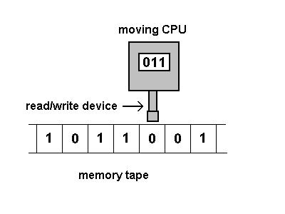
Turing Machines
The proof is intricate and depends on a computing abstraction called a Turing Machine…
which is generalized to allow guessing the answer.

Slide 36
NP-completeness
In fact, Satisfiability can be polynomially reduced to some other NP problems (and vice versa).
These other problems are equivalent to Satisfiability, and so all other problems in NP can be transformed to them, as well.
NP-complete problems thus form an equivalence set in NP (all equivalently hard, i.e., the hardest).
Solving one would give a solution for all of them!
  If any NP-complete problem is in P, then all of NP is in P

Slide 37
What’s NP-complete
Satisfiability of logic formulas
All sorts of constraint problems
All sorts of graph problems, including:
  Hamiltonian Circuits
  Traveling Salesman?
  Graph coloring: decide if the vertices of a graph be colored using K colors, such that no two adjacent vertices have the same color.
Not an overstatement to say that every area of computer science comes up against NP-complete problems.

Slide 38
One tweak and you could be in NP-complete
It’s amazing how “little” tweaks on a problem change the complexity:
  Euler circuit is in P, but Hamiltonian circuit is NP-complete.
  Shortest path between two points is computable in O(|V|²), but longest simple path is NP-complete.

Slide 39
Analyzing Your Hard Problem
Your problem seems really hard.
If you can transform an NP-complete problem into the one you’re trying to solve, then you can stop working on your problem!
…unless you really need that Turing award.

Slide 40
P, NP, NPC, and Exponential Time Problems
All currently known algorithms for NP-complete problems run in exponential worst case time
Diagram depicts relationship between P, NP, and EXPTIME (class of problems that provably require exponential time to solve)
EXPTIME
NPC
NP
P
It is believed that
P ≠ NP ≠ EXPTIME

Slide 41
Coping with NP-Completeness
  Settle for algorithms that are fast on average: Worst case still takes exponential time, but doesn’t occur very often.
    But some NP-Complete problems are also average-time NP-Complete!
  Settle for fast algorithms that give near-optimal solutions: In traveling salesman, may not give the cheapest tour, but maybe good enough.
    But finding even approximate solutions to some NP-Complete problems are NP-Complete!

Slide 42
Coping with NP-Completeness
  Just get the exponent as low as possible! Much work on exponential algorithms for satisfiability: in practice can often solve circuits with 1,000+ inputs
    But even 2^{n/100} will eventual hit the exponential curve!
  Restrict the problem: Longest Path is easy on trees, for example. Many hard problems are easy for restricted inputs.

Slide 43
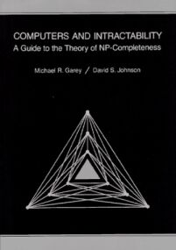
Great Quick Reference
Is this lecture complete? Hardly, but here’s a good reference:
Computers and Intractability:
A Guide to the Theory of
NP-Completeness
by Michael S. Garey and
David S. Johnson

