Slide 1

CSE 332: Data Structures and Parallelism
Spring 2022
Richard Anderson
Lecture 24: Dijkstra’s Algorithm

Slide 2
Announcements
Upcoming lectures
  Intro to graphs
  Topological Sort
  Graph Algorithms
    Graph Traversal
    Shortest Paths
    Minimum Spanning Tree
  Union-Find Data Structure
  Theory of NP-Completeness (2 lectures)

Slide 3
Graph Theory
G = (V, E)
  V: vertices, |V|= n
  E: edges, |E| = m
Undirected graphs
  Edges sets of two vertices {u, v}
Directed graphs
  Edges ordered pairs (u, v)
Many other flavors
  Edge / vertices weights
  Parallel edges
  Self loops
Path: v₁, v₂, …, v_{k}, with (v_{i}, v_{i+1}) in E
  Simple Path
  Cycle
  Simple Cycle
Neighborhood
  N(v)
Distance
Connectivity
  Undirected
  Directed (strong connectivity)
Trees
  Rooted
  Unrooted

Slide 4
Graph Representation
b
V = { a, b, c, d}
a
E = { {a, b}, {a, c}, {a, d}, {b, d} }
d
c
a
b
c
d
1
1
1
b
a
d
1
0
1
c
a
1
0
0
d
a
b
1
1
0
Adjacency List
Adjacency Matrix
O(n + m) space
O(n²) space

Slide 5
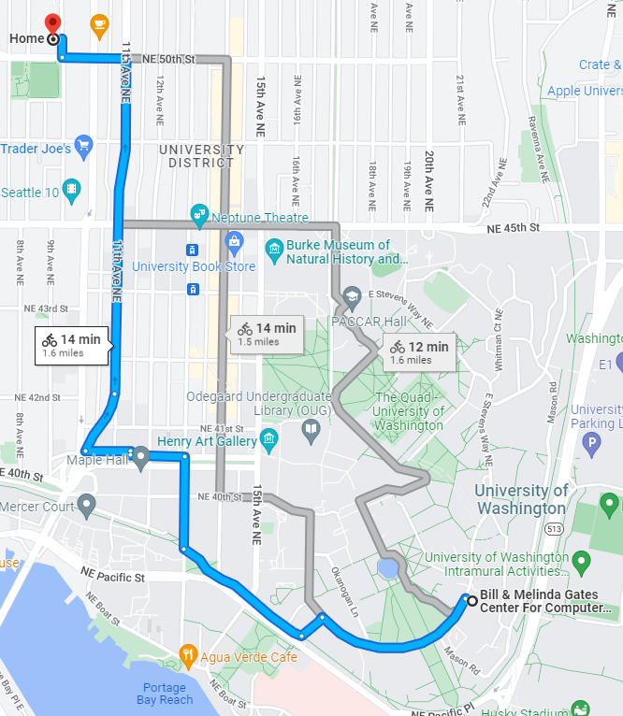
Find the shortest path

Slide 6
The Shortest Path Problem
Given a graph G, and vertices s and t in G, find the shortest path from s to t.
Two cases: weighted and unweighted.
For a path p = v₀ v₁ v₂ … v_{k}
  unweighted length of path p = k (a.k.a. length)
  weighted length of path p = ∑_{i=0..k-1} c_{i,i+1} (a.k.a. cost)
We will assume the graph is directed

Slide 7
Single Source Shortest Paths (SSSP)
Given a graph G and vertex s, find the shortest paths from s to all vertices in G.
  How much harder is this than finding single shortest path from s to t?
    Most algorithms will have to find the shortest path to every vertex in the graph in the worst case
      Although may stop early in some cases

Slide 8
SSSP: Unweighted Version
This is just Breadth First Search
  Build a breadth first search tree starting from s

Slide 9
void BFS(Vertex s){
Queue q(NUM_VERTICES);
Vertex v, w;
for each w {
w.dist = INFINITY;
w.prev = -1;
}
s.dist = 0;
q.enqueue(s);
while (!q.isEmpty()){
v = q.dequeue();
for each w adjacent to v
if (w.dist == INFINITY){
w.dist = v.dist + 1;
w.prev = v;
q.enqueue(w);
}
}
}
each edge examined
at most once – if adjacency lists are used
each vertex enqueued
at most once

Slide 10
s
v₁
v₀
v₂
v₃
v₄
V | Dist | prev
v₀
v₁
v₂
v₃
v₄
v₅
v₆
v₅
v₆

Slide 11
Weighted SSSP:
All edges are not created equal
Home
Ben & Jerry’s
Cedars
Neelam’s
40
285
U Village
Delfino’s
75
70
365
25
Coke Closet
375
The Ave
350
350
10
25
HUB
35
ALLEN
35
Café Allegro
15
Schultzy’s
Vending Machine in EE1
15,356
Parent’s Home
Can we calculate shortest distance to all vertices from Allen Center?
Notes:
So, here’s an example of a weighted graph. Now, let’s ask: what’s the shortest path cost to, say, Ben and Jerry’s?

Slide 12
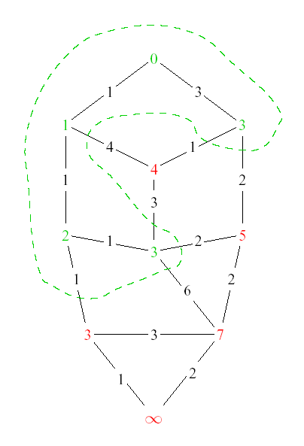
Dijkstra’s Algorithm: Idea
Assume all edges have non-negative cost
Adapt BFS to handle weighted graphs
Two kinds of vertices:
  Known
    shortest distance
    is already known
  Unknown
    Have tentative distance

Slide 13
Dijkstra’s Algorithm: Idea
At each step:
  Pick closest unknown vertex
  Add it to known vertices
  Update distances

Slide 14
Dijkstra’s Algorithm
Assume all edges have non-negative cost
S = { }; d[s] = 0; d[v] = infinity for v != s
while S != V
Choose v in V-S with minimum d[v]
Add v to S
for each w in the neighborhood of v
newCost = d[v] + c(v, w)
if (newCost < d[w])
d[w] = newCost
prev[w] = v
4
3
y
1
1
u
1
0
1
s
4
2
2
x
2
2
v
2
3
z
5

Slide 15
Important Features
Once a vertex is known (in S), the cost of the shortest path to that vertex is correct
While a vertex is still unknown, another shorter path to it might still be found
The shortest path can found by following the previous pointers stored at each vertex

Slide 16
2
s
v₁
v₀
2
1
5
1
1
1
v₂
v₃
v₄
2
6
5
3
10
v₅
v₆
V | Known? | Cost | Previous
v0
v1
v2
v3
v4
v5
v6

Slide 17
Implementation
S = { }; d[s] = 0; d[v] = infinity for v != s
while S != V
Choose v in V-S with minimum d[v]
Add v to S
for each w in the neighborhood of v
newCost = d[v] + c(v, w)
if (newCost < d[w])
d[w] = newCost
prev[w] = v
4
3
y
1
1
u
1
0
1
s
4
2
2
x
2
2
v
2
3
z
5
What are the heap operations?
How many heap operations?

Slide 18
Dijkstra Algorithm
int dist[N], prev[N];
for (int i = 0; i < N; i++){
dist[i] = INFINITY;
prev[i] = -1;
}
dist[s] = 0;
Heap h = new Heap(dist);
while (!h.isEmpty()){
v = h.DeleteMin();
for each w adjacent to v {
int newCost = dist[v] + cost(v,w);
if (newCost < dist[w]){
dist[w] = newCost;
h.DecreaseKey(w, newCost);
prev[w] = v;
}
}
}

Slide 19
Correctness Proof
Elements in S have the correct label
Induction: when v is added to S, it has the correct distance label
  Dist(s, v) = d[v] when v added to S
y
S
x
s
u
v

Slide 20
D-Heaps (again)
Heaps with branching factor D
DeleteMin runtime O(Dlog_{D} N)
Decrease Key runtime O(log_{D} N)

Slide 21
Dijkstra’s Algorithm with D heaps
n DeleteMin operations
m DecreaseKey operations
Runtime O(n Dlog_{D} n + m log_{D} n)
What value for D?

Slide 22
Why do we worry about negative cost edges?

