Slide 1
CSE 332: Data Structures and Parallelism
Spring 2022
Richard Anderson
Lecture 6: Binary Heaps and Algorithm Analysis

Slide 2
Announcements
Reading: Weiss
Friday: Algorithm Analysis, 2.1-2.2
Monday: Binary Search Trees, 4.1-4.3, 4.6
Project #1 Due Tuesday
Write up portion is important
Linked handout provides guidance
Run zip experiment and fuzzy testing to reveal bugs

Slide 3
Today
Heap Initialization
Put n elements into a heap in O(n) time
Algorithm analysis for recursive programs

Slide 4
Building a Heap
12
5
11
3
10
6
9
4
8
1
7
2
Notes:
Let’s try pretending it’s a heap already and just fixing the heap-order property.
The red nodes are the ones that are out of order.
Question: which nodes MIGHT be out of order in any heap?

Slide 5
BuildHeap: Floyd’s Method
12
5
11
3
10
6
9
4
8
1
7
2
Add elements arbitrarily to form a complete tree.
Pretend it’s a heap and fix the heap-order property!
12
Red nodes need to percolate down
5
11
Key idea: fix red nodes from bottom-up
3
10
6
9
4
8
1
7
2
Notes:
Let’s try pretending it’s a heap already and just fixing the heap-order property.
The red nodes are the ones that are out of order.
Question: which nodes MIGHT be out of order in any heap?

Slide 6
BuildHeap: Floyd’s Method
12
12
5
11
5
11
3
10
2
9
3
1
2
9
4
8
1
7
6
4
8
10
7
6
12
12
5
2
1
2
3
1
6
9
3
5
6
9
4
8
10
7
11
4
8
10
7
11

Slide 7
Finally . . .
1
3
2
4
5
6
9
12
8
10
7
11

Slide 8
Buildheap pseudocode
private void buildHeap() {
for ( int i = currentSize/2; i >= 0; i-- )
percolateDown( i );
}
runtime:
Notes:
How long does this take? Well, everything above the fringe might move 1 step.
Everything height 2 or greater might move 2 steps.
Most nodes move only a small number of steps
→ the runtime is O(n).
(see text for proof)
Full sum = (I=0 to height) SUM (h-I) * 2^i

Slide 9
Buildheap Analysis
n/4 nodes percolate at most 1 level
n/8 percolate at most 2 levels
n/16 percolate at most 3 levels
...
runtime:
Notes:
n/4 + 2*n/8 + 3*n/16 + ...
= n (1/4 + 2/8 + 3/16 + ...)
= n*1 = n

Slide 10
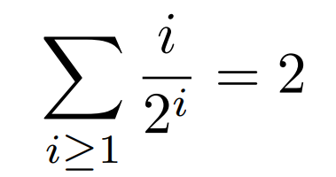
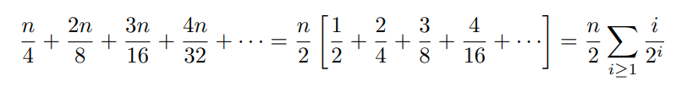
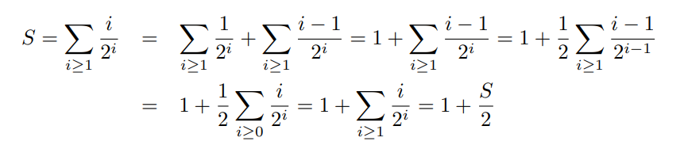
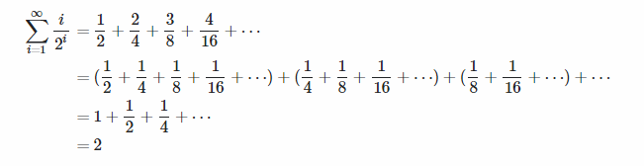
The Math:

Slide 11
Heap sort
Put n elements into a heap
Perform n DeleteMins and put into an array
buildHeap();
for (int i = 0; i < n; i++)
B[i] = DeleteMin();

Slide 12
Heap sort
// Sort array h of size n
void heapSort(int[]h, int n){
for(int i = n/2; i >= 0; i--)
percolateDown(h, i, n);
for (int i = n-1; i > 0; i--){
v = h[0]; h[0] = h[i]; h[i] = v;
percolateDown(h, i, n);
}
}

Slide 13
Analyzing code (“worst case”)
Basic operations take “some amount of” constant time
Arithmetic
Assignment
Access one Java field or array index
Etc.
(This is an approximation of reality: a very useful “lie”.)
Consecutive statements Sum of time of each statement
Loops Num iterations * time for loop body
Conditionals Time of condition plus time of slower branch
Function Calls Time of function’s body
Recursion Solve recurrence equation

Slide 14
Linear search
2
3
5
16
37
50
73
75
126
Find an integer in a sorted array
// requires array is sorted
// returns whether k is in array
boolean find(int[]arr, int k){
for(int i=0; i < arr.length; ++i)
if(arr[i] == k)
return true;
return false;
}
Best case: 6 steps = O(1)
Worst case: 5 * (arr.length) = O(arr.length)

Slide 15
Analyzing Recursive Code
Computing run-times gets interesting with recursion
Say we want to perform some computation recursively on a list of size n
Conceptually, in each recursive call we:
Perform some amount of work, call it w(n)
Call the function recursively with a smaller portion of the list
So, if we do w(n) work per step, and reduce the problem size in the next recursive call by 1, we do total work:
T(n)=w(n)+T(n-1)
With some base case, like T(1)=5=O(1)

Slide 16
Example Recursive code: sum array
Recursive:
Recurrence is
some constant amount of work O(1) done n times
int sum(int[] arr){
return help(arr,0);
}
int help(int[]arr,int i) {
if(i==arr.length)
return 0;
return arr[i] + help(arr,i+1);
}
Each time help is called, it does that O(1) amount of work, and then calls help again on a problem one less than previous problem size.
Recurrence Relation: T(n) = O(1) + T(n-1)

Slide 17
Solving Recurrence Relations
Say we have the following recurrence relation:
T(n)=6 + T(n-1)
T(1)=9 ←base case
Now we just need to solve it; that is, reduce it to a closed form.
Start by writing it out:
T(n)=6+T(n-1)
=6+6+T(n-2)
=6+6+6+T(n-3)
=6+6+6+…+6+T(1) = 6+6+6+…+6+9
=6k+T(n-k)
=6k+9, where k is the # of times we expanded T()
We expanded it out n-1 times, so
T(n)=6k+T(n-k)
=6(n-1)+T(1) = 6(n-1)+9
=6n+3 = O(n)
Or When does n-k=1? Answer: when k=n-1

Slide 18
Binary search
2
3
5
16
37
50
73
75
126
Find an integer in a sorted array
// requires array is sorted
// returns whether k is in array
boolean find(int[]arr, int k){
return help(arr,k,0,arr.length);
}
boolean help(int[]arr, int k, int lo, int hi) {
int mid = (hi+lo)/2; //i.e., lo+(hi-lo)/2
if(lo==hi) return false;
if(arr[mid]==k) return true;
if(arr[mid]< k) return help(arr,k,mid+1,hi);
else return help(arr,k,lo,mid);
}

Slide 19
Binary search
Best case: 9 steps = O(1)
Worst case: T(n) = 10 + T(n/2) where n is hi-lo
O(log n) where n is array.length
Solve recurrence equation to know that…
// requires array is sorted
// returns whether k is in array
boolean find(int[]arr, int k){
return help(arr,k,0,arr.length);
}
boolean help(int[]arr, int k, int lo, int hi) {
int mid = (hi+lo)/2;
if(lo==hi) return false;
if(arr[mid]==k) return true;
if(arr[mid]< k) return help(arr,k,mid+1,hi);
else return help(arr,k,lo,mid);
}

Slide 20
Solving Recurrence Relations
Determine the recurrence relation. What is the base case?
T(n) = 10 + T(n/2) T(1) = 15
“Expand” the original relation to find an equivalent general expression in terms of the number of expansions.
Find a closed-form expression by setting the number of expansions to a value which reduces the problem to a base case

Slide 21
sum array again
Two “obviously” linear algorithms: T(n) = O(1) + T(n-1)
int sum(int[] arr){
int ans = 0;
for(int i=0; i<arr.length; ++i)
ans += arr[i];
return ans;
}
Iterative:
Recursive:
Recurrence is
c + c + … + c
for n times
int sum(int[] arr){
return help(arr,0);
}
int help(int[]arr,int i) {
if(i==arr.length)
return 0;
return arr[i] + help(arr,i+1);
}

Slide 22
What about a binary version of sum?
int sum(int[] arr){
return help(arr,0,arr.length);
}
int help(int[] arr, int lo, int hi) {
if(lo==hi) return 0;
if(lo==hi-1) return arr[lo];
int mid = (hi+lo)/2;
return help(arr,lo,mid) + help(arr,mid,hi);
}

Slide 23
What about a binary version of sum?
int sum(int[] arr){
return help(arr,0,arr.length);
}
int help(int[] arr, int lo, int hi) {
if(lo==hi) return 0;
if(lo==hi-1) return arr[lo];
int mid = (hi+lo)/2;
return help(arr,lo,mid) + help(arr,mid,hi);
}
Recurrence is T(n) = O(1) + 2T(n/2)
1 + 2 + 4 + 8 + … for log n times
2^{(log n)} – 1 which is proportional to n (by definition of logarithm)
Easier explanation: it adds each number once while doing little else
“Obvious”: You can’t do better than O(n) – have to read whole array

Slide 24
Parallelism teaser
But suppose we could do two recursive calls at the same time
Like having a friend do half the work for you!
int sum(int[]arr){
return help(arr,0,arr.length);
}
int help(int[]arr, int lo, int hi) {
if(lo==hi) return 0;
if(lo==hi-1) return arr[lo];
int mid = (hi+lo)/2;
return help(arr,lo,mid) + help(arr,mid,hi);
}
If you have as many “friends of friends” as needed, the recurrence is now T(n) = O(1) + 1T(n/2)
O(log n) : same recurrence as for find

Slide 25
Really common recurrences
Should know how to solve recurrences but also recognize some really common ones:
T(n) = O(1) + T(n/2) logarithmic O(log n)
T(n) = O(1) + 2T(n/2) linear O(n)
T(n) = O(1) + T(n-1) linear O(n)
T(n) = O(n) + T(n-1) quadratic O(n²)
T(n) = O(1) + 2T(n-1) exponential O(2^{n})
T(n) = O(n) + T(n/2) linear O(n)
T(n) = O(n) + 2T(n/2) loglinear O(n log n)

