Slide 1
CSE 332: Data Structures and Parallelism
Spring 2022
Richard Anderson
Lecture 5: Binary Heaps

Slide 2
Announcements
Reading: Weiss
Today: Priority Queues, 6.1-6.5
Friday: Algorithm Analysis, 2.1-2.2

Slide 3
Today
Binary Tree Heaps
Insert
Delete Min
Array implementation
Heap Initialization
Put n elements into a heap in O(n) time

Slide 4
Priority Queue ADT
Operations: Insert an item, Remove the “Best” Item
6 2
15 23
12 18
45 3 7
insert
deleteMin

Slide 5
Binary Heap Properties
Store elements in a binary nodes of a binary tree
Maintain the two properties
Heap Order – parents are smaller than their children
Completeness – the tree is of minimum depth with all leaves as far to the left as possible
10
20
80
40
60
85
99
50
700

Slide 6
Heap Operations
Operations: insert, deleteMin
Maintain heap properties by propagating changes either up or down the tree
The heap properties imply
If there are n values in the heap, the tree has height log n
The smallest value is at the root
When a value is added, a new leaf is created in the left most position

Slide 7
Heap Insert
Put value in first available leaf position
Swap value up until heap condition is satisfied

Slide 8
10
20
80
40
60
85
99
50
700
65
15
10
15
80
40
20
85
99
50
700
65
60

Slide 9
Heap DeleteMin
Remove the root (minimum element)
Promote the last leaf to the root
Swap with smallest child until heap property is restored

Slide 10
10
20
27
40
60
85
99
50
700
65
65
20
27
40
60
85
99
50
700

Slide 11
65
20
27
40
60
85
99
50
700
20
40
27
50
60
85
99
65
700

Slide 12
Correctness Proofs
Show operations preserve heap properties
Insert
Complete tree
Parent smaller than children
DeleteMin
Return smallest element
Complete tree
Parent smaller than children

Slide 13
Nodes on level j are number 2^{j} to 2^{j+1} - 1
Node j has children 2j and 2j+1
1
2
3
4
5
6
7
8
9
10
11
12
13
14
15
16
17
18
19
20
21
22
23
24
25
26
27
28
29
30
31
32
33

Slide 14
Mapping a binary tree to an array Zero indexing
0
Node j has:
Left child 2j + 1
Right child 2j + 2
Parent ⎣(j-1)/2⎦
1
2
3
4
5
6
7
8
9
10
11
12
13
14
15
16

Slide 15
Why use an array

Slide 16
Insert Code
void insert(int v) {
assert(!isFull());
size++;
newPos =
percolateUp(size,v);
Heap[newPos] = v;
}
int percolateUp(int hole,
int val) {
while (hole > 0 &&
val < Heap[(hole-1)/2])
Heap[hole] = Heap[(hole-1)/2];
hole = (hole-1)/2;
}
return hole;
}
Θ(log n) worst case
~ 1.67 = Θ(1) on average: only have to go up a few levels
runtime:
(Java code in book)
Notes:
Optimization: no swaps
Notice that this code is a _lot_ easier.
Runtime: log N worst case, but constant on average
(only have to go up a few levels)

Slide 17
DeleteMin Code
Object deleteMin() {
assert(!isEmpty());
returnVal = Heap[0];
size--;
newPos =
percolateDown(0,
Heap[size + 1]);
Heap[newPos] =
Heap[size + 1];
return returnVal;
}
int percolateDown(int hole,
int val) {
while (2*hole <= size) {
left = 2*hole + 1;
right = left + 1;
if (right ≤ size &&
Heap[right] < Heap[left])
target = right;
else
target = left;
if (Heap[target] < val) {
Heap[hole] = Heap[target];
hole = target;
}
else
break;
}
return hole;
}
Θ(log n) worst/ave case
runtime:
(Java code in book)
Notes:
Note that there are three things going on here:
1. find the smaller child
2. if the smaller child is still smaller than the moving value, move the smaller child up
3. otherwise, we’ve found the right spot, and stop.
Runtime log N (worst case and average)

Slide 18
Insert: 16, 32, 4, 69, 105, 43, 2
0 | 1 | 2 | 3 | 4 | 5 | 6 | 7 | 8
Notes:
Deletemin - > returns 2
Deletemin -> returns 4

Slide 19
More Priority Queue Operations
decreaseKey(nodePtr, amount):
given a pointer to a node in the queue, reduce its priority
Binary heap: change priority of node and ________________
increaseKey(nodePtr, amount):
given a pointer to a node in the queue, increase its priority
Binary heap: change priority of node and ________________
percolateUp
percolateDown
It’s hard to find in a pQ
Notes:
Why do I insist on a pointer to each item in decreaseKey, increaseKey, and remove?
Because it’s hard to find an item in a heap; it’s easy to delete the minimum, but how would you find some arbitrary element?
This is where the Dictionary ADT and its various implementations which we will study soon come up.
decreaseKey: percolateUp
increaseKey: percolateDown

Slide 20
More Priority Queue Operations
remove(objPtr):
given a pointer to an object in the queue, remove it
Binary heap: ______________________________________
findMax( ):
Find the object with the highest value in the queue
Binary heap: ______________________________________
decreasePriority(objPtr,∞), deleteMin O(logn)
Search leaves, O(n)

Slide 21
Building a Heap
12
5
11
3
10
6
9
4
8
1
7
2
Notes:
Let’s try pretending it’s a heap already and just fixing the heap-order property.
The red nodes are the ones that are out of order.
Question: which nodes MIGHT be out of order in any heap?

Slide 22
BuildHeap: Floyd’s Method
12
5
11
3
10
6
9
4
8
1
7
2
Add elements arbitrarily to form a complete tree.
Pretend it’s a heap and fix the heap-order property!
12
Red nodes need to percolate down
5
11
Key idea: fix red nodes from bottom-up
3
10
6
9
4
8
1
7
2
Notes:
Let’s try pretending it’s a heap already and just fixing the heap-order property.
The red nodes are the ones that are out of order.
Question: which nodes MIGHT be out of order in any heap?

Slide 23
BuildHeap: Floyd’s Method
12
12
5
11
5
11
3
10
2
9
3
1
2
9
4
8
1
7
6
4
8
10
7
6
12
12
5
2
1
2
3
1
6
9
3
5
6
9
4
8
10
7
11
4
8
10
7
11

Slide 24
Finally . . .
1
3
2
4
5
6
9
12
8
10
7
11

Slide 25
Buildheap pseudocode
private void buildHeap() {
for ( int i = currentSize/2; i >= 0; i-- )
percolateDown( i );
}
runtime:
Notes:
How long does this take? Well, everything above the fringe might move 1 step.
Everything height 2 or greater might move 2 steps.
Most nodes move only a small number of steps
→ the runtime is O(n).
(see text for proof)
Full sum = (I=0 to height) SUM (h-I) * 2^i

Slide 26
Buildheap Analysis
n/4 nodes percolate at most 1 level
n/8 percolate at most 2 levels
n/16 percolate at most 3 levels
...
runtime:
Notes:
n/4 + 2*n/8 + 3*n/16 + ...
= n (1/4 + 2/8 + 3/16 + ...)
= n*1 = n

Slide 27
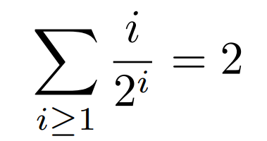
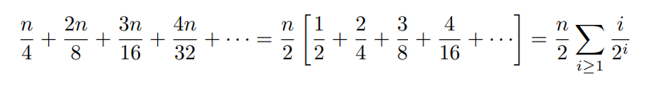
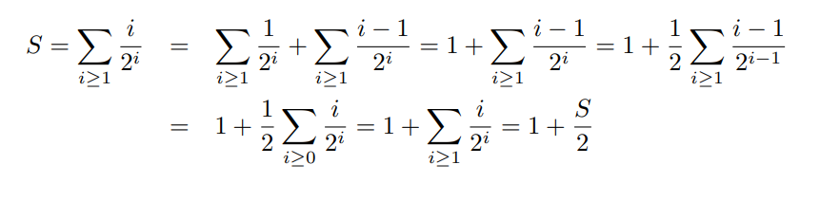
The Math:

