Slide 1
CSE 332: Data Structures and Parallelism
Spring 2022
Richard Anderson
Lecture 3: Algorithm Analysis

Slide 2
Announcements
Project #1: Released
  Due Tuesday, April 12
Exercise #1: Due tonight, 11:59 pm
  Computer set up and some programming
Reading, Weiss, for Monday and Wednesday
  Priority Queues, 6.1-6.5

Slide 3
Analyzing Performance
  We will focus on analyzing time complexity. First, we have some “rules” to help measure how long it takes to do things:
  We are primarily interested in Worst Case performance (average and best case sometimes).
Basic operations
Consecutive statements
Conditionals
Loops
Function calls
Recursive functions
Constant time
Sum of times
Test, plus larger branch cost
Sum of iterations
Cost of function body
Solve recurrence relation…

Slide 4
Complexity cases
We’ll start by focusing on two cases.
Problem size N
  Worst-case complexity: max # steps algorithm takes on “most challenging” input of size N
  Best-case complexity: min # steps algorithm takes on “easiest” input of size N

Slide 5
Exercise - Searching
2
3
5
16
37
50
73
75
bool ArrayContains(int array[], int n, int key){
}
Notes:
Linear, binary

Slide 6
Linear Search Analysis
bool LinearArrayContains(int array[], int n, int key ) {
for( int i = 0; i < n; i++ ) {
if( array[i] == key )
// Found it!
return true;
}
return false;
}
Best Case:
Worst Case:
Best: T(n) = 4, when at [0]
Worst: T(n) = 3n+3, when not found

Slide 7
Binary Search Analysis
2
3
5
16
37
50
73
75
Best case:
Worst case:
bool BinArrayContains( int array[], int low, int high, int key ) {
// The subarray is empty
if( low > high ) return false;
// Search this subarray recursively
int mid = (high + low) / 2;
if( key == array[mid] ) {
return true;
} else if( key < array[mid] ) {
return BinArrayFind( array, low, mid-1, key );
} else {
return BinArrayFind( array, mid+1, high, key );
}
Best: 5 when at [mid] (or 2, n=0)
Worst: 7 + recursion
= 7log(n) + 9 (work out)
Notes:
Here we (somewhat arbitrarily) count arithmetic ops, compares, returns, but not array indexing, function call, conditional.
e.g., mid = (high + low) / 2 is 2 ops, if (key == array[mid]) is 1 op. Lame, but need to choose some convention.
Best = 5, or 2 if n=0,
Worst = 7 + T(n/2)
Uh-oh. Let’s go to the next slide. We’ll come back and fill out these numbers later.
Worst if not found = 7 log_2 n + 9

Slide 8
Solving Recurrence Relations
T(n) = 7 + T(n/2); T(1) = 9
Determine the recurrence relation and base case(s).
“Expand” the original relation to find an equivalent expression in terms of the number of expansions (k).
Find a closed-form expression by setting k to a value which reduces the problem to a base case
T(n) = 7 + (7 + T( n/4 ) )
= 7 + (7 + (7 + T(n/8)))
= 7*3 + T(n/2³)
= … = 7k + T(n/2^{k})
Need (n/2^{k}) = 1, mult by 2^k So k = log n (all logs to base 2) Hence, T(n) = 7 log n + 9
Notes:
1. T(n) = 7 + T( floor(n/2) )
T(1) = 7 + T(0) = 9
2. T(n) = 7 + (7 + T( floor(n/4) ) ) = 14 + T( floor(n/4) )
T(n) = 7 + (7 + (7 + T( floor(n/8) ) ) = 21 + T( floor(n/8) )
So, if k is the number of expansions, the general expression is:
T(n) = 7k + T( floor( n/(2^k) ) )
3. Since the base case is n = 1, we need to find a value of k such that the value of floor( n/(2^k) ) is 1 (which removes T(n) from the RHS of the equation, thus giving us a closed-form expression). A value of k = log_2 n gives us this. Setting k = log_2 n, we have:
T(n) = 7 log_2 n + T(1)
T(n) = 7 log_2 n + 9

Slide 9
Linear Search vs Binary Search
 | Linear Search | Binary Search
Best Case | 4 | 5 at [middle]
Worst Case | 3n+3 | 7 ⎣log n⎦ + 9
BS wins for n>7
But we’re sweeping a lot of stuff under the rug…
  depends on input, processor…
  sorting time for binary search
  but for really large values of n, BS is going to win
Notes:
Linear Search: 3, 3n+3
Binary Search: 4, 7logN + 9
BS wins for n > 7
Some students will probably say “Binary search, because it’s O( log n ), whereas linear search is O( n )”. But the point of this discussion is that big-O notation obscures some important factors (like constants!) and we really don’t know the input size.
To make a meaningful comparison, we need to know more information. What information might that be?
(1) what our priorities are (runtime? Memory footprint?)
(2) what the input size is (or, even better, what the input is!)
(3) our platform/machine – we saw on the earlier chart that architecture made a difference!
(4) other …
Big-O notation gives us a way to compare algorithms without this information, but the cost is a loss of precision.

Slide 10
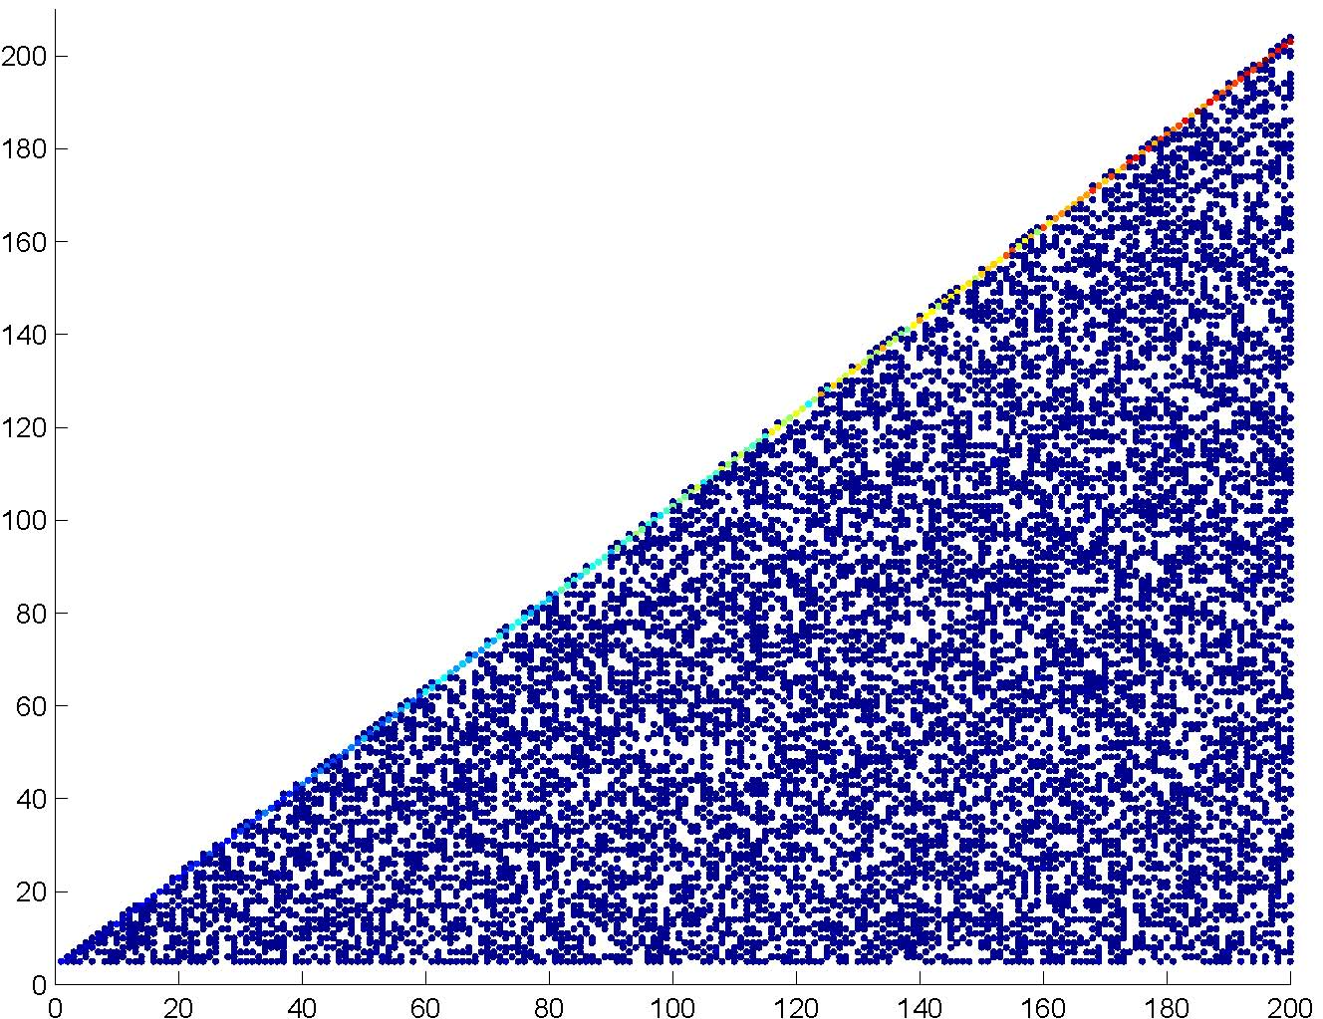
Linear search—empirical analysis
time
(# ops)
N (= array size)
Each search produces a dot in above graph.
Blue = less frequently occurring, Red = more frequent
Notes:
I ran linear search over and over and plotted the running times.
Specifically:
- created a random array of size N
- did several random searches (N/10 to be exact)
- generated a new random array and new searches, iterating 10 times
Note color encoding—some run times occur more often then others (red is most frequent).
- why are the red dots at the top?
This gives a pretty good picture of the running time characteristics of this algorithm—uniform under the triangle, with a peak at the top.

Slide 11
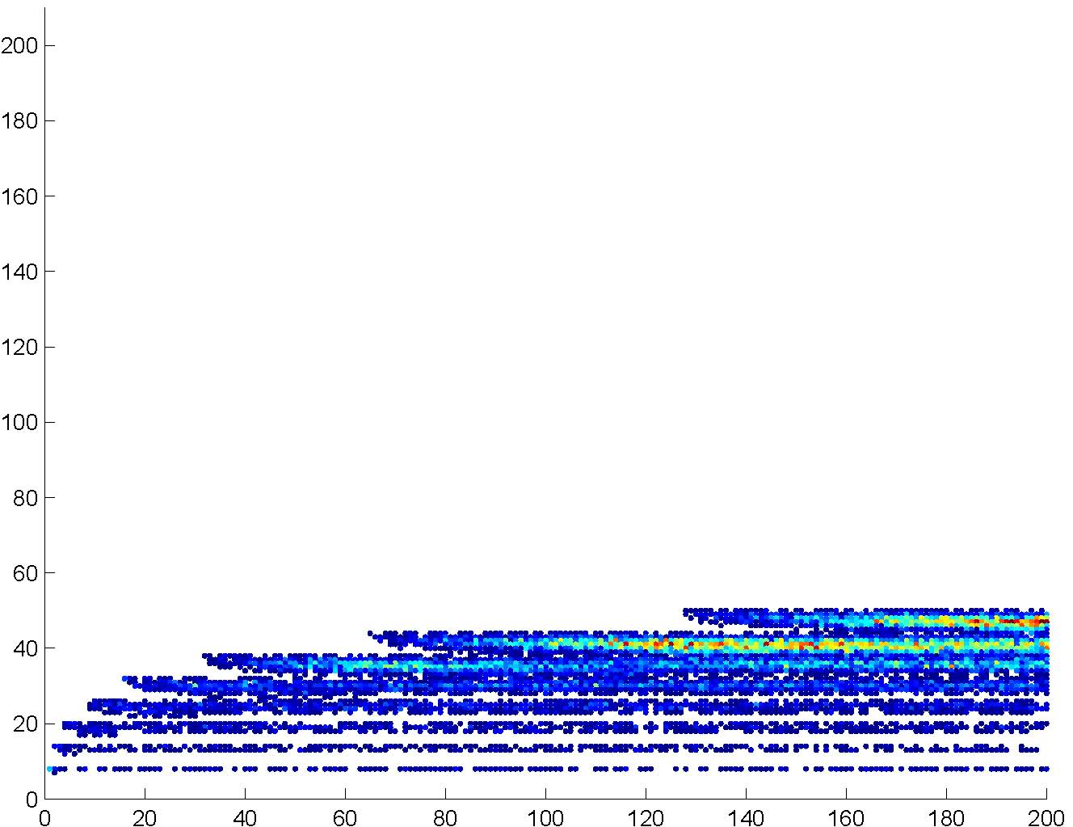
Binary search—empirical analysis
time
(# ops)
N (= array size)
Each search produces a dot in above graph.
Blue = less frequently occurring, Red = more frequent
Notes:
Same for binary search…
How do you compare these?

Slide 12


Empirical comparison
time
(# ops)
N (= array size)
N (= array size)
Linear search
Binary search
Gives additional information
Notes:
Binary better almost all of the time, especially for large values of N.
Linear is better for small values of N
Linear best case always beats out binary best case (bottom of the graph)
There also seem to be some trends (linear slope vs. logarithmic). Can we quantify these?

Slide 13
Asymptotic Analysis
Consider only the order of the running time
  A valuable tool when the input gets “large”
  Ignores the effects of different machines or different implementations of same algorithm
Show lim (3n+3)/(7logn+9), l’Hopital’s rule
Notes:
Okay, so the point of all those pretty pictures is to show that, while constants matter, they don’t really matter as much as the order for “sufficiently large” input (“large” depends, of course, on the constants).

Slide 14
Asymptotic Analysis
To find the asymptotic runtime, throw away the constants and low-order terms
  Linear search is
  Binary search is
Remember: the “fastest” algorithm has the slowest growing function for its runtime
Bases don’t matter, more in a sec

Slide 15
Asymptotic Analysis
Eliminate low order terms
  4n + 5 ⇒
  0.5 n log n + 2n + 7 ⇒
  n³ + 3 2^{n} + 8n ⇒
Eliminate coefficients
  4n ⇒
  0.5 n log n ⇒
  3 2^{n} =>

Slide 16
Properties of Logs
Basic:
A^{logAB} = B
log_{A}A =
Independent of base:
log(AB) =
log(A/B) =
log(A^{B}) =
log((A^{B})^{C}) =

Slide 17
Properties of Logs
Changing base → multiply by constant
  For example: log₂x = 3.22 log₁₀x
  More generally
  Means we can ignore the base for asymptotic analysis
  (since we’re ignoring constant multipliers)
log_{A}n = k log_{B}n

Slide 18
Another example
16n³log₈(10n²) + 100n²
Eliminate
low-order
terms
Eliminate
constant
coefficients

Slide 19
Comparing functions
Plot h(n)=n, f(n) = n^2
f(n) is an upper bound for h(n)
if h(n) ≤ f(n) for all n
This is too strict – we mostly care about large n
Still too strict if we want to ignore scale factors
Another plot where they cross
Notes:
Modify eqn, to h(n) <= cf(n) for all n>= n_0

Slide 20
Definition of Order Notation
Plot h(n)=n, f(n) = n^2
h(n) є O(f(n)) Big-O “Order”
if there exist positive constants c and n₀
such that h(n) ≤ c f(n) for all n ≥ n₀
O(f(n)) defines a class (set) of functions
Another plot where they cross

Slide 21
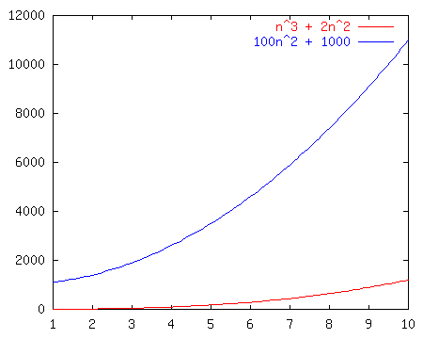
Order Notation: Intuition
a(n) = n³ + 2n²
b(n) = 100n² + 1000
Although not yet apparent, as n gets “sufficiently large”, a(n) will be “greater than or equal to” b(n)

Slide 22
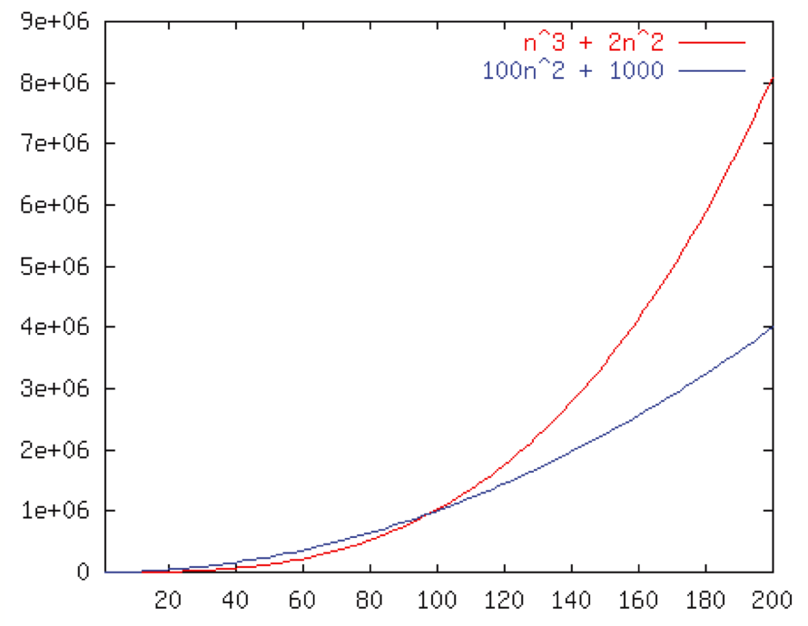
Order Notation: Example
Wait, crossover point at 100, not 198?
If we pick c =1, then n₀=100
100n² + 1000 ≤ (n³ + 2n²) for all n ≥ 100
So 100n² + 1000 ∈ O(n³ + 2n²)
b ∈ O(n³),O(n²),Ω(n²),Θ(n²)
Notes:
For c = 1, the crossover happens at n = 100

Slide 23
Example
h(n) ∈ O( f(n) ) iff there exist positive constants c and n₀ such that:
h(n) ≤ c f(n) for all n ≥ n₀
Example:
100n² + 1000 ≤ 1 (n³ + 2n²) for all n ≥ 100
So 100n² + 1000 ∈ O(n³ + 2n² )

Slide 24
Constants are not unique
h(n) ∈ O( f(n) ) iff there exist positive constants c and n₀ such that:
h(n) ≤ c f(n) for all n ≥ n₀
Example:
100n² + 1000 ≤ 1 (n³ + 2n²) for all n ≥ 100
100n² + 1000 ≤ 1/2 (n³ + 2n²) for all n ≥ 198
Notes:
So why bother with these constants?

Slide 25
Another Example: Binary Search
h(n) ∈ O( f(n) ) iff there exist positive constants c and n₀ such that:
h(n) ≤ c f(n) for all n ≥ n₀
Is 7log₂n + 9 ∈ O (log₂n)?
Notes:
n=2: LHS = 16
So set n_0 = 2, c = 16

Slide 26
Some Notes on Notation
Sometimes you’ll see (e.g., in Weiss)
h(n) = O( f(n) )
or
h(n) is O( f(n) )
These are equivalent to
h(n) ∈ O( f(n) )

Slide 27
Big-O: Common Names
  constant: O(1)
  logarithmic: O(log n) (log_{k}n, log n² ∈ O(log n))
  linear: O(n)
  log-linear: O(n log n)
  quadratic: O(n²)
  cubic: O(n³)
  polynomial: O(n^{k}) (k is a constant)
  exponential: O(c^{n}) (c is a constant > 1)

Slide 28
Asymptotic Lower Bounds
Ω( g(n) ) is the set of all functions asymptotically greater than or equal to g(n)
h(n) ∈ Ω( g(n) ) iff
There exist c>0 and n₀>0 such that h(n) ≥ c g(n) for all n ≥ n₀
Notes:
N in Omega (log N)
N in O(N^2)

Slide 29
Asymptotic Tight Bound
θ( f(n) ) is the set of all functions asymptotically equal to f (n)
h(n) ∈ θ( f(n) ) iff
h(n) ∈ O( f(n) ) and h(n) ∈ Ω(f(n) )
- This is equivalent to:
Notes:
7logN + 9 in O(logN)
7logN + 9 in Omega(logN)

Slide 30
Full Set of Asymptotic Bounds
O( f(n) ) is the set of all functions asymptotically less than or equal to f(n)
  o(f(n) ) is the set of all functions asymptotically strictly less than f(n)
Ω( g(n) ) is the set of all functions asymptotically greater than or equal to g(n)
  ω( g(n) ) is the set of all functions asymptotically strictly greater than g(n)
θ( f(n) ) is the set of all functions asymptotically equal to f (n)
Notes:
The strictly less/greater than versions are less common

Slide 31
Formal Definitions
h(n) ∈ O( f(n) ) iff
There exist c>0 and n₀>0 such that h(n) ≤ c f(n) for all n ≥ n₀
h(n) ∈ o(f(n)) iff
There exists an n₀>0 such that h(n) < c f(n) for all c>0 and n ≥ n₀
  This is equivalent to:
h(n) ∈ Ω( g(n) ) iff
There exist c>0 and n₀>0 such that h(n) ≥ c g(n) for all n ≥ n₀
h(n) ∈ ω( g(n) ) iff
There exists an n₀>0 such that h(n) > c g(n) for all c>0 and n ≥ n₀
  This is equivalent to:
h(n) ∈ θ( f(n) ) iff
h(n) ∈ O( f(n) ) and h(n) ∈ Ω(f(n) )
  This is equivalent to:
Note: only inequality change, or
(there exists c) or (for all c).
Notes:
Note how they all look suspiciously like copy-and-paste definitions …
Make sure that they notice the only difference between the relations -- less-than, less-than-or-equal, etc.

Slide 32
Big-Omega et al. Intuitively
Asymptotic Notation | Mathematics Relation
O | ≤
Ω | ≥
θ | =
o | <
ω | >
Notes:
In fact, it’s not just the intuitive chart, but it’s the chart of definitions! Notice how similar the formal definitions all were … they only differed in the relations which we highlighted in blue!

Slide 33
Complexity cases (revisited)
Problem size N
  Worst-case complexity: max # steps algorithm takes on “most challenging” input of size N
  Best-case complexity: min # steps algorithm takes on “easiest” input of size N
  Average-case complexity: avg # steps algorithm takes on random inputs of size N
  Amortized complexity: max total # steps algorithm takes on M “most challenging” consecutive inputs of size N, divided by M (i.e., divide the max total by M).
Notes:
We already discussed the bound flavor. All of these can be applied to any analysis case. For example, we’ll later prove that sorting in the worst case takes at least n log n time. That’s a lower bound on a worst case.
Average case is hard! What does “average” mean. For example, what’s the average case for searching an unordered list (as precise as possible, not asymptotic).
WRONG! It’s about n, not 1/2 n. Why? You have to search the whole thing if the elt is not there.
Note there’s two senses of tight. I’ll try to avoid the terminology “asymptotically tight” and stick with the lower def’n of tight. O(inf) is not tight!

Slide 34
Bounds vs. Cases
Two orthogonal axes:
  Bound Flavor
    Upper bound (O, o)
    Lower bound (Ω, ω)
    Asymptotically tight (θ)
  Analysis Case
    Worst Case (Adversary), T_{worst}(n)
    Average Case, T_{avg}(n)
    Best Case, T_{best}(n)
    Amortized, T_{amort}(n)
One can estimate the bounds for any given case.
e.g., We’ll show sorting takes at least n log n. That’s a lower bound on a worst case.

