Slide 1
CSE 332: Data Structures and Parallelism
Spring 2022
Richard Anderson
Lecture 1: Introduction, Stacks and Queues

Slide 2
Welcome!
Fundamental data structures and algorithms for organizing and processing information
“Classic” data structures / algorithms and how to analyze rigorously their efficiency and when to use them
Queues, dictionaries, graphs, sorting, etc.
Parallelism and concurrency (!)
NP-Completeness (!!)

Slide 3
CSE 332 Team
Instructor: Richard Anderson, CSE2 344
TAs:
Nathan Akkaraphab
Nile Camai
Arya Krisna
Winston Jodjana
Naveena Karusala
Arthur Liu
Sylvia Wang
Amanda Yuan
Matt Ziegler
Notes:
(Introduce everyone) “ give them a hand”

Slide 4
Today’s Outline
Introductions
Administrative Info
What is this course about?
Review: queues and stacks

Slide 5
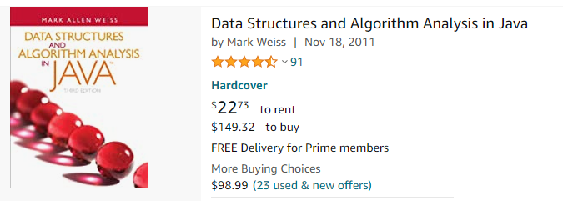
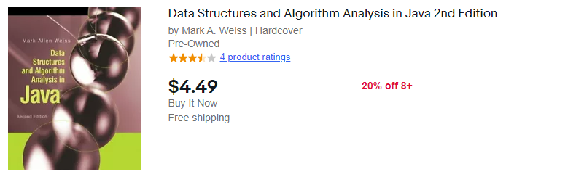
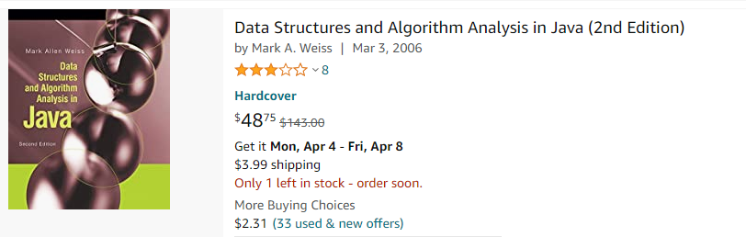
Course Information
http://www.cs.washington.edu/332
Weiss, Data Structures & Algorithm Analysis in Java, 3nd Edition, 2012.
(or buy 2nd edition—1/3 price on Amazon!)
Notes:
Announce is required.
3rd edition ~ $150
2nd edition ~ $45, or $3 used…

Slide 6
Communication
Announcements
cse332a_sp22@u
(you are automatically subscribed @u)
Ed STEM discussion board
first stop for questions about course content and assignments

Slide 7
Course meetings
Lecture
Materials posted (sometimes afterwards), but take notes
Ask questions, focus on key ideas (rarely coding details)
Section
Practice problems!
Answer Java/project/homework questions, etc.
Occasionally may introduce new material
An important part of the course (not optional)
Office hours
Use them: please visit us!

Slide 8
Course Work
~20 Weekly individual homework exercises
3 programming projects (with phases)
Use Java and IntelliJ, Gitlab
Done in partners, partners may be in another quiz section
You may do the projects on your own
Midterm and final exam
In class
Midterm: Friday, April 29
Final: Thursday, June 9, 8:30 AM.

Slide 9
Overall grading
Grading
25% - Written Homework Assignments
35% - Programming Assignments
15% - Midterm Exam (Apr 29)
25% - Final Exam (June 9, 8:30 AM)

Slide 10
Section
Meet on Thursdays
What happens there?
Answer questions about current homework
Previous homeworks returned and discussed
Discuss the project (getting started, getting through it, answering questions)
Finer points of Java, eclipse, etc.
Reinforce lecture material

Slide 11
Homework for Today!!
Project #1: Fill out partner request survey by 6pm Wednesday
Exercise #1 – Due FRIDAY at 11:59pm
Review Java & install IntelliJ
Reading in Weiss (see course web page)
(Topic for Project #1) Weiss 3.1-3.7 – Lists, Stacks, & Queues
(Wed) Weiss 2.1-2.4 –Algorithm Analysis
(Useful) Weiss 1.1-1.6 –Mathematics and Java
Notes:
See course web page for more on both of these

Slide 12
Today’s Outline
Introductions
Administrative Info
What is this course about?
Review: Queues and stacks

Slide 13
Common tasks
Many possible solutions
Choice of algorithm, data structures matters
What properties do we want?
speed, small memory, elegance/simplicity
Why does elegance matter? Easier to debug, maintain.
Often these things are at odds—can’t always have all three, but sometimes you can.
Notes:
Solving these problems requires: algorithm, data structures
Choice of alg/ds can make a huge difference (seconds vs. days)
Desiderada: speed, small memory, elegance/simplicity
Why does elegance matter? Easier to debug, maintain.
Often these things are at odds—can’t always have all three, but sometimes you can.
Usually, the first thing you think of is much slower than the best performing method
People have written PhD theses on memory allocation, sorting algorithms, etc.
Some of these methods are very complex, some are simple and elegant—we’ll be focusing on the latter…

Slide 14
Why should we care?
Computers are getting faster
No need to optimize
Libraries: experts have done it for you
Computers are getting faster→ no need to optimize
Some truth to this—many optimizations no longer matter. But problem size are bigger (terrabytes!)
No more Moore’s law for CPU’s
Libraries—experts have done the hard work for you. But—which routine to call? What if alg isn’t there?
Notes:
Computers are getting faster: no need to optimize?
there’s some truth to this—many optimizations no longer matter
But usually it does matter—problem sizes are getting much bigger
- examples: hard disk—terrabytes! (my first mac had 10M disk).
No more Moore’s law for CPUs…
Libraries: experts have done this for you
How do you know which routine to call?
What if the alg you need isn’t there?

Slide 15
Program Abstraction
Problem defn:
Algorithm:
Implementation:
Sort N numbers
? Quicksort, insertion sort…
quickSort.java, quickSort.c, …
Notes:
Sort N number
Alg: quick sort, insertion sort, bubble sort…
Imp: quickSort.java quickSort.C

Slide 16
Data Abstraction
Abstract Data Type (ADT):
Data Structure:
Implementation:
Stack -> ? push, pop, isEmpty
? Linked list, array, …
java.util.Stack, java.util.LinkedList
Notes:
ADT: Stack → push, pop, isEmpty
DataStructure: linked list, array
Implementation: java.util.Stack, java.util.LinkedList

Slide 17
Trade offs: storing a set

Slide 18
Terminology
Abstract Data Type (ADT)
Mathematical description of an object with set of operations on the object. Useful building block.
Algorithm
A high level, language-independent, description of a step-by-step process.
Data structure
A specific organization of the data to accompany algorithms for an abstract data type.
Implementation of data structure
A specific implementation in a specific language.

Slide 19
Today’s Outline
Introductions
Administrative Info
What is this course about?
Review: queues and stacks

Slide 20
First Example: Queue ADT
FIFO: First In First Out
Queue operations
create
destroy
enqueue
dequeue
is_empty
F E D C B
G
enqueue
dequeue
A
Notes:
You’ve probably seen the Q before. If so, this is an opportunity to get familiar with how we will be treating concepts in this class. If not, then the Q is a simple but very powerful abstraction, and you should make sure you understand it thoroughly.
Note the lack of any implementation details – just the interface and key properties that must be satisfied.

Slide 21
Queues in practice
Print jobs
File serving
Phone calls and operators
(Later, we will consider “priority queues.”)

Slide 22
Array Queue Data Structure
0
size - 1
Q
b
c
d
e
f
back
enqueue(Object x) {
Q[back] = x
back = (back + 1)
}
What’s missing in these functions?
How to find K-th element in the queue?
dequeue() {
x = Q[0]
shiftLeftOne()
back = (back – 1)
return x
}
Notes:
Here is a data structure implementation of the Q.
The queue is stored as an array.
shiftLeftOne is expensive!
There’s also another problem here. What’s wrong with the Enqueue and Dequeue functions?
Your data structures should be robust! Make them robust before you even consider thinking about making them efficient! That is an order!

Slide 23
Circular Array Queue Data Structure
0
size - 1
Q
b
c
d
e
f
front
back
enqueue(Object x) {
assert(!is_full())
Q[back] = x
back = (back + 1)
}
How test for empty/full list?
How to find K-th element in the queue?
What to do when full?
dequeue() {
assert(!is_empty())
x = Q[front]
front = (front + 1)
return x
}
Notes:
Here is another data structure implementation of the Q.
The queue is stored as an array, and, to avoid shifting all the elements each time an element is dequeued, we imagine that the array wraps around on itself.
Test for empty/full: front = back
Can we do something smarter when full?

Slide 24
Linked List Queue Data Structure
b
c
d
e
f
front
back
void enqueue(Object x) {
if (is_empty())
front = back = new Node(x)
else {
back->next = new Node(x)
back = back->next
}
}
bool is_empty() {
return front == null
}
Object dequeue() {
assert(!is_empty())
return_data = front->data
temp = front
front = front->next
delete temp
return return_data
}

Slide 25
Circular Array vs. Linked List
Advantages of circular array?
Advantages of linked list?
- unused space, resizing
+ faster indexing
+ memory coherence
+ can grow as needed
- slow indexing
Notes:
Advantage of circular array? Faster (except for resize), simpler memory management
Advantage of linked list? No max size (or need to reallocate/copy)

Slide 26
Second Example: Stack ADT
LIFO: Last In First Out
Stack operations
create
destroy
push
pop
top
is_empty
A
E D C B A
B
C
D
E
F
F

Slide 27
Stacks in Practice
Function call stack
Removing recursion
Balancing symbols (parentheses)
Evaluating postfix or “reverse Polish” notation

Slide 28
Assigned readings
Reading in Weiss
Chapter 1 – (Review) Mathematics and Java
Chapter 2 – (Next lecture) Algorithm Analysis
Chapter 3 – (Project #1) Lists, Stacks, & Queues

