Slide 1
CSE 332: Data Structures and Parallelism
Spring 2022
Richard Anderson
Lecture 26: Dijkstra’s Algorithm

Slide 2
Announcements
Upcoming lectures
Intro to graphs
Topological Sort
Graph Algorithms
Graph Traversal
Shortest Paths
Minimum Spanning Tree
Theory of NP-Completeness (2 lectures)

Slide 3
Graph Theory
G = (V, E)
V: vertices, |V|= n
E: edges, |E| = m
Undirected graphs
Edges sets of two vertices {u, v}
Directed graphs
Edges ordered pairs (u, v)
Many other flavors
Edge / vertices weights
Parallel edges
Self loops
Path: v₁, v₂, …, v_{k}, with (v_{i}, v_{i+1}) in E
Simple Path
Cycle
Simple Cycle
Neighborhood
N(v)
Distance
Connectivity
Undirected
Directed (strong connectivity)
Trees
Rooted
Unrooted

Slide 4
Graph Representation
b
V = { a, b, c, d}
a
E = { {a, b}, {a, c}, {a, d}, {b, d} }
d
c
a
b
c
d
1
1
1
b
a
d
1
0
1
c
a
1
0
0
d
a
b
1
1
0
Adjacency List
Adjacency Matrix
O(n + m) space
O(n²) space

Slide 5
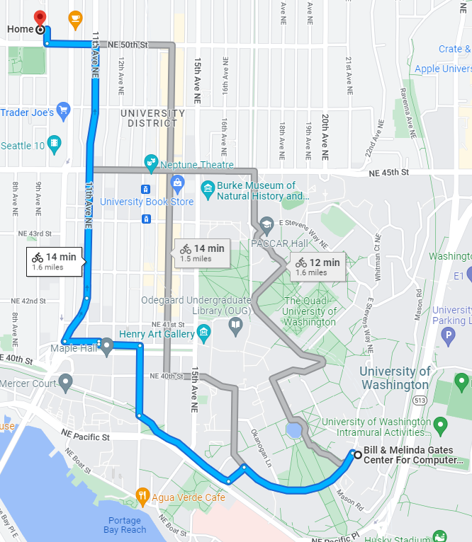
Find the shortest path

Slide 6
The Shortest Path Problem
Given a graph G, and vertices s and t in G, find the shortest path from s to t.
Two cases: weighted and unweighted.
For a path p = v₀ v₁ v₂ … v_{k}
unweighted length of path p = k (length)
weighted length of path p = ∑_{i=0..k-1} c_{i,i+1} (cost)
We will assume the graph is directed

Slide 7
Single Source Shortest Paths (SSSP)
Given a graph G and vertex s, find the shortest paths from s to all vertices in G.
How much harder is this than finding single shortest path from s to t?
Most algorithms will have to find the shortest path to every vertex in the graph in the worst case
Although may stop early in some cases

Slide 8
SSSP: Unweighted Version
This is just Breadth First Search
Build a breadth first search tree starting from s

Slide 9
void BFS(Vertex s){
Queue q(NUM_VERTICES);
Vertex v, w;
for each w {
w.dist = INFINITY;
w.prev = -1;
}
s.dist = 0;
q.enqueue(s);
while (!q.isEmpty()){
v = q.dequeue();
for each w adjacent to v
if (w.dist == INFINITY){
w.dist = v.dist + 1;
w.prev = v;
q.enqueue(w);
}
}
}
each edge examined
at most once – if adjacency lists are used
each vertex enqueued
at most once

Slide 10
s
v₁
v₀
v₂
v₃
v₄
V | Dist | prev
v₀
v₁
v₂
v₃
v₄
v₅
v₆
v₅
v₆

Slide 11
Weighted shortest paths problem
4
i
2
d
1
h
7
a
1
1
4
5
3
6
k
4
2
4
e
j
4
3
c
3
6
s
2
2
l
3
3
m
7
2
7
6
g
6
2
b
7
n
7
3
2
f
2
4
o

Slide 12
Construct Shortest Path Tree from s
2
d
d
a
1
5
a
4
4
4
e
e
1
c
s
2
c
3
s
3
2
6
g
g
b
b
7
3
f
f

Slide 13
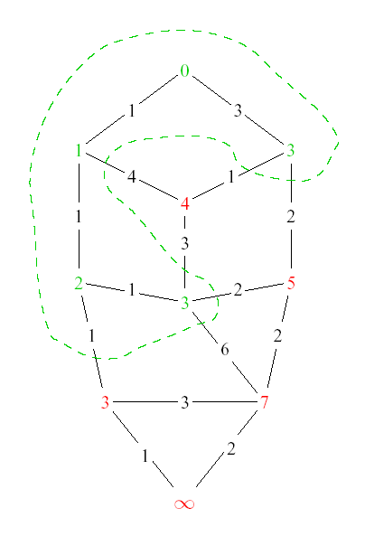
Dijkstra’s Algorithm: Idea
Assume all edges have non-negative cost
Adapt BFS to handle weighted graphs
Two kinds of vertices:
Known
shortest distance is already known
Unknown
Have tentative distance

Slide 14
Dijkstra’s Algorithm: Idea
At each step:
Pick closest unknown vertex
Add it to known vertices
Update distances

Slide 15
Dijkstra’s Algorithm
Assume all edges have non-negative cost
S = { }; d[s] = 0; d[v] = infinity for v != s
while S != V
Choose v in V-S with minimum d[v]
Add v to S
for each w in the neighborhood of v
newCost = d[v] + c(v, w)
if (newCost < d[w])
d[w] = newCost
prev[w] = v
4
3
y
1
1
u
1
0
1
s
4
2
2
x
2
2
v
2
3
z
5

Slide 16
Important Features
Once a vertex is known (in S), the cost of the shortest path to that vertex is correct
While a vertex is still unknown, another shorter path to it might still be found
The shortest path can found by following the previous pointers stored at each vertex

Slide 17
2
s
v₁
v₀
2
1
5
1
1
1
v₂
v₃
v₄
2
6
5
3
10
v₅
v₆
V | Known? | Cost | Previous
v0
v1
v2
v3
v4
v5
v6

Slide 18
Implementation
S = { }; d[s] = 0; d[v] = infinity for v != s
while S != V
Choose v in V-S with minimum d[v]
Add v to S
for each w in the neighborhood of v
newCost = d[v] + c(v, w)
if (newCost < d[w])
d[w] = newCost
prev[w] = v
4
3
y
1
1
u
1
0
1
s
4
2
2
x
2
2
v
2
3
z
5
What are the heap operations?
How many heap operations?

Slide 19
Dijkstra Algorithm
int dist[N], prev[N];
for (int i = 0; i < N; i++){ dist[i] = INFINITY;
prev[i] = -1;
}
dist[s] = 0;
Heap h = new Heap(dist);
while (!h.isEmpty()){
v = h.DeleteMin();
for each w adjacent to v {
int newCost = dist[v] + cost(v,w);
if (newCost < dist[w]){
dist[w] = newCost;
h.DecreaseKey(w, newCost);
prev[w] = v;
}
}
}

Slide 20
Correctness Proof
Elements in S have the correct label
Induction: when v is added to S, it has the correct distance label
Dist(s, v) = d[v] when v added to S
y
S
x
s
u
v

Slide 21
D-Heaps (again)
Heaps with branching factor D
DeleteMin runtime O(Dlog_{D} N)
Decrease Key runtime O(log_{D} N)

Slide 22
Dijkstra’s Algorithm with D heaps
n DeleteMin operations
m DecreaseKey operations
Runtime O(n Dlog_{D} n + m log_{D} n)
What value for D?

Slide 23
Why do we worry about negative cost edges?

