Slide 1
CSE 332: Data Structures and Parallelism
Fall 2022
Richard Anderson
Lecture 25: Graph Traversal and Shortest Paths and Other Algorithms

Slide 2
Announcements
Lectures
Intro to graphs
Topological Sort
Parallelism and Concurrency (6 lectures)
Graph Algorithms
Graph Traversal
Shortest Paths
Minimum Spanning Tree
Theory of NP-Completeness (2 lectures)

Slide 3
Graph Theory
G = (V, E)
V: vertices, |V|= n
E: edges, |E| = m
Undirected graphs
Edges sets of two vertices {u, v}
Directed graphs
Edges ordered pairs (u, v)
Many other flavors
Edge / vertices weights
Parallel edges
Self loops
Path: v₁, v₂, …, v_{k}, with (v_{i}, v_{i+1})∈E
Simple Path
Cycle
Simple Cycle
Neighborhood
N(v)
Distance
Connectivity
Undirected
Directed (strong connectivity)
Trees
Rooted
Unrooted

Slide 4
Graph Representation
b
V = { a, b, c, d}
a
E = { {a, b}, {a, c}, {a, d}, {b, d} }
d
c
a
b
c
d
1
1
1
b
a
d
1
0
1
c
a
1
0
0
d
a
b
1
1
0
Adjacency List
Adjacency Matrix
O(n + m) space
O(n²) space

Slide 5
Topological Sort
while there is a vertex v with in-degree 0 {
output v
remove v from G
}
E
H
I
A
D
G
J
C
F
K
B
L

Slide 6
Graph search
Find a path from s to t
S = {s}
while S is not empty
u = Select(S)
visit u
foreach v in N(u)
if v is unvisited
Add(S, v)
Pred[v] = u
if (v == t) then path found

Slide 7
Graph Search
t
s

Slide 8
Breadth first search
Explore vertices in layers
s in layer 1
Neighbors of s in layer 2
Neighbors of layer 2 in layer 3 . . .
s

Slide 9
Breadth First Search
Build a BFS tree from s
Q = {s}
Level[s] = 1;
while Q is not empty
u = Q.Dequeue()
visit u
foreach v in N(u)
if v is unvisited
Q.Enqueue(v)
Pred[v] = u
Level[v] = Level[u] + 1

Slide 10
Key observation: BFS Levels
All edges go between vertices on the same level or adjacent levels
1
2
3
4
5
6
7
8

Slide 11
Bipartite Graphs
A graph V is bipartite if V can be partitioned into V₁, V₂ such that all edges go between V₁ and V₂
A graph is bipartite if it can be two colored

Slide 12
Can this graph be two colored?

Slide 13
Algorithm
Run BFS
Color odd layers red, even layers blue
If no edges between the same layer, the graph is bipartite
If edge between two vertices of the same layer, then there is an odd cycle, and the graph is not bipartite

Slide 14
A graph is bipartite if and only if it has no odd cycles

Slide 15
Graph Search
Data structure for next vertex to visit determines search order

Slide 16
Graph search
Breadth First Search
S = {s}
while S is not empty
u = Dequeue(S)
if u is unvisited
visit u
foreach v in N(u)
Enqueue(S, v)
Depth First Search
S = {s}
while S is not empty
u = Pop(S)
if u is unvisited
visit u
foreach v in N(u)
Push(S, v)

Slide 17
Breadth First Search
All edges go between vertices on the same layer or adjacent layers
1
2
3
4
5
6
7
8

Slide 18
Depth First Search
1
Each edge goes between vertices on the same branch
No cross edges
2
6
3
4
7
12
5
8
9
10
11

Slide 19
Connected Components
Undirected Graphs

Slide 20
Computing Connected Components in O(n+m) time
A search algorithm from a vertex v can find all vertices in v’s component
While there is an unvisited vertex v, search from v to find a new component

Slide 21
Directed Graphs
A Strongly Connected Component is a subset of the vertices with paths between every pair of vertices.

Slide 22
Identify the Strongly Connected Components

Slide 23
Strongly connected components can be found in O(n+m) time
But it’s tricky!
Simpler problem: given a vertex v, compute the vertices in v’s scc in O(n+m) time

Slide 24
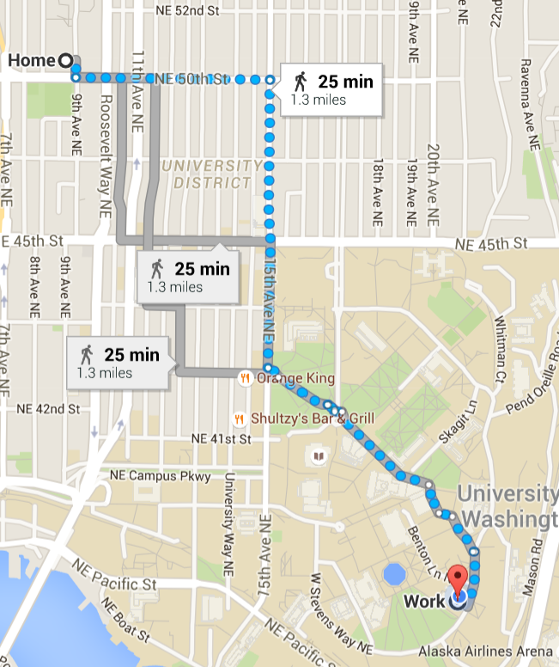
Paths and connectivity

Slide 25
The Shortest Path Problem
Given a graph G, and vertices s and t in G, find the shortest path from s to t.
Two cases: weighted and unweighted.
For a path p = v₀ v₁ v₂ … v_{k}
unweighted length of path p = k (length)
weighted length of path p = ∑_{i=0..k-1} c_{i,i+1} (cost)

Slide 26
Single Source Shortest Paths (SSSP)
Given a graph G and vertex s, find the shortest paths from s to all vertices in G.
How much harder is this than finding single shortest path from s to t?

Slide 27
Variations of SSSP
Weighted vs unweighted
Directed vs undirected
Cyclic vs acyclic
Positive weights only vs negative weights allowed
Shortest path vs longest path
…

Slide 28
Applications
Network routing
Driving directions
Cheap flight tickets
Critical paths in project management (see textbook)
…

Slide 29
SSSP: Unweighted Version

Slide 30
void UnweightedGraphSearch(Vertex s){
Queue q(NUM_VERTICES);
Vertex v, w;
q.enqueue(s);
s.dist = 0;
while (!q.isEmpty()){
v = q.dequeue();
for each w adjacent to v
if (w.dist == INFINITY){
w.dist = v.dist + 1;
w.prev = v;
q.enqueue(w);
}
}
}
each edge examined
at most once – if adjacency lists are used
each vertex enqueued
at most once
total running time: O( )

Slide 31
s
v₁
v₀
v₂
v₃
v₄
V | Dist | prev
v₀
v₁
v₂
v₃
v₄
v₅
v₆
v₅
v₆

Slide 32
Weighted SSSP: All edges are not created equal
Home
Ben & Jerry’s
Cedars
Neelam’s
40
285
U Village
Delfino’s
75
70
365
25
Coke Closet
375
The Ave
350
350
10
25
HUB
35
ALLEN
35
Café Allegro
15
Schultzy’s
Vending Machine in EE1
15,356
Parent’s Home
Can we calculate shortest distance to all vertices from Allen Center?
Notes:
So, here’s an example of a weighted graph. Now, let’s ask: what’s the shortest path cost to, say, Ben and Jerry’s?

Slide 33
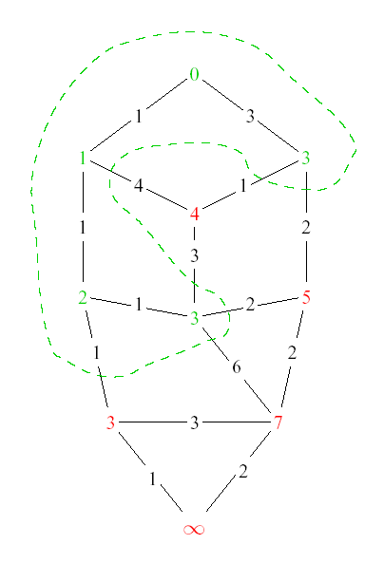
Dijkstra’s Algorithm: Idea
Adapt BFS to handle weighted graphs
Two kinds of vertices:
Known
shortest distance is already known
Unknown
Have tentative distance

Slide 34
Dijkstra’s Algorithm: Idea
At each step:
Pick closest unknown vertex
Add it to known vertices
Update distances

Slide 35
Dijkstra’s Algorithm: Pseudocode
Initialize the cost of each node to ∞
Initialize the cost of the source to 0
While there are unknown vertices left in the graph
Select an unknown vertex a with the lowest cost
Mark a as known
For each vertex b adjacent to a
newcost = cost(a) + cost(a,b)
if (newcost < cost(b))
cost(b) = newcost
previous(b) = a
Notes:
Here’s pseudocode for how dijkstra’s actually works.
Speak the algorithm.
Notice that we need to be able to find a minimum node and also update costs to nodes.

Slide 36
Important Features
Once a vertex is known, the cost of the shortest path to that vertex is known
While a vertex is still unknown, another shorter path to it might still be found
The shortest path can found by following the previous pointers stored at each vertex

Slide 37
2
s
v₁
v₀
2
1
5
1
1
1
v₂
v₃
v₄
2
6
5
3
10
v₅
v₆
V | Known? | Cost | Previous
v0
v1
v2
v3
v4
v5
v6

Slide 38
Dijkstra’s Alg: Implementation
Initialize the cost of each vertex to ∞
Initialize the cost of the source to 0
While there are unknown vertices left in the graph
Select the unknown vertex a with the lowest cost
Mark a as known
For each vertex b adjacent to a
newcost = min(cost(b), cost(a) + cost(a, b))
if newcost < cost(b)
cost(b) = newcost
previous(b) = a
What data structures should we use?
Running time?
Notes:
Here’s pseudocode for how dijkstra’s actually works.
Speak the algorithm.
Notice that we need to be able to find a minimum node and also update costs to nodes.

Slide 39
Dijkstra’s Algorithm: Summary
Classic algorithm for solving SSSP in weighted graphs without negative weights
A greedy algorithm (irrevocably makes decisions without considering future consequences)
Why does it work?
Notes:
Among the wide variety of things he has done, he created Dijkstra’s algorithm more than 40 years ago (in 1959!).
Dijkstra’s algorithm is a greedy algorithm (like Huffman encoding), so it just makes the best local choice at each step.
The choice it makes is which shortest path to declare known next.
It starts by declaring the start node known to have a shortest path of length 0. Then, it updates neighboring node’s path costs according to the start node’s cost.
Then, it just keeps picking the next shortest path and fixing that one until it has all the vertices.

Slide 40
Continuation
I don’t expect to get close to this on Wednesday
I do not plan on giving the correctness proof – you will need to wait for 421. I might wave my hands a bit on the general ideas for the proof
Assuming I have time on Friday, I am going to talk more about the use of heaps in Dijkstra’s algorithm, as this is a data structures course

