Slide 1
CSE 332: Data Structures and Parallelism
Fall 2022
Anjali Agarwal
Lecture 18: Graph Theory

Slide 2
Announcements
Upcoming lectures
Intro to graphs
Topological Sort
Parallelism (3 lectures)
Concurrency (2 lectures)

Slide 3
Graphs
A formalism for representing binary relationships between objects
Graph G = (V,E)
Set of vertices: V = {v₁,v₂,…,v_{n}}
Set of edges: E = {e₁,e₂,…,e_{m}}
Directed
Undirected
D
D
A
A
C
C
B
B
V = {A, B, C, D}
E = {(C, B),(A, B),(B, A),(C, D)}
V = {A, B, C, D}
E = {{C, B},{A, B},{C, D}}
Notes:
I’m not convinced this is really an ADT, but it is certainly an important structure.

Slide 4
Representation 1: Adjacency List
A list (array) of length |V| in which each entry stores a list (linked list) of all adjacent vertices
D
A
A
C
B
B
C
Runtimes:
Iterate over vertices?
Iterate over edges?
Iterate edges adj. to vertex?
Existence of edge?
D
Space requirements?
Best for what kinds of graphs?
Notes:
Some operations:
iterate over vertices
iterate over edges
iterate over vertices adj. to a vertex
check whether an edge exists

Slide 5
Representation 2: Adjacency Matrix
A |V| x |V| matrix M in which an element M[u,v] is true if and only if there is an edge from u to v
A
B
C
D
D
A
A
B
C
C
B
Runtimes:
Iterate over vertices?
Iterate over edges?
Iterate edges adj. to vertex?
Existence of edge?
D
Space requirements?
Best for what kinds of graphs?
Notes:
Some operations:
iterate over vertices
iterate over edges
iterate over vertices adj. to a vertex
check whether an edge exists

Slide 6
Representing Undirected Graphs
What do these reps look like for an undirected graph?
D
A
C
Adjacency matrix:
B
A
B
C
D
Adjacency list:
A
A
B
B
C
C
D
D
Notes:
Some operations:
iterate over vertices
iterate over edges
iterate over vertices adj. to a vertex
check whether an edge exists

Slide 7
|E| and |V|
How many edges |E| in a directed graph with |V| vertices?
How many edges |E| in a undirected graph with |V| vertices?
How many edges |E| in a undirected, connected graph with |V| vertices?
Some (semi-standard) terminology:
A graph is sparse if it has O(|V|) edges (upper bound).
A graph is dense if it has Θ(|V|²) edges.
Notes:
0 <= |E| <= |V| (|V| - 1)
0 <= |E| <= |V| (|V| - 1) / 2
|V| - 1 <= |E| <= |V| (|V| - 1)/2
E.g. straight line graph, or tree
Sparse: Every vertex has an edge to 3 other vertices
Dense: Every vertex has an edge to ½ the other vertices

Slide 8
Directed Acyclic Graphs (DAGs)
DAGs are directed graphs with no (directed) cycles.
main()
mult()
add()
access()
read()
Notes:
And, in fact, if we weaken some of our tree requirements, we get a DAG!
DAGs are a very common representation for dependence graphs. The DAG here shows the non-recursive call-graph from a program.

Slide 9
Topological Sort
Given a directed graph, G = (V,E), output all the vertices in V sorted so that no vertex is output before any other vertex with an edge to it.
142
143
321
341 303
370
378
322
326
403
421
451
457
467
CSE 403
CSE 321
CSE 322
CSE 421
CSE 142
CSE 143
CSE 341
CSE 326
CSE 451
What kind of input
graph is allowed?
CSE 378
CSE 303
CSE 457
CSE 370
CSE 467
Is the output unique?
Notes:
A topological or topo-sort is just a valid sorting of these vertices when we define an edge as an ordering constraint/relationship.
There are many other applications of topological sort. The classic example is getting a valid ordering of classes when edges represent prerequisites
What happens if I add an edge from “CSE 467” to “CSE 142”? This graph is no longer a DAG! In fact, we cannot topo-sort without a DAG!

Slide 10
Find valid topological sorts
2
1
4
3
0
Notes:
Doesn’t have to be connected
Applications:
Degree planning / scheduling
Scheduling tasks that have dependencies
Compiling with the call graph or makefile

Slide 11
Topological Sort: Take One
Label each vertex with its in-degree (# inbound edges)
While there are vertices remaining:
Choose a vertex v of in-degree zero; output v
Reduce the in-degree of all vertices adjacent to v
Remove v from the list of vertices
In-degree
2
0
[3]
1
4
1
[2, 3]
2
[4]
3
0
3
[4]
4
[]
Notes:
That’s a bit less efficient than we can do.
Let’s try this.
How well does this run? Depends on how fast we can find a vertex with degree zero (let’s say |V|). How quickly can we find adjacent vertices? (|E|). So O(|E| + |V|^2) = O(|V|^2)

Slide 12
void topsort(){ labelEachVertexWithItsInDegree();
for (int counter=0; counter < NUM_VERTICES; counter++){
v = findNewVertexOfDegreeZero();
output(v);
for each w adjacent to v
w.indegree--;
mark_as_outputted(v);
}
}
Runtime:
Notes:
We should never find a cycle – this is a DAG
How long does this take?
O((V+E) + V(V + 1 + d_v * 1) = O(E + V^2) = O(V^2)
Observation: The only new (eligible) vertices with indegree 0 are the ones adjacent to the vertex just processed.

Slide 13
Topological Sort: Take Two
Label each vertex with its in-degree
Initialize a queue Q to contain all in-degree zero vertices
While Q not empty
v = Q.dequeue; output v
For each vertex u adjacent to v:
Reduce the in-degree of u
If new in-degree u is zero, Q.enqueue(u)
Notes:
Why use a queue?
Some sense of stability (as discussed during the sorting )

Slide 14
Topological Sort: Take Two
In-degree
0
[3]
Label each vertex with its in-degree
Initialize a queue Q to contain all in-degree zero vertices
While Q not empty
v = Q.dequeue; output v
For each vertex u adjacent to v:
Reduce the in-degree of u
If new in-degree u is zero, Q.enqueue(u)
1
[2, 3]
2
[4]
3
[4]
4
[]
2
1
4
3
0
CSE 332
Notes:
Why use a queue?
Some sense of stability (as discussed during the sorting )

Slide 15
topsort(){
Queue q(NUM_VERTICES);
Vertex v, w;
labelEachVertexWithItsIn-degree();
q.makeEmpty();
for each vertex v
if (v.indegree == 0)
q.enqueue(v);
while (!q.isEmpty()){
v = q.dequeue();
output(v);
for each w adjacent to v
w.indegree--;
if (w.indegree == 0)
q.enqueue(w);
}
}
initialize the
queue
get a vertex with
indegree 0
insert new
eligible
vertices
Runtime?
Notes:
Idea: Use a set data structure to keep track of eligible vertices (Queue or Stack).

Slide 16
Find a topological order for the following graph
Queue q(NUM_VERTICES);
labelEachVertexWithInDegree();
q.makeEmpty();
for each vertex v
if (v.indegree == 0)
q.enqueue(v);
while (!q.isEmpty()):
v = q.dequeue();
output(v);
for each w adjacent to v
w.indegree--;
if (w.indegree == 0)
q.enqueue(w);
H
E
I
A
D
G
J
C
F
K
B
L

Slide 17
When can we find a topological sort of a directed graph?
If the graph has a cycle, there is no topological sort
If the graph is acyclic, there is a topological sort
In other words:
A directed graph has a topological sort if and only if it is acyclic.

Slide 18
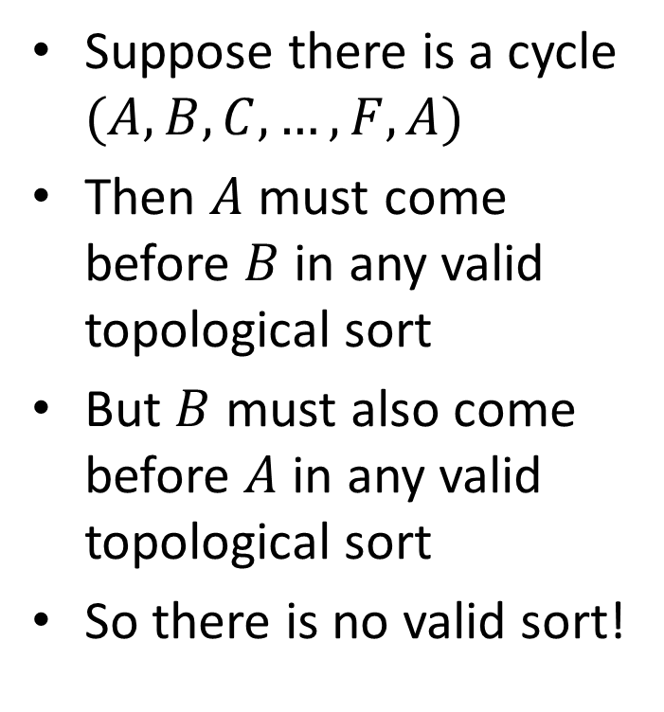
1. If a graph has a cycle, there is no topological sort
Suppose there is a cycle $(A,B,C,…,F,A)$
Then $A$ must come before $B$ in any valid topological sort
But $B$ must also come before $A$ in any valid topological sort
So there is no valid sort!
A
F
B
E
C
D

Slide 19
2. If the graph is acyclic, there is a topological sort
We won’t prove the entire statement. Instead…
Lemma: If a graph is acyclic, it has a vertex with in-degree 0
Proof:
Pick a vertex v₁, if it has in-degree 0 then done
If not, let (v₂, v₁) be an edge, if v₂ has in-degree 0 then done
If not, let (v₃, v₂) be an edge . . .
If this process continues for more than |V| steps, we have a repeated vertex, so we have a cycle

Slide 20
Shortest Paths Problem
Given a directed graph with edge costs and a starting vertex s, find the minimum cost path from s to every other vertex in the graph.
Future results
Dijkstra’s algorithm solves the shortest paths problems if all costs are non-negative
Bellman-Ford’s algorithm solves the shortest paths problem if costs are allowed to be negative
Project 3 implements, and parallelizes Bellman-Ford

Slide 21
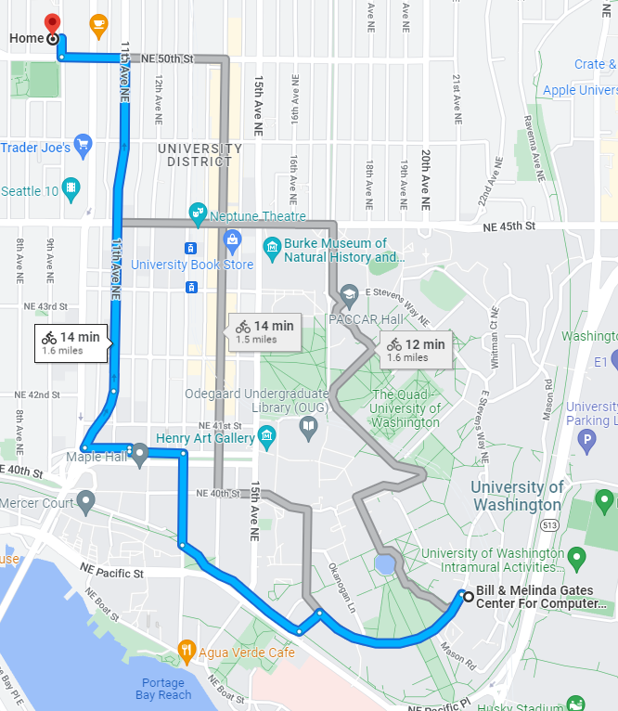
Example: Find the shortest path

Slide 22
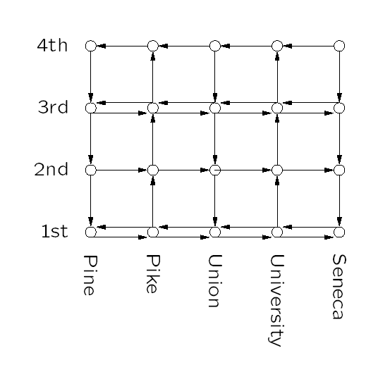
Example: Bus Routes in Downtown Seattle
If we’re at 3rd and Pine, how can we get to
1st and University using Metro?
How about 4th and Seneca?
Notes:
And here’s some directed graph examples

Slide 23
The Shortest Path Problem
Given a graph G, and vertices s and t in G, find the shortest path from s to t.
Two cases: weighted and unweighted.
For a path p = v₀ v₁ v₂ … v_{k}
unweighted length of path p = k (a.k.a. length)
weighted length of path p = ∑_{i=0..k-1} c_{i,i+1} (a.k.a. cost)
We will assume the graph is directed

Slide 24
Single Source Shortest Paths (SSSP)
Given a graph G and vertex s, find the shortest paths from s to all vertices in G.
How much harder is this than finding single shortest path from s to t?
Most algorithms will have to find the shortest path to every vertex in the graph in the worst case
Although may stop early in some cases

