Slide 1
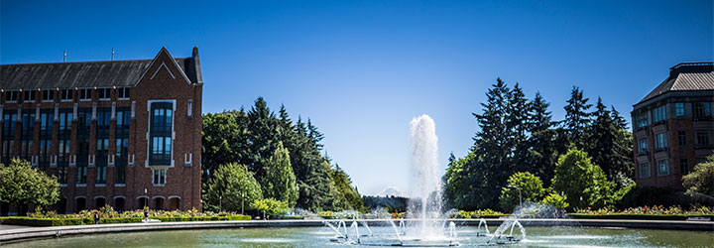
P vs. NP
Data Structures and Parallelism

Slide 2
Announcements
Review session in CSE 403 tomorrow at noon.
P3 due tonight. Exercise 12 & Exercise redos are due tomorrow.
Remember to fill out the token form so we know what exercises you’re redoing. Push to gitlab (for exercises 8-11) or submit to gradescope (all others) to submit.
If something weird happens with either of those, submit them to me in an email.

Slide 3
Announcements
Content from today is last stuff we’ll test you on for the final.
On Wednesday we’ll talk about what you need to know for the “real world” about P vs. NP.
MST lectures have been updated to correct minor bugs in pseudocode.
The way you executed the algorithm in lecture/section was correct, now the pseudocode will match what you did.
Please fill out course feedback forms!

Slide 4
A Longer Example
The best way to really see why topological sorts and strongly connected components are useful would be a bunch of examples.
You’d need to take 421 first. The second best way is to see one example right now...
This problem doesn’t look like it has anything to do with graphs
no maps
no roads
no social media friendships
Nonetheless, a graph representation is the best one.
Notes:
24:00

Slide 5
Example Problem: Final Creation
We have a list of types of problems we might want to put on the final.
ForkJoin code, Hash tables, B-Trees, Graphs,…
To try to make you all happy, we might ask for your preferences. Each of you gives us two preferences of the form “I [do/don’t] want a [] problem on the final” *
We’ll assume you’ll be happy if you get at least one of your two requests.
Given: A list of 2 preferences per student.
Find: A set of questions so every student gets at least one of their preferences (or accurately report no such question set exists).
Final Creation Problem
*This is NOT how I’m making the final.

Slide 6
Final Creation: Take 1
We have Q kinds of questions and S students.
What if we try every possible combination of questions.
How long does this take? O($2^{Q}S)$
If we have a lot of questions, that’s really slow.

Slide 7
Final Creation: Take 2
Problem | YES | NO
B-Tree | X
Hash Table |  | X
Graph
Fork Join
Each student introduces new relationships for data:
Let’s say your preferences are in the top table:
Yes! BTree
Yes!
Hash
Yes!
graph
Yes! FJ
Problem | YES | NO
B-Tree
Hash Table | X
Graph | X
Fork Join
NO BTree
NO Hash
NO graph
NO FJ

Slide 8
Final Creation: Take 2
Problem | YES | NO
B-Tree | X
Hash Table |  | X
Graph
Fork Join
Each student introduces new relationships for data:
Let’s say your preferences are represented by this table:
Yes! BTree
Yes!
Hash
Yes!
graph
Yes! FJ
Problem | YES | NO
B-Tree
Hash Table | X
Graph | X
Fork Join
NO BTree
NO Hash
NO graph
NO FJ
If we don’t include a B-Trees, can you still be happy?
If we do include a hash tables can you still be happy?

Slide 9
Final Creation: Take 2
Hey we made a graph!
What do the edges mean?
We need to avoid an edge that goes TRUE THING → FALSE THING
Let’s think about a single SCC of the graph.
NO C
NO E
NO B
Yes B
Yes A

Slide 10
Final Creation: SCCs
The vertices of a given SCC must either be all true or all false.
Algorithm Step 1: Run SCC on the graph. Check that each question-type-pair are in different SCC.
Now what? Every SCC gets the same value.
Treat it as a single object!
We want to avoid edges from true things to false things.
“Trues” seem more useful for us at the end.
Is there some way to start from the end?
YES! Topological Sort

Slide 11
Making the Final
Algorithm: Make the requirements graph.
Find the SCCs.
If an SCC has including and not including a problem, no final is possible.
Run topological sort on the graph of SCC.
Starting from the end:
if everything in a component is unassigned, set them to true, and set their opposites to false.
Else If one thing in a component is assigned, assign the same value to the rest of the nodes in the component and the opposite value to their opposites.

Slide 12
Making The Final
This works!!
The proof is a bit more involved. Just trust me.
How fast is it?
O(Q + S). That’s a HUGE improvement.

Slide 13
Some More Context
The Final Making Problem was a type of “Satisfiability” problem.
We had a bunch of variables (include/exclude this question), and needed to satisfy everything in a list of requirements.
Because every requirement was “do at least one of these 2” this was a 2-SAT instance.
What happens if we change the 2 to a 3?
Graph algorithm doesn’t seem to work…

Slide 14
P vs. NP

Slide 15
Taking a Big Step Back
What has this quarter been about?
We’ve taken problems you probably knew how to solve slowly,
And we figured out how to solve them faster.
In some sense, that’s the job of a computer scientist.
Figure out how to take our problems
And make the computer do the hard work for us.

Slide 16
Taking a Big Step Back
Let’s take a big step back, and try to break problems into two types:
Those for which a computer might be able to help.
And those which would take so long to solve even on a computer we wouldn’t expect to solve them.
This is not the same as asking for undecideable problems (like the Halting Problem you saw in 311).
There are problems we could solve in finite time…but we’ll all be long dead before our computer tells us the answer.

Slide 17
Running Times
(somewhat old) table from Rosen. How big of a problem can we solve for an algorithm with the given running times.
“very long” means more than ${10}^{25}$ years.

Slide 18
Efficient
We’ll consider a problem “efficiently solvable” if it has a polynomial time algorithm.
I.e. an algorithm that runs in time $O(n^{k})$ where $k$ is a constant.
Are these algorithms always actually efficient?
Well………no
Your $n^{10000}$ algorithm or even your $2^{2^{2^{2^{2}}}}⋅ n^{3}$ algorithm probably aren’t going to finish anytime soon.
But these edge cases are rare, and polynomial time is good as a low bar
If we can’t even find an $n^{10000}$ algorithm, we’re probably not

Slide 19
Decision Problems
Let’s go back to dividing problems into solvable/not solvable. For today, we’re going to talk about decision problems.
Problems that have a “yes” or “no” answer.
Why?
Theory reasons (you’ll see Wednesday).
But also most problems can be rephrased as very similar decision problems.
E.g. instead of “find the shortest path from s to t” ask Is there a path from s to t of length at most $k$?

Slide 20
P
The set of all decision problems that have an algorithm that runs in time $O\left(n^{k}\right)$ for some constant $k$.
P (stands for “Polynomial”)
The decision version of all problems we’ve solved in this class are in P.
P is an example of a “complexity class”
A set of problems that can be solved under some limitations (e.g. with some amount of memory or in some amount of time).

Slide 21
I’ll know it when I see it.
Another class of problems we want to talk about.
“I’ll know it when I see it” Problems.
Decision Problems such that:
If the answer is YES, you can prove the answer is yes by
Being given a “proof” or a “certificate”
Verifying that certificate in polynomial time.
What certificate would be convenient for short paths?
The path itself. Easy to check the path is really in the graph and really short.

Slide 22
I’ll know it when I see it.
More formally,
It’s a common misconception that NP stands for “not polynomial” Please never ever ever ever say that.
Please.
Every time you do a theoretical computer scientist sheds a single tear.
(That theoretical computer scientist is me)
The set of all decision problems such that if the answer is YES, there is a proof of that which can be verified in polynomial time.
NP (stands for “nondeterministic polynomial”)

Slide 23
NP
We can verify YES instances of NP problems efficiently, but can we decide whether the answer is YES or NO efficiently?
I.e. can you bootstrap the ability to check a certificate into the ability to find a certificate?
We don’t know.
This is the P vs. NP problem.

Slide 24
P vs. NP
The set of all decision problems that have an algorithm that runs in time $O\left(n^{k}\right)$ for some constant $k$.
P (stands for “Polynomial”)
The set of all decision problems such that if the answer is YES, there is a proof of that which can be verified in polynomial time.
NP (stands for “nondeterministic polynomial”)
Claim: P $⊆$ NP (do you see why?)

Slide 25
Reductions
Let’s say we want to prove that some problem in NP needs exponential time (i.e. that P is not equal to NP).
Ideally we’d start with a really hard problem in NP.
What does it mean for one problem to be harder than another?
We say A reduces to B in polynomial time, if there is an algorithm for A that calls a black box for B at most polynomially many times
and runs at most polynomially many other operations.
Polynomial Time Reducible

Slide 26
Reductions
We say A reduces to B in polynomial time, if there is an algorithm for A that calls a black box for B at most polynomially many times
and runs at most polynomially many other operations.
Polynomial Time Reducible
If A reduces to B then A should be “easier” than B.
If we can solve B, we can definitely solve A.
Usually denoted A $≤_{P}$B.

Slide 27
NP-complete
Let’s say we want to prove that some problem in NP needs exponential time (i.e. that P is not equal to NP).
Ideally we’d start with a really hard problem in NP.
What is the hardest problem in NP?
A problem B is NP-complete if B is in NP and for all problems A in NP, A reduces to B in polynomial time.
NP-complete

Slide 28
NP-complete
An NP-complete problem is a hardest problem in NP.
Seems like the right place to start for proving P$≠$NP.
It’s also the right place to start for proving P=NP.
A polynomial time algorithm for one NP-complete problem, gives you a polynomial time algorithm for every problem in NP.

Slide 29
Examples
There are literally thousands of NP-complete problems.
And some of them look weirdly similar to problems we do know efficient algorithms for.
In P
NP-Complete
Given a directed graph, report if there is a path from s to t of length at most $k$.
Short Path
Given a directed graph, report if there is a path from s to t of length at least$k$.
Long Path

Slide 30
Examples
In P
NP-Complete
Given a weighted graph, find a spanning tree (a set of edges that connect all vertices) of weight at most $k$.
Light Spanning Tree
Given a weighted graph, find a tour (a walk that visits every vertex and returns to its start) of weight at most $k$.
Traveling Salesperson
The electric company just needs a greedy algorithm to lay its wires.
Amazon doesn’t know a way to optimally route its delivery trucks.

Slide 31
Examples
In P
NP-Complete
Given a list of requirements, all of the form “at least one of three must be true”
Set variables so all requirements are satisfied.
Given a list of requirements, all of the form “at least one of two must be true”
Set variables so all requirements are satisfied.
3-SAT
2-SAT
The “final creation problem” was just 2-SAT.
It didn’t look like there was an easy way to solve it…but there was.
Is the same true of 3-SAT? We don’t know.

Slide 32
NP-hard
One more class:
Problem B is NP-hard if for all problems A in NP, A reduces to B in polynomial time.
NP-hard
An NP-hard problem need not be in NP.
Examples?
Find the “best possible” certificate for an NP-hard problem.
Instead of a path of length at least $k,$find the longest path.
Instead of a tour of weight at most $k$, find the shortest tour.

Slide 33
NP-hard
Problem B is NP-complete if for all problems A in NP, A reduces to B in polynomial time.
NP-hard
Other Examples:
The halting problem is NP-hard (but not NP-complete).
So is n x n chess.
Given an n x n chessboard, can white force a win with perfect play?
n x n Chess

Slide 34
What The World Looks Like (We Think)
NP-hard
Halting Problem
nxn chess
NP-Complete
3-SAT, TSP
Long Path
NP
PP
Short Paths, Light Spanning Tree, 2-SAT

Slide 35
What The World Looks Like (If P=NP)
Still hard:
nxn chess
PP
Short Paths, Light Spanning Tree, 2-SAT
TSP, 3-SAT, Long Paths
Still impossible:
Halting Problem

Slide 36
Why P vs. NP matters
Not tested on final

Slide 37
The set of all decision problems that have an algorithm that runs in time $O\left(n^{k}\right)$ for some constant $k$.
P (stands for “Polynomial”)
The set of all decision problems such that if the answer is YES, there is a proof of that which can be verified in polynomial time.
NP (stands for “nondeterministic polynomial”)
Problem B is NP-complete if B is in NP and for all problems A in NP, A reduces to B in polynomial time.
NP-complete
Problem B is NP-hard if for all problems A in NP, A reduces to B in polynomial time.
NP-hard

Slide 38
Why is it called NP?
You’ve seen nondeterministic computation before.
Way back in 311.
NFAs would “magically” decide among a set of valid transitions.
Always choosing one that would lead to an accept state (if such a transition exists).

Slide 39
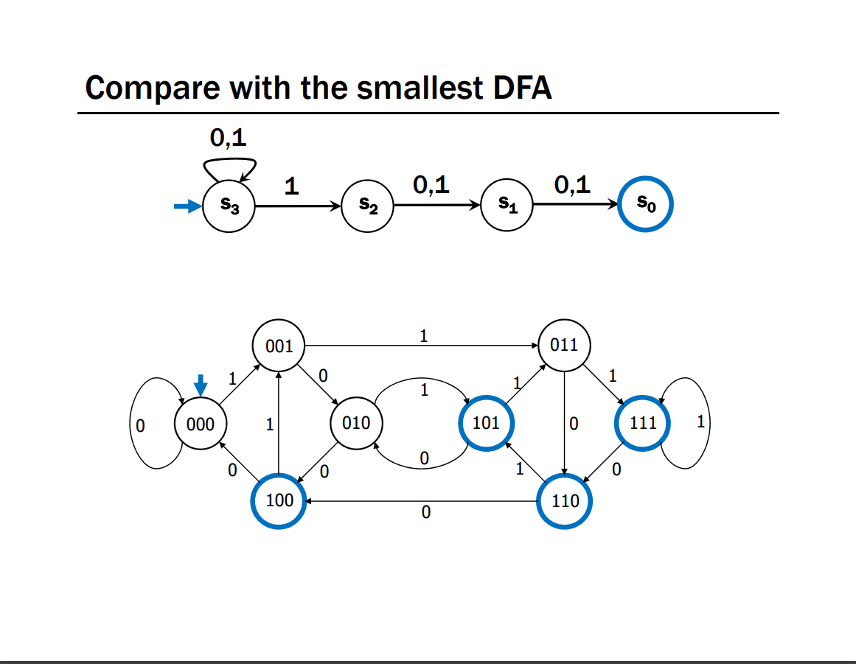
An NFA and a DFA for the language
“binary strings with a 1 in the 3rd position from the end.”
From Kevin & Paul’s 311 Lecture 23.

Slide 40
Nondeterminism
What would a nondeterministic computer look like?
It can run all the usual commands,
But it can also magically (i.e. nondeterministically) decide to set any bit of memory to 0 or 1.
Always choosing 0 or 1 to cause the computer to output YES,
(if such a choice exists).

Slide 41
If we had a nondeterministic computer…
Can you think of a polynomial time algorithm on a nondeterministic computer to:
Solve 2-SAT?
Solve 3-SAT?

Slide 42
If we had a nondeterministic computer…
Can you think of a polynomial time algorithm on a nondeterministic computer to:
Solve 2-SAT?
Just run our regular deterministic polynomial time algorithm
Or nondeterministically guess variable settings, output if they work.
Solve 3-SAT?
nondeterministically guess variable settings, output if they work.

Slide 43
Analogue of NFA/DFA equivalence
You showed in 311 that the set of languages decided by NFAs and DFAs were the same.
I.e. NFAs didn’t let you solve more problems than DFAs.
But it did sometimes make the process a lot easier.
There are languages such that the best DFA is exponentially larger than the best NFA. (like the one from a few slides ago).
P vs. NP is an analogous question. Does non-determinism let us use exponentially fewer resources to solve some problems?

Slide 44
History, and Why P vs. NP?
Not tested on the final.

Slide 45
NP-Completeness
An NP-complete problem is a universal language for encoding “I’ll know it when I see it” problems.
If you find an efficient algorithm for an NP-complete problem, you have an algorithm for every problem in NP
SAT is NP-complete
Cook-Levin Theorem (1971)

Slide 46
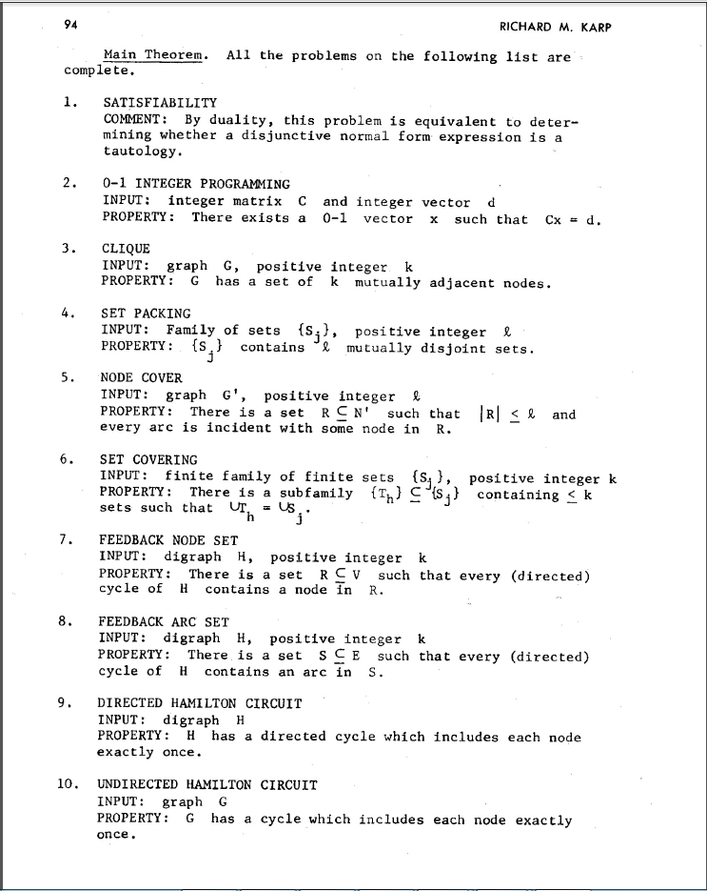
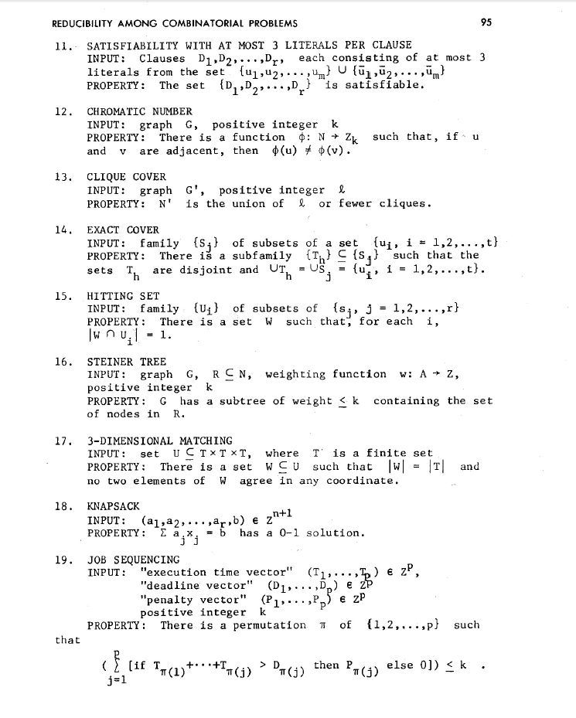
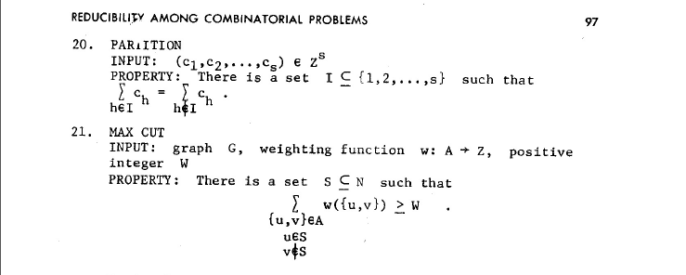
NP-Complete Problems
But Wait! There’s more!
A lot of problems people care about are NP-complete
Karp’s Theorem (1972)

Slide 47
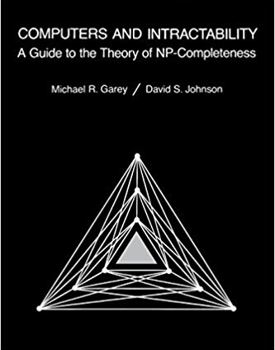
NP-Complete Problems
But Wait! There’s more!
By 1979, at least 300 problems had been proven NP-complete.
Garey and Johnson put a list of all the NP-complete problems they could find in this textbook.
Took them almost 100 pages to just list them all.
No one has made a comprehensive list since.

Slide 48
NP-Complete Problems
But Wait! There’s more!
In the last month, mathematicians and computer scientists have put papers on the arXiv claiming to show (at least) 14 more problems are NP-complete.
If you spend enough time trying to use computers to solve your problems, you will run into an NP-complete problem sooner or later.
What do you do?

Slide 49
Dealing with NP-Completeness
Option 1: Maybe it’s a special case we understand
Maybe you don’t need to solve the general problem, just a special case
2-SAT vs. 3-SAT
Option 2: Maybe it’s a special case we don’t understand (yet)
There are algorithms that are known to run quickly on “nice” instances. Maybe your problem has one of those.
One approach: Turn your problem into a SAT instance, find a solver and cross your fingers.

Slide 50
Dealing with NP-Completeness
Option 3: Approximation Algorithms
You might not be able to get an exact answer, but you might be able to get close.
Given a weighted graph, find a tour (a walk that visits every vertex and returns to its start) of minimum weight.
Optimization version of Traveling Salesperson
Algorithm:
Find a minimum spanning tree.
Have the tour follow the visitation order of a DFS of the spanning tree.
Theorem: This tour is at most twice as long as the best one.

Slide 51
Why should you care about P vs. NP
Most computer scientists are convinced that P$≠$NP.
Why should you care about this problem?
It’s your chance for:
$1,000,000. The Clay Mathematics Institute will give $1,000,000 to whoever solves P vs. NP (or any of the 5 remaining problems they listed)
To get a Turing Award

Slide 52
Why should you care about P vs. NP
Most computer scientists are convinced that P$≠$NP.
Why should you care about this problem?
It’s your chance for:
$1,000,000. The Clay Mathematics Institute will give $1,000,000 to whoever solves P vs. NP (or any of the 5 remaining problems they listed)
To get a Turing Award the Turing Award renamed after you.

Slide 53
Why Should You Care if P=NP?
Suppose P=NP.
Specifically that we found a genuinely in-practice efficient algorithm for an NP-complete problem. What would you do?
$1,000,000 from the Clay Math Institute obviously, but what’s next?

Slide 54
Why Should You Care if P=NP?
We found a genuinely in-practice efficient algorithm for an NP-complete problem. What would you do?
Another $5,000,000 from the Clay Math Institute
Put mathematicians out of work.
Decrypt (essentially) all current internet communication.
No more secure online shopping or online banking or online messaging…or online anything.
Maybe find the cure for cancer?
A world where P=NP is a very very different place from the world we live in now.

Slide 55
Why Should You Care if P$≠$NP?
We already expect P$≠$NP. Why should you care when we finally prove it?
P$≠$NP says something fundamental about the universe.
For some questions there is not a clever way to find the right answer
Even though you’ll know it when you see it.
There is actually a way to obscure information.

Slide 56
Why Should You Care if P$≠$NP?
To prove P$≠$NP we need to better understand the differences between problems.
Why do some problems allow easy solutions and others don’t?
What is the structure of these problems?
We don’t care about P vs NP just because it has a huge effect about what the world looks like.
We will learn a lot about computation along the way.

