Slide 1
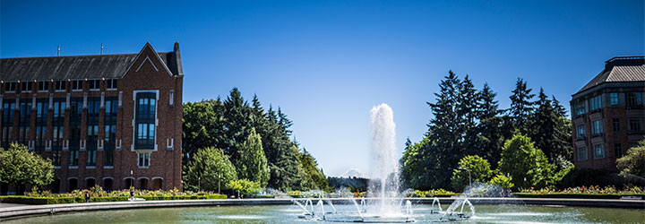
Shortest Paths
Data Structures and Parallelism

Slide 2
Announcements
Parallelism exercises due today
“One” more exercise out this afternoon.
We’ve written two exercises 12A and 12B.
You can either
1. Submit only one of A and B (whichever one you prefer)
2. Or use a token and do both (you get the higher of the two scores).
Because we’re at the end of the quarter, you won’t be able to use a token to redo exercise 12.
Both are useful for studying for the final, you should at least look at both.

Slide 3
Announcements
P3 checkpoint 2 Wednesday.
Using tokens to redo exercises: Redone exercises will be due next Tuesday (Aug 14) at 11:59 PM.
We’ll have a form to tell us
How many tokens you’re using for P3 late days and
Which exercises you’re redoing.
Have to decide by Tuesday Aug. 14.
Redone parallelism exercises will be submitted on gitlab.
Others submitted on gradescope.

Slide 4
Warm Up
Run Breadth First Search on this graph starting from s.
What order are vertices placed on the queue?
When processing a vertex insert neighbors in alphabetical order.
In a directed graph, BFS only follows an edge in the direction it points.
x
bfs(graph)
toVisit.enqueue(first vertex)
mark first vertex as visited
while(toVisit is not empty)
current = toVisit.dequeue()
for (V : current.outneighbors())
if (v is not visited)
toVisit.enqueue(v)
mark v as visited
finished.add(current)
u
s
t
v
y
w
Notes:
9:22

Slide 5
Warm Up
Run Breadth First Search on this graph starting from s.
What order are vertices placed on the queue?
When processing a vertex insert neighbors in alphabetical order.
In a directed graph, BFS only follows an edge in the direction it points.
x
bfs(graph)
toVisit.enqueue(first vertex)
mark first vertex as visited
while(toVisit is not empty)
current = toVisit.dequeue()
for (V : current.outneighbors())
if (v is not visited)
toVisit.enqueue(v)
mark v as visited
finished.add(current)
u
s
t
v
y
Correct order: s,u,v,y,x,w,t
w
Notes:
9:22

Slide 6
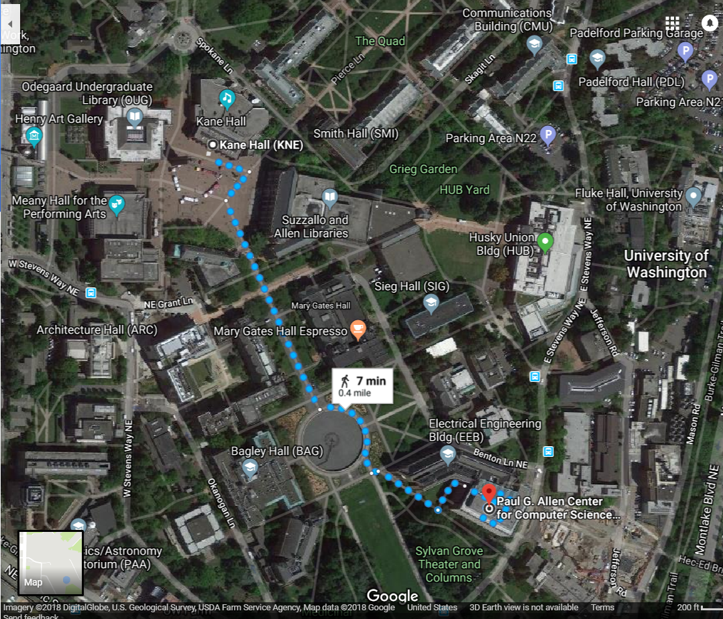
Shortest Paths
How does Google Maps figure out this is the fastest way to get from Kane Hall to CSE?

Slide 7
Representing Maps as Graphs
How do we represent a map as a graph? What are the vertices and edges?

Slide 8
Representing Maps as Graphs
K
2
1
R
2
S
H
4
4
5
D
3
P

Slide 9
Shortest Paths
The length of a path is the sum of the edge weights on that path.
Given a directed graph and vertices s and t
Find: the shortest path from s to t.
Shortest Path Problem
1
y
4
3
w
t
s
5
6
4
5
2
u
v
x
1

Slide 10
Shortest Paths
The length of a path is the sum of the edge weights on that path.
Given a directed graph and vertices s and t
Find: the shortest path from s to t.
Shortest Path Problem
1
y
4
3
w
t
s
5
6
4
5
2
u
v
x
1

Slide 11
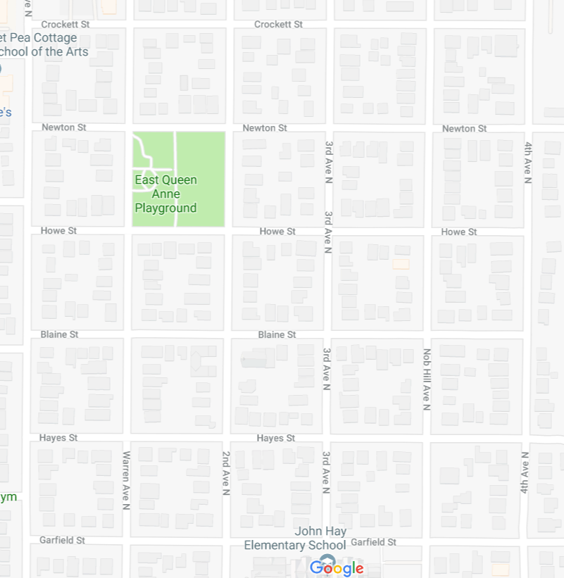
Unweighted graphs
Let’s start with a simpler version: the edges are all the same weight
If the graph is unweighted, how do we find a shortest paths?
Notes:
9:38:30

Slide 12
Unweighted Graphs
If the graph is unweighted, how do we find a shortest paths?
u
w
s
y
t
v
x
What’s the shortest path from s to s?
Well….we’re already there.
What’s the shortest path from s to u or v?
Just go on the edge from s
From s to w,x, or y?
Can’t get there directly from s, for length 2 path, have to go through u or v.

Slide 13
Unweighted Graphs: Key Idea
To find the set of vertices at distance k, just find the set of vertices at distance k-1, and check for outgoing edge to an undiscovered vertex.
Do we already know an algorithm that does something like that?
Yes! BFS!
bfsShortestPaths(graph G, vertex source)
toVisit.enqueue(source)
source.dist = 0
mark source as visited
while(toVisit is not empty){
current = toVisit.dequeue()
for (v : current.outNeighbors()){
if (v is not yet visited){
v.distance = current.distance + 1
v.predecessor = current
toVisit.enqueue(v)
mark v as visited
}
}
}

Slide 14
Unweighted Graphs
Use BFS to find shortest paths in this graph.
u
w
bfsShortestPaths(graph G, vertex source)
toVisit.enqueue(source)
source.dist = 0
mark source as visited
while(toVisit is not empty){
current = toVisit.dequeue()
for (v : current.outNeighbors()){
if (v is not yet visited){
v.distance = current.distance + 1
v.predecessor = current
toVisit.enqueue(v)
mark v as visited
}
}
}
s
y
t
v
x

Slide 15
Unweighted Graphs
Use BFS to find shortest paths in this graph.
1
2
u
w
bfsShortestPaths(graph G, vertex source)
toVisit.enqueue(source)
source.dist = 0
mark source as visited
while(toVisit is not empty){
current = toVisit.dequeue()
for (v : current.outNeighbors()){
if (v is not yet visited){
v.distance = current.distance + 1
v.predecessor = current
toVisit.enqueue(v)
mark v as visited
}
}
}
2
s
y
t
3
v
x
1
2

Slide 16
What about the target vertex?
Given a directed graph and vertices s and t
Find: the shortest path from s to t.
Shortest Path Problem
BFS didn’t mention a target vertex…
It actually finds the shortest path from s to every other vertex.
If you know your target, you can stop the algorithm early, when the target is removed from the queue.
Notes:
9:48

Slide 17
Weighted Graphs
Each edge should represent the “time” or “distance” from one vertex to another.
Sometimes those aren’t uniform, so we put a weight on each edge to record that number.
The length (or “weight” or “cost”) of a path in a weighted graph is the sum of the weights along that path.
Notes:
9:50

Slide 18
Negative Edge Weights
What’s the shortest way to get from s to t?
3
u
-5
s
2
t
w
v
-2
2
s, u,v,w, u,v,w, u,v,w, …
There is no shortest way. You can always go around u,v,w once more.
If there’s a negative weight cycle shortest paths are undefined.

Slide 19
Negative Edge Weights
If there are negative edge weights, but no negative weight cycle, shortest paths are still defined.
For today we’ll assume all of the weights are positive
For GoogleMaps that definitely makes sense.
Sometimes negative weights make sense.
Today’s algorithm doesn’t work for those graphs
There are other algorithms that do work (ask Robbie later)
In section, you’ll see why negative edge weights might be useful.

Slide 20
Weighted Graphs: Take 1
BFS works if the graph is unweighted.
Maybe it just works for weighted graphs too?
1
1
w
x
1
s
u
v
t
20
1
1

Slide 21
Weighted Graphs: Take 1
BFS works if the graph is unweighted.
Maybe it just works for weighted graphs too?
$$∞$$
$$1$$
$$∞$$
1
$$2$$
1
w
x
1
s
u
v
t
0
20
$$∞$$
1
$$∞$$
1
$$∞$$
$$20$$
$$22$$
$$3$$
$$21$$
What went wrong?
When we found a shorter path from s to u,
we needed to update the distance to v
but BFS doesn’t do that.

Slide 22
Weighted Graphs: Take 2
Using an algorithm for Problem B to solve Problem A.
Reduction (informally)
You already do this all the time.
In P1, you reduced implementing a hashset to implementing a hashmap.
They appeared in exercise 7.
Any time you use a library, you’re reducing your problem to the one the library solves.
Can we reduce finding shortest paths on weighted graphs to finding them on unweighted graphs?
Notes:
9:55

Slide 23
Weighted Graphs Take 2
Given a weighted graph, how do we turn it into an unweighted one without messing up the path lengths?

Slide 24
Weighted Graphs: A Reduction
Transform Input
u
2
u
1
2
s
t
s
t
1
v
v
Unweighted Shortest Paths
2
u
s
t
2
v
Transform Output
2
u
1
2
s
t
2
1
v
2

Slide 25
Weighted Graphs: A Reduction
What is the running time of our reduction on this graph?
O(|V|+|E|) of the modified graph, which is…slow.
Does our reduction even work on this graph?
Ummm….
5000
u
150
$$0.5$$
u
$$3$$
200
$$π$$
s
t
s
t
1
v
5000
1
v
5000
Tl;dr: If your graph’s weights are all small positive integers, this reduction might work great.
Otherwise we probably need a new idea.

Slide 26
Weighted Graphs: Take 3
So we can’t just do a reduction.
Instead figure out why BFS worked in the unweighted case, try to make the same thing happen in the weighted case.
How did we avoid this problem:
$$1$$
1
$$2$$
1
w
x
1
s
u
v
t
0
20
$$3$$
1
$$21$$
1
$$22$$
Notes:
10:01

Slide 27
Weighted Graphs: Take 3
In BFS When we used a vertex u to update shortest paths we already knew the exact shortest path to u.
So we never ran into the update problem
If we process the vertices in order of distance from s, we have a chance.

Slide 28
Weighted Graphs: Take 3
Goal: Process the vertices in order of distance from s
Idea:
Have a set of vertices that are “known”
(we know at least one path from s to them).
Record an estimated distance
(the best way we know to get to each vertex).
If we process only the vertex closest in estimated distance, we won’t ever find a shorter path to a processed vertex.
This statement is the key to proving correctness.
It’s nice if you want to practice induction/understand the algorithm better.

Slide 29
Dijkstra’s Algorithm
Vertex | Distance | Predecessor | Processed
s
w
x
u
v
t
Dijkstra(Graph G, Vertex source)
initialize distances to $∞$
mark source as distance 0
mark all vertices unprocessed
while(there are unprocessed vertices){
let u be the closest unprocessed vertex
foreach(edge (u,v) leaving u){
if(u.dist+weight(u,v) < v.dist){
v.dist = u.dist+weight(u,v)
v.predecessor = u
}
}
mark u as processed
}
1
1
w
x
1
s
u
v
t
20
1
1

Slide 30
Dijkstra’s Algorithm
Vertex | Distance | Predecessor | Processed
s | 0 | -- | Yes
w | 1 | s | Yes
x | 2 | w | Yes
u | 20 3 | s x | Yes
v | 4 | u | Yes
t | 5 | v | Yes
Dijkstra(Graph G, Vertex source)
initialize distances to $∞$
mark source as distance 0
mark all vertices unprocessed
while(there are unprocessed vertices){
let u be the closest unprocessed vertex
foreach(edge (u,v) leaving u){
if(u.dist+weight(u,v) < v.dist){
v.dist = u.dist+weight(u,v)
v.predecessor = u
}
}
mark u as processed
}
1
1
w
x
1
s
u
v
t
20
1
1

Slide 31
Implementation Details
One of those lines of pseudocode was a little sketchy
> let u be the closest unprocessed vertex
What ADT have we talked about that might work here?
Minimum Priority Queues!
Notes:
10:06

Slide 32
Making Minimum Priority Queues Work
Min Priority Queue ADT
They won’t quite work “out of the box”.
We don’t have an update priority method. Can we add one?
Percolate up!
To percolate u’s entry in the heap up we’ll have to get to it.
Each vertex need pointer to where it appears in the priority queue
I’m going to ignore this point for the rest of the lecture.
state
Set of comparable values
- Ordered by “priority”
behavior
peek() – find the element with the smallest priority
insert(value) – add new element to collection
removeMin() – returns and removes element with the smallest priority
DecreaseKey(e, p) – decreases priority of element e down to p.

Slide 33
Running Time Analysis
Dijkstra(Graph G, Vertex source)
initialize distances to $∞$, source.dist to 0
mark all vertices unprocessed
initialize MPQ as a Min Priority Queue
add source at priority 0
while(MPQ is not empty){
u = MPQ.removeMin()
foreach(edge (u,v) leaving u){
if(u.dist+weight(u,v) < v.dist){
if(v.dist == $∞$ ) //if v not in MPQ
MPQ.insert(v, u.dist+weight(u,v))
else
MPQ.decreaseKey(v, u.dist+weight(u,v))
v.dist = u.dist+weight(u,v)
v.predecessor = u
}
}
mark u as processed
}

Slide 34
Optional Content More Graph Applications

Slide 35
Another Application of Shortest Paths
Shortest path algorithms are obviously useful for GoogleMaps.
The wonderful thing about graphs is they can encode arbitrary relationships among objects.
I don’t care if you remember all the details.
I just want you to see that these algorithms have non-obvious applications.
Notes:
Need 7 minutes.

Slide 36
Another Application of Shortest Paths
I have a message I need to get from point s to point t.
But the connections are unreliable.
What path should I send the message along so it has the best chance of arriving?
u
0.8
0.7
s
t
0.6
0.2
0.97
v
Given: a directed graph G, where each edge weight is the probability of successfully transmitting a message across that edge
Find: the path from s to t with maximum probability of message transmission
Maximum Probability Path

Slide 37
Another Application of Shortest Paths
Let each edge’s weight be the probability a message is sent successfully across the edge.
What’s the probability we get our message all the way across a path?
It’s the product of the edge weights.
We only know how to handle sums of edge weights.
Is there a way to turn products into sums?
$\log\left(ab\right)=\log{a+\log{b}}$
u
0.8
0.7
s
t
0.6
0.2
0.97
v

Slide 38
Another Application of Shortest Paths
u
-0.32
-0.51
s
t
-0.74
-2.32
-0.04
We’ve still got two problems.
1. When we take logs, our edge weights become negative.
2. We want the maximum probability of success, but that’s the longest path not the shortest one.
Multiplying all edge weights by negative one fixes both problems at once!
We reduced the maximum probability path problem to a shortest path problem by taking $−\log{()}$ of each edge weight.
v

Slide 39
Maximum Probability Path Reduction
Transform Input
u
u
0.8
0.7
0.32
0.51
s
t
s
0.74
t
0.6
0.2
0.97
2.32
0.04
v
v
Weighted Shortest Paths
u
0.32
0.51
s
0.74
t
2.32
0.04
Transform Output
u
v
0.8
0.7
s
0.6
t
0.2
0.97
v

