Slide 1
Graphs
Data Structures and Parallelism

Slide 2
Announcements
P3 checkpoint 1 today
Checkpoint 2 on Wednesday
Parallelism exercises are due Monday.
We’ll announce details of using tokens to redo exercises over the weekend.

Slide 3
ADTs so far
We’ve seen:
Queues and Stacks
Our data points have some order we’re maintaining
Priority Queues
Our data had some priority we needed to keep track of.
Dictionaries
Our data points came as (key, value) pairs.

Slide 4
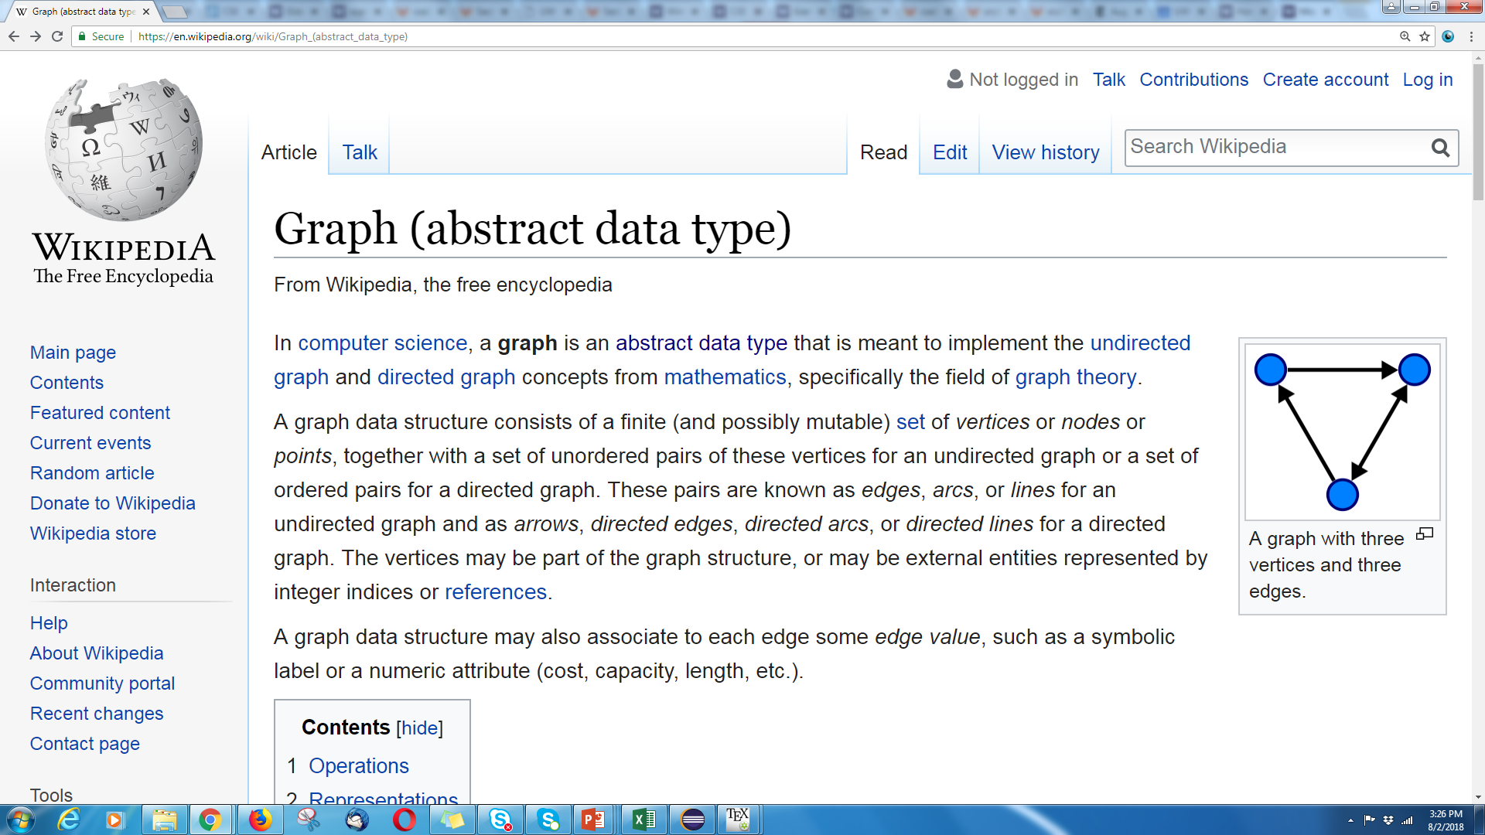
Graphs
Graphs are too versatile to think of them as only an ADT!

Slide 5
Graphs
Represent data points and the relationships between them.
That’s vague.
Formally:
A graph is a pair: G = (V,E)
V: set of vertices (aka nodes)
E: set of edges
Each edge is a pair of vertices.
B
D
A
C
$$\{A,B,C,D\}$$
$$\{(A,B), (B,C), (B,D), (C,D)\}$$

Slide 6
Making Graphs
If your problem has data and relationships, you might want to represent it as a graph
How do you choose a representation?
Usually:
Think about what your “fundamental” objects are
Those become your vertices.
Then think about how they’re related
Those become your edges.

Slide 7
Some examples
For each of the following think about what you should choose for vertices and edges.
The internet.
Facebook friendships
Input data for the “6 degrees of Kevin Bacon” game
Course Prerequisites

Slide 8
Some examples
For each of the following think about what you should choose for vertices and edges.
The internet.
Vertices: webpages. Edges from a to b if a has a hyperlink to b.
Facebook friendships
Vertices: people. Edges: if two people are friends
Input data for the “6 Degrees of Kevin Bacon” game
Vertices: actors. Edges: if two people appeared in the same movie
Or: Vertices for actors and movies, edge from actors to movies they appeared in.
Course Prerequisites
Vertices: courses. Edge: from a to b if a is a prereq for b.

Slide 9
More Graphs
We’ve already used graphs to represent things in this course:
A LOT

Slide 10
Solving Recurrences III
$$5 when n≤4$$
$$T\left(n\right)=$$
$$3T\left(\frac{n}{4}\right)+cn^{2} otherwise$$
$$cn^{2}$$
$$cn^{2}$$
Graph.
Answer the following questions:
What is input size on level $i$?
Number of nodes at level $i$?
Work done at recursive level $i$?
Last level of tree?
Work done at base case?
What is sum over all levels?
$$c{\left(\frac{n}{4}\right)}^{2}$$
$$c{\left(\frac{n}{4}\right)}^{2}$$
$$c{\left(\frac{n}{4}\right)}^{2}$$
$$c{\left(\frac{n}{4}\right)}^{2}$$
$$c{\left(\frac{n}{4}\right)}^{2}$$
$$c{\left(\frac{n}{4}\right)}^{2}$$
$$c{\left(\frac{n}{16}\right)}^{2}$$
$$c{\left(\frac{n}{16}\right)}^{2}$$
$$c{\left(\frac{n}{16}\right)}^{2}$$
$$c{\left(\frac{n}{16}\right)}^{2}$$
$$c{\left(\frac{n}{16}\right)}^{2}$$
$$c{\left(\frac{n}{16}\right)}^{2}$$
$$c{\left(\frac{n}{16}\right)}^{2}$$
$$c{\left(\frac{n}{16}\right)}^{2}$$
$$c{\left(\frac{n}{16}\right)}^{2}$$
…
…
…
…
…
…
…
…
…
…
…
…
…
…
…
…
…
…
…
…
…
…
…
…
…
…
…
5
5
5
5
5
5
5
5
5
5
5
5
5
5
5
5
5
5
5
5
5
5
5
5
5
5
5

Slide 11
BuildHeap: Only One Possibility
But StartBottom() seems to work.
Does it always work?
Graph.
1
7
3
8
1
7
6
7
3
2
1
3
4
1
6
8
2
7

Slide 12
Are These AVL Trees?
6
4
Graph.
3
7
3
7
2
9
2
9
4
6
5
8
10
8
10
5

Slide 13
Deletion – merging nodes
Delete 14. Merge up the tree.
Update “signpost” to be smallest key in its right subtree.
Graph.
18
 |  |  | 32
18
 | 15
 | 32
3 | 1
12 | 3
15 | 7
3 | 1
12 | 3
18 | 2
30 | 4
32 | 5
36 | 6
3 | 1
12 | 3
15 | 7
18 | 2
30 | 4
32 | 5
36 | 6

Slide 14
a<b<c; a<c<b; b<a<c;
b<c<a; c<b<a; c<a<b
Graph.
Ask: is
a < b?
a<b<c; a<c<b; c<a<b
b<a<c; b<c<a; c<b<a
Ask: is
b<c?
Ask: is
a<c?
a<b<c
a<c<b; c<a<b
b<a<c
b<c<a; c<b<a
Ask: is
a<c?
Ask: is
b<c?
a<c<b
c<a<b
b<c<a
c<b<a

Slide 15
Useful Diagram
Edge from $u$ to $v$ if $v$waits for $u.$
I.e. $v$ can’t start until $u$ finishes.
Graph.
One node per O(1) operation
…
…
…
Question: why are there no cycles in this graph?

Slide 16
Your left child gets your left sum.
Sum: 76
Left sum: 0
Your right child has a left sum of:
Your left sum + its sibling’s sum.
Sum: 36
Left Sum: 0
Sum: 40
Left Sum:0+36=36
Graph.
Sum: 10
Left Sum: 0
Sum: 26
Left Sum: 10
Sum: 30
Left Sum: 36
Sum: 10
Left Sum: 66
S: 6
L: 0
S: 4
L: 6
S: 16
L: 10
S: 10
L: 26
S: 16
L: 36
S: 14
L: 52
S: 2
L: 66
S: 8
L: 68
6 | 4 | 16 | 10 | 16 | 14 | 2 | 8

Slide 17
Try by hand
?
MAX
Graph.
X
Y
MIN
A
B
C
D
MAX
5
7
23
33
2
3
14
15

Slide 18
More Graphs
EVERYTHING was graphs.
The whole time.
They don’t just show up in data structures.
311: NFAs/DFAs and relations Compilers: Use graphs to figure out valid compilation orders.
Networking: Building a graph
To the point that some CS people call graphs “networks”
Circuits: represented as graphs

Slide 19
Some examples
For each of the following think about what you should choose for vertices and edges.
The internet.
Vertices: webpages. Edges from a to b if a has a hyperlink to b.
Facebook friendships
Vertices: people. Edges: if two people are friends
Input data for the “6 Degrees of Kevin Bacon” game
Vertices: actors. Edges: if two people appeared in the same movie
Or: Vertices for actors and movies, edge from actors to movies they appeared in.
Course Prerequisites
Vertices: courses. Edge: from a to b if a is a prereq for b.
Edges have direction
Edges don’t have direction
Edges have direction

Slide 20
Graph Terms
This graph is disconnected.
Graphs can be directed or undirected.
Degree: 1
Following on twitter.
Caitlin
Caitlin
Outdegree: 2
Robbie
Robbie
Alon
Degree: 0
Indegree: 2
Friendships on Facebook.

Slide 21
Graph Terms
Walk – A sequence of adjacent vertices. Each connected to next by an edge.
(Directed) Walk–must follow the direction of the edges
Length – The number of edges in a walk
- (A,B,C,D) has length 3.
A,B,C,D is a walk.
So is A,B,A
A
B
C
D
A
B
C
D
A,B,C,D,B is a directed walk.
A,B,A is not.
Notes:
Terminology here varies by source. This is what the textbook uses – some people use walk instead of path’ and reserve path for what we called a simple path.

Slide 22
Graph Terms
Path – A walk that doesn’t repeat a vertex. A,B,C,D is a path. A,B,A is not.
Cycle – path with an extra edge from last vertex back to first.
Be careful looking at other sources.
Some people call our “walks” “paths” and our “paths” “simple paths”
Use the definitions on these slides.
A
B
C
D
A
B
C
D
Notes:
Terminology here varies by source. This is what the textbook uses – some people use walk instead of path’ and reserve path for what we called a simple path.

Slide 23
Representing and Using Graphs

Slide 24
Adjacency Matrix
4
0
1
5
6
2
3
In an adjacency matrix a[u][v] is 1 if there is an edge (u,v), and 0 otherwise.
Time Complexity (|V| = n, |E| = m):
Add Edge:
Remove Edge:
Check edge exists from (u,v):
Get neighbors of u (out):
Get neighbors of u (in):
Space Complexity:
 | 0 | 1 | 2 | 3 | 4 | 5 | 6
0 | 0 | 1 | 1 | 0 | 0 | 0 | 0
1 | 1 | 0 | 0 | 1 | 0 | 0 | 0
2 | 1 | 0 | 0 | 1 | 0 | 0 | 0
3 | 0 | 1 | 1 | 0 | 0 | 1 | 0
4 | 0 | 0 | 0 | 0 | 0 | 1 | 0
5 | 0 | 0 | 0 | 1 | 1 | 0 | 0
6 | 0 | 0 | 0 | 0 | 0 | 0 | 0
O(1)
O(1)
O(1)
O(n)
O(n)
$$O(n^{2})$$
Notes:
It is usual to write |V| = n and |E| = m, though sometimes we’ll abuse notation and just use V and E.

Slide 25
Adjacency List
0
1
4
5
6
2
3
An array where the u’th element contains a list of neighbors of u.
Directed graphs: put the out neighbors (a[u] has v for all (u,v) in E)
Time Complexity (|V| = n, |E| = m):
Add Edge:
Remove Edge:
Check edge exists from (u,v):
Get neighbors of u (out):
Get neighbors of u (in):
Space Complexity:
0
1
2
3
4
5
6
1 → 2
0 → 3
0 → 3
O(1)
1 → 2 → 5
5
O( min(n, m) )
3 → 4
O( min(n, m) )
O(n)
O(n + m)
Suppose we use a linked list for each node.
O(n + m)

Slide 26
Adjacency List
0
1
4
5
6
2
3
An array where the u’th element contains a list of neighbors of u.
Directed graphs: put the out neighbors (a[u] has v for all (u,v) in E)
Time Complexity (|V| = n, |E| = m):
Add Edge:
Remove Edge:
Check edge exists from (u,v):
Get neighbors of u (out):
Get neighbors of u (in):
Space Complexity:
0
1
2
3
4
5
6
1 → 2
0 → 3
0 → 3
O(1)
1 → 2 → 5
5
O( 1 )
3 → 4
O( 1 )
O(n)
Switch the linked lists to hash tables, and do average case analysis.
O(n )
O(n + m)

Slide 27
Breadth First Search
search(graph)
toVisit.enqueue(first vertex)
mark first vertex as visited
while(toVisit is not empty)
current = toVisit.dequeue()
for (V : current.neighbors())
if (v is not visited)
toVisit.enqueue(v)
mark v as visited
finished.add(current)
F
J
G
D
A
I
H
E
B
C
H
Current node:
Queue:
Finished:
I
A
E
D
B
G
F
C
G
B
D
E
C
F
G
H
I
A
B
D
E
C
F
G
H
I

Slide 28
Breadth First Search
search(graph)
toVisit.enqueue(first vertex)
mark first vertex as visited
while(toVisit is not empty)
current = toVisit.dequeue()
for (V : current.neighbors())
if (v is not visited)
toVisit.enqueue(v)
mark v as visited
finished.add(current)
F
J
G
D
A
I
H
E
B
C
What’s the running time of this algorithm?
We visit each vertex at most twice, and each edge at most once: $O(|V| + |E|)$

Slide 29
Depth First Search (DFS)
BFS uses a queue to order which vertex we move to next
Gives us a growing “frontier” movement across graph
Can you move in a different pattern? What if you used a stack instead?
bfs(graph)
toVisit.enqueue(first vertex)
mark first vertex as visited
while(toVisit is not empty)
current = toVisit.dequeue()
for (V : current.neighbors())
if (v is not visited)
toVisit.enqueue(v)
mark v as visited
finished.add(current)
dfs(graph)
toVisit.push(first vertex)
mark first vertex as visited
while(toVisit is not empty)
current = toVisit.pop()
for (V : current.neighbors())
if (V is not visited)
toVisit.push(v)
mark v as visited
finished.add(current)

Slide 30
Depth First Search
dfs(graph)
toVisit.push(first vertex)
mark first vertex as visited
while(toVisit is not empty)
current = toVisit.pop()
for (V : current.neighbors())
if (V is not visited)
toVisit.push(v)
mark v as visited
finished.add(current)
F
J
G
D
A
I
H
E
B
C
G
A
B
H
F
E
D
C
Current node:
Stack:
Finished:
I
D
C
B
E
I
H
G
F
A
B
E
H
G
F
I
C
D

Slide 31
DFS
Running time?
Same as BFS: $O(\left|V\right|+\left|E\right|)$
You can rewrite DFS to be a recursive method.
Use the call stack as your stack.
No easy trick to do the same with BFS.
Next week: Using BFS, DFS and other algorithms to solve problems!
Notes:
Point out the importance of returning visited and re-assigning it after each call

