Slide 1
Concurrency
Data Structures and Parallelism

Slide 2
Announcements
Today is “recommended deadline” for exercises 8-9
We’re not grading them until the real deadline, but we recommend you finish them by about today.
P1 checkpoint 1 on Friday.

Slide 3
Sharing Resources
So far we’ve been writing parallel algorithms that don’t share resources.
Fork-join algorithms all had a simple structure
Each thread had memory only it accesses.
Results of one thread not accessed until joined.
The structure of the code ensured sharing didn’t go wrong.
Can’t use the same strategy when memory overlaps
Thread doing independent tasks on same resources.

Slide 4
Parallel Code
PC
local
vars
Heap memory
PC
local
vars
Objects
PC
Data Structures
local
vars

Slide 5
Why Concurrency?
If we’re not using them to solve the same big problem, why threads?
Code responsiveness
One thread responds to GUI, another does big computations
Processor utilization
If a thread needs to go to disk, can throw another thread on while it waits.
Failure isolation
Don’t want one exception to crash the whole program.

Slide 6
Concurrency
Different threads might access the same resources
In unpredictable orders or even simultaneously
Simultaneous access is rare
Makes testing very difficult
Instead we’ll be disciplined when writing the code.
In this class, we’ll focus on code idioms that are known to work.
Won’t talk about java specifics – there are some details in the Grossman notes.

Slide 7
Sharing a Queue
Two threads both want to insert into a queue.
Each has its own program counter, they can each be running different parts of the code simultaneously.
They can arbitrarily “interrupt” each other.
What can go wrong?

Slide 8
Bad Interleaving
Enqueue(x){
if(back==null){
back=new Node(x);
front=back;
}
else{
back.next=new Node(x);
back=back.next;
}
Enqueue(x){
if(back==null){
back=new Node(x);
front=back;
}
else{
back.next=new Node(x);
back=back.next;
}

Slide 9
Bad Interleaving
Enqueue(x){
if(back==null){
back=new Node(x);
front=back;
}
else{
back.next=new Node(x);
back=back.next;
}
Enqueue(x){
if(back==null){
back=new Node(x);
front=back;
}
else{
back.next=new Node(x);
back=back.next;
}
1
2
3
5
4
6

Slide 10
One Example
class BankAccount{
private int balance=0;
int getBalance() {return balance;}
void setBalance(int x) {balance = x;}
void withdraw(int amount){
int b = getBalance();
if(amount > b)
throw new WithdrawTooLargeException();
setBalance(b-amount);
}
… }

Slide 11
Bad Interleavings
Suppose the account has balance of 150.
Two threads run: one withdrawing 100, another withdrawing 75.
Find a bad interleaving – what can go wrong?

Slide 12
Bad Interleaving
void withdraw(int amount){
int b = getBalance();
if(amount > b)
throw new …;
setBalance(b-amount);
}
void withdraw(int amount){
int b = getBalance();
if(amount > b)
throw new …;
setBalance(b-amount);
}

Slide 13
Bad Interleaving
void withdraw(int amount){
int b = getBalance();
if(amount > b)
throw new …;
setBalance(b-amount);
}
void withdraw(int amount){
int b = getBalance();
if(amount > b)
throw new …;
setBalance(b-amount);
}
1
3
2
4
6
5

Slide 14
Bad Interleavings
What’s the problem?
We stored the result of balance locally, but another thread overwrote it after we stored it.
The value became stale.

Slide 15
A Principle
Principle: don’t let a variable that might be written become stable.
Ask for it again right before you use it
void withdraw(int amount){
int b = getBalance();
if(amount > getBalance())
throw new …;
setBalance(getBalance()-amount);
}

Slide 16
A Principle
NO
Principle: don’t let a variable that might be written become stable.
Ask for it again right before you use it
void withdraw(int amount){
int b = getBalance();
if(amount > getBalance())
throw new …;
setBalance(getBalance()-amount);
}
That’s not a real concurrency principle. It doesn’t solve anything.

Slide 17
Bad Interleaving
There’s still a bad interleaving. Find one.
void withdraw(int amount){
int b = getBalance();
if(amount > getBalance())
throw new …;
setBalance(
getBalance()-amount);
}
void withdraw(int amount){
int b = getBalance();
if(amount > getBalance())
throw new …;
setBalance(
getBalance()-amount);
}

Slide 18
Bad Interleaving
There’s still a bad interleaving. Find one.
void withdraw(int amount){
int b = getBalance();
if(amount > getBalance())
throw new …;
setBalance(
getBalance()-amount);
}
void withdraw(int amount){
int b = getBalance();
if(amount > getBalance())
throw new …;
setBalance(
getBalance()-amount);
}
1
3
2
4
7
8
5
6

Slide 19
Bad Interleaving
There’s still a bad interleaving. Find one.
void withdraw(int amount){
int b = getBalance();
if(amount > getBalance())
throw new …;
setBalance(
getBalance()-amount);
}
void withdraw(int amount){
int b = getBalance();
if(amount > getBalance())
throw new …;
setBalance(
getBalance()-amount);
}
1
3
2
4
6
8
5
7
In this version, we can have negative balances without throwing the exception!

Slide 20
A Real Principle
Mutual Exclusion (aka Mutex, aka Locks)
Rewrite our methods so only one thread can use a resource at a time
All other threads must wait.
We need to identify the critical section
Portion of the code only a single thread can execute at once.
This MUST be done by the programmer.

Slide 21
class BankAccount{
private int balance=0;
private boolean busy = false;
void withdraw(int amount){
while(busy){ /* spin wait */ }
busy = true;
int b = getBalance();
if(amount > b)
throw new WithdrawTooLargeException();
setBalance(b-amount);
busy = false;
}
… }
Does this code work?

Slide 22
Locks
We can still have a bad interleaving.
If two threads see busy = false and get past the loop simultaneously.
We need a single operation that
Checks if busy is false
AND sets it to true if it is
Where no other thread can interrupt us.
An operation is atomic if no other threads can interrupt it/interleave with it.

Slide 23
Locks
There’s no regular java command to do that.
We need a new library
Lock (not a real object)
acquire() – blocks if lock is unavailable. When lock becomes available, one thread only gets lock.
release() – allow another thread to acquire lock.
Need OS level support to implement.
Take an operating systems course to learn more.

Slide 24
Locks
class BankAccount{
private int balance = 0;
private Lock lk = new Lock();
…
void withdraw(int amount){
lk.acquire(); //might block
int b = getBalance();
if(amount > b)
throw new WithdrawTooLargeException();
setBalance(b – amount);
lk.release();
}

Slide 25
Using Locks
Questions:
What is the critical section (i.e. the part of the code protected by the lock)?
How many locks should we have
One per BankAccount object?
Two per BankAccount object (one in withdraw and a different lock in deposit)?
One (static) one for the entire class (shared by all BankAccount objects)?
There is a subtle bug in withdraw(), what is it?
Do we need locks for
getBalance()?
setBalance()?
For the purposes of this question, assume those methods are public.

Slide 26
Using Locks
How many locks?
Different locks for withdraw and deposit will lead to bad interleavings.
The shared resource is balance not the methods themselves.
One lock for the whole class isn’t wrong…
But it is a bad design decision.
Only one thread anywhere can do any withdraw/deposit operation.
No matter how many bank accounts there are.
There’s a tradeoff in how granular you make critical sections:
Bigger: easier to rule out errors, but fewer threads can work at once.

Slide 27
Using Locks
Bug in withdraw:
When you throw an exception, you still hold onto the lock!
You could release the lock before throwing the exception.
Or use try{} finally{} blocks
try{ critical section }
finally{ lk.release()}

Slide 28
Re-entrant Locks
Do we need to lock setBalance()
If it’s public, yes.
But now we have a problem:
withdraw will acquire the lock,
Then call setBalance()…
Which needs the same lock

Slide 29
Re-entrant Locks
Our locks need to be re-entrant.
That is, the lock isn’t held by a single method call
But rather by a thread.
Execution can re-enter another critical section, while holding the same lock.
Lock needs to know which release call is the “real” release, and which one is just the end of an inner method call.
Intuition: have a counter. Increment it when you “re-acquire” the lock, decrement when you release. Until releasing on 0 then really release.
Take an operating systems course to learn more.

Slide 30
Deadlock

Slide 31
Multiple Locks
What happens when you need to acquire more than one lock?
void transferTo(int amt, BankAccount a){
this.lk.acquire();
a.lk.acquire();
this.withdraw(amt);
a.deposit(amt);
a.lk.release();
this.lk.release();
}

Slide 32
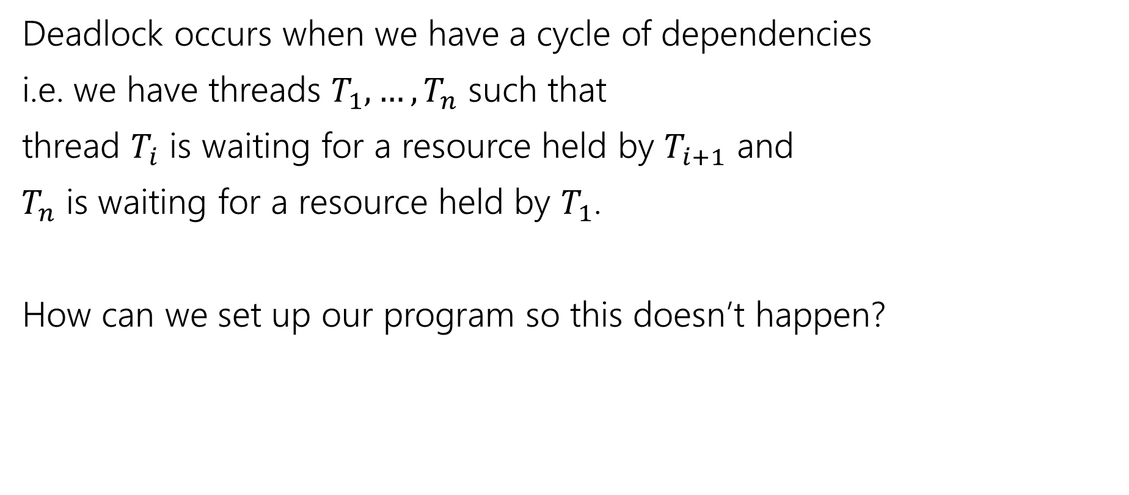
Deadlock
Deadlock occurs when we have a cycle of dependencies
i.e. we have threads $T_{1},…,T_{n}$ such that
thread $T_{i}$ is waiting for a resource held by $T_{i+1}$ and
$T_{n}$ is waiting for a resource held by $T_{1}$.
How can we set up our program so this doesn’t happen?

Slide 33
Deadlock Solutions
Smaller critical section:
Acquire bank account 1’s lock, withdraw, release that lock
Acquire bank account 2’s lock, deposit, release that lock
Maybe ok here, but exposes wrong total amount in bank while blocking.
Coarsen the lock granularity
One lock for all accounts.
Probably too coarse for good behavior
All methods acquiring multiple locks acquire them in order.
E.g. in order of account number.
More options – take Operating Systems!

Slide 34
Conventional Wisdom

Slide 35
Conventional Wisdom
There are three types of memory
Thread local (each thread has its own copy)
Immutable (no thread overwrites that memory location)
Shared and mutable
Synchronization needed to control access.
Whenever possible make memory of type 1 or 2.
If you can minimize/eliminate side-effects in your code, you can make more memory type 2.

Slide 36
Conventional Wisdom
Consistent locking:
Every location that reads or writes a shared resource has a lock.
Even if you can’t think of a bad interleaving, better safe than sorry.
When deciding how big to make a critical section:
Start coarse grained, and move finer if you really need to improve performance.

Slide 37
Conventional Wisdom
Avoid expensive computations or I/O in critical sections.
If possible release the lock, do the long computation, and reacquire the lock.
Just make sure you haven’t introduced a race condition.
Think in terms of what operations need to be atomic.
i.e. consider atomicity first, then think about where the locks go.

Slide 38
Conventional Wisdom
Don’t write your own.
There’s probably a library that does what you need.
Use it.
There are thread-safe libraries like ConcurrentHashMap.
No need to do it yourself when experts already did it
and probably did it better.

Slide 39
Some Java Notes

Slide 40
Real Java locks
A re-entrant lock is available in java.util
java.util.concurrent.locks.ReentrantLock
Methods are lock() and unlock()

Slide 41
synchronized
Java has built-in support for reentrant locks with the keyword synchronized
synchronized (expression) {
Critical section
}
Expression must evaluate to an object.
Every object “is a lock” in java
Lock is acquired at the opening brace and released at the matching closing brace.
Released even if control leaves due to throw/return/etc.

Slide 42
synchronized
If your whole method is a critical section
And the object you want for your lock is this
You can change the method header to include synchronized.
E.g. private synchronized void getBalance()
Equivalent of having
synchronized(this){ } around entire method body.

