Slide 1
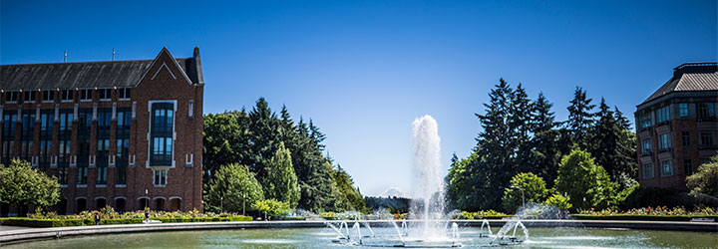
Games
Data Structures and Parallelism

Slide 2
Announcements
Remember exercises 5-7 due today
Individual Gitlab repositories for exercises 8-11 are out.
P3 repos are out.
You’ve done a ton of work so far.
You’ve implemented every core data structure.
And in 4-5 days less than students get during the regular school year.
You should be proud of yourselves.

Slide 3
Let’s Play a Game
Of tic-tac-toe!

Slide 4
Tic-Tac-Toe
What happened?
We both have strategies memorized that guarantee a draw (probably).
Let’s make a computer do it for us!

Slide 5
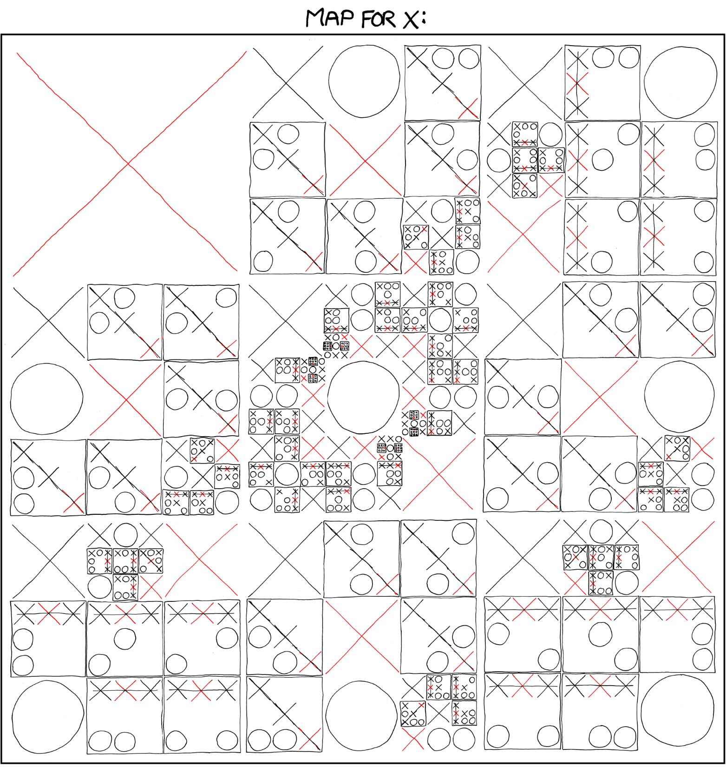
www.xkcd.com/832

Slide 6
Tic-Tac-Toe Bot
if(board is empty)
play upper left
if(we can win)
make winning move
if(opponent can win)
block that move
else{
//uhhh….
}

Slide 7
Tic-Tac-Toe Bot
Could we just list out all positions?
There are $9!$ of them.
What if we want a more complicated game? Like checkers. Or chess.

Slide 8
Zero-Sum Games
Tic-Tac-Toe, Checkers, and Chess are all zero-sum games
Meaning what’s good for me is (equally) bad for you.
Not all “games” are zero-sum (Prisoner’s dilemma).
All of these games are also turn-based
Which will make writing our bot easier.

Slide 9
Checkers Bot
Let’s try checkers!
Like our tic-tac-toe bot, we need to define the optimal move at every time.
But we DEFINITELY can’t hard-code this.
Key idea:
Computers are good at calculating.
Make the bot re-derive what the best decision is every term.

Slide 10
Checkers Bot
What’s the best move?
It’s the one such that
when our opponent responds with their move
And we respond with our best move
And they respond with their move
….
We win (or at least draw)

Slide 11
Decision Tree

Slide 12
Minimax
Now that we have our tree, how do we choose our move?
How will our opponent respond in round 2?
Assume they will make the best possible move for them.
i.e. the worst possible move for us.

Slide 13
Checkers Bot
If we make this tree for tic-tac-toe, how big is it?
The nodes at level $k$ have $9−k$ options.
Something like $9!$ nodes.
For checkers?
The analysis is harder. Checkers experts say there are about $10$ possible moves each turn.
So our tree will have ${10}^{t}$ nodes after $t$ turns

Slide 14
Checkers Bot
That’s probably too big.
If we want to play chess, the branching factor is much worse.
(experts say about $35)$.
We can’t get all the way down the tree!
At a certain point, we’ll need to look at the board and estimate how things are going.

Slide 15
Minimax
if(we’re at a leaf)
return board evalutation //we’re done!
else{
for(every possible move mv){
apply mv to the current board
value = - minimax(board)
undo mv from board
if(value > bestVale)
bestValue = value
}
}

Slide 16
Pruning
The further down the tree we can go, the more likely we are to get a good move.
What tricks could we use to get further down the tree?
In tic-tac-toe, we didn’t evaluate other moves once we knew our opponent could win in the next turn.
Generalize that idea – we don’t need to evaluate further in a subtree if we know that optimal play won’t take us there.

Slide 17
Alpha-Beta Pruning
MAX
10
Y
MIN
10
60
3
X
MAX

Slide 18
Pruning
There’s no need to evaluate X
If it’s bigger than 3, min will choose Y to go in the left branch.
If it’s less than 3, min will choose the right branch…
but then at the root max will choose the left branch.
The value doesn’t matter!
Don’t bother going down that subtree.

Slide 19
Try by hand
?
MAX
X
Y
MIN
A
B
C
D
MAX
5
7
23
33
2
3
14
15

Slide 20
Try by hand
?
MAX
X
Y
MIN
$$≤7$$
7
B
C
D
MAX
5
7
23
33
2
3
14
15

Slide 21
Try by hand
?
MAX
X
Y
MIN
$$≤7$$
$$≥23$$
7
B
C
D
MAX
5
7
23
33
2
3
14
15

Slide 22
Try by hand
?
MAX
7
$$≥7$$
Y
MIN
$$≤7$$
$$≥23$$
7
B
C
D
MAX
5
7
23
33
2
3
14
15

Slide 23
Try by hand
?
MAX
7
$$≥7$$
Y
MIN
$$≤7$$
$$≤3$$
$$≥23$$
7
B
3
D
MAX
5
7
23
33
2
3
14
15

Slide 24
Pseudocode
alphabeta(Position p, int alpha, int beta){
if(p is a leaf)
return p.evaluate()
for( every move mv){
p.apply(mv)
int value = -alphabeta(p, -beta, -alpha)
p.undoMove()
if(value > alpha)
alpha = value;
if(alpha >= beta) //we won’t be able to reach this move.
return alpha;
}
return alpha;

Slide 25
Project 3
The games pdf on the webpage has more examples.
P3 is out, you’ll be making a chess bot.
You’ll implement minimax (sequentially first, then in parallel)
Then you’ll implement alphabeta (sequential only)

