Slide 1
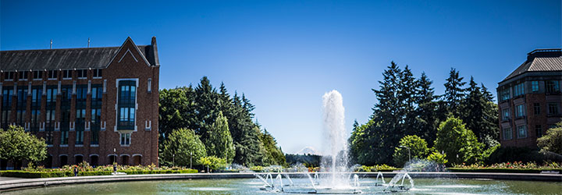
Algorithm Analysis
Data Structures and Algorithms

Slide 2
Logistics
Piazza
  Sign up for Piazza
  Directions to opt out of Piazza careers are on piazza.
Section tomorrow
  Caitlin and Alon will co-lead section
  Chance to practice problems about what we learned in lecture.
  Occasionally learn new material
  This week: Talk about concepts in your first programming project.
Project 1 out (late) tonight
If you don’t have a partner yet, meet up here at the end of class, and we’ll pair you up.

Slide 3
Algorithm Analysis
I have some problem I need solved.
Caitlin and Alon have different ideas for how to solve the problem. How do we know which is better?
Easy. Have them both write the code and run it, and see which is faster.
THIS IS A TERRIBLE IDEA
How can we analyze their suggestions before they have to write the code, and in a way that is independent of their machines?

Slide 4
Comparing Algorithms
We want to know when one algorithm will be better than another
  Better might mean faster.
  Or using less memory.
We really care about large inputs.
  If n=15, any algorithm will probably finish in less than a second anyway…
Want our answer to be independent of computer speed or programming language.
And we want an answer that’s mathematically rigorous.

Slide 5
Analyzing Code
Assume basic operations take the same constant amount of time.
What’s a basic operation?
  Adding ints or doubles
  Assignment
  Incrementing a variable
  A return statement
  Accessing an array index or an object field
What’s not a basic operation?
  Making a method call.
This is a LIE but it’s a very useful lie.

Slide 6
What Are We Counting?
Worst case analysis
  For a given input size, what’s the running time for the worst state our data structure we can be in or the worst input we can give?
Best case analysis
  What is the number of steps for the best state of our structure and the best question?
Average case analysis
  How are we doing on average over all possible inputs/states of our data structure?
  Have to ask this question very carefully to get a meaningful answer
We usually do worst case analysis.

Slide 7
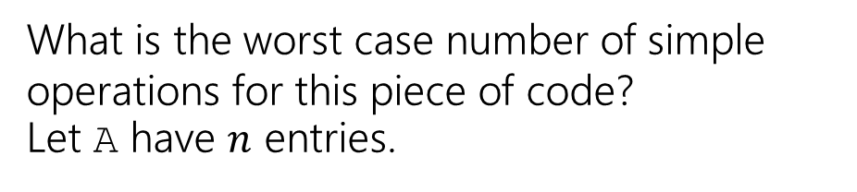
Example
What is the worst case number of simple operations for this piece of code?
Let A have $n$ entries.
Linear search
int linearSearch(int[] A, int target){
for(int i = 0; i < A.length; i++){
if(A[i] == target)
return i;
}
return -1;
}

Slide 8

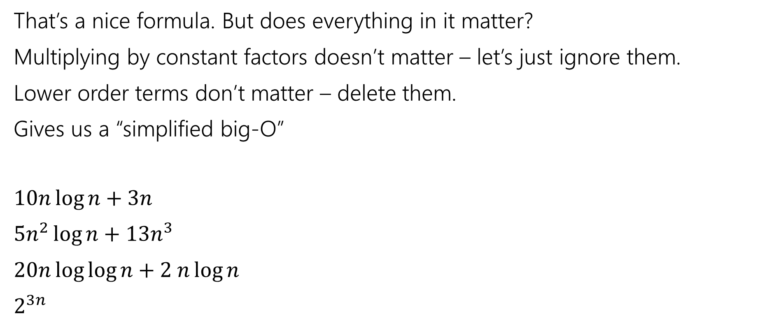
Asymptotic Notation
That’s a nice formula. But does everything in it matter?
Multiplying by constant factors doesn’t matter – let’s just ignore them.
Lower order terms don’t matter – delete them.
Gives us a “simplified big-O”
$10n\log{n}+3n$
$5n^{2}\log{n}+13n^{3}$
$20n\log{\log{n}+2 n\log{n}}$
$2^{3n}$
$$O(n\log{n)}$$
$$O\left(n^{3}\right)$$
$$O(n\log{n})$$
$$O(8^{n})$$

Slide 9
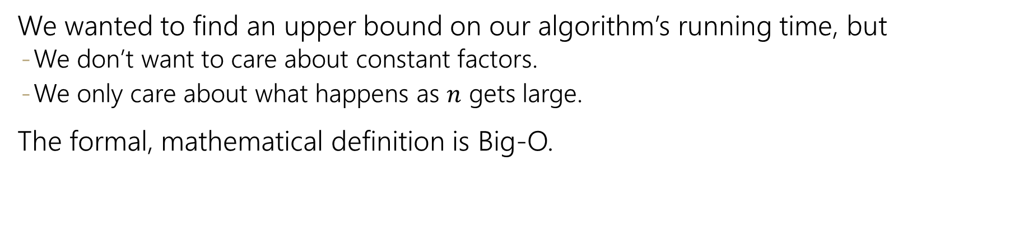
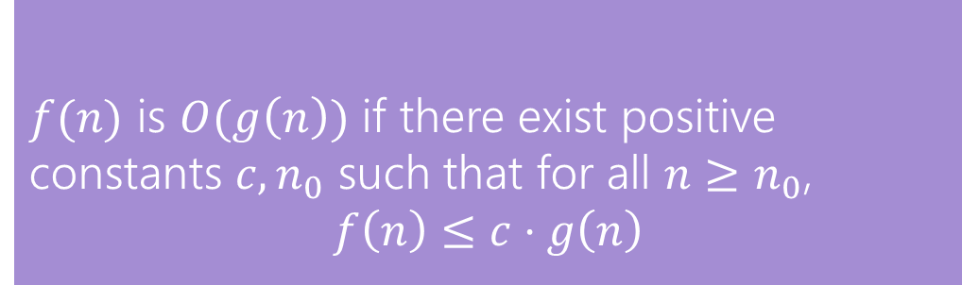
Formally Big-O
We wanted to find an upper bound on our algorithm’s running time, but
  We don’t want to care about constant factors.
  We only care about what happens as $n$ gets large.
The formal, mathematical definition is Big-O.
$f(n)$ is $O(g\left(n\right))$ if there exist positive constants $c, n_{0}$ such that for all $n≥n_{0}$,
$$f\left(n\right)≤c⋅g\left(n\right)$$
Big-O
We also say that $g\left(n\right)$ “dominates” $f(n)$.

Slide 10
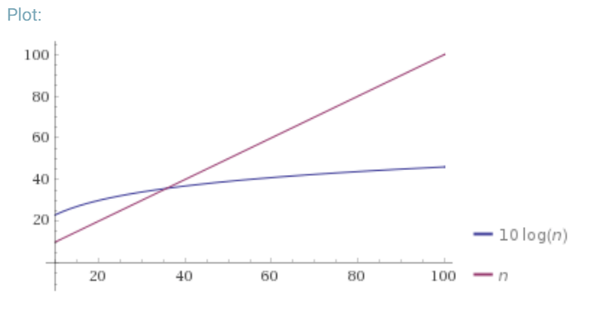
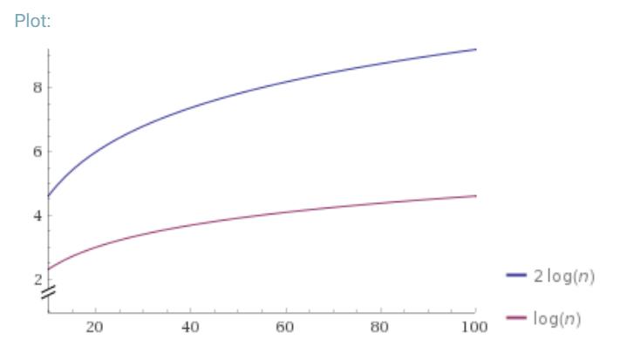



Why is that the definition?
$f(n)$ is $O(g\left(n\right))$ if there exist positive constants $c, n_{0}$ such that for all $n≥n_{0}$,
$$f\left(n\right)≤c⋅g\left(n\right)$$
Big-O
Why $n_{0}$?
Why $c$?

Slide 11
Why Are We Doing This?
You already intuitively understand what big-O means.
Who needs a formal definition anyway?
  We will.
Your intuitive definition and my intuitive definition might be different.
We’re going to be making more subtle big-O statements in this class.
  We need a mathematical definition to be sure we’re on the same page.
Once we have a mathematical definition, we can go back to intuitive thinking.
  But when a weird edge case, or subtle statement appears, we can figure out what’s correct.

Slide 12
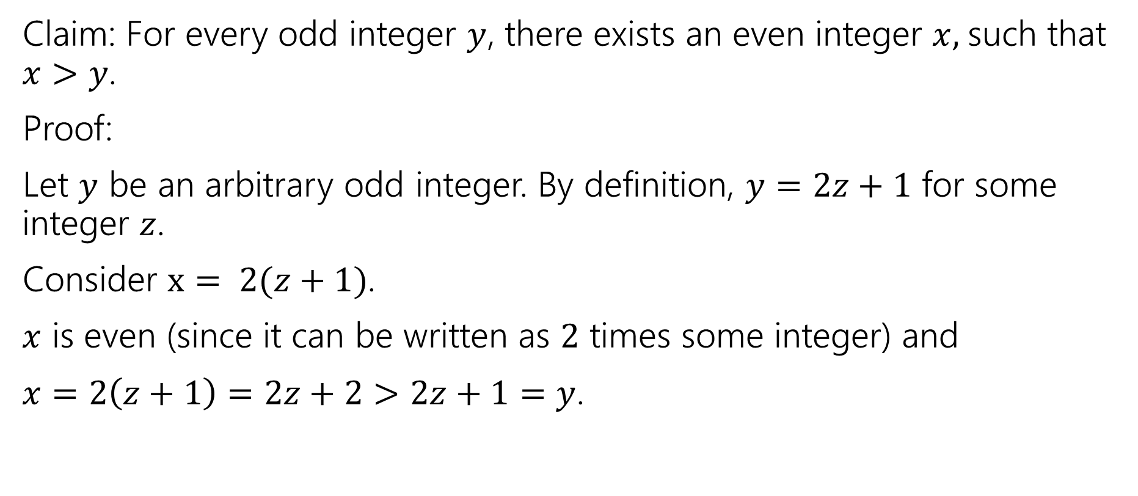
Writing Proofs
Claim: For every odd integer $y$, there exists an even integer $x,$such that $x>y$.
Proof:
Let $y$ be an arbitrary odd integer. By definition, $y=2z+1$ for some integer $z$.
Consider $x= 2(z+1)$.
$x$ is even (since it can be written as $2$ times some integer) and
$x=2\left(z+1\right)=2z+2>2z+1=y$.

Slide 13
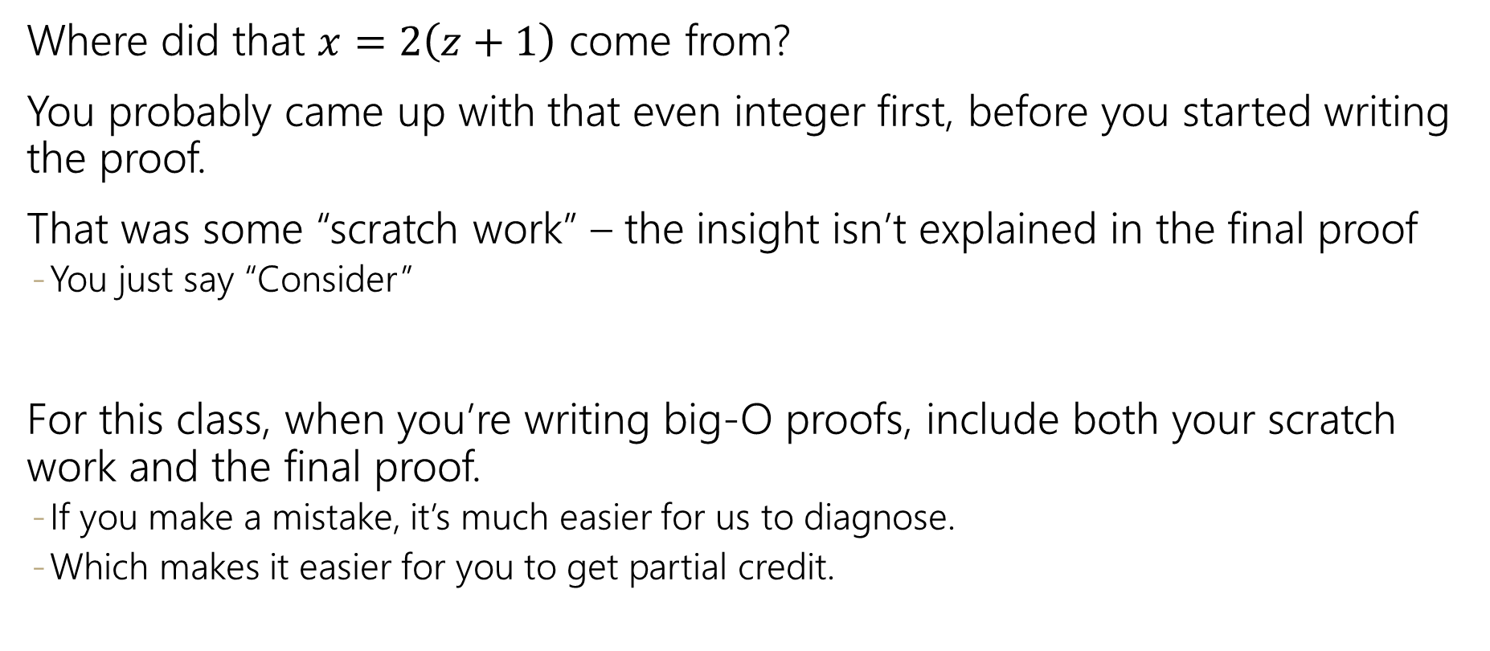
Writing Proofs
Where did that $x=2\left(z+1\right)$ come from?
You probably came up with that even integer first, before you started writing the proof.
That was some “scratch work” – the insight isn’t explained in the final proof
  You just say “Consider”
For this class, when you’re writing big-O proofs, include both your scratch work and the final proof.
  If you make a mistake, it’s much easier for us to diagnose.
  Which makes it easier for you to get partial credit.

Slide 14


Using the Definition
Let’s show: $10n^{2}+15n$is $O(n^{2})$
Recreation of whiteboard:
Scratch work:
$$10n^{2}≤10n^{2}$$
$15n≤15n^{2}$ for $n≥1$
$10n^{2}+15n≤25n^{2}$for $n≥1$
Proof:
Take $c=25$ and $n_{0}=1$.
The inequality $10n^{2}≤10n^{2}$ is always true. The inequality $15n≤15n^{2}$ is true for $n≥1$, as the right hand side is a factor of $n$ more than the right hand side.
As long as both inequalities are true we can add them, thus
$10n^{2}+15n≤25n^{2}$ holds as long as $n≥1$.
This is exactly the inequality we needed to show.

Slide 15
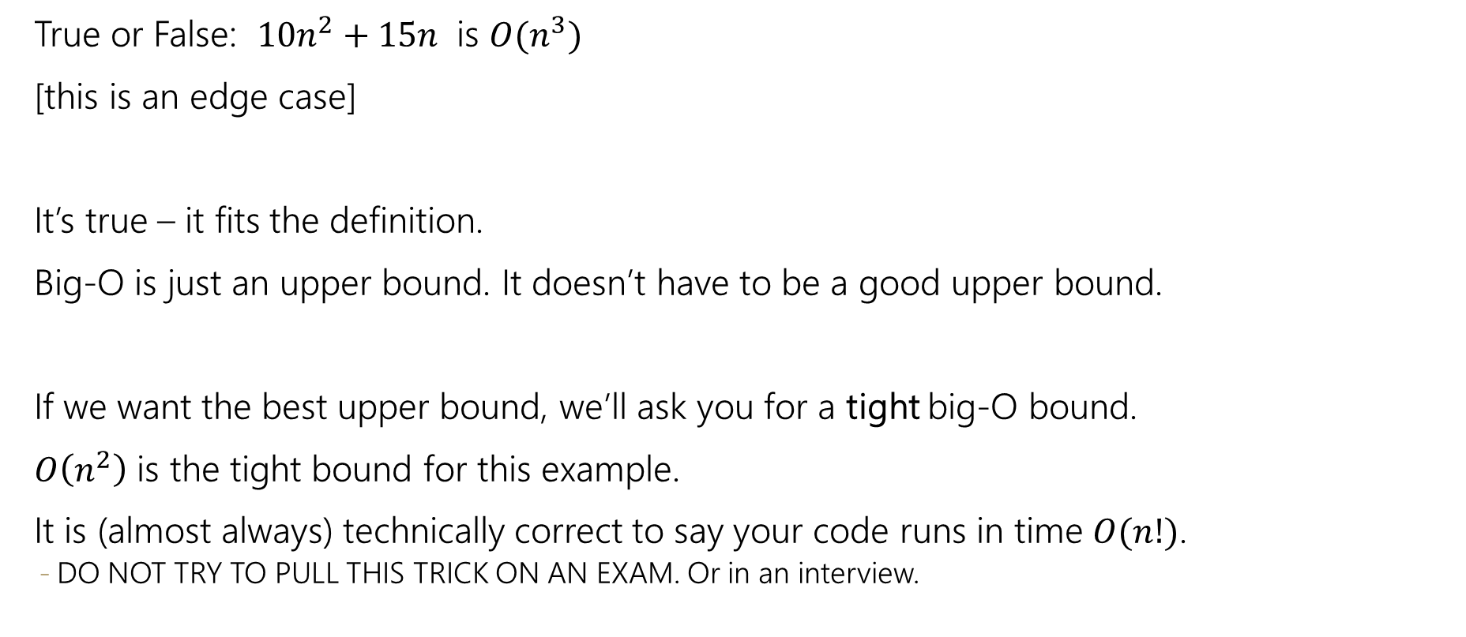
Edge Cases
True or False: $10n^{2}+15n$ is $O(n^{3})$
[this is an edge case]
It’s true – it fits the definition.
Big-O is just an upper bound. It doesn’t have to be a good upper bound.
If we want the best upper bound, we’ll ask you for a tight big-O bound.
$O\left(n^{2}\right)$ is the tight bound for this example.
It is (almost always) technically correct to say your code runs in time $O(n!)$.
  DO NOT TRY TO PULL THIS TRICK ON AN EXAM. Or in an interview.

Slide 16
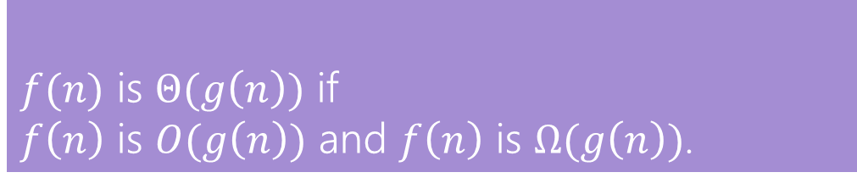

O, Omega, Theta [oh my?]
Big-O is an upper bound
  My code takes at most this long to run
Big-Omega is a lower bound
Big Theta is “equal to”
$f(n)$ is $Ω(g\left(n\right))$ if there exist positive constants $c, n_{0}$ such that for all $n≥n_{0}$,
$$f\left(n\right)≥c⋅g\left(n\right)$$
Big-Omega
$f(n)$ is $Θ(g\left(n\right))$ if
$f\left(n\right)$ is $O(g\left(n\right))$ and $f\left(n\right)$ is $Ω(g\left(n\right))$.
Big-Theta

Slide 17
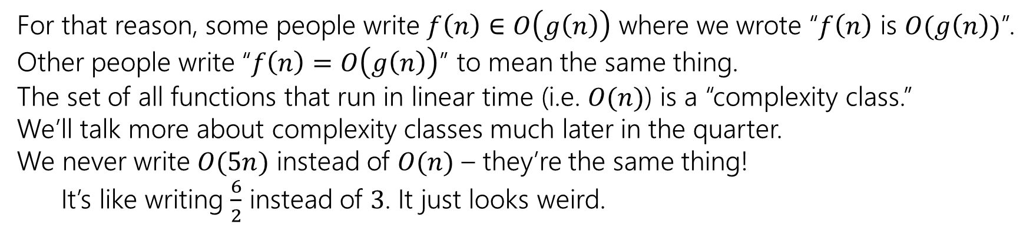
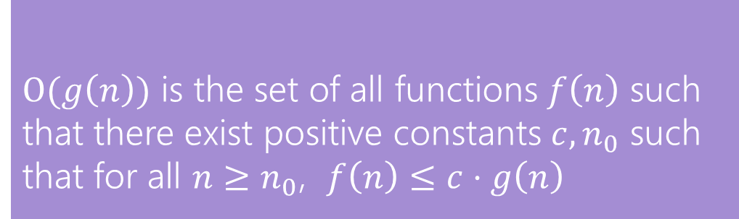
Viewing O as a class
Sometimes you’ll see big-O defined as a family or set of functions.
$O(g\left(n\right))$ is the set of all functions $f\left(n\right)$ such that there exist positive constants $c, n_{0}$ such that for all $n≥n_{0}$, $f\left(n\right)≤c⋅g\left(n\right)$
Big-O (alternative definition)
For that reason, some people write $f\left(n\right)∈O\left(g\left(n\right)\right)$ where we wrote “$f\left(n\right)$ is $O(g\left(n\right))$”.
Other people write “$f\left(n\right)=O\left(g\left(n\right)\right)$” to mean the same thing.
The set of all functions that run in linear time (i.e. $O(n)$) is a “complexity class.”
We’ll talk more about complexity classes much later in the quarter.
We never write $O(5n)$ instead of $O(n)$ – they’re the same thing!
It’s like writing $\frac{6}{2}$ instead of $3$. It just looks weird.

Slide 18
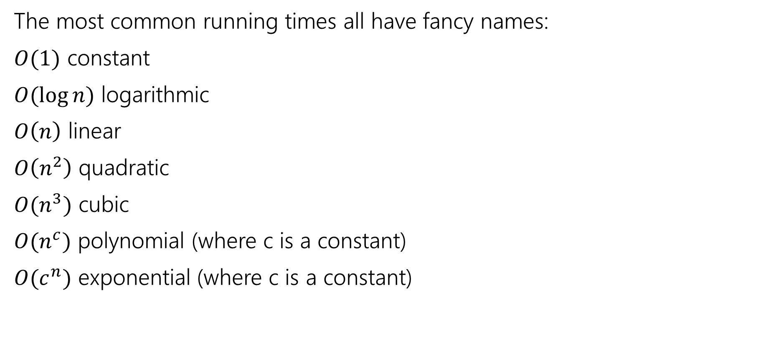
Useful Vocab
The most common running times all have fancy names:
$O(1)$ constant
$O(\log{n})$ logarithmic
$O\left(n\right)$ linear
$O\left(n^{2}\right)$ quadratic
$O(n^{3})$ cubic
$O(n^{c})$ polynomial (where c is a constant)
$O(c^{n})$ exponential (where c is a constant)

Slide 19
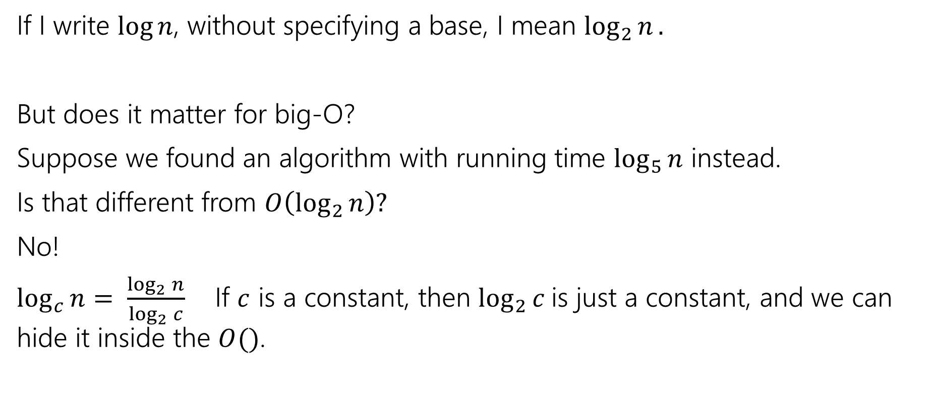
What’s the base of the log?
If I write $\log{n}$, without specifying a base, I mean $\log_{2}{n}.$
But does it matter for big-O?
Suppose we found an algorithm with running time $\log_{5}{n}$ instead.
Is that different from $O\left(\log_{2}{n}\right)?$
No!
$\log_{c}{n}= \frac{\log_{2}{n}}{\log_{2}{c}}$ If $c$ is a constant, then $\log_{2}{c}$is just a constant, and we can hide it inside the $O()$.

