Slide 1
Welcome to CSE 332
Data Structures and Parallelism

Slide 2
Welcome
We have 9 weeks to learn a lot!
Fundamental data structures and algorithms.
And their analysis
Writing Parallel Code

Slide 3
Outline
Introductions
Course Mechanics
Start of content
Review of queues and stacks

Slide 4
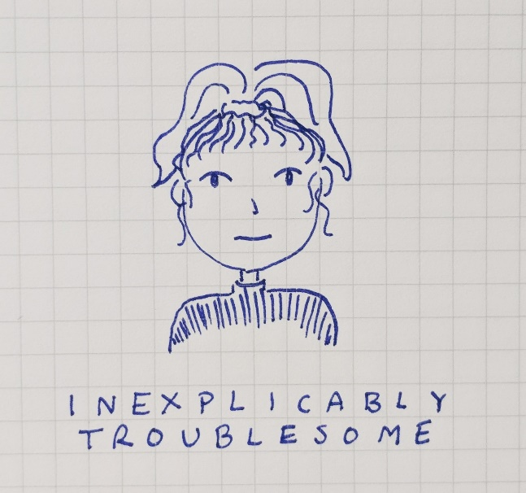
Course Staff
Instructor: Robbie Weber
PhD student in CSE
Research in algorithm design
TAs
Caitlin Schaefer Alon Milchgrub

Slide 5
What’s in this course?
Data Structures and Parallelism
Data structures and Algorithms (about 80% of the course)
Starting to really think like a computer scientist.
Make design decisions, think about trade-offs.
Core data structures and algorithms.
Mathematically analyze those structures and algorithms.
Implement them
Parallelism
First serious treatment of programming with multiple threads

Slide 6
Logistics
Textbook:
Weiss, Data Structures and Algorithm Analysis in Java
OPTIONAL (useful if you want more info, or an alternative presentation)
Piazza (message board) please sign up.
Gradescope
Midterm: Friday July 13th (in lecture)
Final: Split over the last two days of classes:
Thursday August 16th (in section)
Friday August 17th (in lecture)
Email Robbie ASAP if you have a conflict with any of these dates.

Slide 7
Logistics – Projects
We have a lot to cover…
in less time than usual.
3 Programming Projects
Done with a partner
Split over multiple weeks
“Checkpoints” along the way
Your first project comes out Wednesday
There is a partner form on the webpage, fill it out by Tuesday afternoon.
In the meantime: update your Java and Eclipse installs.

Slide 8
Logistics – Exercises
Assigned throughout the quarter.
More frequent (about 10-12). Not as significant time investment as programming projects.
Starting earlier is better (they can take some thought).
Practice the theoretical aspects of the course.
Individual

Slide 9
Academic Honesty
Partners can obviously talk about every aspect of your code in the projects
And you should, pair programming is highly recommended.
In all other cases, high level discussion is fine.
But you must:
Not take any written notes away from your discussion.
List everyone you collaborated with on your assignment.
Goal is for you to learn the material.
More details in syllabus.

Slide 10
Abstract Data Type
An Abstract Data Type (ADT) is a set of expected behaviors for a set of operations.
Queue ADT
Stack ADT
state
state
Set of elements
Set of elements
behavior
behavior
insert(element) – add a new element to the collection.
insert(element) – add a new element to the collection.
remove () – returns the element that has been in the collection the longest, and removes it.
remove () – returns the element that has been in the collection the shortest, and removes it.
peek () – find, but do not remove the element that has been in the collection the longest.
peek () – find, but do not remove the element that has been in the collection the shortest.

Slide 11
Data Structure
A clever way of organizing data points
A data structure is an implementation of an ADT.
Ways to implement a queue
Array
LinkedList
10
17
3
4
15
13
head
tail
7
23
15
14

Slide 12
“Circular” Array
A different queue implementation
Removing elements is expensive. What if we just remember where the next element is?
front
back
10
17
3
4
15
13

Slide 13
“Circular” Array
What about insertions?
We can “wrap around”
At least until the array is completely full.
front
back
5
17
3
4
15
13
10
23

Slide 14
Tradeoffs
With a doubly-linked list, you can get $O(1)$ insertions and removals as well.
If they’re both $O(1)$ why would you choose one over the other?
Updating all those pointers is a constant, but it’s a larger constant than array lookups.
If you know the size in advance a circular array has less overhead
But if you don’t a linked list easily handles growing. The circular array would be annoying to grow.

Slide 15
Things To Do
Now is a great time to find a partner
I’ll be up here if you have questions
Things to do: Survey
Sign up for Piazza
Fill out partner form by tomorrow
Get your programming environment ready.

