Slide 1
CSE 332: Graphs II
Paul Beame in lieu of Richard Anderson
Spring 2016
1

Slide 2
Trees as Graphs
D
E
A tree is a graph that is:
undirected
acyclic
connected
Hey, that doesn’t look like a tree!
B
A
C
F
G
H
2
Notes:
Each of the red areas breaks one of these constraints.
We won’t always require the constraint that the tree be directed.
In fact, if it’s not directed, we can just pick a root and hang everything from that node (making the edges directed); so, it’s not a big deal.

Slide 3
Rooted Trees
We are more accustomed to:
Rooted trees (a tree node that is “special”)
Directed edges from parents to children (parent closer to root).
A rooted tree (root indicated in red)
drawn two ways
Rooted tree with directed
edges from parents to children.
D
E
A
B
A
B
C
A
B
C
D
E
F
C
D
E
F
G
H
F
G
H
Characteristics of this one?
G
H
3
Notes:
Each of the red areas breaks one of these constraints.
We won’t always require the constraint that the tree be directed.
In fact, if it’s not directed, we can just pick a root and hang everything from that node (making the edges directed); so, it’s not a big deal.

Slide 4
Directed Acyclic Graphs (DAGs)
DAGs are directed graphs with no (directed) cycles.
main()
mult()
add()
Aside: If program call-graph is a DAG, then all procedure calls can be in-lined
access()
read()
4
Notes:
And, in fact, if we weaken some of our tree requirements, we get a DAG!
DAGs are a very common representation for dependence graphs. The DAG here shows the non-recursive call-graph from a program.

Slide 5
|E| and |V|
How many edges |E| in a graph with |V| vertices?
What if the graph is directed?
What if it is undirected and connected?
Can the following bounds be simplified?
Arbitrary graph: O(|E| + |V|)
Arbitrary graph: O(|E| + |V|²)
Undirected, connected: O(|E| log|V| + |V| log|V|)
Some (semi-standard) terminology:
A graph is sparse if it has O(|V|) edges (upper bound).
A graph is dense if it has Θ(|V|²) edges.
5

Slide 6
What’s the data structure?
Common query: which edges are adjacent to a vertex
6

Slide 7
Representation 2: Adjacency List
A list (array) of length |V| in which each entry stores a list (linked list) of all adjacent vertices
D
A
A
C
B
B
C
Runtimes:
Iterate over vertices?
Iterate over edges?
Iterate edges adj. to vertex?
Existence of edge?
D
Space requirements?
Best for what kinds of graphs?
7
Notes:
Some operations:
iterate over vertices
iterate over edges
iterate over vertices adj. to a vertex
check whether an edge exists

Slide 8
Representation 1: Adjacency Matrix
A |V|⨯|V| matrix M in which an element M[u,v] is true if and only if there is an edge from u to v
A
B
C
D
D
A
A
B
C
B
C
Runtimes:
Iterate over vertices?
Iterate over edges?
Iterate edges adj. to vertex?
Existence of edge?
D
Space requirements?
Best for what kinds of graphs?
8
Notes:
Some operations:
iterate over vertices
iterate over edges
iterate over vertices adj. to a vertex
check whether an edge exists

Slide 9
Representing Undirected Graphs
What do these reps look like for an undirected graph?
D
A
C
Adjacency matrix:
B
A
B
C
D
Adjacency list:
A
A
B
B
C
C
D
D
9
Notes:
Some operations:
iterate over vertices
iterate over edges
iterate over vertices adj. to a vertex
check whether an edge exists

Slide 10
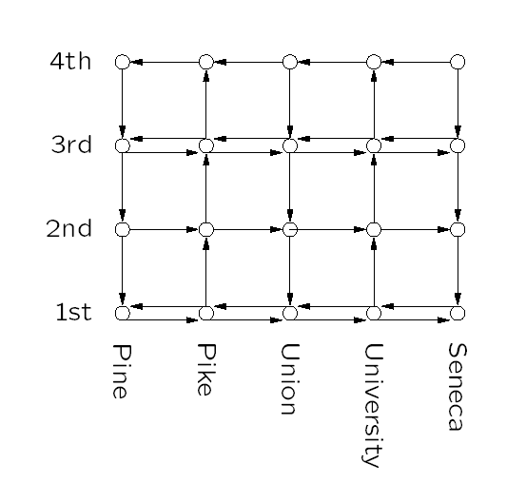
Some Applications: Bus Routes in Downtown Seattle
If we’re at 3rd and Pine, how can we get to
1st and University using Metro?
How about 4th and Seneca?
10
Notes:
And here’s some directed graph examples

Slide 11
Application: Topological Sort
Given a graph, G = (V,E), output all the vertices in V sorted so that no vertex is output before any other vertex with an edge to it.
CSE 403
CSE 321
CSE 322
CSE 421
CSE 142
CSE 143
CSE 341
CSE 326
CSE 451
CSE 378
CSE 303
CSE 457
CSE 370
CSE 467
What kind of input
graph is allowed?
Is the output unique?
11
Notes:
A topological or topo-sort is just a valid sorting of these vertices when we define an edge as an ordering constraint/relationship.
There are many other applications of topological sort. The classic example is getting a valid ordering of classes when edges represent prerequisites
What happens if I add an edge from “CSE 467” to “CSE 142”? This graph is no longer a DAG! In fact, we cannot topo-sort without a DAG!

Slide 12
Topological Sort: Take One
Label each vertex with its in-degree (# inbound edges)
While there are vertices remaining:
Choose a vertex v of in-degree zero; output v
Reduce the in-degree of all vertices adjacent to v
Remove v from the list of vertices
Runtime:
12
Notes:
That’s a bit less efficient than we can do.
Let’s try this.
How well does this run? Depends on how fast we can find a vertex with degree zero (let’s say |V|). How quickly can we find adjacent vertices? (|E|). So O(|E| + |V|^2) = O(|V|^2)

Slide 13
142
143
321
341
378
370
322
326
303
403
421
451
457
467
CSE 403
CSE 321
CSE 322
CSE 421
CSE 142
CSE 143
CSE 341
CSE 326
CSE 451
CSE 378
CSE 457
CSE 303
CSE 370
CSE 467
13
Notes:
A topological or topo-sort is just a valid sorting of these vertices when we define an edge as an ordering constraint/relationship.
There are many other applications of topological sort. The classic example is getting a valid ordering of classes when edges represent prerequisites
What happens if I add an edge from “CSE 467” to “CSE 142”? This graph is no longer a DAG! In fact, we cannot topo-sort without a DAG!

Slide 14
void Graph::topsort(){
Vertex v, w;
labelEachVertexWithItsInDegree();
for (int counter=0; counter < NUM_VERTICES; counter++){
v = findNewVertexOfDegreeZero();
v.topologicalNum = counter;
for each w adjacent to v
w.indegree--;
}
}
14
Notes:
We should never find a cycle – this is a DAG
How long does this take?
Observation: The only new (eligible) vertices with indegree 0 are the ones adjacent to the vertex just processed.

Slide 15
Topological Sort: Take Two
Label each vertex with its in-degree
Initialize a queue Q to contain all in-degree zero vertices
While Q not empty
v = Q.dequeue; output v
Reduce the in-degree of all vertices adjacent to v
If new in-degree of any such vertex u is zero Q.enqueue(u)
Note: could use a stack, list, set, box, … instead of a queue
Runtime:
15
Notes:
Why use a queue?
Some sense of stability (as discussed during the sorting )

Slide 16
void Graph::topsort(){
Queue q(NUM_VERTICES);
int counter = 0;
Vertex v, w;
labelEachVertexWithItsIn-degree();
q.makeEmpty();
for each vertex v
if (v.indegree == 0)
q.enqueue(v);
while (!q.isEmpty()){
v = q.dequeue();
v.topologicalNum = ++counter;
for each w adjacent to v
if (--w.indegree == 0)
q.enqueue(w);
}
}
intialize the
queue
get a vertex with
indegree 0
insert new
eligible
vertices
16
Notes:
Idea: Use a set data structure to keep track of eligible vertices (Queue or Stack).

Slide 17
Find a topological order for the following graph
H
E
I
A
D
G
J
C
F
K
B
L

Slide 18
If a graph has a cycle, there is no topological sort
Consider the first vertex on the cycle in the topological sort
It must have an incoming edge
A
F
B
E
C
D

Slide 19
Lemma: If a graph is acyclic, it has a vertex with in degree 0
Proof:
Pick a vertex v₁, if it has in-degree 0 then done
If not, let (v₂, v₁) be an edge, if v₂ has in-degree 0 then done
If not, let (v₃, v₂) be an edge . . .
If this process continues for more than n steps, we have a repeated vertex, so we have a cycle

