Slide 1
CSE 332: Abstractions Stacks and Queues
Spring 2016
Richard Anderson
Lecture 2

Slide 2
Announcements
Homework requires you get the textbook (Either 2nd or 3rd Edition)
Section Thursday
Homework #1 out today (Wednesday)
Due at the beginning of class next Wednesday(Apr 6).
Program Assignment #1 is available
Get environment set up and compile the program by Thursday
Office hours:
Richard Anderson, MW, 3:30-4:30
Andrew Li, TuF, 3:30-4:30
Hunter Zahn

Slide 3
First Example: Queue ADT
FIFO: First In First Out
Queue operations
create
destroy
enqueue
dequeue
is_empty
F E D C B
G
enqueue
dequeue
A
Notes:
You’ve probably seen the Q before. If so, this is an opportunity to get familiar with how we will be treating concepts in this class. If not, then the Q is a simple but very powerful abstraction, and you should make sure you understand it thoroughly.
Note the lack of any implementation details – just the interface and key properties that must be satisfied.

Slide 4
Queues in practice
Print jobs
File serving
Phone calls and operators
(Later, we will consider “priority queues.”)

Slide 5
Array Queue Data Structure
0
size - 1
Q
b
c
d
e
f
back
enqueue(Object x) {
Q[back] = x
back = (back + 1)
}
What’s missing in these functions?
How to find K-th element in the queue?
dequeue() {
x = Q[0]
shiftLeftOne()
back = (back – 1)
return x
}
Notes:
Here is a data structure implementation of the Q.
The queue is stored as an array.
shiftLeftOne is expensive!
There’s also another problem here. What’s wrong with the Enqueue and Dequeue functions?
Your data structures should be robust! Make them robust before you even consider thinking about making them efficient! That is an order!

Slide 6
Circular Array Queue Data Structure
0
size - 1
Q
b
c
d
e
f
front
back
enqueue(Object x) {
assert(!is_full())
Q[back] = x
back = (back + 1) % Q.size
}
How test for empty/full list?
How to find K-th element in the queue?
What to do when full?
dequeue() {
assert(!is_empty())
x = Q[front]
front = (front + 1) % Q.size
return x
}
Notes:
Here is another data structure implementation of the Q.
The queue is stored as an array, and, to avoid shifting all the elements each time an element is dequeued, we imagine that the array wraps around on itself.
Test for empty/full: front = back
Can we do something smarter when full?

Slide 7
Linked List Queue Data Structure
b
c
d
e
f
front
back
void enqueue(Object x) {
if (is_empty())
front = back = new Node(x)
else {
back->next = new Node(x)
back = back->next
}
}
bool is_empty() {
return front == null
}
Object dequeue() {
assert(!is_empty())
return_data = front->data
temp = front
front = front->next
delete temp
return return_data
}

Slide 8
Circular Array vs. Linked List
Advantages of circular array?
Advantages of linked list?
- unused space, resizing
+ faster indexing
+ memory coherence
+ can grow as needed
- slow indexing
Notes:
Advantage of circular array? Faster (except for resize), simpler memory management
Advantage of linked list? No max size (or need to reallocate/copy)

Slide 9
Second Example: Stack ADT
LIFO: Last In First Out
Stack operations
create
destroy
push
pop
top
is_empty
A
E D C B A
B
C
D
E
F
F

Slide 10
Stacks in Practice
Function call stack
Removing recursion
Balancing symbols (parentheses)
Evaluating postfix or “reverse Polish” notation

Slide 11
CSE 332: Data Abstractions Asymptotic Analysis
Richard Anderson, Spring 2016

Slide 12
Algorithm Analysis
Correctness:
Does the algorithm do what is intended.
Performance:
Speed time complexity
Memory space complexity
Why analyze?
To make good design decisions
Enable you to look at an algorithm (or code) and identify the bottlenecks, etc.

Slide 13
How to measure performance?
Empirical (plot): code it up, run lots of times, plot times
Analytical (eqs): count ops, derive bounds
Notes:
Emperical approach: run the program many times—this is probably the best thing to do if you have time to do it.
Some caveats
- requires you to implement every alg you want to evaluate
- results may be particular to type of machine you’re using
- need to test on same data sizes and distributions you expect to see in practice
Analytical approach: count operations, come up with (upper/lower) bounds on running time

Slide 14
Analyzing Performance
We will focus on analyzing time complexity. First, we have some “rules” to help measure how long it takes to do things:
Second, we will be interested in Worse performance (average and best case sometimes).
Basic operations
Consecutive statements
Conditionals
Loops
Function calls
Recursive functions
Constant time
Sum of times
Test, plus larger branch cost
Sum of iterations
Cost of function body
Solve recurrence relation…
14
Notes:
14

Slide 15
Complexity cases
We’ll start by focusing on two cases.
Problem size N
Worst-case complexity: max # steps algorithm takes on “most challenging” input of size N
Best-case complexity: min # steps algorithm takes on “easiest” input of size N

Slide 16
Exercise - Searching
2
3
5
16
37
50
73
75
bool ArrayContains(int array[], int n, int key){
// Insert your algorithm here
}
What algorithm would you choose to implement this code snippet?
Notes:
Linear, binary

Slide 17
Linear Search Analysis
bool LinearArrayContains(int array[], int n, int key ) {
for( int i = 0; i < n; i++ ) {
if( array[i] == key )
// Found it!
return true;
}
return false;
}
Best Case:
Worst Case:
Best: T(n) = 4, when at [0]
Worst: T(n) = 3n+3, when not found
Notes:
CURLESS: this is a weird algorithm, shouldn’t it actually return the location of the key, rather than just say if it was found?
Arguably, the best case is a zero length array query…n=0…but this doesn’t tell us best case a fn of n.
T(n) = n (we are looking for “exact” runtimes)
loop init: 1
Loop check: n+1 (max, if not found)
Loop counter: n
Conditional inside loop: n
Best = T(n)=4, T(0) = 2, Worst if not found = T(n) = 3n + 3
[note that average depends on if found]

Slide 18
Binary Search Analysis
2
3
5
16
37
50
73
75
Best case:
Worst case:
bool BinArrayContains( int array[], int low, int high, int key ) {
// The subarray is empty
if( low > high ) return false;
// Search this subarray recursively
int mid = (high + low) / 2;
if( key == array[mid] ) {
return true;
} else if( key < array[mid] ) {
return BinArrayFind( array, low, mid-1, key );
} else {
return BinArrayFind( array, mid+1, high, key );
}
Best: 5 when at [mid] (or 2, n=0)
Worst: 7 + recursion
= 7log(n) + 9 (work out)
Notes:
Here we (somewhat arbitrarily) count arithmetic ops, compares, returns, but not array indexing, function call, conditional.
e.g., mid = (high + low) / 2 is 2 ops, if (key == array[mid]) is 1 op. Lame, but need to choose some convention.
Best = 5, or 2 if n=0,
Worst = 7 + T(n/2)
Uh-oh. Let’s go to the next slide. We’ll come back and fill out these numbers later.
Worst if not found = 7 log_2 n + 9

Slide 19
Solving Recurrence Relations
T(n) = 7 + T(n/2); T(1) = 9
Determine the recurrence relation and base case(s).
“Expand” the original relation to find an equivalent expression in terms of the number of expansions (k).
Find a closed-form expression by setting k to a value which reduces the problem to a base case
T(n) = 7 + (7 + T( n/4 ) ) = 7 + (7 + (7 + T(n/8)))
= 7*3 + T(n/2³)
= … = 7k + T(n/2^{k})
Need (n/2^{k}) = 1, mult by 2^k So k = log n (all logs to base 2) Hence, T(n) = 7 log n + 9
Notes:
1. T(n) = 7 + T( floor(n/2) )
T(1) = 7 + T(0) = 9
2. T(n) = 7 + (7 + T( floor(n/4) ) ) = 14 + T( floor(n/4) )
T(n) = 7 + (7 + (7 + T( floor(n/8) ) ) = 21 + T( floor(n/8) )
So, if k is the number of expansions, the general expression is:
T(n) = 7k + T( floor( n/(2^k) ) )
3. Since the base case is n = 1, we need to find a value of k such that the value of floor( n/(2^k) ) is 1 (which removes T(n) from the RHS of the equation, thus giving us a closed-form expression). A value of k = log_2 n gives us this. Setting k = log_2 n, we have:
T(n) = 7 log_2 n + T(1)
T(n) = 7 log_2 n + 9

Slide 20
Linear Search vs Binary Search
 | Linear Search | Binary Search
Best Case | 4 | 5 at [middle]
Worst Case | 3n+3 | 7 ⎣log n⎦ + 9
BS wins for n>7
But we’re sweeping a lot of stuff under the rug…
depends on input, processor…
sorting time for binary search
but for really large values of n, BS is going to win
Notes:
Linear Search: 3, 3n+3
Binary Search: 4, 7logN + 9
BS wins for n > 7
Some students will probably say “Binary search, because it’s O( log n ), whereas linear search is O( n )”. But the point of this discussion is that big-O notation obscures some important factors (like constants!) and we really don’t know the input size.
To make a meaningful comparison, we need to know more information. What information might that be?
(1) what our priorities are (runtime? Memory footprint?)
(2) what the input size is (or, even better, what the input is!)
(3) our platform/machine – we saw on the earlier chart that architecture made a difference!
(4) other …
Big-O notation gives us a way to compare algorithms without this information, but the cost is a loss of precision.

Slide 21
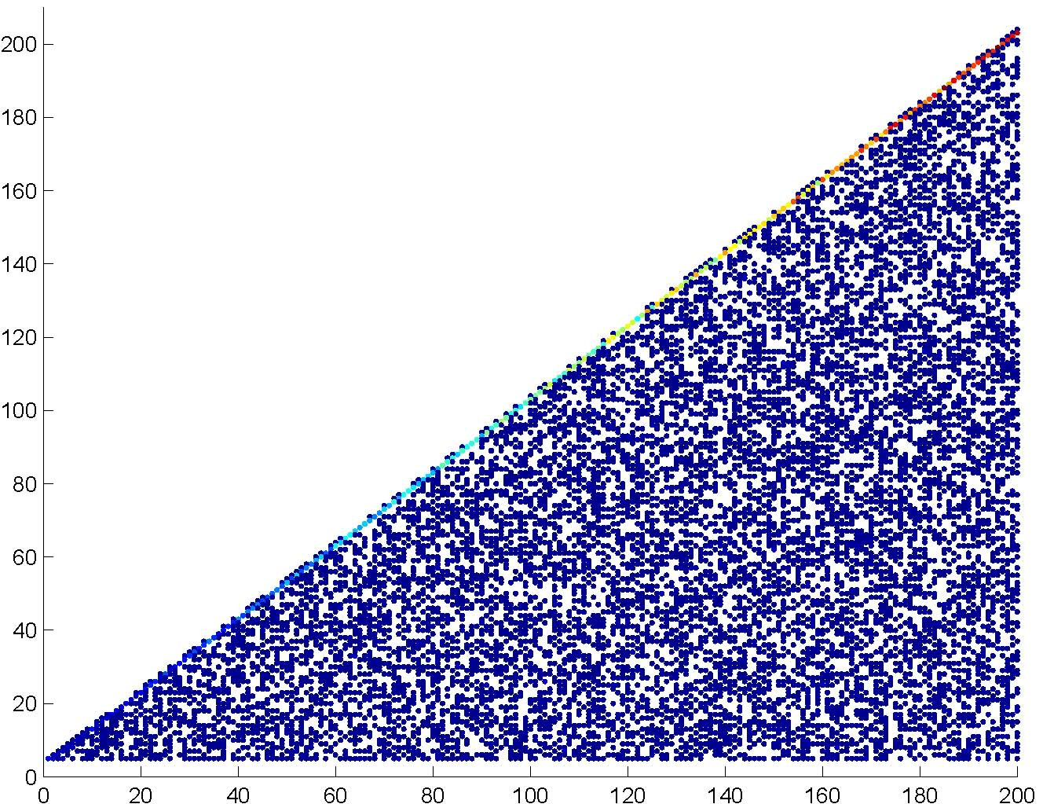
Linear search—empirical analysis
time (# ops)
N (= array size)
Each search produces a dot in above graph. Blue = less frequently occurring, Red = more frequent
Notes:
I ran linear search over and over and plotted the running times.
Specifically:
- created a random array of size N
- did several random searches (N/10 to be exact)
- generated a new random array and new searches, iterating 10 times
Note color encoding—some run times occur more often then others (red is most frequent).
- why are the red dots at the top?
This gives a pretty good picture of the running time characteristics of this algorithm—uniform under the triangle, with a peak at the top.

Slide 22
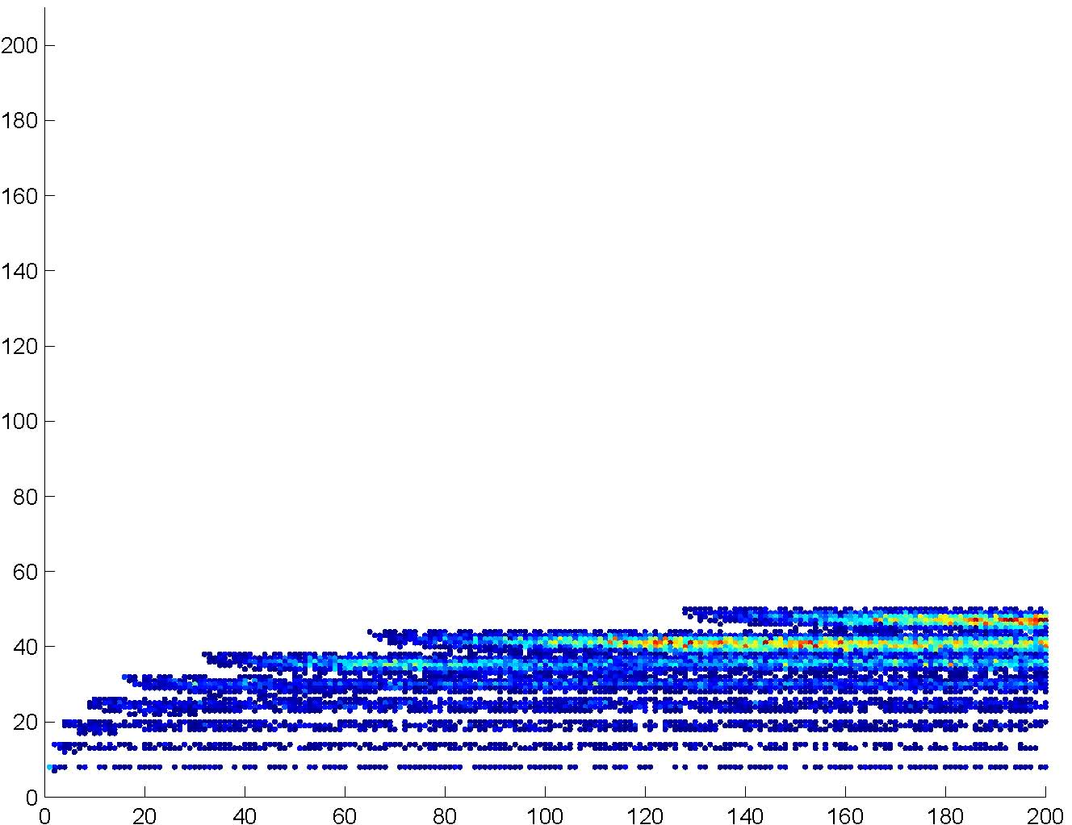
Binary search—empirical analysis
time (# ops)
N (= array size)
Each search produces a dot in above graph. Blue = less frequently occurring, Red = more frequent
Notes:
Same for binary search…
How do you compare these?

Slide 23
Empirical comparison
time (# ops)
N (= array size)
N (= array size)
Linear search
Binary search
Gives additional information
Notes:
Binary better almost all of the time, especially for large values of N.
Linear is better for small values of N
Linear best case always beats out binary best case (bottom of the graph)
There also seem to be some trends (linear slope vs. logarithmic). Can we quantify these?

Slide 24
Asymptotic Analysis
Consider only the order of the running time
A valuable tool when the input gets “large”
Ignores the effects of different machines or different implementations of same algorithm
Show lim (3n+3)/(7logn+9), l’Hopital’s rule
Notes:
Okay, so the point of all those pretty pictures is to show that, while constants matter, they don’t really matter as much as the order for “sufficiently large” input (“large” depends, of course, on the constants).

Slide 25
Asymptotic Analysis
To find the asymptotic runtime, throw away the constants and low-order terms
Linear search is
Binary search is
Remember: the “fastest” algorithm has the slowest growing function for its runtime
Bases don’t matter, more in a sec

Slide 26
Asymptotic Analysis
Eliminate low order terms
4n + 5 ⇒
0.5 n log n + 2n + 7 ⇒
n³ + 3 2^{n} + 8n ⇒
Eliminate coefficients
4n ⇒
0.5 n log n ⇒
3 2^{n} =>

Slide 27
Properties of Logs
Basic:
A^{logAB} = B
log_{A}A =
Independent of base:
log(AB) =
log(A/B) =
log(A^{B}) =
log((A^{B})^{C}) =

Slide 28
Properties of Logs
Changing base → multiply by constant
For example: log₂x = 3.22 log₁₀x
More generally
Means we can ignore the base for asymptotic analysis (since we’re ignoring constant multipliers)
log_{A}n = k log_{B}n

Slide 29
Another example
Eliminate low-order terms
Eliminate constant coefficients
16n³log₈(10n²) + 100n²

Slide 30
Comparing functions
Plot h(n)=n, f(n) = n^2
f(n) is an upper bound for h(n)
if h(n) ≤ f(n) for all n
This is too strict – we mostly care about large n
Still too strict if we want to ignore scale factors
Another plot where they cross
Notes:
Modify eqn, to h(n) <= cf(n) for all n>= n_0

Slide 31
Definition of Order Notation
Plot h(n)=n, f(n) = n^2
h(n) є O(f(n)) Big-O “Order”
if there exist positive constants c and n₀
such that h(n) ≤ c f(n) for all n ≥ n₀
O(f(n)) defines a class (set) of functions
Another plot where they cross

Slide 32
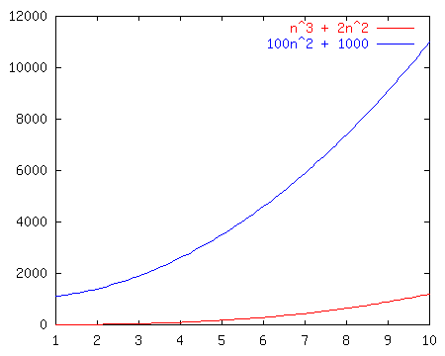
Order Notation: Intuition
a(n) = n³ + 2n²
b(n) = 100n² + 1000
Although not yet apparent, as n gets “sufficiently large”, a(n) will be “greater than or equal to” b(n)

Slide 33
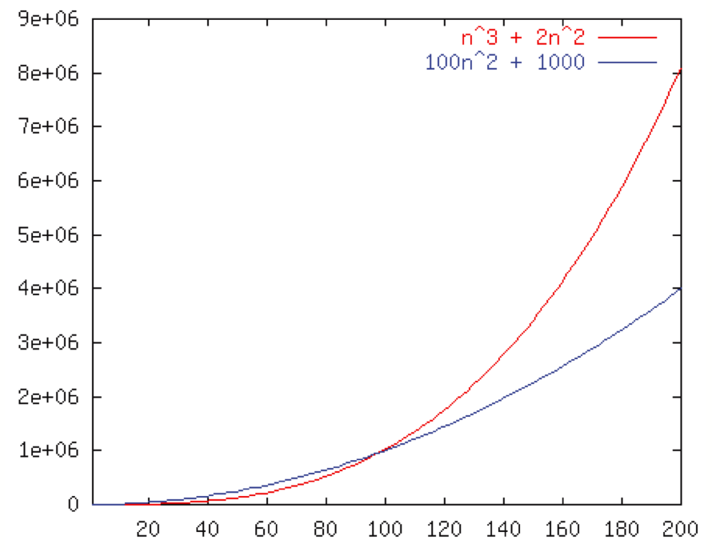
Order Notation: Example
Wait, crossover point at 100, not 198?
If we pick c =1, then n₀=100
100n² + 1000 ≤ (n³ + 2n²) for all n ≥ 100
So 100n² + 1000 ∈ O(n³ + 2n²)
b ∈ O(n³),O(n²),Ω(n²),Θ(n²)
Notes:
For c = 1, the crossover happens at n = 100

Slide 34
Example
h(n) ∈ O( f(n) ) iff there exist positive constants c and n₀ such that: h(n) ≤ c f(n) for all n ≥ n₀
Example:
100n² + 1000 ≤ 1 (n³ + 2n²) for all n ≥ 100 So 100n² + 1000 ∈ O(n³ + 2n² )

Slide 35
Constants are not unique
h(n) ∈ O( f(n) ) iff there exist positive constants c and n₀ such that: h(n) ≤ c f(n) for all n ≥ n₀
Example:
100n² + 1000 ≤ 1 (n³ + 2n²) for all n ≥ 100
100n² + 1000 ≤ 1/2 (n³ + 2n²) for all n ≥ 198
Notes:
So why bother with these constants?

Slide 36
Another Example: Binary Search
h(n) ∈ O( f(n) ) iff there exist positive constants c and n₀ such that: h(n) ≤ c f(n) for all n ≥ n₀
Is 7log₂n + 9 ∈ O (log₂n)?
Notes:
n=2: LHS = 16
So set n_0 = 2, c = 16

Slide 37
Order Notation: Worst Case Binary Search
Plot: T^{BS}_{worst} = 7log n + 9 > 2 log n < 10 log n (when n gets large) so Θ(log n)
Notes:
plot 7logN + 9 bounded by 15logN above, and 5logN below

Slide 38
Some Notes on Notation
Sometimes you’ll see (e.g., in Weiss)
h(n) = O( f(n) )
or
h(n) is O( f(n) )
These are equivalent to
h(n) ∈ O( f(n) )

Slide 39
Big-O: Common Names
constant: O(1)
logarithmic: O(log n) (log_{k}n, log n² ∈ O(log n))
linear: O(n)
log-linear: O(n log n)
quadratic: O(n²)
cubic: O(n³)
polynomial: O(n^{k}) (k is a constant)
exponential: O(c^{n}) (c is a constant > 1)

Slide 40
Asymptotic Lower Bounds
Ω( g(n) ) is the set of all functions asymptotically greater than or equal to g(n)
h(n) ∈ Ω( g(n) ) iff There exist c>0 and n₀>0 such that h(n) ≥ c g(n) for all n ≥ n₀
Notes:
N in Omega (log N)
N in O(N^2)

Slide 41
Asymptotic Tight Bound
θ( f(n) ) is the set of all functions asymptotically equal to f (n)
h(n) ∈ θ( f(n) ) iff
h(n) ∈ O( f(n) ) and h(n) ∈ Ω(f(n) )
- This is equivalent to:
Notes:
7logN + 9 in O(logN)
7logN + 9 in Omega(logN)

Slide 42
Full Set of Asymptotic Bounds
O( f(n) ) is the set of all functions asymptotically less than or equal to f(n)
o(f(n) ) is the set of all functions asymptotically strictly less than f(n)
Ω( g(n) ) is the set of all functions asymptotically greater than or equal to g(n)
ω( g(n) ) is the set of all functions asymptotically strictly greater than g(n)
θ( f(n) ) is the set of all functions asymptotically equal to f (n)
Notes:
The strictly less/greater than versions are less common

Slide 43
Formal Definitions
h(n) ∈ O( f(n) ) iff There exist c>0 and n₀>0 such that h(n) ≤ c f(n) for all n ≥ n₀
h(n) ∈ o(f(n)) iff There exists an n₀>0 such that h(n) < c f(n) for all c>0 and n ≥ n₀
This is equivalent to:
h(n) ∈ Ω( g(n) ) iff There exist c>0 and n₀>0 such that h(n) ≥ c g(n) for all n ≥ n₀
h(n) ∈ ω( g(n) ) iff There exists an n₀>0 such that h(n) > c g(n) for all c>0 and n ≥ n₀
This is equivalent to:
h(n) ∈ θ( f(n) ) iff h(n) ∈ O( f(n) ) and h(n) ∈ Ω(f(n) )
This is equivalent to:
Note: only inequality change, or
(there exists c) or (for all c).
Notes:
Note how they all look suspiciously like copy-and-paste definitions …
Make sure that they notice the only difference between the relations -- less-than, less-than-or-equal, etc.

Slide 44
Big-Omega et al. Intuitively
Asymptotic Notation | Mathematics Relation
O | ≤
Ω | ≥
θ | =
o | <
ω | >
Notes:
In fact, it’s not just the intuitive chart, but it’s the chart of definitions! Notice how similar the formal definitions all were … they only differed in the relations which we highlighted in blue!

Slide 45
Complexity cases (revisited)
Problem size N
Worst-case complexity: max # steps algorithm takes on “most challenging” input of size N
Best-case complexity: min # steps algorithm takes on “easiest” input of size N
Average-case complexity: avg # steps algorithm takes on random inputs of size N
Amortized complexity: max total # steps algorithm takes on M “most challenging” consecutive inputs of size N, divided by M (i.e., divide the max total by M).
Notes:
We already discussed the bound flavor. All of these can be applied to any analysis case. For example, we’ll later prove that sorting in the worst case takes at least n log n time. That’s a lower bound on a worst case.
Average case is hard! What does “average” mean. For example, what’s the average case for searching an unordered list (as precise as possible, not asymptotic).
WRONG! It’s about n, not 1/2 n. Why? You have to search the whole thing if the elt is not there.
Note there’s two senses of tight. I’ll try to avoid the terminology “asymptotically tight” and stick with the lower def’n of tight. O(inf) is not tight!

Slide 46
Bounds vs. Cases
Two orthogonal axes:
Bound Flavor
Upper bound (O, o)
Lower bound (Ω, ω)
Asymptotically tight (θ)
Analysis Case
Worst Case (Adversary), T_{worst}(n)
Average Case, T_{avg}(n)
Best Case, T_{best}(n)
Amortized, T_{amort}(n)
One can estimate the bounds for any given case.
e.g., We’ll show sorting takes at least n log n. That’s a lower bound on a worst case.

