Slide 1
CSE332: Data Abstractions Section 1
HyeIn Kim
Spring 2013

Slide 2
Section Agenda
Introduction
Generics
Project 1
Eclipse Tutorial

Slide 3
Introduction - Me
HyeIn (Han) Kim
From Korea
5th year Master’s student
BS in Biology & CSE at UW
Teaching section AA & AB
- Office hour: Thursday 12:30 ~ 01:30, CSE 216
- Email: kainby87@uw.edu

Slide 4
Introduction - You
Name
Year
Home Town
Interesting Fact about yourself
What you did over the break

Slide 5
Generics
What is generics?
- Technique of writing class/Interface without
specifying type of data it uses
- Idea: class/interface can have type parameter
Usually denoted as T or E
Notes:
public void method_A(String s) { ... } s<-”Hi”, “Bye”
public void method_B(T t) { ... } T<-String, Integer

Slide 6
Generics
Want a Bag class to store Items
public class Bag {
private String item;
public void setItem(String x) { item = x; }
public String getItem( ) { return item; }
}
public class Bag {
private Book item;
public void setItem(Book x) { item = x; }
public Book getItem( ) { return item; }
}
- Don’t want to make Bag class for all kind of fields.
Notes:
Want to create Bag class that stores Items. Each Bag stores an Item – can be anything.

Slide 7
Generics
Want a Bag class to store Items
public class Bag<E> {
private E item;
public void setItem(E x) { item = x; }
public E getItem( ) { return item; }
}
public interface List <E> {
void add(E x);
…
}
Notes:
Declare type parameter at the top of class.
Can you think of writing a Bag class without using generic? It can store any type of objects.

Slide 8
Generics
Want a Bag class to store Items
- Pre Java 5: Objects
public class Bag {
private Object item;
public void setItem(Object x ) { item = x; }
public Object getItem() { return item; }
}
Bag b = new Bag();
b.setItem("How about that?”);
String contents = (String) b.getItem();
Notes:
How do you use it?
Can you guess what is advantage of using generic over objects?

Slide 9
Generics
Why generics?
Bag b = new Bag();
b.setItem( "How about that?" );
String contents = (String) b.getItem();
double contents = (double) b.getItem();
// Ok
// Error (Runtime)
Bag b = new Bag<String>();
b.setItem( "How about that?" );
String contents = b.getItem();
double contents = (double) b.getItem();
// Ok
// Error (Compile time)
Notes:
which one using object and which one using generic? How do you know?
Is this going to compile?
Is it going to throw exception when run?

Slide 10
Generics
Why generics?
Type Safe Containers
- Main advantage: compile-time type checking
- Generics: Ensure correct type at compile time
No need for cast or Type checking
Cannot create generic array!
* Note:
E[] myArray = new E[INITIAL_SIZE]; // Error
E[] myArray = (E[]) new Object[INITIAL_SIZE]; // Ok
Notes:
How can we work it around? Any ideas?

Slide 11
Generics
More Generics: References
- Generics & Inheritance
- Wild cards
http://www.cs.washington.edu/education/courses/cse332/12sp/section/week1/GenericsAndJUnit.pdf
http://www.cs.washington.edu/education/courses/cse332/12sp/section/week1/Bag.java
http://www.cs.washington.edu/education/courses/cse332/12sp/section/week1/Tuple.java
Textbook 1.4 ~ 1.5

Slide 12
Project 1
Sound Blaster!
- Part A: Due next Wednesday, 11pm
Part B: Due Tuesday April 16th, 11pm
- Personal Project: No partners!
Collaboration Policy
http://www.cs.washington.edu/education/courses/cse332/13wi/policies.shtml
Grading Policy
http://www.cs.washington.edu/education/courses/cse332/13wi/grading-policies.shtml
Programming Guidelines
http://www.cs.washington.edu/education/courses/cse332/13wi/programming-guidelines.shtml

Slide 13
Project 1
Part A
- Implement Stack ADT: Stores double
Implement interface DStack
Using Array (ArrayStack)
Using Linked List (ListStack)
Part B
- Implement Stack ADT: Use generic
Implement interface GStack
Using Array (GArrayStack)
Using Linked List (GListStack)
Notes:
2 interface provided -> DStack & GStack

Slide 14
Project 1
Reverse.java
- Handles all music stuff
- No need to edit for part A
- Reverses in.dat file and writes it to out.dat
- Accepts 4 command line parameters
Stack Implementation: array or list
Content type: double or generic
Input file name: ex) in.dat
Output file name: ex) out.dat

Slide 15
Project 1
Sound Exchange (SOX)
- Converts .wav file to .dat file & vice versa
Reverse.java needs .dat file
You need .wav file to play sound
- Installed in lab machine
- Use in command prompt / terminal
ex) sox secret.wav secret.dat
- Can also do what Reverse.java does
ex) sox secret.wav secret_rev.wav reverse
Notes:
Can use it to check your answer

Slide 16
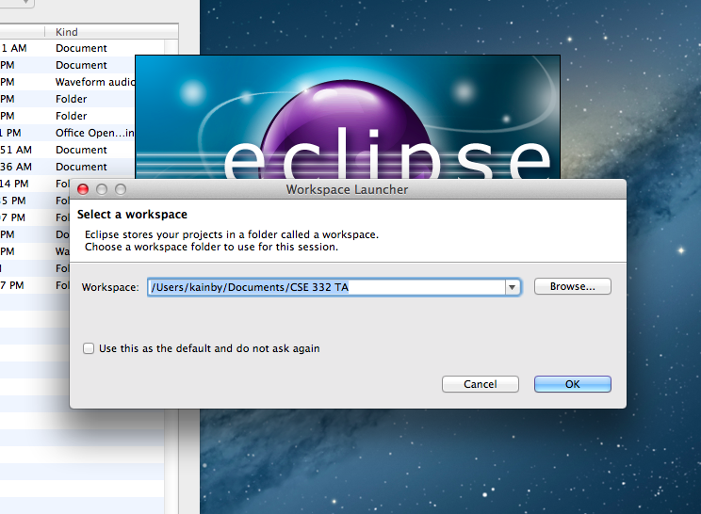
Eclipse Tutorial
Select WorkSpace

Slide 17
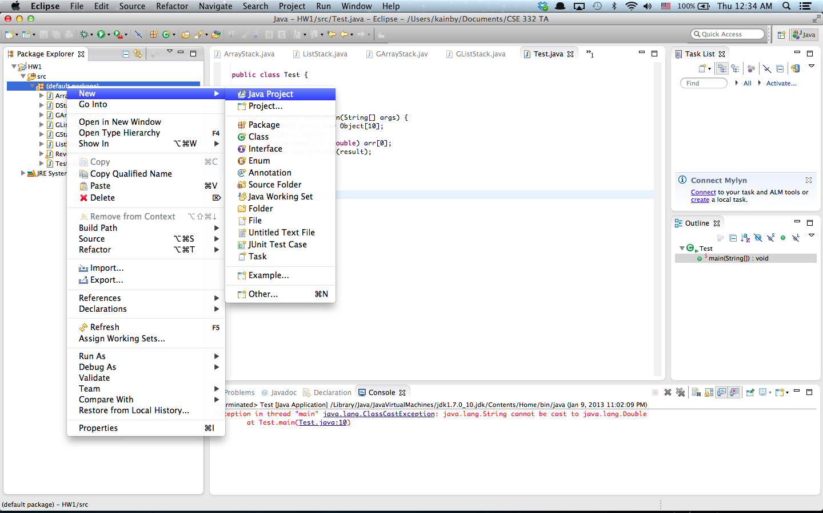
Eclipse Tutorial
Create Project

Slide 18
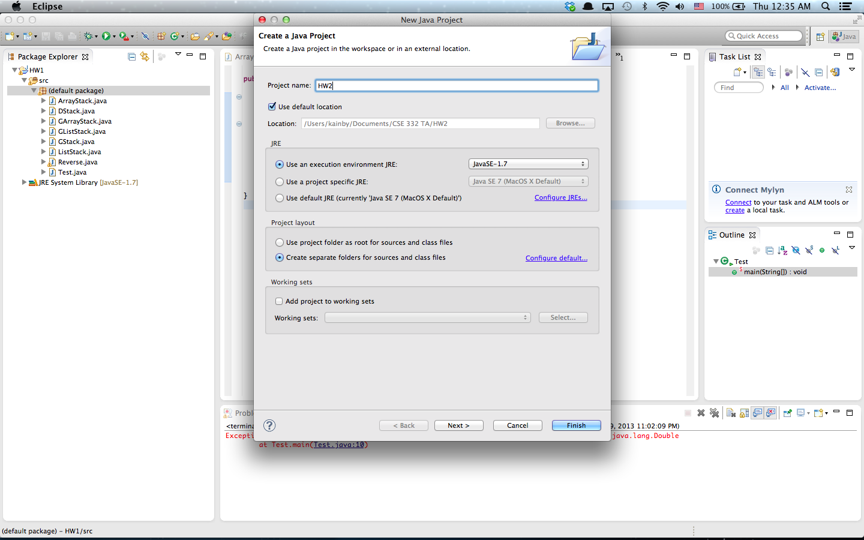
Eclipse Tutorial
Create Project

Slide 19
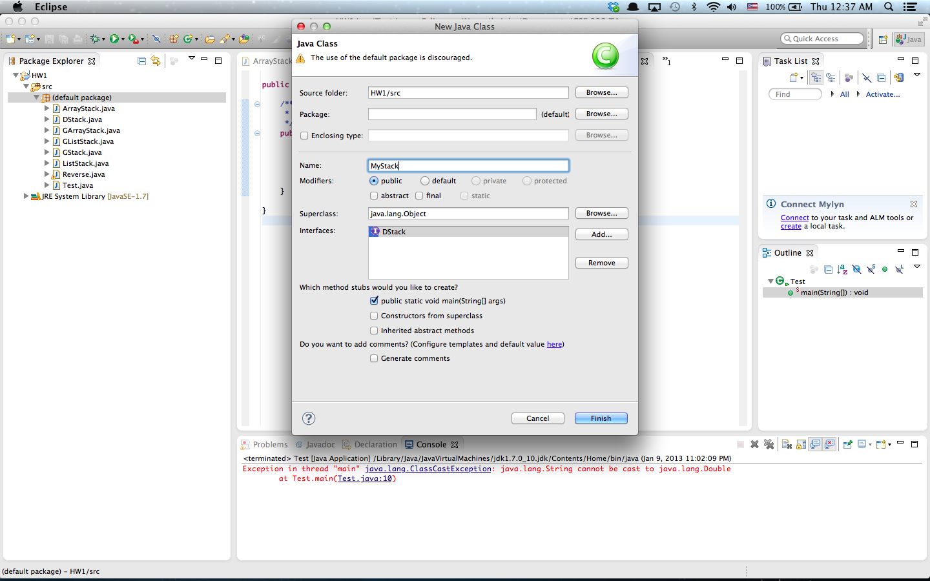
Eclipse Tutorial
Create Class

Slide 20
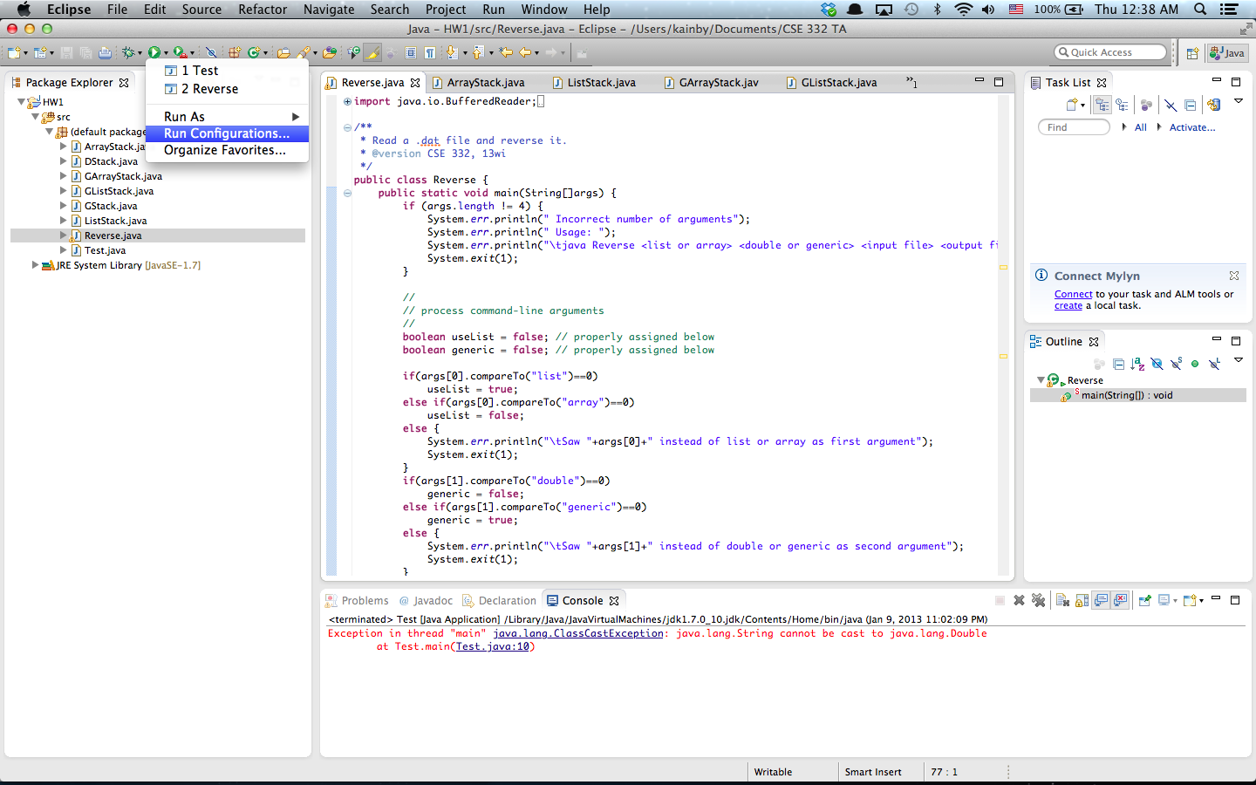
Eclipse Tutorial
Run Configuration (Command line Args)

Slide 21
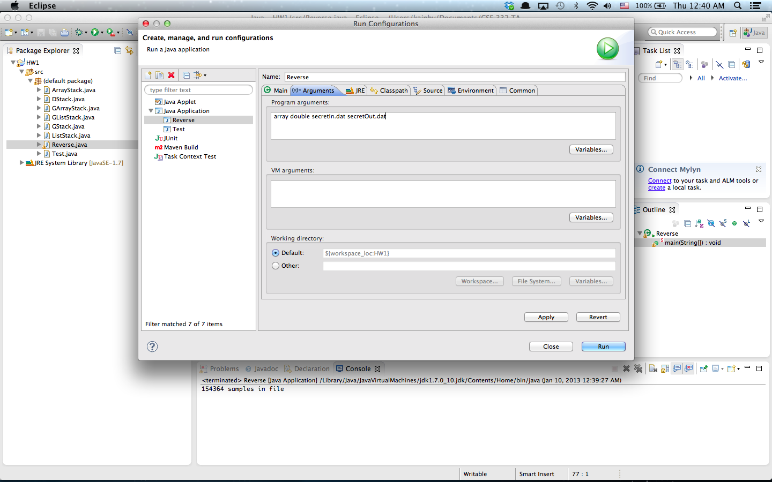
Eclipse Tutorial
Run Configuration (Command line Args)

Slide 22
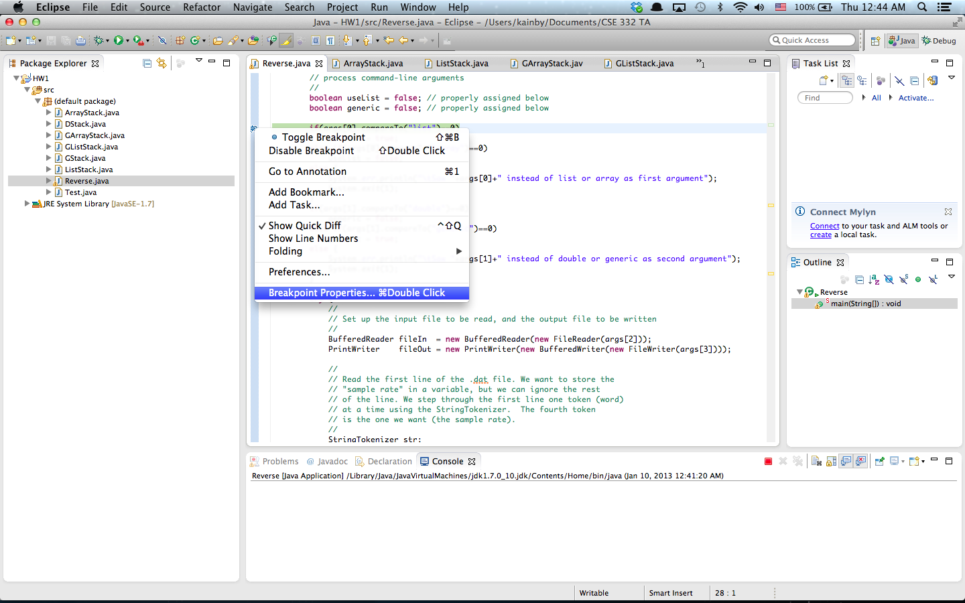
Eclipse Tutorial
Conditional Debugging

Slide 23
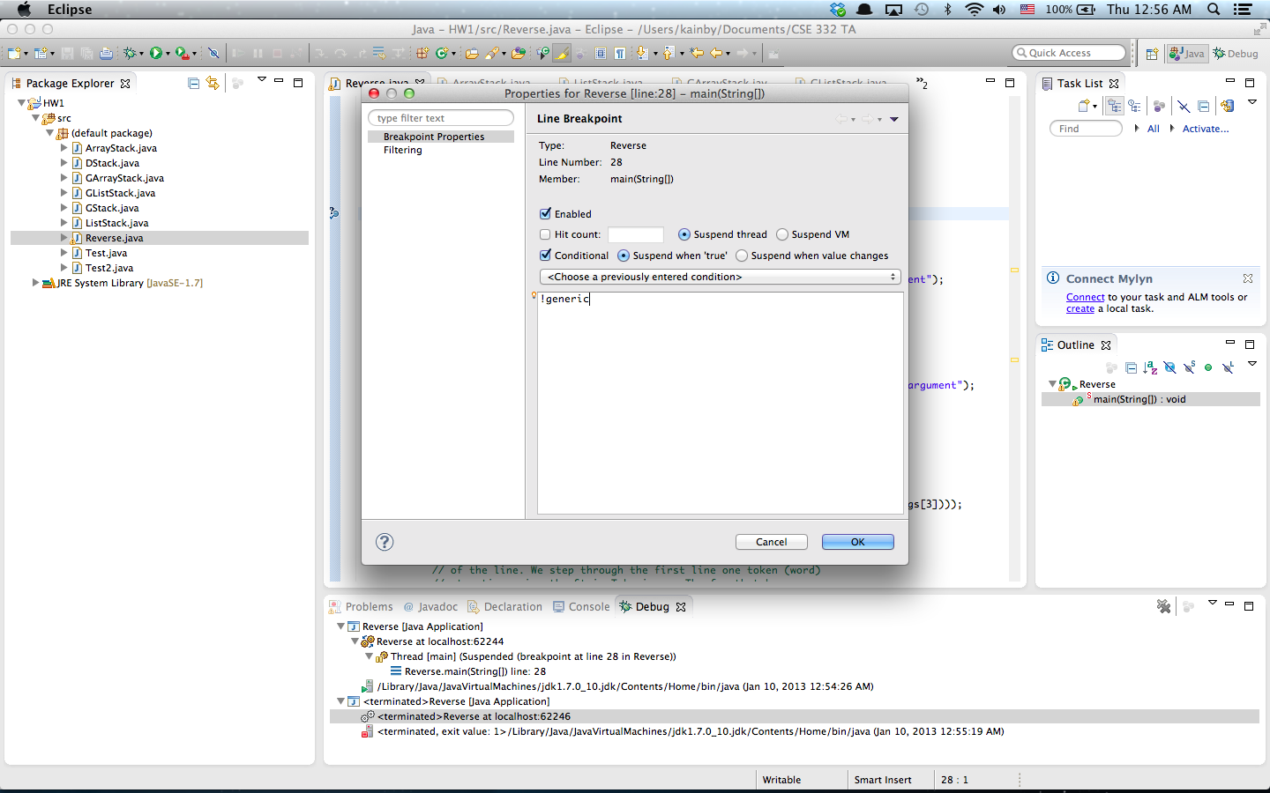
Eclipse Tutorial
Conditional Debugging

Slide 24
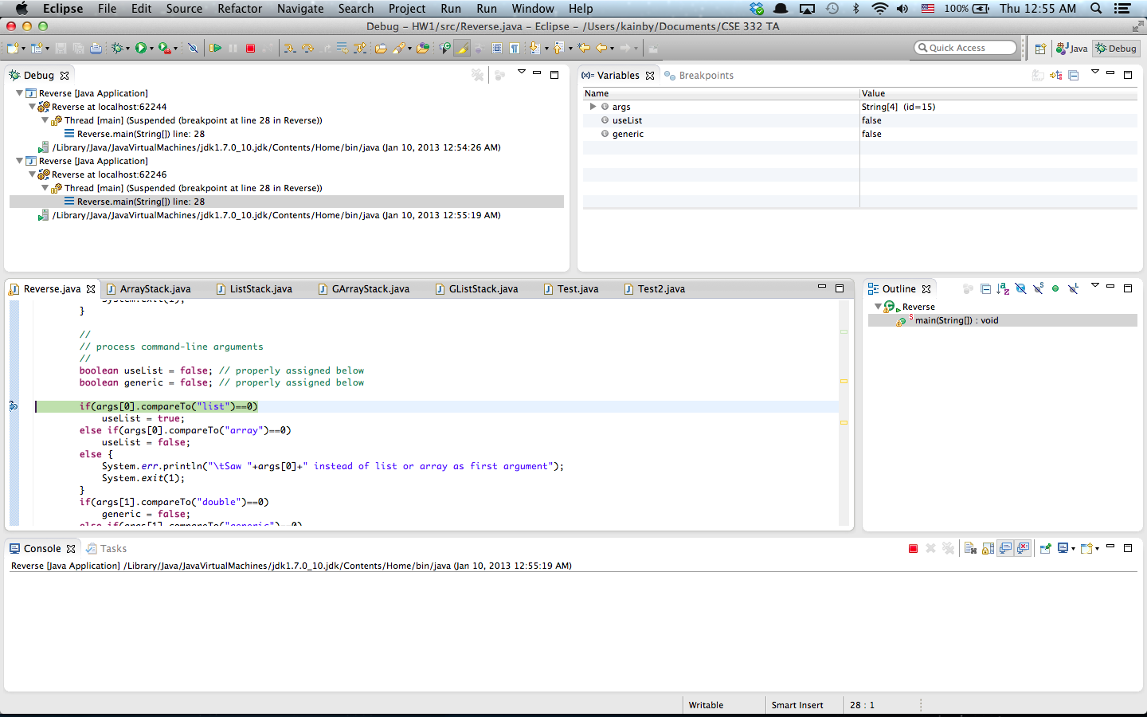
Eclipse Tutorial
Conditional Debugging

Slide 25
Eclipse Tutorial
More Tutorials
- Written Tutorial
http://www.vogella.com/articles/Eclipse/article.html
- Video Tutorial
http://eclipsetutorial.sourceforge.net/totalbeginner.html
- Eclipse Shortkeys
http://www.rossenstoyanchev.org/write/prog/eclipse/eclipse3.html

