Slide 1
CSE332: Data Abstractions Lecture 1: Introduction; Stacks/Queues
Dan Grossman
Spring 2010

Slide 2
Welcome!
We have 10 weeks to learn fundamental data structures and algorithms for organizing and processing information
“Classic” data structures / algorithms and how to analyze rigorously their efficiency and when to use them
Queues, dictionaries, graphs, sorting, etc.
Parallelism and concurrency (new!)
Today in class:
Course mechanics
What this course is about (“the new 326”)
And how it fits into the revised curriculum
Start (finish?) stacks and queues (largely review)

Slide 3
Concise to-do list
In the 24-48 hours:
Adjust class email-list settings
Email homework 0 (worth 0 points) to me
Read all course policies
Read/skim Chapters 1 and 3 of Weiss book
Relevant to Project 1, due next week
Will start Chapter 2 on Wednesday
Possibly:
Set up your Eclipse / Java environment for project 1
Thursday’s section will help
http://www.cs.washington.edu/education/courses/cse332/10sp/

Slide 4
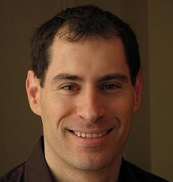
Who
Course Staff:
Dan Grossman Tyler Robison Brent Sandona
Dan: Faculty, “a 341 guy”, excited about 332 (& curriculum revision)
Tyler: Grad student, Summer2010 332 instructor, Winter2010 326 TA
Brent: Senior, CompE, veteran TA, including 326
Office hours, email, etc. on course web-page

Slide 5
Staying in touch
Course email list: cse332a_sp10@u
Students and staff already subscribed
You must get announcements sent there
Fairly low traffic
Course staff: cse332-staff@cs plus individual emails
Message Board
For appropriate discussions; Brent will monitor
Optional, won’t use for important announcements
Anonymous feedback link on webpage
For good and bad: if you don’t tell me, I don’t know

Slide 6
Course meetings
Lecture (Dan)
Material posted (sometimes afterwards), but take notes
Ask questions, focus on key ideas (rarely coding details)
Section (Tyler)
Often focus on software (Java features, tools, project issues)
Reinforce key issues from lecture (good practice)
Answer homework questions, etc.
Goal: More important than it was for your friends in 326
Office hours
Use them: please visit me
Ideally not just for homework questions (but that’s great too)

Slide 7
Course materials
All lecture and section materials will be posted
But they are visual aids, not always a complete description!
If you have to miss, find out what you missed
Textbook: Weiss 2nd Edition in Java
Good reading, but only responsible for lecture/section/hw topics
Will assign homework problems from it
Core Java book: A good Java reference (there may be others)
Don’t struggle Googling for features you don’t understand
Same book recommended for CSE331
Weeks 8-10 not in either book (or any appropriate one)
Will write and post more thorough lecture notes, etc.

Slide 8
Course Work
8 written/typed homeworks (25%)
Due at beginning of class each Friday (not this week)
No late homeworks accepted
Often covers through Monday before it’s due
3 programming projects (with phases) (25%)
First phase of first project due in 9 days
Use Java and Eclipse (see this week’s section)
One 24-hour late-day for the quarter
Projects 2 and 3 will allow partners
Midterm Friday April 30 (20%)
Final Tuesday June 8 (25%)

Slide 9
Collaboration and Academic Integrity
Read the course policy very carefully
Explains quite clearly how you can and cannot get/provide help on homework and projects
Always explain any unconventional action on your part
Your instructor has promoted and enforced academic integrity since he was a freshman
Believes in great trust with little sympathy for violations
Honest work is the most important feature of a university

Slide 10
Unsolicited advice
Get to class on time!
Instructor pet peeve (I will start and end promptly)
First 2 minutes are much more important than last 2!
April 30 will prove beyond any doubt you are capable
Learn this stuff
You need it for so many later classes/jobs anyway
Falling behind only makes more work for you
Embrace being a “charter member” of CSE332
Things may be a little rough around the edges
But we make up for it with excitement and a nice class size

Slide 11
Today in Class
Course mechanics – Did I forget anything?
What this course is about (“the new 326”)
And how it fits into the revised curriculum
Start stacks and queues (largely review)

Slide 12
Last word about 326
Many new courses have no one obvious counterpart in the old
But 332 is about 70% of the material from 326
First 7 weeks or so, obviously cutting out some topics
and a little moving to 312
Timeless, essential stuff
And a good chance to clean up some 326 “cruft”
Biggest new topic: a serious treatment of programming with multiple threads
For parallelism: To use multiple processors to finish sooner
For concurrency: Allow properly synchronized access to shared resources

Slide 13
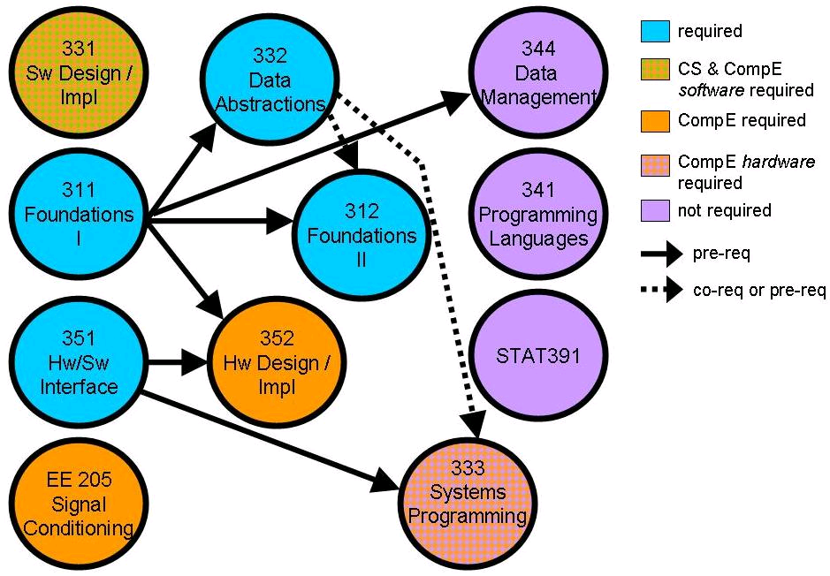
Where 332 fits
Note: This picture was the story of
my life in 2009

Slide 14
Okay, so what is 332 about already!
Introduction to many (not all) of the basic data structures used in computer software
Understand the data structures and the trade-offs they make
Rigorously analyze the algorithms that use them (math!)
Learn how to pick “the right thing for the job”
More thorough and rigorous take on topics introduced in 143
And more
Practice design and analysis of data structures / algorithms
Practice implementing and using these data structures by writing programs
Experience the purposes and headaches of multithreading

Slide 15
Goals
To be able to make good design choices as a developer, project manager, etc.
Reason in terms of the general abstractions that come up in all non-trivial software (and many non-software) systems
To be able to justify and communicate your design decisions
Dan’s take:
3 years from now this course will seem like it was a waste of your time because you can’t imagine not “just knowing” every main concept in it
Key abstractions computer scientists and engineers use almost every day
A big piece of what separates us from others

Slide 16
Data structures
(Often highly non-obvious) ways to organize information in order to enable efficient computation over that information
Key goal over the next week is introducing asymptotic analysis to precisely and generally describe efficient use of time and space
A data structure supports certain operations, each with a:
Meaning: what does the operation do/return
Performance: how efficient is the operation
Examples:
List with operations insert and delete
Stack with operations push and pop

Slide 17
Trade-offs
A data structure strives to provide many useful, efficient operations
But there are unavoidable trade-offs:
Time vs. space
One operation more efficient if another less efficient
Generality vs. simplicity vs. performance
That is why there are many data structures and educated CSEers internalize their main trade-offs and techniques
And recognize logarithmic < linear < quadratic < exponential

Slide 18
Terminology
Abstract Data Type (ADT)
Mathematical description of a “thing” with set of operations on that “thing”
Algorithm
A high level, language-independent description of a step-by-step process
Data structure
A specific family of algorithms for implementing an ADT
Implementation of a data structure
A specific implementation in a specific language

Slide 19
Example: Stacks
The Stack ADT supports operations:
isEmpty: initially true, later have there been same number of pops as pushes
push: takes an item
pop: raises an error if isEmpty, else returns most-recently pushed item not yet returned by a pop
… (Often some more operations)
A Stack data structure could use a linked-list or an array or something else, and associated algorithms for the operations
One implementation is in the library java.util.Stack

Slide 20
Why useful
The Stack ADT is a useful abstraction because:
It arises all the time in programming (see text for more)
Recursive function calls
Balancing symbols (parentheses)
Evaluating postfix notation: 3 4 + 5 *
Clever: Infix ((3+4) * 5) to postfix conversion (see text)
We can code up a reusable library
We can communicate in high-level terms
“Use a stack and push numbers, popping for operators…”
Rather than, “create a linked list and add a node when…”

Slide 21
The Queue ADT
Operations
create
destroy
enqueue
dequeue
is_empty
Just like a stack except:
Stack: LIFO (last-in-first-out)
Queue: FIFO (first-in-first-out)
Just as useful and ubiquitous
F E D C B
G
enqueue
dequeue
A

Slide 22
Circular Array Queue Data Structure
Q:
0
size - 1
b
c
d
e
f
front
back
// Basic idea only!
enqueue(x) {
Q[back] = x;
back = (back + 1) % size
}
What if queue is empty?
Enqueue?
Dequeue?
What if array is full?
How to test for empty?
What is the complexity of the operations?
Can you find the k^{th} element in the queue?
// Basic idea only!
dequeue() {
x = Q[front];
front = (front + 1) % size;
return x;
}

Slide 23
Linked List Queue Data Structure
b
c
d
e
f
front
back
// Basic idea only!
enqueue(x) {
back.next = new Node(x);
back = back.next;
}
What if queue is empty?
Enqueue?
Dequeue?
Can list be full?
How to test for empty?
What is the complexity of the operations?
Can you find the k^{th} element in the queue?
// Basic idea only!
dequeue() {
x = front.item;
front = front.next;
return x;
}

Slide 24
Circular Array vs. Linked List
(This is something every trained computer scientist knows in his/her sleep – it’s like knowing how to do arithmetic.)
Array:
May waste unneeded space or run out of space
Space per element excellent
Operations very simple / fast
Constant-time access to k^{th} element
For operation insertAtPosition, must shift all later elements
Not in Queue ADT
List:
Always just enough space
But more space per element
Operations very simple / fast
No constant-time access to k^{th} element
For operation insertAtPosition must traverse all earlier elements
Not in Queue ADT

Slide 25
The Stack ADT
A
E D C B A
Operations
create
destroy
push
pop
top
is_empty
Can also be implemented with an array or a linked list
This is Project 1!
Like queues, type of elements is irrelevant
Ideal for Java’s generic types (section and Project 1B)
F
B
C
D
E
F

