Slide 1
Floyd Logic I
CSE 331 Summer 2025
Jaela Field

Slide 2
Administrivia
HW5 is out!
  Start early!
  8 Tasks of varying length
    ~ 1/2 a day is a good goal!
HW4 due yesterday
  Let me know ASAP if you don’t think you’ll be able to get it in by Saturday late deadline
Remember to look at Gradescope feedback!

Slide 3
Wrap up: Structural Induction in General
General case: assume P holds for constructor arguments
    type T := A | B(x : ℤ) | C(y : ℤ , t : T) | D(z : ℤ , u : T, v : T)
To prove P(t) for any t, we need to prove:
  P(A)
  P(B(x)) for any x : ℤ
  P(C(y, t)) for any y : ℤ and t : T assuming P(t) is true
  P(D(z, u, v)) for any z : ℤ and u, v : T assuming P(u) and P(v)
These four facts are enough to prove P(t) for any t
  for each constructor, have proof that it produces an object satisfying P
  generally, each inductive type has its own form of induction

Slide 4
Induction Wrap up: Defining Cases
Case in inductive data type = case in structural inductive proof
  “Smallest” form of data type = Base case in proof
  Recursive case in data type = Inductive step in proof
To prove P(t) for any t of type T:
  We have 2 base cases
    type T := A | B(x : ℤ) | C(y : ℤ , t : T) | D(z : ℤ , u : T, v : T)
  and 2 recursive cases
    type T := A | B(x : ℤ) | C(y : ℤ , t : T) | D(z : ℤ , u : T, v : T)
  Inductive proof will cover base cases in base case and recursive cases cases in inductive step

Slide 5
Induction Wrap up: Defining Cases
If math def defines a case for recursive form of with a fixed size, that is still part of inductive step!
  Example, from last lecture:
    allEqual(nil) := true
    allEqual(x :: nil) := true
    allEqual(x :: y :: L) := x = y and allEqual(y :: L)
    x :: nil uses recursive constructor of a List, so it should be part of the inductive step:
Base Case (nil): allEqual(nil) = true def of allEqual
Inductive Step (x :: S):
Case (S = nil): allEqual(x:: nil) = true def of allEqual
Case (S = y :: L): …
we don’t use the IH in every case. That’s okay!

Slide 6
Reasoning So Far
Code so far made up of three elements
  straight-line code
  conditionals
  recursion
All code without mutation looks like this

Slide 7
Recall: Finding Facts at a Return Statement
Consider this code
    // Inputs a and b must be integers.
    // Returns a non-negative integer.
    const f = (a: bigint, b: bigint): bigint => {
    if (a >= 0n && b >= 0n) {
    const L: List = cons(a, cons(b, nil));
    return sum(L);
    }
    …
Known facts include “a ≥ 0”, “b ≥ 0”, and “L = cons(…)”
Prove that postcondition holds: “sum(L) ≥ 0”
find facts by reading along path
from top to return statement

Slide 8
Finding Facts at Returns, with Mutation
Consider this code
    // Inputs a and b must be integers.
    // Returns a non-negative integer.
    const f = (a: bigint, b: bigint): bigint => {
    if (a >= 0n && b >= 0n) {
    a = a – 1n;
    const L: List = cons(a, cons(b, nil));
    return sum(L);
    }
    …
Facts no longer hold throughout the function
When we state a fact, we have to say where it holds
a ≥ 0
a ≥ 0?
No!

Slide 9
Correctness Levels
Description | Testing | Tools | Reasoning
no mutation | coverage | type checking | calculation induction
local variable mutation | “” | “” | Floyd logic
array mutation | “” | “” | for-any facts
heap state mutation | “” | “” | rep invariants

Slide 10
Notation: Facts at a Point in Time
    // Inputs a and b must be integers.
    // Returns a non-negative integer.
    const f = (a: bigint, b: bigint): bigint => {
    if (a >= 0n && b >= 0n) {
    {{ a ≥ 0 }}
    a = a – 1n;
    {{ a ≥ –1 }}
    const L: List = cons(a, cons(b, nil));
    return sum(L);
    }
When we state a fact, we have to say where it holds
{{ .. }} notation indicates facts true at that point
  cannot assume those are true anywhere else

Slide 11
Forwards & Backwards Reasoning, Informally
    // Inputs a and b must be integers.
    // Returns a non-negative integer.
    const f = (a: bigint, b: bigint): bigint => {
    if (a >= 0n && b >= 0n) {
    {{ a ≥ 0 }}
    a = a – 1n;
    {{ a ≥ –1 }}
    const L: List = cons(a, cons(b, nil));
    return sum(L);
    }
There are mechanical tools for moving facts around
  “forward reasoning” says how they change as we move down
  “backward reasoning” says how they change as we move up

Slide 12
Reasoning and Programming
    // Inputs a and b must be integers.
    // Returns a non-negative integer.
    const f = (a: bigint, b: bigint): bigint => {
    if (a >= 0n && b >= 0n) {
    {{ a ≥ 0 }}
    a = a – 1n;
    {{ a ≥ –1 }}
    const L: List = cons(a, cons(b, nil));
    return sum(L);
    }
Professionals are absurdly good at forward reasoning
  “programmers are the Olympic athletes of forward reasoning”
  you’ll have an edge by learning backward reasoning too

Slide 13
Floyd Logic

Slide 14

History of Floyd Logic
Invented by Robert Floyd and Sir Anthony Hoare
  Floyd won the Turing award in 1978
  Hoare won the Turing award in 1980
Robert Floyd
Tony Hoare
picture from Wikipedia
picture from Wikipedia

Slide 15
Floyd Logic Terminology
The program state is the values of the variables
An assertion (in {{ .. }}) is a T/F claim about the state
  an assertion “holds” if the claim is true
  assertions are math not code
    (we do our reasoning in math)
Most important assertions:
  precondition: claim about the state when the function starts
  postcondition: claim about the state when the function ends

Slide 16
Hoare Triples
A Hoare triple has two assertions and some code
    {{ P }}
    S
    {{ Q }}
  P is the precondition, Q is the postcondition
  S is the code
Triple is “valid” if the code is correct:
  S takes any state satisfying P into a state satisfying Q
    does not matter what the code does if P does not hold initially
  otherwise, the triple is invalid

Slide 17
Correctness with Mutation Example (Setup)
    /**
    * @param n an integer with n >= 1
    * @returns an integer m with m >= 10
    */
    const f = (n: bigint): bigint => {
    n = n + 3n;
    return n * n;
    };
Check that value returned, m = n², satisfies m ≥ 10

Slide 18
Correctness with Mutation Example (Triples)
    /**
    * @param n an integer with n >= 1
    * @returns an integer m with m >= 10
    */
    const f = (n: bigint): bigint => {
    {{ n ≥ 1 }}
    n = n + 3n;
    {{ n² ≥ 10 }}
    return n * n;
    };
Precondition and postcondition come from spec
Remains to check that the triple is valid

Slide 19
Hoare Triples with No Code
Code could be empty:
    {{ P }}
    {{ Q }}
When is such a triple valid?
  valid iff P implies Q
  we already know how to check validity in this case:
  prove each fact in Q by calculation, using facts from P

Slide 20
Hoare Triples with No Code: Example
Code could be empty:
    {{ a ≥ 0, b ≥ 0, L = cons(a, cons(b, nil)) }}
    {{ sum(L) ≥ 0 }}
Check that P implies Q by calculation
    sum(L) = sum(cons(a, cons(b, nil))) since L = …
    = a + sum(cons(b, nil)) def of sum
    = a + b + sum(nil) def of sum
    = a + b def of sum
    ≥ 0 + b since a ≥ 0
    ≥ 0 + 0 since b ≥ 0
    = 0

Slide 21
Hoare Triples with Multiple Lines of Code
Code with multiple lines:
    {{ P }}
    S
    T
    {{ Q }}
Valid iff there exists an R making both triples valid
  i.e., {{ P }} S {{ R }} is valid and {{ R }} T {{ Q }} is valid
Will see next how to put these to good use…
    {{ P }}
    S
    {{ R }}
    T
    {{ Q }}

Slide 22
Stronger Assertions vs Specifications
Assertion is stronger iff it holds in a subset of states
Stronger assertion implies the weaker one
  stronger is a synonym for “implies”
  weaker is a synonym for “is implied by”
Q₁
Q₂

Slide 23
Weakest & Strongest Assertions
Assertion is stronger iff it holds in a subset of states
Weakest possible assertion is “true” (all states)
  an empty assertion (“”) also means “true”
Strongest possible assertion is “false” (no states!)
Q₁
Q₂

Slide 24
Defining Forward & Backward Reasoning
Forward / backward reasoning fill in assertions
  mechanically create valid triples
Forward reasoning fills in postcondition
    {{ P }} S {{ ___ }}
  gives strongest postcondition making the triple valid
Backward reasoning fills in precondition
    {{ ___ }} S {{ Q }}
  gives weakest precondition making the triple valid

Slide 25
Correctness via Forward Reasoning
Apply forward reasoning
    {{ P }} {{ P }}
    S S
    {{ Q }} {{ R }}
    {{ Q }}
  first triple is always valid
  only need to check second triple
    just requires proving an implication (since no code is present)
If second triple is invalid, the code is incorrect
  true because R is the strongest assertion possible here
1
2

Slide 26
Correctness via Backward Reasoning
Apply backward reasoning
    {{ P }} {{ P }}
    S {{ R }}
    {{ Q }} S
    {{ Q }}
  second triple is always valid
  only need to check first triple
    just requires proving an implication (since no code is present)
If first triple is invalid, the code is incorrect
  true because R is the weakest assertion possible here
1
2

Slide 27
Using Mechanical Reasoning Tools
Forward / backward reasoning fill in assertions
  mechanically create valid triples
Reduce correctness to proving implications
  this was already true for functional code
  will soon have the same for imperative code
Implication will be false if the code is incorrect
  reasoning can verify correct code
  reasoning will never accept incorrect code

Slide 28
Correctness via Forward & Backward Reasoning
Can use both types of reasoning on longer code
    {{ P }}
    S
    {{ R₁ }}
    {{ R₂ }}
    T
    {{ Q }}
  first and third triples is always valid
  only need to check second triple
    verify that R₁ implies R₂
1
2
3

Slide 29
Forward & Backward
Reasoning

Slide 30
Forward and Backward Reasoning in Practice
Imperative code made up of
  assignments (mutation)
  conditionals
  loops
Anything can be rewritten with just these
We will learn forward / backward rules to handle them
  will also learn a rule for function calls
  once we have those, we are done

Slide 31
Ex: Forward Reasoning with Assignments (1/6)
    {{ w > 0 }}
    x = 17n;
    {{ _______________________ }}
    y = 42n;
    {{ _______________________ }}
    z = w + x + y;
    {{ _______________________ }}
What do we know is true after x = 17 ?
  want the strongest postcondition (most precise)

Slide 32
Ex: Forward Reasoning with Assignments (2/6)
    {{ w > 0 }}
    x = 17n;
    {{ w > 0 and x = 17 }}
    y = 42n;
    {{ _______________________ }}
    z = w + x + y;
    {{ _______________________ }}
What do we know is true after x = 17 ?
  w was not changed, so w > 0 is still true
  x is now 17
What do we know is true after y = 42 ?

Slide 33
Ex: Forward Reasoning with Assignments (3/6)
    {{ w > 0 }}
    x = 17n;
    {{ w > 0 and x = 17 }}
    y = 42n;
    {{ w > 0 and x = 17 and y = 42 }}
    z = w + x + y;
    {{ _______________________ }}
What do we know is true after y = 42 ?
  w and x were not changed, so previous facts still true
  y is now 42
What do we know is true after z = w + x + y ?

Slide 34
Ex: Forward Reasoning with Assignments (4/6)
    {{ w > 0 }}
    x = 17n;
    {{ w > 0 and x = 17 }}
    y = 42n;
    {{ w > 0 and x = 17 and y = 42 }}
    z = w + x + y;
    {{ w > 0 and x = 17 and y = 42 and z = w + x + y }}
What do we know is true after z = w + x + y ?
  w, x, and y were not changed, so previous facts still true
  z is now w + x + y
Could also write z = w + 59 (since x = 17 and y = 42)

Slide 35
Ex: Forward Reasoning with Assignments (5/6)
    {{ w > 0 }}
    x = 17n;
    {{ w > 0 and x = 17 }}
    y = 42n;
    {{ w > 0 and x = 17 and y = 42 }}
    z = w + x + y;
    {{ w > 0 and x = 17 and y = 42 and z = w + x + y }}
Could write z = w + 59, but do not write z > 59 !
  that is true since w > 0, but…

Slide 36
Ex: Forward Reasoning with Assignments (6/6)
z > 59 and w > 0
Could write z = w + 59, but do not write z > 59 !
  that is true since w > 0, but…
z = w + 59 and w > 0
w
z
60

Slide 37
Picking the Strongest Postcondition
    {{ w > 0 }}
    x = 17n;
    {{ w > 0 and x = 17 }}
    y = 42n;
    {{ w > 0 and x = 17 and y = 42 }}
    z = w + x + y;
    {{w > 0 and x = 17 and y = 42 and z = w + x + y }}
Could write z = w + 59, but do not write z > 59 !
  that is true since w > 0, but…
  that is not the strongest postcondition
    correctness check could now fail even if the code is right

Slide 38
Forward Reasoning with Code (1/4)
    // @param w an integer > 0
    // @returns an integer z > 59
    const f = (w: bigint): bigint => {
    const x = 17n;
    const y = 42n;
    const z = w + x + y;
    return z;
    };
Let’s check correctness using Floyd logic…

Slide 39
Forward Reasoning with Code (2/4)
    // @param w an integer > 0
    // @returns an integer z > 59
    const f = (w: bigint): bigint => {
    {{ w > 0 }}
    const x = 17n;
    const y = 42n;
    const z = w + x + y;
    {{ z > 59 }}
    return z;
    };
Reason forward…

Slide 40
Forward Reasoning with Code (3/4)
    // @param w an integer > 0
    // @returns an integer z > 59
    const f = (w: bigint): bigint => {
    {{ w > 0 }}
    const x = 17n;
    const y = 42n;
    const z = w + x + y;
    {{ w > 0 and x = 17 and y = 42 and z = w + x + y }}
    {{ z > 59 }}
    return z;
    };
Check implication:
z = w + x + y
= w + 17 + y since x = 17
= w + 59 since y = 42
> 59 since w > 0

Slide 41
Forward Reasoning with Code (4/4)
    // @param w an integer > 0
    // @returns an integer z > 59
    const f = (w: bigint): bigint => {
    const x = 17n;
    const y = 42n;
    const z = w + x + y;
    return z;
    };
How about if we use our old approach?
Known facts: w > 0, x = 17, y = 42, and z = w + x + y
Prove that postcondition holds: z > 59
find facts by reading along path
from top to return statement

Slide 42
Finding Facts at Returns is Forward Reasoning
    // @param w an integer > 0
    // @returns an integer z > 59
    const f = (w: bigint): bigint => {
    const x = 17n;
    const y = 42n;
    const z = w + x + y;
    return z;
    };
We’ve been doing forward reasoning already!
  forward reasoning is (only) “and” with no mutation
Line-by-line facts are for “let” (not “const”)

Slide 43
Forward Reasoning with Mutation (1/2)
Forward reasoning is trickier with mutation
  gets harder if we mutate a variable
    w = x + y;
    {{ w = x + y }}
    x = 4n;
    {{ w = x + y and x = 4 }}
    y = 3n;
    {{ w = x + y and x = 4 and y = 3 }}
Final assertion is not necessarily true
  w = x + y is true with their old values, not the new ones
  changing the value of “x” can invalidate facts about x
    facts refer to the old value, not the new value
  avoid this by using different names for old and new values

Slide 44
Notation: Subscripts for Variables Across Time
Can use subscripts to refer to values at different times
    … (x: bigint) => …
    … x₀
    x = …
    … x₁
    x = …
    … x₂
    x = …
    … x₃
    x = …
    … x₄
x = x₀
"x" means current value
x = x₁
x = x₂
x = x₃
x = x₄

Slide 45
Forward Reasoning with Mutation (2/2)
Rewrite existing facts to use names of earlier values
  will use “x” and “y” to refer to current values
  can use “x₀” and “y₀” (or other subscripts) for earlier values
    {{ w = x + y }}
    x = 4n;
    {{ w = x₀ + y and x = 4 }}
    y = 3n;
    {{ w = x₀ + y₀ and x = 4 and y = 3 }}
Final assertion is now accurate
  w is equal to the sum of the initial values of x and y

Slide 46
Generalized Forward Reasoning Rule
For assignments, general forward reasoning rule is
    {{ P }}
    x = y;
    {{ P[x ↦ x_{k}] and x = y[x ↦ x_{k}] }}
  replace all “x”s in P and y with “x_{k}”s
This process can be simplified in many cases
  no need for x₀ if we can write it in terms of new value
  e.g., if “x = x₀ + 1”, then “x₀ = x – 1”
  assertions will be easier to read without old values
    (Technically, this is weakening, but it’s usually fine
    Postconditions usually do not refer to old values of variables.)

Slide 47
Example of “Shortcut” for Invertible Operations
For assignments, general forward reasoning rule is
    {{ P }}
    x = y;
    {{ P[x ↦ x_{k}] and x = y[x ↦ x_{k}] }} x_{k} is name of previous value
If x₀ = f(x), then we can simplify this to
    {{ P }}
    x = … x …;
    {{ P[x ↦ f(x)] }} no need for, e.g., “and x = x₀ + 1”
  if assignment is “x = x₀ + 1”, then “x₀ = x – 1”
  if assignment is “x = 2x₀”, then “x₀ = x/2”
  does not work for integer division (an un-invertible operation)

Slide 48
Revisiting Correctness with Forward Reasoning
    /**
    * @param n an integer with n >= 1
    * @returns an integer m with m >= 10
    */
    const f = (n: bigint): bigint => {
    {{ n ≥ 1 }}
    n = n + 3n;
    {{ n – 3 ≥ 1 }}
    {{ n² ≥ 10 }}
    return n * n;
    };
    n² ≥ 4² since n – 3 ≥ 1 (i.e., n ≥ 4)
    = 16
    > 10
n = n₀ + 3 means n – 3 = n₀
check this implication
This is the preferred approach.
Avoid subscripts when possible.

Slide 49
Mutation in Straight-Line Code
Alternative ways of writing this code:
    n = n + 3n; const n1 = n + 3n;
    return n * n; return n1 * n1;
Mutation in straight-line code is unnecessary
  can always use different names for each value
Why would we prefer the former?
  seems like it might save memory…
  but it doesn't!
    most compilers will turn the left into the right on their own (SSA form)
    it's better at saving memory than you are, so it does it itself

Slide 50
Backwards Reasoning by Example (1/4)
    {{ _______________________ }}
    x = 17n;
    {{ _______________________ }}
    y = 42n;
    {{ _______________________ }}
    z = w + x + y;
    {{ z < 0 }}
What must be true before z = w + x + y so z < 0 ?
  want the weakest precondition (most allowed states)

Slide 51
Backwards Reasoning by Example (2/4)
    {{ _______________________ }}
    x = 17n;
    {{ _______________________ }}
    y = 42n;
    {{ w + x + y < 0 }}
    z = w + x + y;
    {{ z < 0 }}
What must be true before z = w + x + y so z < 0 ?
  must have w + x + y < 0 beforehand
What must be true before y = 42 for w + x + y < 0 ?

Slide 52
Backwards Reasoning by Example (3/4)
    {{ _______________________ }}
    x = 17n;
    {{ w + x + 42 < 0 }}
    y = 42n;
    {{ w + x + y < 0 }}
    z = w + x + y;
    {{ z < 0 }}
What must be true before y = 42 for w + x + y < 0 ?
  must have w + x + 42 < 0 beforehand
What must be true before x = 17 for w + x + 42 < 0 ?

Slide 53
Backwards Reasoning by Example (4/4)
    {{ w + 17 + 42 < 0 }}
    x = 17n;
    {{ w + x + 42 < 0 }}
    y = 42n;
    {{ w + x + y < 0 }}
    z = w + x + y;
    {{ z < 0 }}
What must be true before x = 17 for w + x + 42 < 0 ?
  must have w + 59 < 0 beforehand
All we did was substitute right side for the left side
  e.g., substitute “w + x + y” for “z” in “z < 0”
  e.g., substitute “42” for “y” in “w + x + y < 0”
  e.g., substitute “17” for “x” in “w + x + 42 < 0”

Slide 54
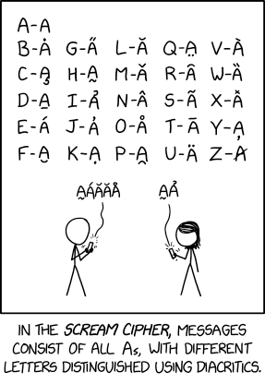
Floyd Logic II
CSE 331
Summer 2025
Jaela Field
xkcd #3054, ty Matt

Slide 55
Floyd Logic Agenda
Last Friday:
  vocab: Hoare triple, “stronger” assertions
  forward reasoning
Today:
  (finish) backwards reasoning
  conditionals
  function calls
Wednesday:
  loops & loop invariants

Slide 56
Recall: Defining Forward & Backward Reasoning
Forward / backward reasoning fill in assertions
  mechanically create valid triples
Forward reasoning fills in postcondition
    {{ P }} S {{ ___ }}
  gives strongest postcondition making the triple valid
Backward reasoning fills in precondition
    {{ ___ }} S {{ Q }}
  gives weakest precondition making the triple valid

Slide 57
Recall: Forward Reasoning (with code)
    // @param w an integer > 0
    // @returns an integer z > 59
    const f = (w: bigint): bigint => {
    {{ w > 0 }}
    const x = 17n;
    const y = 42n;
    const z = w + x + y;
    {{ w > 0 and x = 17 and y = 42 and z = w + x + y }}
    {{ z > 59 }}
    return z;
    };
"Collecting the facts" was forward reasoning
  only this simple because there was no mutation

Slide 58
Recall: Full Forward Reasoning Example (on code)
    /**
    * @param n an integer with n >= 1
    * @returns an integer m with m >= 10
    */
    const f = (n: bigint): bigint => {
    {{ n ≥ 1 }}
    n = n + 3n;
    {{ n – 3 ≥ 1 }}
    {{ n² ≥ 10 }}
    return n * n;
    };
    n² ≥ 4² since n – 3 ≥ 1 (i.e., n ≥ 4)
    = 16
    > 10
n = n₀ + 3 means n – 3 = n₀
check this implication
This is the preferred approach.
Avoid subscripts when possible.

Slide 59
Recall: Backwards Reasoning Example
    {{ w + 17 + 42 < 0 }}
    x = 17n;
    {{ w + x + 42 < 0 }}
    y = 42n;
    {{ w + x + y < 0 }}
    z = w + x + y;
    {{ z < 0 }}
All we did was substitute right side for the left side

Slide 60
Generalized Backwards Reasoning Rule
For assignments, backward reasoning is substitution
    {{ Q[x ↦ y] }}
    x = y;
    {{ Q }}
  just replace all the “x”s with “y”s
  we will denote this substitution by Q[x ↦ y]
Mechanically simpler than forward reasoning
  no need for subscripts

Slide 61
Backwards Reasoning with Code (1/2)
    /**
    * @param n an integer with n >= 1
    * @returns an integer m with m >= 10
    */
    const f = (n: bigint): bigint => {
    {{ n ≥ 1 }}
    n = n + 3n;
    {{ n² ≥ 10 }}
    return n * n;
    };
Code is correct if this triple is valid…

Slide 62
Backwards Reasoning with Code (2/2)
    /**
    * @param n an integer with n >= 1
    * @returns an integer m with m >= 10
    */
    const f = (n: bigint): bigint => {
    {{ n ≥ 1 }}
    {{ (n + 3)² ≥ 10 }}
    n = n + 3n;
    {{ n² ≥ 10 }}
    return n * n;
    };
    (n+3)² ≥ (1 + 3)² since n ≥ 1
    = 16
    > 10
check this implication

Slide 63
Recall: Forwards Reasoning with Code
    /**
    * @param n an integer with n >= 1
    * @returns an integer m with m >= 10
    */
    const f = (n: bigint): bigint => {
    {{ n ≥ 1 }}
    n = n + 3n;
    {{ n – 3 ≥ 1 }}
    {{ n² ≥ 10 }}
    return n * n;
    };
    n² ≥ 4² since n – 3 ≥ 1 (i.e., n ≥ 4)
    = 16
    > 10
check this implication
Forward reasoning produces known facts.
Backward reasoning produces facts to prove.

Slide 64
Think – Pair - Share
  /**
  * @param a – an integer with a > 1
  * @param b – an integer with b > 0
  * @returns an integer c with c >= 0
  */
  const f = (a: bigint, b: bigint): bigint => {
  {{ pre: ________________________ }}
  a = a – 1n;
  {{ post: ________________________ }}
  return a * b;
  };
Fill in the pre and post condition assertions according to the spec?

Slide 65
Think – Pair - Share
  /**
  * @param a – an integer with a > 1
  * @param b – an integer with b > 0
  * @returns an integer c with c >= 0
  */
  const f = (a: bigint, b: bigint): bigint => {
  {{ pre: a ≥ 2 and b ≥ 1 }}
  a = a – 1n;
  {{ ________________________ }}
  {{ post: ab ≥ 0 }}
  return a * b;
  };
Fill in the assertion using forward reasoning
ab ≥ a * 1 since b ≥ 1
≥ 1 * 1 since a + 1 ≥ 2
= 1
≥ 0

Slide 66
Think – Pair - Share
  /**
  * @param a – an integer with a > 1
  * @param b – an integer with b > 0
  * @returns an integer c with c >= 0
  */
  const f = (a: bigint, b: bigint): bigint => {
  {{ pre: a ≥ 2 and b ≥ 1 }}
  {{ ________________________ }}
  a = a – 1n;
  {{ post: ab ≥ 0 }}
  return a * b;
  };
Fill in the assertion using backward reasoning
(a - 1) * b ≥ (a – 1) * 1 since b ≥ 1
  ≥ (2 – 1) * 1 since a ≥ 2
  = 1
  ≥ 0

Slide 67
Conditionals

Slide 68
Conditionals in Floyd Logic (1/2)
    // Inputs a and b must be integers.
    // Returns a non-negative integer.
    const f = (a: bigint, b: bigint): bigint => {
    if (a >= 0n && b >= 0n) {
    const L: List = cons(a, cons(b, nil));
    return sum(L);
    }
    …
Prior reasoning also included conditionals
  what does that look like in Floyd logic?

Slide 69
Conditionals in Floyd Logic (2/2)
    // Inputs a and b must be integers.
    // Returns a non-negative integer.
    const f = (a: bigint, b: bigint): bigint => {
    {{ }}
    if (a >= 0n && b >= 0n) {
    {{ a ≥ 0 and b ≥ 0 }}
    const L: List = cons(a, cons(b, nil));
    return sum(L);
    }
    …
Conditionals introduce extra facts in forward reasoning
  simple “and” since nothing is mutated

Slide 70
Conditionals Worked Example: Setup
    // Returns an integer m with m > n
    const g = (n: bigint): bigint => {
    let m;
    if (n >= 0n) {
    m = 2n * n + 1n;
    } else {
    m = 0n;
    }
    return m;
    }
Code like this was impossible without mutation
  cannot write to a “const” after its declaration
How do we handle it now?

Slide 71
Conditionals Worked Example: Cases
    // Returns an integer m with m > n
    const g = (n: bigint): bigint => {
    let m;
    if (n >= 0n) {
    m = 2n * n + 1n;
    } else {
    m = 0n;
    }
    return m;
    }
Reason separately about each path to a return
  handle each path the same as before
  but now there can be multiple paths to one return

Slide 72
Conditionals Worked Example: “Then” (1/5)
    // Returns an integer m with m > n
    const g = (n: bigint): bigint => {
    {{ }}
    let m;
    if (n >= 0n) {
    m = 2n * n + 1n;
    } else {
    m = 0n;
    }
    {{ m > n }}
    return m;
    }
Check correctness path through “then” branch

Slide 73
Conditionals Worked Example: “Then” (2/5)
    // Returns an integer m with m > n
    const g = (n: bigint): bigint => {
    {{ }}
    let m;
    if (n >= 0n) {
    {{ n ≥ 0 }}
    m = 2n * n + 1n;
    } else {
    m = 0n;
    }
    {{ m > n }}
    return m;
    }

Slide 74
Conditionals Worked Example: “Then” (3/5)
    // Returns an integer m with m > n
    const g = (n: bigint): bigint => {
    {{ }}
    let m;
    if (n >= 0n) {
    {{ n ≥ 0 }}
    m = 2n * n + 1n;
    {{ n ≥ 0 and m = 2n + 1}}
    } else {
    m = 0n;
    }
    {{ m > n }}
    return m;
    }

Slide 75
Conditionals Worked Example: “Then” (4/5)
    // Returns an integer m with m > n
    const g = (n: bigint): bigint => {
    {{ }}
    let m;
    if (n >= 0n) {
    {{ n ≥ 0 }}
    m = 2n * n + 1n;
    {{ n ≥ 0 and m = 2n + 1}}
    } else {
    m = 0n;
    }
    {{ n ≥ 0 and m = 2n + 1 }}
    {{ m > n }}
    return m;
    }
m = 2n+1
> 2n since 1 > 0
≥ n since n ≥ 0

Slide 76
Conditionals Worked Example: “Then” (5/5)
    // Returns an integer m with m > n
    const g = (n: bigint): bigint => {
    {{ }}
    let m;
    if (n >= 0n) {
    m = 2n * n + 1n;
    } else {
    m = 0n;
    }
    {{ n ≥ 0 and m = 2n + 1 }}
    {{ m > n }}
    return m;
    }
Note: no mutation, so we can do this in our head
  read along the path, and collect all the facts

Slide 77
Conditionals Worked Example: “Else”
    // Returns an integer m with m > n
    const g = (n: bigint): bigint => {
    {{ }}
    let m;
    if (n >= 0n) {
    m = 2n * n + 1n;
    } else {
    m = 0n;
    }
    {{ n < 0 and m = 0 }}
    {{ m > n }}
    return m;
    }
Check correctness path through “else” branch
  note: no mutation, so we can do this in our head
m = 0
> n since 0 > n

Slide 78
Conditionals Worked Example: Join (1/2)
    // Returns an integer m with m > n
    const g = (n: bigint): bigint => {
    {{ }}
    let m;
    if (n >= 0n) {
    m = 2n * n + 1n;
    {{ n ≥ 0 and m = 2n + 1 }}
    } else {
    m = 0n;
    {{ n < 0 and m = 0 }}
    }
    {{ _________________________________________________________________ }}
    {{ m > n }}
    return m;
    }
What do we know is true
even if we don't know
which branch was taken?

Slide 79
Conditionals Worked Example: Join (2/2)
    // Returns an integer m with m > n
    const g = (n: bigint): bigint => {
    {{ }}
    let m;
    if (n >= 0n) {
    m = 2n * n + 1n;
    } else {
    m = 0n;
    }
    {{ (n ≥ 0 and m = 2n + 1) or (n < 0 and m = 0) }}
    {{ m > n }}
    return m;
    }
The “or” means we must reason by cases anyway!

Slide 80
Generalizing Conditional Floyd Logic (1/2)
    {{ P }}
    if (cond) {
    {{ P and cond }}
    S₁
    } else {
    {{ P and not cond }}
    S₂
    }
    {{ R }}
    {{ Q }}
2 possible paths to execute
R is in the form of {{A or B}}
  A being what we know if we had taken the if branch

Slide 81
Generalizing Conditional Floyd Logic (2/2)
    {{ P }}
    if (cond) {
    {{ P and cond }}
    S₁
    } else {
    {{ P and not cond }}
    S₂
    }
    {{ R }}
    {{ Q }}
2 possible paths to execute
R is in the form of {{A or B}}
  A being what we know if we had taken the if branch
  B being what we know if we had taken the else

Slide 82
Conditionals and Early Returns (1/2)
    // Returns an integer m with m > n
    const g = (n: bigint): bigint => {
    {{ }}
    let m;
    if (n >= 0n) {
    m = 2n * n + 1n;
    } else {
    return 0n;
    }
    {{ (n ≥ 0 and m = 2n + 1) or (n < 0 and ??) }}
    {{ m > n }}
    return m;
    }
What is the state after a “return”?

Slide 83
Conditionals and Early Returns (2/2)
    // Returns an integer m with m > n
    const g = (n: bigint): bigint => {
    {{ }}
    let m;
    if (n >= 0n) {
    m = 2n * n + 1n;
    } else {
    return 0n;
    }
    {{ (n ≥ 0 and m = 2n + 1) or (n < 0 and false) }}
    {{ m > n }}
    return m;
    }
State after a “return” is false (no states)
simplifies to just n ≥ 0 and m = 2n + 1

Slide 84
Generalizing Early Returns and Forward Reasoning
Latter rule for "if .. return" is useful:
    {{ P }}
    if (cond)
    return something;
    {{ P and not cond }}
    …
    return something else;
Only reach the line after the "if" if cond was false
Only one path to each "return" statement
  forward reason to the "return" inside the "if"
  forward reason to the "return" after the "if"

Slide 85
Complex Conditionals Example: Paths? (1/2)
    // Returns an integer m, with m > 0
    const h = (x: bigint): bigint => {
    {{ }}
    let m = x;
    if (x < 0n) {
    m = m * -1n;
    } else if (x === 0n) {
    return 1n;
    }
    {{ _________________________________________________________________ }}
    m = m + 1n;
    {{ m > 0 }}
    return m;
    }
How many paths can the code take?

Slide 86
Complex Conditionals Example: Paths? (2/2)
    // Returns an integer m, with m > 0
    const h = (x: bigint): bigint => {
    {{ }}
    let m = x;
    if (x < 0n) {
    m = m * -1n;
    } else if (x === 0n) {
    return 1n;
    } else {
    // do nothing
    }
    {{ ________________ or ________________ or ________________ }}
    m = m + 1n;
    {{ m > 0 }}
    return m;
    }
3 paths! else branch is not written out, but it’s there implicitly
After the conditional, there are 3 sets of facts that could be true

Slide 87
Complex Conditionals Example: “Then” (1/3)
    // Returns an integer m, with m > 0
    const h = (x: bigint): bigint => {
    {{ }}
    let m = x;
    if (x < 0n) {
    {{ ____________________ }}
    m = m * -1n;
    {{ ____________________ }}
    } else if (x === 0n) {
    return 1n;
    } // else: do nothing
    {{ ________________ or ________________ or ________________ }}
    m = m + 1n;
    {{ m > 0 }}
    return m;
    }

Slide 88
Complex Conditionals Example: “Then” (2/3)
    // Returns an integer m, with m > 0
    const h = (x: bigint): bigint => {
    {{ }}
    let m = x;
    if (x < 0n) {
    {{ m = x and x < 0 }}
    m = m * -1n;
    {{ ____________________ }}
    } else if (x === 0n) {
    return 1n;
    } // else: do nothing
    {{ ________________ or ________________ or ________________ }}
    m = m + 1n;
    {{ m > 0 }}
    return m;
    }

Slide 89
Complex Conditionals Example: “Then” (3/3)
    // Returns an integer m, with m > 0
    const h = (x: bigint): bigint => {
    {{ }}
    let m = x;
    if (x < 0n) {
    {{ m = x and x < 0 }}
    m = m * -1n;
    {{ m = - x and x < 0 }}
    } else if (x === 0n) {
    return 1n;
    } // else: do nothing
    {{ (m = - x and x < 0) or ________________ or ________________ }}
    m = m + 1n;
    {{ m > 0 }}
    return m;
    }

Slide 90
Complex Conditionals Example: “Else If” (1/3)
    // Returns an integer m, with m > 0
    const h = (x: bigint): bigint => {
    {{ }}
    let m = x;
    if (x < 0n) {
    m = m * -1n;
    } else if (x === 0n) {
    {{ ____________________ }}
    return 1n;
    } // else: do nothing
    {{ (m = - x and x < 0) or ________________ or ________________ }}
    m = m + 1n;
    {{ m > 0 }}
    return m;
    }

Slide 91
Complex Conditionals Example: “Else If” (2/3)
    // Returns an integer m, with m > 0
    const h = (x: bigint): bigint => {
    {{ }}
    let m = x;
    if (x < 0n) {
    m = m * -1n;
    } else if (x === 0n) {
    {{ x = 0 and m = x }}
    return 1n;
    } // else: do nothing
    {{ (m = - x and x < 0) or ________________ or ________________ }}
    m = m + 1n;
    {{ m > 0 }}
    return m;
    }

Slide 92
Complex Conditionals Example: “Else If” (3/3)
    // Returns an integer m, with m > 0
    const h = (x: bigint): bigint => {
    {{ }}
    let m = x;
    if (x < 0n) {
    m = m * -1n;
    } else if (x === 0n) {
    {{ x = 0 and m = x }}
    return 1n;
    } else {
    //
    }
    {{ (m = - x and x < 0) or (x = 0 and m = x and false) or _________ }}
    m = m + 1n;
    {{ m > 0 }}
    return m;
    }
Must prove that post
condition holds here
false: no states can reach beyond return

Slide 93
Complex Conditionals Example: Implicit Else (1/2)
    // Returns an integer m, with m > 0
    const h = (x: bigint): bigint => {
    {{ }}
    let m = x;
    if (x < 0n) {
    m = m * -1n;
    } else if (x === 0n) {
    return 1n;
    } // else: do nothing
    {{ (m = - x and x < 0) or ________________ }}
    m = m + 1n;
    {{ m > 0 }}
    return m;
    }
What do we know in implicit else case?
When neither of the then cases were entered

Slide 94
Complex Conditionals Example: Implicit Else (2/2)
    // Returns an integer m, with m > 0
    const h = (x: bigint): bigint => {
    {{ }}
    let m = x;
    if (x < 0n) {
    m = m * -1n;
    } else if (x === 0n) {
    return 1n;
    } // else: do nothing
    {{ (m = - x and x < 0) or (x > 0 and m = x) }}
    m = m + 1n;
    {{ m > 0 }}
    return m;
    }

Slide 95
Complex Conditionals Example: Backwards Step
    // Returns an integer m, with m > 0
    const h = (x: bigint): bigint => {
    {{ }}
    let m = x;
    if (x < 0n) {
    m = m * -1n;
    } else if (x === 0n) {
    return 1n;
    } // else: do nothing
    {{ (m = - x and x < 0) or (x > 0 and m = x) }}
    {{ _________________ }}
    m = m + 1n;
    {{ m > 0 }}
    return m;
    }
Can reason backward and forward and meet in the middle

Slide 96
Complex Conditionals Example: Prove Implication
    // Returns an integer m, with m > 0
    const h = (x: bigint): bigint => {
    {{ }}
    let m = x;
    if (x < 0n) {
    m = m * -1n;
    } else if (x === 0n) {
    return 1n;
    } // else: do nothing
    {{ (m = - x and x < 0) or (x > 0 and m = x) }}
    {{ m + 1 > 0 }}
    m = m + 1n;
    {{ m > 0 }}
    return m;
    }
check this implication
Does the set of facts we know at this point in the program satisfy what must be true to reach our post condition

Slide 97
Aside: Proving “Or” Implications by Cases
Prove by cases
{{ (m = - x and x < 0) or (x > 0 and m = x) }}
{{ m + 1 > 0 }}
  Case 1: m = - x and x < 0
  m + 1 = -x + 1 since m = -x
  > 1 since x < 0
  > 0
  Case 2: x > 0 and m = x
  m + 1 = x + 1 since m = x
  > 1 since x > 0
  > 0
Already proved for the branch with the return, so proved the postcondition holds, in general

Slide 98
Function Calls

Slide 99
Reasoning about Function Calls
Causes no extra difficulties if…
  defined for all inputs
  no inputs are mutated (much, much harder with mutation)
Forward reasoning rule is
    {{ P }}
    x = Math.sin(a);
    {{ P[x ↦ x₀] and x = sin(a) }}
Backward reasoning rule is
    {{ Q[x ↦ sin(a)] }}
    x = Math.sin(a);
    {{ Q }}

Slide 100
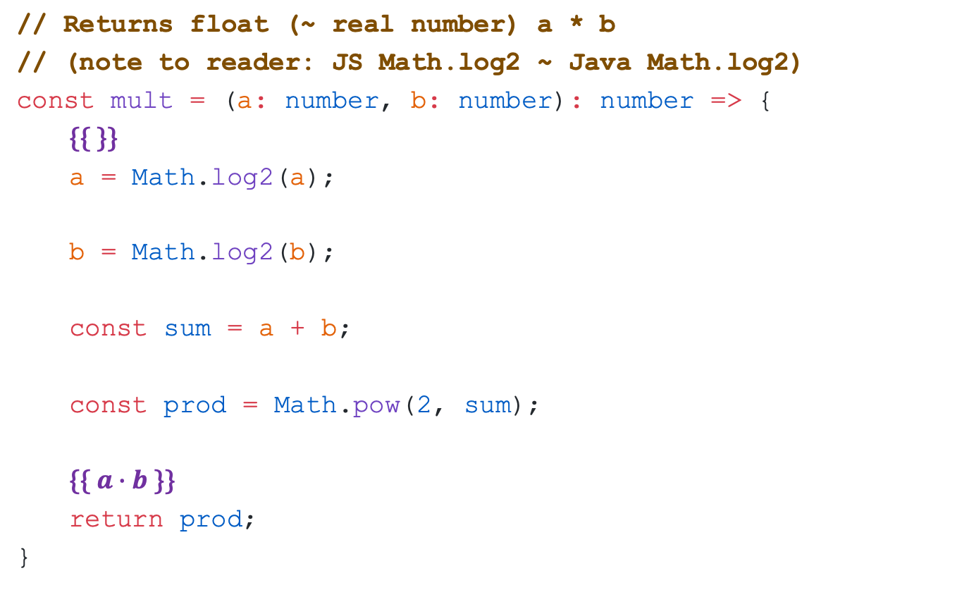
Pause & Think: “Debugging Logs” (1/2)
// Returns float (~ real number) a * b
// (note to reader: JS Math.log2 ~ Java Math.log2)
const mult = (a: number, b: number): number => {
{{ }}
  a = Math.log2(a);
  b = Math.log2(b);
  const sum = a + b;
  const prod = Math.pow(2, sum);
  {{ $a∙b$ }}
  return prod;
}

Slide 101
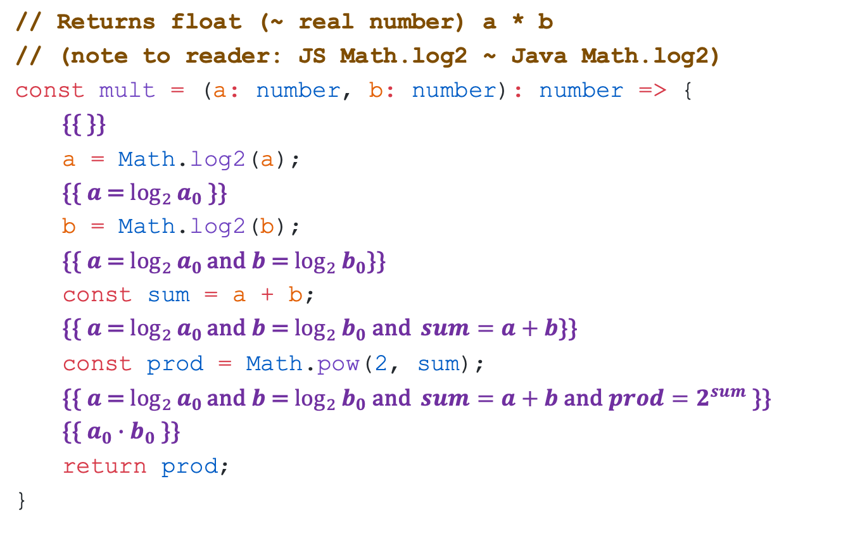
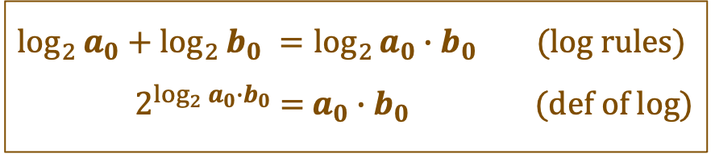
Pause & Think: “Debugging Logs” (2/2)
// Returns float (~ real number) a * b
// (note to reader: JS Math.log2 ~ Java Math.log2)
const mult = (a: number, b: number): number => {
{{ }}
  a = Math.log2(a);
  {{ $a$ = $\log_{2}{a_{0}}$ }}
  b = Math.log2(b);
  {{ $a$ = $\log_{2}{a_{0}}\text{and} b$ = $\log_{2}{b_{0}}$}}
  const sum = a + b;
  {{ $a$ = $\log_{2}{a_{0}}\text{and} b$ = $\log_{2}{b_{0} \text{and}} sum=a+b$}}
  const prod = Math.pow(2, sum);
  {{ $a$ = $\log_{2}{a_{0}}\text{and} b$ = $\log_{2}{b_{0} \text{and}} sum=a+b$ and $prod=2^{sum}$ }}
  {{ $a_{0}∙b_{0}$ }}
  return prod;
}
This code is wrong! Why? Hint: it’s not the log rules, but does involve log…
$\log_{2}{a_{0}}$ + $\log_{2}{b_{0}} =\log_{2}{a_{0}∙b_{0}}$ (log rules)
${ 2}^{\log_{2}{a_{0}∙b_{0}}}$ = $a_{0}∙b_{0}$ (def of log)

Slide 102
Reasoning about Function Calls: Preconditions
Preconditions must be checked
  not valid to call the function on disallowed inputs
Forward reasoning rule is
    {{ P }}
    x = Math.log(a);
    {{ P[x ↦ x₀] and x = ln(a) }}
Backward reasoning rule is
    {{ Q[x ↦ ln(a)] and a > 0 }}
    x = Math.log(a);
    {{ Q }}
Must also check a > 0

Slide 103
Function Calls with Imperative Specs
Applies to functions we define with imperative specs
    // @param n a non-negative integer
    // @returns square(n), where
    // square(0) := 0
    // square(n+1) := square(n) + 2n + 1
    const square = (n: bigint): bigint => {..}
Reasoning is the same. E.g., forward rule is
    {{ P }}
    x = square(n);
    {{ P[x ↦ x₀] and x = square(n) }}
Must also check that n is non-negative

Slide 104
Floyd Logic III
CSE 331 Summer 2025
Jaela Field

Slide 105
Admin & Agenda
HW4 Grades will be released today
  Look at your feedback!
  Remember this was an assignment about notation
Floyd logic agenda
  Last Friday: vocab, forward reasoning
  Last Monday: backwards reasoning, conditionals
  Today: finish function calls, loops & loop invariants

Slide 106
Recall: Reasoning about Function Calls
Spec for Math.log() says:
  /**
  * @param x - A number greater than or equal to 0.
  * @returns natural log (base e) of a, ln(x)
  */
Forward reasoning rule is
    {{ P }}
    x = Math.log(a);
    {{ P[x ↦ x₀] and x = ln(a) }}
Backward reasoning rule is
    {{ Q[x ↦ log(a)] and a > 0 }}
    x = Math.log(a);
    {{ Q }}
Must also check precondition: a > 0

Slide 107
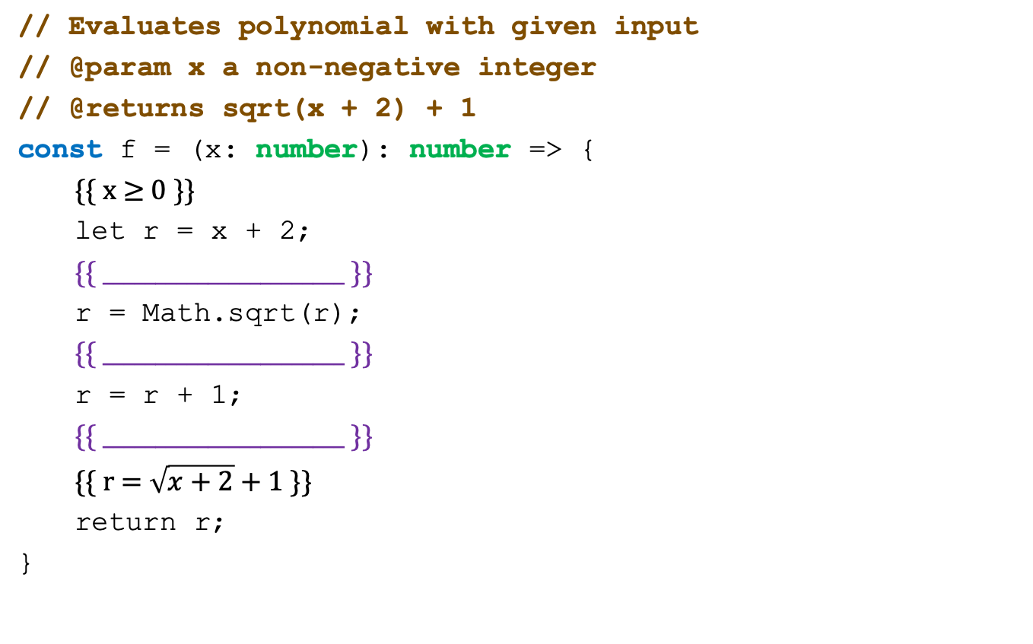
Function Call with Imperative Spec: Forward (1/5)
// Evaluates polynomial with given input
// @param x a non-negative integer
// @returns sqrt(x + 2) + 1
const f = (x: number): number => {
{{ x $≥$ 0 }}
let r = x + 2;
{{ _______________________ }}
r = Math.sqrt(r);
{{ _______________________ }}
r = r + 1;
{{ _______________________ }}
{{ r = $\sqrt{x+2}$+ 1 }}
return r;
}

Slide 108
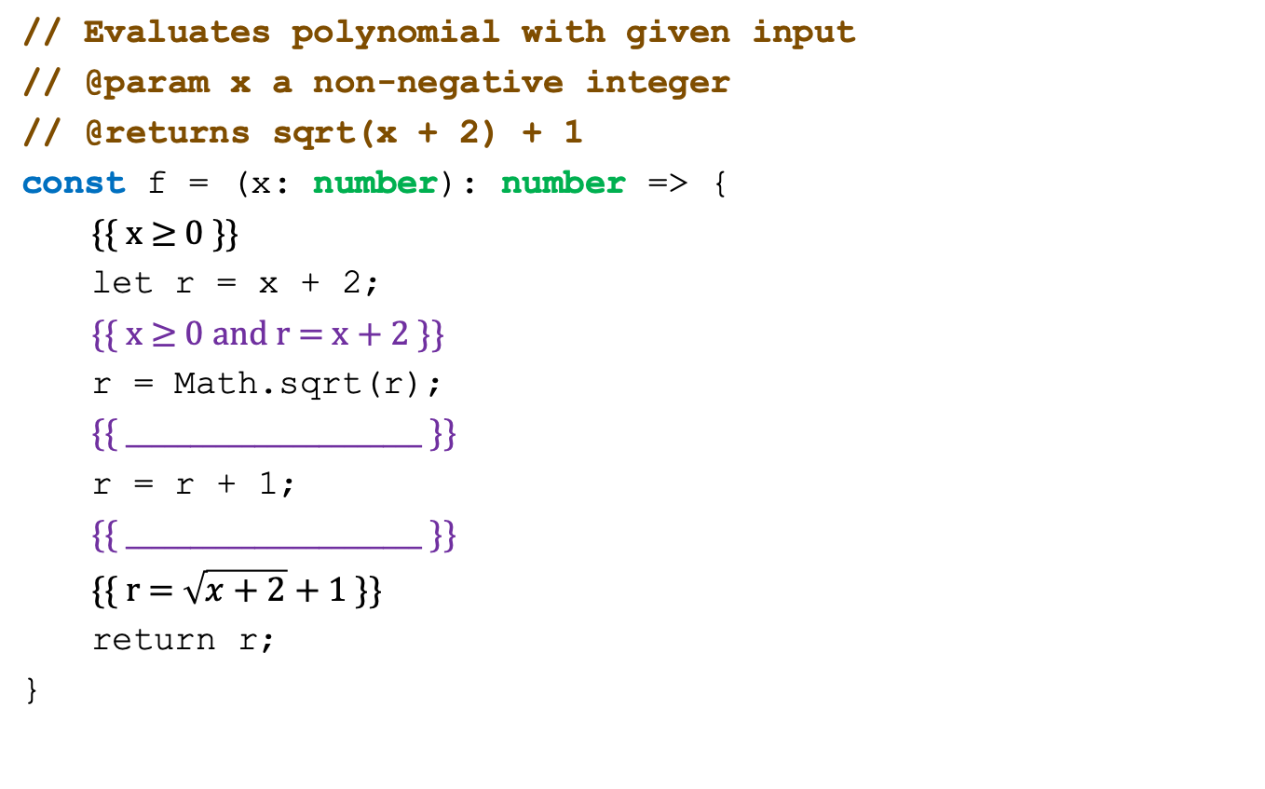
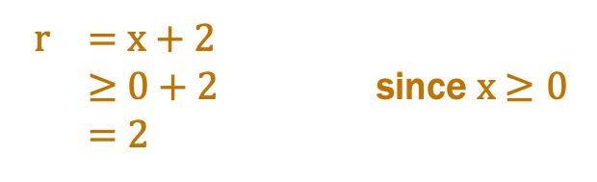
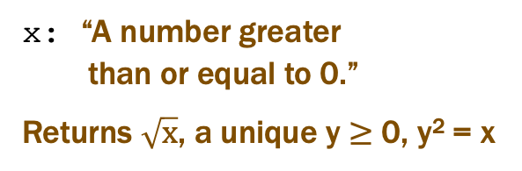
Function Call with Imperative Spec: Forward (2/5)
// Evaluates polynomial with given input
// @param x a non-negative integer
// @returns sqrt(x + 2) + 1
const f = (x: number): number => {
{{ x $≥$ 0 }}
let r = x + 2;
{{ x $≥$ 0 and r = x + 2 }}
r = Math.sqrt(r);
{{ _______________________ }}
r = r + 1;
{{ _______________________ }}
{{ r = $\sqrt{x+2}$+ 1 }}
return r;
}
x: “A number greater
than or equal to 0.”
Returns $\sqrt{x}$, a unique y $≥$ 0, y² = x
r = x + 2
$≥$ 0 + 2 since x $≥0$
= 2

Slide 109
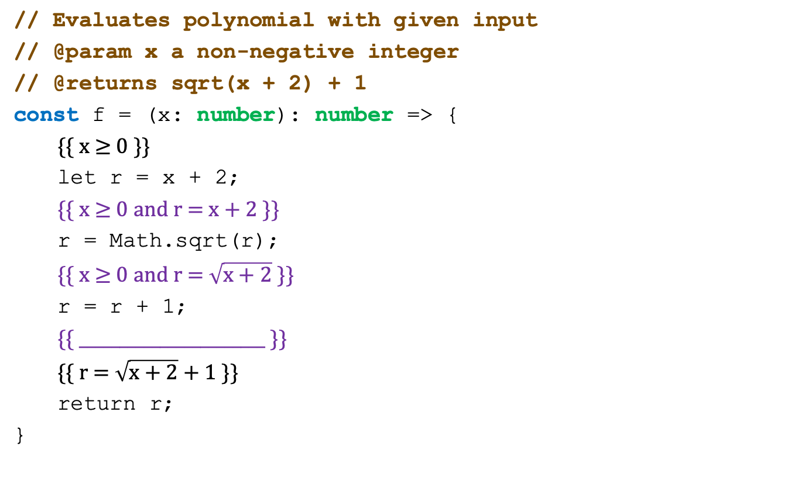
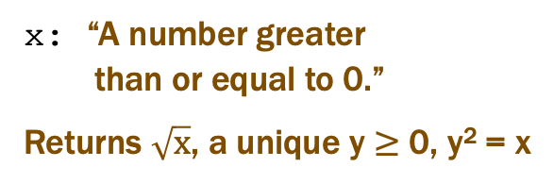
Function Call with Imperative Spec: Forward (3/5)
// Evaluates polynomial with given input
// @param x a non-negative integer
// @returns sqrt(x + 2) + 1
const f = (x: number): number => {
{{ x $≥$ 0 }}
let r = x + 2;
{{ x $≥$ 0 and r = x + 2 }}
r = Math.sqrt(r);
{{ x $≥$ 0 and r = $\sqrt{x+2}$ }}
r = r + 1;
{{ _______________________ }}
{{ r = $\sqrt{x+2}$+ 1 }}
return r;
}
x: “A number greater
than or equal to 0.”
Returns $\sqrt{x}$, a unique y $≥$ 0, y² = x
r = x + 2
$≥$ 0 + 2 since x $≥0$
= 2

Slide 110
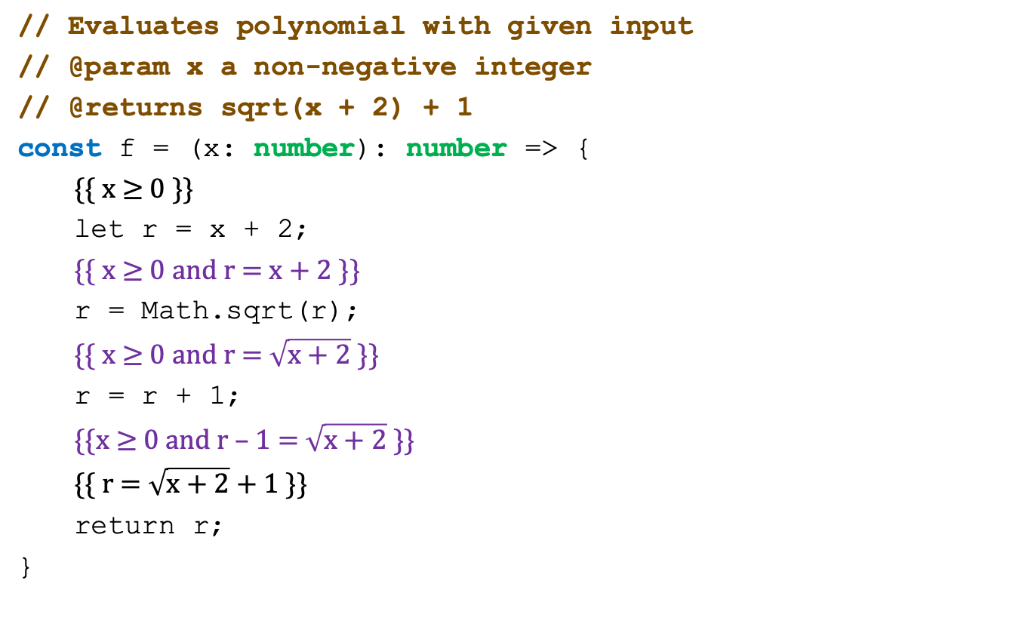
Function Call with Imperative Spec: Forward (4/5)
// Evaluates polynomial with given input
// @param x a non-negative integer
// @returns sqrt(x + 2) + 1
const f = (x: number): number => {
{{ x $≥$ 0 }}
let r = x + 2;
{{ x $≥$ 0 and r = x + 2 }}
r = Math.sqrt(r);
{{ x $≥$ 0 and r = $\sqrt{x+2}$ }}
r = r + 1;
{{x $≥$ 0 and r – 1 = $\sqrt{x+2}$ }}
{{ r = $\sqrt{x+2}$+ 1 }}
return r;
}
check this implication

Slide 111

Function Call with Imperative Spec: Forward (5/5)
// Evaluates polynomial with given input
// @param x a non-negative integer
// @returns sqrt(x + 2) + 1
const f = (x: number): number => {
{{ x $≥$ 0 }}
let r = x + 2;
{{ x $≥$ 0 and r = x + 2 }}
r = Math.sqrt(r);
{{ x $≥$ 0 and r = $\sqrt{x+2}$ }}
r = r + 1;
{{x $≥$ 0 and r = $\sqrt{x+2}$ + 1}}
{{ r = $\sqrt{x+2}$+ 1 }}
return r;
}
holds!

Slide 112
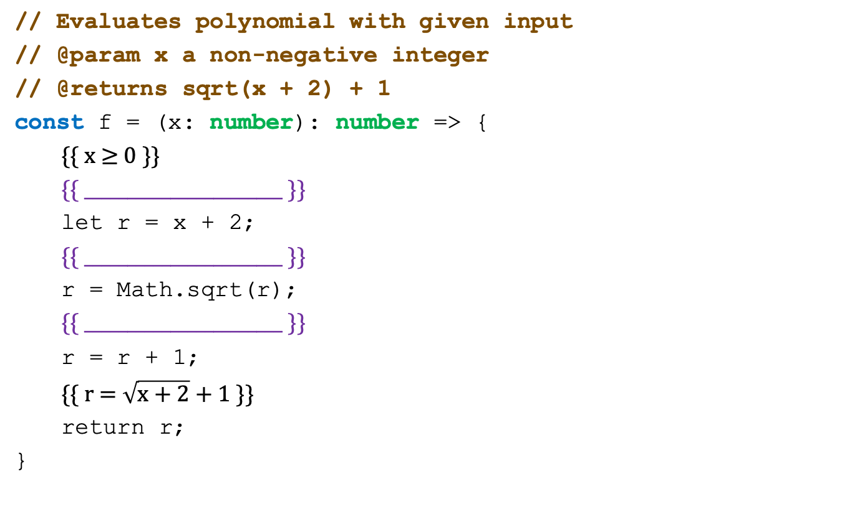
Function Call w/ Imperative Spec: Backward (1/6)
// Evaluates polynomial with given input
// @param x a non-negative integer
// @returns sqrt(x + 2) + 1
const f = (x: number): number => {
{{ x $≥$ 0 }}
{{ _______________________ }}
let r = x + 2;
{{ _______________________ }}
r = Math.sqrt(r);
{{ _______________________ }}
r = r + 1;
{{ r = $\sqrt{x+2}$+ 1 }}
return r;
}

Slide 113
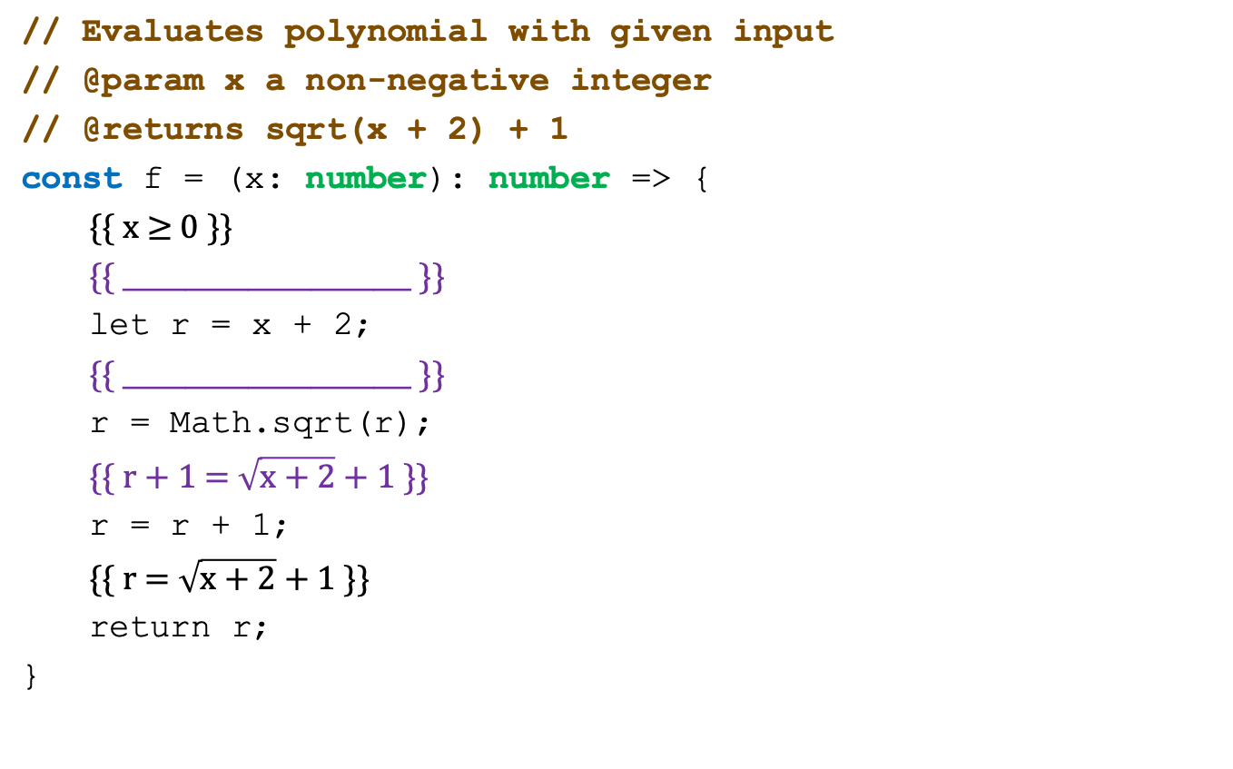
Function Call w/ Imperative Spec: Backward (2/6)
// Evaluates polynomial with given input
// @param x a non-negative integer
// @returns sqrt(x + 2) + 1
const f = (x: number): number => {
{{ x $≥$ 0 }}
{{ _______________________ }}
let r = x + 2;
{{ _______________________ }}
r = Math.sqrt(r);
{{ r + 1 = $\sqrt{x+2}$+ 1 }}
r = r + 1;
{{ r = $\sqrt{x+2}$+ 1 }}
return r;
}

Slide 114
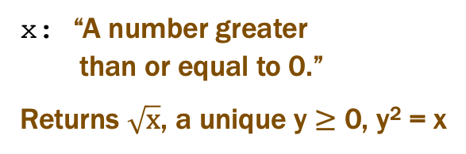
Function Call w/ Imperative Spec: Backward (3/6)
// Evaluates polynomial with given input
// @param x a non-negative integer
// @returns sqrt(x + 2) + 1
const f = (x: number): number => {
{{ x $≥$ 0 }}
{{ _______________________ }}
let r = x + 2;
{{ _______________________ }}
r = Math.sqrt(r);
{{ r + 1 = $\sqrt{x+2}+1$}}
r = r + 1;
{{ r = $\sqrt{x+2}$+ 1 }}
return r;
}
x: “A number greater
than or equal to 0.”
Returns $\sqrt{x}$, a unique y $≥$ 0, y² = x

Slide 115
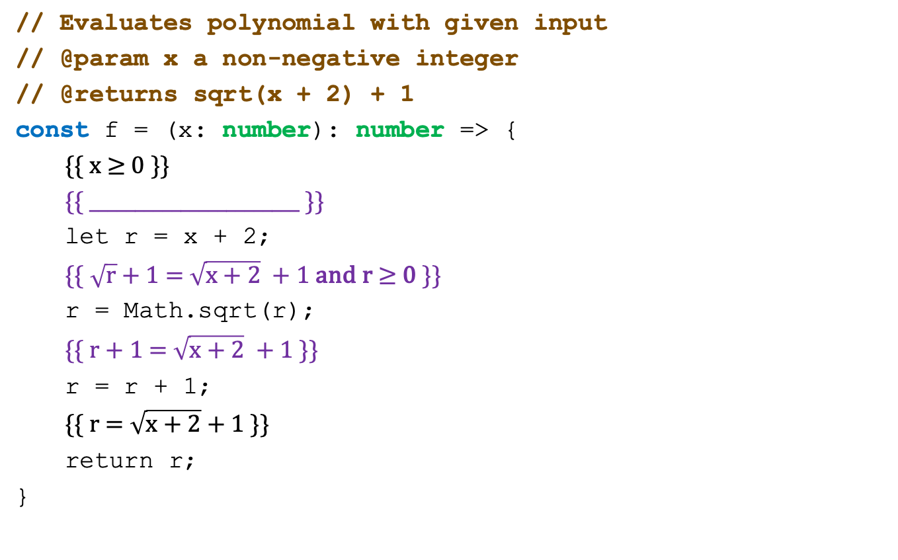
Function Call w/ Imperative Spec: Backward (4/6)
// Evaluates polynomial with given input
// @param x a non-negative integer
// @returns sqrt(x + 2) + 1
const f = (x: number): number => {
{{ x $≥$ 0 }}
{{ _______________________ }}
let r = x + 2;
{{$\sqrt{r}$ + 1 = $\sqrt{x+2}$ + 1 and r $≥$ 0 }}
r = Math.sqrt(r);
{{ r + 1 = $\sqrt{x+2}$ + 1 }}
r = r + 1;
{{ r = $\sqrt{x+2}$+ 1 }}
return r;
}
x: “A number greater
than or equal to 0.”
Returns $\sqrt{x}$, a unique y $≥$ 0, y² = x

Slide 116
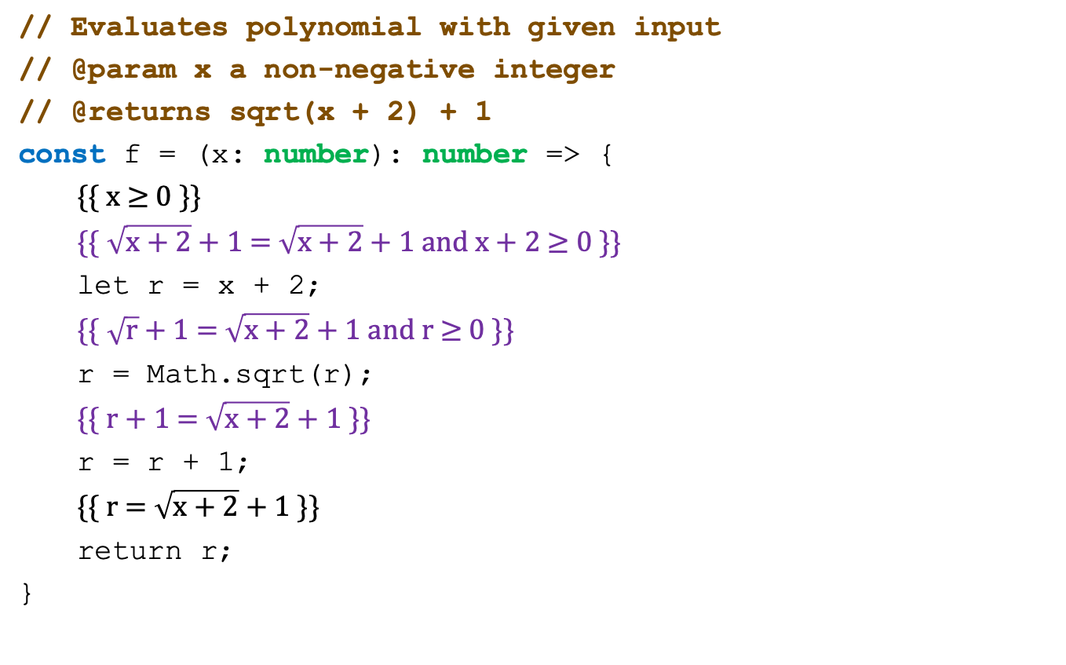
Function Call w/ Imperative Spec: Backward (5/6)
// Evaluates polynomial with given input
// @param x a non-negative integer
// @returns sqrt(x + 2) + 1
const f = (x: number): number => {
{{ x $≥$ 0 }}
{{$\sqrt{x+2}$ + 1 = $\sqrt{x+2}+1$ and x + 2 $≥$ 0 }}
let r = x + 2;
{{$\sqrt{r}$ + 1 = $\sqrt{x+2}$+ 1 and r $≥$ 0 }}
r = Math.sqrt(r);
{{ r + 1 = $\sqrt{x+2}$ + 1 }}
r = r + 1;
{{ r = $\sqrt{x+2}$+ 1 }}
return r;
}

Slide 117
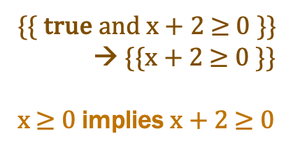
Function Call w/ Imperative Spec: Backward (6/6)
// Evaluates polynomial with given input
// @param x a non-negative integer
// @returns sqrt(x + 2) + 1
const f = (x: number): number => {
{{ x $≥$ 0 }}
{{$\sqrt{x+2}$ + 1 = $\sqrt{x+2}+1$ and x + 2 $≥$ 0 }}
let r = x + 2;
{{$\sqrt{r}$ + 1 = $\sqrt{x+2}+1$ and r $≥$ 0 }}
r = Math.sqrt(r);
{{ r + 1 = $\sqrt{x+2}+1$ }}
r = r + 1;
{{ r = $\sqrt{x+2}$+ 1 }}
return r;
}
{{ true and x + 2 $≥$ 0 }}
→ {{x + 2 $≥$ 0 }}
x $≥$ 0 implies x + 2 $≥$ 0

Slide 118
Function Calls with Declarative Specs
    // @requires P₂ -- preconditions a, b
    // @returns x such that R -- conditions on a, b, x
    const f = (a: bigint, b: bigint): bigint => {..}
Forward reasoning rule is
    {{ P }}
    x = f(a, b);
    {{ P[x ↦ x₀] and R }}
Backward reasoning rule is
    {{ Q₁ and P₂ }}
    x = f(a, b);
    {{ Q₁ and Q₂ }}
Must also check that P implies P₂
Must also check that R implies Q₂
Q₂ is the part of postcondition using “x”
Notes:
Doesn’t tell you exactly what the answer is, just tells you some properties about the result

Slide 119
Loops

Slide 120
Correctness of Loops
Assignment and condition reasoning is mechanical
Loop reasoning cannot be made mechanical
  no way around this
    (311 alert: this follows from Rice’s Theorem)
Thankfully, one extra bit of information fixes this
  need to provide a “loop invariant”
  with the invariant, reasoning is again mechanical

Slide 121
Recall: Binary Search Trees
Larger values to the right of a node, smaller values to the left
This is an “invariant” about BSTs
  A property that remains true about the data structure
    Must be maintained
    If broken, it’s no longer a valid BST
6
3
9
1
4
8

Slide 122
Loop Invariants (1/2)
Loop invariant is true every time at the top of the loop
    {{ Inv: I }}
    while (cond) {
    S
    }
  must be true when we get to the top the first time
  must remain true each time execute S and loop back up
Use “Inv:” to indicate a loop invariant
    otherwise, it would be a standard assertion only claiming to be true the first time at the loop

Slide 123
Loop Invariants (2/2)
Loop invariant is true every time at the top of the loop
    {{ Inv: I }}
    while (cond) {
    S
    }
  must be true 0 times through the loop (at top the first time)
  if true n times through, must be true n+1 times through
Why do these imply it is always true?
  follows by structural induction (on ℕ)

Slide 124
Loop Invariants as Three Distinct Triples (1/5)
    {{ P }}
    {{ Inv: I }}
    while (cond) {
    S
    }
    {{ Q }}
How do we check validity with a loop invariant?
  intermediate assertion splits into three triples to check

Slide 125
Loop Invariants as Three Distinct Triples (2/5)
    {{ P }}
    {{ Inv: I }}
    while (cond) {
    S
    }
    {{ Q }}
Splits correctness into three parts
  I holds initially
  S preserves I
  Q holds when loop exits
1. I holds initially

Slide 126
Loop Invariants as Three Distinct Triples (3/5)
    {{ P }}
    {{ Inv: I }}
    while (cond) {
    {{ I and cond }}
    S
    {{ I }}
    }
    {{ Q }}
Splits correctness into three parts
  I holds initially
  S preserves I
  Q holds when loop exits
1. I holds initially
2. S preserves I

Slide 127
Loop Invariants as Three Distinct Triples (4/5)
    {{ P }}
    {{ Inv: I }}
    while (cond) {
    {{ I and cond }}
    S
    {{ I }}
    }
    {{ I and not cond }}
    {{ Q }}
Splits correctness into three parts
  I holds initially implication
  S preserves I forward/back then implication
  Q holds when loop exits implication
1. I holds initially
2. S preserves I
3. Q holds when loop exits

Slide 128
Loop Invariants as Three Distinct Triples (5/5)
    {{ P }}
    {{ Inv: I }}
    while (cond) {
    S
    }
    {{ Q }}
Formally, invariant split this into three Hoare triples:
  {{ P }} {{ I }} I holds initially
  {{ I and cond }} S {{ I }} S preserves I
  {{ I and not cond }} {{ Q }} Q holds when loop exits

Slide 129
Loop Invariant Example: Square (1/8)
This loop claims to calculate n²
    {{ }}
    let j: bigint = 0n;
    let s: bigint = 0n;
    {{ Inv: s = j² }}
    while (j !== n) {
    j = j + 1n;
    s = s + j + j - 1;
    }
    {{ s = n² }}
    return s;
Easy to get this wrong!
might be initializing “j” wrong (j = 1?)
might be exiting at the wrong time (j ≠ n–1?)
might have the assignments in wrong order
…
Fact that we need to check 3 implications is a
strong indication that more bugs are possible.

Slide 130
Loop Invariant Example: Square (2/8)
This loop claims to calculate n²
    {{ }}
    let j: bigint = 0n;
    let s: bigint = 0n;
    {{ Inv: s = j² }}
    while (j !== n) {
    j = j + 1n;
    s = s + j + j - 1;
    }
    {{ s = n² }}
    return s;
Loop Idea
move j from 0 to n
keep track of j² in s
j | s
0 | 0
1 | 1
2 | 4
3 | 9
4 | 16
… | …
Loop Invariant formalizes the Loop Idea

Slide 131
Loop Invariant Example: Square (3/8)
This loop claims to calculate n²
    {{ }}
    let j: bigint = 0n;
    let s: bigint = 0n;
    {{ j = 0 and s = 0 }}
    {{ Inv: s = j² }}
    while (j !== n) {
    j = j + 1n;
    s = s + j + j - 1;
    }
    {{ s = n² }}
    return s;
s = 0 since s = 0
= 0²
= j² since j = 0

Slide 132
Loop Invariant Example: Square (4/8)
This loop claims to calculate n²
    {{ Inv: s = j² }}
    while (j !== n) {
    j = j + 1n;
    s = s + j + j - 1;
    }
    {{ s = j² and j = n }}
    {{ s = n² }}
    return s;
s = j² since s = j² (Inv)
= n² since j = n

Slide 133
Loop Invariant Example: Square (5/8)
This loop claims to calculate n²
    {{ Inv: s = j² }}
    while (j !== n) {
    {{ s = j² and j ≠ n }}
    j = j + 1n;
    s = s + j + j - 1;
    {{ s = j² }}
    }
    {{ s = n² }}
    return s;

Slide 134
Loop Invariant Example: Square (6/8)
This loop claims to calculate n²
    {{ Inv: s = j² }}
    while (j !== n) {
    {{ s = j² and j ≠ n }}
    j = j + 1n;
    {{ s = (j – 1)² and j – 1 ≠ n }}
    s = s + j + j - 1;
    {{ s = j² }}
    }
    {{ s = n² }}
    return s;
j = j₀ + 1 means j₀ = j – 1

Slide 135
Loop Invariant Example: Square (7/8)
This loop claims to calculate n²
    {{ Inv: s = j² }}
    while (j !== n) {
    {{ s = j² and j ≠ n }}
    j = j + 1n;
    {{ s = (j – 1)² and j – 1 ≠ n }}
    s = s + j + j - 1;
    {{ s – 2j + 1 = (j – 1)² and j – 1 ≠ n }}
    {{ s = j² }}
    }
    {{ s = n² }}
    return s;
s = s₀ + 2j – 1 means s₀ = s – 2j + 1

Slide 136
Loop Invariant Example: Square (8/8)
This loop claims to calculate n²
    {{ Inv: s = j² }}
    while (j !== n) {
    {{ s = j² and j ≠ n }}
    j = j + 1n;
    {{ s = (j – 1)² and j – 1 ≠ n }}
    s = s + j + j - 1;
    {{ s – 2j + 1 = (j – 1)² and j – 1 ≠ n }}
    {{ s = j² }}
    }
    {{ s = n² }}
    return s;
s = 2j – 1 + (j – 1)² since s – 2j + 1 = (j – 1)²
= 2j – 1 + j² – 2j + 1
= j²

Slide 137
Loop Invariant Example: Sum of List (1/8)
Recursive function to calculate sum of list
    sum(nil) := 0
    sum(x :: L) := x + sum(L)
This loop claims to calculate it as well:
    {{ L = L₀ }}
    let s: bigint = 0n;
    {{ Inv: sum(L₀) = s + sum(L) }}
    while (L.kind !== "nil") {
    s = s + L.hd;
    L = L.tl;
    }
    {{ s = sum(L₀) }}
    return s;
Loop Idea
move through L front-to-back
keep sum of prior part in s

Slide 138
Loop Invariant Example: Sum of List (2/8)
Recursive function to calculate sum of list
    sum(nil) := 0
    sum(x :: L) := x + sum(L)
Check that the invariant holds initially
    {{ L = L₀ }}
    let s: bigint = 0n;
    {{ L = L₀ and s = 0 }}
    {{ Inv: sum(L₀) = s + sum(L) }}
    while (L.kind !== "nil") {
    …
sum(L₀)
= sum(L) since L = L₀
= 0 + sum(L)
= s + sum(L) since s = 0

Slide 139
Loop Invariant Example: Sum of List (3/8)
Recursive function to calculate sum of list
    sum(nil) := 0
    sum(x :: L) := x + sum(L)
Check that the postcondition holds at loop exit
    {{ Inv: sum(L₀) = s + sum(L) }}
    while (L.kind !== "nil") {
    s = s + L.hd;
    L = L.tl;
    }
    {{ sum(L₀) = s + sum(L) and L = nil }}
    {{ s = sum(L₀) }}
    return s;
sum(L₀)
= s + sum(L) given (Inv)
= s + sum(nil) since L = nil
= s def of sum

Slide 140
Loop Invariant Example: Sum of List (4/8)
Recursive function to calculate sum of list
    sum(nil) := 0
    sum(x :: L) := x + sum(L)
Check that the loop body preserves the invariant
    {{ Inv: sum(L₀) = s + sum(L) }}
    while (L.kind !== "nil") {
    {{ sum(L₀) = s + sum(L) and L ≠ nil }}
    s = s + L.hd;
    L = L.tl;
    {{ sum(L₀) = s + sum(L) }}
    }
L ≠ nil means L = L.hd :: L.tl

Slide 141
Loop Invariant Example: Sum of List (5/8)
Recursive function to calculate sum of list
    sum(nil) := 0
    sum(x :: L) := x + sum(L)
Check that the loop body preserves the invariant
    {{ Inv: sum(L₀) = s + sum(L) }}
    while (L.kind !== "nil") {
    {{ sum(L₀) = s + sum(L) and L = L.hd :: L.tl }}
    s = s + L.hd;
    L = L.tl;
    {{ sum(L₀) = s + sum(L) }}
    }

Slide 142
Loop Invariant Example: Sum of List (6/8)
Recursive function to calculate sum of list
    sum(nil) := 0
    sum(x :: L) := x + sum(L)
Check that the loop body preserves the invariant
    {{ Inv: sum(L₀) = s + sum(L) }}
    while (L.kind !== "nil") {
    {{ sum(L₀) = s + sum(L) and L = L.hd :: L.tl }}
    s = s + L.hd;
    {{ sum(L₀) = s + sum(L.tl) }}
    L = L.tl;
    {{ sum(L₀) = s + sum(L) }}
    }

Slide 143
Loop Invariant Example: Sum of List (7/8)
Recursive function to calculate sum of list
    sum(nil) := 0
    sum(x :: L) := x + sum(L)
Check that the loop body preserves the invariant
    {{ Inv: sum(L₀) = s + sum(L) }}
    while (L.kind !== "nil") {
    {{ sum(L₀) = s + sum(L) and L = L.hd :: L.tl }}
    {{ sum(L₀) = s + L.hd + sum(L.tl) }}
    s = s + L.hd;
    {{ sum(L₀) = s + sum(L.tl) }}
    L = L.tl;
    {{ sum(L₀) = s + sum(L) }}
    }

Slide 144
Loop Invariant Example: Sum of List (8/8)
Recursive function to calculate sum of list
    sum(nil) := 0
    sum(x :: L) := x + sum(L)
Check that the loop body preserves the invariant
    {{ Inv: sum(L₀) = s + sum(L) }}
    while (L.kind !== "nil") {
    {{ sum(L₀) = s + sum(L) and L = L.hd :: L.tl }}
    {{ sum(L₀) = s + L.hd + sum(L.tl) }}
    s = s + L.hd;
    {{ sum(L₀) = s + sum(L.tl) }}
    L = L.tl;
    {{ sum(L₀) = s + sum(L) }}
    }
sum(L₀)
= s + sum(L) given (Inv)
= s + sum(L.hd :: L.tl) since L = L.hd :: L.tl
= s + L.hd + sum(L.tl) def of sum

Slide 145
Loop Invariant Example: List Contains (1/7)
Recursive function to check if y appears in list L
    contains(y, nil) := false
    contains(y, x :: L) := true if x = y
    contains(y, x :: L) := contains(y, L) if x ≠ y
This loop claims to calculate it as well:
    {{ Inv: contains(y, L₀) = contains(y, L) }}
    while (L.kind !== "nil") {
    if (L.hd === y)
    return true;
    L = L.tl;
    }
    return false;
Loop Idea
move through L front-to-back
answer remains the same as on the original list L₀
can only do that if y is not found

Slide 146
Loop Invariant Example: List Contains (2/7)
Check that the invariant holds initially
    {{ L₀ = L }}
    {{ Inv: contains(y, L₀) = contains(y, L) }}
    while (L.kind !== "nil") {
    if (L.hd === y)
    return true;
    L = L.tl;
    }
    return false;
contains(y, L₀)
= contains(y, L) since L₀ = L
    contains(y, nil) := false
    contains(y, x :: L) := true if x = y
    contains(y, x :: L) := contains(y, L) if x ≠ y

Slide 147
Loop Invariant Example: List Contains (3/7)
Check that the invariant implies the postcondition
    {{ Inv: contains(y, L₀) = contains(y, L) }}
    while (L.kind !== "nil") {
    if (L.hd === y)
    return true;
    L = L.tl;
    }
    {{ contains(y, L₀) = contains(y, L) and L = nil }}
    {{ contains(y, L₀) = false }}
    return false;
contains(y, L₀)
= contains(y, L) given (Inv)
= contains(y, nil) since L = nil
= false def of contains
    contains(y, nil) := false
    contains(y, x :: L) := true if x = y
    contains(y, x :: L) := contains(y, L) if x ≠ y

Slide 148
Loop Invariant Example: List Contains (4/7)
Check that the body preserves the invariant
    {{ Inv: contains(y, L₀) = contains(y, L) }}
    while (L.kind !== "nil") {
    {{ contains(y, L₀) = contains(y, L) and L ≠ nil }}
    if (L.hd === y)
    return true;
    L = L.tl;
    {{ contains(y, L₀) = contains(y, L) }}
    }
    return false;
L ≠ nil means L = L.hd :: L.tl
    contains(y, nil) := false
    contains(y, x :: L) := true if x = y
    contains(y, x :: L) := contains(y, L) if x ≠ y

Slide 149
Loop Invariant Example: List Contains (5/7)
Check that the body preserves the invariant
    {{ Inv: contains(y, L₀) = contains(y, L) }}
    while (L.kind !== "nil") {
    {{ contains(y, L₀) = contains(y, L) and L = L.hd :: L.tl }}
    if (L.hd === y)
    {{ contains(y, L₀) = contains(y, L) and L = L.hd :: L.tl and L.hd = y }}
    {{ contains(y, L₀) = true }}
    return true;
    L = L.tl;
    {{ contains(y, L₀) = contains(y, L) }}
    }
    return false;
contains(y, L₀)
= contains(y, L) given (Inv)
= contains(y, L.hd :: L.tl) since L = L.hd :: L.tl
= true since y = L.hd
    contains(y, nil) := false
    contains(y, x :: L) := true if x = y
    contains(y, x :: L) := contains(y, L) if x ≠ y

Slide 150
Loop Invariant Example: List Contains (6/7)
Check that the body preserves the invariant
    {{ Inv: contains(y, L₀) = contains(y, L) }}
    while (L.kind !== "nil") {
    {{ contains(y, L₀) = contains(y, L) and L = L.hd :: L.tl }}
    if (L.hd === y)
    {{ contains(y, L₀) = true }}
    return true;
    {{ contains(y, L₀) = contains(y, L) and L = L.hd :: L.tl and L.hd ≠ y }}
    L = L.tl;
    {{ contains(y, L₀) = contains(y, L) }}
    }
    return false;
enter implicit else
    contains(y, nil) := false
    contains(y, x :: L) := true if x = y
    contains(y, x :: L) := contains(y, L) if x ≠ y

Slide 151
Loop Invariant Example: List Contains (7/7)
Check that the body preserves the invariant
    {{ Inv: contains(y, L₀) = contains(y, L) }}
    while (L.kind !== "nil") {
    {{ contains(y, L₀) = contains(y, L) and L = L.hd :: L.tl }}
    if (L.hd === y)
    {{ contains(y, L₀) = true }}
    return true;
    {{ contains(y, L₀) = contains(y, L) and L = L.hd :: L.tl and L.hd ≠ y }}
    {{ contains(y, L₀) = contains(y, L.tl) }}
    L = L.tl;
    {{ contains(y, L₀) = contains(y, L) }}
    }
    return false;
contains(y, L₀)
= contains(y, L) given (Inv)
= contains(y, L.hd :: L.tl) since L = L.hd :: L.tl
= contains(y, L.tl) since y ≠ L.hd
    contains(y, nil) := false
    contains(y, x :: L) := true if x = y
    contains(y, x :: L) := contains(y, L) if x ≠ y

Slide 152
Hoare Logic & Termination
This analysis does not check that the code terminates
  it shows that the postcondition holds if the loop exits
  but we never showed that the loop does exit
Termination follows from the running time analysis
  e.g., if the code runs in O(n²) time, then it terminates
  an infinite loop would be O(infinity)
  any finite bound on the running time proves it terminates
Normal to also analyze the running time of our code, and we get termination already from that analysis

Slide 153
Evaluating Correctness of Loops
With straight-line code and conditionals,
if the triple is not valid…
  the code is wrong
  there is some test case that will prove it
    (doesn't mean we found that case in our tests, but it exists)
With loops, if the triples are not valid…
  the code is wrong with that invariant
  there may not be any test case that proves it
    the code may behave correctly on all inputs
  the code could be right but with a different invariant
Loops are inherently more complicated

Slide 154
Simplification within Assertions
Valid to do basic arithmetic
  e.g. {{ x – 1 < 3 }} → {{ x < 4 }}
Valid to substitute in exactly know variable values
  e.g. {{ x = 3 and y = x + 1 }} → {{ x = 3 and y = 4 }}
Invalid to apply math definitions:
  e.g. {{ sum(a::b::nil) > b }} → {{ a + b > b }}
Invalid to substitute in variable value range:
  e.g. {{ x = y + z and y > 10 }}
    → {{ x > 10 + z and y > 10 }}
  This is a weakening of the assertion

Slide 155
Loop Invariant Example: sqrt (1/9)
Declarative spec of sqrt(x)
    return y ∈ ℤ such that (y – 1)² < x ≤ y²
  precondition that x is positive: 0 < x
  precondition that x is not too large: x < 10¹² = (10⁶)²

Slide 156
Loop Invariant Example: sqrt (2/9)
    return y ∈ ℤ such that (y – 1)² < x ≤ y²
This loop claims to calculate it:
    let a: bigint = 0;
    let b: bigint = 1000000;
    {{ Inv: a² < x ≤ b² }}
    while (a !== b - 1) {
    const m = (a + b) / 2n;
    if (m*m < x) {
    a = m;
    } else {
    b = m;
    }
    }
    return b;
Loop Idea
maintain a range a ... b
with x in the range a² ... b²

Slide 157
Loop Invariant Example: sqrt (3/9)
    return y ∈ ℤ such that (y – 1)² < x ≤ y²
Check that the invariant holds initially:
    {{ Pre: 0 < x ≤ 10¹² }}
    let a: bigint = 0;
    let b: bigint = 1000000;
    {{ Inv: a² < x ≤ b² }}
    while (a !== b - 1) {
    …
    }
    return b;

Slide 158
Loop Invariant Example: sqrt (4/9)
    return y ∈ ℤ such that (y – 1)² < x ≤ y²
Check that the invariant holds initially:
    {{ Pre: 0 < x ≤ 10¹² }}
    let a: bigint = 0;
    let b: bigint = 1000000;
    {{ 0 < x ≤ 10¹² and a = 0 and b = 10⁶ }}
    {{ Inv: a² < x ≤ b² }}
    while (a !== b - 1) {
    …
    }
    return b;
a² = 0² since a = 0
= 0
< x
x < 10¹²
= (10⁶)²
= b² since b = 10⁶

Slide 159
Loop Invariant Example: sqrt (5/9)
    return y ∈ ℤ such that (y – 1)² < x ≤ y²
Check that the postcondition hold after exit
    {{ Inv: a² < x ≤ b² }}
    while (a !== b - 1) {
    …
    }
    {{ a² < x ≤ b² and a = b – 1 }}
    {{ (b – 1)² < x ≤ b² }}
    return b;
Does (y – 1)² < x < y² hold with y = b?
(b – 1)²
= a² since a = b – 1
< x

Slide 160
Loop Invariant Example: sqrt (6/9)
    return y ∈ ℤ such that (y – 1)² < x ≤ y²
Check that the body preserves the invariant:
    {{ Inv: a² < x ≤ b² }}
    while (a !== b - 1) {
    {{ a² < x ≤ b² and a ≠ b – 1 }}
    const m = (a + b) / 2n;
    if (m*m < x) {
    a = m;
    } else {
    b = m;
    }
    {{ a² < x ≤ b² }}
    }

Slide 161
Loop Invariant Example: sqrt (7/9)
    return y ∈ ℤ such that (y – 1)² < x ≤ y²
Check that the body preserves the invariant:
    {{ Inv: a² < x ≤ b² }}
    while (a !== b - 1) {
    {{ a² < x ≤ b² and a ≠ b – 1 }}
    const m = (a + b) / 2n;
    if (m*m < x) {
    {{ a² < x ≤ b² and a ≠ b – 1 and m = (a + b) / 2 and m² < x }}
    a = m;
    } else {
    {{ a² < x ≤ b² and a ≠ b – 1 and m = (a + b) / 2 and x ≤ m² }}
    b = m;
    }
    {{ a² < x ≤ b² }}
    }

Slide 162
Loop Invariant Example: sqrt (8/9)
    return y ∈ ℤ such that (y – 1)² < x ≤ y²
Check that the body preserves the invariant:
    {{ Inv: a² < x ≤ b² }}
    while (a !== b - 1) {
    const m = (a + b) / 2n;
    if (m*m < x) {
    {{ a² < x ≤ b² and a ≠ b – 1 and m = (a + b) / 2 and m² < x }}
    {{ m² < x ≤ b² }}
    a = m;
    } else {
    {{ a² < x ≤ b² and a ≠ b – 1 and m = (a + b) / 2 and x ≤ m² }}
    b = m;
    }
    {{ a² < x ≤ b² }}
    }
Immediate!

Slide 163
Loop Invariant Example: sqrt (9/9)
    return y ∈ ℤ such that (y – 1)² < x ≤ y²
Check that the body preserves the invariant:
    {{ Inv: a² < x ≤ b² }}
    while (a !== b - 1) {
    const m = (a + b) / 2n;
    if (m*m < x) {
    a = m;
    } else {
    {{ a² < x ≤ b² and a ≠ b – 1 and m = (a + b) / 2 and x ≤ m² }}
    {{ a² < x ≤ m² }}
    b = m;
    }
    {{ a² < x ≤ b² }}
    }
Immediate!
Correctness of binary search is pretty easy
once you have the invariant clear!

