Slide 1
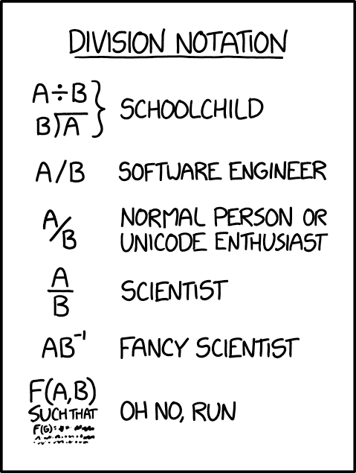
Specifications
CSE 331
Summer 2025
Jaela Field
xkcd #2687, ty Matt

Slide 2
Where We Are in the Course
Eight assignments split into these groups:
HW1
HW2
learn to write more complex apps
practice debugging
HW3
HW4
HW5
learn how to be 100% sure the code is correct
(most of the work done on paper)
HW6
HW7
HW8

Slide 3
Correctness and Specifications
Correctness requires a definition of the correct answer
Description must be precise
  can’t have disagreement about what is correct
Informal descriptions (English) are usually imprecise
  necessary to “formalize” the English
    turn the English into a precise mathematical definition
  professionals are very good at this
    usually just give English definitions
    important skill to practice
  we will start out completely formal to make it easier

Slide 4
Kinds of Specifications
Imperative specification says how to calculate the answer
  lays out the exact steps to perform to get the answer
Declarative specification says what the answer looks like
  does not say how to calculate it
  up to us to ensure that our code satisfies the spec
Can implement a different imperative specification
  again, up to us to ensure that our code satisfies the spec

Slide 5
Example: Imperative Specification (abs)
Absolute value: |x| = x if x ≥ 0 and –x otherwise
  definition is an “if” statement
const abs = (x: bigint): bigint => {
if (x >= 0n) {
return x;
} else {
return –x;
}
}
just translating math to TypeScript

Slide 6
Example: Declarative Specification (sub)
Subtraction (a – b): return x such that b + x = a
  can see that b + (a – b) = b + a – b = a
const sub = (a : bigint, b: bigint): bigint => {
??
}
we are left to figure out how to do this…
and convince ourselves it satisfies the spec

Slide 7
Example: Declarative Specification (sqrt)
Square root of x is number y such that y² = x
  not all positive integers have integer square roots,
  so… let’s round up
  (y – 1)² ≤ x ≤ y²
    smallest integer y such that x ≤ y²
const sqrt = (x: bigint): bigint => {
??
}
we are left to figure out how to do this…
and convince ourselves it satisfies the spec

Slide 8
Example: Declarative Specification (abs)
Absolute value |x| is an integer y such that
  y ≥ x
  y ≥ –x
  y = x or y = –x
const abs = (x: bigint): bigint => {
if (x >= 0) {
return x;
} else {
return –x;
}
}
requires some thinking to make sure this code
returns a number with the properties above

Slide 9
"Straight From the Spec"
If imperative, just translate math into code
  TypeScript here, but could also be Java
  we often call this "straight from the spec"
if declarative (or implementing different imperative spec), then we will need new tools for checking its correctness

Slide 10
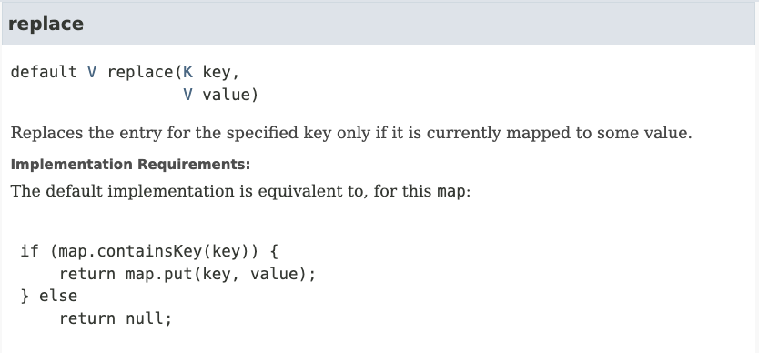

Examples from Java: Map .replace()
java.util.Map — set of (key, value) pairs
sli.do #cse331
Imperative
Notes:
https://docs.oracle.com/en/java/javase/17/docs/api/java.base/java/util/Map.html#replace(K,V)

Slide 11
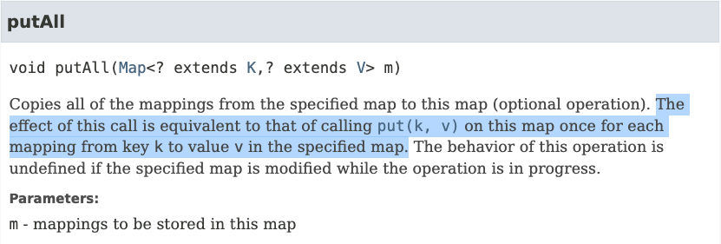
Examples from Java: Map .putAll()
java.util.Map — set of (key, value) pairs
Imperative
Notes:
https://docs.oracle.com/en/java/javase/17/docs/api/java.base/java/util/Map.html#putAll(java.util.Map)

Slide 12
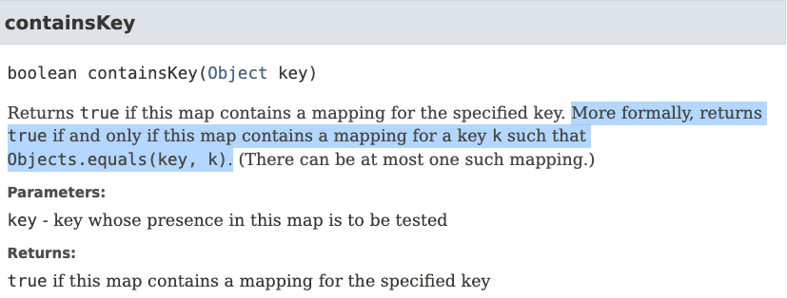
Examples from Java: Map .containsKey()
java.util.Map — set of (key, value) pairs
Declarative (probably)
Notes:
https://docs.oracle.com/javase/8/docs/api/java/util/Map.html#containsKey-java.lang.Object-

Slide 13
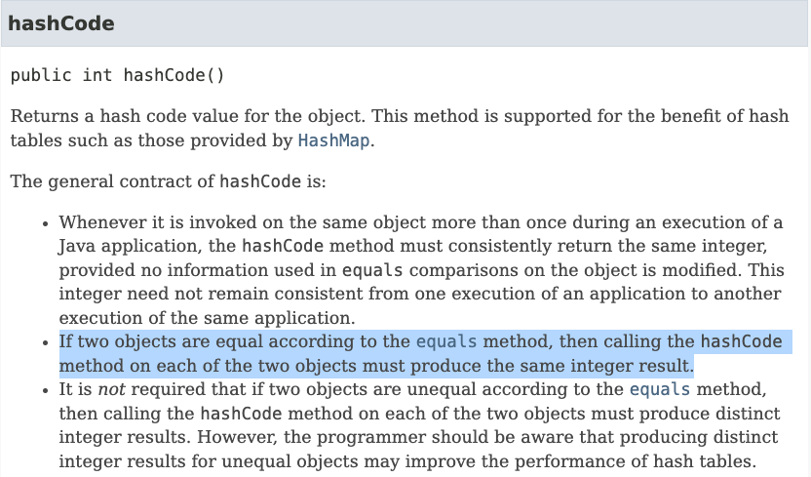
Examples from Java: Object .hashCode()
java.util.Object
Declarative
Notes:
https://docs.oracle.com/en/java/javase/17/docs/api/java.base/java/lang/Object.html#hashCode()

Slide 14
This Topic’s Goal: Imperative Specifications
Toolkit for writing imperative specifications
  define math for data and code
    write specifications that are language independent
    (don't want a toolkit that only works for TypeScript)
  describe how to translate imperative specs into TypeScript
    try to make the translations as straightforward as possible (fewer mistakes)
  mention new TypeScript features when related
    critical to understand what bugs the type system catches and which it does not
Will look at declarative specifications later

Slide 15
Math Notation

Slide 16
Basic Data Types in Math
In math, the basic data types are “sets”
  sets are collections of objects called elements
  write x ∈ S to say that “x” is an element of set “S”,
  and x ∉ S to say that it is not.
Examples:
x ∈ ℤ x is an integer
x ∈ ℕ x is a non-negative integer (natural)
x ∈ ℝ x is a real number
x ∈ 𝔹 x is T or F (boolean)
x ∈ 𝕊 x is a character
x ∈ 𝕊* x is a string
non-standard names

Slide 17
Basic Data Types in TypeScript
English | Math | TypeScript | Up to Us
integer | x ∈ ℤ | bigint
natural | x ∈ ℕ | bigint | non-negative
real | x ∈ ℝ | number
boolean | x ∈ 𝔹 | boolean
character | x ∈ 𝕊 | string | length 1
string | x ∈ 𝕊* | string
we will often write
x : ℤ instead of x ∈ ℤ
  only subtraction on non-negative can produce negative

Slide 18
Specifications & Inductive Data Types
CSE 331 Summer 2025
Jaela Field

Slide 19
Summary of Last Time: Specifications
Specification is necessary to even discuss correctness
Goals: develop a toolkit for
  writing (imperative) specs that are fully precise
  writing specs in a language-independent manner
Solution: rely on standard mathematical notation

Slide 20
Creating New Types in Math (Unions)
Union Types 𝕊* ∪ ℕ
  contains every object in either (or both) of those sets
  e.g., all strings and natural numbers
If x ∈ ℕ ∪ 𝕊*, then x could be a natural or string
Two sets can contain common elements
  ℕ and 𝕊* do not contain common elements, they are “disjoint”

Slide 21
Creating New Types in TypeScript (Unions)
Union Types string | bigint
  can be either one of these
How do we work with this code?
    const x: string | bigint = …;
    // can I call isPrime(x)?
We can check the type of x using “typeof”
  TypeScript understands these expressions
  will “narrow” the type of x to reflect that information

Slide 22
Type Narrowing With “If” Statements
Union Types string | bigint
  can be either one of these
How do we work with this code?
    const x: string | bigint = …;
    if (typeof x === "bigint") {
    console.log(isPrime(x)) // okay! x is a bigint
    } else {
    … // x is a string
    }

Slide 23
Type Narrowing vs Casting
    const x: string | bigint = …;
    if (typeof x === "bigint") {
    console.log(isPrime(x)) // okay! x is a bigint
    } else {
    … // x is a string
    }
Note that this does not require a type cast
  TypeScript knows x is a bigint inside the “if” (narrowing)
331: there are no type casts (won’t even show syntax)
  unlike Java, TypeScript casts are unchecked at runtime
  seem designed to create extremely painful debugging

Slide 24
Recall: Type Narrowing
    const x: string | bigint = …;
    if (typeof x === "bigint") {
    console.log(isPrime(x)) // okay! x is a bigint
    } else {
    … // x is a string
    }
TypeScript knows x is a bigint inside the “if” (narrowing)
  This does not require a type cast
  No type casts in 331!
    Unlike Java, TypeScript takes your word for it (no runtime checks)
    = painful debugging

Slide 25
Type Narrowing Gotcha
    const f = (x: bigint): string | bigint => …;
    if (typeof f(x) === "bigint") {
    console.log(isPrime(f(x))) // why not allowed?
    }
TypeScript will (properly) reject this
  no guarantee that f(x) returns the same value both times!
Notes:
Functions in math will always give you the same result, TS does not have the same guarantee!

Slide 26
Type Narrowing of Function Calls
    const f = (x: bigint): string | bigint => …;
    const y = f(x);
    if (typeof y === "bigint") {
    console.log(isPrime(y)) // this works now
    }
TypeScript can see that the two values are the same
Functions that return different values for the same inputs are confusing!
  maybe better to avoid that

Slide 27
Record Types in Math
Record Types {x : ℕ, y : ℕ}
  record with fields “x” and “y” each containing a number
    e.g., {x: 3, y: 5}
  To get field values, use “.” notation
    e.g., r := {x: 3, y: 5}, r.x would get 3
Note that {x: 3, y: 5} = {y: 5, x: 3} in math
  field names matter, not order
  note that these are not "===" in JavaScript
    in math, “=“ means same values
    in JavaScript, "===" is reference equality

Slide 28
Record Types in TypeScript
Record Types {x: bigint, y: bigint}
  anything with at least fields “x” and “y”
Retrieve a part by name:
    const t: {x: bigint, y: bigint} = … ;
    console.log(t.x);

Slide 29
Optional Fields in TypeScript
Records can have optional fields
    type T = {x: bigint, y?: bigint};
    const t: T = {x: 1n};
  type of “ t.y ” is “ bigint | undefined ”
Functions can have optional arguments
    const f = (a: bigint, b?: bigint): bigint => {
    console.log(b);
    };
  type of “ b ” is “ bigint | undefined ”

Slide 30
Tuple Types in Math
Record Types {x : ℕ, y : ℕ}
  record with fields “x” and “y” each containing a number
    e.g., {x: 3, y: 5}
Tuple Types ℕ ⨉ ℕ
  pair of two natural numbers, e.g., (5, 7)
  can do tuples of 3, 4, or more elements also
Mostly equivalent alternatives
  both let us put parts together into a larger object
  record distinguishes parts by name
  tuple distinguishes parts by order
Notes:
Cartesian product

Slide 31
Retrieving Part of a Tuple
To refer to tuple parts, we must give them names
Tuple Types ℕ ⨉ ℕ
    Let (a, b) := t. Suppose we know that t = (5, 7)
    Then, we have a = 5 and b = 7
Tuple Types [bigint, bigint]
    const t: [bigint, bigint] = …;
    const [a, b] = t;
    console.log(a); // first part of t
“:=” means a definition

Slide 32
Simple Functions in Math
Simplest function definitions are single expressions
Will write them in math like this:
    double : ℕ → ℕ
    double(n) := 2n
  first line declares the type of double function
    takes a natural number input to a natural number output
  second line shows the calculation
    know that "n" is a natural number from the first line
  will often put the type in the text before the definition, e.g.,
    The function double : ℕ → ℕ is defined by…
    double(n) := 2n

Slide 33
Functions in TypeScript
There are functions in TypeScript too!
  // Implements double : N -> N
  const double = (x: bigint): bigint => {
  return 2n * x;
  }
Recall, the type of double in TS is
(x: bigint): bigint

Slide 34
Simple Functions in Math (and shorthands)
Another example:
    dist : {x: ℝ, y: ℝ} → ℝ
    dist(p) := (p.x² + p.y²)^{1/2}
  first line tells us that "p" is a record and "p.x" is a real number
Can define short-hand for types in math also
    type Point := {x: ℝ, y: ℝ}
    dist : Point → ℝ
    dist(p) := (p.x² + p.y²)^{1/2}

Slide 35
Complex Functions in Math
Most interesting functions are not simple expressions
  need to use different expressions in different cases
Can use side-conditions to split into cases
    abs : ℝ → ℝ
    abs(x) := x if x ≥ 0
    abs(x) := –x if x < 0
  conditions must be exclusive and exhaustive
    we do not want to require on order to determine which applies
  there is a better way to do this in many cases…
Notes:
case-wise notation

Slide 36
Pattern Matching
Can also define functions by “pattern matching”
    double : ℕ → ℕ
    double(0) := 0
    double(n+1) := double(n) + 2
  first case matches only 0
  second case matches numbers 1 more than some n : ℕ …
    double(6) = double(5+1) so it matches with n = 5
    since n ≥ 0, we have n+1 ≥ 1, so it matches 1, 2, 3, …
  pattern “n+2” would match 2, 3, 4, …
Simplifies the math in multiple ways…

Slide 37
Pattern Matching on Natural Numbers
Pattern matching definition
    double(0) := 0
    double(n+1) := double(n) + 2
is simpler than using side conditions
    double(n) := 0 if n = 0
    double(n) := double(n-1) + 2 if n > 0
  e.g., need to explain why double(n-1) is legal
    easy in this case, but it gets harder
We will prefer pattern matching whenever possible

Slide 38
Pattern Matching on Booleans
Booleans have only two legal values: T and F
Can pattern match just by listing the values:
  the function not : 𝔹 → 𝔹 is defined as follows:
    not(T) := F
    not(F) := T
  negates a boolean value
  no simpler way to define this function!

Slide 39
Pattern Matching on Records
Can pattern match on individual fields of a record
    type Steps := {n : ℕ, fwd : 𝔹}
    change : Steps → ℤ
    change({n: m, fwd: T}) := m
    change({n: m, fwd: F}) := –m
  clear that the rules are exclusive and exhaustive
Can match on multiple parameters
  e.g., change({n: m+5, fwd: T}) := 2m
  just make sure the rules are exclusive and exhaustive

Slide 40
Pattern Matching in TypeScript
TypeScript does not provide pattern matching
  some other languages do! (see 341)
We must translate into “if”s on our own
    type Steps = {n: number, fwd: boolean};
    const change = (s: Steps) => {
    if (s.fwd) {
    return s.n;
    } else {
    return –s.n;
    }
    };
still straight from the spec
but easy to make mistakes

Slide 41
Pattern Matching in TypeScript: Gotcha
    double(0) := 0
    double(n+1) := double(n) + 2
Also need to be careful with natural numbers
    // m is non-negative
    const double = (m: bigint) => {
    if (m === 0n) {
    return 0n;
    } else {
    return double(m – 1n) + 2n;
    }
    };
  pattern matching uses “n+1” but the code uses “m” (or “n”)
    sadly, TypeScript will not let “n+1” be the argument value
spec says double(n)
but code says double(m – 1)

Slide 42
Code Without Mutation
Saw all types of code without mutation:
  straight-line code
  conditionals
  recursion
This is all that there is!
  can write anything computable with just these
Saw TypeScript syntax for these already…

Slide 43
Code Without Mutation Example
Example function with all three types
// m must be a non-negative integer
const f = (m: bigint): bigint => {
if (m === 0n) {
return 1n;
} else {
const n = m – 1n;
return 2n * f(n);
}
};
What does this compute?
f(m) = 2^{m}
    f : ℕ → ℕ
    f(0) := 1
    f(n+1) := 2 · f(n)

Slide 44
Concept Check – Partner Practice
How do we declare the type of this function in math?
// m must contain non-negative integer
const sometimesSquare =
(m: [bigint, boolean]): bigint => {
How does the body of the function translate into math?
const [n, b] = m;
if (!b) {
return n;
} else {
return n ** 2n;
}
}

Slide 45
Concept Check - Solutions
// m must contain non-negative integer
const sometimesSquare =
(m: [bigint, boolean]): bigint => {
const [n, b] = m;
if (!b) {
return n;
} else {
return n ** 2n;
}
}
sometimesSquare: ℕ ⨉ 𝔹 → ℕ
    sometimesSquare( (n, F) ) := n
    sometimesSquare( (n, T) ) := n²

Slide 46
JSDocs with math definitions
/**
* Finds square of int sometimes
* @param m, tuple containing non-negative int and a bool
* to indicate if int should be squared
* @returns sometimesSquare(m)
*/
const sometimesSquare =
(m: [bigint, boolean]): bigint => {
const [n, b] = m;
if (!b) {
return n;
} else {
return n ** 2n;
}
}

Slide 47
Inductive Data Types

Slide 48
Inductive Data Types: Recursion in Data
Previous saw records, tuples, and unions
  very useful but limited
    can only create types that are “small” in some sense
  missing one more way of defining types
    arguably the most important
One critical element is missing: recursion
    Java classes can have fields of same type, but (math) records cannot
Inductive data types are defined recursively
  combine union with recursion

Slide 49
Inductive Data Types: Constructors
Describe a set by ways of creating its elements
  each is a “constructor”
    type T := C(x : ℤ) | D(x : ℤ, y : T)
  second constructor is recursive
  can have any number of arguments (even none)
    will leave off the parentheses when there are none
Examples of elements
    C(1)
    D(2, C(1))
    D(3, D(2, C(1)))
in math, these are not function calls

Slide 50
Inductive Data Types: Equality
Each element is a description of how it was made
    C(1)
    D(2, C(1))
    D(3, D(2, C(1)))
Equal when they were made exactly the same way
  C(1) ≠ C(2)
  D(2, C(1)) ≠ D(3, C(1))
  D(2, C(1)) ≠ D(2, C(2))
  D(1, D(2, C(3))) = D(1, D(2, C(3)))

Slide 51
Natural Numbers
    type ℕ := zero | succ(n : ℕ)
Inductive definition of the natural numbers
    zero 0
    succ(zero) 1
    succ(succ(zero)) 2
    succ(succ(succ(zero))) 3
The most basic set we have is defined inductively!
(interested? see “Peano axioms”)

Slide 52
Even Natural Numbers
    type 𝔼 := zero | two-more(n : 𝔼)
Inductive definition of the even natural numbers
    zero 0
    two-more(zero) 2
    two-more(two-more(zero)) 4
    two-more(two-more(two-more(zero))) 6
much better notation

Slide 53
Lists
    type List := nil | cons(x : ℤ, L : List)
Inductive definition of lists of integers
    nil
    cons(3, nil)
    cons(2, cons(3, nil))
    cons(1, cons(2, cons(3, nil)))
Our most important data type!
1
2
3

Slide 54
Shorthand Notation for Lists
    type List := nil | cons(x : ℤ, L : List)
We will use:
  "x :: L" to mean "cons(x, L)"
  "[1, 2, 3]" to mean "1 :: 2 :: 3 :: nil"
Examples:
    nil nil []
    cons(3, nil) 3 :: nil [3]
    cons(2, cons(3, nil)) 2 :: 3 :: nil [2, 3]
    cons(1, cons(2, cons(3, nil))) 1 :: 2 :: 3 :: nil [1, 2, 3]

Slide 55
Practice:
Create a list with a 9 at the beginning of the list, a 3 in the middle, and a 7 at the end.
cons(9, cons(3, cons(7, nil))) 9::3::7::nil
To create this ⤴️, how many times do we utilize the list constructor?
type List := nil | cons(x : ℤ, L : List)
4

Slide 56
Inductive Data Types in TypeScript
TypeScript does not natively support inductive types
  some “functional” languages do (e.g., OCaml and Haskell)
We must think of a way to cobble them together…
  our answer is a design pattern…

Slide 57

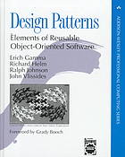
Design Patterns
Popularized in 1994 book of that name
  written by the “Gang of Four”
    Gamma, Helm, Johnson, Vlissides
  worked in C++ and SmallTalk
  (SmallTalk hugely influenced OOP in Java, etc.)
Found that they independently developed
many of the same solutions to recurring problems
  wrote a book about them
Many are problems with OO languages
  authors worked in C++ and SmallTalk
  some things are not easy to do in those languages

Slide 58
Type Narrowing with Records
Use a literal field to distinguish records types
  require the field to have one specific value
  called a “tag” field
    cleanest way to make unions of records
    type T1 = {kind: "T1", a: number};
    type T2 = {kind: "T2", a: string, b: bigint};
    const x: T1 | T2 = …;
    if (x.kind === "T1") { // legal for either type
    console.log(x.a); // must be T1… x.a is a number
    } else {
    console.log(x.a); // must be T2… x.a is a string
    console.log(x.b); // x.b is defined
    }

Slide 59
Inductive Data Type Design Pattern (1/2)
    type T := C(x : ℤ) | D(x : 𝕊* , t : T)
Implement in TypeScript as
    type T = {kind: "C", x: bigint}
    | {kind: "D", x: string, t: T};

Slide 60
Inductive Data Type Design Pattern (2/2)
    type T := A | B | C(x : ℤ) | D(x : 𝕊*, t : T)
Implement in TypeScript as
    type T = {kind: "A"}
    | {kind: "B"}
    | {kind: "C", x: bigint}
    | {kind: "D", x: string, t: T};

Slide 61
Inductive Lists in TypeScript
    type List := nil | cons(x : ℤ, L : List)
Implemented in TypeScript as
    type List = {kind: "nil"}
    | {kind: "cons", hd: bigint, tl: List};

Slide 62
Inductive Lists in TypeScript: empty?
    type List = {kind: "nil"}
    | {kind: "cons", hd: bigint, tl: List};
How do I check if my list is empty?
    if (mylist.kind === "nil") {
    …
    }
Importantly, not:
    if (mylist === null) {
    …
    }
(very different from Java!)

Slide 63
Defining Inductive Lists
    type List = {kind: "nil"}
    | {kind: "cons", hd: bigint, tl: List};
1
2
3
const list: List = {
kind: "cons",
hd: 1n,
tl: {
kind: "cons",
hd: 2n,
tl: {
kind: "cons",
hd: 3n,
tl: { kind: "nil" }
}
}
}
Correct but clunky.
Like math: can we define easier notation?

Slide 64
Inductive List Helpers (1/2)
Make this look more like math notation…
    type List = {kind: "nil"}
    | {kind: "cons", hd: bigint, tl: List};
    const nil: Readonly<List> = {kind: "nil"};
    const cons = (hd: bigint, tl: List): List => {
    return {kind: "cons", hd: hd, tl: tl};
    }
  use only these two functions to create Lists
    do not create the records directly
  note that we only have one instance of nil
    this is called a “singleton” (there is a design pattern for ensuring this)

Slide 65
Inductive List Helpers (2/2)
Make this look more like math notation…
    const nil: Readonly<List> = {kind: "nil"};
    const cons = (hd: bigint, tl: List): List => { .. };
Can now write code like this:
    const list: List = cons(1, cons(2, nil));

Slide 66
Inductive List Helpers: Equality Gotcha
Make this look more like math notation…
    const nil: Readonly<List> = {kind: "nil"};
    const cons = (hd: bigint, tl: List): List => { .. };
Still not perfect:
  JS “===” (references to same object) does not match “=”
    cons(1, cons(2, nil)) === cons(1, cons(2, nil)) // false!
  need to define an equal function for this
    will see this later…

Slide 67
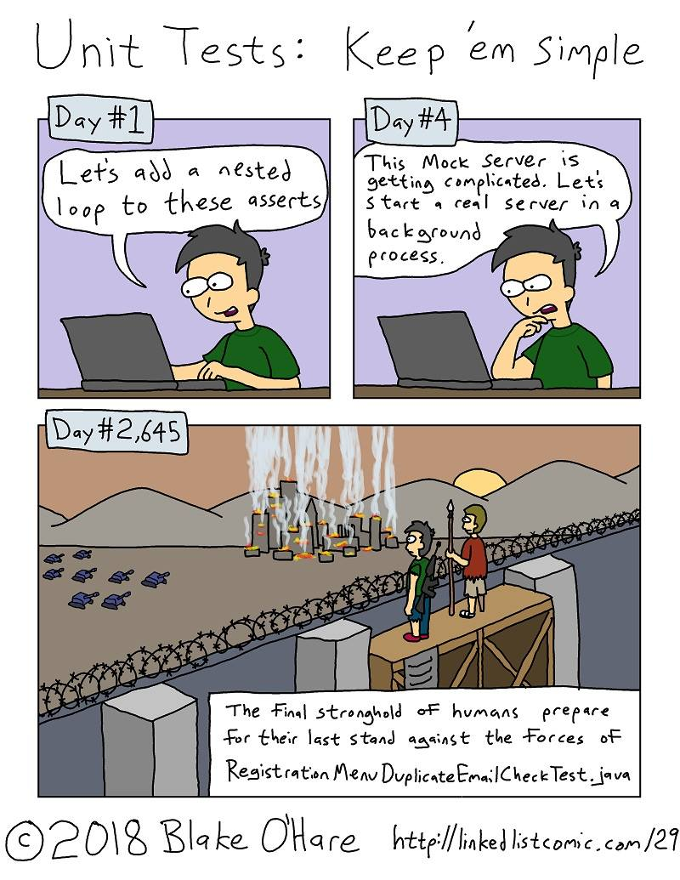
Inductive Data Types & Testing
CSE 331 Summer 2025
Jaela Field

Slide 68
Recall: Inductive Lists
Defined in math as
    type List := nil | cons(x : ℤ, L : List)
Implemented in TypeScript as
    type List = {kind: "nil"}
    | {kind: "cons", hd: bigint, tl: List};
  For convenience and to look more like our math, we define nil “singleton” and cons function
    const list: List = cons(1, cons(2, cons(3, nil)))

Slide 69
Functions Defined on Inductive Data Types
We need recursion to define interesting functions
Inductive types fit esp. well with pattern matching
  every object is created using some constructor
  match based on which constructor was used

Slide 70
Length of a List (in Math)
    type List := nil | cons(hd: ℤ, tl: List)
Mathematical definition of list length:
    len : List → ℕ
    len(nil) := 0
    len(x :: L) := 1 + len(L)
  any list is either nil or x :: L for some x and L
  thus, cases are exclusive and exhaustive
Notes:
Pattern matching is very natural for inductively defined data!

Slide 71
Length of a List (translated to TypeScript)
Mathematical definition of length
    len(nil) := 0
    len(x :: L) := 1 + len(L)
Translation to TypeScript
    const len = (S: List): bigint => {
    if (S.kind === "nil") {
    return 0n;
    } else {
    return 1n + len(S.tl);
    }
    };
TypeScript will see that this is valid
since S.kind != "nil"

Slide 72
Swapping Elements in a List (in Math)
    type List := nil | cons(hd: ℤ, tl: List)
Function that swaps adjacent elements in a list:
    swap : List → List
    swap(nil) := nil
    swap(x :: nil) := x :: nil
    swap(x :: y :: L) := y :: x :: swap(L)
  any list is either nil or x :: nil or x :: y :: L for some x, y, and L
  thus, cases are exclusive and exhaustive

Slide 73
Swapping Elements in a List (in TypeScript)
    swap(nil) := nil
    swap(x :: nil) := x :: nil
    swap(x :: y :: L) := y :: x :: swap(L)
Translation to TypeScript
    const swap = (S: List): List => {
    if (S.kind === "nil") {
    return nil;
    } else if (S.tl.kind === "nil") {
    return cons(S.hd, nil);
    } else {
    return cons(S.tl.hd, cons(S.hd, swap(S.tl.tl)));
    }
    };
= S
TypeScript will see that these are valid since
S.kind != "nil" and S.tl.kind != "nil"

Slide 74
Structural Recursion
Examples only recurse on parts of the input
    len(x :: L) := 1 + len(L)
  call on x :: L recurses on L
    swap(x :: y :: L) := y :: x :: swap(L)
  call on x :: y :: L recurses on L
  such cases are called "structural recursion"
Guarantees no infinite recursion!
  one argument gets strictly smaller on each call
  restrict ourselves to structural recursion in math and TS

Slide 75
Recall: Natural Numbers
    type ℕ := zero | succ(prev: ℕ)
Potential definition in TypeScript
    type Nat = {kind: "zero"}
    | {kind: "succ", prev: Nat};
    const zero: Nat = {kind: "zero"};
    const succ = (prev: Nat): Nat => {
    return {kind: "succ", prev: prev};
    };

Slide 76
Induction on Natural Numbers
Could use a type that only allows natural numbers:
const f = (m: Nat): bigint => {
if (m.kind === "zero") {
return 1n;
} else {
return 2n * f(m.prev);
}
};
Cleaner definition of the function (though inefficient)
m.prev represents “m – 1”

Slide 77
Formalizing Specifications

Slide 78
Formalizing a Specification
Sometimes the instructions are written in English
  English is often imprecise or ambiguous
First step then is to “formalize” the specification:
  translate it into math with a precise meaning
Best to start by looking at some examples
  try to spot a pattern
  recursive data usually involves recursive functions
    each base case usually corresponds to a pattern-match
    can have one or more base cases

Slide 79
Formalizing Sum of a List
Sum of a List: “add up all the values in the list”
Look at some examples…
    L sum(L)
    nil 0
    3 :: nil 3
    2 :: 3 :: nil 2+3
    1 :: 2 :: 3 :: nil 1+2+3
    … …
Notes:
Not an imperative spec

Slide 80
Formalizing Sum of a List: the Math
Look at some examples…
    L sum(L)
    nil 0
    3 :: nil 3
    2 :: 3 :: nil 2+3
    1 :: 2 :: 3 :: nil 1+2+3
    … …
Mathematical definition of sum:
    sum: List → ℕ
    sum(nil) :=
    sum(x :: L) :=

Slide 81
Formalizing Sum of a List: Trying Examples
    L sum(L)
    1 :: 2 :: 3 :: nil 1+2+3
Mathematical definition of sum: List → ℕ :
    sum(nil) := 0
    sum(x :: L) := x + sum(L)
Check that this works on the examples…
    sum(1 :: 2 :: 3 :: nil)
    = 1 + sum(2 :: 3 :: nil) def of sum (2nd line)
    = 1 + 2 + sum(3 :: nil) def of sum (2nd line)
    = 1 + 2 + 3 + sum(nil) def of sum (2nd line)
    = 1 + 2 + 3 def of sum (1st line)

Slide 82
Converting Sum of a List to TypeScript
Mathematical definition of sum
    sum(nil) := 0
    sum(x :: L) := x + sum(L)
Translation to TypeScript
    const sum = (S: List): bigint => {
    if (S.kind === "nil") {
    return 0n;
    } else {
    return S.hd + sum(S.tl);
    }
    };

Slide 83
Formalizing List Equality
Equal lists: “built with same steps”
Look at some examples…
    L R equal(L, R)
    nil nil
    nil 1 :: nil
    1 :: nil nil
    1 :: nil 1 :: nil
    2 :: nil 3 :: nil
    1 :: 2 :: nil 1 :: 3 :: nil

Slide 84
Formalizing List Equality: the Math
    L R equal(L, R)
    nil nil T
    nil 1 :: nil F
    1 :: nil nil F
    1 :: nil 1 :: nil T
    2 :: nil 3 :: nil F
    1 :: 2 :: nil 1 :: 3 :: nil F
Mathematical definition of equal : (List, List) → 𝔹
    equal(nil, nil) := T
    equal(nil, y :: R) := F
    equal(x :: L, nil) := F
    equal(x :: L, y :: R) := (x = y) and equal(L, R)
Notes:
There was interactivity on this slide (25sp)
“Partner Practice:
What patterns would
you match on?”

Slide 85
Formalizing List Equality: Trying Examples
    L R equal(L, R)
    1 :: 2 :: nil 1 :: 3 :: nil F
Mathematical definition of equal : (List, List) → 𝔹
    equal(nil, nil) := T
    equal(nil, y :: R) := F
    equal(x :: L, nil) := F
    equal(x :: L, y :: R) := (x = y) and equal(L, R)
Check that this works on the examples…
    equal(1 :: 2 :: nil, 1 :: 3 :: nil)
    = (1 = 2) and equal(2 :: nil, 3 :: nil) def of equal (4th line)
    = (1 = 2) and (2 = 3) and equal(nil, nil) def of equal (4th line)
    = T and F and T def of equal (1st line)

Slide 86
Converting List Equality to TypeScript
    type List = {kind: "nil"}
    | {kind: "cons", hd: bigint, tl: List};
    const equal = (L: List, R: List): boolean => {
    if (L.kind === "nil" && R.kind === "nil") {
    return true;
    } else if (L.kind === "nil"){
    return false;
    } else if (R.kind === "nil") {
    return false;
    } else {
    return L.hd === R.hd && equal(L.tl, R.tl);
    }
    };
note: can combine some cases!
but this is easier to read

Slide 87
Formalizing List Concatenation
Concatenate L and R: “a single list containing
the elements of L followed by the elements of R”
Look at some examples…
    L R concat(L, R)
    nil nil nil
    nil 3 :: 4 :: nil 3 :: 4 :: nil
    2 :: nil 3 :: 4 :: nil 2 :: 3 :: 4 :: nil
    1 :: 2 :: nil 3 :: 4 :: nil 1 :: 2 :: 3 :: 4 :: nil
    …

Slide 88
Formalizing List Concatenation: the Math
    L R concat(L, R)
    nil nil nil
    nil 3 :: 4 :: nil 3 :: 4 :: nil
    2 :: nil 3 :: 4 :: nil 2 :: 3 :: 4 :: nil
    1 :: 2 :: nil 3 :: 4 :: nil 1 :: 2 :: 3 :: 4 :: nil
Mathematical definition of concat : (List, List) → List
    concat(nil, R) :=
    concat(x :: L, R) :=
Notes:
There was interactivity on this slide in 25sp:
“Pause & Ponder
(with a partner)
What patterns
would you
match on?
“

Slide 89
Formalizing List Concatenation: Examples
    1 :: 2 :: nil 3 :: 4 :: nil 1 :: 2 :: 3 :: 4 :: nil
Mathematical definition of concat : (List, List) → List
    concat(nil, R) := R
    concat(x :: L, R) := x :: concat(L, R)
Check that this matches examples…
    concat(1 :: 2 :: nil, 3 :: 4 :: nil)
    = 1 :: concat(2 :: nil, 3 :: 4 :: nil) def of concat (2nd line)
    = 1 :: 2 :: concat(nil, 3 :: 4 :: nil) def of concat (2nd line)
    = 1 :: 2 :: 3 :: 4 :: nil def of concat (1st line)

Slide 90
Converting List Concatenation to TypeScript
Mathematical definition of concat : (List, List) → List
    concat(nil, R) := R
    concat(x :: L, R) := x :: concat(L, R)
Translation to TypeScript
    const concat = (S: List, R: List): List => {
    if (S.kind === "nil") {
    return R;
    } else {
    return cons(S.hd, concat(S.tl, R));
    }
    };

Slide 91
Generic List
“generic” list type takes a “type parameter”
    type List<A> = {kind: “nil”}
    | {kind: ”cons”, hd: A, tl: List<A>};
We can pick any type for A
  TypeScript replaces all the “A”s by the type we give
  e.g., List<bigint> is this type:
    type List<bigint> =
    | {kind: “nil”}
    | {kind: ”cons”, hd: bigint, tl: List<bigint>};

Slide 92
Generic Functions
We also need to update the cons helper function
    type List<A> = {kind: “nil”}
    | {kind: ”cons”, hd: A, tl: List<A>};
    const cons = <A,>(x: A, L: List<A>): List<A> => {
    return {kind: “cons”, hd: x, tl: L};
    };
This is now a “generic function”
  it has its own type parameter <A,>
  extra comma is weird but required
    compiler thinks <A> is an HTML tag

Slide 93
Formalizing a Specification
We “formalize” English instructions into precise specifications to define intended behavior
How do we tell if the specification is wrong?
  specifications can contain bugs!
    Is it obvious that equal & concat are correct? Maybe not.
We tested our definition on a few examples
  what can we do to increase the odds we spot bugs?

Slide 94
Testing

Slide 95
Unit, Integration, and End-to-End Tests (1/2)
A unit test checks one function
  ideally, without testing anything else (not always possible)
An integration test makes sure units work together
  many (most?) bugs in practice are here
An end-to-end test exercises almost all the code
How are we testing in HW3?
  we are doing end-to-end testing
  this makes debugging harder! (more to search)

Slide 96
Unit, Integration, and End-to-End Tests (2/2)
A unit test checks one function
An integration test makes sure units work together
An end-to-end test exercises almost all the code
You will be expected to write unit tests in industry
There will also be integration and end-to-end tests
  someone will write them, but maybe not you
  (requires understanding the whole system)
We will focus on unit testing

Slide 97
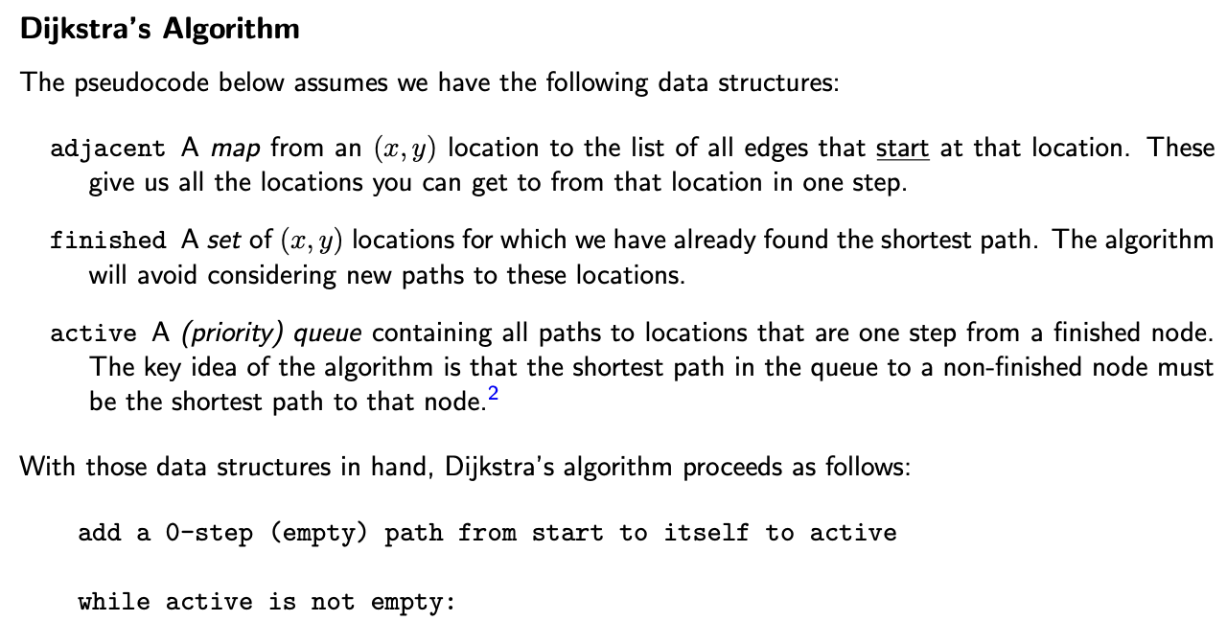
Unit Testing: Dijkstra’s
Even individual functions might be too big…
a lot of code here…
more in here…

Slide 98
Unit Testing via Small Functions
Even individual functions might be too big…
  split out pieces into their own functions
Our coding conventions help enforce this
  <input type=“text” onChange={(evt) => {
  … multi-line calculation …
  }}></input>
  make this its own function
    makes the code more understandable and testable
Purposefully design the code to be testable
  important part of programming in practice

Slide 99
“Manual” vs Programmatic Tests
Usually possible to run the code by hand (“manually”)
  open it in node and execute it
  open it in the browser and look at it (UI)
What if the code changes?
  then, you need to do the tests again
Programmatic tests are code that tests other code
  easy to run them again whenever the code changes
  these are generally preferred
What did we do in HW1 -- HW3?

Slide 100
“Manual” vs Programmatic Tests in UI
For UI, manual testing is still common
  written tests are hard to write and imperfect
    need to see it in the browser to be sure that it looks right
  we will test UI manually
  non-UI functions and all server code tested programmatically

Slide 101
“Engineers are paid to think and understand.”
— Class slogan #1

Slide 102
Writing a Programmatic Test
Choose an input / configuration
  description of the inputs / configuration is the “test case”
Think through what the expected answer is
  look at the specification for the correct answer
  if you run the code to get the answer, you are not testing
Write code that
  calls the function that input
  compares the actual answer to the expected one
  throws an error if they do not match
  useful libraries for doing this…

Slide 103
Writing a Programmatic Test: Example Code
// number.ts
/** Determines whether m is a prime number. */
export const isPrime = (m: bigint): boolean => {
…
};
/** Returns the mth Fibonacci number. */
export const fib = (m: bigint): bigint => {
…
};

Slide 104
Writing a Programmatic Test with Mocha
// number_test.ts
import * as assert from "assert";
import { isPrime, fib } from "./number";
describe("number", function() {
it("isPrime", function() {
assert.strictEqual(isPrime(2n), true);
assert.strictEqual(isPrime(3n), true);
assert.strictEqual(isPrime(4n), false);
});
it("fib", function() {
assert.strictEqual(fib(1n), 1n);
assert.strictEqual(fib(3n), 2n);
assert.strictEqual(fib(9n), 34n);
});
});
Don't worry too much
about the details here….

Slide 105
Mocha Asserts & Equality
// number_test.ts
import * as assert from "assert";
import { isPrime, fib } from "./number";
describe("number", function() {
it("isPrime", function() {
assert.strictEqual(isPrime(2n), true);
assert.strictEqual(isPrime(3n), true);
assert.strictEqual(isPrime(4n), false);
});
  use assert.strictEqual to compare primitive values
  use assert.deepStrictEqual to compare records & arrays

Slide 106
Running Programmatic Tests with Mocha
$ npm run test
number
1) isPrime
✓ fib
1 passing(5ms)
1 failing
1) number
isPrime:
AssertionError [ERR_ASSERTION]: Expected values to be strictly equal:
false !== true
+ expected - actual
-false
+true
at Context.<anonymous> (src/number_test.ts:9:12)
at processImmediate (node:internal/timers:511:21)

Slide 107
Running Programmatic Tests with Mocha
$ npm run test
number
✓ isPrime
✓ fib
2 passing (2ms)

Slide 108
Ground Rules for Testing (1/4)
Only need to test inputs allowed by the spec
  there is no correct answer for other inputs
  /** Determines whether a positive integer is prime. */
  export const isPrime = (n: bigint): boolean => {
  if (n <= 0n)
  throw new Error(`not a positive integer: ${n}`);
  …
  };

Slide 109
Ground Rules for Testing (2/4)
Only need to test inputs allowed by the spec
  there is no correct answer for other inputs
Choose tests for each function individually
  pick tests to do a good job of testing that one function
  /** Determines whether a positive integer is prime. */
  export const isPrime = (n: bigint): boolean => {
  if (n <= 0n)
  throw new Error(`not a positive integer: ${n}`);
  const m = intSqrt(n); // integer square root of n
  …
  };
intSqrt has its own tests!

Slide 110
Ground Rules for Testing (3/4)
Only need to test inputs allowed by the spec
  there is no correct answer for other inputs
Test each function individually
  assume anything it calls is correct (its own tests will check)
Test code should be simple
  any loops in tests need their own tests!

Slide 111
How Many Tests are Strictly Necessary?
Consider the following function:
    // Allows inputs 0 <= a, b, c <= 10,000 …
    const f = (a: bigint, b: bigint, c: bigint) => {
    …
    };
How many tests needed guarantee correctness?
  1 trillion!
  "just write a loop and …"
    the code in that loop could also be wrong
  cannot think through even 1000 tests
    most code we write cannot be exhaustively tested

Slide 112
Ground Rules for Testing (4/4)
Only need to test inputs allowed by the spec
  there is no correct answer for other inputs
Test each function individually
  assume anything it calls is correct (its own tests will check)
Test code should be simple
  any loops in tests need their own tests!
If there are fewer than 10 allowed inputs,
then do test them all!
  take advantage of the easy case

Slide 113
Choosing Test Cases
// Returns true iff n is a prime number
const isPrime = (n: bigint): boolean => { … }
How about if we test 2, 3, 4, 7, 12, 97, 99?
  seems okay?

Slide 114
Choosing Test Cases (Gone Wrong!)
// Returns true iff n is a prime number
const isPrime = (n: bigint): boolean => {
if (n < 100n) {
return PRIME_CACHE[n]; // precomputed answers
} else {
for (let k = 2n; k*k <= n; k++) {
if (n % k === 0n)
return false;
}
return true;
}
};
Cases 2 .. 100 are table lookups!
We didn't test the loop at all!
Impossible to know this without
looking at the actual code.

Slide 115
Clear-Box Testing
We need to look at the code to know what to test
  this is called "clear-box testing"
  it will be our primary heuristic
In this class, we want a clear rule for how many tests
  you want homework and tests to have clear right answers
Outside of class, these rules are also good
  most programmers will be familiar with these concepts
  but, not comprehensive (usually a “floor”)

Slide 116
Statement Coverage by Example (isPrime)
Simplest metric is "statement coverage"
  what percentage of the statements in the code are
  executed by at least one test
  this should be nearly 100%
  export const isPrime = (n: bigint): boolean => {
  if (n <= 0n)
  throw new Error(`not a positive integer: ${n}`);
  … // code for positive integer inputs
  };
The "throw" is not executed by any allowed input
  we only test the allowed inputs

Slide 117
Statement Coverage
Simplest metric is "statement coverage"
  what percentage of the statements in the code are
  executed by at least one test
Must test 100% of code reachable on allowed inputs
  cannot send code to users that you didn't even try!
  we will refer to this as having "full statement coverage"
Are we done?

Slide 118
Statement Coverage and Conditionals
Consider the following function:
    /** Returns the smaller of a and b. */
    const min = (a: bigint, b: bigint): bigint => {
    let m = a;
    if (a <= b)
    m = a;
    return m;
    };
  testing on a=1 b=2 gives full statement coverage
  what is the bug?
    gives the wrong answer whenever a > b
  we never tested the case where the "if" doesn't execute

Slide 119
Conditionals
Conditionals are "if" statements
if (n > 0) {
x = 2*(n – 1);
} else {
x = 0;
}
Every conditional has two branches (“then” and “else”)

Slide 120
Conditionals and Implicit Else
Conditionals are "if" statements
if (n > 0) { = if (n > 0) {
x = 2*(n – 1); = x = 2*(n – 1);
} = } else {
= }
Every conditional has two branches (“then” and “else”)
  missing "else" still has an empty else branch

Slide 121
Branch Coverage: Back to min
Consider the following function:
    /** Returns the smaller of a and b. */
    const min = (a: bigint, b: bigint): bigint => {
    let m = a;
    if (a <= b)
    m = a;
    return a;
    };
  problem only arises when "if" falls through to code after
  if every branch ends with return / throw,
  then statement coverage = branch coverage
    always true for code without mutation of local variables
Notes:
Should initialize let m = b

Slide 122
Branch Coverage
Next metric is "branch coverage"
  for what percentage of the conditionals, are both branches executed by some test
Must test all branches reachable on allowed inputs
  can ignore branches that are unreachable
    i.e., the ones that throw new Error on bad inputs
Are we done?

Slide 123
Is Branch Coverage Enough?
Consider the following function:
    /** Returns quadrant containing (x, y). */
    const quad = (x: number, y: number): 1|2|3|4 => {
    let answer;
    if (x >= 0) {
    answer = 1;
    } else {
    answer = 2;
    }
    if (y < 0)
    answer = 4;
    return answer;
    };
  testing on (2, -2) and (-2, 2) gives full branch coverage
  this code is really wrong… it never returns 3!
1
4

Slide 124
Path Coverage?
More advanced metrics could fix this
  "path coverage" would require 4 tests
  #paths can grow exponentially in #branches
For straight-line code and conditionals,
we will only require branch coverage
What about loops / recursion?

Slide 125
Test Coverage and Loops
Consider the following function:
    const bsearch = (x: bigint, arr: Array<bigint>): number => {
    let lo = 0;
    let hi = arr.length;
    while (lo < hi) { // x could be in arr[lo .. hi-1]
    const m = Math.floor((lo + hi) / 2);
    if (x < arr[m]) {
    hi = m;
    } else if (x > arr[m]) {
    lo = m + 2;
    } else {
    return m;
    }
    }
    return hi;
    };
Testing on x=1, 2, 3 arr=[2]
gives full statement coverage
But the code is wrong.
In general, values written inside the loop
are not read until the next time around,
so you need 2+ iterations to test them.

Slide 126
Loop Coverage (and Recursion Coverage)
Our last metric is "loop coverage" (non-standard terminology)
  what percent of loops are executed 0, 1, and many (2+) times by some test case
Same idea applies to recursion
  some arguments passed to recursive calls may not be read until the second recursive call
  full loop coverage means every recursive call is executed 0, 1, and many times by some test
Are we done?
  no!

Slide 127


What Can We Learn From Testing?
“Program testing can be used to show the presence of bugs, but never to show their absence!”
Edsger Dijkstra
Notes on Structured Programming, 1970
“Beware of bugs in the above code;
I have only proved it correct, not tried it.”
Donald Knuth, 1977

Slide 128
Summary of testing requirements
At least two tests for any function (non-UI)
Must have full coverage of reachable
  statements: must be executed
  branches: must execute both branches
  loops / recursion: must run 0, 1, & many times

Slide 129
Agenda
Administrivia
Finish Testing (finish topic 4)
  Practice exercises
Reasoning (start topic 5)

Slide 130
How Many Tests: Example 0
// x must be a non-negative integer
const f = (x: bigint): number => {
if (x === 0n) {
return 0;
} else {
return Math.sin(Math.PI * (Number(x) + 0.5));
}
}
How many tests? Which ones?
  0 (top branch) and 1 (bottom branch)
    statement coverage = branch coverage since no "fall through"

Slide 131

How Many Tests: Example 1
// x must be a non-negative integer
const f = (x: bigint): bigint => {
if (x < 3n) {
return 0n;
} else if (x < 10n) {
return (x – 3n) / 10n;
} else {
return 1n;
}
}
How many tests? Which ones?
  2 (top), 6 (middle), and 10 (bottom)
Think-pair-share!
sli.do #cse331
Notes:
Multiple choice slid.do

Slide 132
How Many Tests: Example 2
// a and b must be a non-negative
const f = (a: number, b: number): number => {
if (a > b)
a = b;
return Math.abs(a);
}
How many tests? Which ones?
  a=2, b=1 gives full statement coverage
  adding a=1, b=2 gives branch coverage
Think-pair-share!
sli.do #cse331
Notes:
Open text sli.do

Slide 133
How Many Tests: Example 3
// x must be a non-negative integer
const f = (x: bigint): number => {
if (x <= 1n) {
return 0;
} else {
return 1 + f(x / 2n);
}
}
How many tests? Which ones?
  1 (0 recursive calls)
  2 (1 recursive call)
  5 (2 recursive calls)
Think-pair-share!
sli.do #cse331
Notes:
Either Open text or multiple select options: [-1,10]

Slide 134
How Many Tests: Example 4
// x must be an integer between 1 and 10
const f = (x: bigint): bigint => {
if (x === 1n) {
return 0n;
} else if (x % 2 === 1n) {
return -1n * f(x - 1n);
} else {
return 4n + f(x – 2n);
}
}
How many tests? Which ones?
  only 10 inputs, so… all of them
Think-pair-share!
sli.do #cse331
Notes:
Either Open text or multiple select options: [-1,10]

Slide 135
Other Heuristics
Not mandatory for 331 but useful in practice:
Make sure every argument value is changed
Look at special values
  null, undefined, NaN, empty array, etc. often have bugs
Look at the specification for branches
  maybe the code doesn’t split inputs where it should!
  e.g., spec splits into “if x ≥ 0” but code is “if (x > 0)”

Slide 136
How to Fix a Bug
Start with an example that fails
  make sure you see it fail!
  can mistakenly write a test that worked already
Understand why it fails
  understand where your reasoning was wrong
Fix the bug
Make sure the all the tests now pass
  new test and all previous tests

Slide 137
Notes Posted on the Website
Shorter version of everything we've discussed
List notes additionally include
Defines a few more useful list functions
Describes important properties of concat:
  operator notation "⧺"
  associativity and identity
Mentions important applications of lists
  maps are lists of (key, value) pairs, sets can be defined as lists
  Lists are our most important data type!

Slide 138

Administrivia
Office hours
  Polled y’all, no long-term changes for now
  Jaela’s Friday OH cancelled (this week only)
Tomorrow: section + HW3 due (on-time)!

