Slide 1
Client-Server Interaction I
CSE 331 Summer 2025
Jaela Field

Slide 2

HW1 Feedback request!
Any thoughts 💭
  how long did it take you?
  opinions on submitting answers on Gradescope
  was it good JS & server code practice?
  any unclear directions?
  any gripes?
Anonymous Feedback
i ❤️ index cards

Slide 3
Reminders
HW 2
  Must identify defect causing specific failure
    include only that line of code, or label clearly
    (ed post)
  No Ed after 11pm Thursday!

Slide 4
Client-Server Interaction

Slide 5
Steps to Writing a Full Stack App
Data stored only in the client is generally ephemeral
  closing the window means you lose it forever
  to store it permanently, we need a server
We recommend writing in the following order:
  Write the client UI with local data
    no client/server interaction at the start
  Write the server
    official store of the data (client state is ephemeral)
  Connect the client to the server
    use fetch to update data on the server before doing same to client

Slide 6
Steps to Writing a Full Stack App: Server
We recommend writing in the following order:
  Write the client UI with local data
    no client/server interaction at the start
  Write the server
    official store of the data (client state is ephemeral)
  Connect the client to the server
    use fetch to update data on the server before doing same to client

Slide 7
Designing the Server
Decide what state you want to be permanent
  e.g., items on the To-Do list
Decide what operations the client needs
  e.g., add/remove from the list, mark an item completed
    look at the client code to see how the list changes
    each way of changing the list becomes an operation
  also need a way to get the list initially
  only provide those operations
    can always add more operations later

Slide 8
Example: To-Do List Server

Slide 9
Server Documentation
Client cannot use the server unless it knows how!
  What are the required inputs?
  What are the expected outputs? (including error responses)
We’ll talk more about JSDocs later on!
/**
* Add the item to the list.
* - 200 response containing {name: string, added: boolean},
* where 'added’ indicates if item was added or not (because
* it already exists in list)
* - 400 if required name was not provided
* @param req the request. Must contain string name of item to
* add in body.
* @param res the response.
*/
export const addItem = (req: SafeRequest, res: SafeResponse)

Slide 10
Steps to Writing a Full Stack App: Connect
We recommend writing in the following order:
  Write the client UI with local data
    no client/server interaction at the start
  Write the server
    official store of the data (client state is ephemeral)
  Connect the client to the server
    use fetch to update data on the server before doing same to client

Slide 11
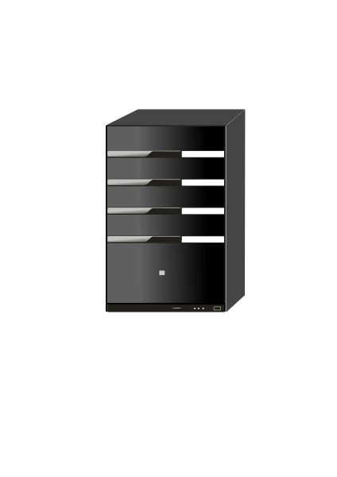


Recall: Client-Server Interaction
Clients need to talk to server & update UI in response
GET /api/list
current to-do list
our server
Client will make requests to the server to
get the list
add, remove, and complete items

Slide 12
Development Setup
Two servers: ours and webpack-dev-server
8080
GET /api/list
response
webpack-dev-server
8088
Only one server can run on each port
webpack-dev-server will forward all requests to /api/… to our server
(Attempting to start a second will see a EADDRINUSE error)
our server

Slide 13
Client-Server Interaction: Making Requests?
Clients need to talk to server & update UI in response
GET /api/list
current to-do list
our server
Components give us the ability to update the UI when we get new data from the server (an event)
How does the client make requests to the server?

Slide 14
Fetch Requests Are Complicated
Four different methods involved in each fetch:
  method that makes the fetch
  handler for fetch Response
  handler for fetched JSON
  handler for errors
200
response data
fetch
connect
status code
doListJson
doListResp
400
error message
doListError

Slide 15
Making HTTP Requests: Using Fetch
Send & receive data from the server with “fetch”
    fetch("/api/list")
    .then(this.doListResp)
    .catch(() => this.doListError("failed to connect"))
Fetch returns a “promise” object
  has .then & .catch methods
  both methods return the object again
  above is equivalent to:
    const p = fetch("/api/list");
    p.then(this.doListResp);
    p.catch(() => this.doListError("failed to connect"));

Slide 16
Making HTTP Requests: After Fetch
Send & receive data from the server with “fetch”
    fetch("/api/list")
    .then(this.doListResp)
    .catch(() => this.doListError("failed to connect"))
  then handler is called if the request can be made
  catch handler is called if it cannot be
    only if it could not connect to the server at all
    status 400 still calls then handler
  catch is also called if then handler throws an exception

Slide 17
Making HTTP Requests: Query Parameters
Send & receive data from the server with “fetch”
    const url = "/api/list? " +
    "category=" + encodeURIComponent(category);
    fetch(url)
    .then(this.doListResp)
    .catch(() => this.doListError("failed to connect"))
All query parameter values are strings
Some characters are not allowed in URLs
  the encodeURIComponent function converts to legal chars
  server will automatically decode these (in req.query)
    in example above, req.query.name will be “laundry”

Slide 18
Making HTTP Requests: Status Codes
Still need to check for a 200 status code
    doListResp = (res: Response): void => {
    if (res.status === 200) {
    console.log("it worked!");
    } else {
    this.doListError(`bad status ${res.status}`);
    }
    };
    doListError = (msg: string) => {
    console.log(`fetch of /list failed: ${msg} `);
    };
  (often need to tell users about errors with some UI…)

Slide 19
Handling HTTP Responses
Response has methods to ask for response data
  our doListResp called once browser has status code
  may be a while before it has all response data (could be GBs)
With our conventions, status code indicates data type:
  with 200 status code, use res.json() to get record
    we always send records for normal responses
  with 400 status code, use res.text() to get error message
    we always send strings for error responses
These methods return a promise of response data
  use .then(..) to add a handler that is called with the data
  handler .catch(..) called if it fails to parse

Slide 20
Making HTTP Requests: Error Handling
    doListResp = (res: Response): void => {
    if (res.status === 200) {
    res.json().then(this.doListJson);
    .catch(() => this.doListError("not JSON");
    } …
    …
    };
Second promise can also fail
  e.g., fails to parse as valid JSON, fails to download
Important to catch every error and make it visible
  painful debugging if an error occurs and you don’t see it!

Slide 21
Making HTTP Requests: More Error Handling
    doListResp = (res: Response): void => {
    if (res.status === 200) {
    res.json().then(this.doListJson);
    .catch(() => this.doListError("not JSON"));
    } else if (res.status === 400) {
    res.text().then(this.doListError);
    .catch(() => this.doListError("not text"));
    } else {
    this.doListError(`bad status: ${res.status}`);
    }
    };
We know 400 response comes with an error message
  could also be large, so res.text() also returns a promise

Slide 22
Recall: Function Literals
Function literals for error handlers
    componentDidMount = (): void => {
    const p = fetch("/api/list");
    p.then(this.doListResp);
    p.catch(() => this.doListError("connect failed"));
    };
Our coding convention:
  one-line functions (no {..}) can be written in place
    most often used to fill in or add extra arguments in function calls
  longer functions need to be declared normally

Slide 23
Recall: Fetch Requests Are Complicated
Four different methods involved in each fetch:
  method that makes the fetch
  handler for fetch Response
  handler for fetched JSON
  handler for errors
200
response data
fetch
connect
status code
doListJson
doListResp
400
error message
doListError

Slide 24
Fetch Requests Are Complicated (2/2)
Four different methods involved in each fetch:
  method that makes the fetch
  handler for fetch Response e.g., doListResp
  handler for fetched JSON e.g., doListJson
  handler for errors e.g., doListError
Three different events involved:
  getting status code, parsing JSON, parsing text
  any of those can fail!
    important to make all error cases visible

Slide 25
Recall: HTTP GET vs POST
When you type in a URL, browser makes “GET” request
  request to read something from the server
Clients often want to write to the server also
  this is typically done with a “POST” request
    ensure writes don’t happen just by normal browsing
POST requests also send data to the server in body
  GET only sends data via query parameters
  limited to a few kilobytes of data
  POST requests can send arbitrary amounts of data

Slide 26
Making HTTP POST Requests
Extra parameter to fetch for additional options:
    fetch(”/add”, {method: "POST"})
Arguments then passed in body as JSON
    const args = {name: "laundry"};
    fetch("/add", {method: "POST",
    body: JSON.stringify(args),
    headers: {"Content-Type”: "application/json"}})
    .then(this.doAddResp)
    .catch(() => this.doAddError("failed to connect"))
  add as many fields as you want in args
  Content-Type tells the server we sent data in JSON format

Slide 27
Lifecycle Methods
React also includes events about its “life cycle”
  componentDidMount: UI is now on the screen
  componentDidUpdate: UI was just changed to match render
  componentWillUnmount: UI is about to go away
Often use “mount” to get initial data from the server
  constructor shouldn’t do that sort of thing
    componentDidMount = (): void => {
    fetch("/api/list")
    .then(this.doListResp)
    .catch(() => this.doListError("connect failed");
    };

Slide 28
Lifecycle Events Gotcha: Unmounting
Warning: React doesn’t unmount when props change
  instead, it calls componentDidUpdate and re-renders
  you can detect a props change there
    componentDidUpdate =
    (prevProps: HiProps, prevState: HiState): void => {
    if (this.props.name !== prevProps.name) {
    … // our props were changed!
    }
    };
This is used in HW2:
changes to markers cause an
update to name and color state

Slide 29
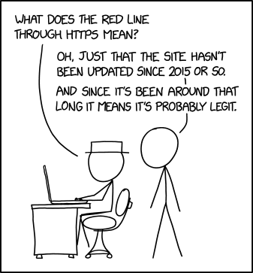
Client-Server
Interaction II
CSE 331
Summer 2025
Jaela Field
xkcd #1537 (and Matt, ty)

Slide 30

Feedback from last time
Lectures: too fast!
  Please ask me to chill out
HW1
  Wide range of amount of time to complete
    come visit us in OH! Ask questions on Ed!
  Unclear expectations for Gradescope questions and Scope of debugging
    Will add examples again for HW3! + see HW1 feedback
Jaela switching between screens in lecture (not good)

Slide 31
Recall: Fetch Requests Are Complicated
Four different methods involved in each fetch:
  method that makes the fetch
  handler for fetch Response
  handler for fetched JSON
  handler for errors
200
response data
fetch
connect
status code
doListJson
componentDidMount
doListResp
400
error message
doListError

Slide 32
Recall: Another JavaScript Feature: for … of
for (const item of val)
“for .. of” iterates through array elements in order
  ... or the entries of a Map or the values of a Set
    entries of a Map are (key, value) pairs
  can use .entries() function on array, to iterate over [index, value] tuples for each entry
  like Java's "for (… : …)"
  fine to use these

Slide 33
To-Do List: wrap up requests

Slide 34
One More Change
Don’t have the items initially…
type TodoState = {
items: Item[] | undefined; // items or undefined if loading
newName: string; // mirrors text in name-to-add field
};
renderItems = (): JSX.Element => {
if (this.state.items === undefined) {
return <p>Loading To-Do list...</p>;
} else {
const items = [];
// … old code to fill in array with one DIV per item …
return <div>{items}</div>;
}
};

Slide 35
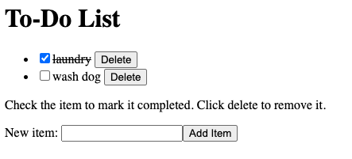
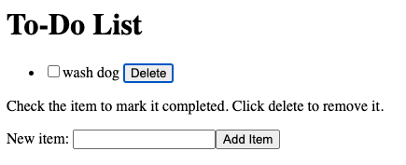
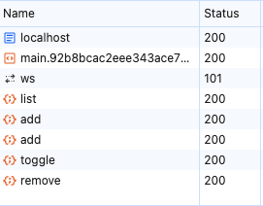
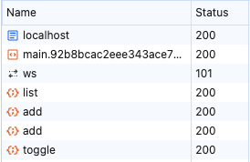
New TodoApp — Requests

Slide 36
Dynamic Type Checking

Slide 37
New TodoApp – Add Json and Types
    doAddJson = (data: unknown): void => {
    … // how do we use data?
    };
  type of returned data is unknown
  to be safe, we should write code to check that it looks right
    check that the expected fields are present
    check that the field values have the right types
    Type Narrowing
  only turn off type checking if you love painful debugging!
    otherwise, check types at runtime

Slide 38
Checking Types of Requests & Response (1/2)
All our 200 responses are records, so start here
    if (!isRecord(data))
    throw new Error(`not a record: ${typeof data}`);
  the isRecord function is provided for you
  like built-in Array.isArray function
    still need to check the type of each array element!
Would be reasonable to log an error instead
  using console.error is probably easier for debugging

Slide 39
Checking Types of Requests & Response (2/2)
Fields of the record can have any types
    if (typeof data.name !== "string") {
    throw new Error(
    `name is not a string: ${typeof data.name}`);
    }
    if (typeof data.amount !== "number") {
    throw new Error(
    `amount is not a number: ${typeof data.amount}`);
    }

Slide 40
TodoApp: processing /api/list JSON
// Called with the JSON response from /api/list
doListJson = (data: unknown): void => {
const items = parseListResponse(data);
this.setState({items: items});
};
  often useful to move this type checking to helper functions
    we will may provide these for you in future assignments
  not part of the UI logic, so doesn’t belong it that file

Slide 41
TodoApp: parseListResponse
// Retrieve the items sent back by /api/list
const parseListResponse = (data: unknown): Item[] => {
if (!isRecord(data))
throw new Error(`not a record: ${typeof data}`);
return parseItems(data.items);
};
  can only write "data.items" after we know it's a record
    type checker will object otherwise
    retrieving a field on undefined or null would crash

Slide 42
TodoApp: parseItems – Type Checking the Array
const parseItems = (data: unknown): Item[] => {
if (!Array.isArray(data))
throw new Error(`not an array: ${typeof data}`);
const items: Item[] = [];
for (const item of data) {
items.push(parseItem(item));
}
return items;
};

Slide 43
TodoApp: parseItems – Type Checking Items
const parseItem = (data: unknown): Item[] => {
if (!isRecord(data))
throw new Error(`not an record: ${typeof data}`);
if (typeof data.name !== "string")
throw new Error(`name is not a string: ${typeof data.name}`);
if (typeof data.completed !== "boolean")
throw new Error(`not a boolean: ${typeof data.completed}`);
return {name: data.name, completed: data.completed};
};

Slide 44
Use Type Checking to Avoid Debugging (1/2)
Resist the temptation to skip checking types in JSON
  “easy is the path that leads to debugging”
Query parameters also require checking:
    const url = "/list? " +
    "category=" + encodeURIComponent(category);
  converting from a string back to JS data is also parsing
  can be a bug in encoding or parsing

Slide 45
Use Type Checking to Avoid Debugging (2/2)
Be careful of turning off type checking:
    resp.json().then(this.doAddJson)
    …
    doAddJson = (data: TodoItem): void => {
    this.setState(
    {items: this.state.items.concat([data])});
    };
  promises use “any” instead of “unknown”, so
  TypeScript let you do this
imagine this debugging
when you make a mistake

Slide 46
Debugging Client-Server

Slide 47
Writing the Server
Full-stack apps introduce new ways of failing
  can fail in the client due to a bug in the server
  can fail in the server due to a bug in the client
Debugging a full-stack app is much harder
  requires understanding client, server, & interactions
  will take more time…

Slide 48
“Engineers are paid to think and understand.”
— Class slogan #1

Slide 49
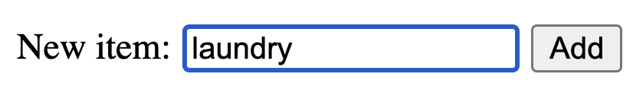
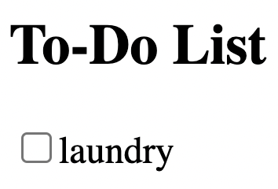
Client-Server Communication Complexity
client
server
doAddClick
fetch /api/add
express
find route
doAddJson
check response
update state
addItem
check parameters
send {
name: "laundry”,
added: true
}

Slide 50
Client-Server Debugging
Client-server communication can fail in many ways
  almost always requires debugging
Include all required .catch handlers
  at least log an error message
Here are steps you can use when
  the client should have made a request
  but you don’t see the expected result afterward
  (will practice this in section tomorrow!)

Slide 51
Client-Server Debugging Tips (1/2)
Do you see the request in the Network tab?
  the client didn’t make the request
Does the request show a 404 status code?
  the URL is wrong (doesn’t match any app.get / app.post) or
  the query parameters were not encoded properly
Does the request show a 400 status code?
  your server rejected the request as invalid
  look at the body of the response for the error message or
  add console.log’s in the server to see what happened
  the request itself is shown in the Network tab

Slide 52
Client-Server Debugging Tips (2/2)
Does the request show a 500 status code?
  the server crashed!
  look in the terminal where you started the server for a stack trace
Does the request say “pending” forever?
  your server forgot to call res.send to deliver a response
Look for an error message in browser Console
  if 1-5 don’t apply, then the client got back a response
  client should print an error message if it doesn’t like the response
  client crashing will show a stack trace

Slide 53
Recall: Fetch Requests Are Complicated
200
response promise resolves
res.json()
parse response text
setState()
console.error()
parse unknown data
fetch(url)
express finds route
res.send()
400
validate body/query
4
7
9
11
1
2
3
6
8
10
12
5

Slide 54
Recall: Fetch Requests Are Complicated
200
response Promise resolves
res.json()
parse text
setState()
console.error()
parse unknown data
fetch(url)
express finds route
res.send()
400
validate body/query
4
c
a
11
7
9
g
e
1
2
3
6
h
i
l
b
10
12
8
d
f
5
k
j

