Slide 1
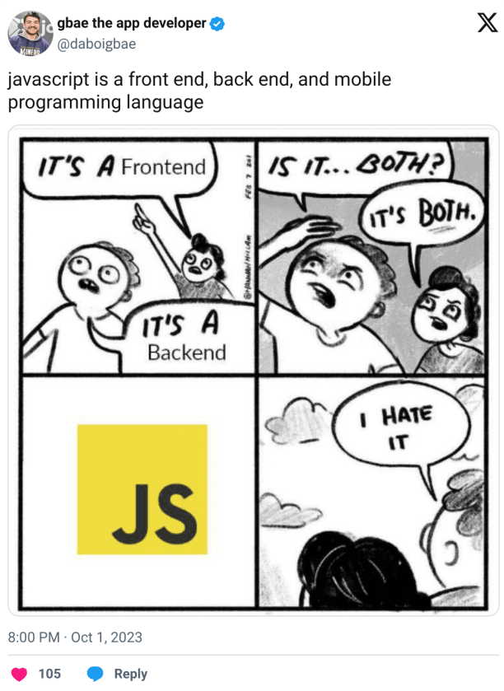
Intro to the Browser
CSE 331
Summer 2025
Jaela Field

Slide 2
June 27 Administrivia
HW1 out!
HW is mostly about debugging, not just coding
This assignment got a refresh this quarter! We welcome feedback.
advice:
Don’t forget about Gradescope!
read spec carefully
It’s expected that you’ll have questions about JS, node, NPM, and express. Ask them!
start early! & take advantage of office hours!

Slide 3
The 123 Programming Model
Run code from front-to-back, once.*
.java
file
(optionally)
user input
output
(usually System.out)
(optionally)
loop until a condition is met

Slide 4
The 331 Server Programming Model
Server Code runs forever!
GET: /hi
for each
incoming request…
.js
file
server calls the route function,
and sends a response
response: {
msg: "see saylaufey.com”
}
infinite loop!

Slide 5
The 331 Programming Model, Zooming Out
Client-Server programming has two programs
request
response
(e.g., HTML)
client
server
HW2
HW1
HW3

Slide 6
The Browser, HTML, and CSS

Slide 7
Recall: Browser Operation
Browser reads the URL to find what HTML to load
server name
path
Contacts the given server and asks for the given path
request
response
(e.g., HTML)
client
server

Slide 8
Browsers: JavaScript and HTML
request
response
(e.g., HTML)
client
server
Browser natively knows how to display HTML
Page can also include JavaScript to execute
but it is not required
if present, the JavaScript can change the HTML displayed

Slide 9
HTML
HTML = Hyper Text Markup Language
text format for describing a document / UI
HTML describes the structure of the content, and (partially) what you want drawn in the browser
HTML text consists primarily of “tags” and text

Slide 10
HTML Tags
Element
<p> Some Text </p>
Tag Name
Content
Closing Tag
Element
<p id="firstParagraph"> Some Text </p>
Tag Name
Attribute Value
Content
Attribute Name
Closing Tag

Slide 11
HTML as a Tree
Elements can have children (text or elements)
text is always a leaf in the tree
<div>
<p id="firstParagraph"> Some Text </p>
<br>
<div>
<p>Hello</p>
</div>
</div>
div
p
br
div
p

Slide 12
Parsing HTML
HTML is a text format that describes a tree
nodes are elements or text
<div>
<p>Some text</p>
<p>More text</p>
</div>
div
parse
p
p
HTML text
HTML tree
HTML text is parsed into a tree (“DOM”)
JS can access the tree in the variable “document”
our code lives in the world on the right side

Slide 13
Displaying HTML
Browser window displays an HTML document
tree is turned into drawing in the page
div
Some text
More text
draw
p
p
HTML display
HTML tree
browser displays the HTML in the window
browsers parse and draw very quickly
JS has limited access to display information
HTML tree

Slide 14
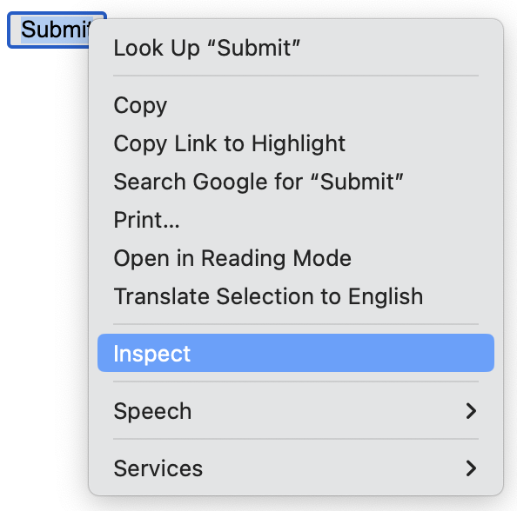
Developer Tools show the HTML
Click on any HTML element and choose "Inspect"
can see exact size in pixels, colors, etc.

Slide 15
Styling
The “style” attribute controls appearance details
margins, padding, width, fonts, etc.
see an HTML reference for details (when necessary)
Attribute value can include many properties
each is “name: value”
separate multiple using “;”
<p>Hi,
<span style="color: red; margin-left: 15px">Bob</span>!
</p>
we will generally not worry much about looks in this class…

Slide 16
Cascading Style Sheets (CSS)
Commonly used styles can be named
association of names to styles goes in a .css file
// foo.css
span.fancy { color: red; margin-left: 15px }
// foo.html
… <p>Hi, <span class="fancy">Bob</span></p> …
Useful to avoid repetition of styling
makes it easier to change

Slide 17
Old School Web UI

Slide 18
Including JavaScript in HTML
Server usually sends back HTML to the browser
Include code to execute inside of script tag:
<script>
console.log("Hi, browser");
</script>
Can also put the script into another file:
<script src="mycode.js"></script>

Slide 19
Events in the Browser
Client applications are event-driven
register "handlers" for various events
Can do so like this in HTML (but don't!)
<button onClick="handleClick(event)">Click Me</button>
<script>
const handleClick = (evt) => {
console.log("ouch");
};
</script>

Slide 20
Changing the HTML
Change the HTML displayed like this (but don't!)
<p>Add 2 to <input type="text" id="num"></input></p>
<p><button onClick="doAdd(event)">Submit</button></p>
<div id="answer"></div>
<script>
const doAdd = (evt) => {
const numElem = document.getElementById("num");
const num = Number(numElem.value);
const ansElem = document.getElementById("answer");
ansElem.innerHTML = `The answer is ${num+2}`;
};
</script>

Slide 21
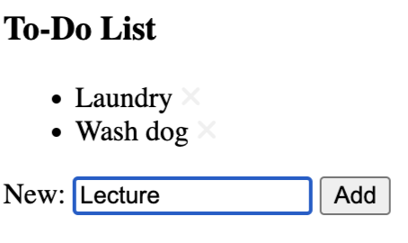
Updating the DOM: Adding Nodes
<h3>To-Do List</h3>
<ul id="items">
<li>Laundry</li>
<li>Wash Dog</li>
</ul>
ul
li
li
li
Laundry
Wash Dog
Lecture

Slide 22
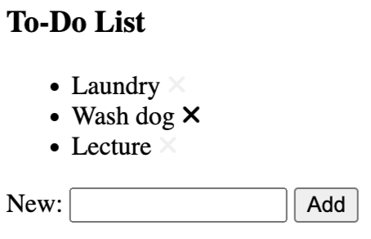
Updating the DOM: Removing Nodes
<h3>To-Do List</h3>
<ul id="items">
<li>Laundry</li>
<li>Wash Dog</li>
<li>Lecture</li>
</ul>
ul
li
li
li
Laundry
Wash Dog
Lecture

Slide 23
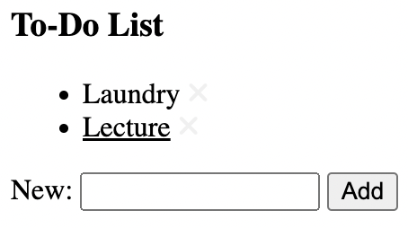
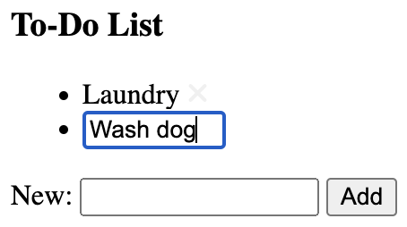
Updating the DOM: Editing Nodes
ul
li
li
Laundry
Lecture
input

Slide 24
Problems with Old School UI
Write code for every way the UI could change
many, many cases
particularly tricky when working in teams/groups
Not specific to HTML
same issue exists in Windows, on the iPhone, Xbox, etc.
if you write code to put things on screen, then you write code to change where they are on screen

Slide 25
New School UI
New approach: what should it look like now?
write function that maps current state to desired HTML
compare desired HTML to what is on the screen now
make any changes needed to turn former into latter
Huge improvement in productivity
introduced in Meta's "React" library
library performs the "compare" and "change" parts
Faster to write HTML UI than anything else
many similar libraries exist for the web
same approach also used in mobile apps, games, …

Slide 26
React
we will use React in this class
goal is not to make you React experts
teach you just enough React to understand “New School UI” ideas
these ideas will apply everywhere
similar to JS & Express, only using small subset of the library
practical note: React is a library installed with npm

Slide 27
React Components

Slide 28
HTML Literals in JSX
JSX: extension of JS that allows HTML expressions
file extension must be .jsx
const x = <p>Hi there!</p>;

Slide 29
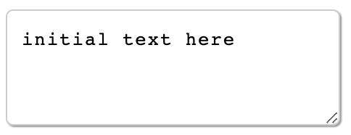
Substitution in JSX
Supports substitution like `..` string literals,
but uses {..} not ${..}
const name = "Fred";
return <p>Hi {name}</p>;
Can also substitute the value of an attribute:
const rows = 3;
return <textarea rows={rows} cols="25">
initial text here
</textarea>;

Slide 30
JSX Gotchas
Must have a single root tag (i.e., must be a tree)
e.g., cannot do this
return <p>one</p><p>two</p>;
instead, wrap in a <div> or just <>..</> (“fragment”)
Replacements for attributes matching keywords
use “className=” instead of “class=”
use “htmlFor=” instead of “for=”

Slide 31
CSS in JSX
CSS styling can be used in JSX
// foo.css
span.fancy { color: red; margin-left: 15px }
// foo.jsx
import './foo.css'; // another weird import
…
return <p>Hi, <span className="fancy">Bob</span>!</p>;
Nice to get this out of the source code

Slide 32
Anatomy of a React Component
split up large web pages into individual components
React components are classes
class “extends” React’s Component class
has a constructor that takes in one argument (more on this in a moment)
has a field called state (that holds the app’s … data/state)
components should have a render method
goal: convert app’s state to JSX (which it returns)
method should have be “pure” and have no “side effects”; in other words, it should not change state
we never call the render method – React does for us

Slide 33
Simplest React Component
Component that prints a Hello message:
class HiElem extends Component {
constructor(props) {
super(props);
this.state = {lang: "en"};
}
render = () => {
if (this.state.lang === "es") {
return <p>Hola, Ali!</p>;
} else {
return <p>Hi, Ali!</p>;
}
};
}
How do we change "lang"?

Slide 34
Simplest React Component (rendered)
Hello Ali!
Hola Ali!

Slide 35
Changing State in our Component
render = () => {
if (this.state.lang === "es") {
return <p>Hola, Ali!
<button onClick={this.doEngClick}>Eng</button>
</p>;
} else {
return <p>Hi, Ali!
<button onClick={this.doEspClick}>Esp</button>
</p>;
}
};
doEspClick = (evt) => {
this.setState({lang: "es"};
};

Slide 36
React and Component State Changes
<button onClick={this.doEspClick}>Esp</button>
doEspClick = (evt) => {
this.setState({lang: "es"};
};
Must call setState to change the state
directly modifying this.state is a (painful) bug
React will automatically re-render when state changes
but this does not happen instantly

Slide 37
React Responds to setState calls
HTML on screen = render(this.state)
Component
React
t = 10
this.state = s₁
doc = HTML₁ = render(s₁)
t = 20
this.setState(s₂)
t = 30
this.state = s₂
doc HTML₂ = render(s₂)
React updates this.state to s₂ and doc to HTML₂ simultaneously

Slide 38
React Component with an Event Handler
Pass method to be called as argument (a “callback”):
<button onClick={this.doEspClick}>Esp</button>
Be careful not to do this:
<button onClick={this.doEspClick()}>Esp</button>
Including parentheses here is a bug!
that would call the method inside render
passing its return value as the value of the onClick attribute
we want to pass the method to the button, and have it called when the click occurs

Slide 39
Putting the UI in the Page
Initial page has a placeholder in the HTML:
<div id="main"></div> (empty DIV in index.html)
Put HTML into it from code like this:
const elem = document.getElementById("main");
const root = createRoot(elem);
root.render(<HiElem />);
createRoot is a function provided by the React library
tells React that it should keep the HTML in the page matching what render returns

Slide 40
Putting the UI in the Page: Props
Initial page has a placeholder in the HTML:
<div id="main"></div> (empty DIV in index.html)
Put HTML into it from code like this:
const elem = document.getElementById("main");
const root = createRoot(elem);
root.render(<HiElem name={”Jaela"} size={3}/>);
in HiElem, this.props will be {name: ”Jaela", size: 3}
each component is a custom tag with its own attributes ("properties")

Slide 41
Props and State, Together
render = () => {
if (this.state.lang === "es") {
return <p>Hola, {this.props.name}!
<button onClick={this.doEngClick}>Eng</button>
</p>;
…
}
};
render can use both this.props and this.state
difference 1: caller give us props, but we set our state
difference 2: we can change our state

Slide 42
CSE 331 Summer 2025
React
ft. 🐛 🐞 🐜
Jaela Field

Slide 43
The next few slides were “drawn” live in lecture. Unfortunately, the audio didn’t work for this portion, so these slides include text that repeats what was said!
This is a recap of what we went over last time, comparing the “Old school UI” and the “New school UI,” React approach.

Slide 44
This is our user, they are looking at our app in a browser
This is our example app, it has a text box (with “hello” typed in) and an “OK” button. (It’s not the best app ever)
🧑‍💻
💻
hello
🆗
👉
This is our user’s finger/mouse for clicking!
In the “old school” JS version of this app, this image essentially captures the entirety of the app.

Slide 45
🧑‍💻
💻
hello
🆗
👉
In old school JS, All of the app’s state is displayed directly in the browser, “stored” within the HTML elements the user sees.
If we want to access the value displayed in the text area, we track down that html element and ask “what value do you hold!!”
If we want to change the value displayed, we reach into the HTML on the screen and replace the contents with something new

Slide 46
🧑‍💻
React state
💻
hello
msg = “hello”
🆗
👉
In new school JS (React), there is an additional layer that sits “behind” the browser, holding the actual program state.
This adds an extra layer of complexity, but the payoff is worth it, especially as apps grow

Slide 47
🧑‍💻
React state
💻
hello
msg = “hello”
render()
🆗
👉
Key idea: render function
Computes the HTML the user sees, given the stored state
render takes the state msg and creates an input element containing it
<input value={this.state.msg}></input>

Slide 48
🧑‍💻
React state
💻
hello
msg = “hello”
render()
🆗
👉
In React, the source of truth for what the browser should displayed is contained in the state
VS. in “old school” JS the source of truth is exactly the html on the screen

Slide 49
🧑‍💻
React state
💻
hello
msg = “hello”
render()
🆗
👉
This is our user’s finger clicking the button ☺
What happens when a user clicks 🆗 ?
In “old school” JS, an event handler will run each on click (resulting in editing HTML on screen, adding HTML, etc.)

Slide 50
🧑‍💻
React state
💻
hello
msg = “hello”
done = true
render()
👉
🆗
event handler
→ state update
What happens when a user clicks 🆗 ?
In React, we translate the click action into a state update
We do not change the html! It is render()’s job to reflect change in browser

Slide 51
Reminder: React in Practice
Writing User Interface with React:
write a class that extends Component
implement the render method
Each component becomes a new HTML tag:
root.render(<HiElem name={”Jaela"}/>);
in HiElem, this.props will be {name: ”Jaela"}
Can use props and state (and only those!) in render:
render = () => {
if (this.state.lang === "en") {
return <p>Hi, {this.props.name}!
<button onClick={this.doEspClick}>Esp</button>
</p>;
…

Slide 52
Second React Component: More User Input
Put name in state and let the user change it:
class HiElem extends Component {
constructor(props) {
super(props);
this.state = {name: ”Jaela"};
}
render = () => {
return <p>Hi, {this.state.name}</p>;
};
}
How do we change the name?
Ask the user for their name.

Slide 53
Second React Component: The View
Hello Jaela!

Slide 54
Second React Component: adding <input>
constructor(props) {
super(props);
this.state = {showGreeting: false};
}
render = () => {
if (this.state.showGreeting) {
return <p>Hi, {this.state.name}!</p>;
} else {
return <p>What is your name?
<input type="text"></input>
<button …>Done</button>
</p>
}
};

Slide 55
Second React Component: Updating State?
<input type="text"></input>
<button onClick={this.doDoneClick}>Done</button>
doDoneClick = (evt) => {
this.setState({showGreeting: true});
// what about "name"?
};
How do we get the name text?
Do not reach into document! (Always a bug. Often a heisenbug.)

Slide 56
Text Value of Input Elememts
These two are different:
<input type="text"></input>
<input type="text" value="abc"></input>
missing value means value=""
The render method says what HTML should be now
bug if calling render would inadvertently change things
particularly if it would delete user data!
if we want the second picture, we need to set value in render

Slide 57
Second React Component: Input Events
<input type="text" value={this.state.name}
onChange={this.doNameChange}></input>
<button onClick={this.doDoneClick}>Done</button>
doNameChange = (evt) => {
this.setState({name: evt.target.value});
};
evt.target is the input element
evt.target.value is the current text in the input element

Slide 58
Second React Component: Input Event Handler
<input type="text" value={this.state.name}
onChange={this.doNameChange}></input>
<button onClick={this.doDoneClick}>Done</button>
doNameChange = (evt) => {
this.setState({name: evt.target.value});
};
doDoneClick = (evt) => {
this.setState({showGreeting: true});
};
Never reach into the document to get state!
React can re-render at any time
will be a heisenbug when you forget (usually, it still works!)

Slide 59
Second React Component: Mirrored State
<input type="text" value={this.state.name}
onChange={this.doNameChange}></input>
<button onClick={this.doDoneClick}>Done</button>
doNameChange = (evt) => {
this.setState({name: evt.target.value});
};
doDoneClick = (evt) => {
this.setState({showGreeting: true});
};
Any state you need should be mirrored in your state
set value and handle onChange

Slide 60
Event Handler Conventions
We will use this convention for event handlers
doMyCompMyEvent
e.g., doDoneClick, doNewNameChange
Reduces the need to explain these methods
method name is enough to understand what it is for
method name is the only thing you know they read
Components should be just rendering & event handlers
component
name
event
name

Slide 61
Example: To-Do List

Slide 62
React Payoff
No need to write code to
add a new item to the HTML
remove an item from the HTML
update an item in the HTML
all of this is code is tricky (especially if state is not mirrored properly)
Instead, we only write:
state: what does our app care about?
render method: tell React what it should look like right now
event handlers: tell React how to update state when buttons are clicked
React figures out what to add, remove, and update

Slide 63
React Requirements for Lists
To do this, React needs more from
needs to distinguish change from add/remove
<li>wash dog</li> <li>wash dog</li>
<li>laundry</li> <li>write lecture</li>
<li>laundry</li>
did I insert a new item or change one and add another?
impossible to really know without more information
React requires each list item to have a key=".." property that uniquely identifies it

Slide 64
React Requirements for Lists: Keys
To do this, React needs more from
needs to distinguish change from add/remove
<li key="1">wash dog</li> <li key="1">wash dog</li>
<li key="2">laundry</li> <li key="3">write lecture</li>
<li key="2">laundry</li>
can now see that "2" was not changed
only difference is that "3" was inserted
React will give you a warning (console) if you forget
will try its best to figure out what happened
always fix these to be safe

