Slide 1
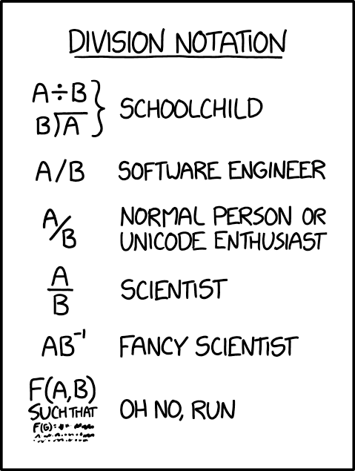
Specifications
CSE 331
Spring 2025
Matt Wang
xkcd #2687
& Ali, Alice, Andrew, Anmol, Antonio, Connor, Edison, Helena, Jonathan, Katherine, Lauren, Lawrence, Mayee, Omar, Riva, Saan, and Yusong

Slide 2
A Brief Look at HW: Time Spent
Time spent per bug: ~ 42 min/bug, 25% > 1 hour
~ 1 bug per 22 lines of code (harder with JSX)
Long tail is making itself visible…

Slide 3
HW2 & Mutation
Was the bug due to a disallowed mutation?
students reported 'yes' for 11.5% of bugs
such bugs took >40% longer to debug on average

Slide 4
HW2 Debugging via User Report (1/2)
User reports the following bug:
"Sometimes, I can't click on one of the markers.
Usually, it it works fine. But occasionally, you can't click on it."
First step is to figure out how to reproduce it
can't debug otherwise
wouldn't know that you've fixed the bug
key reason why event-driven debugging is harder
command-line failure is instantly reproducible
debugging a crash is easier than a non-crash!
crash comes with a stack trace (line of code with a failure)

Slide 5
HW2 Debugging via User Report (2/2)
Eventually, you find a way to reproduce it
no longer clickable after you move it very far away
To debug, you must learn how App.tsx works
markers are stored in some kind of tree
searches the tree to find markers near the click
To debug, you must learn how marker_tree.ts works
internal tree nodes split into NW, NE, SE, SW regions
marker was inserted into the correct region
when you search for it, it's no longer in the right region

Slide 6
One "Solution" to HW2 (1/2)
type EditorState = {
newMarker: Marker;
…
};
doNameChange = (evt: ChangeEvent<…>): void => {
this.state.newMarker.name = evt.target.value;
this.setState({newName: evt.target.value});
};
doSaveClick = (evt: MouseEvent<…>): void => {
this.props.onSaveClick(newMarker.name, …);
};
already suspicious…
mutating this.state directly

Slide 7
One "Solution" to HW2 (2/2)
constructor(props) {
super(props);
this.state = {newMarker: this.props.marker, …};
}
doMoveToChange = (evt: ChangeEvent<…>): void => {
const bldg = findBuildingByName(evt.target.value);
newMarker.location = bldg.location;
this.setState({moveTo: evt.target.value});
};
Starting to get nervous…
are we allowed to mutate that marker?
no! that location is a key in a tree

Slide 8
Staying Safe in 331
Do not use mutable state
don’t need to think about aliasing at all
any number of aliases is fine
Do not allow aliases to mutable state
do not hand out aliases yourself
make a copy of anything you want to keep
For 331, mutable aliasing across files is a bug!
gives other parts the ability to break your code
we will stick to these simple strategies for avoiding it
ensures only one reference to the object (no aliases)

Slide 9
An Advanced (Two-Stage) Approach
Mutable object has only one reference (owner)
one reference that is allowed to use & mutate it
Object is eventually “frozen”, making it immutable
no longer necessary to track ownership
Example: Java’s StringBuilder vs String
StringBuilder is mutable (be careful!)
StringBuilder.toString returns the value as a String
String is immutable

Slide 10
Rules of Thumb: Mutation XOR Aliasing
Client Side
Data is small
anything on screen is O(1)
Aliasing is common
UI design forces modules
data is widely shared
Rule: avoid mutation
create new values instead
performance will be fine
(local-only mutation can be OK)
Server Side
Data is large
efficiency matters
Aliasing is avoidable
you decide on modules
data is not widely shared
Rule: avoid aliases
do not allow aliases to your data
hand out copies not aliases
(good enough for us in 331)

Slide 11
Language Features & Aliasing
Most recent languages have some answer to this…
Java chose to make String immutable
most keys in maps are strings
hugely controversial at the time, but great decision
Python chose to only allow immutable keys in maps
only numbers, strings, and tuples allowed
surprisingly, not that inconvenient
Rust has built-in support for “mutation XOR aliasing”
ownership of value can be “borrowed” and returned
type system ensures there is only one usable alias

Slide 12
Readonly in TypeScript (1/2)
TypeScript can ensure values aren’t modified
extremely useful!
but, only a compile-time check (not a runtime guarantee)
Readonly tuples:
type IntPair = readonly [bigint, bigint];
Readonly fields of records:
type IntPoint = {readonly x: bigint,
readonly y: bigint};

Slide 13
Readonly in TypeScript (2/2)
Readonly fields of records:
type IntPoint = {readonly x: bigint,
readonly y: bigint};
Readonly records:
type IntPoint = Readonly<{x: bigint, y: bigint}>;
this.props is Readonly<MyPropsType>
More readonly…
ReadonlyArray<bigint>
ReadonlyMap<string, bigint>
ReadonlySet<string>

Slide 14
comfy-tslint
we’ve written a TS linter for this class that enforces some of our conventions, e.g.
requiring type annotations for functions
disallowing the any type
naming & structure conventions for React methods
available to you…
as a VSCode extension
as an npm module (that you can run yourself)
please:
take a careful look at the HW3 spec + autograder
briefly read the website page on comfy-tslint

Slide 15
Precise Specifications

Slide 16
Where We Are in the Course
Nine assignments split into these groups:
HW1
HW2
learn to write more complex apps
practice debugging
HW3
HW4
HW5
learn how to be 100% sure the code is correct
(most of the work done on paper)
HW6
HW7
HW8
HW9

Slide 17
Correctness and Specifications
Correctness requires a definition of the correct answer
Description must be precise
can’t have disagreement about what is correct
Informal descriptions (English) are usually imprecise
necessary to “formalize” the English
turn the English into a precise mathematical definition
professionals are very good at this
usually just give English definitions
important skill to practice
we will start out completely formal to make it easier

Slide 18
Kinds of Specifications
Imperative specification says how to calculate the answer
lays out the exact steps to perform to get the answer
Declarative specification says what the answer looks like
does not say how to calculate it
up to us to ensure that our code satisfies the spec
Can implement a different imperative specification
again, up to us to ensure that our code satisfies the spec

Slide 19
Example: Imperative Specification (abs)
Absolute value: |x| = x if x ≥ 0 and –x otherwise
definition is an “if” statement
const abs = (x: bigint): bigint => {
if (x >= 0n) {
return x;
} else {
return –x;
}
}
just translating math to TypeScript

Slide 20
Example: Declarative Specification (sub)
Subtraction (a – b): return x such that b + x = a
can see that b + (a – b) = b + a – b = a
const sub = (a : bigint, b: bigint): bigint => {
??
}
we are left to figure out how to do this…
and convince ourselves it satisfies the spec

Slide 21
Example: Declarative Specification (sqrt)
Square root of x is number y such that y² = x
not all positive integers have integer square roots, so… let’s round up
(y – 1)² ≤ x ≤ y²
smallest integer y such that x ≤ y²
const sqrt = (x: bigint): bigint => {
??
}
we are left to figure out how to do this…
and convince ourselves it satisfies the spec

Slide 22
Example: Declarative Specification (abs)
Absolute value |x| is an integer y such that
y ≥ x
y ≥ –x
y = x or y = –x
const abs = (x: bigint): bigint => {
if (x >= 0) {
return x;
} else {
return –x;
}
}
requires some thinking to make sure this code
returns a number with the properties above

Slide 23
Example: Imperative Specification (HW3)
From HW3: Dijkstra's Algorithm
add a 0-step (empty) path from start to itself to active
while active is not empty:
minPath = active.removeMin() // shortest active path
if minPath.end is end:
return minPath // shortest path from start to end!
if minPath.end is in finished:
continue // longer path to minPath.end than the one we found before
add minPath.end to finished // just found shortest path to here!
// add all paths that have one step added to this shortest path
for each edge e in adjacent.get(minPath.end):
if e.end is not in finished:
newPath = minPath + e
add newPath to active
return undefined // no path from start to end :(
steps are described fully
(just translate to TypeScript)

Slide 24
"Straight From the Spec"
If imperative, just translate math into code
TypeScript here, but could also be Java
we often call this "straight from the spec"
if declarative (or implementing different imperative spec), then we will need new tools for checking its correctness

Slide 25
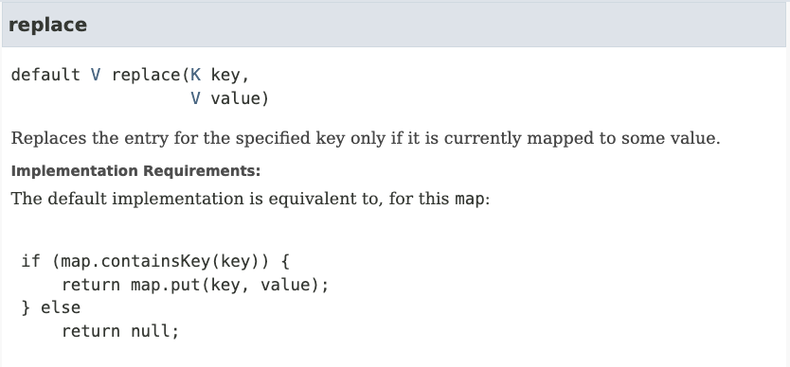
Examples from Java: Map .replace()
java.util.Map — set of (key, value) pairs
Imperative
Notes:
https://docs.oracle.com/en/java/javase/17/docs/api/java.base/java/util/Map.html#replace(K,V)

Slide 26
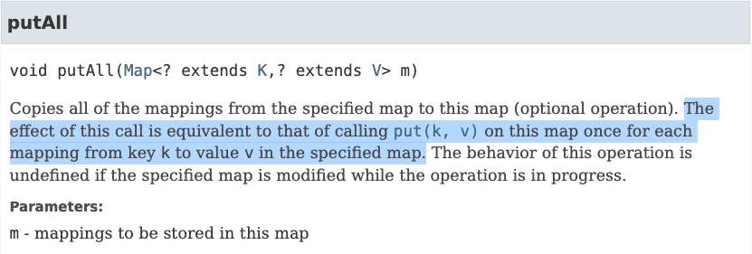
Examples from Java: Map .putAll()
java.util.Map — set of (key, value) pairs
Imperative
Notes:
https://docs.oracle.com/en/java/javase/17/docs/api/java.base/java/util/Map.html#putAll(java.util.Map)

Slide 27
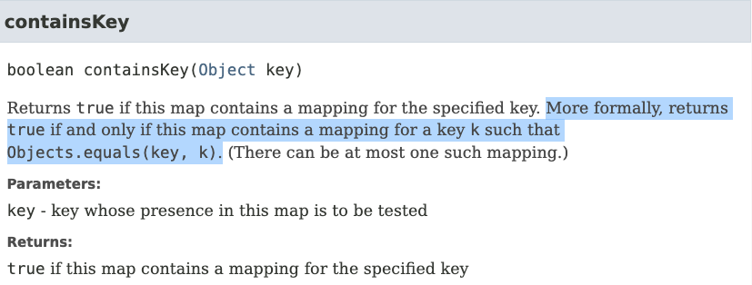
Examples from Java: Map .containsKey()
java.util.Map — set of (key, value) pairs
Declarative (probably)
Notes:
https://docs.oracle.com/javase/8/docs/api/java/util/Map.html#containsKey-java.lang.Object-

Slide 28
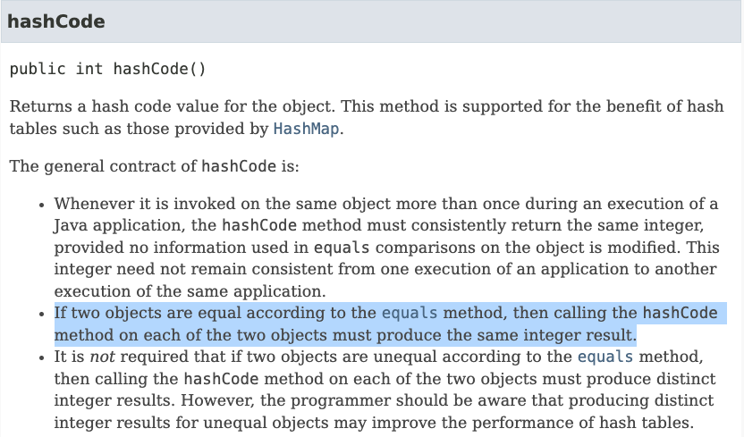
Examples from Java: Object .hashCode()
java.util.Object
Declarative
Notes:
https://docs.oracle.com/en/java/javase/17/docs/api/java.base/java/lang/Object.html#hashCode()

Slide 29
This Topic’s Goal: Imperative Specifications
Toolkit for writing imperative specifications
define math for data and code
write specifications that are language independent
(don't want a toolkit that only works for TypeScript)
describe how to translate imperative specs into TypeScript
try to make the translations as straightforward as possible (fewer mistakes)
mention new TypeScript features when related
critical to understand what bugs the type system catches and which it does not
Will look at declarative specifications later

Slide 30
Math Notation

Slide 31
Basic Data Types in Math
In math, the basic data types are “sets”
sets are collections of objects called elements
write x ∈ S to say that “x” is an element of set “S”, and x ∉ S to say that it is not.
Examples:
x ∈ ℤ x is an integer
x ∈ ℕ x is a non-negative integer (natural)
x ∈ ℝ x is a real number
x ∈ 𝔹 x is T or F (boolean)
x ∈ 𝕊 x is a character
x ∈ 𝕊* x is a string
non-standard names

Slide 32
Basic Data Types in TypeScript
English | Math | TypeScript | Up to Us
integer | x ∈ ℤ | bigint
natural | x ∈ ℕ | bigint | non-negative
real | x ∈ ℝ | number
boolean | x ∈ 𝔹 | boolean
character | x ∈ 𝕊 | string | length 1
string | x ∈ 𝕊* | string
we will often write
x : ℤ instead of x ∈ ℤ
only subtraction on non-negative can produce negative

Slide 33
Creating New Types in Math (Unions)
Union Types 𝕊* ∪ ℕ
contains every object in either (or both) of those sets
e.g., all strings and natural numbers
If x ∈ ℕ ∪ 𝕊*, then x could be a natural or string
Two sets can contain common elements
in this case, the sets are disjoint

Slide 34
Creating New Types in TypeScript (Unions)
Union Types string | bigint
can be either one of these
How do we work with this code?
const x: string | bigint = …;
// can I call isPrime(x)?
We can check the type of x using “typeof”
TypeScript understands these expressions
will “narrow” the type of x to reflect that information

Slide 35
Type Narrowing With “If” Statements
Union Types string | bigint
can be either one of these
How do we work with this code?
const x: string | bigint = …;
if (typeof x === "bigint") {
console.log(isPrime(x)) // okay! x is a bigint
} else {
… // x is a string
}

Slide 36
Type Narrowing vs Casting
const x: string | bigint = …;
if (typeof x === "bigint") {
console.log(isPrime(x)) // okay! x is a bigint
} else {
… // x is a string
}
Note that this does not require a type cast
TypeScript knows x is a bigint inside the “if” (narrowing)
331: there are no type casts (won’t even show syntax)
unlike Java, TypeScript casts are unchecked at runtime
seem designed to create extremely painful debugging

Slide 37
Type Narrowing Gotcha
const f = (x: bigint): string | bigint => …;
if (typeof f(x) === "bigint") {
console.log(isPrime(f(x))) // why not allowed?
}
TypeScript will (properly) reject this
no guarantee that f(x) returns the same value both times!

Slide 38
Type Narrowing of Function Calls
const f = (x: bigint): string | bigint => …;
const y = f(x);
if (typeof y === "bigint") {
console.log(isPrime(y)) // this works now
}
TypeScript can see that the two values are the same
Functions that return different values for the same inputs are confusing!
maybe better to avoid that

Slide 39
Record Types in Math
Record Types {x : ℕ, y : ℕ}
record with fields “x” and “y” each containing a number
e.g., {x: 3, y: 5}
Note that {x: 3, y: 5} = {y: 5, x: 3} in math
field names matter, not order
note that these are not "===" in JavaScript
in math, “=“ means same values
in JavaScript, "===" is reference equality

Slide 40
Record Types in TypeScript
Record Types {x: bigint, y: bigint}
anything with at least fields “x” and “y”
Retrieve a part by name:
const t: {x: bigint, y: bigint} = … ;
console.log(t.x);

Slide 41
Optional Fields in TypeScript
Records can have optional fields
type T = {x: bigint, y?: bigint};
const t: T = {x: 1n};
type of “ t.y ” is “ bigint | undefined ”
Functions can have optional arguments
const f = (a: bigint, b?: bigint): bigint => {
console.log(b);
};
type of “ b ” is “ bigint | undefined ”

Slide 42
Tuple Types in Math
Record Types {x : ℕ, y : ℕ}
record with fields “x” and “y” each containing a number
e.g., {x: 3, y: 5}
Tuple Types ℕ ⨉ ℕ
pair of two natural numbers, e.g., (5, 7)
can do tuples of 3, 4, or more elements also
Mostly equivalent alternatives
both let us put parts together into a larger object
record distinguishes parts by name
tuple distinguishes parts by order

Slide 43
Retrieving Part of a Tuple
To refer to tuple parts, we must give them names
Tuple Types ℕ ⨉ ℕ
Let (a, b) := t. Suppose we know that t = (5, 7)
Then, we have a = 5 and b = 7
Tuple Types [bigint, bigint]
const t: [bigint, bigint] = …;
const [a, b] = t;
console.log(a); // first part of t
“:=” means a definition

Slide 44
Simple Functions in Math
Simplest function definitions are single expressions
Will write them in math like this:
double : ℕ → ℕ
double(n) := 2n
first line declares the type of double function
takes a natural number input to a natural number output
second line shows the calculation
know that "n" is a natural number from the first line
will often put the type in the text before the definition, e.g.,
The function double : ℕ → ℕ is defined by…
double(n) := 2n

Slide 45
Simple Functions in Math (and shorthands)
Another example:
dist : {x: ℝ, y: ℝ} → ℝ
dist(p) := (p.x² + p.y²)^{1/2}
first line tells us that "p" is a record and "p.x" is a real number
Can define short-hand for types in math also
type Point := {x: ℝ, y: ℝ}
dist : Point → ℝ
dist(p) := (p.x² + p.y²)^{1/2}

Slide 46
Complex Functions in Math
Most interesting functions are not simple expressions
need to use different expressions in different cases
Can use side-conditions to split into cases
abs : ℝ → ℝ
abs(x) := x if x ≥ 0
abs(x) := –x if x < 0
conditions must be exclusive and exhaustive
we do not want to require on order to determine which applies
there is a better way to do this in many cases…

Slide 47
Pattern Matching
Can also define functions by “pattern matching”
double : ℕ → ℕ
double(0) := 0
double(n+1) := double(n) + 2
first case matches only 0
second case matches numbers 1 more than some n : ℕ …
double(6) = double(5+1) so it matches with n = 5
since n ≥ 0, we have n+1 ≥ 1, so it matches 1, 2, 3, …
pattern “n+2” would match 2, 3, 4, …
Simplifies the math in multiple ways…

Slide 48
Pattern Matching on Natural Numbers
Pattern matching definition
double(0) := 0
double(n+1) := double(n) + 2
is simpler than using side conditions
double(n) := 0 if n = 0
double(n) := double(n-1) + 2 if n > 0
e.g., need to explain why double(n-1) is legal
easy in this case, but it gets harder
We will prefer pattern matching whenever possible

Slide 49
Pattern Matching on Booleans
Booleans have only two legal values: T and F
Can pattern match just by listing the values:
the function not : 𝔹 → 𝔹 is defined as follows:
not(T) := F
not(F) := T
negates a boolean value
no simpler way to define this function!

Slide 50
Pattern Matching on Records
Can pattern match on individual fields of a record
type Steps := {n : ℕ, fwd : 𝔹}
change : Steps → ℤ
change({n: m, fwd: T}) := m
change({n: m, fwd: F}) := –m
clear that the rules are exclusive and exhaustive
Can match on multiple parameters
e.g., change({n: m+5, fwd: T}) := 2m
just make sure the rules are exclusive and exhaustive

Slide 51
Pattern Matching in TypeScript
TypeScript does not provide pattern matching
some other languages do! (see 341)
We must translate into “if”s on our own
type Steps = {n: number, fwd: boolean};
const change = (s: Steps) => {
if (s.fwd) {
return s.n;
} else {
return –s.n;
}
};
still straight from the spec
but easy to make mistakes

Slide 52
Pattern Matching in TypeScript: Gotcha
double(0) := 0
double(n+1) := double(n) + 2
Also need to be careful with natural numbers
// m is non-negative
const double = (m: bigint) => {
if (m === 0n) {
return 0n;
} else {
return double(m – 1n) + 2n;
}
};
pattern matching uses “n+1” but the code uses “m” (or “n”)
sadly, TypeScript will not let “n+1” be the argument value
spec says double(n)
but code says double(m – 1)

Slide 53
Code Without Mutation
Saw all types of code without mutation:
straight-line code
conditionals
recursion
This is all that there is!
can write anything computable with just these
Saw TypeScript syntax for these already…

Slide 54
Code Without Mutation Example
Example function with all three types
// n must be a non-negative integer
const f = (m: bigint): bigint => {
if (m === 0n) {
return 1n;
} else {
const n = m – 1n;
return 2n * f(n);
}
};
What does this compute?
f(m) = 2^{m}
f : ℕ → ℕ
f(0) := 1
f(n+1) := 2 · f(n)

