Slide 1
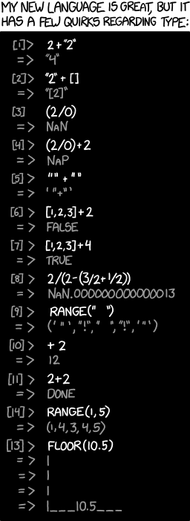
Client-Server Interaction
xkcd #1537
CSE 331
Spring 2025
Matt Wang
& Ali, Alice, Andrew, Anmol, Antonio, Connor, Edison, Helena, Jonathan, Katherine, Lauren, Lawrence, Mayee, Omar, Riva, Saan, and Yusong

Slide 2
Summary of HW1: Number of Bugs
Number of bugs logged:
average of 4.1 (median of just 4, but barely)
Average solution was ~72 lines of code
1 bug every ~18 lines of code
1 bug every 20–30 lines in industry

Slide 3
Summary of HW1: Time Spent Debugging
Time spent per bug:
average min per bug: 38 (37 fall, 52 winter)
23% took more than 1 hour to find (22% in winter)
Every 10–20 lines you lose this much time
worthwhile to see what we can do to reduce debugging

Slide 4
Summary of HW1: Bottom Line
In HW1, we asked: would a type checker help?
students reported: 41% fall, 45% winter, 39% spring
industry studies found even higher numbers (over 60%)
Programming (and thinking) is a time trade-off
“waste” ~ 2-5 minutes adding type annotations, fighting compiler errors, handling “impossible” cases
spend one hour debugging a long-tail types bug
at mega-scale, the long-tail is inevitable; good programmers plan around this

Slide 5
Multiple Components

Slide 6
Client-Server Interaction

Slide 7
Steps to Writing a Full Stack App
Data stored only in the client is generally ephemeral
closing the window means you lose it forever
to store it permanently, we need a server
We recommend writing in the following order:
Write the client UI with local data
no client/server interaction at the start
Write the server
official store of the data (client state is ephemeral)
Connect the client to the server
use fetch to update data on the server before doing same to client

Slide 8
Steps to Writing a Full Stack App: Server
We recommend writing in the following order:
Write the client UI with local data
no client/server interaction at the start
Write the server
official store of the data (client state is ephemeral)
Connect the client to the server
use fetch to update data on the server before doing same to client

Slide 9
Designing the Server
Decide what state you want to be permanent
e.g., items on the To-Do list
Decide what operations the client needs
e.g., add/remove from the list, mark an item completed
look at the client code to see how the list changes
each way of changing the list becomes an operation
also need a way to get the list initially
only provide those operations
can always add more operations later

Slide 10
Example: To-Do List Server

Slide 11
Steps to Writing a Full Stack App: Connect
We recommend writing in the following order:
Write the client UI with local data
no client/server interaction at the start
Write the server
official store of the data (client state is ephemeral)
Connect the client to the server
use fetch to update data on the server before doing same to client

Slide 12
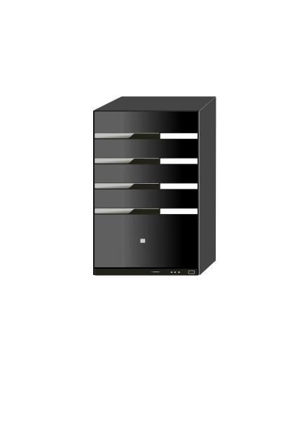
Recall: Client-Server Interaction
Clients need to talk to server & update UI in response
GET /api/list
current to-do list
our server
Client will make requests to the server to
get the list
add, remove, and complete items

Slide 13
Development Setup
Two servers: ours and webpack-dev-server
8080
GET /api/list
response
webpack-dev-server
8088
Only one server can run on each port
webpack-dev-server will forward all requests to /api/… to our server
(Attempting to start a second will see a EADDRINUSE error)
our server

Slide 14
Client-Server Interaction: Making Requests?
Clients need to talk to server & update UI in response
GET /api/list
current to-do list
our server
Components give us the ability to update the UI when we get new data from the server (an event)
How does the client make requests to the server?

Slide 15
Fetch Requests Are Complicated (1/2)
Four different methods involved in each fetch:
method that makes the fetch
handler for fetch Response
handler for fetched JSON
handler for errors
200
response data
fetch
connect
status code
doListJson
doListResp
400
error message
doListError

Slide 16
Making HTTP Requests: Using Fetch
Send & receive data from the server with “fetch”
fetch("/api/list")
.then(this.doListResp)
.catch(() => this.doListError("failed to connect"))
Fetch returns a “promise” object
has .then & .catch methods
both methods return the object again
above is equivalent to:
const p = fetch("/api/list");
p.then(this.doListResp);
p.catch(() => this.doListError("failed to connect"));

Slide 17
Making HTTP Requests: After Fetch
Send & receive data from the server with “fetch”
fetch("/api/list")
.then(this.doListResp)
.catch(() => this.doListError("failed to connect"))
then handler is called if the request can be made
catch handler is called if it cannot be
only if it could not connect to the server at all
status 400 still calls then handler
catch is also called if then handler throws an exception

Slide 18
Making HTTP Requests: Query Parameters
Send & receive data from the server with “fetch”
const url = "/api/list? " +
"category=" + encodeURIComponent(category);
fetch(url)
.then(this.doListResp)
.catch(() => this.doListError("failed to connect"))
All query parameter values are strings
Some characters are not allowed in URLs
the encodeURIComponent function converts to legal chars
server will automatically decode these (in req.query)
in example above, req.query.name will be “laundry”

Slide 19
Making HTTP Requests: Status Codes
Still need to check for a 200 status code
doListResp = (res: Response): void => {
if (res.status === 200) {
console.log("it worked!");
} else {
this.doListError(`bad status ${res.status}`);
}
};
doListError = (msg: string) => {
console.log(`fetch of /list failed: ${msg} `);
};
(often need to tell users about errors with some UI…)

Slide 20
Handling HTTP Responses
Response has methods to ask for response data
our doListResp called once browser has status code
may be a while before it has all response data (could be GBs)
With our conventions, status code indicates data type:
with 200 status code, use res.json() to get record
we always send records for normal responses
with 400 status code, use res.text() to get error message
we always send strings for error responses
These methods return a promise of response data
use .then(..) to add a handler that is called with the data
handler .catch(..) called if it fails to parse

Slide 21
Making HTTP Requests: Error Handling
doListResp = (res: Response): void => {
if (res.status === 200) {
res.json().then(this.doListJson);
.catch(() => this.doListError("not JSON");
} …
…
};
Second promise can also fail
e.g., fails to parse as valid JSON, fails to download
Important to catch every error
painful debugging if an error occurs and you don’t see it!

Slide 22
Making HTTP Requests: More Error Handling
doListResp = (res: Response): void => {
if (res.status === 200) {
res.json().then(this.doListJson);
.catch(() => this.doListError("not JSON");
} else if (res.status === 400) {
res.text().then(this.doListError);
.catch(() => this.doListError("not text");
} else {
this.doListError(`bad status: ${res.status}`);
}
};
We know 400 response comes with an error message
could also be large, so res.text() also returns a promise

Slide 23
Recall: Fetch Requests Are Complicated
Four different methods involved in each fetch:
method that makes the fetch
handler for fetch Response
handler for fetched JSON
handler for errors
200
response data
fetch
connect
status code
doListJson
doListResp
400
error message
doListError

Slide 24
Fetch Requests Are Complicated (2/2)
Four different methods involved in each fetch:
method that makes the fetch
handler for fetch Response e.g., doListResp
handler for fetched JSON e.g., doListJson
handler for errors e.g., doListError
Three different events involved:
getting status code, parsing JSON, parsing text
any of those can fail!
important to make all error cases visible

Slide 25
Recall: HTTP GET vs POST
When you type in a URL, browser makes “GET” request
request to read something from the server
Clients often want to write to the server also
this is typically done with a “POST” request
ensure writes don’t happen just by normal browsing
POST requests also send data to the server in body
GET only sends data via query parameters
limited to a few kilobytes of data
POST requests can send arbitrary amounts of data

Slide 26
Making HTTP POST Requests
Extra parameter to fetch for additional options:
fetch(”/add”, {method: "POST"})
Arguments then passed in body as JSON
const args = {name: "laundry"};
fetch("/add", {method: "POST",
body: JSON.stringify(args),
headers: {"Content-Type”: "application/json"}})
.then(this.doAddResp)
.catch(() => this.doAddError("failed to connect"))
add as many fields as you want in args
Content-Type tells the server we sent data in JSON format

Slide 27
Lifecycle Methods
React also includes events about its “life cycle”
componentDidMount: UI is now on the screen
componentDidUpdate: UI was just changed to match render
componentWillUnmount: UI is about to go away
Often use “mount” to get initial data from the server
constructor shouldn’t do that sort of thing
componentDidMount = (): void => {
fetch("/api/list")
.then(this.doListResp)
.catch(() => this.doListError("connect failed");
};

Slide 28
Example: To-Do List 2.0

Slide 29
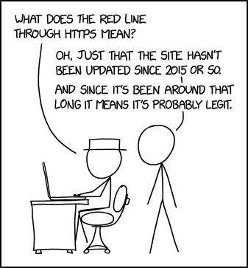
Client-Server Interaction++
CSE 331
Spring 2025
Matt Wang
xkcd #1537
& Ali, Alice, Andrew, Anmol, Antonio, Connor, Edison, Helena, Jonathan, Katherine, Lauren, Lawrence, Mayee, Omar, Riva, Saan, and Yusong

Slide 30
Quick Notes Re: OH & seeking help
Alice & Connor’s location is updated
quick reminder/spiel on OH policy
goal is not to discourage you from seeking help!
doing the section worksheet is probably the first thing you should do when confused
feeling like you’re not having “productive struggle”? please reach out!

Slide 31
Recall: Fetch Requests Are (Still) Complicated
Four different methods involved in each fetch:
method that makes the fetch
handler for fetch Response
handler for fetched JSON
handler for errors
200
response data
fetch
connect
status code
doListJson
doListResp
400
error message
doListError

Slide 32
Recall: Lifecycle Methods
React also includes events about its “life cycle”
componentDidMount: UI is now on the screen
componentDidUpdate: UI was just changed to match render
componentWillUnmount: UI is about to go away
Often use “mount” to get initial data from the server
constructor shouldn’t do that sort of thing
componentDidMount = (): void => {
const p = fetch("/api/list");
p.then(this.doListResp);
p.catch(() => this.doListError("connect failed");
};

Slide 33
Lifecycle Events Gotcha: Unmounting
Warning: React doesn’t unmount when props change
instead, it calls componentDidUpdate and re-renders
you can detect a props change there
componentDidUpdate =
(prevProps: HiProps, prevState: HiState): void => {
if (this.props.name !== prevProps.name) {
… // our props were changed!
}
};
This is used in HW2 in Editor.tsx:
changes to marker cause an update to name and color state

Slide 34
Recall: Function Literals
We used function literals for error handlers
componentDidMount = (): void => {
const p = fetch("/api/list");
p.then(this.doListResp);
p.catch(() => this.doListError("connect failed");
};
Our coding convention:
one-line functions (no {..}) can be written in place
most often used to fill in or add extra arguments in function calls
longer functions need to be declared normally

Slide 35
Recall: Another JavaScript Feature: for … of
for (const item of val)
“for .. of” iterates through array elements in order
... or the entries of a Map or the values of a Set
entries of a Map are (key, value) pairs
like Java's "for (… : …)"
fine to use these

Slide 36
One More Change
Don’t have the items initially…
type TodoState = {
items: Item[] | undefined; // items or undefined if loading
newName: string; // mirrors text in name-to-add field
};
renderItems = (): JSX.Element => {
if (this.state.items === undefined) {
return <p>Loading To-Do list...</p>;
} else {
const items = [];
// … old code to fill in array with one DIV per item …
return <div>{items}</div>;
}
};

Slide 37
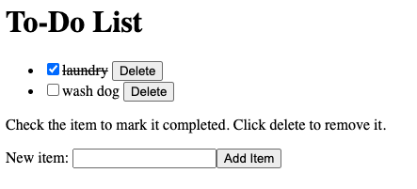
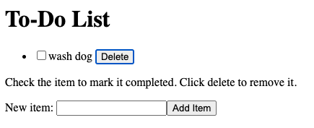
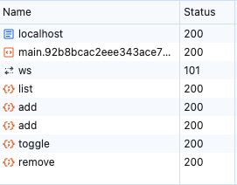
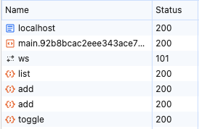
New TodoApp — Requests

Slide 38
Example: To-Do List 2.0++ (refer to completed code)

Slide 39
Client-Server Interaction+++ (and aliasing)
CSE 331
Spring 2025
JS Wacky Weekly Wednesday
In Node’s REPL, {} + {} is:
[object Object][object Object]
In Chrome, {} + {} is:
NaN
Why? What is Chrome doing? Hint: there are two places you can insert a semicolon to make this valid JS.
Matt Wang
& Ali, Alice, Andrew, Anmol, Antonio, Connor, Edison, Helena, Jonathan, Katherine, Lauren, Lawrence, Mayee, Omar, Riva, Saan, and Yusong

Slide 40
A note on slides
The slides are almost always not a comprehensive review of lecture!
Likely more important resources:
the lecture recording(s)
source code from lecture examples

Slide 41
Dynamic Type Checking

Slide 42
New TodoApp – Add Json and Types
doAddJson = (data: unknown): void => {
… // how do we use data?
};
type of returned data is unknown
to be safe, we should write code to check that it looks right
check that the expected fields are present
check that the field values have the right types
only turn off type checking if you love painful debugging!
otherwise, check types at runtime

Slide 43
Checking Types of Requests & Response (1/2)
All our 200 responses are records, so start here
if (!isRecord(data))
throw new Error(`not a record: ${typeof data}`);
the isRecord function is provided for you
like built-in Array.isArray function
still need to check the type of each array element!
Would be reasonable to log an error instead
using console.error is probably easier for debugging

Slide 44
Checking Types of Requests & Response (2/2)
Fields of the record can have any types
if (typeof data.name !== "string") {
throw new Error(
`name is not a string: ${typeof data.name}`);
}
if (typeof data.amount !== "number") {
throw new Error(
`amount is not a number: ${typeof data.amount}`);
}

Slide 45
TodoApp: processing /api/list JSON
// Called with the JSON response from /api/list
doListJson = (data: unknown): void => {
const items = parseListResponse(data);
this.setState({items: items});
};
often useful to move this type checking to helper functions
we will may provide these for you in future assignments
not part of the UI logic, so doesn’t belong it that file

Slide 46
TodoApp: parseListResponse
// Retrieve the items sent back by /api/list
const parseListResponse = (data: unknown): Item[] => {
if (!isRecord(data))
throw new Error(`not a record: ${typeof data}`);
return parseItems(data.items);
};
can only write "data.items" after we know it's a record
type checker will object otherwise
retrieving a field on undefined or null would crash

Slide 47
TodoApp: parseItems – Type Checking the Array
const parseItems = (data: unknown): Item[] => {
if (!Array.isArray(data))
throw new Error(`not an array: ${typeof data}`);
const items: Item[] = [];
for (const item of data) {
items.push(parseItem(item));
}
return items;
};

Slide 48
TodoApp: parseItems – Type Checking Items
const parseItem = (data: unknown): Item[] => {
if (!isRecord(data))
throw new Error(`not an record: ${typeof data}`);
if (typeof data.name !== "string")
throw new Error(`name is not a string: ${typeof data.name}`);
if (typeof data.completed !== "boolean")
throw new Error(`not a boolean: ${typeof data.completed}`);
return {name: data.name, completed: data.completed};
};

Slide 49
Use Type Checking to Avoid Debugging (1/2)
Resist the temptation to skip checking types in JSON
“easy is the path that leads to debugging”
Query parameters also require checking:
const url = "/list? " +
"category=" + encodeURIComponent(category);
converting from a string back to JS data is also parsing
can be a bug in encoding or parsing

Slide 50
Use Type Checking to Avoid Debugging (2/2)
Be careful of turning off type checking:
resp.json().then(this.doAddJson)
…
doAddJson = (data: TodoItem): void => {
this.setState(
{items: this.state.items.concat([data])});
};
promises use “any” instead of “unknown”, so TypeScript let you do this
imagine this debugging
when you make a mistake

Slide 51
Debugging Client-Server

Slide 52
Writing the Server
Full-stack apps introduce new ways of failing
can fail in the client due to a bug in the server
can fail in the server due to a bug in the client
Debugging a full-stack app is much harder
requires understanding client, server, & interactions
will take more time…

Slide 53
“Engineers are paid to think and understand.”
— Class slogan #1

Slide 54
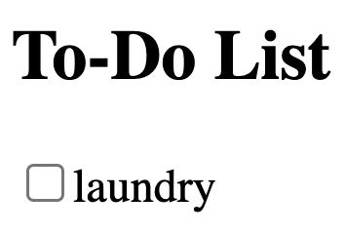
Client-Server Communication Complexity
client
server
doAddClick
fetch /api/add
express
find route
doAddJson
check response
update state
addItem
check parameters
send { name: "laundry”, added: true }

Slide 55
Client-Server Debugging
Client-server communication can fail in many ways
almost always requires debugging
Include all required .catch handlers
at least log an error message
Here are steps you can use when
the client should have made a request
but you don’t see the expected result afterward
(will practice this in section tomorrow!)

Slide 56
Client-Server Debugging Tips (1/2)
Do you see the request in the Network tab?
the client didn’t make the request
Does the request show a 404 status code?
the URL is wrong (doesn’t match any app.get / app.post) or the query parameters were not encoded properly
Does the request show a 400 status code?
your server rejected the request as invalid
look at the body of the response for the error message or add console.log’s in the server to see what happened
the request itself is shown in the Network tab

Slide 57
Client-Server Debugging Tips (2/2)
Does the request show a 500 status code?
the server crashed!
look in the terminal where you started the server for a stack trace
Does the request say “pending” forever?
your server forgot to call res.send to deliver a response
Look for an error message in browser Console
if 1-5 don’t apply, then the client got back a response
client should print an error message if it doesn’t like the response
client crashing will show a stack trace

Slide 58
Mutation

Slide 59
HW2 – mutation?
In HW2, we asked you about “mutation bugs”
we argue: these are not-as-common as type related errors, but much nastier to debug
today: let’s establish some shared vocabulary
our goal: help you build ability to detect “code smells”, without running code (or seeing all of it)
(will do some post-HW2 analysis on Friday!)

Slide 60
Recall: Binary Search Trees
Consider the following tree
searching for "4" proceeds as follows:
Suppose someone changed "3" into "5"…
6
3
9
1
4
8

Slide 61
Binary Search Trees & Mutation
Suppose someone changed "3" into "5"…
now this happens when we search for "4":
It can no longer be found!
Doesn't crash. It's just not found.
Problem doesn't occur on the line with the change
6
5
9
1
4
8

Slide 62
Scary Bugs
Do not fear crashes
often no debugging at all
get a stack trace that tells you exactly where it went wrong
Do fear unexpected mutation
failure will give you no clue what went wrong
will take a long time to realize the BST invariant was violated by mutation
bug could be almost anywhere in the code
could take weeks to track it down

Slide 63
Debugging Mutation
mutation bugs are especially nasty to deal with once they ship out to users
typical mutation-related bug report from users: “uh, sometimes when I enter a todo item, it shows up, but sometimes I don’t. I tried restarting my computer and it doesn’t fix the problem. I paid $4.99 for this app, it shouldn’t have this issue…”
how do you debug this?
just reproducing this bug is challenging enough
no error message (or Exception) to go off of

Slide 64
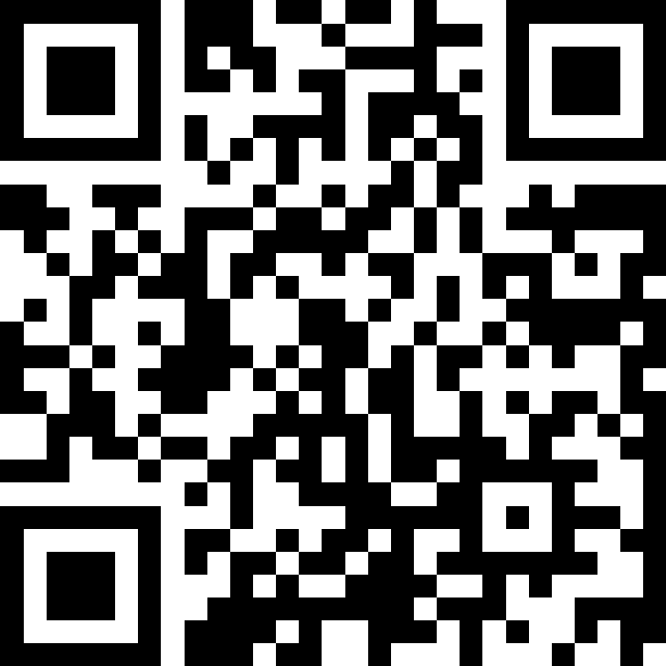
Think Pair Share: M-you-tation
const todos: Array<TodoItem> = /* ... */; const incompleteTodos: Array<TodoItem> = findAllIncompleteTodos(todos);
incompleteTodos.shuffle(); // NASTY foo FUNCTION HERE :))
console.log(`Why not try: ${incompleteTodos[0]}`);
Consider these functions – which could break this feature? How?
foo(todos)
foo(incompleteTodos)
foo(todos[0])
foo(incompleteTodos[0])
sli.do #cse331

Slide 65
Aliasing

Slide 66
Heap State
“Heap state” = still used after the call stack finishes
after current function and those calling it all return
state could be arrays or records
Extra references to the objects are called "aliases"
No different from before when immutable
we don’t care who reads the data
Vastly more complex when mutable…
common with event-driven applications
creates the potential for failures far from bugs

Slide 67
Coupling
High-quality code needs to be "modular"
split into pieces that can be understood individually
When not possible, pieces are "coupled"
must understand both parts to understand each one
Mutable heap state creates coupling
all pieces must know who else has aliases
all pieces must know who is allowed to mutate
Coupling creates potential for painful debugging
bugs in one piece can cause failures in another

Slide 68
Mutable Heap State
“With great power, comes great responsibility”
from Uncle Ben (1972, 2002-*)
With aliases to mutable heap state:
gain efficiency in some cases
must keep track of every alias that could mutate that state
any alias, anywhere in the entire program could cause a bug

Slide 69
“Programmers overestimate the importance of efficiency and underestimate the difficulty of correctness.”
— Class slogan #2

Slide 70
Easy Ways to Stay Safe
Do not mutate heap state
don’t need to think about aliasing at all
any number of aliases is fine
Do not allow aliases…
create the state in your constructor and don’t share it
class MyClass {
vals: Array<string>;
constructor() {
this.vals = new Array(0); // only alias
}
…

Slide 71
Easy Ways to Stay Safe: Copy-on-Write
2. Do not allow aliases
(a) do not hand out aliases yourself
return copies instead
class MyClass {
// RI: vals is sorted
vals: Array<string>;
…
values: (): Array<string> => {
return this.vals; // unsafe!
return this.vals.slice(0); // make a copy
};
…

Slide 72
Easy Ways to Stay Safe: Copy-on-Read
2. Do not allow aliases
(b) make a copy of anything you want to keep
does not matter if the caller mutates the original
class MyClass {
// RI: vals is sorted
vals: Array<string>;
…
// @requires A is sorted
constructor(A: Array<string>) {
this.vals = A; // unsafe!
this.vals = A.slice(0); // make a copy
};
…

Slide 73
Staying Safe in 331
Do not use mutable state
don’t need to think about aliasing at all
any number of aliases is fine
Do not allow aliases to mutable state
do not hand out aliases yourself
make a copy of anything you want to keep
For 331, mutable aliasing across files is a bug!
gives other parts the ability to break your code
we will stick to these simple strategies for avoiding it
ensures only one reference to the object (no aliases)

Slide 74
An Advanced (Two-Stage) Approach
Mutable object has only one reference (owner)
one reference that is allowed to use & mutate it
Object is eventually “frozen”, making it immutable
no longer necessary to track ownership
Example: Java’s StringBuilder vs String
StringBuilder is mutable (be careful!)
StringBuilder.toString returns the value as a String
String is immutable

Slide 75
Rules of Thumb: Mutation XOR Aliasing
Client Side
Data is small
anything on screen is O(1)
Aliasing is common
UI design forces modules
data is widely shared
Rule: avoid mutation
create new values instead
performance will be fine
(local-only mutation can be OK)
Server Side
Data is large
efficiency matters
Aliasing is avoidable
you decide on modules
data is not widely shared
Rule: avoid aliases
do not allow aliases to your data
hand out copies not aliases
(good enough for us in 331)

Slide 76
Language Features & Aliasing
Most recent languages have some answer to this…
Java chose to make String immutable
most keys in maps are strings
hugely controversial at the time, but great decision
Python chose to only allow immutable keys in maps
only numbers, strings, and tuples allowed
surprisingly, not that inconvenient
Rust has built-in support for “mutation XOR aliasing”
ownership of value can be “borrowed” and returned
type system ensures there is only one usable alias

Slide 77
Readonly in TypeScript (1/2)
TypeScript can ensure values aren’t modified
extremely useful!
but, only a compile-time check (not a runtime guarantee)
Readonly tuples:
type IntPair = readonly [bigint, bigint];
Readonly fields of records:
type IntPoint = {readonly x: bigint,
readonly y: bigint};

Slide 78
Readonly in TypeScript (2/2)
Readonly fields of records:
type IntPoint = {readonly x: bigint,
readonly y: bigint};
Readonly records:
type IntPoint = Readonly<{x: bigint, y: bigint}>;
this.props is Readonly<MyPropsType>
More readonly…
ReadonlyArray<bigint>
ReadonlyMap<string, bigint>
ReadonlySet<string>

Slide 79
comfy-tslint

Slide 80
comfy-tslint
we’ve written a TS linter for this class that enforces some of our conventions, e.g.
requiring type annotations for functions
disallowing the any type
naming & structure conventions for React methods
available to you…
as a VSCode extension
as an npm module (that you can run yourself)
please:
keep an eye out for an Ed post from Matt
take a careful look at the HW3 spec + autograder

