Slide 1
Intro to the Browser
CSE 331
Spring 2025
Matt Wang
xkcd #1118
& Ali, Alice, Andrew, Anmol, Antonio, Connor, Edison, Helena, Jonathan, Katherine, Lauren, Lawrence, Mayee, Omar, Riva, Saan, and Yusong

Slide 2
Notes on HW1
HW1 out!
HW is mostly about debugging, not just coding
so: we are mostly assessing you on debugging, and not really on correctness (see: spec!)
but, you do need to attempt all functions
advice:
read spec carefully – app is complex, but you are implementing a small subset
you probably have questions about JS, node, NPM, and express. That’s expected – ask them!
start early! & take advantage of office hours!

Slide 3
The 123 Programming Model
Run code from front-to-back, once.*
.java
file
(optionally)
user input
output
(usually System.out)
(optionally)
loop until a condition is met

Slide 4
The 331 Server Programming Model
Server Code runs forever!
GET: /hi
for each
incoming request…
.js
file
server calls the route function,
and sends a response
response: {
msg: "see saylaufey.com”
}
infinite loop!

Slide 5
The 331 Programming Model, Zooming Out
Client-Server programming has two programs
request
response
(e.g., HTML)
client
server
HW2
HW1
HW3

Slide 6
The Browser, HTML, and CSS

Slide 7
Recall: Browser Operation
Browser reads the URL to find what HTML to load
server name
path
Contacts the given server and asks for the given path
request
response
(e.g., HTML)
client
server

Slide 8
Browsers: JavaScript and HTML
request
response
(e.g., HTML)
client
server
Browser natively knows how to display HTML
Page can also include JavaScript to execute
but it is not required
if present, the JavaScript can change the HTML displayed

Slide 9
HTML
HTML = Hyper Text Markup Language
text format for describing a document / UI
HTML describes the structure of the content, and (partially) what you want drawn in the browser
HTML text consists primarily of “tags” and text

Slide 10
HTML Tags
Element
<p> Some Text </p>
Tag Name
Content
Closing Tag
Element
<p id="firstParagraph"> Some Text </p>
Tag Name
Attribute Value
Content
Attribute Name
Closing Tag

Slide 11
HTML as a Tree
Elements can have children (text or elements)
text is always a leaf in the tree
<div>
<p id="firstParagraph"> Some Text </p>
<br>
<div>
<p>Hello</p>
</div>
</div>
div
p
br
div
p

Slide 12
Parsing HTML
HTML is a text format that describes a tree
nodes are elements or text
<div>
<p>Some text</p>
<p>More text</p>
</div>
div
parse
p
p
HTML text
HTML tree
HTML text is parsed into a tree (“DOM”)
JS can access the tree in the variable “document”
our code lives in the world on the right side

Slide 13
Displaying HTML
Browser window displays an HTML document
tree is turned into drawing in the page
div
Some text
More text
draw
p
p
HTML display
HTML tree
browser displays the HTML in the window
browsers parse and draw very quickly
JS has limited access to display information
HTML tree

Slide 14
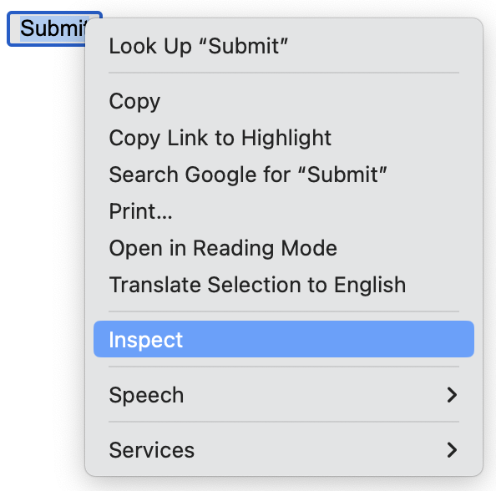
Developer Tools show the HTML
Click on any HTML element and choose "Inspect"
can see exact size in pixels, colors, etc.

Slide 15
Styling
The “style” attribute controls appearance details
margins, padding, width, fonts, etc.
see an HTML reference for details (when necessary)
Attribute value can include many properties
each is “name: value”
separate multiple using “;”
<p>Hi,
<span style="color: red; margin-left: 15px">Bob</span>!
</p>
we will generally not worry much about looks in this class…

Slide 16
Cascading Style Sheets (CSS)
Commonly used styles can be named
association of names to styles goes in a .css file
// foo.css
span.fancy { color: red; margin-left: 15px }
// foo.html
… <p>Hi, <span class="fancy">Bob</span></p> …
Useful to avoid repetition of styling
makes it easier to change

Slide 17
Old School Web UI

Slide 18
Including JavaScript in HTML
Server usually sends back HTML to the browser
Include code to execute inside of script tag:
<script>
console.log("Hi, browser");
</script>
Can also put the script into another file:
<script src="mycode.js"></script>

Slide 19
Events in the Browser
Client applications are event-driven
register "handlers" for various events
Can do so like this in HTML (but don't!)
<button onClick="handleClick(event)">Click Me</button>
<script>
const handleClick = (evt) => {
console.log("ouch");
};
</script>

Slide 20
Changing the HTML
Change the HTML displayed like this (but don't!)
<p>Add 2 to <input type="text" id="num"></input></p>
<p><button onClick="doAdd(event)">Submit</button></p>
<div id="answer"></div>
<script>
const doAdd = (evt) => {
const numElem = document.getElementById("num");
const num = Number(numElem.value);
const ansElem = document.getElementById("answer");
ansElem.innerHTML = `The answer is ${num+2}`;
};
</script>

Slide 21
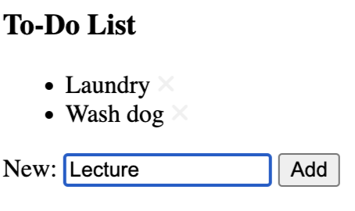
Updating the DOM: Adding Nodes
<h3>To-Do List</h3>
<ul id="items">
<li>Laundry</li>
<li>Wash Dog</li>
</ul>
ul
li
li
li
Laundry
Wash Dog
Lecture

Slide 22
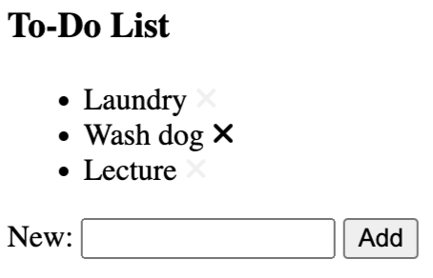
Updating the DOM: Removing Nodes
<h3>To-Do List</h3>
<ul id="items">
<li>Laundry</li>
<li>Wash Dog</li>
<li>Lecture</li>
</ul>
ul
li
li
li
Laundry
Wash Dog
Lecture

Slide 23
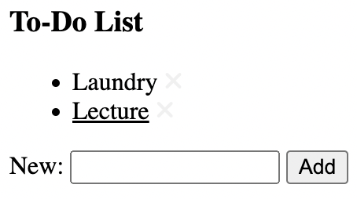
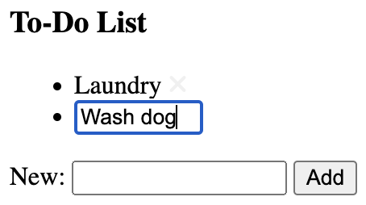
Updating the DOM: Editing Nodes
ul
li
li
Laundry
Lecture
input

Slide 24
Problems with Old School UI
Write code for every way the UI could change
many, many cases
particularly tricky when working in teams/groups
Not specific to HTML
same issue exists in Windows, on the iPhone, Xbox, etc.
if you write code to put things on screen, then you write code to change where they are on screen

Slide 25
New School UI
New approach: what should it look like now?
write function that maps current state to desired HTML
compare desired HTML to what is on the screen now
make any changes needed to turn former into latter
Huge improvement in productivity
introduced in Meta's "React" library
library performs the "compare" and "change" parts
Faster to write HTML UI than anything else
many similar libraries exist for the web
same approach also used in mobile apps, games, …

Slide 26
React
we will use React in this class
goal is not to make you React experts
teach you just enough React to understand “New School UI” ideas
these ideas will apply everywhere
similar to JS & Express, only using small subset of the library
practical note: React is a library installed with npm

Slide 27
React Components

Slide 28
HTML Literals in JSX
JSX: extension of JS that allows HTML expressions
file extension must be .jsx
const x = <p>Hi there!</p>;

Slide 29
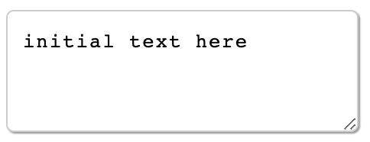
Substitution in JSX
Supports substitution like `..` string literals,
but uses {..} not ${..}
const name = "Fred";
return <p>Hi {name}</p>;
Can also substitute the value of an attribute:
const rows = 3;
return <textarea rows={rows} cols="25">
initial text here
</textarea>;

Slide 30
JSX Gotchas
Must have a single root tag (i.e., must be a tree)
e.g., cannot do this
return <p>one</p><p>two</p>;
instead, wrap in a <div> or just <>..</> (“fragment”)
Replacements for attributes matching keywords
use “className=” instead of “class=”
use “htmlFor=” instead of “for=”

Slide 31
CSS in JSX
CSS styling can be used in JSX
// foo.css
span.fancy { color: red; margin-left: 15px }
// foo.jsx
import './foo.css'; // another weird import
…
return <p>Hi, <span className="fancy">Bob</span>!</p>;
Nice to get this out of the source code

Slide 32
Anatomy of a React Component
split up large web pages into individual components
React components are classes
class “extends” React’s Component class
has a constructor that takes in one argument (more on this in a moment)
has a field called state (that holds the app’s … data/state)
components should have a render method
goal: convert app’s state to JSX (which it returns)
method should have be “pure” and have no “side effects”; in other words, it should not change state
we never call the render method – React does for us

Slide 33
Simplest React Component
Component that prints a Hello message:
class HiElem extends Component {
constructor(props) {
super(props);
this.state = {lang: "en"};
}
render = () => {
if (this.state.lang === "es") {
return <p>Hola, Matt!</p>;
} else {
return <p>Hi, Matt!</p>;
}
};
}
How do we change "lang"?

Slide 34
Simplest React Component (rendered)
Hello Matt!
Hola Matt!

Slide 35
Changing State in our Component
render = () => {
if (this.state.lang === "es") {
return <p>Hola, Matt!
<button onClick={this.doEngClick}>Eng</button>
</p>;
} else {
return <p>Hi, Matt!
<button onClick={this.doEspClick}>Esp</button>
</p>;
}
};
doEspClick = (evt) => {
this.setState({lang: "es"};
};

Slide 36
React and Component State Changes
<button onClick={this.doEspClick}>Esp</button>
doEspClick = (evt) => {
this.setState({lang: "es"};
};
Must call setState to change the state
directly modifying this.state is a (painful) bug
React will automatically re-render when state changes
but this does not happen instantly

Slide 37
React Responds to setState calls
HTML on screen = render(this.state)
Component
React
t = 10
this.state = s₁
doc = HTML₁ = render(s₁)
t = 20
this.setState(s₂)
t = 30
this.state = s₂
doc HTML₂ = render(s₂)
React updates this.state to s₂ and doc to HTML₂ simultaneously

Slide 38
React Component with an Event Handler
Pass method to be called as argument (a “callback”):
<button onClick={this.doEspClick}>Esp</button>
Be careful not to do this:
<button onClick={this.doEspClick()}>Esp</button>
Including parentheses here is a bug!
that would call the method inside render
passing its return value as the value of the onClick attribute
we want to pass the method to the button, and have it called when the click occurs

Slide 39
Putting the UI in the Page
Initial page has a placeholder in the HTML:
<div id="main"></div> (empty DIV in index.html)
Put HTML into it from code like this:
const elem = document.getElementById("main");
const root = createRoot(elem);
root.render(<HiElem />);
createRoot is a function provided by the React library
tells React that it should keep the HTML in the page matching what render returns

Slide 40
Putting the UI in the Page: Props
Initial page has a placeholder in the HTML:
<div id="main"></div> (empty DIV in index.html)
Put HTML into it from code like this:
const elem = document.getElementById("main");
const root = createRoot(elem);
root.render(<HiElem name={"Matt"} size={3}/>);
in HiElem, this.props will be {name: "Matt", size: 3}
each component is a custom tag with its own attributes ("properties")

Slide 41
Props and State, Together
render = () => {
if (this.state.lang === "es") {
return <p>Hola, {this.props.name}!
<button onClick={this.doEngClick}>Eng</button>
</p>;
…
}
};
render can use both this.props and this.state
difference 1: caller give us props, but we set our state
difference 2: we can change our state

Slide 42
More React
CSE 331
Spring 2025
Matt Wang
xkcd #1118
& Ali, Alice, Andrew, Anmol, Antonio, Connor, Edison, Helena, Jonathan, Katherine, Lauren, Lawrence, Mayee, Omar, Riva, Saan, and Yusong

Slide 43
The “Old School UI” model (1/2)
Hello Matt
Español

Slide 44
The “Old School UI” model (2/2)
State is stored in
the DOM / HTML.
Works for small examples, breaks
with complex apps
Hola Matt
English

Slide 45
The React Model (1/3)
Hello Matt
{ lang: "en" }
Español
button click triggers an event…

Slide 46
The React Model (2/3)
eventually, React re-renders
state is updated
Hello Matt
{ lang: "es" }
Español
button click triggers an event…

Slide 47
The React Model (3/3)
eventually, React re-renders
state is updated
Hola Matt
{ lang: "es" }
English
button click triggers an event…

Slide 48
Reactive UIs, more generally
(re-)renders
the actual web page
(the DOM, browser, or “view”)
the app’s state
events
you only have to write event handlers & render function
but, you have to play by the rules, or new bugs!!
view must be a function of just the app state
render must be “pure” (no side effects!)

Slide 49
Reminder: React in Practice
Writing User Interface with React:
write a class that extends Component
implement the render method
Each component becomes a new HTML tag:
root.render(<HiElem name={"Matt"}/>);
in HiElem, this.props will be {name: "Matt"}
Can use props and state (and only those!) in render:
render = () => {
if (this.state.lang === "en") {
return <p>Hi, {this.props.name}!
<button onClick={this.doEspClick}>Esp</button>
</p>;
…

Slide 50
Second React Component: More User Input
Put name in state and let the user change it:
class HiElem extends Component {
constructor(props) {
super(props);
this.state = {name: "Matt"};
}
render = () => {
return <p>Hi, {this.state.name}</p>;
};
}
How do we change the name?
Ask the user for their name.

Slide 51
Second React Component: The View
Hello Matt!

Slide 52
Second React Component: adding <input>
constructor(props) {
super(props);
this.state = {showGreeting: false};
}
render = () => {
if (this.state.showGreeting) {
return <p>Hi, {this.state.name}!</p>;
} else {
return <p>What is your name?
<input type="text"></input>
<button …>Done</button>
</p>
}
};

Slide 53
Second React Component: Updating State?
<input type="text"></input>
<button onClick={this.doDoneClick}>Done</button>
doDoneClick = (evt) => {
this.setState({showGreeting: true});
// what about "name"?
};
How do we get the name text?
Do not reach into document! (Always a bug. Often a heisenbug.)

Slide 54
Text Value of Input Elememts
These two are different:
<input type="text"></input>
<input type="text" value="abc"></input>
missing value means value=""
The render method says what HTML should be now
bug if calling render would inadvertently change things
particularly if it would delete user data!
if we want the second picture, we need to set value in render

Slide 55
Second React Component: Input Events
<input type="text" value={this.state.name}
onChange={this.doNameChange}></input>
<button onClick={this.doDoneClick}>Done</button>
doNameChange = (evt) => {
this.setState({name: evt.target.value});
};
evt.target is the input element
evt.target.value is the current text in the input element

Slide 56
Second React Component: Input Event Handler
<input type="text" value={this.state.name}
onChange={this.doNameChange}></input>
<button onClick={this.doDoneClick}>Done</button>
doNameChange = (evt) => {
this.setState({name: evt.target.value});
};
doDoneClick = (evt) => {
this.setState({showGreeting: true});
};
Never reach into the document to get state!
React can re-render at any time
will be a heisenbug when you forget (usually, it still works!)

Slide 57
Second React Component: Mirrored State
<input type="text" value={this.state.name}
onChange={this.doNameChange}></input>
<button onClick={this.doDoneClick}>Done</button>
doNameChange = (evt) => {
this.setState({name: evt.target.value});
};
doDoneClick = (evt) => {
this.setState({showGreeting: true});
};
Any state you need should be mirrored in your state
set value and handle onChange

Slide 58
Event Handler Conventions
We will use this convention for event handlers
doMyCompMyEvent
e.g., doDoneClick, doNewNameChange
Reduces the need to explain these methods
method name is enough to understand what it is for
method name is the only thing you know they read
Components should be just rendering & event handlers
component
name
event
name

Slide 59
Example: To-Do List

Slide 60
React Payoff
No need to write code to
add a new item to the HTML
remove an item from the HTML
update an item in the HTML
all of this is code is tricky (especially if state is not mirrored properly)
Instead, we only write:
state: what does our app care about?
render method: tell React what it should look like right now
event handlers: tell React how to update state when buttons are clicked
React figures out what to add, remove, and update

Slide 61
React Requirements for Lists
To do this, React needs more from
needs to distinguish change from add/remove
<li>wash dog</li> <li>wash dog</li>
<li>laundry</li> <li>write lecture</li>
<li>laundry</li>
did I insert a new item or change one and add another?
impossible to really know without more information
React requires each list item to have a key=".." property that uniquely identifies it

Slide 62
React Requirements for Lists: Keys
To do this, React needs more from
needs to distinguish change from add/remove
<li key="1">wash dog</li> <li key="1">wash dog</li>
<li key="2">laundry</li> <li key="3">write lecture</li>
<li key="2">laundry</li>
can now see that "2" was not changed
only difference is that "3" was inserted
React will give you a warning (console) if you forget
will try its best to figure out what happened
always fix these to be safe

Slide 63
Typescript & Modular Code (with React)
CSE 331
Spring 2025
JS Wacky Weekly Wednesday
Why does (in JS):
[98, 100, 99].sort()
evaluate to [100, 98, 99]?
How would JS evaluate:
[ console.log, -5, -42, console.log("hi") ].sort()
Matt Wang
& Ali, Alice, Andrew, Anmol, Antonio, Connor, Edison, Helena, Jonathan, Katherine, Lauren, Lawrence, Mayee, Omar, Riva, Saan, and Yusong

Slide 64
Types?
Many JS shenanigans have to do with types :(
In HW1, we asked: would a type checker help?
students reported: 41% fall, 45% winter, spring TBD :)
industry studies found even higher numbers (over 60%)
Mega-scale applications use type-checked languages
problems get even worse with multiple programmers
basically, unheard of to not use one
Now: huge shift to “bolt-on” types to dynamically-typed languages (JS, Python, Ruby, …)

Slide 65
TypeScript

Slide 66
TypeScript Adds Declared Types to JavaScript
TypeScript includes declared types for variables
file names end with .ts or .tsx (not .js or .jsx)
one extra config file tsconfig.json
Compiler checks that the types are valid
produces JS just by removing the types
Critical to understand how the type system works
know which bugs it catches and which it misses
you can then focus your attention on the second group

Slide 67
TypeScript Adds Declared Types
Type is declared after the variable name:
const u: bigint = 3n;
const v: bigint = 4n;
const add = (x: bigint, y: bigint): bigint => {
return x + y;
};
console.log(add(u, v)); // prints 7n
return type is declared after the argument list (…) and before =>
“Where types go” is the main syntax difference vs Java

Slide 68
Basic Data Types of TypeScript
JavaScript includes the following types
number
bigint
string
boolean
null
undefined
Object (record types)
Array (e.g., string[] as in Java)
TypeScript has these and also…
unknown (could be anything)
any (turns off type checking — do not use!)

Slide 69
Function Type Notation
Functions themselves have types. Given:
const add = (x: bigint, y: bigint): bigint => {
return x + y;
};
the type of add itself is (x: bigint, y: bigint) => bigint
different notion than “what does add return”
will see this frequently with event handlers

Slide 70
Think Pair Share: I’ve Become So Numb(er)
// TS
const addTS = (x: number, y: number): number => {
return x + y;
};
addTS(1n, 2n);
// Java
double addJava(double a, double b) {
return a + b;
}
addJava(1, 2);
sli.do #cse331
Which of these would compile?

Slide 71
Literal Types
Any literal value is also a type:
let x: "foo" = "foo";
let y: 16n = 16n;
Variable can only hold that specific value!
can assign it again, but only with the same value
seems silly, but turns out to be useful…

Slide 72
Creating New Types: Unions
Union Types string | bigint
can be either one of these
Not possible in Java!
TS can describe types of code that Java cannot
Unknown type is (essentially) a union
type unknown = number | bigint | string | boolean | …

Slide 73
Enumerations
unions of literals are “enums”
const dist = (dir: "left"|"right", amt: bigint): bigint => {
if (dir === "right") {
return amt;
} else {
return –amt;
}
};
TypeScript ensures that callers will only pass one of those two strings (“left” or “right”)
impossible to do this in Java
(must fake it with the enumeration design pattern)

Slide 74
Java Enums
Another design pattern built into Java:
enum Dir {
LEFT, RIGHT
}
Dir.LEFT and Dir.RIGHT are the only 2 instances
Cannot pass a Dir where String is expected
must add methods to convert between them

Slide 75
Creating New Types: Records
Can create compound types in multiple ways
put multiple types together into one larger type
Record Types {x: bigint, s: string}
anything with at least fields “x” and “s”
const p: {x: bigint, s: string} = {x: 1n, s: "hi"};
console.log(p.x); // prints 1n

Slide 76
Creating New Types: Tuples
Can create compound types in multiple ways
put multiple types together into one larger type
Tuple Types [bigint, string]
create them like this
const p: [bigint, string] = [1n, "hi"]; // an array
give names to the parts (“destructuring”) to use them
const [x, y] = p;
console.log(x); // prints 1n

Slide 77
Records vs Tuples
Records and tuples provide the same functionality
both allow you to put parts together into one object
conceptually interchangeable
They differ in who names the parts and when
record: creator picks the names
everyone must use the same name
tuple: user of the tuple picks the names
each user can pick their own names
331 convention: destructure tuples (only)
no reason to destructure records, so we disallow it

Slide 78
Optional Fields in TypeScript
Records can have optional fields
type T = {x: bigint, y?: bigint};
const t: T = {x: 1n};
type of “ t.y ” is “ bigint | undefined ”
Functions can have optional arguments
const f = (a: bigint, b?: bigint): bigint => {
console.log(b);
};
type of “ b ” is “ bigint | undefined ”

Slide 79
Type Aliases
TypeScript lets you give shorthand names for types
type Point = {x: bigint, y: bigint};
const p: Point = {x: 1n, y: 2n};
console.log(p.x); // prints 1n
Usually nicer but not necessary
e.g., this does the same thing
const p: {x: bigint, y: bigint} = {x: 1n, y: 2n};
console.log(x); // prints 1n

Slide 80
Structural Typing
Deep difference between TypeScript and Java types
TypeScript uses “structural typing”
sometimes called “duck typing”
“if it walks like a duck and quacks like a duck, it’s a duck”
type T1 = {a: bigint, b: string};
type T2 = {a: bigint, b: string};
const x: T1 = {a: 1n, b: “two”};
can pass “ x ” to a function expecting a “ T2 ”!
can pass “ x ” to any function expecting a record with a bigint a and a string b

Slide 81
Nominal Typing
Java uses “nominal typing”
class T1 { int a; int b; }
class T2 { int a; int b; }
T1 x = new T1();
cannot pass “ x ” to a function expecting a “ T2 ”
Libraries do not interoperate unless it was pre-planned
create “adapters” to work around this
example of a design pattern used to work around language limitations

Slide 82
Think Pair Share: Be There, or Be Square
type Square = { width: number };
type Rectangle = { width: number, height: number };
type SquareOrRect = { width: number, height?: number };
const squareArea = (s: Square) : number => {
return s.width * s.width;
}
sli.do #cse331
Can we pass to squareArea:
any Square?
squareOrRects with no height
any SquareOrRect?
any Rectangle?

Slide 83
Type Inference
If you leave off the type, TS will try to guess it
often, but not always, it guesses correctly
This will work fine
const p = {x: 1n, y: 2n};
console.log(p.x); // prints 1n
compiler should correctly guess{x: bigint, y: bigint}
can see in VS Code by hovering over “p”

Slide 84
Type Inference in 331
If you leave off the type, TS will try to guess it
often, but not always, it guesses correctly
331 convention: type declarations are required on…
function arguments and return values
variables declared outside of any function (“top-level”)
these could be exported, so types should be explicit
We do not require declarations on local variables
but it is fine to include them
if TS guesses wrong, you will need to include it

Slide 85
React Components and TypeScript
type HiProps = {name: string};
type HiState = {greeting: string};
class HiElem extends Component<HiProps, HiState> {
constructor(props: HiProps) {
super(props);
this.state = {greeting: “Hi”};
}
Component is a generic type
first component is type of this.props (readonly)
second component is type of this.state

Slide 86
Linters

Slide 87
Linters
Linters are like type checkers
try to find potential bugs in the program
as well as poor style / design issues
In 331, we have our own linter (“comfy-tslint”)
e.g., types are declared except local vars in functions
coming in HW3 :)
They can be overzealous
can flag issues that aren’t really problems
(happens with type checkers also, but less frequently)

Slide 88
Unused Variables & Linters
Linter will complain about unused variables
const f = (a: bigint, b: bigint): bigint => {
return b;
};
linter will complain that a is unused
this looks suspicious, doesn’t it?
This ignores variables whose names start with “_”
the underscore indicates you know it is unused
change the variable name to get rid of the error

