Slide 1
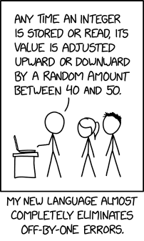
Intro to JavaScript
CSE 331
Spring 2025
Software Design & Implementation
Matt Wang
& Ali, Alice, Andrew, Anmol, Antonio, Connor, Edison, Helena, Jonathan, Katherine, Lauren, Lawrence, Mayee, Omar, Riva, Saan, and Yusong
xkcd #3062

Slide 2
Hello, World!
I’m Matt (he/him), teaching professor in Allen School
have been in intro-adjacent for a bit, teaching 331 for the first time
small research background in programming languages, large professional background in web dev
one spin: have written code used by thousands -- millions of devs, daily*
but: have written bugs that have affected millions of devs*
goal: don’t make my mistakes!

Slide 3
Hello, TAs!
17 lovely TAs this quarter
~ 1:15 ratio – which is amazing
better perspective than me on student experience in the class, tips & tricks, …
lets us have ~ 19 hours of office hours / week
quiz sections are co-taught
meet your TAs on Thursday!

Slide 4
Shoulders of Giants
Materials designed over many iterations of 331
These folks (& others) deserve the flowers
50+ years of professional programming experience
30+ years of research in creating correct software
course is their (+ our) collective wisdom
all mistakes are Matt’s :)

Slide 5
You & Computer Science (approximately)
You already know Java
some basic data structures and algorithms
Working on expanding your knowledge
Programming
Languages
Data
Structures
Java
Algorithms
Databases

Slide 6
Learning More Computer Science
Operating Systems
Distributed Systems
Compilers
Programming
Languages
Data
Structures
Machine
Learning
Networking
Java
AI
Algorithms
Databases
Graphics

Slide 7
Traits of Learning Computer Science
First time solving this kind of problem
Given lots of help
will often tell you if it’s right
Expected to make mistakes
90% is an “A”!
All of these are
different in industry
Skills

Slide 8
Traits of Practicing Computer Science
Not the first time solving this kind of problem
normal to hire someone with prior experience
learn new skills in class or in spare time
No one to tell you if your code is right
That’s your job!
(senior engineers will double check your work, but they expect it to be right)
you will almost never be given tests
😀
Skills

Slide 9
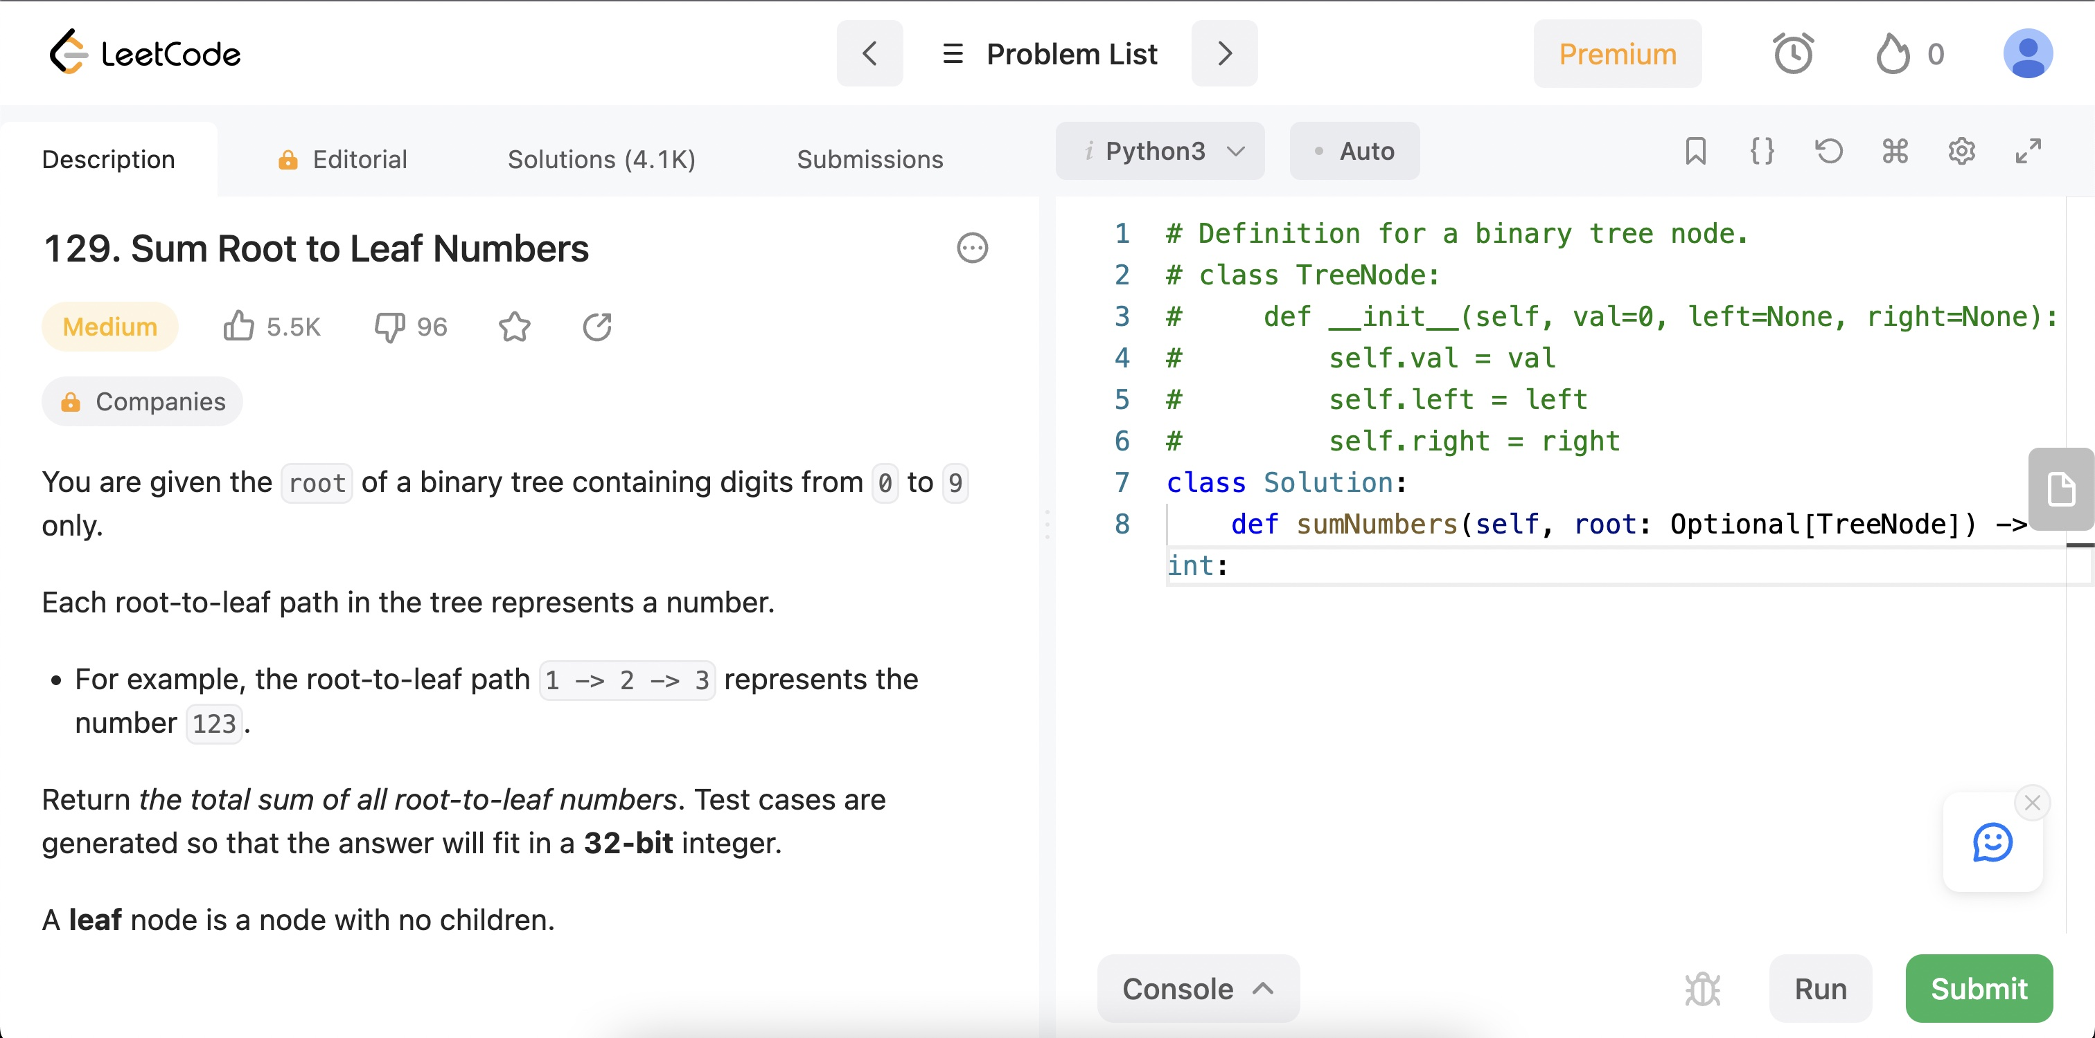
Least “Real World” Setting Possible
Would give you a button to click to see if it’s right…
Someone else already solved this problem.
They only need you for new problems.

Slide 10
Practicing Computer Science: Mistakes
Not the first time solving this kind of problem
normal to hire someone with prior experience
learn new skills in class or in spare time
No one to tell you if your code is right
That’s your job!
(senior engineers will double check your work, but they expect it to be right)
you will almost never be given tests
Mistakes are not acceptable (to users)
90% is not an “A”
10% of 1m users is 100k users calling customer service
1% of 1m users is 10k users calling customer service
😀
☹️
Skills

Slide 11
What This Class is About
Learning what engineers do to make sure their code is correct before sending it to users
Learn a toolkit for being 100% sure it is right
any “computer scientist” must know this
Learn when to use the toolkit
not every problem requires it

Slide 12
We Will Ask You to Write Code Differently
Our goal is not to teach you to write code that looks exactly like what you will see in industry
nor is it to use the libraries most common in industry
the most popular languages and libraries change all the time
Our goal is to teach you to think through your code and to understand how all the parts work
That is best served by writing slowly and carefully
We will force that by
changing programming languages to something unfamiliar
having unusual coding conventions at times

Slide 13
Homework
CSE 331 is a hard class
because coding & debugging are hard!
Most of the work is done outside of class
university policy is 2 hours per hour of class time
plan for 8 hours per week, but…
Wide variation in time required
some students will average 10-15 hours
but this is not expected! be sure to get help if you are averaging over 15 hours (~ “debug” your approach to 331)

Slide 14
Homework Assignments
Nine assignments split into these groups:
HW1
HW2
learn to write more complex apps
practice debugging
HW3
HW4
HW5
learn how to be 100% sure the code is correct
(most of the work done on paper)
HW6
HW7
HW8
learn to use the tools productively
(when to use then and when not to)
HW9

Slide 15
The “Cadence” of the Course
~ 1 topic per week, usually “ending” on Wed
Thu quiz section: practice & ramp-in to HW
HW released Thu night, due following Wed
assumes you’ve gone to section!
section worksheet is HW warmup
by release, know all content needed to do HW
“capstone” of topic (and great exam studying)

Slide 16
Syllabus Pause (and, answering your questions)

Slide 17
Learning a New Language
We’re going to learn some JavaScript
The second language can be the hardest to learn!
some things you took for granted no longer hold
must slow down think about think about every step
We will move slowly
we won’t use all the language this quarter
will not learn every feature of the language
comparison with Java will be useful

Slide 18
Running JavaScript
Can be run in different environments
command line (like Java)
instead of "java MyClass", it is "node mycode.js"
inside the browser
Primarily interesting because of the browser
likely would not be used much otherwise
command line provided so you can use one language for both
In both environments, print output with console.log(..)
prints to command line or “Developer Console” in the browser

Slide 19
Programming for the Browser
JavaScript is the lingua franca of web browsers
Previously, other languages were tried in the browser
Java was used but is no longer supported
Flash was used but is no longer supported
Google’s “Dart” language is still around (probably)
Now, other languages used by compiling into JavaScript
will see an example of this next week
Java can be compiled to JS (but it’s not great)
you can’t really get around needing to learn JS

Slide 20
JavaScript

Slide 21
History of JavaScript
Incredibly simple language
created in 10 days by Brendan Eich in 1995
often difficult to use because it is so simple
Features added later to fix problem areas
imports (ES6)
classes (ES6)
integers (ES2020)

Slide 22
Relationship to Java
Initially had no relation to Java
picked the name because Java was popular then
added Java’s Math library to JS also
e.g., Math.sqrt is available in JS, just like Java
copied some of Java’s String functions to JS string
Both are in the “C family” of languages
much of the syntax is the same
more differences in data types
We will discuss syntax (code) first and then data…

Slide 23
JavaScript Syntax
Both are in the “C family” of languages
Much of the syntax is the same
most expressions (+, -, *, /, ?:, function calls, etc.)
if, for , while , break , continue , return
comments with // or /* .. */
Different syntax for a few things
declaring variables
declaring functions
equality (===)

Slide 24
Java vs JavaScript Syntax
The following code is legal in both languages:
assume “s” and “j” are already declared
s = 0;
j = 0;
while (j < 10) {
s += j;
j++;
}
// Now s == 45
OR for (j = 0; j < 10; j++)

Slide 25
Differences from Java: Type Declarations
JavaScript variables have no declared types
this is a problem… (we will get them back later)
Declare variables in one of these ways:
const x = 1;
let y = "foo";
“const” cannot be changed; “let” can be changed
use “const” whenever possible!

Slide 26
Basic Data Types of JavaScript
JavaScript includes the following runtime types
number
bigint
string
boolean
undefined
null (another undefined)
Object
Array (special subtype of Object)

Slide 27
Differences from Java: “===” operator
JavaScript’s “==” is problematic
tries to convert objects to the same type
e.g., 3 == "3" and even 0 == "" are… true?!?
We will use “===” (and “!==”) instead:
no type conversion will be performed
e.g., 3 === "3" is false
Mostly same as Java
compares values on primitives, references on objects
but strings are primitive in JS (no .equals needed)
== on strings common source of bugs in Java

Slide 28
Checking Types at Run Time
Condition | Code
x is undefined | x === undefined
x is null | x === null
x is a number | typeof x === "number"
x is an integer | typeof x === "bigint"
x is a string | typeof x === "string"
x is an object or array (or null) | typeof x === "object"
x is an array | Array.isArray(x)

Slide 29
Numbers
bigint integers
number floating point (like Java double)
By default, JS uses number not bigint
0, 1, 2 are numbers not integers
add an “n” at the end for integers (e.g., 2n)
All the usual operators: + - * / ++ -- += …
division is different with number and bigint
we will prefer bigint because correctness is more important
Math library largely copied from Java
e.g., Math.sqrt returns the square root

Slide 30
Strings
Mostly the same as Java
immutable
string concatenation with “+”
A few improvements
string comparison with “===” and “<”
no need for s.equals(t)… just write s === t
use either ’..’ or ”..” (single or double quotes)
new string literals that support variable substitution:
const name = "Fred";
console.log(`Hi, ${name}!`); // prints “Hi, Fred!”

Slide 31
Boolean
All the usual operators: && || !
“if” can be used with any value
“falsey” things: false, 0, NaN, "", null, undefined
“truthy” things: everything else
A common source of bugs…
stick to boolean values for all conditions

Slide 32
Record Types
JavaScript “Object” is something with “fields”
JavaScript has special syntax for creating them
const p = {x: 1n, y: 2n};
console.log(p.x); // prints 1n
The term “object” is potentially confusing
used for many things
I prefer it as shorthand for “mathematical object”
Will refer to things with fields as “records”
normal name in programming languages

Slide 33
Record Types: Field Names
Quotes are optional around field names
const p = {x: 1n, y: 2n};
console.log(p.x); // prints 1n
const q = {"x": 1n, "y": 2n};
console.log(q.x); // also prints 1n
Field names are literal strings, not expressions!
const x = "foo";
console.log({x: x}); // prints {”x”: ”foo”}

Slide 34
Record Types: Checking Presence
Retrieving a non-existent field returns “undefined”
const p = {x: 1n, y: 2n};
console.log(p.z); // prints undefined
Can also check for presence with “in”
console.log("x" in p); // prints true
console.log("z" in p); // prints false
Be careful: all records have hidden properties
console.log("toString" in p); // prints true!

Slide 35
Maps
Do not try to use a record as a map!
usually why reason people use “in” and p["name"]
Just use Map instead:
const M = new Map([["a", 1], ["b", 5]]);
console.log(M.get("a")); // prints 1
console.log(M.get("a")); // prints 5
console.log(M.get("toString")); // prints undefined
M.set("a", 2);
M.set("c", 3);
console.log(M.get("a")); // prints 2
console.log(M.get("c")); // prints 3

Slide 36
Sets
JavaScript also provides Set:
const S = new Set(["a", "b"]);
console.log(S.has("a")); // prints true
console.log(S.has("c")); // prints false
S.add("c");
console.log(S.has("c")); // prints true
Constructor takes an (optional) list of initial values
constructor of Map takes a list of pairs

Slide 37
Arrays (like Java ArrayLists)
Simpler syntax for literals:
const A = [1, 2, "foo"]; // no type restriction!
console.log(A[2]); // prints “foo”
Add and remove using push and pop:
A.pop();
console.log(A); // prints [1, 2]
A.push(3);
console.log(A); // prints [1, 2, 3]

Slide 38
Arrays as Objects
Length field stores the length of the array
const A = [1, 2, "foo"];
console.log(A.length); // prints 3
A.pop();
console.log(A.length); // prints 2
Arrays are a special type of object:
console.log(typeof A); // prints ”object”
console.log(Array.isArray(A)); // prints true
console.log(Array.isArray({x: 1})); // prints false

Slide 39
Functions
Functions are first class objects
“arrow” expressions creates functions
store these into a variable to use it later
const add2 = (x, y) => x + y;
console.log(add2(1n, 2n)); // prints 3n
const add3 = (x, y, z) => {
return x + y + z;
};
console.log(add3(1n, 2n, 3n)); // prints 6n

Slide 40
Declaring and Using Functions
We will declare functions like this
const add = (x, y) => {
return x + y;
};
// add(2n, 3n) == 5n
Functions can be passed around
“functional” programming language
but we won’t do that (much) this quarter
we will pass functions to buttons to tell them what to do when clicked
see CSE 341 for more on that topic

Slide 41
Classes
Class syntax is similar to Java but no types:
class Pair {
constructor(x, y) {
this.x = x;
this.y = y;
}
}
const p = new Pair(1, 2);
const q = new Pair(2, 2);
fields are not declared (because there are no types)
constructor is called “constructor” not class name

Slide 42
Declaring Classes
We will declare classes like this:
class Pair {
…
distTo = (p) => {
const dx = this.x – p.x;
const dy = this.y – p.y;
return Math.sqrt(dx*dx + dy*dy);
};
}
console.log(p.distTo(q)); // prints 1
this assignment is executed as part of the constructor
there is another syntax for method declarations but avoid it
leads to big problems when we are writing UI shortly

Slide 43
JavaScript Summary (1/2)
Most of the syntax is the same
even has Map and Set like Java
Main difference is no declared types
That means new syntax for
declaring variables, functions, and classes
checking type a runtime with typeof
That means you can mix types in expressions
but you don't want to! avoid this!
use explicit type conversions (e.g. Number(..)) if necc.

Slide 44
JavaScript Summary (2/2)
A few new features that are useful…
Strings are primitive types
can use "===" and "<" on them
simpler syntax for accessing characters: "s[1]"
Integers have their own type
literals use an "n" suffix, e.g., "3n"
"/" is then integer division
New syntax for string literals: `Hi, ${name}`

Slide 45
HTTP Basics
CSE 331
Spring 2025
JS Weekly Wednesday
Why does
5 + - '2'
evaluate to 3 in JS?
How would JS evaluate:
'5' + - + + - + - - '2'
Software Design & Implementation
Matt Wang
& Ali, Alice, Andrew, Anmol, Antonio, Connor, Edison, Helena, Jonathan, Katherine, Lauren, Lawrence, Mayee, Omar, Riva, Saan, and Yusong

Slide 46
Modules

Slide 47
Imports
Originally, all JavaScript lived in the same "namespace"
problems if two programmers use the same function name
tools would rename functions to avoid conflicts (e.g., webpack)
Now, by default, declarations are hidden outside the file
Add the keyword “export” to make it visible
export const MAX_NUMBER = 15; // in src/foo.js
Use the “import” statement to bring into another file
import { MAX_NUMBER } from './foo.js'; // in src/bar.js
‘./foo.js’ is relative path from this file to foo.js

Slide 48
Imports in (and out) of this class
export const MAX_NUMBER = 15; // in src/foo.js
import { MAX_NUMBER } from ‘./foo.js’; // in src/bar.js
For code you write, you will only need this syntax
JS includes other ways of importing things
full explanation is very complicated
don’t worry about it…
Starter code will include some that look different, e.g.:
import express from 'express';
import './foo.png'; // include a file along with the code

Slide 49
Put Code in Multiple Files
Each file is a separate namespace ("module")
names can be shared (exported) or kept private
Use npm (package manager) to enable this behavior
file called package.json contains project setup
scripts run node with module system enabled
{
"name": "my-project",
"type": "module",
"scripts": {
"exec": "node src/index.js"
}
}

Slide 50
Packages
import express from 'express';
This imports from a package called "express"
use package name not a relative path (like "./foo.js")
Use npm to download libraries
in package.json:
"dependencies": {
"express": "^4.2.1"
}
second part is the version number we want to use
getting the wrong version can make things break, so be specific
"npm install" downloads all libraries listed here

Slide 51
HTTP Servers

Slide 52
Browser Operation
Browser reads the URL to find what HTML to load
server name
path
Contacts the given server and asks for the given path
request
response
(e.g., HTML)
client
server
Notes:
*Two programs* are used to run our app. Second one is started using “npm run start”

Slide 53
URL Parts
URLs have more parts than just server and path:
server name
path
search
fragment
Server name identifies the computer to talk to
uses the HTTP(S) protocol
Conceptually:
path identifies code to execute on the server
search string is input passed to that file when run
(fragment will not be important for us)

Slide 54
Query Parameters
Search string can pass multiple values at once
we call these “query parameters”
Each parameter is of the form “name=value”
no spaces around the “=“
Multiple values are placed together with “&”s in between
?a=3&b=foo&c=Matt
encodes three query parameters: a is “3”, b is “foo”, c is “Matt”

Slide 55
Query Parameter Types
?a=3&b=foo&c=Matt%20W
All values are strings
Special characters (like spaces) are encoded
the encodeURIComponent function does this for us
Will not need to write code to parse query params
have libraries that do this for us

Slide 56
Custom Server with Express
Use "express" library to write a custom server:
const F = (req, res) => {
…
}
const app = express();
app.get(“/foo”, F);
app.listen(8080);
request for http://localhost:8080/foo will call F
mapping from “/foo” to F is called a “route”
can have as many routes as we want (with different URLs)

Slide 57
HTTP Terminology: Requests
HTTP request includes
URL: path and query parameters
method: GET or POST
GET is used to read data stored on the server (cacheable)
POST is used to change data stored on the server
body (for POST only)
useful for sending large or non-string data with the request
Browser issues a GET request when you type URL

Slide 58
HTTP Terminology: Responses
HTTP response includes
status code: 200 (ok), 400-99 (client error), or 500-99 (server error)
was the server able to respond
content type: text/HTML or application/JSON (for us)
what sort of data did the server send back
content
in format described by the Content Type
Browser expects HTML to display in the page
we will always send JSON or text to the browser

Slide 59
Custom Server: Responding to a Request
Query parameters (e.g., ?name=Matt) in req
const F = (req, res) => {
if (req.query.name === undefined) {
res.status(400).send(“Missing ‘name’”);
return;
}
… // name was provided
};
set status to 400 to indicate a client error (Bad Request)
set status to 500 to indicate a server error
default status is 200 (OK)

Slide 60
Custom Server: Content Type
Query parameters (e.g., ?name=Matt) in req
const F = (req, res) => {
if (req.query.name === undefined) {
res.status(400).send(“Missing ‘name’”);
return;
}
res.send(`Hi, ${req.query.name}`); // sent as text
};
Content type will be set automatically:
send of string returned as text/HTML
send of record returned as application/JSON
use this coding convention rather than explicit content type

Slide 61
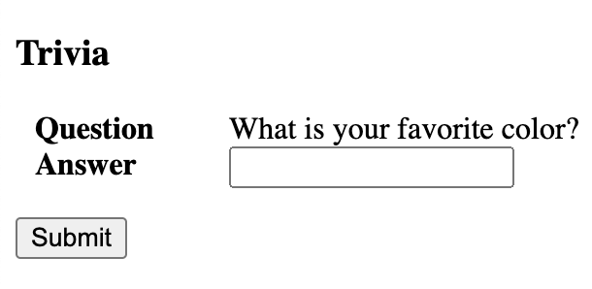
Example App: Interface
User types “blue” and presses “Submit”…

Slide 62
Example App: Requests and Responses
Apps will make sequence of requests to server
GET /new
{text: “Your fav color is?”}
our server
GET /check?answer=blue
{correct: false}
GET /check?answer=yellow
{correct: true}

Slide 63
“Network” Tab Shows Requests
Shows every request to the server
first request loads the app (as usual)
“new” is a request to get a question
“check?index=0&answer=blue” is a request to check answer
Click on a request to see details…

Slide 64
“Network” Tab Shows Request & Response

Slide 65
JSON
JavaScript Object Notation
text description of JavaScript object
allows strings, numbers, null, arrays, and records
no undefined and no instances of classes
no ‘..’ (single quotes), only “..”
requires quotes around keys in records
Translation into string done automatically by send
res.send({index: 0, text: ’What is your …?’});

Slide 66
POST Body
Sent in request as JSON
parsed into a JS object by express library
POST body available in req.body
e.g., if POST body is {"a": 3, "b": 5}
const getAvg = (req, res) => {
const avg = (req.body.a + req.body.b) / 2;
res.send({avg: avg}); // sent as JSON
};
note that req.body.a is a number, not a string

Slide 67
Servers
app.get("/foo", F);
app.listen(8080);
Program does not exit at the end of the file
call to listen tells it to run forever
runs until forcibly stopped (Ctrl-C)
Does work only when request "events" occur
called "event-driven" programs
This is how most real-world programs work
client applications wait for user interaction
servers wait for new requests from clients

Slide 68
Debugging Event-Driven Programs
When command-line program fails…
know the exact inputs that caused it
can re-run it over and over until you understand the cause
When event-driven program fails…
might know the last event that occurred (e.g., that request)
don't know the full sequence of events
don't know the state of all the variables in the program
usually unclear how to reproduce the failure
Debugging real-world programs is hard
in some settings, it is nearly impossible

