Slide 1
Administrivia
Course evaluations due by Sunday
would like to see 50+% participation
Final exam next Tuesday in KNE 220
section B at 2:30 – 4:20
section A at 4:30 – 6:20
No notes or devices
Midterm was 50 minutes and had 5 problems
Final is 110 minutes, so…

Slide 2
Administrivia
At most 9 problems
5 problems on reasoning & testing
primary focus, as promised
three categories of reasoning problems discussed before
Other large problems on:
generics
subtypes, overloading vs overriding
TypeScript
Small problems on anything else (comprehensive)

Slide 3
US News CS Rankings
1 | MIT
2 | CMU
 | UC Berkley
 | Stanford
5 | UIUC
6 | UW
 | Cornell
 | Georgia Tech
Notes:
One area where Stanford does better: almost every student considers founding a company

Slide 4
CSE 331 Software Design & Implementation
Kevin Zatloukal
Spring 2023
Startups

Slide 5
Why Startups?
Startups are a critical part of the economy
responsible for nearly all net job growth
young companies perform the majority of R&D
Obvious examples of world-changing impact
PCs, ecommerce, ride hailing, EVs, cheap space flight, etc.
Most startups fail
about 2/3rd lose all or most money invested
others must increase 5-10x to get normal investment returns
“Expected to fail” path is not as scary as it sounds…

Slide 6
Myth #1: You’ll Go Bankrupt
Startups are corporations (C corps)
Corporations have “limited liability”
In the event of bankruptcy
creditors split up the corporation’s assets
creditors do not get founder’s personal assets
You can only lose the money you put in

Slide 7
Myth #2: You’ll Ruin Your Career
“Founder of X” looks great on a resume
even when the company failed
demonstrates grit, risk-taking, leadership, etc.
requires you to learn a lot of different skills
“Founder of X, Acquired by Y” looks even better
but the first part is already good
A personal example…

Slide 8
Realities
Asymmetric risk/reward
cannot lose more than you put in
can make a lot more than that
money, respect of peers, impact on world, etc.
Forming a startup looks great on a resume
Joining an existing startup also has benefits
more learning
more opportunity for rapid advancement
(this was my path after UW)

Slide 9
Basic Corporation Finances
Revenue money earned
– Expenses
= Income profit
Almost every company loses money initially
new companies (“startups”) need to raise money
Once you are profitable, you control your own destiny
non-profits usually raise money forever
Top Line
Bottom Line

Slide 10
Sources of Funding
Two sources of funding
Debt: a loan
low up-side (fixed percentage)
debt holders have low risk tolerance
frequently want collateral to limit downside
Equity: exchange for part of all future profits
unlimited up-side
equity investors have high risk tolerance

Slide 11
Angel Investors
Most risk-tolerant investors are “angels”
they invest when no one else will
Thomas Edison’s story is widely known
invented the light bulb and electric lighting
took years of hard work
who paid for it?
He had an angel investor
found more money each time Edison ran out
that part of the story is often left out

Slide 12
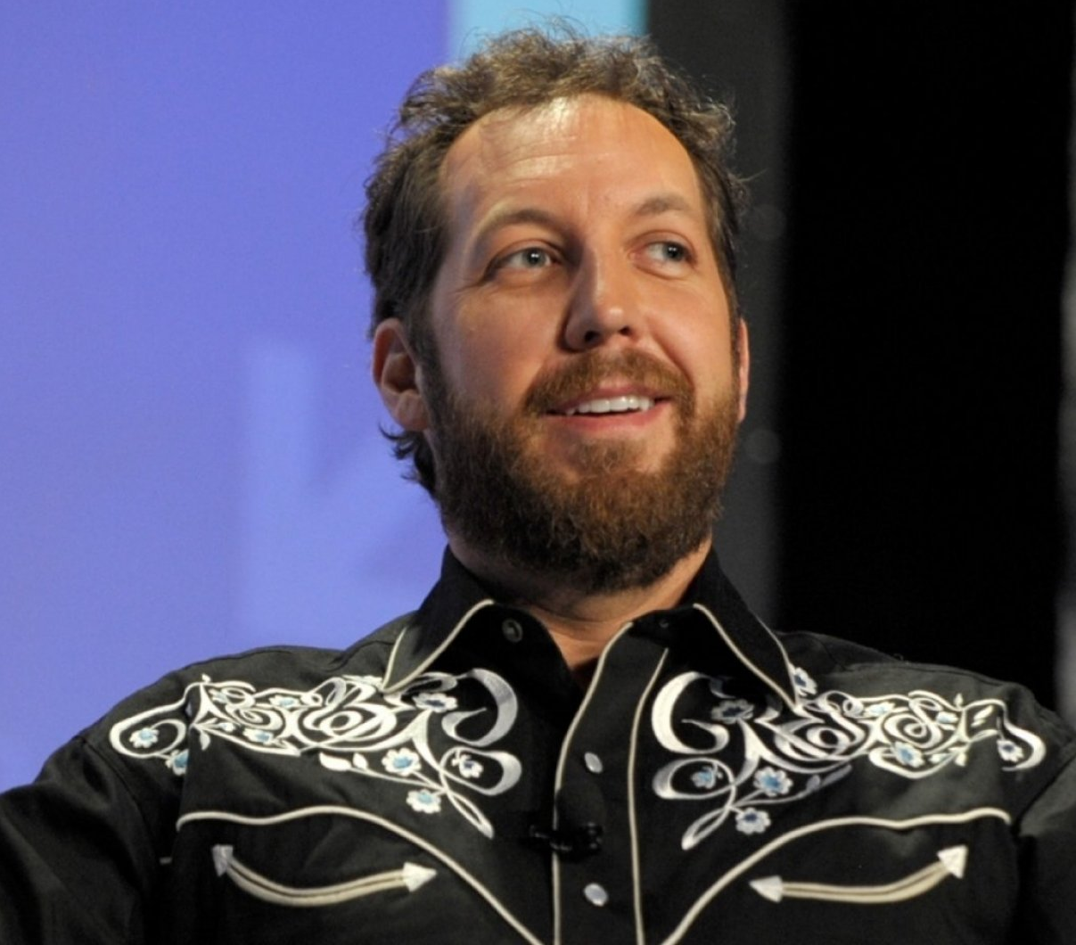
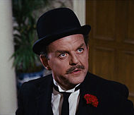
Funding Rounds
Pre-seed angels
Series Seed VC firms / angels
Series A VC firms / institutions
Series B …
…
IPO public market investors
Debt banks / investors
Each stage is less risky than previous

Slide 13
Funding Rounds Sizes (Median)
Pre-seed hundreds of thousands
Series Seed low single-digit millions
Series A high single-digit millions
Series B tens of millions
…
What if you’re not comfortable raising such amounts?
there are ways to raise smaller amounts (more later)
you also might be misunderstanding the relationship between founders and investors

Slide 14
Raising Money
An old saying in finance:
When you owe the bank $100, that’s your problem.
When you owe the bank $100m, that’s the bank’s problem.
The bigger the check, the more they work for you
they don’t want to lose the money invested
they don’t want a bad result on their investment record
“an investment is an endorsement of that company as the winner in this space” — Secrets of Sand Hill Road
VCs can connect you with customers, potential hires, potential new investors, etc.

Slide 15
Raising Money
Expect to sell 20-30% of the company in each round
“dilution” of earlier investors
each round usually includes an option pool
used to hire & replenish the founders’ stake
Recall: only need funding when revenue < expenses
paying customers reduce the need for more funding
also shows that you’re building the right product
can “self-fund” if expenses are low enough
friends & family are sometimes an option
some startups have skipped early rounds (e.g., Calendly)

Slide 16
Company Stages (a16z)
Pre-seed
Series Seed
Series A
Series B
…
IPO
Debt
Product stage
finding product / market fit
Growth stage
taking market share
Operations stage
improving margins & efficiency

Slide 17
Company Stages (a16z)
Pre-seed
Series Seed
Series A
…
Founders of businesses raising Series A/B rounds…
will typically be millionaires on paper
will have lots of help from their investors
Let’s just focus on the product stage
Product stage
finding product / market fit

Slide 18
Series A/B Funding
Established clear “product / market” fit (PMF)
lots of paying customers
e.g., $1m in annual recurring revenue
core group of customers that love the product
high engagement
Raising money to switch into growth mode
hire more people to expand the product
spend on advertising and marketing
capture market share before bigger competitors arrive

Slide 19
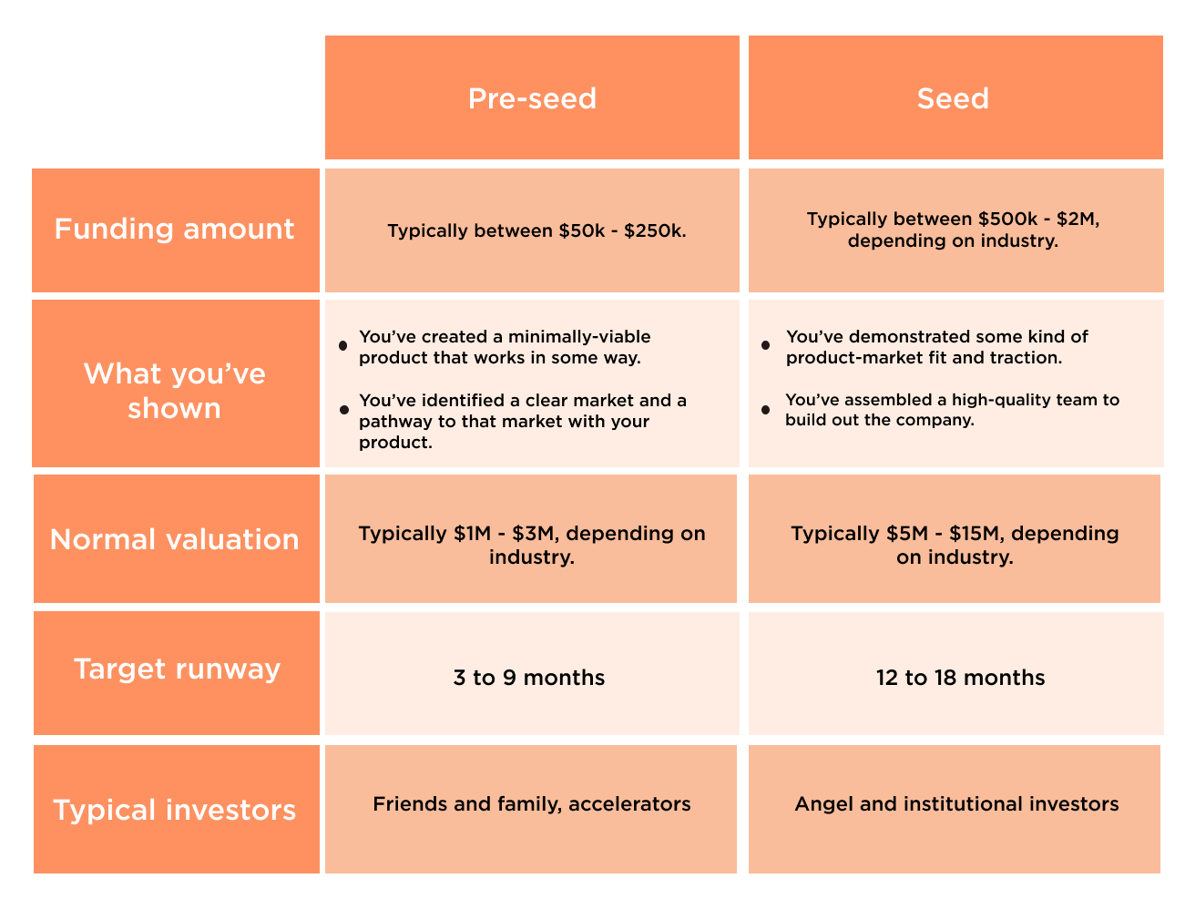
Pre-Seed & Seed Funding
$500k – $1m
$2m – $5m
from brex.com (numbers updated for 2022)

Slide 20
Steps in the Product Stage
Minimally-viable product
can raise pre-seed funding
Some evidence of PMF / traction
can raise seed funding
Clear evidence of PMF (e.g., $1m in ARR)
can raise series A/B funding
Various forms of evidence of PMF
paying customers, waiting lists, letters of intent, etc.

Slide 21
Steps in the Product Stage
Each funding round is to help get to the next round
have a plan for how the money will accomplish that
External funding can start with pre-seed round
Steps involved in pre-seed funding:
find a problem worth solving
identify customers willing to use minimal solution
form a C corporation
prepare a pitch to describe your product / business vision
find investors who want to back you
agree on funding terms with a “SAFE”
5 pages, just two numbers to agree on

Slide 22
Pre-seed Pitch
Can be live or recorded
Questions from potential investors:
Can you ship?
need to finish building the product
Can you sell?
need customers who want to buy the product
Can you hire?
need more than a few people to build most products

Slide 23
Pre-seed Pitch
Can you ship?
need to finish building the product
We spent the whole quarter talking about this!
writing high quality code
tools, inspection, and testing
Pitch includes a demo that shows what you can do
you’ve just seen one!
You also need product ideas & design
must ship a product that people want

Slide 24
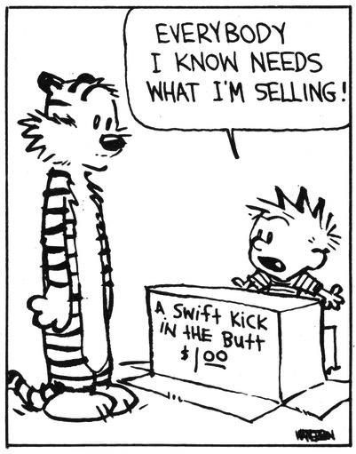
Pre-seed Pitch
Can you sell?
need customers who want to buy the product
what evidence do you have that they exist?
Get feedback
talk to potential customers & investors
code must work (correctness)
Hard to get it right the first time
iterate! (changeability)
How will you find paying customers?
have a plan to use the money for this

Slide 25
Pre-seed Pitch
Can you hire?
need more than a few people to build most products
do you have a story to convince others to join
You are asking employees to bet on the company also
need to sell to them just as much as customers
You will need more programmers (& designers etc.)
must contribute quickly (understandability, modularity)
have a plan to use the money for this

Slide 26
Preparing to Pitch
Expect to hear a lot of “no”s
angel investors may pass on 24 out of 25 pitches
successful companies have had 100 “no”s before a yes
thousands of angel investors… only takes one “yes”
Hard to know what a particular VC is going to think
a16z: “we invest in good ideas that sounds like bad ideas”
may like the team but not the idea or vice versa
Why back this team going after this idea?
what is your personal connection to the problem solved?

Slide 27
More Help
UW CoMotion
startup training
connections and mentoring
office space (part of their startup incubator)
grants based on impact and financial need
CSE 599: Entrepreneurship (offered winter quarter)
co-taught by Greg Gottesman from PSL
PSL is a local startup incubator
Angel investors in Gates & Allen
VCs down the street (e.g., Pack Ventures)

Slide 28
Think About It
Never been easier to do a startup. Vs 40 years ago:
100x more funding available
100x less money required
Startup / venture community
(naïvely) optimistic
supportive
VCs are happy to talk & help before you are ready to pitch
Still many opportunities
one obvious area…
new business ideas any time expensive things become cheap
connectivity, wireless, parallel computing… now AI

