Slide 1
CSE 331 Software Design & Implementation
Kevin Zatloukal
Spring 2022
Generics

Slide 2
Generic Classes
class NewSet<T> implements Set<T> {
// rep invariant:
// non-null, contains no duplicates
// …
List<T> theRep;
T lastItemInserted;
…
}

Slide 3
Generics and subtyping
Number
List<Number>
Collection<Integer>
?
Integer
List<Integer>
List<Integer>
interface List<T> extends Collection<T> {
boolean add(T elt);
T get(int index);
}
Java subtyping is invariant with respect to generics
Not covariant and not contravariant
Neither List<Number> nor List<Integer> subtype of other

Slide 4
Consequences of invariant subtyping
class Utils {
static double sumList(List<Number> lst) {
double result = 0.0;
for (Number n : lst) {
result += n.doubleValue();
}
return result;
}
}
Cannot pass List<Double> to this method!
List<Double> is not a subtype of List<Number>

Slide 5
Generic Methods
class Utils {
static <T extends Number>
double sumList(List<T> lst) {
double result = 0.0;
for (Number n : lst) { // T also works
result += n.doubleValue();
}
return result;
}
}
Can now pass List<Double> to this method
Java can see that this is safe by checking the method body
generic methods work around limitations of generic classes

Slide 6
Where are we?
Done:
basics of generic types for classes and interfaces
basics of bounding generics
Now:
generics and subtyping
generic methods [not just using type parameters of class]
using bounds for more flexible subtyping
using wildcards for more convenient bounds
related digression: Java’s array subtyping
Java realities: type erasure
unchecked casts
equals interactions
creating generic arrays

Slide 7
More verbose first
Last Time:
how to use type bounds to write reusable code despite invariant subtyping
elegant technique using generic methods
general guidelines for making code as reusable as possible
(though not always the most important consideration)
Today: Java wildcards
essentially provide the same expressiveness
less verbose: No need to declare type parameters that would be used only once
better style because Java programmers recognize how wildcards are used for common idioms
easier to read (?) once you get used to it

Slide 8
Best type for addAll
interface Set<E> {
// Adds all elements in c to this set
// (that are not already present)
void addAll(_______ c);
}
<T extends E> void addAll(Collection<T> c);
Can pass a List<Integer> to addAll for a Set<Number>
List<Integer> is a subtype of Collection<Integer>
Collection<Integer> is allowed above
have T = Integer and E = Number

Slide 9
Where are we?
Done:
basics of generic types for classes and interfaces
basics of bounding generics
Now:
generics and subtyping
generic methods [not just using type parameters of class]
using bounds for more flexible subtyping
using wildcards for more convenient bounds
related digression: Java’s array subtyping
Java realities: type erasure
unchecked casts
equals interactions
creating generic arrays

Slide 10
Examples
[Compare to earlier version]
interface Set<E> {
void addAll(Collection<? extends E> c);
}
More idiomatic (but equally powerful) compared to
<T extends E> void addAll(Collection<T> c);
More powerful than void addAll(Collection<E> c);

Slide 11
Wildcards
Syntax: for a type-parameter instantiation (inside the <…>), can write:
? extends Type, some unspecified subtype of Type
? is shorthand for ? extends Object
A wildcard is essentially an anonymous type variable
each ? stands for some possibly-different unknown type

Slide 12
? versus Object
? indicates a particular but unknown type
void printAll(List<?> lst) {…}
Difference between List<?> and List<Object>:
can instantiate ? with any type: Object, String, …
List<Object> much more restrictive:
e.g., wouldn't take a List<String>
Difference between List<Number> and List<? extends Number>:
can instantiate ? with Number, Integer, Double, …
first version is much more restrictive

Slide 13
Non-example
<T extends Comparable<T>> T max(Collection<T> c);
No change because T used more than once
must choose a name to say that two types must match

Slide 14
Wildcards
Syntax: for a type-parameter instantiation (inside the <…>), can write:
? extends Type, some unspecified subtype of Type
? is shorthand for ? extends Object
A wildcard is essentially an anonymous type variable
each ? stands for some possibly-different unknown type
use a wildcard when you would use a type variable only once (no need to give it a name)
communicates to readers of your code that the type’s “identity” is not needed anywhere else

Slide 15
Wildcards
Syntax: for a type-parameter instantiation (inside the <…>), can write:
? extends Type, some unspecified subtype of Type
? is shorthand for ? extends Object
? super Type, some unspecified superclass of Type
Wildcard can have lower bounds instead of upper bounds!
says that ? must be Type or a superclass of Type

Slide 16
Type Bounds
Upper Bound
? extends Number
Lower bound
? super Number
Object
Object
Number
Number
Integer
Integer

Slide 17
Revisit copy method
First version:
<T> void copyTo(List<T> dst, List<T> src) {
for (T t : src)
dst.add(t);
}
More general version:
<T1, T2 extends T1> void copyTo(List<T1> dst,
List<T2> src) {
for (T2 t : src)
dst.add(t);
}

Slide 18
More examples
<T> void copyTo(List<? super T> dst, List<? extends T> src) {
for (T t : src)
dst.add(t);
}
Why this works:
lower bound of T for where callee puts values
upper bound of T for where callee gets values
callers get the subtyping they want
Example: copy(numberList, integerList)
Example: copy(stringList, stringList)

Slide 19
PECS: Producer Extends, Consumer Super
Should you use extends or super or neither?
use ? extends T when you get values (from a producer)
no problem if it’s a subtype
(the co-variant subtyping case)
use ? super T when you put values (into a consumer)
no problem if it’s a supertype
(the contra-variant subtyping case)
use neither (just T, not ?) if you both get and put
can’t be as flexible here
<T> void copyTo(List<? super T> dst, List<? extends T> src);

Slide 20
More on lower bounds
As we’ve seen, lower-bound ? super T is useful for “consumers”
Upper-bound ? extends T could be rewritten without wildcards, but wildcards preferred style where they suffice
But lower-bound is only available for wildcards in Java
this does not parse:
<T super Foo> void m(Bar<T> x);
no good reason for Java not to support such lower bounds except designers decided it wasn’t useful enough to bother
¯\_(ツ)_/¯

Slide 21
Legal operations on wildcard types
Object o;
Number n;
Integer i;
PositiveInteger p;
List<? extends Integer> lei;
First, which of these is legal?
lei = new ArrayList<Object>();
lei = new ArrayList<Number>();
lei = new ArrayList<Integer>();
lei = new ArrayList<PositiveInteger>();
lei = new ArrayList<NegativeInteger>();

Slide 22
Legal operations on wildcard types
Object o;
Number n;
Integer i;
PositiveInteger p;
List<? extends Integer> lei;
First, which of these is legal?
lei = new ArrayList<Object>();
lei = new ArrayList<Number>();
lei = new ArrayList<Integer>();
lei = new ArrayList<PositiveInteger>();
lei = new ArrayList<NegativeInteger>();

Slide 23
Legal operations on wildcard types
Object o;
Number n;
Integer i;
PositiveInteger p;
List<? extends Integer> lei;
First, which of these is legal?
lei = new ArrayList<Object>();
lei = new ArrayList<Number>();
lei = new ArrayList<Integer>();
lei = new ArrayList<PositiveInteger>();
lei = new ArrayList<NegativeInteger>();
Which of these is legal?
o = lei.get(0);
n = lei.get(0);
i = lei.get(0);
p = lei.get(0);

Slide 24
Legal operations on wildcard types
Object o;
Number n;
Integer i;
PositiveInteger p;
List<? extends Integer> lei;
First, which of these is legal?
lei = new ArrayList<Object>();
lei = new ArrayList<Number>();
lei = new ArrayList<Integer>();
lei = new ArrayList<PositiveInteger>();
lei = new ArrayList<NegativeInteger>();
Which of these is legal?
o = lei.get(0);
n = lei.get(0);
i = lei.get(0);
p = lei.get(0);

Slide 25
Legal operations on wildcard types
Object o;
Number n;
Integer i;
PositiveInteger p;
List<? extends Integer> lei;
First, which of these is legal?
lei = new ArrayList<Object>();
lei = new ArrayList<Number>();
lei = new ArrayList<Integer>();
lei = new ArrayList<PositiveInteger>();
lei = new ArrayList<NegativeInteger>();
Which of these is legal?
o = lei.get(0);
n = lei.get(0);
i = lei.get(0);
p = lei.get(0);
lei.add(o);
lei.add(n);
lei.add(i);
lei.add(p);
lei.add(null);

Slide 26
Legal operations on wildcard types
Object o;
Number n;
Integer i;
PositiveInteger p;
List<? extends Integer> lei;
First, which of these is legal?
lei = new ArrayList<Object>();
lei = new ArrayList<Number>();
lei = new ArrayList<Integer>();
lei = new ArrayList<PositiveInteger>();
lei = new ArrayList<NegativeInteger>();
Which of these is legal?
o = lei.get(0);
n = lei.get(0);
i = lei.get(0);
p = lei.get(0);
lei.add(o);
lei.add(n);
lei.add(i);
lei.add(p);
lei.add(null);

Slide 27
Legal operations on wildcard types
Object o;
Number n;
Integer i;
PositiveInteger p;
List<? super Integer> lsi;
First, which of these is legal?
lsi = new ArrayList<Object>;
lsi = new ArrayList<Number>;
lsi = new ArrayList<Integer>;
lsi = new ArrayList<PositiveInteger>;
lsi = new ArrayList<NegativeInteger>;

Slide 28
Legal operations on wildcard types
Object o;
Number n;
Integer i;
PositiveInteger p;
List<? super Integer> lsi;
First, which of these is legal?
lsi = new ArrayList<Object>;
lsi = new ArrayList<Number>;
lsi = new ArrayList<Integer>;
lsi = new ArrayList<PositiveInteger>;
lsi = new ArrayList<NegativeInteger>;

Slide 29
Legal operations on wildcard types
Object o;
Number n;
Integer i;
PositiveInteger p;
List<? super Integer> lsi;
First, which of these is legal?
lsi = new ArrayList<Object>;
lsi = new ArrayList<Number>;
lsi = new ArrayList<Integer>;
lsi = new ArrayList<PositiveInteger>;
lsi = new ArrayList<NegativeInteger>;
Which of these is legal?
lsi.add(o);
lsi.add(n);
lsi.add(i);
lsi.add(p);
lsi.add(null);

Slide 30
Legal operations on wildcard types
Object o;
Number n;
Integer i;
PositiveInteger p;
List<? super Integer> lsi;
First, which of these is legal?
lsi = new ArrayList<Object>;
lsi = new ArrayList<Number>;
lsi = new ArrayList<Integer>;
lsi = new ArrayList<PositiveInteger>;
lsi = new ArrayList<NegativeInteger>;
Which of these is legal?
lsi.add(o);
lsi.add(n);
lsi.add(i);
lsi.add(p);
lsi.add(null);

Slide 31
Legal operations on wildcard types
Object o;
Number n;
Integer i;
PositiveInteger p;
List<? super Integer> lsi;
First, which of these is legal?
lsi = new ArrayList<Object>;
lsi = new ArrayList<Number>;
lsi = new ArrayList<Integer>;
lsi = new ArrayList<PositiveInteger>;
lsi = new ArrayList<NegativeInteger>;
Which of these is legal?
lsi.add(o);
lsi.add(n);
lsi.add(i);
lsi.add(p);
lsi.add(null);
o = lsi.get(0);
n = lsi.get(0);
i = lsi.get(0);
p = lsi.get(0);

Slide 32
Legal operations on wildcard types
Object o;
Number n;
Integer i;
PositiveInteger p;
List<? super Integer> lsi;
First, which of these is legal?
lsi = new ArrayList<Object>;
lsi = new ArrayList<Number>;
lsi = new ArrayList<Integer>;
lsi = new ArrayList<PositiveInteger>;
lsi = new ArrayList<NegativeInteger>;
Which of these is legal?
lsi.add(o);
lsi.add(n);
lsi.add(i);
lsi.add(p);
lsi.add(null);
o = lsi.get(0);
n = lsi.get(0);
i = lsi.get(0);
p = lsi.get(0);

Slide 33
Where are we?
Done:
basics of generic types for classes and interfaces
basics of bounding generics
Now:
generic methods [not just using type parameters of class]
generics and subtyping
using bounds for more flexible subtyping
using wildcards for more convenient bounds
related digression: Java’s array subtyping
Java realities: type erasure
unchecked casts
equals interactions
creating generic arrays

Slide 34
Java arrays
We know how to use arrays:
declare an array holding Type elements: Type[]
get an element: x[i]
set an element x[i] = e;
Java included the syntax above because it’s common and concise
But can reason about how it should work the same as this:
class Array<T> {
public T get(int i) { … “magic” … }
public T set(T newVal, int i) {… “magic” …}
}
So: If Type1 is a subtype of Type2, how should Type1[] and Type2[] be related??

Slide 35
Java Arrays
Given everything we have learned, if Type1 is a subtype of Type2, then Type1[] and Type2[] should be unrelated
invariant subtyping for generics
because arrays are mutable

Slide 36
Surprise!
Given everything we have learned, if Type1 is a subtype of Type2, then Type1[] and Type2[] should be unrelated
invariant subtyping for generics
because arrays are mutable
But in Java, if Type1 is a subtype of Type2, then Type1[] is a subtype of Type2[] (covariant subtyping)
not true subtyping: the subtype does not support setting an array element to hold a Type2 (spoiler: throws an exception)
Java (and C#) made this decision in pre-generics days
needed to write reusable sorting routines, etc.
also ¯\_(ツ)_/¯

Slide 37
What can happen: the good
Programmers can use this subtyping to “do okay stuff”
void maybeSwap(LibraryHolding[] arr) {
if(arr[17].dueDate() < arr[34].dueDate())
// … swap arr[17] and arr[34]
}
// client with subtype
Book[] books = …;
maybeSwap(books); // relies on covariant
// array subtyping
LibraryHolding
Book
CD

Slide 38
What can happen: the bad
Something in here must go wrong!
void replace17(LibraryHolding[] arr,
LibraryHolding h) {
arr[17] = h;
}
// client with subtype
Book[] books = …;
LibraryHolding theWall = new CD("Pink Floyd",
"The Wall", …);
replace17(books, theWall);
Book b = books[17]; // would hold a CD
b.getChapters(); // so this would fail
LibraryHolding
Book
CD

Slide 39
Java’s choice
Java normally guarantees run-time type is a subtype of the compile-time type
this was violated for the Book b variable
To preserve the guarantee, Java must never get that far:
each array “knows” its actual run-time type (e.g., Book [])
trying to store a supertype into an index causes ArrayStoreException (at run time)
So the body of replace17 would raise an exception
even though replace17 is entirely reasonable
and fine for plenty of “careful” clients
every Java array-update includes this run-time check
(array-reads never fail this way – why?)
beware careful with array subtyping

Slide 40
Where are we?
Done:
basics of generic types for classes and interfaces
basics of bounding generics
Now:
generic methods [not just using type parameters of class]
generics and subtyping
using bounds for more flexible subtyping
using wildcards for more convenient bounds
related digression: Java’s array subtyping
Java realities: type erasure
unchecked casts
equals interactions
creating generic arrays

Slide 41
Type erasure
All generic types become type Object once compiled
List<String> lst = new ArrayList<String>();
at runtime, becomes
List<Object> lst = new ArrayList<Object>();
Generics are purely a compiler feature!

Slide 42
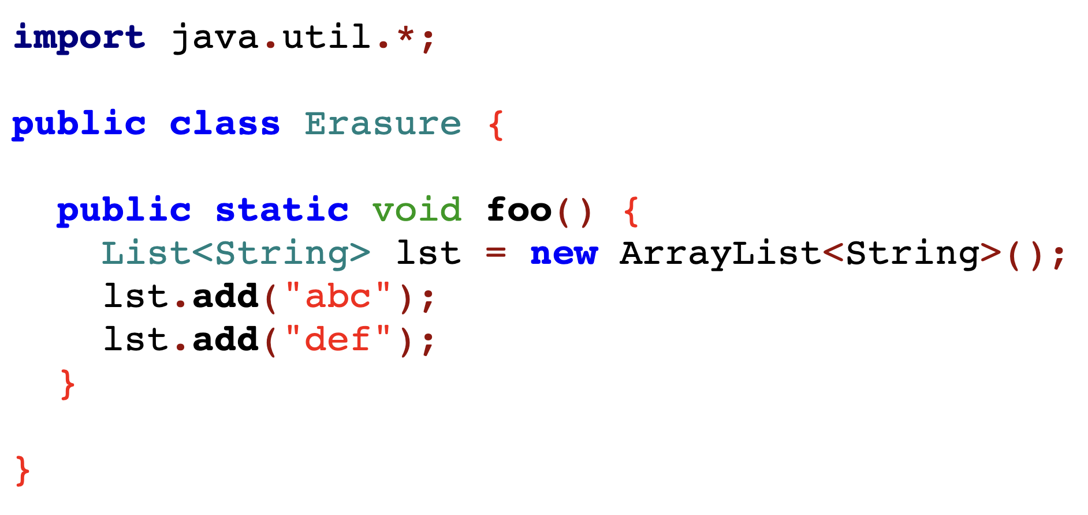
Type erasure example

Slide 43
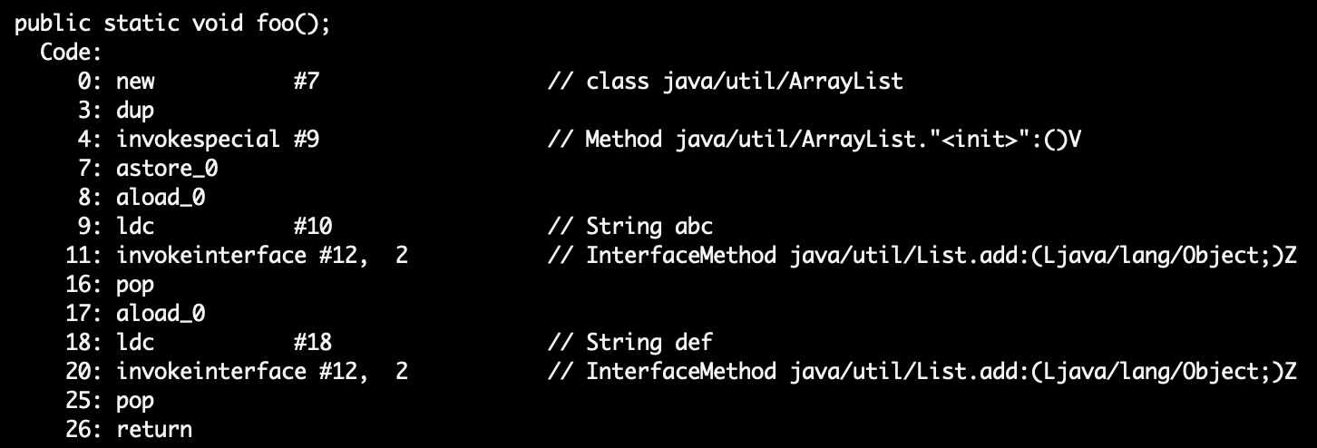
Type erasure example
Compile-time signature is add(String) but the bytecodes say…

Slide 44
Type erasure
All generic types become type Object once compiled
gives backward compatibility (a selling point at time of adoption)
at run-time, all generic instantiations have the same type
Cannot use instanceof to discover a type parameter
Collection<?> cs = new ArrayList<String>();
if (cs instanceof Collection<String>) { // illegal
...
}

Slide 45
Generics and casting
Casting to generic type results in an important warning
List<?> lg = new ArrayList<String>(); // ok
List<String> ls = (List<String>) lg; // warn
Compiler gives a warning because this is something the runtime system will not check for you
Usually, if you think you need to do this, you're wrong
a real need to do this is extremely rare
Object can also be cast to any generic type ☹
public static <T> T badCast(T t, Object o) {
return (T) o; // unchecked warning
}

Slide 46
The bottom-line
Java guarantees a List<String> variable always holds a (subtype of) the raw type List
Java does not guarantee a List<String> variable always has only String elements at run-time
will be true if no unchecked cast warnings are shown
compiler inserts casts to/from Object for generics
if these casts fail, hard-to-debug errors result: often far from where conceptual mistake occurred
So, two reasons not to ignore warnings:
You’re violating good style/design/subtyping/generics
You’re risking difficult debugging

Slide 47
Recall equals
class Node {
…
@Override
public boolean equals(Object obj) {
if (!(obj instanceof Node)) {
return false;
}
Node n = (Node) obj;
return this.data.equals(n.data);
}
…
}

Slide 48
equals for a parameterized class
Erasure: Type arguments do not exist at runtime
class Node<E> {
…
@Override
public boolean equals(Object obj) {
if (!(obj instanceof Node<E>)) {
return false;
}
Node<E> n = (Node<E>) obj;
return this.data.equals(n.data);
}
…
}

Slide 49
equals for a parameterized class
class Node<E> {
…
@Override
public boolean equals(Object obj) {
if (!(obj instanceof Node<E>)) {
return false;
}
Node<E> n = (Node<E>) obj;
return this.data.equals(n.data);
}
…
}
More erasure: At run time, do not know what E is and will not be checked, so don’t indicate otherwise

Slide 50
equals for a parameterized class
class Node<E> {
…
@Override
public boolean equals(Object obj) {
if (!(obj instanceof Node<?>)) {
return false;
}
Node<?> n = (Node<?>) obj;
return this.data.equals(n.data);
}
…
}
Works if the type of obj is Node<Elephant> or Node<String> or …
Leave it to here to “do the right thing” if this and n differ on element type
Node<? extends Object>
Node<Elephant>
Node<String>

Slide 51
Generics and arrays
public class Foo<T> {
private T aField; // ok
private T[] anArray; // ok
public Foo() {
aField = new T(); // compile-time error
anArray = new T[10]; // compile-time error
}
}
You cannot create objects or arrays of a parameterized type
type info is not available at runtime

Slide 52
Necessary array cast
public class Foo<T> {
private T aField;
private T[] anArray;
@SuppressWarnings("unchecked")
public Foo(T param) {
aField = param;
anArray = (T[]) new Object[10];
}
}
You can declare variables of type T, accept them as parameters, return them, or create arrays by casting Object[]
casting to generic types is not type-safe (hence the warning)
Effective Java: use ArrayList instead

Slide 53
Final Thoughts

Slide 54
Generics clarify your code
interface Map {
Object put(Object key, Object value);
…
}
interface Map<Key,Value> {
Value put(Key key, Value value);
…
}
Generics always make the client code prettier and safer
Generics usually clarify the implementation
(but sometimes uglify: wildcards, arrays, instantiation)
plus casts in client code
→ possibility of run-time errors
Notes:
Why do we care?

Slide 55
Tips when writing a generic class
Think through whether you really need to make it generic
if it’s not really a container, most likely a mistake
Start by writing a concrete instantiation
get it correct (testing, reasoning, etc.)
consider writing a second concrete version
Generalize it by adding type parameters
think about which types are the same or different
the compiler will help you find errors
It will become easier with practice to write generic from the start

