Slide 1
CSE 331 Software Design & Implementation
Kevin Zatloukal
Spring 2022
Module Design & Style

Slide 2
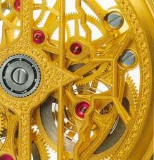
The limits of scaling
Can’t built arbitrarily large physical structures that work perfectly and indefinitely
friction, gravity, wear-and-tear
Software has no such problems!
So what prevents arbitrarily large software?
… it’s the difficulty of understanding it!
The force of friction is replaced by a force in software that creates interdependence (“coupling”) between different parts of the code
in particular, this force makes it hard to understand one part of the code without understanding many other parts

Slide 3
The limits of scaling
Can’t built arbitrarily large physical structures that work perfectly and indefinitely
friction, gravity, wear-and-tear
Software has no such problems!
So what prevents arbitrarily large software?
… it’s the difficulty of understanding it!
We make software easier to understand by breaking it into pieces that can be understood (and built) separately — using modularity

Slide 4
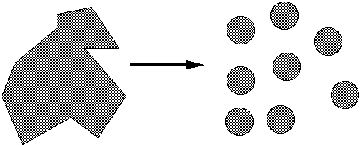
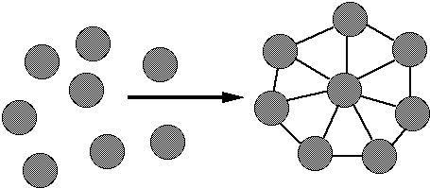
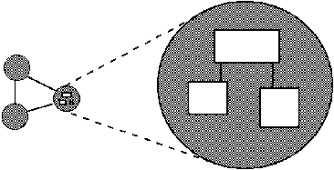
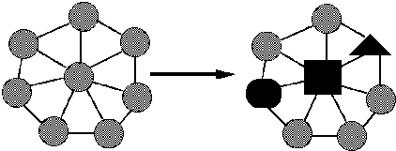
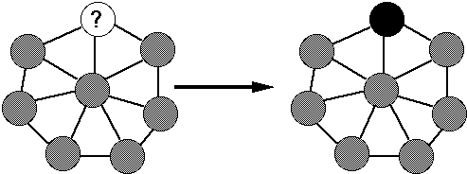
Many goals of modular software...
Decomposable – can be broken down into modules to reduce complexity and allow teamwork
Composable – “Having divided to conquer, we must reunite to rule [M. Jackson].”
Understandable – one module can be examined, reasoned about, & developed in isolation
Continuity – a small change in the requirements should affect a small number of modules
Isolation – an error in one module should be as contained as possible

Slide 5
Most important design issues
Coupling – how much dependency there is between components
want to understand each component without (much) understanding of the others
Cohesion – how well parts of a component fit and work together
form something that is self-contained, independent, and with a single, well-defined purpose
Goals: decrease coupling, increase cohesion
Applies to modules and smaller units
each method should do one thing well
each module should provide a single abstraction

Slide 6
Cohesion
The common design objective, separation of concerns,
suggests a module should represent a single concept
a common kind of “concept” is an ADT
If a module implements more than one abstraction,
consider breaking it into separate modules for each one

Slide 7
Coupling
How are modules dependent on one another?
statically (in the code)? dynamically (at run-time)? for us:
do we need to understand one to understand the other?
ideally, split design into parts with little interdependency
The more coupled modules are, the more they need to be thought about all at the same time in order to be understood
MY
FINAL
PROJECT
MY
MY
FINAL
PROJECT
FINECT
PROJAL
An application
A poor decomposition
(parts strongly coupled)
A better decomposition
(parts weakly coupled)

Slide 8
Coupling leads to Spaghetti Code
Coupling induces more and more coupling eventually turning into ”spaghetti code”
Lacks all the properties of high quality code
hard to understand
hard to change
hard to make correct
Can be necessary to throw away the code and start over

Slide 9
“God” classes
god class: hoards most of the data or functionality of a system
depends on and is depended on by every other module
poor cohesion – little thought about why all the elements are placed together
reduces coupling but only by collapsing multiple modules into one (which replaces dependences between modules with dependences within a module)
A god class is an example of an anti-pattern
a known bad way of doing things

Slide 10
DESIGN in Java

Slide 11
Class design ideals
Cohesion and coupling, already discussed
Completeness: should every class present a complete interface?
good advice for public libraries
for other code, better to avoid unnecessary work
can leave TODOs for what you want to add later
or have methods that throw RuntimeException(“not yet implemented”)
Consistency: in names, param/returns, ordering, and behavior
(more later...)

Slide 12
Class Cohesion Examples
Confine user interaction to a core set of “view” classes and isolate these from the classes that maintain the key system data
see HW7-9
Do not put print statements in your core classes
this locks your code into a text representation
makes it less useful if the client wants a GUI, a web app, etc.
Instead, have your core classes return data that can be displayed by the view classes
which of the following is better?
public void printMyself()
public String toString()

Slide 13
Method Cohesion
Methods should do one thing well:
compute a value but let client decide what to do with it
don’t print as a side effect of some other operation
observe or mutate, don’t do both
Having a method do multiple, not-necessarily-related things limits future possible uses
“Flag” variables are often a symptom of poor method cohesion
often mean the method is doing multiple things

Slide 14
Method design
Effective Java (EJ) Tip: Design method signatures carefully
avoid long parameter lists
especially error-prone if parameters are all the same type
avoid methods that take lots of Boolean “flag” parameters
Which of these has a bug?
memset(ptr, size, 0);
memset(ptr, 0, size);
EJ Tip: Use overloading judiciously
Can be useful, but avoid overloading with same number of parameters, and think about whether methods really are related
Notes:
Memset example from Zero Bugs and Program Faster by Kate Thompson

Slide 15
Consistency
A class or interface should have consistent names, parameters/returns, ordering, and behavior
Use similar naming; accept parameters in the same order
Counterexamples:
setFirst(int index, String value) setLast(String value, int index)
Date/GregorianCalendar use 0-based months
String methods: equalsIgnoreCase, compareToIgnoreCase; but regionMatches(boolean ignoreCase)
String.length(), array.length, collection.size()

Slide 16
Constructor design
Constructors should have all the arguments necessary to initialize the object's state – no more, no less
Object should be completely initialized after constructor is done
(i.e., the rep invariant should hold)
Shouldn't need to call other methods to “finish” initialization
sometimes tempting but an easy way to cause bugs
complex initialization can be done using a “builder” pattern
(more on this in later in the course)

Slide 17
Field design
A variable should be made into a field if and only if:
it has a value that retains meaning throughout the object's life
its state must persist past the end of any one public method
All other variables can and should be local to the methods
fields should not be used to avoid parameter passing
not every constructor parameter needs to be a field
Exception to the rule: when we don’t control the interface
example: Thread.run

Slide 18
Choosing types – some hints
Numbers: favor int and long for most numeric computations
EJ Tip: avoid float / double if exact answers are required
Classic example: money (round-off is bad here)
Strings are often used since much data is read as text,
but keeping numbers as strings is a bad idea.

Slide 19
Enums make code more readable
Consider use of enums, even with only two values – which of the following is better?
oven.setTemp(97, true);
oven.setTemp(97, Temperature.CELSIUS);

Slide 20
Last thoughts (for now)
Always remember your reader and add comments for them
Who are they?
Clients of your code
Other programmers working with the code
(including yourself in 6 weeks/months/years)
What do they need to know?
How to use it (clients)
How it works, but more important, why it was done this way (implementers)
Think about mistakes that might be made (by you or others)
if you have enough clients, someone will make that mistake
design to prevent or at least catch those mistakes
pay special attention to bugs that will be hard to detect

Slide 21
Readability

Slide 22
Naming
Choosing good names is important for readability
With well chosen names, code can be “self-documenting”
no need to include comments with explanation
code explains itself

Slide 23
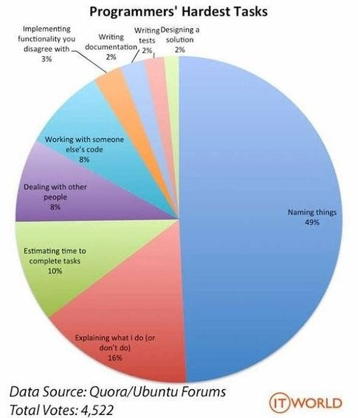

Slide 24
Bad names
flag, status, compute, check, pointer, names starting with my…
convey very little useful information!
(count is okay if meaning is very clear from context)
Describe what is being counted, what the “flag” indicates, etc.
numStudents, courseIsFull, … (fields) calculatePayroll, validateWebForm, … (methods)
But short names in local contexts are good:
Good: for (i = 0; i < size; i++) items[i]=0;
Bad: for (theLoopCounter = 0; theLoopCounter < theCollectionSize; theLoopCounter++) theCollectionItems[theLoopCounter]=0;
Notes:
But theSystemIsAboutToDieAHorribleDeath was pretty good in an old OS

Slide 25
Good names
EJ Tip: Adhere to generally accepted naming conventions
Class names: generally nouns
start with a capital letter (unlike fields & variables)
use CamelCaps not Underscore_Name
Interface names often –able/-ible adjectives:
Iterable, Comparable, …
Method names: noun or verb phrases
verbs+noun for observers: getX, isX, hasX
verbs for mutators: move, append
verbs+noun for mutators: setX
choose affirmative, positive names over negative ones
isSafe not isUnsafe
isEmpty not hasNoElements

Slide 26
Method Bodies
Write method bodies to make them easy to read
make life easier for your code reviewer
(make life easier for yourself when you come back later)
Break code into nicely sized “paragraphs”
i.e., consecutive lines of code with no blank lines
Put a comment at the top of the paragraph
(unless the code is just as readable as the comment)
use full sentences and correct English

Slide 27
Method Bodies Example 1
This code computes “edit distance” (see CSE 421)
Even if you know what it does, it’s hard to follow.
for (int i = 0; i < m; i++)
A[i][0] = i;
for (int j = 0; j < n; j++)
A[0][j] = j;
for (int i = 1; i < m; i++)
for (int j = 1; j < n; j++)
A[i][j] = min(A[i-1][j] + 1, A[i][j-1] + 1,
(s[i-1] == t[j-1]) ? A[i-1][j-1] : infinity);
return A[m][n];

Slide 28
Method Bodies Example 1
Break into smaller paragraphs and explain what each does.
// Fill in match costs for empty prefixes.
for (int i = 0; i < m; i++)
A[i][0] = i;
for (int j = 0; j < n; j++)
A[0][j] = j;
// Find the match costs between every pair of prefixes.
for (int i = 1; i < m; i++)
for (int j = 1; j < n; j++)
A[i][j] = min(A[i-1][j] + 1, A[i][j-1] + 1,
(s[i-1] == t[j-1]) ? A[i-1][j-1] : infinity);
// Return the least cost to match the whole strings.
return A[m][n];

Slide 29
Method Bodies Example 1
Break into smaller paragraphs and comment each one.
// Fill in match costs for empty prefixes.
for (int i = 0; i < m; i++)
A[i][0] = i;
for (int j = 0; j < n; j++)
A[0][j] = j;
// Find the match costs between every pair of prefixes.
for (int i = 1; i < m; i++) {
for (int j = 1; j < n; j++) {
// Least cost way to match s[0:i] to t[0:j] is lowest
// of three options: (1) ...
A[i][j] = min(A[i-1][j] + 1, A[i][j-1] + 1,
(s[i-1] == t[j-1]) ? A[i-1][j-1] : infinity);

Slide 30
Method Bodies Example 2
Don’t necessarily need to comment each loop.
This has one comment that describes two for loops.
// Create directed edges between each pair of nodes.
for (Node start : nodes) {
for (Node end : nodes) {
if (!start.equals(end)) {
graph.addEdge(start, end);
}
}
}
This is also a case where writing the invariant in detail makes it harder to understand. (Generally true for “do X for each Y” loops.)

Slide 31
Method Bodies Example 3
This comment is unnecessary (even insulting):
// close the reader
reader.close() 😑
A comment should add something. This adds a little:
// clean up
reader.close()
But really, the code is fine by itself:
reader.close()

Slide 32
But…
Don’t include everything you can possibly think of
if you include it, you’re stuck with it forever (even if almost nobody ever uses it)
Tricky balancing act: include what’s useful, but don’t make things overly complicated
you can always add it later if you really need it
except for public libraries, better to wait if you can
less code is thrown away when you realize it’s all wrong
“Everything should be made as simple as possible, but not simpler.”
- Einstein

Slide 33
Documenting a class
Keep internal and external documentation separate
External: /** ... */ Javadoc for classes, interfaces, methods
describes things that clients need to know about the class
should be specific enough to exclude unacceptable implementations, but general enough to allow for all correct implementations
includes all pre/postconditons, etc.
Internal: // comments inside method bodies
describes details of how the code is implemented
information for fellow developer working on this class
tricky parts of the code
loop and representation invariants
important decisions you made

