Slide 1
CSE 331 Software Design & Implementation
Kevin Zatloukal
Spring 2022
Exceptions and Assertions

Slide 2
Outline
General concepts about dealing with errors and failures
Assertions: what, why, how
for things you believe will/should never happen
Exceptions: what, how
how to throw, catch, and declare exceptions in Java
subtyping of exceptions
checked vs. unchecked exceptions
Exceptions: why in general
for things you believe are bad and should rarely happen
and many other style issues
Alternative with trade-offs: Returning special values
Summary and review

Slide 3
Not all “errors” should be failures
Some “error” cases:
1. Misuse of your code
e.g., precondition violation
should be a failure (i.e., made visible to the user)
2. Errors in your code vs reasoning
e.g., representation invariant fails to hold
should be a failure
3. Unexpected resource problems
e.g., missing file, server offline, …
not an error in the sense above (... these are not bugs)
should not be a failure (i.e., do try to recover)

Slide 4
What to do when failing
Fail fast and fail friendly
Goal 1: Prevent harm
stop before anything worse happens
(do still need to perform cleanup: close open resources etc.)
Goal 2: Give information about the problem
failing quickly helps localize the defect
a good error message is important for debugging

Slide 5
Errors that should be failures
A precondition prohibits misuse of your code
weakens the spec by throwing out unhandled cases
This ducks the problem of errors-will-happen
with enough clients, someone will use your code incorrectly
Practice defensive programming:
usually makes sense to check for these errors
even though you don’t specify what the behavior will be, it still makes sense to fail fast

Slide 6
Outline
General concepts about dealing with errors and failures
Assertions: what, why, how
for things you believe will/should never happen
Exceptions: what, how
how to throw, catch, and declare exceptions in Java
subtyping of exceptions
checked vs. unchecked exceptions
Exceptions: why in general
for things you believe are bad and should rarely happen
and many other style issues
Alternative with trade-offs: Returning special values
Summary and review

Slide 7
Defensive programming
Assertions about your code:
precondition, postcondition, representation invariant, etc.
Check these statically via reasoning and tools
Check these dynamically via assertions
assert index >= 0;
assert items != null : "null item list argument"
assert size % 2 == 0 : "Bad size for " + toString();
throws AssertionError if condition is false
includes descriptive messages

Slide 8
Enabling assertions
In Java, assertions can be enabled or disabled at runtime
(no recompile is required)
Command line:
java –ea runs code with assertions enabled
java runs code with assertions disabled (default)
Eclipse:
Select Run > Run Configurations… then add -ea to VM arguments under (x)=arguments tab
Turn them off only in rare circumstances
(e.g., production code running on a client machine)

Slide 9
How not to use assertions
Don’t clutter the code with useless assertions
x = y + 1;
assert x == y + 1; // the compiler worked!
Too many assertions can make the code hard to read
Be judicious about where you include them. Good choices:
preconditions & postconditions
invariants of non-trivial loops
representation invariants after mutations

Slide 10
How not to use assertions
Don’t perform side effects:
assert list.remove(x); // won’t happen if disabled
// better:
boolean found = list.remove(x);
assert found;

Slide 11
assert and checkRep()
CSE 331’s checkRep() is another dynamic check
Strategy: use assert in checkRep() to test and fail with meaningful message if trouble found
CSE 331 tests will check that assertions are enabled
Easy to forget to enable them in your own projects
Google didn’t use them for this reason

Slide 12
Expensive checkRep()tests
Detailed checks can be too slow in production
especially if asymptotically slower than code being checked
But complex tests can be very helpful during testing & debugging (let the computer find problems for you!)
Suggested strategy for checkRep:
create a static, global “debug” or “debugLevel” variable
run expensive tests when this is enabled
turn it on during unit tests
can use JUnit’s @Before for this

Slide 13
Square root
// requires: x >= 0
// returns: approximation to square root of x
public double sqrt(double x) {
...
}

Slide 14
Square root with assertion
// requires: x >= 0
// returns: approximation to square root of x
public double sqrt(double x) {
assert x >= 0.0;
double result;
… compute result …
assert Math.abs(result*result – x) < .0001;
return result;
}
These two assertions serve different purposes
(Note: the Java library Math.sqrt method returns NaN for x<0. We use different specifications in this lecture as examples.)

Slide 15
Outline
General concepts about dealing with errors and failures
Assertions: what, why, how
for things you believe will/should never happen
Exceptions: what, how
how to throw, catch, and declare exceptions in Java
subtyping of exceptions
checked vs. unchecked exceptions
Exceptions: why in general
for things you believe are bad and should rarely happen
and many other style issues
Alternative with trade-offs: Returning special values
Summary and review

Slide 16
Square root, specified for all inputs
// throws: NegativeArgumentException if x < 0
// returns: approximation to square root of x
public double sqrt(double x)
throws NegativeArgumentException {
if (x < 0)
throw new NegativeArgumentException();
…
}
throws is part of a method signature: “it might happen”
comma-separated list
like @modifies, promises are in what is not listed
throw is a statement that actually causes exception-throw
immediate control transfer [like return but different]

Slide 17
Using try-catch to handle exceptions
public double sqrt(double x)
throws NegativeArgumentException
…
Client code:
try {
y = sqrt(…);
... other statements ...
} catch (NegativeArgumentException e) {
e.printStackTrace(); // or other actions
}
Handled by nearest dynamically enclosing try/catch
top-level default handler: print stack trace & crash

Slide 18
Catching with inheritance
try { code… } catch (FileNotFoundException fnfe) { code to handle a file not found exception } catch (IOException ioe) { code to handle any other I/O exception } catch (Exception e) { code to handle any other exception }
A SocketException would match the second block
An ArithmeticException would match the third block
(Subsequent catch blocks need not be supertypes like this)

Slide 19
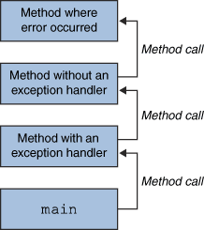
Throwing and catching
Executing program has a stack of currently executing methods
dynamic: reflects runtime order of method calls
no relation to static nesting of classes, packages, etc.
When an exception is thrown, control transfers to nearest method with a matching catch block
if none found, top-level handler used
Exceptions allow non-local error handling
a method many levels up the stack can handle a deep error

Slide 20
The finally block
finally block is always executed
whether an exception is thrown or not
try { …code… } catch (Type name) { code to handle the exception } finally { code to run after the try or catch finishes }

Slide 21
What finally is for
finally is used for common “must-always-run” or “clean-up” code
avoids duplicated code in catch branch[es] and after
avoids having to catch all exceptions
try { // ... write to out; might throw exception } catch (IOException e) { System.out.println("Caught IOException: " + e.getMessage()); } finally { out.close(); }

Slide 22
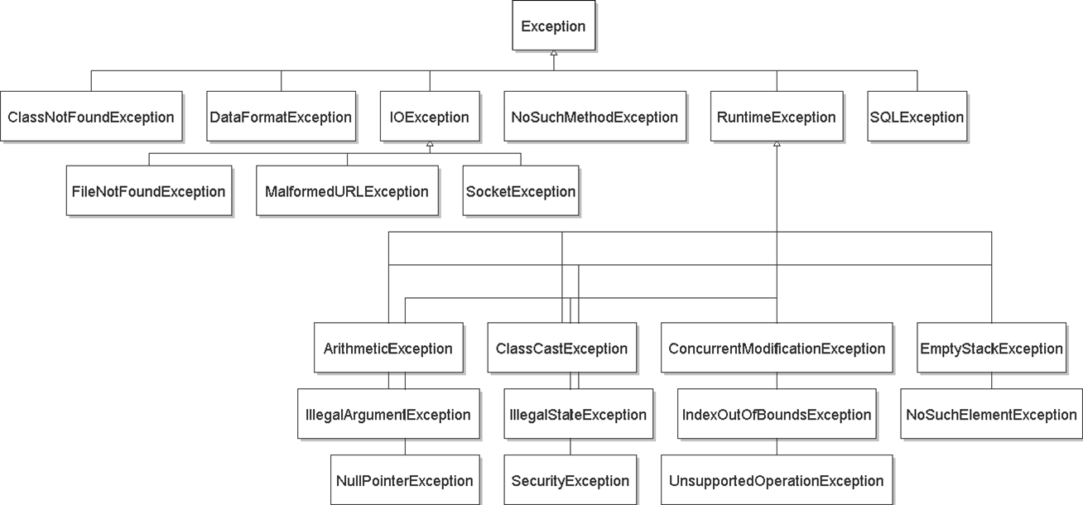
(Abridged) Exception Hierarchy

Slide 23
Java’s checked/unchecked distinction
Checked exceptions (style: for special cases / abnormal cases)
callee must declare in signature (else type error)
client must either catch or declare (else type error)
even if you can prove it will never happen at run time, the type system does not “believe you”
guaranteed to be a matching enclosing catch at runtime
Unchecked exceptions (style: for never-expected)
library has no need to declare
client has no need to catch
these are subclasses of:
RuntimeException
Error (rarely caught)
Throwable
Exception
Error
Checked exceptions
Runtime Exception
Notes:
e.g., AssertionError

Slide 24
Outline
General concepts about dealing with errors and failures
Assertions: what, why, how
for things you believe will/should never happen
Exceptions: what, how
how to throw, catch, and declare exceptions in Java
subtyping of exceptions
checked vs. unchecked exceptions
Exceptions: why in general
for things you believe are bad and should rarely happen
and many other style issues
Alternative with trade-offs: Returning special values
Summary and review

Slide 25
Two distinct uses of exceptions
Errors that should be failures
unexpected (ideally, should not happen at all)
should be rare with high quality client and library
can be the client’s fault or the library’s
often unrecoverable
Special cases (a.k.a. exceptional cases)
expected, just not the common case
possibly unpredictable or unpreventable by client

Slide 26
Handling exceptions
Errors that should be failures
usually can’t recover
unchecked exceptions the better choice (avoids much work)
if condition not checked, exception propagates up the stack
top-level handler prints the stack trace
Special cases
take special action and continue computing
should always check for this condition
should handle locally by code that knows how to continue
checked exceptions the better choice

Slide 27
Checked vs. unchecked
No perfect answer to the question “should clients be forced to catch (or declare they throw) this exception?”
Java provided both options
Advantages to checked exceptions:
Static checking of callee: only declared exceptions are thrown
Static checking of caller: exception is caught or declared
Disadvantages:
impedes implementations and overrides (can’t add exceptions)
prevents truly giving no promises when @requires is false
often in your way when prototyping
have to catch or declare even if the exception is not possible

Slide 28
Propagating an exception
// returns: x such that ax^2 + bx + c = 0
// throws: NegativeArgumentException if no real soln exists
double solveQuad(double a, double b, double c)
throws NegativeArgumentException {
// No need to catch exception thrown by sqrt
return (-b + sqrt(b*b - 4*a*c)) / (2*a);
}
Aside: does “negative argument” make sense to the caller?

Slide 29
Why catch exceptions locally?
Problems:
Failure to catch exceptions often violates modularity
call chain: A -> IntSet.insert -> IntList.insert
IntList.insert throws some exception
implementer of IntSet.insert knows how list is being used
implementer of A may not even know that IntList exists
Possible that a method on the stack may think that it is handling an exception raised by a different call
Alternative: catch it and throw again
“chaining” or “translation”
do this even if the exception is better handled up a level
makes it clear to reader of code that it was not an omission

Slide 30
Exception translation
// returns: x such that ax^2 + bx + c = 0
// throws: NotRealException if no real solution exists
double solveQuad(double a, double b, double c) throws NotRealException {
try {
return (-b + sqrt(b*b - 4*a*c)) / (2*a);
} catch (NegativeArgumentException e) {
throw new NotRealException(); // “chaining”
}
}
class NotRealException extends Exception {
NotRealException() { super(); }
NotRealException(String message) { super(message); }
NotRealException(Throwable cause) { super(cause); }
NotRealException(String msg, Throwable c) { super(msg, c); }
}

Slide 31
Don’t ignore exceptions
Effective Java Tip: Don't ignore exceptions
Empty catch block is poor style
try { readFile(filename); } catch (IOException e) {} // silent failure
At a minimum, print out the exception so you know it happened
and exit if that’s appropriate for the application
} catch (IOException e) { e.printStackTrace();
System.exit(1);
}
sometimes okay inside of an exception handler
Notes:
Counter-example: exception during cleanup code (e.g., Writer.close).

Slide 32
Outline
General concepts about dealing with errors and failures
Assertions: what, why, how
for things you believe will/should never happen
Exceptions: what, how in Java
how to throw, catch, and declare exceptions
subtyping of exceptions
checked vs. unchecked exceptions
Exceptions: why in general
for things you believe are bad and should rarely happen
and many other style issues
Alternative with trade-offs: Returning special values
Summary and review

Slide 33
Informing the client of a problem
Special value:
null for Map.get
-1 for indexOf
NaN for sqrt of negative number
Advantages:
can be less verbose than try/catch machinery
Disadvantages:
error-prone: callers forget to check, forget spec, etc.
need “extra” result: doesn’t work if every result could be real
example: if a map could store null keys
has to be propagated manually one call at a time
General Java style advice: exceptions for exceptional conditions

Slide 34
Outline
General concepts about dealing with errors and failures
Assertions: what, why, how
For things you believe will/should never happen
Exceptions: what, how in Java
How to throw, catch, and declare exceptions
Subtyping of exceptions
Checked vs. unchecked exceptions
Exceptions: why in general
For things you believe are bad and should rarely happen
And many other style issues
Alternative with trade-offs: Returning special values
Summary and review

Slide 35
Exceptions: review
Use an assertion for internal consistency checks that should not fail
when checking at runtime is possible
Use only a precondition when
used in a context in which calls can be checked via reasoning
but checking at runtime would be prohibitive
e.g., requiring that a list be sorted
Use an exception when
used in a dynamic / unpredictable context (client can’t predict)
for exceptional cases only
Use a special value when
it is a common case (not really exceptional)
clients are likely (?) to remember to check for it

Slide 36
Exceptions: review, continued
Use checked exceptions most of the time
static checking is helpful! (tools, inspection, & testing)
Avoid checked exceptions if there is probably no way to recover
Handle exceptions sooner rather than later
Good reference: Effective Java chapter
a whole chapter: exception-handling design matters!

