Slide 1
CSE 331 Software Design & Implementation
Kevin Zatloukal
Spring 2022
Identity, equals, and hashCode

Slide 2
Overview
Using the libraries reduces bugs in most cases
take advantage of code already inspected & tested
In Java, collection classes depend on equals and hashCode
EJ 47: “Know and use the libraries”
“every programmer should be familiar with the contents of java.lang and java.util”
e.g., List may not work properly if equals is wrong
e.g., HashSet may not work properly of hashCode is wrong

Slide 3
Object.equals method
public class Object { public boolean equals(Object o) { return this == o; }
… }
Implements reference equality
Subclasses can override to implement a different equality
But library includes a contract equals should satisfy
Reference equality satisfies it
So should any overriding implementation
Balances flexibility in notion-implemented and what-clients-can-assume even in presence of overriding

Slide 4
equals specification
public boolean equals(Object obj) should be:
reflexive: for any reference value x, x.equals(x) == true
symmetric: for any reference values x and y, x.equals(y) == y.equals(x)
transitive: for any reference values x, y, and z, if x.equals(y) and y.equals(z) are true, then x.equals(z) is true
consistent: for any reference values x and y, multiple invocations of x.equals(y) consistently return true or consistently return false (provided neither is mutated)
For any non-null reference value x, x.equals(null) should return false

Slide 5
Overriding equals
public class Duration {
@Override
public boolean equals(Object o) {
if (!(o instanceof Duration))
return false;
Duration d = (Duration) o; return this.min==d.min && this.sec==d.sec; }
}
Correct and idiomatic Java
Cast cannot fail
Gets null case right too (null instanceof C always false)

Slide 6
Overloading vs Overriding
Methods in Java are identified by the signature
name + argument types
Classes can have only one method with a given signature
subclass method overrides superclass method with its own
Classes can have many methods with the same name
e.g., List.add(Object) and List.add(int, Object)
this is called overloading

Slide 7
Java Method Calls
Signature of the method to call is chosen at compile time
suppose class has equals(Object) and equals(Duration)
x.equals(d1) becomes a call to equals(Duration), best match
x.equals(o1) becomes a call to equals(Object), only match
Finding the method with that signature to call happens at run time
Java looks in the actual class of x (at run time)
if it has a method with that signature, that method is called
otherwise, it continues looking in the superclass (recursively)

Slide 8
DEMO

Slide 10
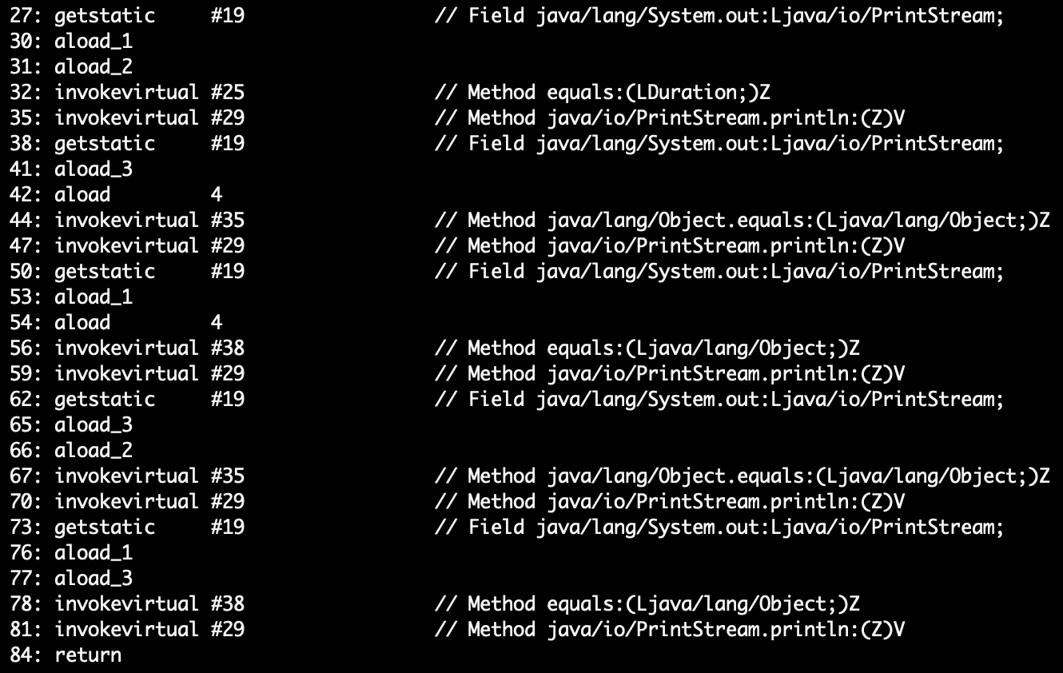
javap –c Duration

Slide 11
Equality, mutation, and time
If two objects are equal now, will they always be equal?
in mathematics, “yes”
in Java, “you choose”
Object contract doesn't specify
For immutable objects:
abstract value never changes
equality should be forever (even if rep changes)
For mutable objects, either:
use reference equality (never changes)
not forever: mutation changes abstract value hence equals
Common source of bugs...

Slide 12
Examples
StringBuilder is mutable and sticks with reference-equality:
StringBuilder s1 = new StringBuilder("hello");
StringBuilder s2 = new StringBuilder("hello");
s1.equals(s1); // true
s1.equals(s2); // false
By contrast:
Date d1 = new Date(0); // Jan 1, 1970 00:00:00 GMT
Date d2 = new Date(0);
d1.equals(d2); // true
d2.setTime(1);
d1.equals(d2); // false

Slide 13
Behavioral and observational equivalence
Two objects are “behaviorally equivalent” if there is no sequence of operations (excluding ==) that can distinguish them
Two objects are “observationally equivalent” if there is no sequence of observer operations that can distinguish them
excludes mutators and ==

Slide 14
Equality and mutation
Date class implements (only) observational equality
Set<Date> s = new HashSet<Date>();
Date d1 = new Date(0);
Date d2 = new Date(1000);
s.add(d1);
s.add(d2);
d2.setTime(0);
for (Date d : s) { // prints two of same date
System.out.println(d);
}
Violates rep invariant of a Set by mutating after insertion

Slide 15
Pitfalls of observational equivalence
Have to make do with caveats in specs:
“Note: Great care must be exercised if mutable objects are used as set elements. The behavior of a set is not specified if the value of an object is changed in a manner that affects equals comparisons while the object is an element in the set.”
Same problem applies to keys in maps
Same problem applies to mutations that change hash codes
Especially hard bugs to detect! (Be frightened!)
failure doesn’t show up on the line with the bug (e.g., setTime)
Easy to cause when modules don’t list everything they mutate
why we need @modifies

Slide 16
Benefits of Immutability
Seen so far:
No worries about representation exposure
mutable objects need copy-in & copy-out
No worries about equals consistency violations
(no good way to check for this at all!)
Some other languages have tools to prevent this
e.g., Python
I would include similar tools in any new language

Slide 17
Summary
Different notions of equality:
reference equality stronger than
behavioral equality stronger than
observational equality
Java’s equals has an elaborate specification, but does not require any one of the above notions
concepts more general than Java
Mutation and/or subtyping make things even murkier
more on this later…
good reason not to overuse/misuse either

Slide 18
hashCode
Another method in Object:
public int hashCode()
“Returns a hash code value for the object. This method is supported for the benefit of hash tables such as those provided by java.util.HashMap.”
Contract (again essential for correct overriding):
Self-consistent: o.hashCode() is fixed (unless o is mutated)
Consistent with equality:
a.equals(b) implies a.hashCode() == b.hashCode()
Contrapositive: a.hashCode() != b.hashCode() implies !a.equals(b)
Notes:
Note contrapositive of the last statement

Slide 19
Think of it as a pre-filter
If two objects are equal, they must have the same hash code
up to implementers of equals and hashCode to satisfy this
if you override equals, you must override hashCode
If objects have same hash code, they may or may not be equal
“usually not” leads to better performance
hashCode in Object tries to (but may not) give every object a different hash code
If hash codes are cheaper to compute, you could first check if those are the same before doing a full comparison – a pre-filter

Slide 20
hashCode
Another method in Object:
public int hashCode()
“Returns a hash code value for the object. This method is supported for the benefit of hash tables such as those provided by java.util.HashMap.”
Contract (again essential for correct overriding):
Self-consistent: o.hashCode() is fixed (unless o is mutated)
Consistent with equality:
a.equals(b) implies a.hashCode() == b.hashCode()
Want !a.equals(b) implies a.hashCode() != b.hashCode()
but not actually in contract and (not true in most implementations)

Slide 21
Asides
Hash codes are used for hash tables
common implementation of collection ADTs
see CSE332
libraries won’t work if your classes break relevant contracts
Cheaper pre-filtering is a more general idea
Example: Are two large video files the exact same video?
Quick pre-filter: Are the files the same size?

Slide 22
Recall: Duration example
public class Duration {
private final int min; // RI: min>=0
private final int sec; // RI: 0<=sec<60
@Override
public boolean equals(Object o) {
if (!(o instanceof Duration))
return false;
Duration d = (Duration) o; return this.min==d.min && this.sec==d.sec; }
}

Slide 23
Doing it
So: we have to override hashCode in Duration
Must obey contract
Aim for non-equals objects usually having different results
Correct but expect poor performance:
public int hashCode() { return 1; }
A bit better:
public int hashCode() { return min; }
Better:
public int hashCode() { return min ^ sec; }
Best
public int hashCode() { return 60*min+sec; }

Slide 24
Correctness depends on equals
Suppose we change the spec for Duration’s equals:
public boolean equals(Object o) {
if (!(o instanceof Duration))
return false;
Duration d = (Duration) o;
return min == d.min && sec/10 == d.sec/10;
}
Must update hashCode – why?
public int hashCode() {
return 6*min+sec/10;
}

