Slide 1
CSE 331 Software Design & Implementation
Kevin Zatloukal
Spring 2022
Lecture 1 – Introduction

Slide 2
“Software is eating the world.” (2011)
— Marc Andreessen (VC)
“This isn’t the beginning of the end. It’s not even the end of the beginning.” (2021)
— Alex Rubalcava (Software VC)
“There are just not enough software engineers for everyone.
… and this is not going away. It’s getting worse, actually” (last week)
— Olivier Pomel (CEO of Datadog)

Slide 3
Agenda
Motivation
Administrivia
Advice
HW0

Slide 4
Motivation

Slide 5
What are the goals of CSE 331?
Learn the skills to be able to contribute to a modern software project
move from CSE 143 problems toward what you’ll see in industry and in upper-level courses
Specifically, how to write code of
higher quality
increased complexity
We will discuss tools and techniques to help with this and the concepts and ideas behind them
there are timeless principles to both
widely used across the industry
Notes:
Help you step up from 143 to 400 level courses.
What do I mean by quality?

Slide 6
What is high quality?
Code is high quality when it is
​​​​​​​​Correct
everything else is of secondary importance
Easy to change
most work is making changes to existing systems
Easy to understand
needed for 1 & 2 above

Slide 7
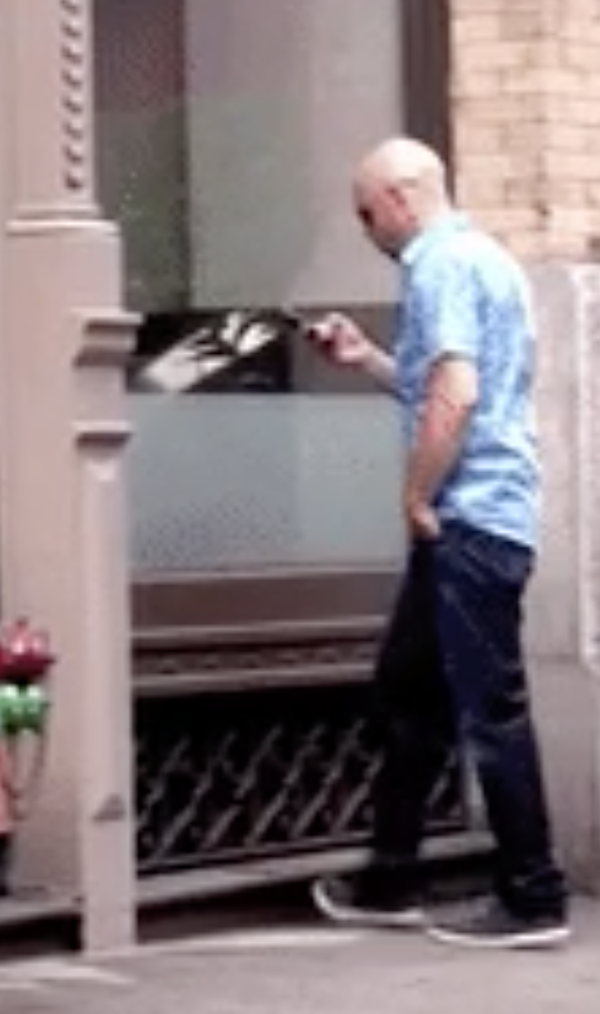
How do we ensure correctness...
... when people are involved?
People have been known to
walk into windows
drive away with a coffee cup on the roof
drive away still tied to gas pump
lecture wearing one brown shoe and one black shoe
Key Insight
Can’t stop people from making mistakes

Slide 8
Scale of Modern Software Projects
Analogy to building physical objects:
100 well-tested LOC = a nice cabinet
2,500 LOC = a room with furniture
2,500,000 LOC = 1000 rooms ≈
North Carolina class WW2 battleship

Slide 9
≈
the entire British Naval fleet in WW2

Slide 10
Scale makes everything harder
Many studies showing scale makes quality harder to achieve
Time to write N-line program grows faster than linear
Good estimate is O(N^{1.05}) [Boehm, ‘81]
Bugs grow like Θ(N log N) [Jones, ‘12]
10% of errors are between modules [Seaman, ‘08]
Communication costs dominate schedules [Brooks, ‘75]
Small probability cases become high probability cases
Corner cases are more important with more users
Corollary: quality must be even higher, per line, in order to achieve overall quality in a large program

Slide 11
Full Scope of the Challenge
Problem facing us
software is built by people, who make mistakes all the time
surprisingly difficult to get even a small program to work
needed to write hundreds of millions of lines of code
each line gets harder to write as the program scale
Despite those challenges, we have lots of software that works
hundreds of millions of lines of working programs
products rarely fail because the software is too buggy
How do we do it?

Slide 12
How do we ensure correctness...
... when people are involved?
People have been known to
walk into windows
drive away with a coffee cup on the roof
drive away still tied to gas pump
lecture wearing one brown shoe and one black shoe
Key Insights
Can’t stop people from making mistakes
Can stop mistakes from getting to users

Slide 13
How do we ensure correctness?
Best practice: use three techniques (we’ll study each)
​Tools
type checkers, test runners, etc.
​Inspection
think through your code carefully
have another person review your code
​Testing
usually >50% of the work in building software
Each removes ~2/3 of bugs. Together >97%
interviews focus on this
(a.k.a. “reasoning”)
Notes:
Which is the most effective? Inspection!
Inspection is the main tool for interviews

Slide 14
How do we cope with scale?
We tackle increased software scale with modularity
Split code into pieces that can be built independently
Each must be documented so others can use it
Also helps understandability and changeability

Slide 15
What are the goals of CSE 331?
In summary, we want our code to be:
Correct
Easy to change
Easy to understand
Modular
These qualities also allow us to solve more complex problems
increased complexity = larger scale and sophistication

Slide 16
What we will cover in CSE 331
Everything we cover relates to the 4 goals
We’ll use Java but the principles apply in any setting
Correctness
Tools
Git, IntelliJ, JUnit, Javadoc, …
Java libraries: equality & hashing
Adv. Java: generics, assertions, …
debugging
Inspection
reasoning about code
specifications
Testing
test design
coverage
Changeability
specifications, ADTs
listeners & callbacks
Understandability
specifications, ADTs
Adv. Java: exceptions
subtypes
Modularity
module design & design patterns
event-driven programming, MVC, GUIs

Slide 17
Administrivia

Slide 18
Who: Course staff
Instructor: Kevin Zatloukal (kevinz at cs)
15 years in industry (30 years of programming)
7th year teaching
17 great TAs
mix of new and veteran
Office hours posted soon
(starting later this week)
Get to know us!
We’re here to help you succeed

Slide 19
Who: Students
Assuming you have mastered CSE142 and CSE143
Hoping (but not assuming) have you taken 311
will connect to 311 material where it arises
Assuming you are in your first year of CSE major courses
seniors may be bored

Slide 20
Prerequisites
Basic Java knowledge is a prerequisite
Examples:
Difference between int and Integer
Distinction between x == y and x.equals(y)
multiple references to the same object (aliasing)
what does assignment (x = y) really mean?
Subtyping via extends (classes) and implements (interfaces)
Method calls: inheritance and overriding; dynamic dispatch
Difference between compile-time and run-time type

Slide 21
Staying in touch
Ed message board (link on course web page)
should have access already
best place to ask questions
Course staff: cse331-staff@cs.washington.edu
for things that don’t make sense to post on message board
also fine to email me directly for private matters
Course email list: cse331{a,b}_sp22@u.washington.edu
students already subscribed (your UW email address)
for me to email you… do not “reply all”
infrequent, but important emails

Slide 22
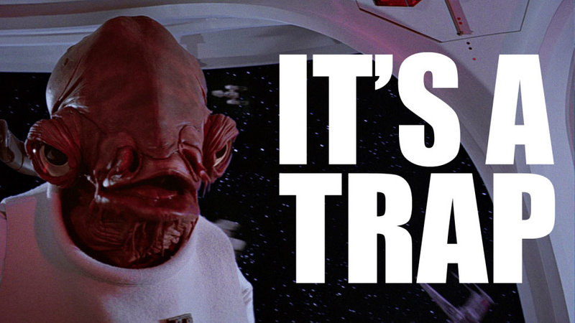
Lectures
In person lectures focused on key ideas
Morning section will be recorded
recordings available on Canvas
Don’t fall into the trap of skipping lectures to work on HW
can spiral into falling further and further behind in class

Slide 23
Section
Will be focused on helping with homework
typically fall on day when a new HW is released
get you get you started with the work to be done
they should be very useful
Not recorded
materials will be posted

Slide 24
Homework Assignments
Exactly 1 assignment per week (10 total)
HW0
HW1
HW2
HW3
HW4
practice reasoning (and testing)
midterm
HW5
HW6
HW7
HW8
HW9
build an app
(also practice adv Java tools)
final

Slide 25
Tests
Midterm exam will be in class (50 min)
Friday, May 6th, just after HW5 is due
focus on reasoning and testing
Final exam during finals week (110 min)
Tuesday, June 7th
time and location
Section B: KNE 220 at 2:30–4:20pm
Section A: KNE 220 at 4:30–6:20pm (unusual)
focus on reasoning and testing

Slide 26
Grading
Approximate weighting (subject to change):
Very difficult to fail this class
likely need to not submit multiple assignments
But scores may be lower than in other classes
these aren’t nearly as important as you think they are
60% | Homework
15% | Midterm Exam
25% | Final Exam

Slide 27
Late Policy
All students given free “late days”
Up to 4 times this quarter you can turn in a homework assignment one day late
Late days are 24-hour chunks
Why have due dates?
keep you on schedule (real world has deadlines)
finishing late means one less day for next assignment
get feedback to you before next deadline
Intended to handle special situations
plan to complete each assignment on time
Any additional lateness requires special permission
Do not use all of yours and then ask for a special extension when an emergency does arise

Slide 28
Academic Integrity
“The code you submit must be your own”
no copying from other students, web pages, etc.
can talk to others but you must do the work yourself
Read the full course policy carefully
ask questions if you are unsure
Always explain in your HW any unconventional action
worst result then is some points lost
worst result otherwise is expulsion
Violations are unfair to other students and yourself

Slide 29
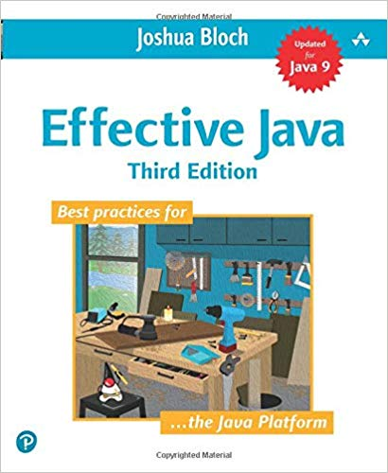
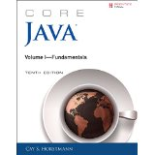
Books
Required book
Effective Java 3rd ed, Bloch (EJ)
Optional book
Pragmatic Programmer, new 20th anniversary (2nd) edition, Hunt & Thomas (PP)
Other books
Program Development in Java, Liskov & Guttag
would be the textbook if not from 2001
Core Java Vol I, Horstmann
good reference on language & libraries

Slide 30
Readings
Calendar will include book sections for you to read
EJ = required, PP = optional
Readings are fair game for exams
want to make sure you do it

Slide 31
Important Websites
Course website (cs.uw.edu/331) for
calendar
assignments
section materials
Gradescope for
submit assignments
request regrades (for obvious errors)
Canvas for
recorded lectures
final scores for assignments (after regrades)
ignore percentages, totals, etc.

Slide 32
Advice

Slide 33
CSE 331 can be challenging
Experience tells us CSE 331 can be hard
not my intention to make it difficult!
Big change to move
from programming by trial & error
technique that does not work for building large scale software
to programming by careful design, reasoning, and testing
Programming itself can be hard
surprisingly difficult to specify, design, implement, test, debug, and maintain even a simple program

Slide 34
CSE 331 can be challenging
We strive to create assignments that are reasonable if you apply the techniques taught in class…
… but likely hard to do in a trial & error manner
… and almost certainly impossible to finish if you
put them off until a few days before they’re due
Assignments will take more time than you think (start early)
even professionals routinely underestimate by 3x
these assignments will be a step up in difficulty
aim to finish early
If you are having trouble, think before you act
then, look for help

Slide 35
HW0

Slide 36
An exercise before next class
Do HW0 (90 minutes max) before lecture on Wednesday
practice interview question
write an algorithm to rearrange array elements as described
argue in concise, convincing English that it is correct
don’t just explain what the code does!
do not run your code! (pretend it’s on a whiteboard)
know that is correct without running it (a necessary skill)
This is expected to be difficult (esp. the ”argue” part)
participation credit, not graded for correctness
do not spend more than 90 minutes on it
want you to see that it is tricky… without the tools coming next

Slide 37
Before next class...
Familiarize yourself with website:
http://courses.cs.washington.edu/courses/cse331/22sp/
read the syllabus
read the academic integrity policy
find the homework list
find the link to Canvas
Do HW0 before lecture on Wednesday!
submit a PDF on Gradescope
limit this to at most 90 min

Slide 38
Actually, software is more complex…
Every bit of code is unique, individually designed
US built 10 identical Essex carriers
Software equivalent would be one carrier 10 times as large:
Defects can be even more destructive
A defect in one room can sink the ship
But a defective OS could sink the whole fleet

Slide 39
Resubmission: Coding Assignments
We will allow re-submission of coding assignments
first five coding assignments (HW4–HW7) only
allowed for 1 week after these grades are first published
Aim of the policy is to limit the deductions for minor mistakes that end up causing a disproportionate number of test failures
We will re-calculate the correctness score up to a maximum score of 80%
other scores (design, style, etc.) are not changed

Slide 40
Books? In the 21st century?
Why not just use Google, Stack Overflow, Reddit, Quora, …?
Web-search good for
Finding the parameters of a Java API function
(can be) Bad for
Why does it work this way?
What is the intended use?
How does my issue fit into the bigger picture?
Beware:
Answers on the web are often quickly out of date
aim is to answer the question at the time when asked
“This incantation solved my problem”
give that to users without knowing how it works?

Slide 41
Other Advice
Don’t be afraid to make mistakes
accepting that you will make mistakes is perhaps the most important lesson of this course
we often learn best from our mistakes
if you’re not making mistakes, you’re not challenging yourself
“Never promote someone who hasn’t made some bad mistakes because, if you do, you are promoting someone who has never done anything” — Dr. Herbert Dow (founder of the Dow Chemical Company)
Don’t expect everything to be spelled out for you
real-world problems don’t come that way
if there are detailed instructions for solving a problem, then there should already be a program that does it
world needs you for your intuition, creativity, & intelligence
Notes:
Past student: how did that [mistake] happen? how is that even possible?
Review feedback on design patterns (needing to come earlier)

