Slide 1
CSE 331 Software Design & Implementation
Andrew Gies & Hal Perkins
Winter 2021
HTML + TypeScript Overview

Slide 2
Administrivia
Quiz 3 out now – finish by 7 pm tonight
TypeScript code demo video on 331 course canvas panopto page
Must watch this before Wednesday’s class (or else that will be really confusing/mysterious)
Extended TypeScript Q&A zoomathon with Andrew tomorrow afternoon 4-6 pm. Zoom link on the course canvas calendar
And keep going on hw7 – due Thursday

Slide 3
The Weeks Ahead
We’re building an application that can find walking paths on the campus (hw7)
We’d like to add a graphical user interface front-end (hw9)
The web is a common way to build/distribute apps
Web programming uses the same concepts we're learning
So: We're going to make a webapp for this.
Therefore: Let's learn how to do this!
Note: There are many ways to approach web programming. We're doing just one…

Slide 4
Our Approach
We're going to be using several different pieces:
HTML
The language that web browsers render
Describes the structure and content of the page
TypeScript (TS)
A version of JavaScript that adds type-safety
Used to create the bulk of our application
Adds interactivity to the webpage
React
A UI library – handles the interactions between TS and HTML, makes UI programming easier

Slide 5
Our Approach (2)
We’re going to learn just enough to display a map, allow users to select endpoints, and draw a path
So we we’ll focus on the basics, particularly key differences between what we're doing and Java
But also realize our goal isn’t to exhaustively cover everything – don’t have time, so core ideas only
Will probably be outside your comfort zone – this is new stuff!
Remember to ask questions ☺
Last two assignments this quarter:
HW8 draw dots and lines on an image (using TS/React)
HW9: use HW8 framework to build campus path GUI, use your existing Java graph/pathfinding

Slide 6
Credits
CSE 331 JS/TS project due to Andrew Gies and Avi Bhagat
Slides due to Andrew Gies, Hal Perkins & Kevin Zatloukal
Thanks to Lauren Bricker and CSE 154 crew for some recent notes (even if you took 154 recently this stuff probably will look different)
And from wherever we can find useful things…
Notes: JS = JavaScript. ECMAScript is the official standard version (we’re using v6/2015) so you’ll also see ES or ES6 or ES2015, etc.

Slide 7
A little history
In the beginning was the web page
It was displayed in a browser
It had links
But it was static
There was no way to update or compute content dynamically or interact with users
Solution: add a scripting language to the browser
Users (page developers) should be able to write code
Code should be able to interact with the browser’s data structures to read / update / modify the page contents
World Wide Web
The WorldWideWeb (W3) is a wide-area hypermedia information retrieval initiative aiming to give universal access to a large universe of documents.
Everything there is online about W3 is linked directly or indirectly to this document, including an executive summary of the project, Mailing lists , Policy , November's W3 news , Frequently Asked Questions .
What's out there? Pointers to the world's online information, subjects , W3 servers, etc.
Help on the browser you are using
Software Products A list of W3 project components and their current state. (e.g. Line Mode ,X11 Viola , NeXTStep , Servers , Tools , Mail robot , Library )
Technical Details of protocols, formats, program internals etc
Bibliography Paper documentation on W3 and references.
People A list of some people involved in the project.
History A summary of the history of the project.
How can I help ? If you would like to support the web..
Getting code Getting the code by anonymous FTP , etc.

Slide 8
Enter JavaScript
Created in 1995 by Brenden Eich as a “scripting language” for Mozilla’s browser
Done in 10 days!
Used to make web pages interactive:
Change the content/structure in HTML
React to events (page load, user clicks)
Discover info about local computer
Do local calculations
No relation to Java other than trying to piggyback on all the Java hype at that time

Slide 9
Why JavaScript now?
JavaScript is a web standard & ships in every browser
But not supported identically by all of them ☹
De facto execution engine for dynamic code on web
If a website is doing something interesting, there's probably JavaScript inside
We will try to stick to portable, generic stuff
We use tooling that "smooths out" the difference between browsers as much as possible (it's the wild west out there)
But for hw8/hw9 we’re only supporting Chrome (at least this time around) to avoid cross-platform grief
Install and update to current version please

Slide 10
In Context…
The "Original" Model of (Dynamic) Web Development
(small amount)
JavaScript
Interactivity/Animation/Changes
Modifies
(lots of this)
HTML
Document Structure & Content

Slide 11
So that's what we're doing, right?
Not quite…
The original model was meant for simple things
click a button to submit a form, change a color, etc..
The modern web now hosts full-fledged applications entirely using web technology
JS + HTML were never designed for this
The "old" way:
Language + tooling doesn't help much, difficult to write big programs correctly/safely/efficiently
Managing large parts of the webpage with pure JS is difficult to get right

Slide 12
One* Modern Alternative
* There are a lot of ways to do things in modern web dev
TypeScript
TS = JS with extra features
Type System (!)
The compiler is smart – helps you find bugs, just like Java
React = UI Library
Main idea: users create the content with JS/TS
Uses data to create the web content – change the data to change the content
(lots of this)
React
Compiled Into
JavaScript
Modifies + Creates Content
Browsers don't speak TS
Need to convert to JS before running
We don't need to read/write (we write TS), but you should know that this is what's happening
(very little)
HTML

Slide 13
Resources
Lectures will (try to) point out key things
TypeScript is mostly JavaScript – only big difference is types
Wondering how to do something? Look for JavaScript answers
Wondering how to type something? Look for TypeScript answers
For more…
Mozilla (MDN) tutorials are good
CodeAcademy JavaScript basics
React documentation – small doses, way more info than we need
TypeScript documentation – focused on the "new stuff" in TS vs JS
Be very careful about web searches
There are 1000 ways to do anything, many of which may be different than what we're doing
Code snippets from the web may lead you way off.
When in doubt, make an Ed post!

Slide 14
Our plan…
First, look at basic HTML on its own
No scripting, no dynamic content
Just how content/structure is communicated to the browser
Second, look at basic TypeScript on its own
No browser, no HTML, just the language
Get a feel for what's different from Java
Third, use TypeScript with React with HTML
Write TypeScript code, using the React library
Generates the page content using HTML-like syntax

Slide 15
HTML, Formally
HTML - HyperText Markup Language
Consists of tags and their contents
Each tag has a different meaning
button, paragraph, link, etc…
Each one has a beginning and end.
Can contain text (content) and other tags. Optional attributes (organized as key-value pairs)
Can think of them like “constructor parameters”: pieces of data that specify extra info about the tag.
Define document structure and content

Slide 16
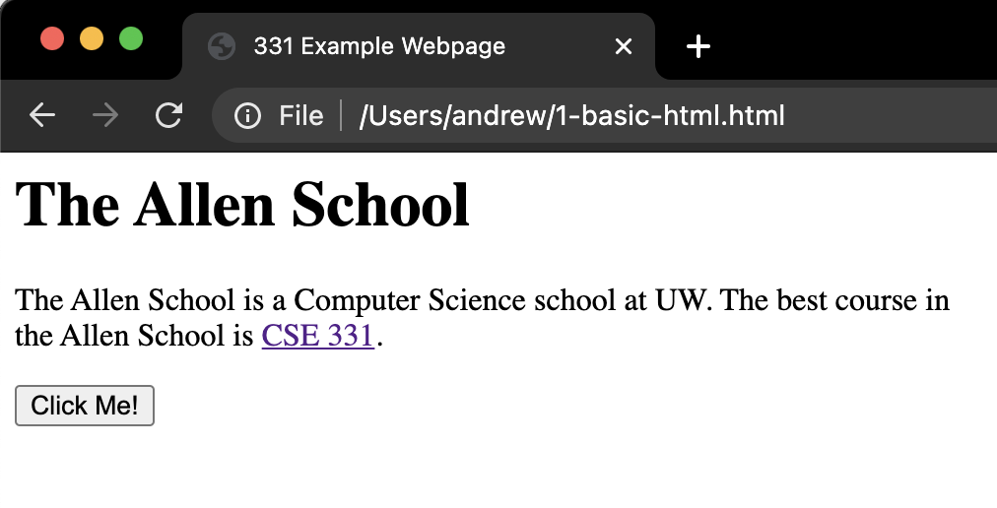
Demo
<html lang="en"> <head> <title>331 Example Webpage</title> </head> <body> <h1>The Allen School</h1> <div> <p> The Allen School is a Computer Science school at UW. The best course in <br/> the Allen School is <a href="https://cs.uw.edu/331">CSE 331</a>. </p> <button>Click Me!</button> </div> </body> </html>

Slide 17
Anatomy of a Tag
Element
<p> Some Text </p>
Tag Name
Content
Closing Tag

Slide 18
Anatomy of a Tag
Element
<p id=”firstParagraph”> Some Text </p>
Tag Name
Attribute Value
Content
Attribute Name
Closing Tag
Self-Closing Tag (No Content)
<br />
We’ll see what <p> and <br> mean soon...

Slide 19
Tags form a Tree
<div>
<p id=”firstParagraph”> Some Text </p>
<br />
<div>
<p>Hello</p>
</div>
</div>
div
This tree data structure, which lives in the browser, is often called the "DOM" – Document Object Model
p
br
div
p

Slide 20
A Few Useful Tags
A few worth mentioning here:
<html> and <head> and <body> - Used to organize a basic HTML document.
<title> - Sets the title of the webpage
<p> - Paragraph tag, surrounds text with whitespace/line breaks.
<a> - Link tag – links to another webpage.
<div> - “The curly braces of HTML” - used for grouping other tags. Surrounds its content with whitespace/line breaks.
<span> - Like <div>, but no whitespace/line breaks.
<br /> - Forces a new line (like “\n”). Has no content.
<button> - Create a clickable button on the screen
See the W3Schools HTML reference for a complete list, along with all their supported attributes.

Slide 21
Demo Again
<html lang="en"> <head> <title>331 Example Webpage</title> </head> <body> <h1>The Allen School</h1> <div> <p> The Allen School is a Computer Science school at UW. The best course in <br/> the Allen School is <a href="https://cs.uw.edu/331">CSE 331</a>. </p> <button>Click Me!</button> </div> </body> </html>

Slide 22
What's next?
Done:
First, look at basic HTML on its own
No scripting, no dynamic content
Just how content/structure is communicated to the browser
Now:
Second, look at basic TypeScript on its own
No browser, no HTML, just the language
Get a feel for what's different from Java
Third, use TypeScript with React with HTML
Write TypeScript code, using the React library
Generates the page content using HTML-like syntax

Slide 23
JavaScript (1)
Like Java in many ways:
Variables:
let allows rebinding
const is like Java's final – can't change after creation
Types of values:
number – floating point only, no integer type
boolean – true/false
string – similar to Java's strings
undefined – "unset" values
object (includes null) – more info later
let something = "hello, world";
const pi = 3.1415;

Slide 24
JavaScript (2)
if/else if/else statements
Structurally identical to Java
Any value can be used as a boolean:
false, 0, "", null, undefined, NaN behave as false
Everything else (!) behaves as true
Values are described as "falsey" and "truthy"
Loops
for & while – same as Java
for-in and for-of are like Java's for-each
Be careful with for-in and for-of, they're tricky
Arrays
Can mix types in the array – [123, "hello", false]
No bounds checks, possible to access after the end
Versatile: behave as stacks/queues/lists

Slide 25
JavaScript (3)
Functions
Can exist outside of classes/objects
Functions are values
Put them in variables
Pass them to functions
(more in demo)
Objects
Similar to a Java HashMap
key/value pairs
The values can be functions
This is how we get methods!
Written using { and }
(more in demo)
let mul = function(x, y) {
return x * y;
}
let add = function(x, y) {
return x + y;
}
add(2, 3); // result is 5
add = mul;
add(2, 3); // result is 6
let simpleObj = {
x: 8,
y: "abc",
z: true
};
simpleObj.x; // result is 8

Slide 26
Why TypeScript?
JS variables are dynamically typed
The type of a variable can change based on its value
JS will attempt to convert values where it can
This leads to tricky bugs
TS = Mostly JS, but adds static types (like Java)
Can declare type when creating a variable
TypeScript compiler will enforce this – prevents bugs!
let x = 5; // x holds a number
x = "35"; // x now holds a string
x += 7; // x = "357"
let x: number = 5;
x = "35"; // TypeScript error!

Slide 27
Up Next
Finish the current quiz before 7pm tonight
Watch the TS Demo video before Wednesday
On Canvas under "Panopto Recordings"
Details on how the language works
Then zoom Q&A tomorrow on TS, 4-6 pm, optional but likely really useful
Wednesday class: Using React + TS to create websites
Thursday sections: HW8, TS + React Practice, Q+A

