Slide 1
CSE 331
Software Design & Implementation
Hal Perkins
Winter 2021
Module Design and General Style Guidelines

Slide 2
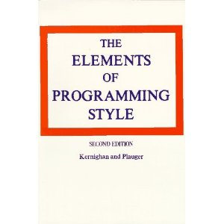

Style
“Use the active voice.”
“Omit needless words.”
“Don't patch bad code - rewrite it.”
“Make sure your code 'does nothing' gracefully.”

Slide 3
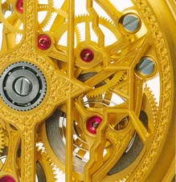
The limits of scaling
Can’t built arbitrarily large physical structures that work perfectly and indefinitely
  friction, gravity, wear-and-tear
Software has no such problems!
So what prevents arbitrarily large software?
… it’s the difficulty of understanding it!
The problem in software is interdependence (“coupling”) between different parts of the code
  Coupling makes it hard to understand one part of the code without understanding many other parts and how they all interact

Slide 4
Modules
We make software easier to understand by breaking it into pieces that can be understood (and built) separately
A module is a unit in a software system
Class, ADT, package, layer, …
Modular design is the heart of software design
  What modules
  What are their specifications
  How they interact
  But not the implementations of the modules
Each module respects other modules’ abstraction barriers and enforces its own

Slide 5
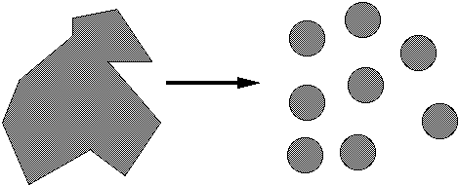
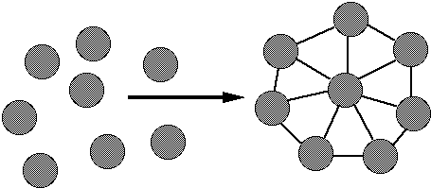
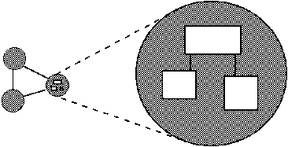
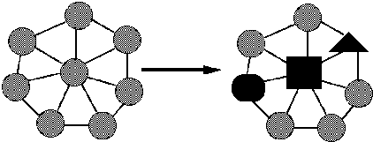
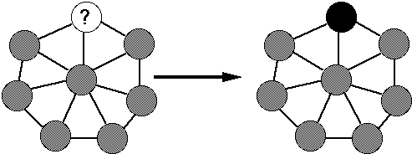
Goals of modular design
Decomposable – can be broken down into modules to reduce complexity and allow teamwork
Composable – “Having divided to conquer, we must reunite to rule [M. Jackson].”
Understandable – one module can be examined, reasoned about, developed, etc. in isolation
Continuity – a small change in the requirements should affect a small number of modules
Isolation – an error in one module should be as contained as possible

Slide 6
Most important design issues
Cohesion = internal consistency
A property of the module specification
  And applies to implementations
Want module to be self-contained, independent, and with a single, well-defined purpose
Coupling = dependency between components
A property of module implementation
Is usually low when each subpart has good cohesion
Goal: increase cohesion, decrease coupling

Slide 7
Cohesion
Separation of concerns
For methods: do one thing well
  Compute a value, let client decide what to do with it
  Observe or mutate; don’t do both
  Don’t print as a side effect of another operation
  “Flag” variables are often a symptom of poor cohesion
For ADTs: provide a single abstraction, represent a single concept
Poor cohesion limits future possible uses
If your module violates this principle, redesign it
  Refactor a method into multiple simpler methods
  Break an ADT or module into separate ones, each of which represents a single abstraction or concept

Slide 8
Coupling
How are modules dependent on one another?
  Statically (in the code)? Dynamically (at run-time)? More?
  Ideally, split design into parts that don't interact much
If modules are highly coupled you must reason about them as though they are a single, larger module
MY
FINAL
PROJECT
MY
MY
FINAL
PROJECT
FINECT
PROJAL
An application
A poor decomposition
(parts strongly coupled)
A better decomposition
(parts weakly coupled)

Slide 9

Coupling is the path to the dark side
Coupling leads to complexity
Complexity leads to confusion
Confusion leads to suffering
Once you start down the dark
path, forever will it dominate
your destiny, consume you it will

Slide 10
God classes
God class: a class that hoards much of the data or functionality of a system
  Poor cohesion – little thought about why all the elements are placed together
  Reduces coupling but only by collapsing multiple modules into one (which replaces dependences between modules with dependences within a module)
A god class is an example of an anti-pattern: a known bad way of doing things

Slide 11
Class design ideals
Cohesion: already discussed
Coupling: already discussed
Completeness: Every class should present a complete interface
Consistency: In names, param/returns, ordering, and behavior

Slide 12
Completeness
Include important methods to make a class easy to use
  Counterexamples:
    A mutable collection with add but no remove
    A tool object with a setHighlighted method to select it, but no setUnhighlighted method to deselect it
    Date class with no date-arithmetic operations
Also:
  Objects that have a natural ordering should implement Comparable
  Usually implement (override) equals (and therefore hashCode) – more about these in next lecture(s)
  Always override Object.toString (a superclass may have done this for you)

Slide 13
Don’t include the kitchen sink
Don’t include everything you can possibly think of
  If you include it, you’re stuck with it forever
  (even if almost nobody ever uses it)
  Don’t include compound operations
  (client can call two operations)
  Sometimes use cases mean rethinking completeness: does remove always make sense for a mutable collection if it is ghastly expensive and never used?
Tricky balancing act that depends on taste
Err on the side of omitting an operation
  You can always add it later if you really need it
“Everything should be made as simple
as possible, but not simpler.”
- Einstein

Slide 14
Consistency
A module should have consistent names, parameters in the same order, and consistent behavior
Counterexamples:
  setFirst(int index, String value)
  setLast(String value, int index)
  Date/GregorianCalendar use 0-based months
  String methods: equalsIgnoreCase,
  compareToIgnoreCase;
  but regionMatches(boolean ignoreCase)
  Collection size:
  String.length(), array.length, collection.size()

Slide 15
Good names
Choosing good names is important (and takes work)
EJ Tip #68: Adhere to generally accepted naming conventions
Class names: generally nouns describing the type (often ADT) or concept represented by the class
  Beware "verb + er" names, e.g. Manager, Scheduler, ShapeDisplayer
Interface names often –able/-ible adjectives:
Iterable, Comparable, …
Method names: noun or verb phrases
  Nouns for observers: size, totalSales
  Verbs+noun for observers: getX, isX, hasX
  Verbs for mutators: move, append
  Verbs+noun for mutators: setX
  Choose affirmative, positive names over negative ones
      isSafe not isUnsafe
      isEmpty not hasNoElements

Slide 16
Bad names
count, flag, status, compute, check, value, pointer, names starting with my…
  Convey no useful information
Describe what is being counted, what the “flag” indicates, etc.
  numberOfStudents, courseFull, noMorePizza, calculatePayroll, validateWebForm, …
But short names in local contexts are good:
  Good: for(i = 0; i < size; i++) items[i]=0;
  Not: for(theLoopCounter = 0;
  theLoopCounter < theCollectionSize;
  theLoopCounter++)
  theCollectionItems[theLoopCounter]=0;
Notes:
But theSystemIsAboutToDieAHorribleDeath was pretty good in an old OS

Slide 17
Documenting a class
Keep internal and external documentation separate
External documentation: Specification
  /** ... */ Javadoc for classes, interfaces, methods
  What clients need to know
  Includes abstract values & invariants, pre/postconditons, etc.
Internal documentation: Implementation
  // comments inside method bodies & classes
  Clients don’t need this information and shouldn’t know (see) it
  What someone reading the code needs to know to understand it
  Includes rep. invariant, abstraction function, internal pre/post conditions, algorithm explanations, rationale for design and implementation choices, why it was done this way
  If it’s hard to document/explain, redesign it

Slide 18
Field design
A variable should be made into a field if and only if:
  It is part of the inherent internal state of the object
  It has a value that retains meaning throughout the object's life
  Its state must persist between public method invocations
All other variables should be local to a method
  Fields should not be used to avoid parameter passing
  Not every constructor parameter needs to be a field
Exception: Certain cases where overriding is needed
  Example: Thread.run

Slide 19
Constructor design
Constructors should have all the arguments necessary to initialize the object's state – no more, no less
Object should be completely initialized after constructor is done
  The rep invariant should hold
Client shouldn't need to call other methods to “finish” initialization

Slide 20
Method design
Effective Java (3rd ed.) Tip # 51: Design method signatures carefully
Avoid long parameter lists
  Perlis: “If you have a procedure with ten parameters, you probably missed some.”
Especially error-prone if parameters are all the same type
  Which of these has a bug?
    memset(ptr, size, 0);
    memset(ptr, 0, size);
Avoid methods that have lots of (or any?) Boolean “flag” parameters
EJ Tip #52: Use overloading judiciously
Avoids having arbitrary different method names
But use only when specifications are analogous
Notes:
Memset example from Zero Bugs and Program Faster by Kate Thompson

Slide 21
Method Bodies
Write method bodies to make them easy to read
  make life easier for your code reviewer
  (make life easier for yourself when you come back later)
Break code into nicely sized “paragraphs”
  i.e., consecutive lines of code with no blank lines
Put a comment at the top of the paragraph
  (unless the code is just as readable as the comment)
  use full sentences and correct English
Think about whether “paragraphs” should be broken out into separate methods (not always, but sometimes, especially if code is duplicated or reusable elsewhere)

Slide 22
Open-Closed Principle
Software entities should be open for extension, but closed for modification
  Add features by adding new classes or reusing existing ones in new ways
  Avoid modifying existing ones
    Changing existing code can introduce bugs and errors
Related: Code to interfaces, not to classes
  Example: accept a List parameter, not ArrayList or LinkedList
  EJ Tip #64: Refer to objects by their interfaces
    Really: use the most general/highest type that provides the needed operations

Slide 23
Enums improve readability
Consider use of enums, even with only two values
Which of the following is better?
  oven.setTemp(97, true);
  oven.setTemp(97, Temperature.CELSIUS);
(see EJ #51)

Slide 24
Choosing types – some hints
Numbers: Favor int and long for most numeric computations
EJ Tip #60: Avoid float and double if exact answers are required
  Classic example: money (round-off is bad here)
Avoid using String representations
  If implementation is parsing String representations, redesign
    (watch for String.indexOf, regular expressions)
  String is tempting because it’s a common input/output format, but avoid unless the data actually is text
  EJ Tip #12: provide observer methods so client doesn’t have to rely on exact format of toString() output

Slide 25
Independence of views
Confine user interaction to a core set of “view” classes
  Isolate these from the “model” classes that maintain the key system data
Do not put print statements in your core (model) classes
  This locks your code into a text representation
  Makes it less useful if the client wants a GUI, a web app, etc.
Instead, have model classes return data for use by view classes
  Which of the following is better?
    public void printMyself()
    public String toString()

Slide 26

The model is small
Do keep the core model of what you are doing small and independent
Don’t get sloppy on the “extra layers” around it
  It ends up being most of your code!
Less than 10% of the code has to do with the ostensible purpose of the system; the rest deals with input-output, data validation, data structure maintenance, and other housekeeping.
-- Mary Shaw

Slide 27
Last thoughts (for now)
Specs and code are read more often than written – writing matters!
Who are your readers?
  Clients of your code – need to know how to use it
  Programmers maintaining the code – need to know how it works, but, even more, why it was done this way
    (including you in 3 weeks/months/years)
Write comments and documentation when you create things – don’t try to reconstruct “why” later
Read/reread style and design advice regularly
Keep practicing – mastery takes time and experience
You’ll always be learning. Get feedback! Keep looking for better ways to do things!

