Slide 1
CSE 331
Software Design & Implementation
Hal Perkins
Winter 2021
Lecture 1 – Introduction & Overview
(Based on slides by Mike Ernst, Dan Grossman, Kevin Zatloukal, me, and many others)

Slide 2
What is CSE 331 about?
It’s about 10 weeks…
It’s lots of Java programming…
It’s weird Java language stuff like generic type bounds…
It’s git and gradle and Intellij and junit (and I already know all that stuff from my internship)…
It’s JavaScript and TypeScript and React, but I’m already a Full-Stack® Developer!...
Yes, we’ll do those things, but it’s not (just) those things
  It’s the “why” behind the “what”
  It’s the rest of the course that goes with the lab (think chemistry, physics, construction, etc.)

Slide 3
What is the goal of CSE 331?
How to build harder-to-build software
Move from CSE 143 problems toward what you’ll see in upper-level CSE courses and in industry
Specifically, how to write code of
Higher quality
Increased complexity
We will discuss tools and techniques to help with this and the concepts and ideas behind them
  There are timeless principles to both
  Widely used across industry
Notes:
Help you step up from 143 to 400 level courses.
What do I mean by quality?

Slide 4
What is high quality?
Code is high quality when it is
​​​​​​​​Correct
  Everything else is of secondary importance
Easy to change
  Most work is making changes to existing systems
Easy to understand
  Needed for 1 & 2 above

Slide 5
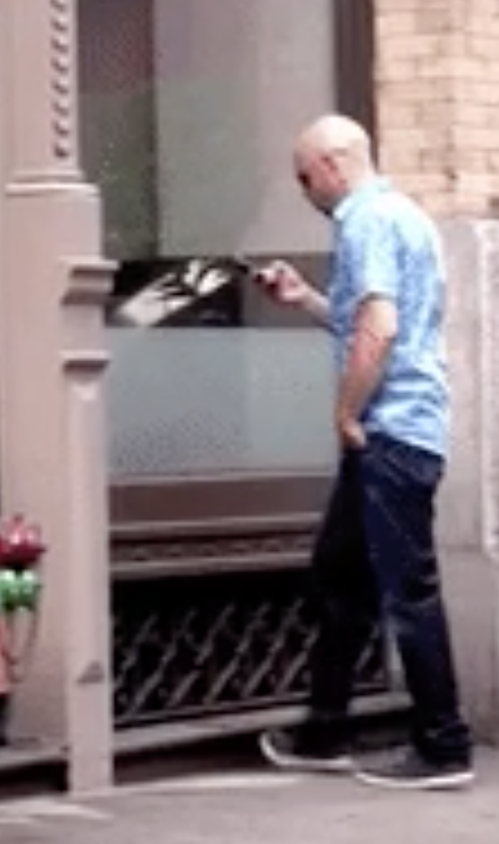
How do we ensure correctness...
... when people are involved?
People have been known to
  walk into windows
  drive away with a coffee cup on the roof
  drive away still tied to gas pump
  lecture wearing one brown shoe and one black shoe
Notes:
Cannot skip any and produce highest quality software.
Which is the most effective? Inspection!
Inspection is the main tool for interviews

Slide 6
What is increased complexity?
Analogy to building physical objects:
100 well-tested LOC = a nice cabinet
2,500 LOC = a room with furniture
2,500,000 LOC = 1000 rooms ≈
North Carolina class WW2 battleship

Slide 7
≈
the entire British Naval fleet in WW2

Slide 8
Actually, software is more complex…
Every bit of code is unique, individually designed
  US built 10 identical Essex carriers
  Software equivalent would be one carrier 10 times as large:
Defects can be even more destructive
  A defect in one room can sink the ship
  But a defective OS could sink the whole fleet

Slide 9
How do we cope with complexity?
We tackle complexity with modularity
Split code into pieces that can be built independently
Each must be documented so others can use it
Also helps understandability and changeability

Slide 10
Scale makes everything harder
Modularity makes scale possible but it’s still hard…
Time to write N-line program grows faster than linear
  Good estimate is O(N^{1.05}) [Boehm, ‘81]
Bugs grow like Θ(N log N) [Jones, ‘12]
  10% of errors are between modules [Seaman, ‘08]
Communication costs dominate schedules [Brooks, ‘75]
Small probability cases become high probability cases
  Corner cases are more important with more users
Corollary: quality must be even higher, per line, in order to achieve overall quality in a large program

Slide 11
People Do Build Great Software
Full scope of the challenge:
software is built by people, who make mistakes all the time
surprisingly difficult to get even a small program to work
needed to write hundreds of millions of lines of code
each line gets harder to write as the program scale
Despite those challenges, we have lots of software that works
hundreds of millions of lines of working programs
products rarely fail because the software is too buggy
How do we do it?

Slide 12
How do we ensure correctness...
... when people are involved?
People have been known to
  walk into windows
  drive away with a coffee cup on the roof
  drive away still tied to gas pump
  lecture wearing one brown shoe and one black shoe
Key insights:
  Can’t stop people from making mistakes
  Can stop mistakes from getting to users
Notes:
Cannot skip any and produce highest quality software.
Which is the most effective? Inspection!
Inspection is the main tool for interviews

Slide 13
How do we ensure correctness?
Best practice: use three techniques (we’ll study each)
​Tools
  Type checkers, test runners, etc.
​Inspection
  Think through your code carefully
  Have another person review your code
​Testing
  Usually >50% of the work in building software
Each removes ~2/3 of bugs. Together >97%
Notes:
Cannot skip any and produce highest quality software.
Which is the most effective? Inspection!
Inspection is the main tool for interviews

Slide 14
What is high quality code?
In summary, we want our code to be:
Correct
Easy to change
Easy to understand
Easy to scale (modular)
These qualities also allow for increased complexity

Slide 15
What we will cover in CSE 331
Everything we cover relates to the 4 goals
We’ll use Java but the principles apply in any setting
Correctness
Tools
  Git, IntelliJ, JUnit, Javadoc, …
  Java libraries: equality & hashing
  Adv. Java: generics, assertions, …
  debugging
Inspection
  reasoning about code
  specifications
Testing
  test design
  coverage
Changeability
specifications, ADTs
listeners & callbacks
Understandability
specifications, ADTs
Adv. Java: exceptions
subtypes
Modularity
module design & design patterns
event-driven programming, MVC, GUIs

Slide 16
Administrivia

Slide 17
Who: Course staff
Lecturer:
  Hal Perkins (long-time CSE 331 veteran)
TAs:
  ≈16 great TAs, lots of veterans and some new folks
Office hours posted soon
  (Hope to start tomorrow)
Get to know us!
  We’re here to help you succeed

Slide 18
Who: Students
Assuming you have mastered CSE142 and CSE 143
  Will review things quickly, but not re-teach them
Helpful if you’ve taken CSE 311
  But not required – we cover everything we need
  But will try to connect to CSE 311 when it arises
Assuming you are fairly new to the Allen School
  Good course to take before that internship
  May be more redundant if you’re about to graduate, but you’ll probably see new connections between things

Slide 19
Prerequisites
Knowing Java is a prerequisite
Examples:
Difference between int and Integer
Distinction between == and equals()
Aliasing: multiple references to the same object, what does assignment (x=y;) really mean?
Subtyping via extends (classes) and implements (interfaces)
Method calls: inheritance and overriding; dynamic dispatch
Difference between compile-time and run-time type

Slide 20
Staying in touch
“ed” Message Board for general discussion
  You should have already received an invitation
  Join in! Staff will read/contribute too
  Help each other out and stay in touch outside of class
“ed” Message Board for debugging/assignment help
  We’ll use private ed messages to supplement office hours
Course staff: cse331-staff@cs.washington.edu
  For things that don’t make sense to post on message board
    Personal situations, grading questions, etc.
  Please do not send messages to individual staff if possible –easier to route and follow up if it goes to the list

Slide 21
Lecture and section
Both required – all zoom
All materials posted, but they are visual aids
  Attend regularly and pay attention (& take notes!)
  If doing so doesn’t save you time, one of us is messing up (!)
    (And yes, it’s harder on both ends to do this via zoom)
Section will often be more tools and homework-details focused
  Held the day most HW is released – should help you get started
  Demos/tutorials will be recorded or we’ll have videos
  Group work and discussions not recorded

Slide 22
Laptops, phones & gadgets in class?
No
Why? You’ll learn more/better if you are mentally present in the room, not just physically
  And gadgets really distract your neighbors
Exception: if you actually use a tablet or something to take notes (but paper is better for learning!)
Urge to search? Ask a question!!
You may close/silence/put away your gadgets now
We thank you for your help

Slide 23
Homework Assignments
Biggest misconception (?) about CSE331
  “Homework was programming projects that seemed disconnected from lecture”
  If you think so, you are making them harder!
    Reconsider
    Seek out the connections by thinking-before-typing
    Approaching them as CSE143 homework won’t work well
    Don’t keep cutting with a dull blade
First few assignments are on paper “like math problems”, followed by software development and related problems that are increasingly substantial

Slide 24
Late Policy
Assignments must be submitted by deadline. Full stop.
But, stuff happens (bugs, computer crashes, …)
So:
  Up to 4 times this quarter you can turn in a homework assignment one (1) day late =>max<=
  That’s it. Not accepted for credit after that.
  Late days are 24-hour chunks
Why?
  Keep you on schedule (most important)
  Allow staff to get feedback to you before next deadline
This is almost certainly different from what you’re used to. No excuses for not knowing what the policy is.

Slide 25
Unusual Situations
Especially in these unsettled times, different people have unusual challenges
We will do our best to work with you, but you need to contact course staff or the instructor well in advance (unless not possible because of a true emergency)
  Please reach out early – don’t let things fester until it’s late and much harder to fix

Slide 26
Resubmission: Coding Assignments
We will allow re-submission of coding assignments
  send email to the staff (cse331-staff at cs)
Aim of the policy is to limit the deductions for minor mistakes that end up causing a disproportionate number of test failures
We will re-calculate the correctness score up to a maximum score of 80%
  other scores (design, style, etc.) are not changed

Slide 27
Academic Integrity
“The code you submit must be your own”
  no copying from other students, web pages, etc.
Read the full course policy carefully
  ask questions if you are unsure
Always explain in your HW any unconventional action
  worst result then is some points lost
Violations are unfair to other students and yourself

Slide 28
Exams
No regular exams this quarter
  no midterm, no final
Will have ≈6 or 7 quizzes during the quarter
  30-45 minutes each
  mainly multiple choice
  will have 24 hours in which to complete them
  each test can be taken twice, with higher score used
Will ask you to demo your final project to a TA
  may ask you to explain how some parts are implemented, why you implemented them that way, etc.
  normal score is 100% for the demo

Slide 29
Grading
Approximate weighting (subject to change):
65% | Homework
25% | Quizzes
10% | Final Project Demo

Slide 30
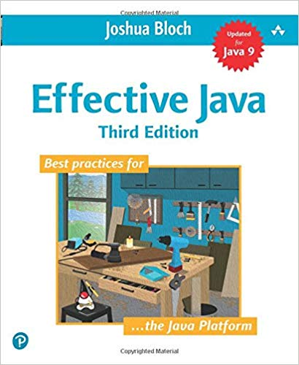

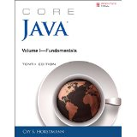
Books
Required textbooks
Effective Java 3rd ed, Bloch (EJ)
Pragmatic Programmer, new 20th
anniversary (2nd) edition, Hunt &
Thomas (PP)
Other useful books:
Program Development in Java, Liskov & Guttag
  would be the textbook if not from 2001
Core Java Vol I, Horstmann
  good reference on language & libraries

Slide 31
Readings (and quizzes)
These are “real” books about software, approachable in 331
  Occasionally slight reach: accept the challenge
Overlap only partial with lectures
Important to “do it”
  Reading and thinking about software design is essential
    Books may seem expensive given your budget, but very cheap as a time-constrained professional
    But: you can access them free!! online (see syllabus)
  Quizzes ☺

Slide 32
Books? In the 21st century?
Why not just use Google, Stack Overflow, Reddit, Quora, …?
Web-search good for:
  Quick reference (What is the name of the function that does … in Java? What are its parameters?)
(can be) Bad for
  Why does it work this way?
  What is the intended use?
  How does my issue fit into the bigger picture?
Beware:
  Answers on the web are often quickly out of date (especially software configuration information)
    aim is to answer the question at the time when asked
  “This inscrutable incantation solved my problem on an unknown version for no known reason”

Slide 33
CSE 331 can be challenging
Past experience tells us CSE 331 is hard
  not our intention to make it difficult!
Big change to move
  from programming by trial & error
    technique that does not work for building large scale software
  to programming by careful design, reasoning, and testing
Programming itself can be hard
  surprisingly difficult to specify, design, implement, test, debug, and maintain even a simple program

Slide 34
CSE 331 can be challenging
We strive to create assignments that are reasonable if you apply the techniques taught in class…
  … but likely hard to do in a trial & error manner
  … and almost certainly impossible to finish if you
  put them off until a few days before they’re due
Assignments will take more time than you think (start early)
  even professionals routinely underestimate by 3x
  these assignments will be a step up in difficulty
If you are having trouble, think before you act
  then, look for help

Slide 35
Other Advice
Don’t be afraid to make mistakes
  accepting that you will make mistakes is perhaps the
  most important lesson of this course
  we often learn best from our mistakes
  if you’re not making mistakes, you’re not challenging yourself
    “Never promote someone who hasn’t made some bad mistakes because, if you do, you are promoting someone who has never done anything”
    — Dr. Herbert Dow (founder of the Dow Chemical Company)
Don’t expect everything to be spelled out for you
  real-world problems don’t come that way
    if there are detailed instructions for solving a problem,
    then there should already be a program that does it
  world needs you for your intuition, creativity, & intelligence
Notes:
Past student: how did that [mistake] happen? how is that even possible?
Review feedback on design patterns (needing to come earlier)

Slide 36
You have homework!
Homework 0, due online by 10AM Wednesday (no late days)
  Write (don’t run!) an algorithm to rearrange (swap) the elements in an array
  in O(n) time (and preferably in a single pass)
  And argue (prove) in concise, convincing English that your solution is correct!
  (Pretend that you are presenting this on a whiteboard to someone – you cannot run the code!)
Purpose:
  Great practice
  Surprisingly difficult (and useful calibration on what’s easy!)
  Help us start thinking about how we can reason about code and build code that works as intended

Slide 37
Concise to-do list
Before next class:
Familiarize yourself with website, do readings (when posted)
  Lecture slides will be posted on web evening before class
Read syllabus and academic-integrity policy
Do Homework 0 (see web calendar), due by 10AM Wednesday! (no late days on this time)
  Use gradescope to submit pdf copy (scan or use your phone)
  Gradescope accounts will be created for everyone later today
  (send mail to cse331-staff with name, ID #, and UW Email address if not registered so we can add you to the gradescope course roster to turn in the assignment)

